Slide 1



Qualifying Ezz Al-Maslamani Company to Match the Requirements of Quality Management Systems ISO 9001: 2015
An-Najah National University
Faculty of Engineering and Information Technology
Industrial Engineering Department
Graduation Project ( II )
Supervisor Name: Eng. Suleiman Daifi
29/1/2024

Slide 2

Team members
Amro Almasri
Shukri Bitar
Yousuf Shakhshir
Ayman sharif
Majd Haj Ali

Slide 3

Outline
1
2
Introduction
Problem Statement
6
7
3
Results & Analysis
Conclusion & Recommendations
Objectives
5
4
Methodology
GP1 Overview

Slide 4


Introduction
Company Background
Theoretical Background

Slide 5

Company Background

Slide 6
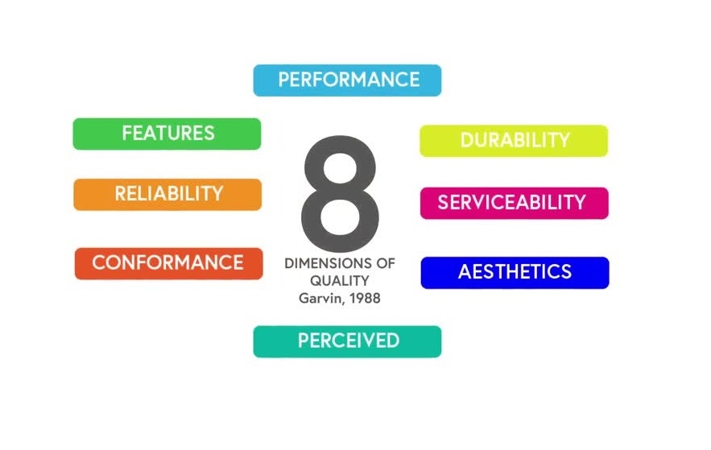

Theoretical Background
Quality
Quality Management System
ISO 9001

Slide 7
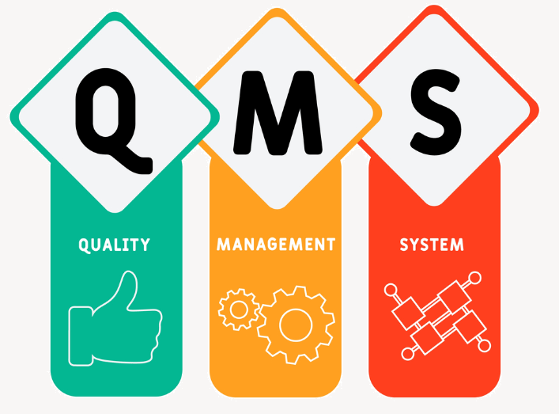
Theoretical Background
Quality
Quality Management System
ISO 9001

Slide 8
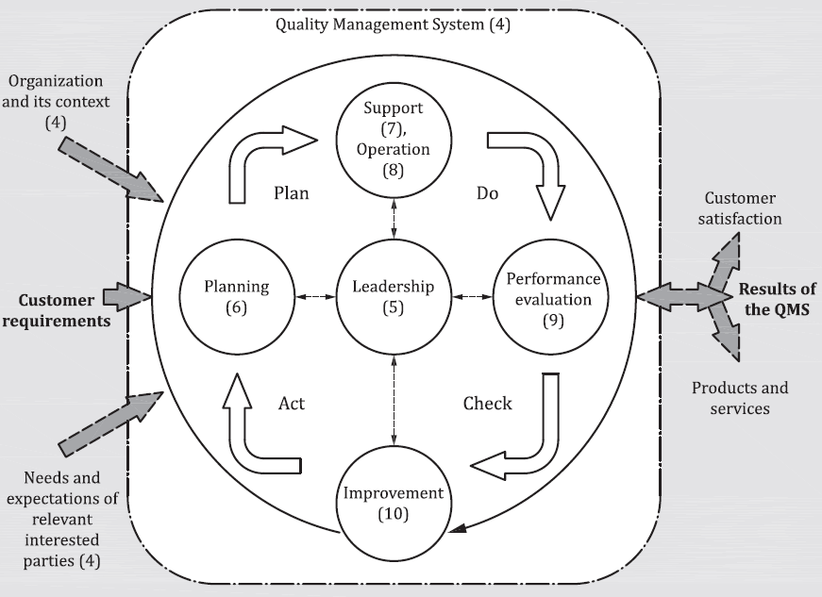
Theoretical Background
Quality
Quality Management System
ISO 9001

Slide 9


Problem Statement
Exploit an opportunity of quality management system development through ISO 9001

Slide 10





Objectives
Prepare the company to match the requirements of ISO 9001 standard
Meet the statutory and regulatory requirements
Customer satisfaction
Address risks and opportunities
Analyze and document all operations
Increase Quality, Productivity, and Performance

Slide 11

Graduation Project 1
Overview
Gap Analysis Checklist
Gap Analysis Report

Slide 12
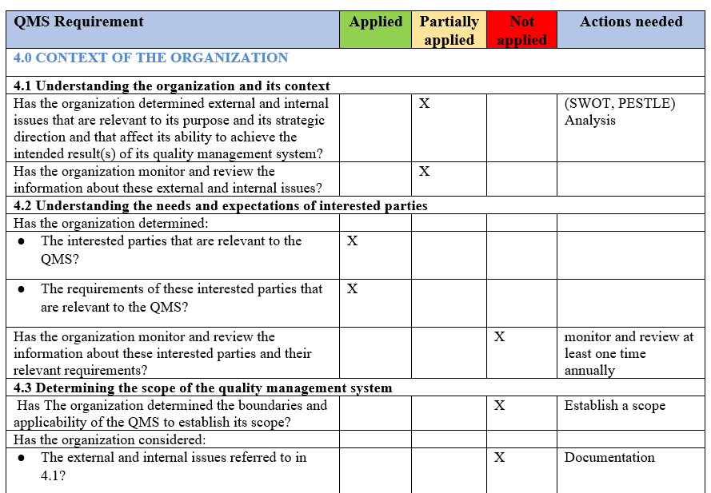
Gap Analysis Checklist

Slide 13
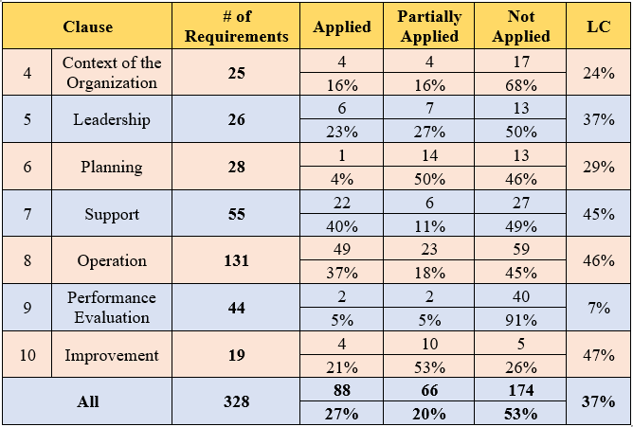

Gap Analysis Report

Slide 14
Methodology
Quality Manual Creation
Develop Required Documents
Data Collection
Final Audit
Management Approval

Slide 15
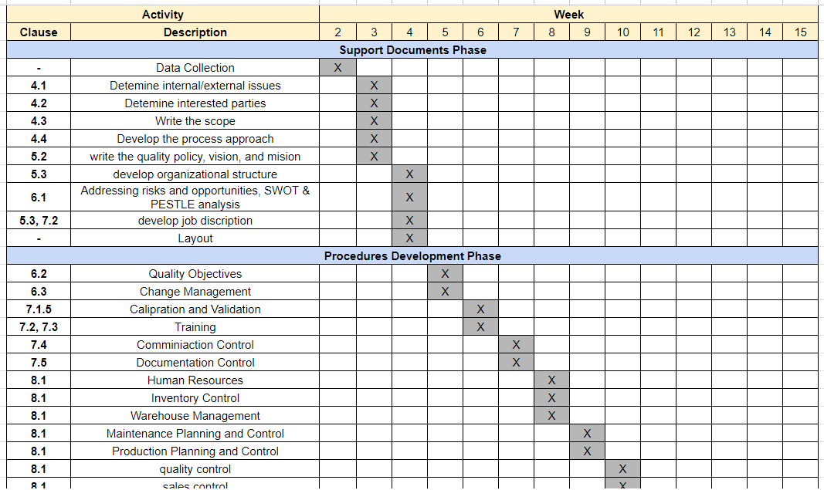
System Development Plan

Slide 16
Results & Analysis
ISO 9001:2015 Clauses
and the accomplished work to satisfy them

Slide 17
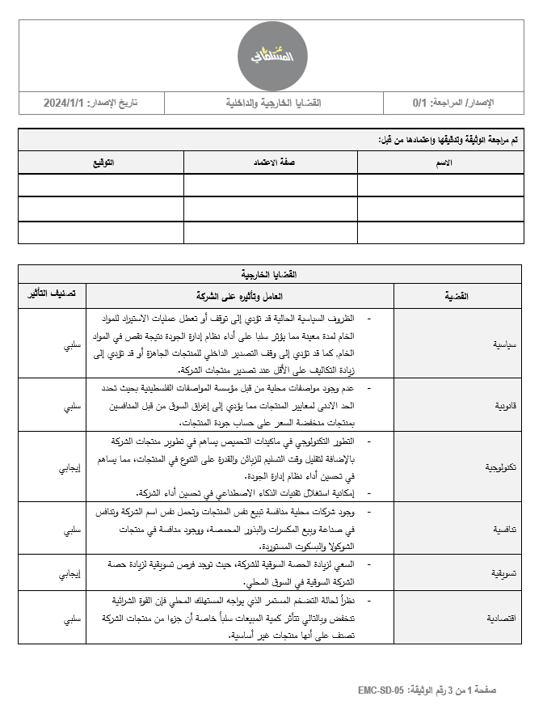
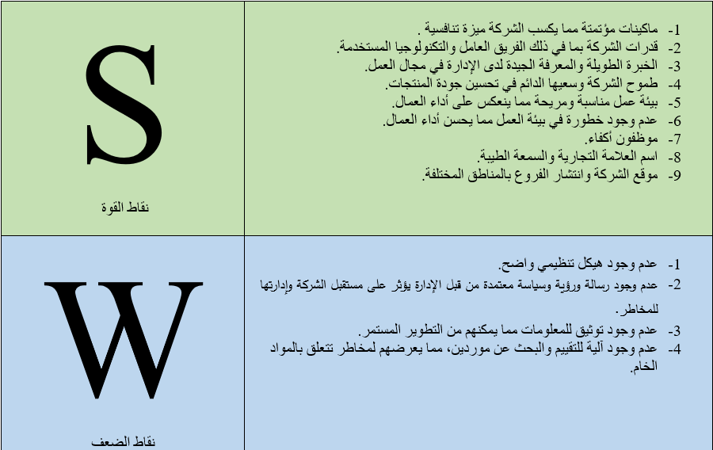
Clause 4: Context of the Organization
4.1 Understanding the organization and its context

Slide 18
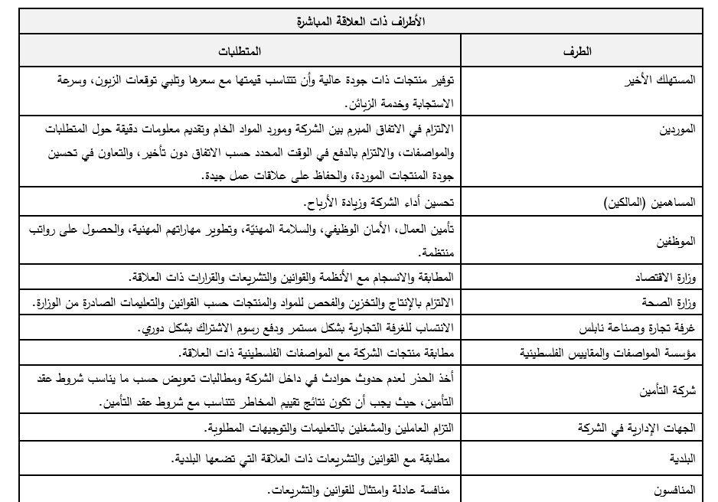
Clause 4: Context of the Organization
4.2 Understanding the needs and expectations of interested parties

Slide 19
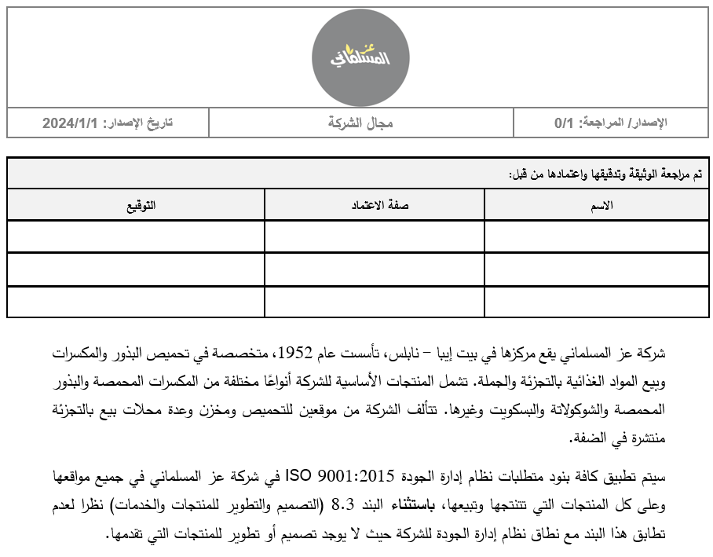
Clause 4: Context of the Organization
4.3 Determining the scope of the quality management system

Slide 20
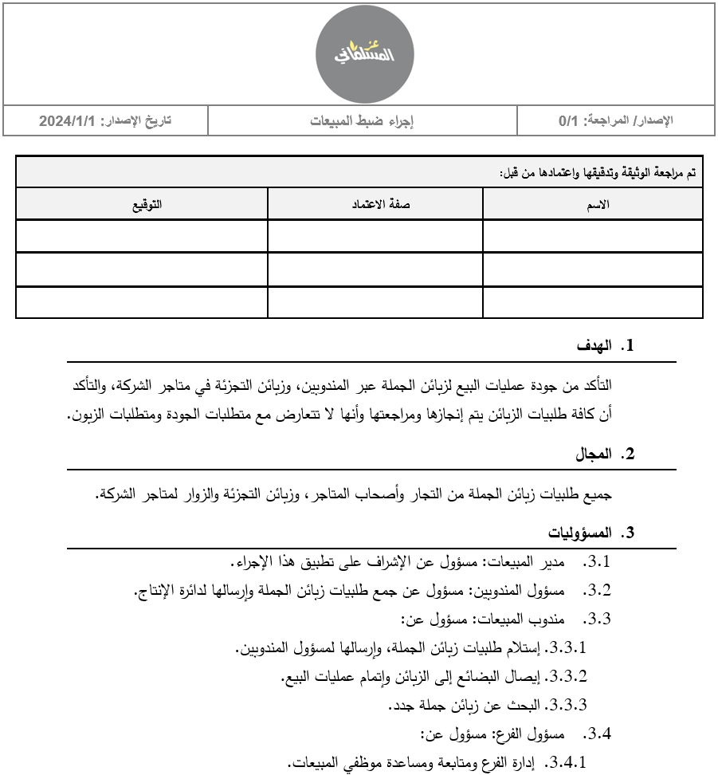
Clause 4: Context of the Organization
4.4 Quality management system and its processes

Slide 21

Clause 5: Leadership
5.1 Leadership and commitment

Slide 22
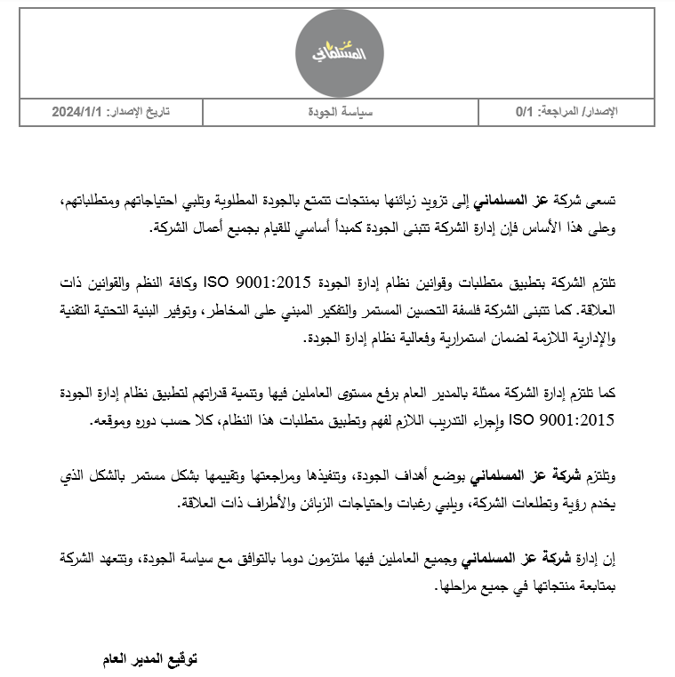
Clause 5: Leadership
5.2 Policy

Slide 23
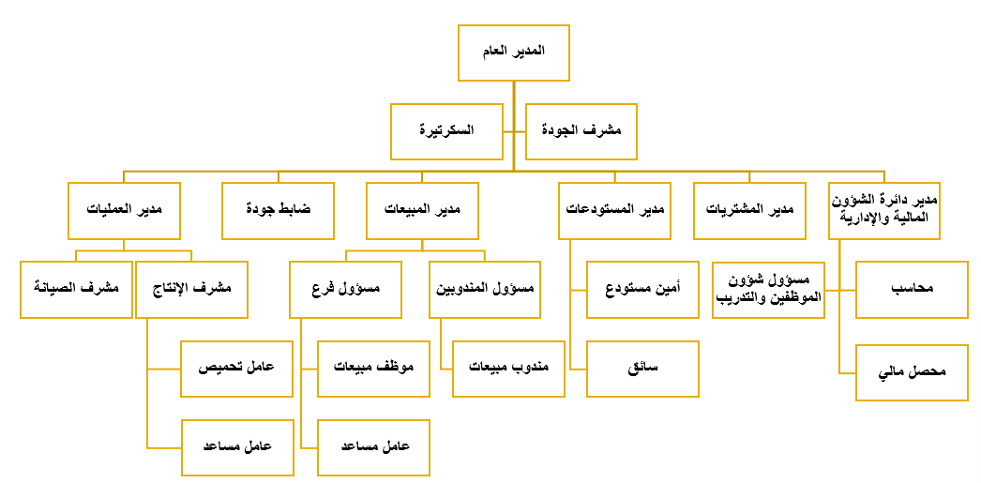
Clause 5: Leadership
5.3 Organizational roles, responsibilities and authorities

Slide 24
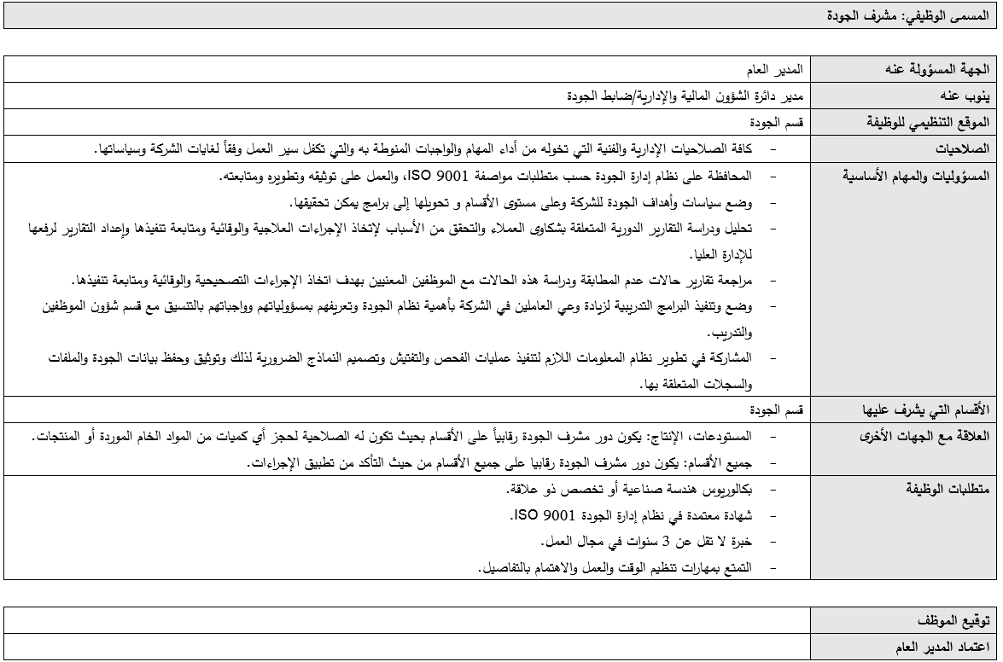
Clause 5: Leadership
5.3 Organizational roles, responsibilities and authorities

Slide 25
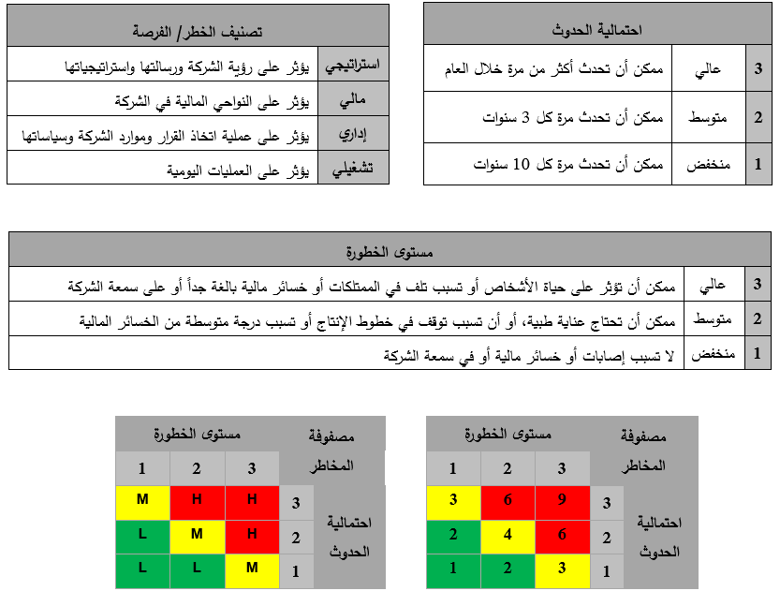
Clause 6: Planning
6.1 Actions to address risks and opportunities
- Risk Matrix
- Risk Register

Slide 26
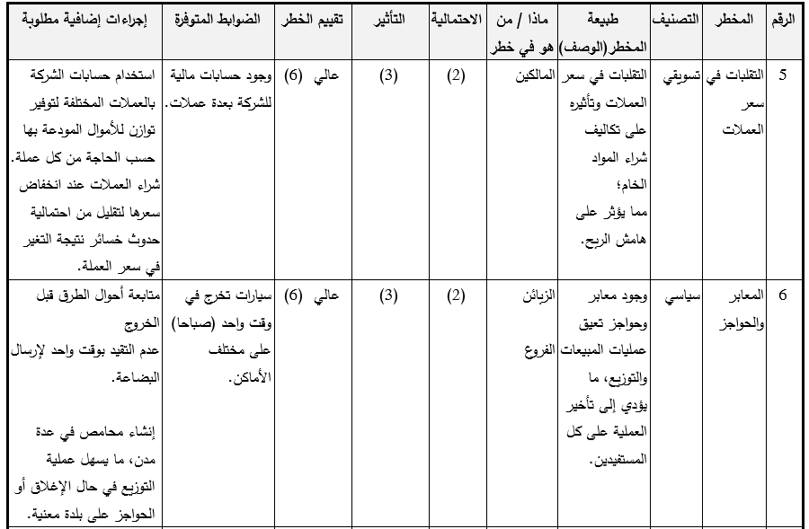
Clause 6: Planning
6.1 Actions to address risks and opportunities
- Risk Matrix
- Risk Register

Slide 27
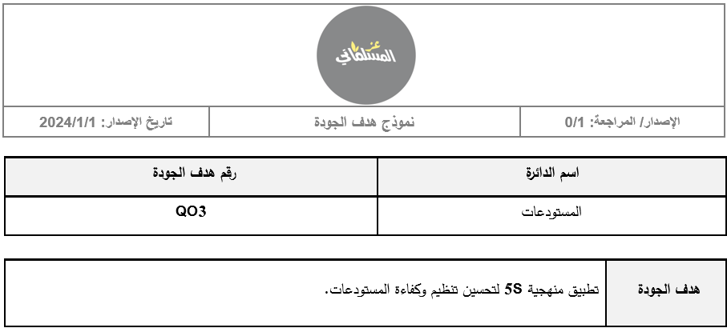
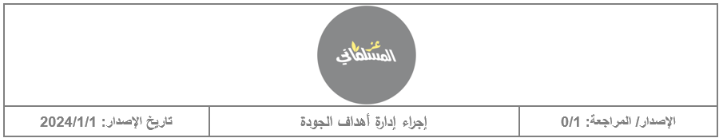
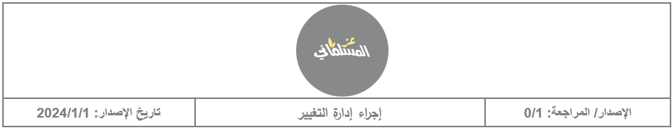
Clause 6: Planning
6.2 Quality objectives and planning to achieve them
6.3 Planning of changes

Slide 28
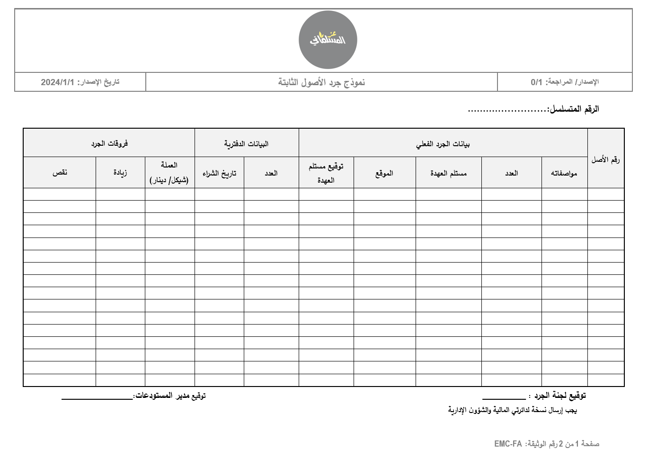
Clause 7: Support
7.1 Resources

Slide 29
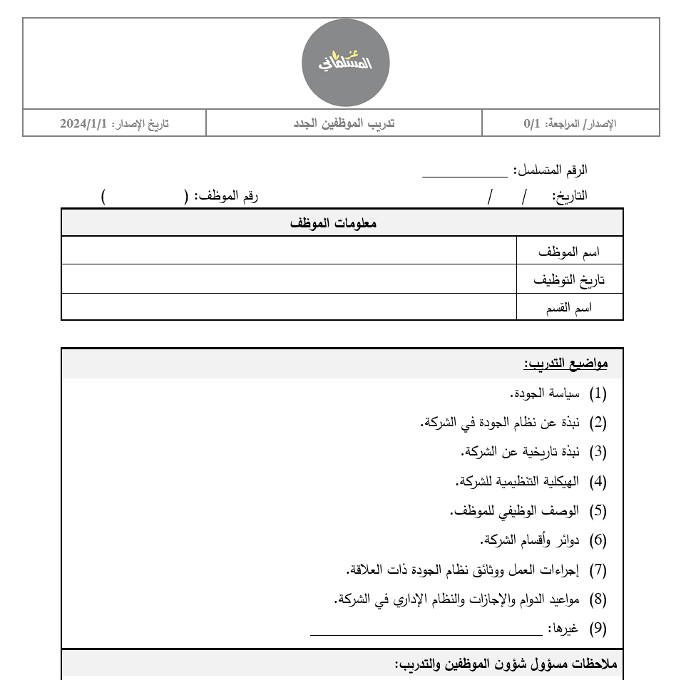
Clause 7: Support
7.2 Competence
7.3 Awareness

Slide 30
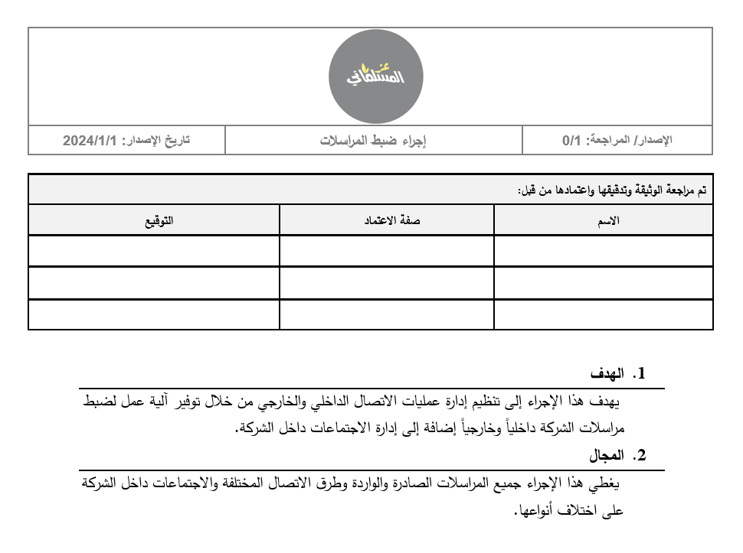
Clause 7: Support
7.4 Communication

Slide 31
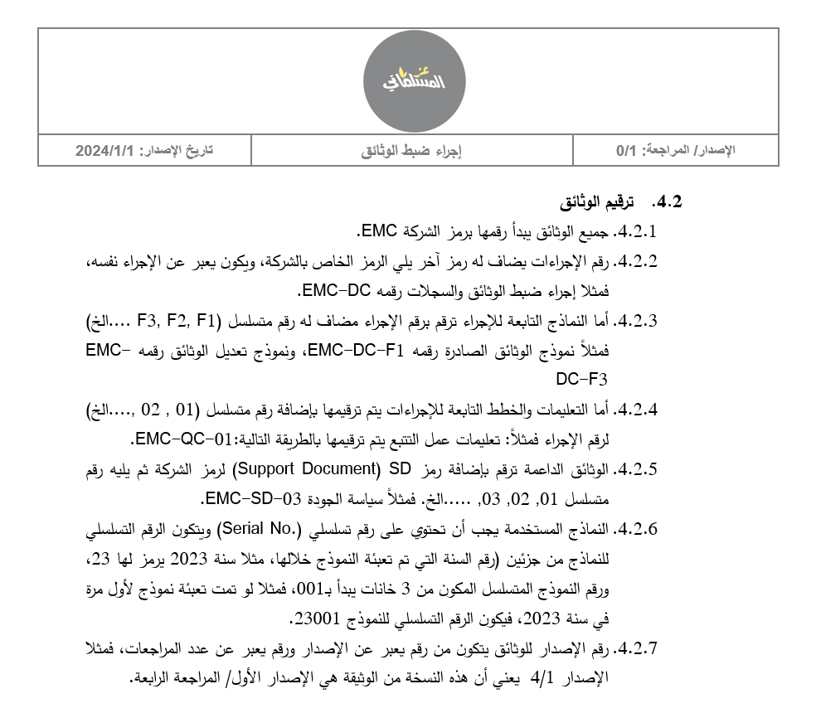
Clause 7: Support
7.5 Documented information

Slide 32
Clause 8: Operation
8.1 Operational planning and control
8.2 Requirements for products and services
8.3 Design and development of products and services
8.4 Control of externally provided processes, products and services
8.5 Production and service provision
8.6 Release of products and services
8.7 Control of nonconforming outputs

Slide 33
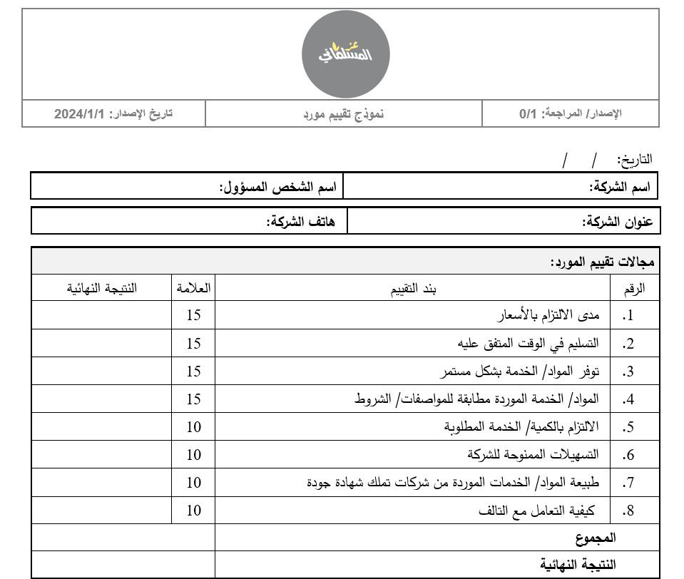
Clause 8: Operation
8.1 Operational planning and control
8.2 Requirements for products and services
8.3 Design and development of products and services
8.4 Control of externally provided processes, products and services
8.5 Production and service provision
8.6 Release of products and services
8.7 Control of nonconforming outputs

Slide 34
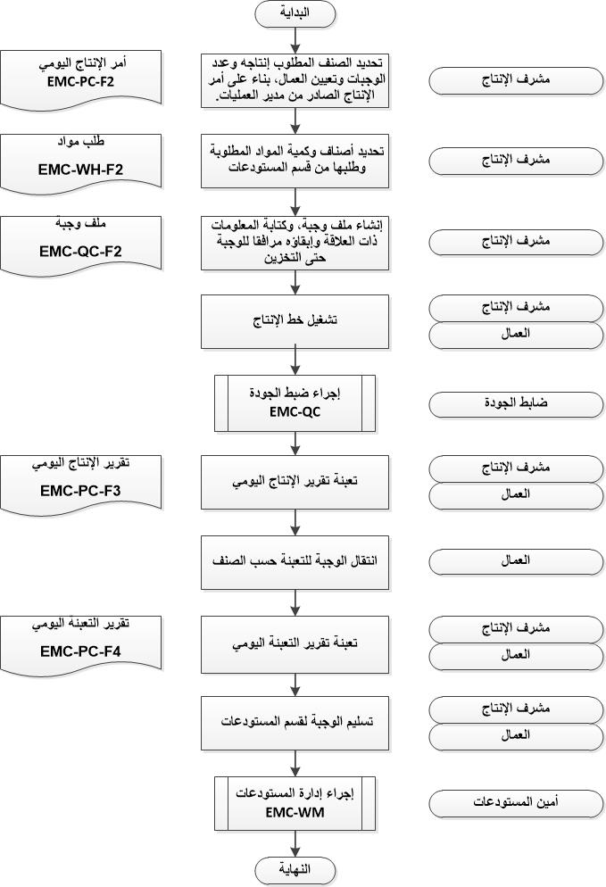
Clause 8: Operation
8.1 Operational planning and control
8.2 Requirements for products and services
8.3 Design and development of products and services
8.4 Control of externally provided processes, products and services
8.5 Production and service provision
8.6 Release of products and services
8.7 Control of nonconforming outputs

Slide 35
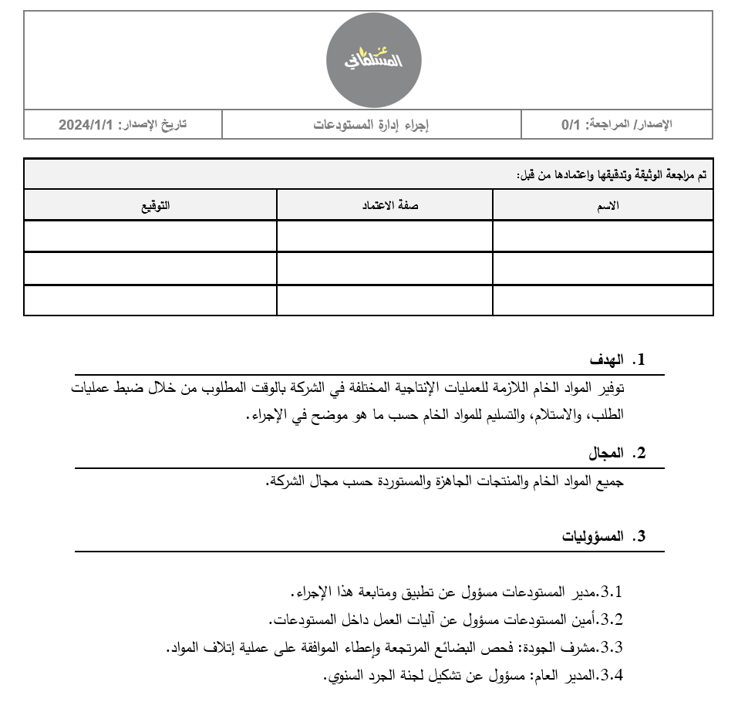
Clause 8: Operation
8.1 Operational planning and control
8.2 Requirements for products and services
8.3 Design and development of products and services
8.4 Control of externally provided processes, products and services
8.5 Production and service provision
8.6 Release of products and services
8.7 Control of nonconforming outputs

Slide 36
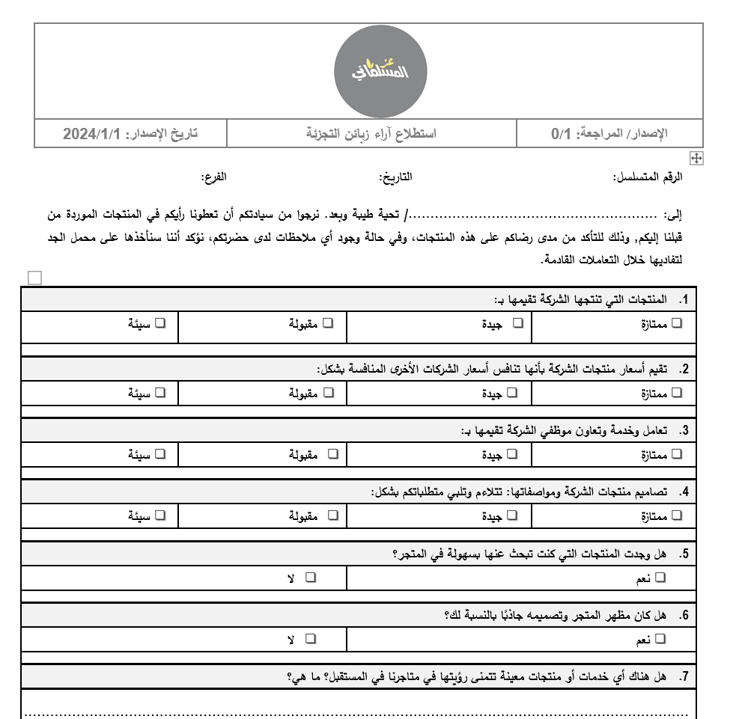
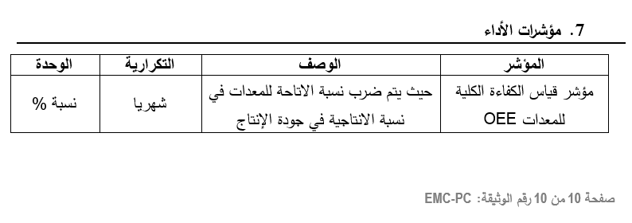
Clause 9: Performance Evaluation
9.1 Monitoring, measurement, analysis and evaluation

Slide 37
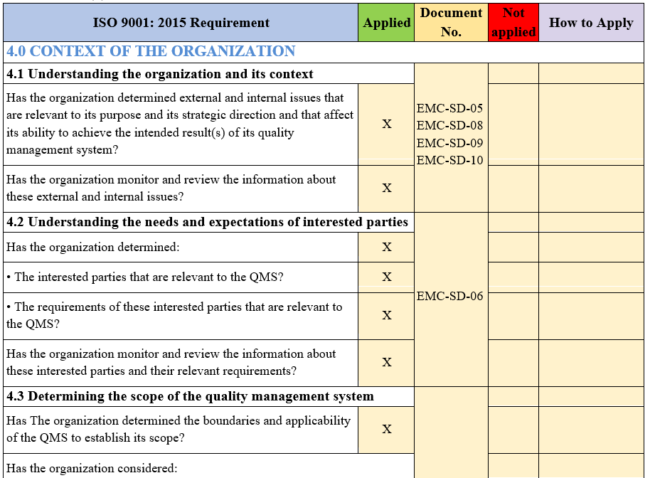
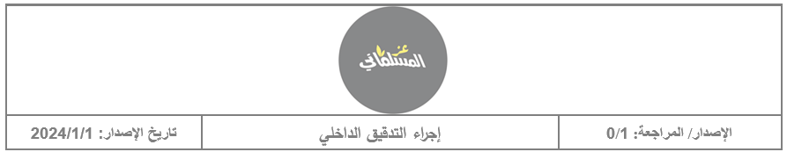

Clause 9: Performance Evaluation
9.2 Internal audit
9.3 Management review

Slide 38
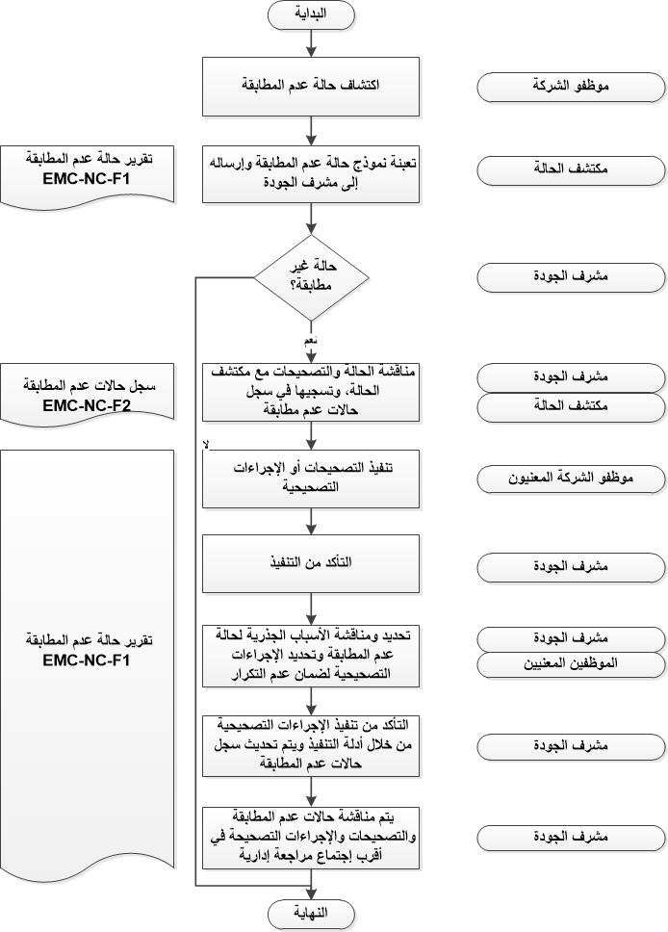
Clause 10: Improvement
10.1 General
10.2 Nonconformity and corrective action
10.3 Continual improvement

Slide 39
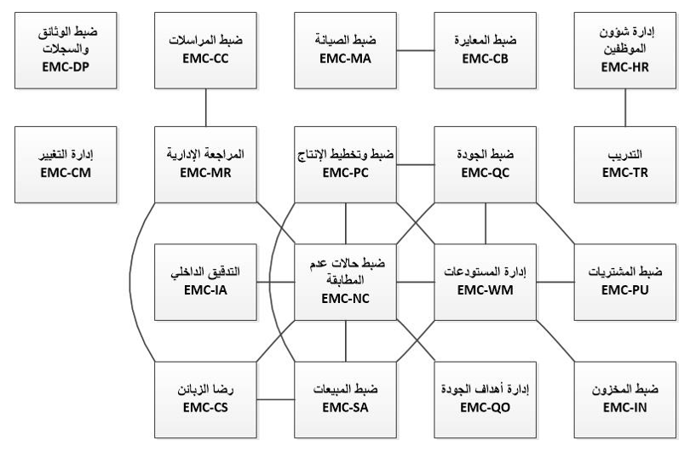
Relationship between Procedures

Slide 40

Conclusion
Reaching appropriate quality, development and ensuring continuity
Adjusting performance with KPIs that result in a higher level of innovation
Increased productivity through repetitive approved processes due to documentation having one unified formant
Promoting growth opportunities, represented by increased participation in the labor market

Slide 41
Recommendations
Implement the other standards such as ISO 22000 Food Safety Management
Start implementing the QMS that have been developed and continually improving it
Complete the remaining steps to obtain the ISO 9001:2015 certification
Focus on the principles of the standard to ensure the maximum benefit of applying ISO 9001:2015
Train the employees on how to operate the QMS and use its documents and forms

Slide 42



Thank you
Any Questions?

