Slide 1
Smart Home Pharmacy
Prepared by: Haneen Sabra
Leena Masri
Supervised by: Dr.Sufyan Samara

Slide 2
Outline:
      Idea
      Introduction
      What is Smart Home Pharmacy
      Hardware Components
      Software Needed
      Problems and Constraint
      Future Work

Slide 3
Idea:
How?
What?
Why SHM ?

Slide 4
Introduction
The main aspects and functionalities of this project are:
A system that can be download in a cabinet .
Alarm System .
Reminder System.

Slide 5
Who can use SHM:
People who had to take several type of medications.
People who had memory problems.
Elderly people who live alone.

Slide 6
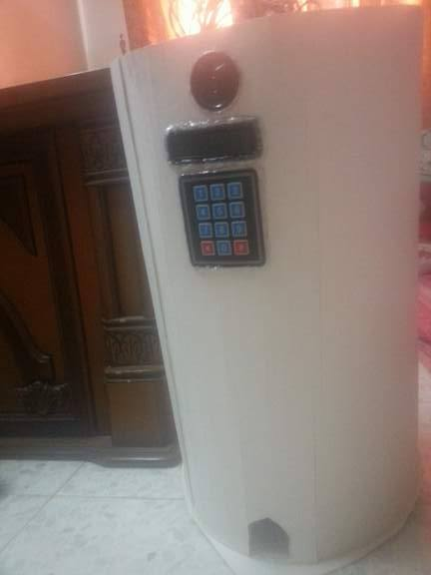
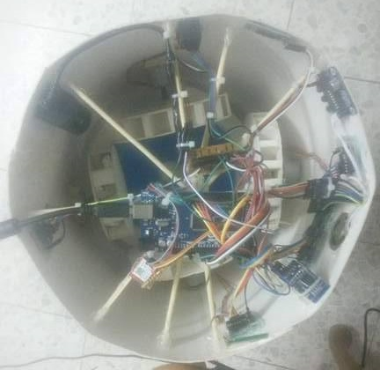
What is SHM :
Cabinet Shape
Connection

Slide 7
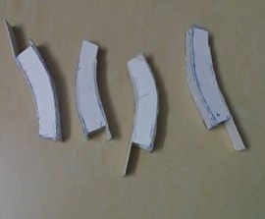
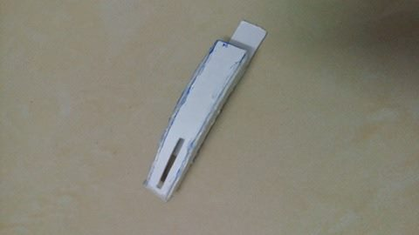
What is SHM:
Medication Containers :First try

Slide 8
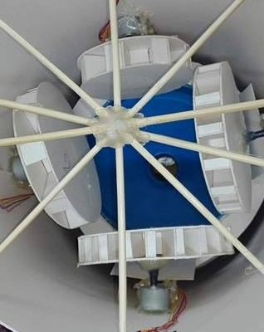
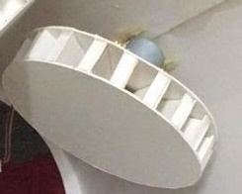
What is SHM:
Medication Containers (Wheels)

Slide 9
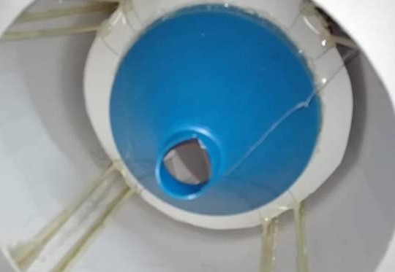
What is SHM:

Slide 10
Hardware
Components

Slide 11
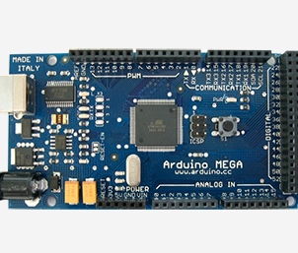
Hardware: Arduino Board
Arduino MEGA 2560

Slide 12
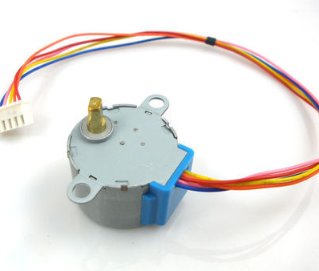
Stepper Motor

Slide 13
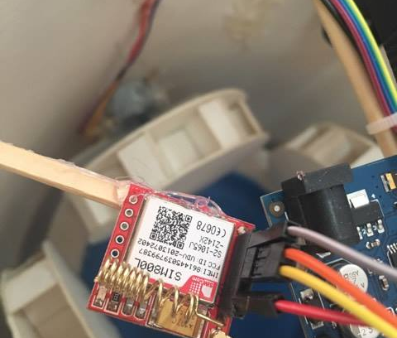
GSM Chip

Slide 14
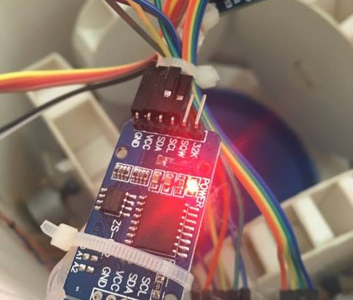
RTC Chip

Slide 15
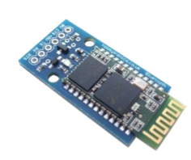
Bluetooth HC-06

Slide 16
Other Hardware Components:
Buzzer
Keypad
LCD
IR Sensor

Slide 17
Software Needed:
We used Arduino software (IDE):
connect it to the Arduino and Genuino hardware to upload programs and communicate with them.

Slide 18
Software Needed:
The following libraries where used:
  Stepper library : to control the stepper motor .
  RTC library : that keeps track of the current time and that can be used in order to program actions at a certain time.

Slide 19
Problem and Constraints
Time constrains.
Physical constrains.
Designing the Cabinet and the medication contiener to be user friendly.
Hardware availability.
Some Incomprehensible glitches .

Slide 20
Future Work
Update the cabinet to manage pills for multiple user s instead of one user at same time.
Develop mobile application that can be used by the users to sechdule their pills and add more features.

Slide 21
Future Work
Add a warning reminder when pills running low in order to refill.

