Slide 1

An-Najah National University
Computer Engineering Department
Remote Controlled Submarine
Students
Osama Naji Abu-Omar
Hakam Marwan Risheh
Supervisor
Dr. Luai Malhis

Slide 2
Overview
Project idea
Body design
Drivers and Wireless communication
The microcontroller
The remote
Non-stationary water mode
Demo
Conclusions and future work

Slide 3
Project idea
Small remote controlled submarine
Mainly built as an entertaining project for mini games underwater
Can moves in three dimensions
Controlled via a wireless connection
Can Hold Position in non-stationary water

Slide 4
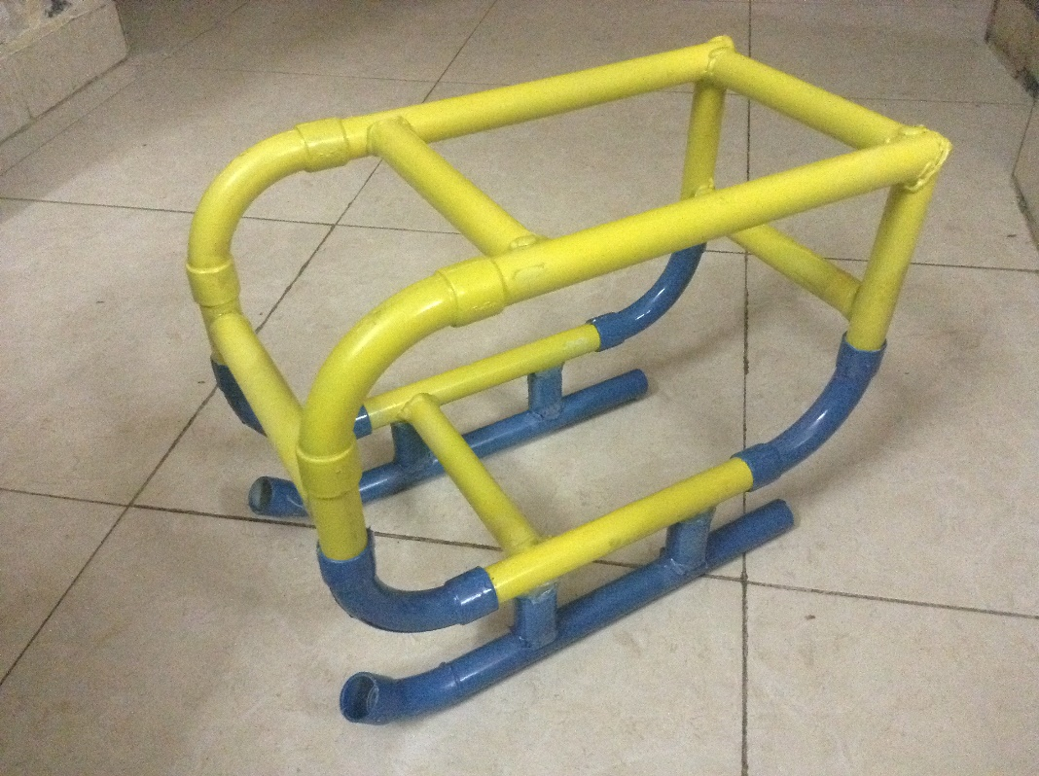
Body Design
Initial submarine body:

Slide 5
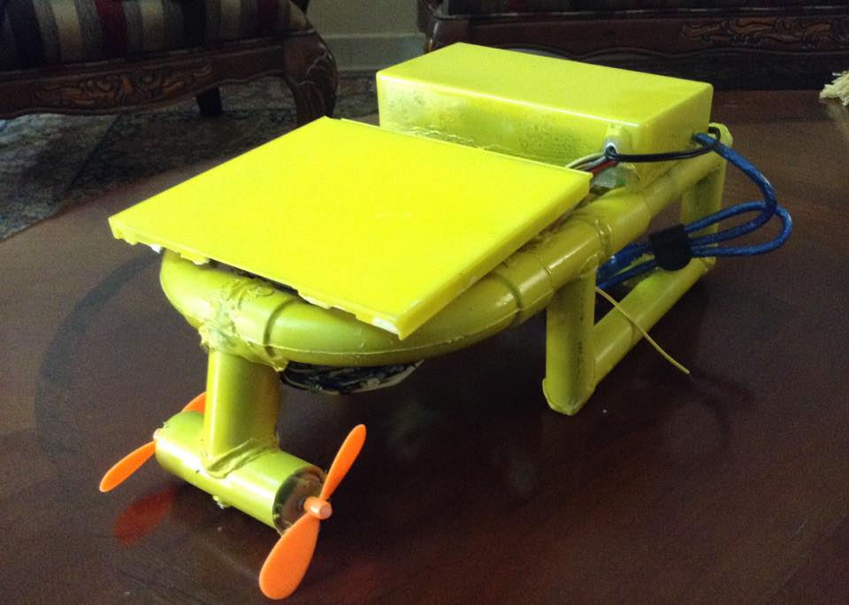
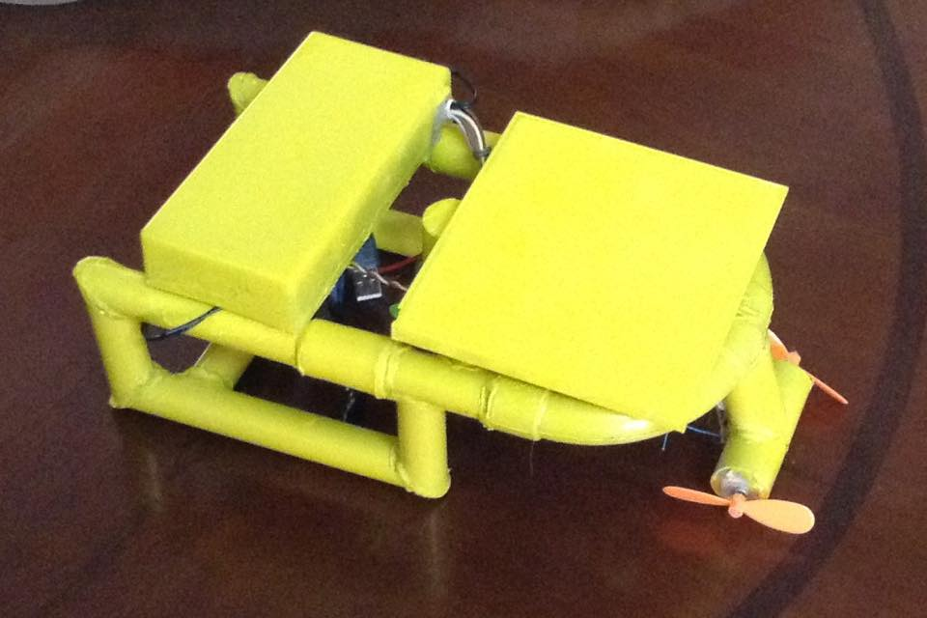
The new body shape:

Slide 6
Considerations taken:
Size fits the components
Light enough for motors
Balanced in water (horizontal position)
Directional motors give enough torque
Protection from hitting the propellers

Slide 7
Motor drivers
Free / stall motor current draw:
Motor rating | Free (no load) mA | Stall (stopped) mA
M1 (Forward) | 220 | 1300
M2 | 250 | 1500
M3 (Up/ Down) | 750 | 1700
M4 (Left/ Right) | 50 | 500
M5 | 350 | 1200

Slide 8
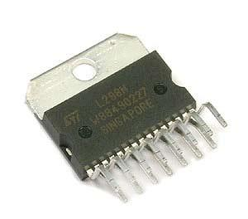
Choosing the Driver
The L298N dual h-bridge motor driver was chosen
Can supply up to 4 amps of current
Control in both directions
Speed control using PWM

Slide 9
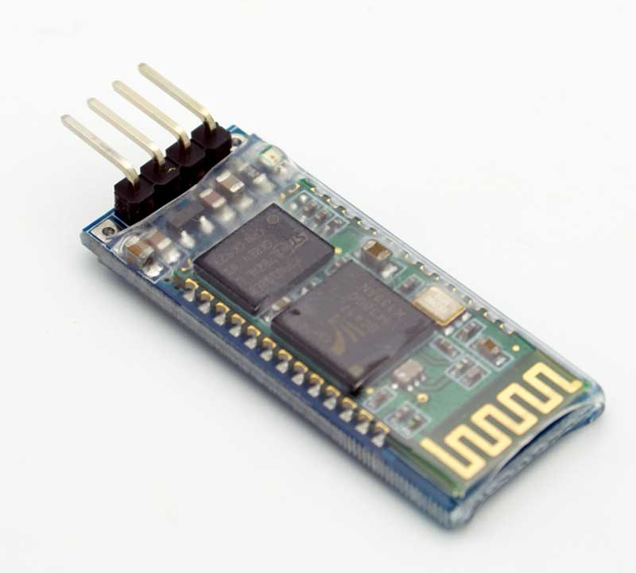
Wireless Control
Controller communicates via Bluetooth
fits the requirements of the project
  Short distance controlling
  Easy to implement (less time)
  BT module is available and relatively cheap
  Control using an application (any phone)

Slide 10
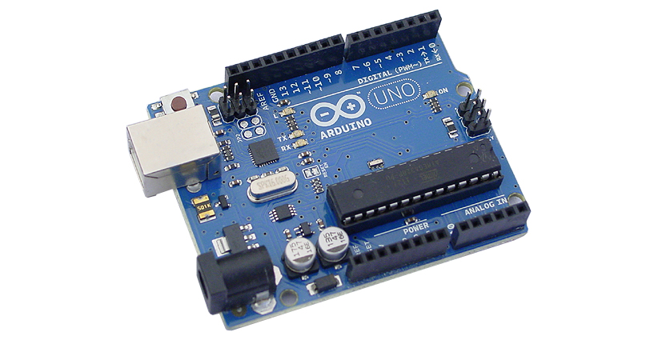
The Microcontroller
Arduino Uno R3

Slide 11
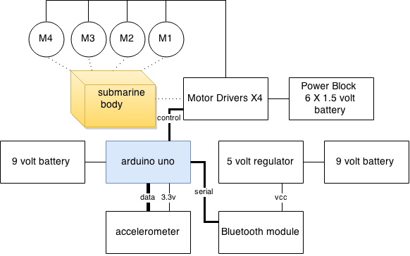
Block Diagram

Slide 12
Command Messages
UI Command | event | String command | Notes
up arrow | Press | F,1,SPEED | Thrust speed
Up arrow | Release | F,0,SPEED | Thrust speed
Down arrow | Press | B,1,SPEED | Thrust speed
Down arrow | Release | B,0,SPEED | Thrust speed
Left arrow | Press | R,1 | No speed
Left arrow | Release | R,0 | No speed
Right arrow | Press | L,1 | No speed
Right arrow | Release | L,0 | No speed
D | Press | D,1,DSPEED | Diving speed
D | Release | D,0,DSPEED | Diving speed
S | Press | S,1,DSPEED | Diving speed
S | Release | S,0,DSPEED | Diving speed
ON | Click – toggle 1 | O,1 | On/off
OFF | Click – toggle 2 | O,0 | On/off
H | Click – toggle 1 | H,1 | Hold or Auto
H | Click – toggle 2 | H,0 | Hold or Auto

Slide 13
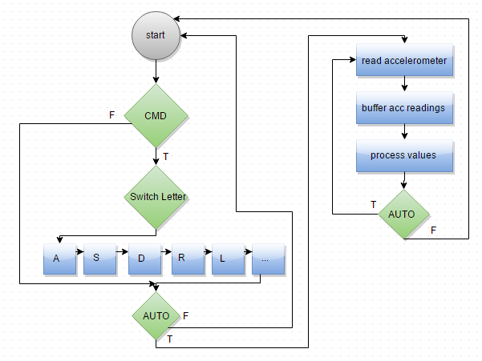
Controller Operation

Slide 14
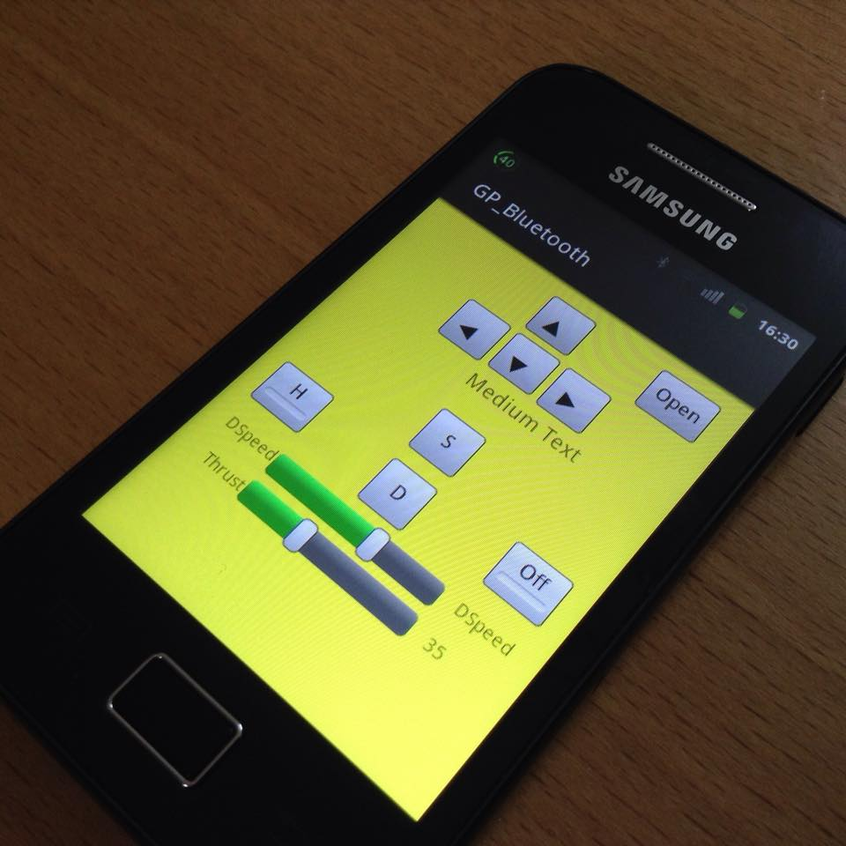
The Remote
We Build an Android application as a remote control for the submarine.

Slide 15
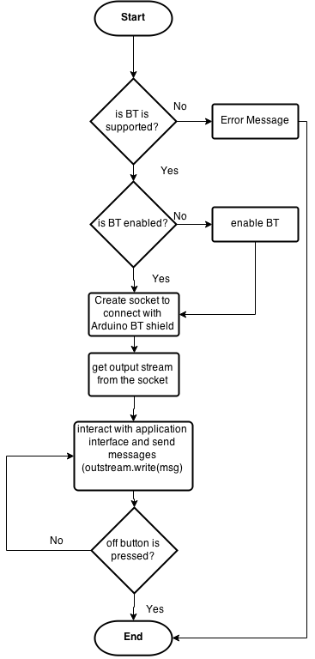
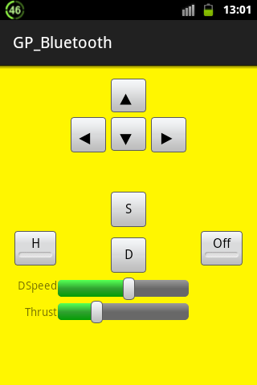
The Remote

Slide 16
Non-stationary water mode
Submarine gets HOLD POSITION command
Water streams push the body
Accelerations (forces) are detected
The submarine responds by pushing to the opposite direction of the water stream
Returns to it’s initial position

Slide 17
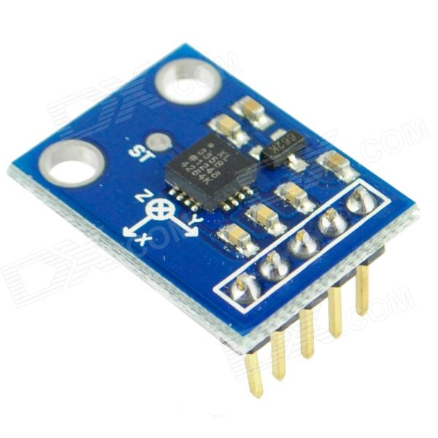
Non-stationary water mode
We used an Accelerometer sensor
It detects Accelerations applied to the submarine
The ADXL335 3-axis accelerometer

Slide 18
Enhancements
Custom body, better material
Custom remote control, radio frequency operation (more range)
Brushless Motors
Smaller components (smaller whole size)
Special water propellers

Slide 19
Future work
Grabber arm (for other types of games)
Auto obstacle avoidance (protection from crashes)
Hooking up other sensors, an off line camera.
Think of others ?...

Slide 20
Conclusion
Submarine operation in static water tested and worked as expected with acceptable results.
Accelerometer is barely accurate enough to detect water streams in water
in the final testing stage, water (moisture) leaked into the components and some damaged, due to poor isolation.

Slide 21
Demo

Slide 22
Thank you

