Slide 1
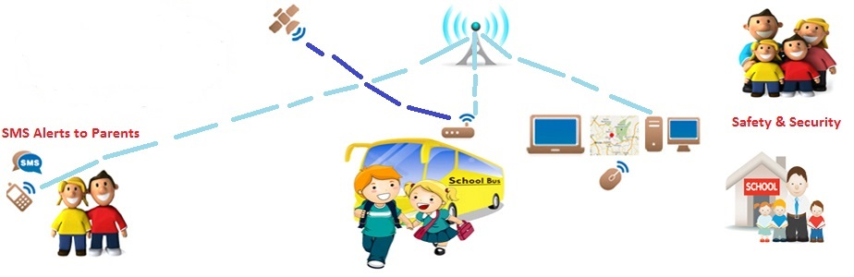
School Bus Tracking System
Submitted by:
Walaa Shbak & Saja Abusair
Haya Khuffash
Supervised by :
Dr. Saed Tarapiah

Slide 2
Outline
Introduction.
Objectives.
The system model.
System Hardware Components
System Software Components
sequence of system functionalities
the system model
feasibility study
SWOT analysis
Recommendations And Conclusion

Slide 3
Introduction
School Bus Tracking system connects parents with their child school transport system, which it is enabling them to know the time their children enter and exit the bus.
The main technology used in this system is Global Positioning System (GPS). which it gives the location of the bus, On the other hand we will use GSM or 3G, Raspberry pi 3 and many microcontrollers, also some programming languages ​​such as PHP and Python.

Slide 4
objectives
Reduce long wait times, with the help of this system, parents can know when the bus will arrive.
parents no longer have to worry about their children because they will receive SMS alerts when their children enter or exit the buses.
School authorities benefit from buses with tracking service in several ways to reduce fuel costs, because in this system parents can tell the bus in advance that the child will be absent.

Slide 5
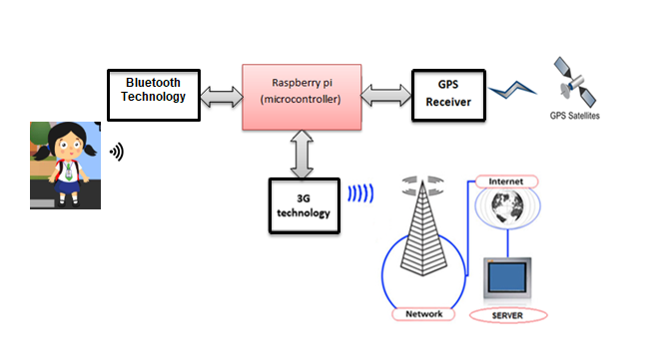
the system model

Slide 6
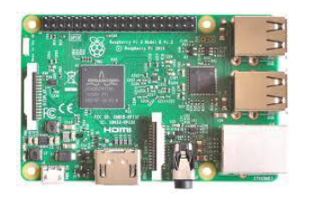
System Hardware Components:
Raspberry pi3 model B:
is a microcontroller based credit card sized Single Board Computer which offers endless opportunities.

Slide 7
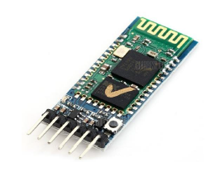
Bluetooth Module: It’s serial Bluetooth Module for Arduino , Raspberry pi and Another microcontroller. It’s used for wireless data transmission between small distances and work at Ultra High Frequency regarding ISM radio band it ranges from (2.402 to 2.480) GHz.

Slide 8
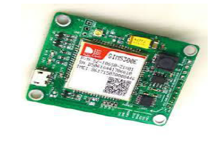
3G SIM5300E module: its work at dual band WCDMA/HSPA 900/2100MHz and dual band GSM/GPRS , for controlling this module we use AT commends ,its achieve maximum data rate at downlink up to 7.2Mbps and at uplink it achieve 5.7Mbps.

Slide 9
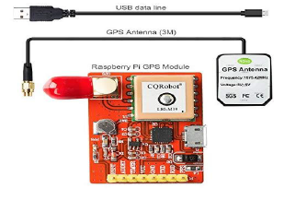
GPS module kit-CQROO48: this module support different raspberry pi module for example A , B , B+ and zero, as well its support time service application and M2M application such as portable device, personal tracking, security and auto motivate , communicates satellite with UART or USB.

Slide 10
System Software Components:
PHP: It is used to store all information about the bus, driver, student and parents, connect this information with IDs. The data interface is called XAMPP which stands for Cross-Platform (X), Apache (A), MariaDB (M), PHP (P) and Perl (P).

Slide 11
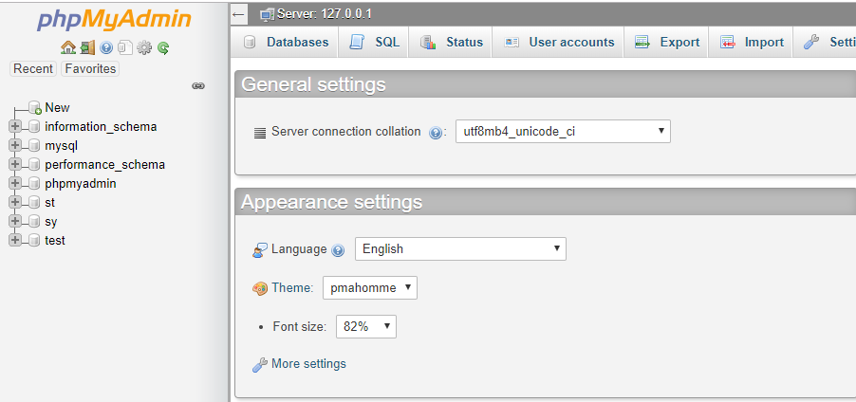
Database :

Slide 12
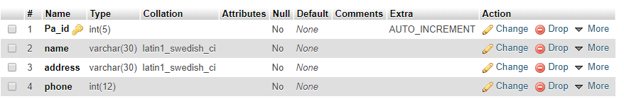
Paerents ID in database

Slide 13
sequence of system functionalities

Slide 14
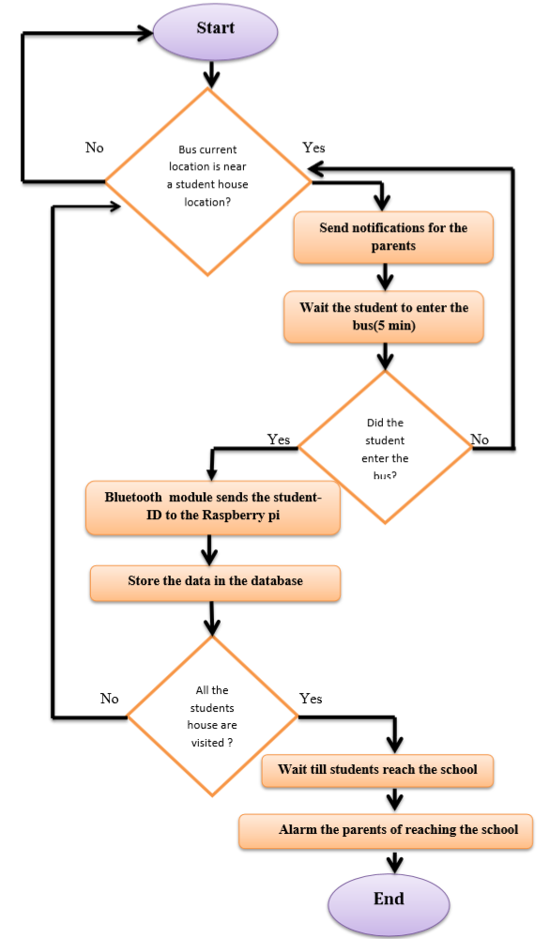

Slide 15
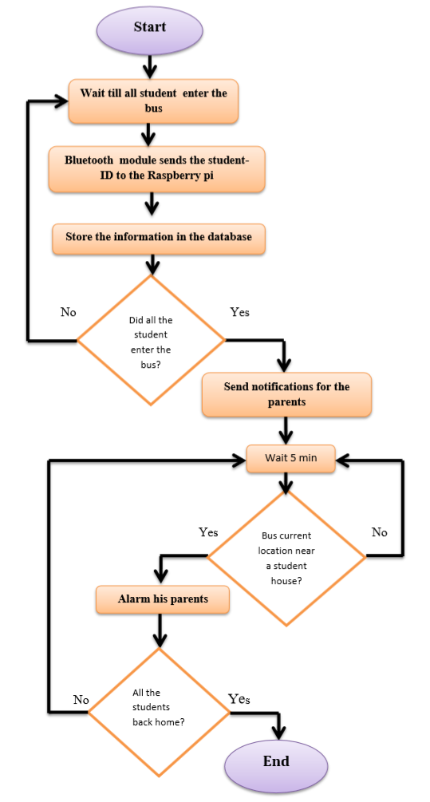

Slide 16
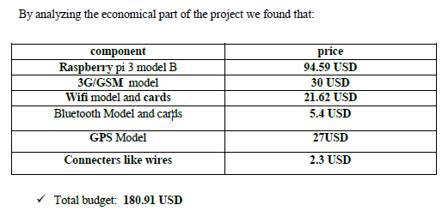
feasibility study
we can say that budget for your project is
suitable and logical .

Slide 17
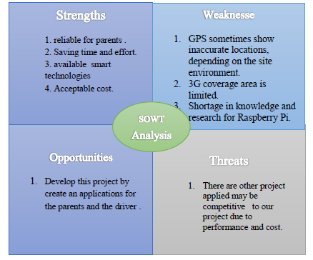
SWOT analysis:

Slide 18
Recommendations And Conclusion
We hope this system achieved the goals that we designed for it, reducing cases of missing children or delay their return to house which increase feeling parents that their child safe, additionally facilitation of arrival of bus at certain time. All this for keeping Children safe and secure.
In the second graduation project we will build system that we designed in both hardware and software, Aggregation of components that we select to implement this project, interfacing the component with raspberry pi by using code written in python software language and we will try to create an android application if possible.

Slide 19
Thank you

