Slide 1
Light Led Panel
Esra’a Nassar
Mona Amer
Supervisor : Dr.Ashraf Armoush

Slide 2
Outline
Overview
Goals
Tools
System software
Constraints
Processing
Demo

Slide 3
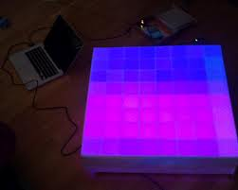

Slide 4
Overview
The LED Light Panel is an 8x8 array of individually-controllable RGB LEDs .
It can stream content from a PC via USB .
An Arduino-compatible microcontroller is used to interface the LEDs to a PC

Slide 5
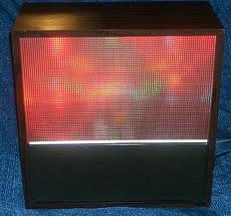
Where the idea come from ?
  In the past humans are communicating
  via a huge color organ to create
  the scene of pattern , image and
  movies.
  Color organ is electronic devices that responded to their music inputs with light shows .

Slide 6
What is the problem with color organ ?
need about 20 more years of piano lessons to reach the maximum potential of this instrument.
It is a musical instrument thought, a LED instrument .
It show simple patterns and animations and complex to control.

Slide 7
Pixelbrite

Slide 8
What Light Led Panel added ?
Show complex patterns and animations and simpler controls.
Add texture, color, and motion to music.

Slide 9
Characteristics Light LED Panel
It’s bright, dark and colorful.
It can be use as a center-piece or a perimeter-piece .
Programmable and easy to setup .
easy to play.

Slide 10
What this panel do ?
A light show Display.
Better than LCD on view the resulted picture like 3D
Create new pattern and animation.

Slide 11
Where it can be use ?
Basement wall décor
Club /wedding rooms
Living room coffee tables
Dorm rooms

Slide 12
Hardware Prerequisites
PNP Transistor
Diffusion RGB LED
Shift Register 74HC595
Open Collectors ULN2003
Arduino Microcontroller
bread bored for testing
Different value of Resistances
Jumper
Power Supply 5 Volt 3A.

Slide 13
Why Arduino UNO ?
The Uno differs from all preceding boards in that it does not use the FTDI USB-to-serial driver chip.
It programmed as a USB-to-serial converter.
Notes:
Future technology device international
FTDI, is a Scottish privately held semiconductor device company, specializing in Universal Serial Bus (USB) technology. It develops, manufactures, and supports devices and their related software drivers for converting RS-232 or TTL serial transmissions to USB signals

Slide 14
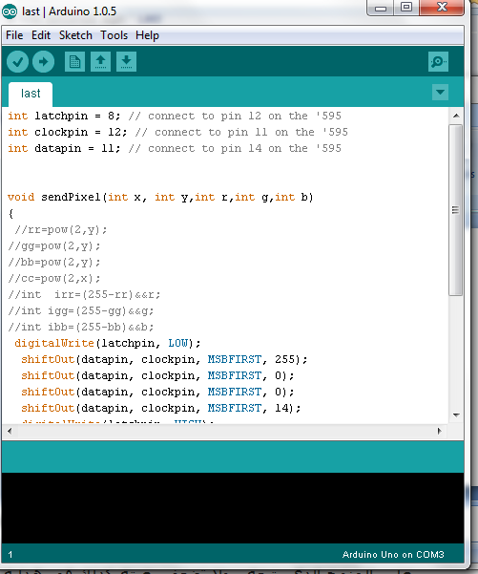

System Software
Arduino 1.5.5 BETA for Windows

Slide 15
Arduino Software
The software of Arduino is open-source environment makes it easy to write code and upload it to the i/o board.
Arduino software runs on Windows, Mac OS X, and Linux.
The environment is written in Java .
Notes:
standard programming language compiler and a boot loader that executes on the microcontroller.

Slide 16
Methodology
LED Light Panel provide a study of pixels , each photo or pattern is pixelized then transfer through USB to be show in the panel .

Slide 17
Systematic of displaying pattern
Defining array char as a Buffer [8][8]
Set Buffer
Call it every t time pass as parameter
Modifying
Set Pixel
Show Function
Called here
Shift it Out To Data pin on Microcontroller
Send Pixel

Slide 18
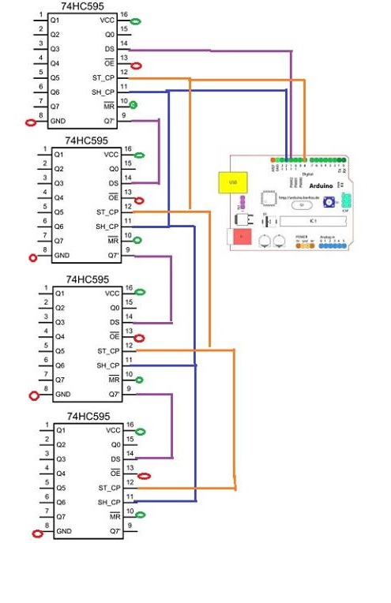
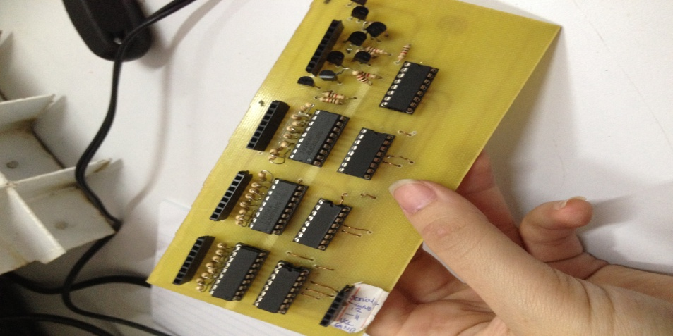
Processing
Getting Start with our PCB

Slide 19
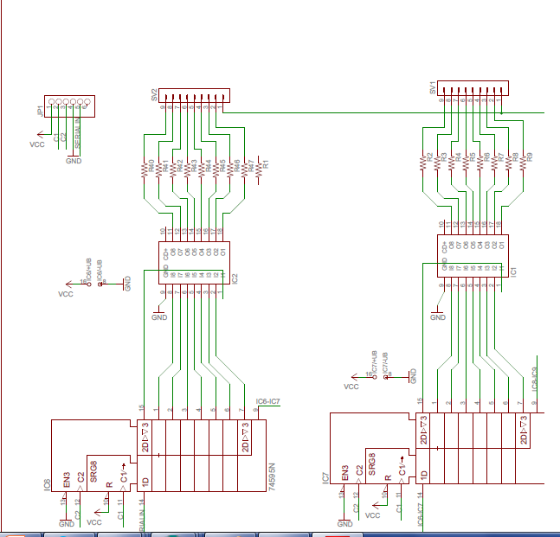
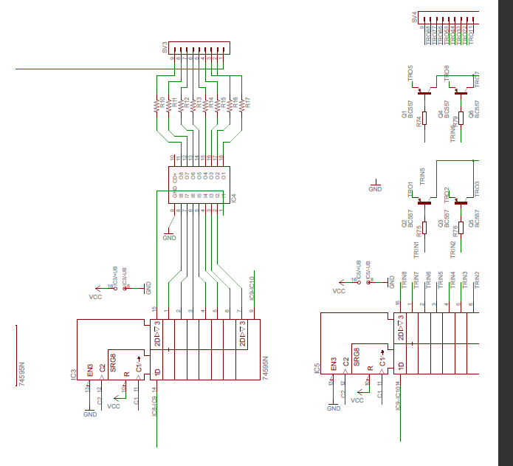
Processing –cont

Slide 20
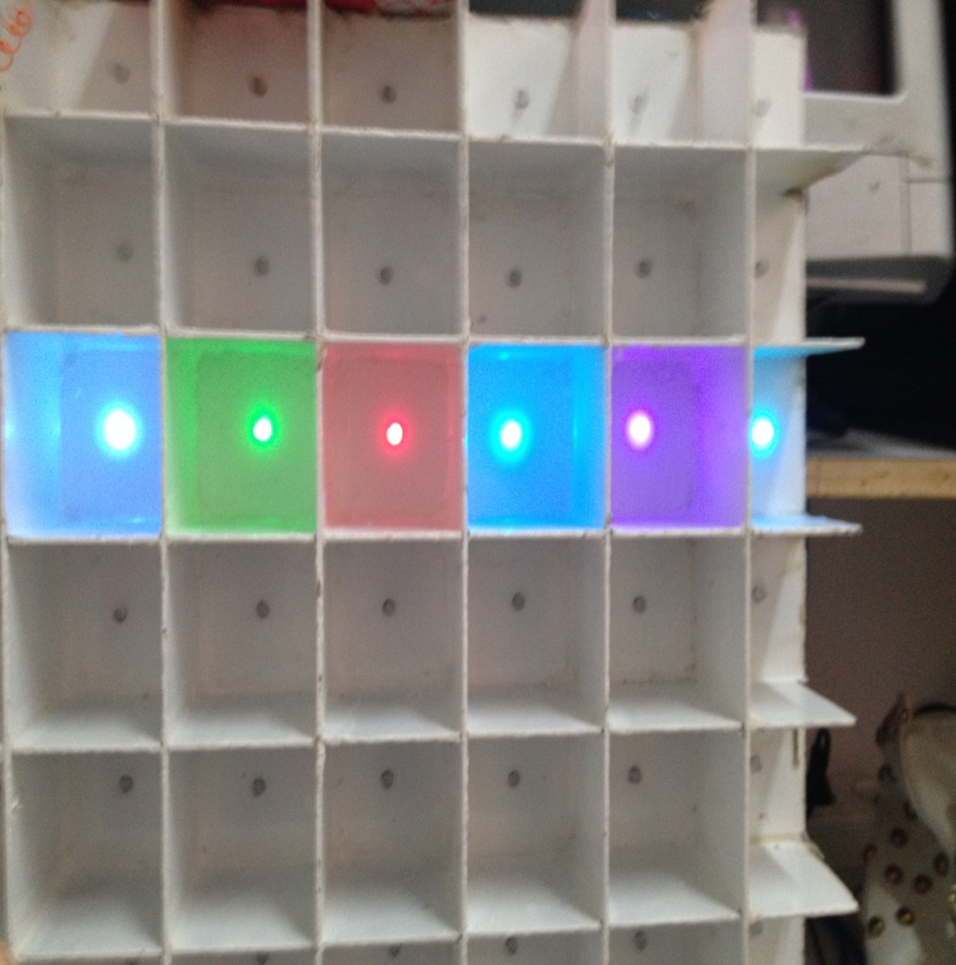
Processing
Selecting Row
void selectThirdRowWithDifferentColor(){ sendPixel(3, 5,0,1,1);//cyan sendPixel(3, 4,0,1,0);//green sendPixel(3, 3,1,0,0);//red sendPixel(3, 3,0,2,1);// cyan sendPixel(3, 1,1,0,1);//purple sendPixel(3, 0,0,1,1);//cyan
}

Slide 21
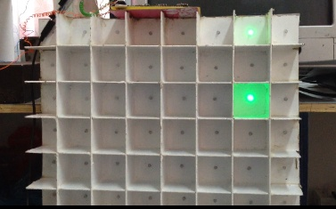
Processing-cont
Select the intersection between row and column
setPixel( videobuffer[i],videobuffer[j],0,1,0);

Slide 22
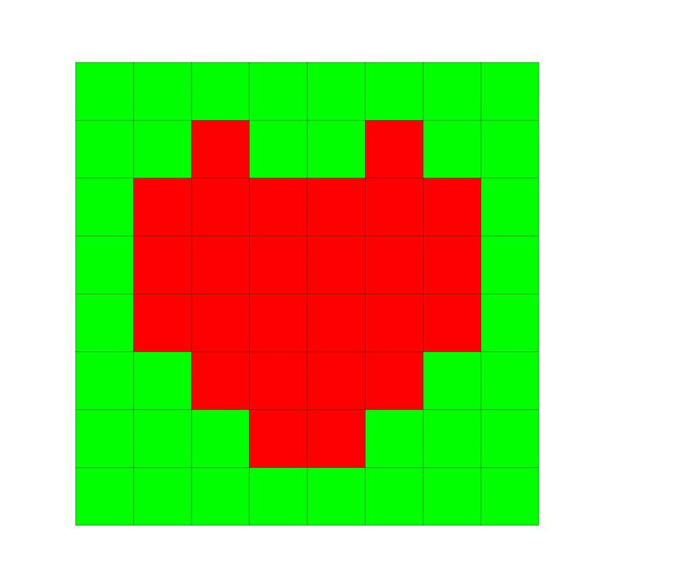
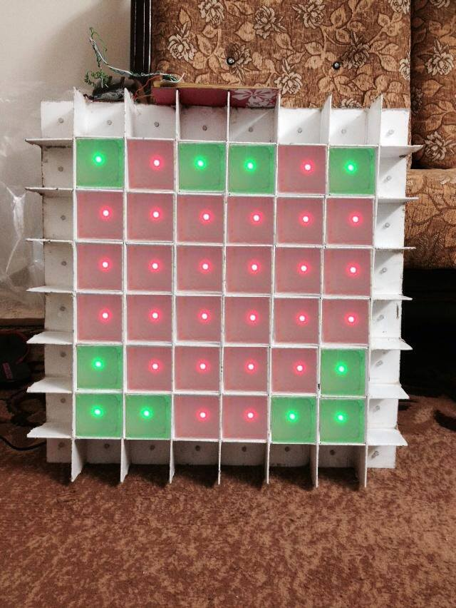
Displaying pattern
After we had control of almost the LEDs we will do the following pattern simple heart

Slide 23
Constraints
Financial constraint
The Project cost around 1100 NS
    Material constraint.
    Number of IC’s that we need.
    IC’ replacement “shift Register “

Slide 24
Constraint-cont
Resource Constraint
  Can’t Find an exact tools that we need.
    Amplifier that is Compatible with Arduino.
    386AMP audio amplifier Module (Arduino compatible).
    Strip of RGB LEDs.
  Limitation of the number of the devices.
    Can’t Find 100 Led of Common Anode LEDs .

Slide 25
Problems
Noise Done by the PCB affected the result that comes from the Microcontroller .
Finding a suitable Resistor that match with the three LEDs.
Pnp Transistors used for selecting anode command Do not respond to the change of the code

Slide 26
Solution
Check Out Microcontroller. (blinking test )
Check Our Code that we program it.
check IC’s that we connect manually.
Check out the wires and the connectivity for each one of them using Multimeter .
The current must used on the circuit used it as a sinking current.

Slide 27
Our Future work
Adding sound sensor
Light sensor
Playing game it by adding a joystick

Slide 28
Demo Time

Slide 29
Any Questions ?

