Slide 1

Useful Life Of Artificial Shoulder
Graduation Project 2
2
+

Slide 2

Students:
1. Nofal Nofal
2. Mohammad Zamel
3.Montaser Salameh
2
+
2
+
Advisor: Dr. Iyad Assaf

Slide 3
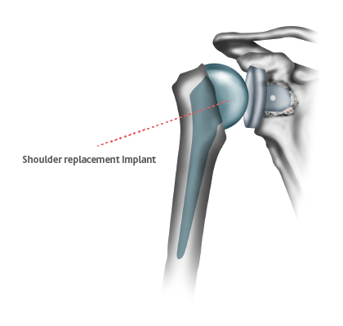
Outline
2
+
Introduction
Methodology
Force and Material
Finite Element
Result and Conclusion

Slide 4
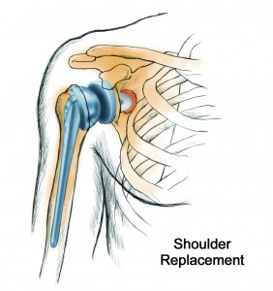
Introduction
2
+
What is the Shoulder Replacement ?
Shoulder replacement is a surgical procedure in which all or part of the glenohumeral joint is replaced by a prosthetic implant. Such joint replacement surgery generally is conducted to relieve arthritis pain or fix severe physical joint damage.

Slide 5
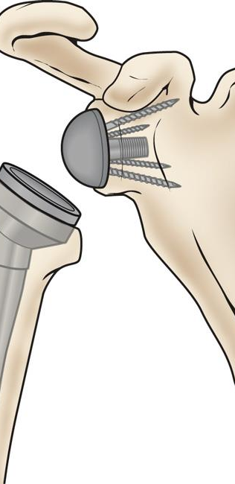
Title
Shoulder Replacement Parts
Types of Shoulder Replacement
Screw
Baseplate
Glenosphere
Humeral Cup
Humeral Stem
Total Shoulder Replacement
Partial Shoulder Replacement

Slide 6
Material Requirements
To use materials in a human body it must be considered these points :
Biocompatible and produce minimal rejection.
High Mechanical properties of the material in order to withstand the forces affecting the shoulder. such as (yield strength, tensile strength, fatigue strength, fracture hardness, and ductility ).
Density and cost : recommended to use lightweight components and responsible price.
Must be nonmagnetic: used medical diagnostic tool is magnetic resonance imaging ,The presence of any magnetic materials implanted in the patient will disrupt the applied magnetic field.

Slide 7
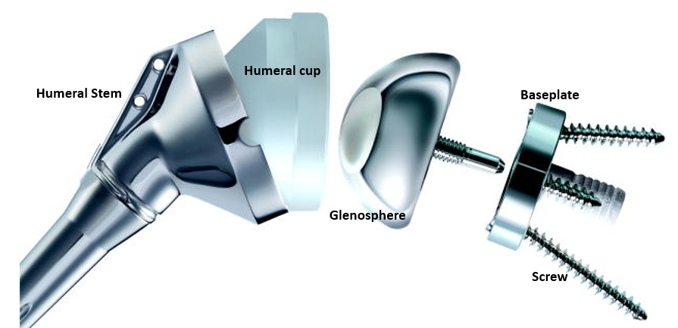
Material Used
Component | Material
Baseplate | Titanium Alloy
Glenosphere | CoCr Mo alloy
Humeral Cup | UHMWPE
Humeral Stem | Titanium Alloy
Screws | Titanium Alloy

Slide 8
Wear Of The Polyethylene
The wear of the polyethylene part causes instability leading to the dislocation of the artificial Shoulder, and the long-term used causes a weariness.
It is necessary to find a suitable solution for the problem of erosion of this piece of Polyethylene and increase its life span and this is the main aim of this research.
Most of the artificial shoulder has useful life range between 10 to 20 years.

Slide 9
Methodology
1. Studying Shoulder joint in general with its parts and components.
2. After that we will discuss the Free body diagram and the relation between forces acts on the Joint to found these forces.
3. Use finite element software “Solid work” to study the stresses and deformations during different situations.
the fatigue life of the shoulder could be determined by Fatigue formulas.

Slide 10

We choose the Solidwork program to make our simulation to create a 3D model.
so we could change the material that we choose and see the output stress and deformations so that we use it to obtain the fatigue and see how much it affect the lifetime.

Slide 11
To do analysis, Our team used different material as shown on table below.

Slide 12
Force analysis
The picture below illustrates the force on shoulder.

Slide 13
And this photo show us the range of motion
Flexion, Extension, Abduction, Internal and External Rotations

Slide 14
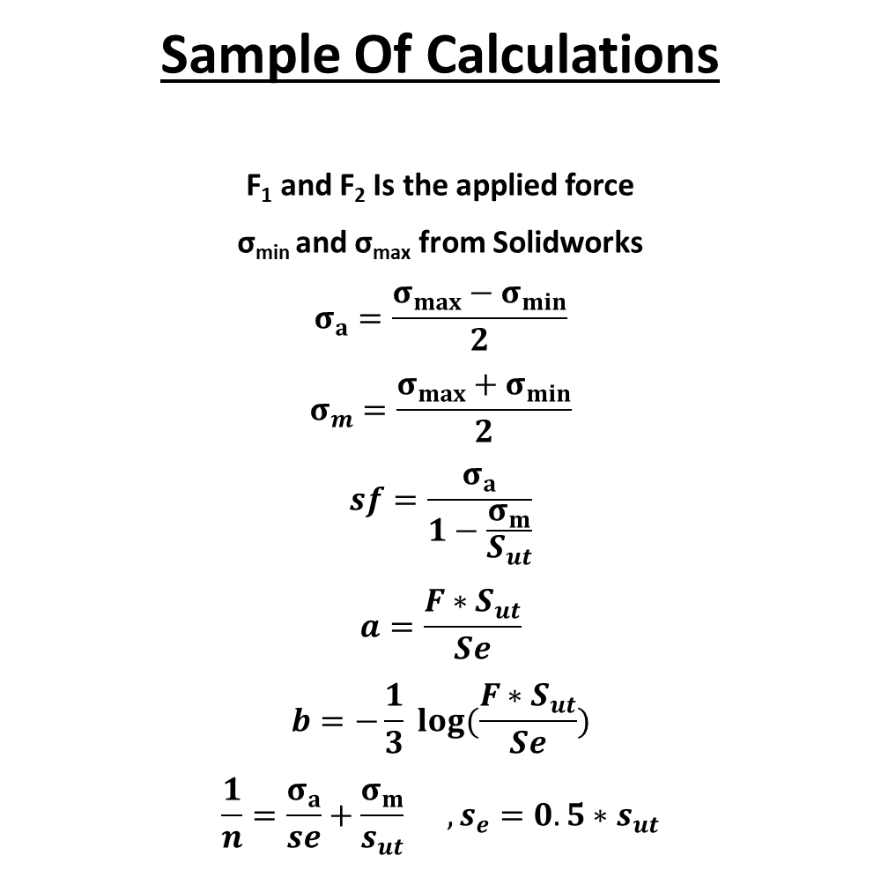
Sample Of Calculations
F₁ and F₂ Is the applied force
σ_{min} and σ_{max} from Solidworks
$$σ_{a}=\frac{σ_{max}−σ_{min}}{2}$$
$$σ_{m}=\frac{σ_{max}+σ_{min}}{2}$$
$$sf=\frac{σ_{a}}{1−\frac{σ_{m}}{S_{ut}}}$$
$$a=\frac{F∗S_{ut}}{Se}$$
$$b=−\frac{1}{3} log⁡(\frac{F∗S_{ut}}{Se})$$
$$\frac{1}{n}=\frac{σ_{a}}{se}+\frac{σ_{m}}{s_{ut}} , s_{e}=0.5∗s_{ut}$$

Slide 15
Finite Elements
finite element method (FEM), is a numerical method for solving problems of engineering and mathematical physics. To solve the problem, it subdivides a large problem into smaller, simpler parts that are called finite elements.

Slide 16
Using Solidwork we made these parts
Baseplate
Glenosphere
Humeral Cup
Humeral Stem
Screw

Slide 17
After run a detected material and run simulation

Slide 18
At our project we focused on Polyethylene part and Voss Mass Result

Slide 19
Result
Using the SolidWorks analysis, we have been able to design a cartilage of up to 42 years old.

Slide 20
Conclusion
This table shows that a material that has an ultimate tensile strength of 14𝑀𝑃𝑎, it will serve for 40-50 years, and this material is not precisely defined in this project.

Slide 21
THANK YOU
2
+
Ready for your questions

