Slide 1

An-Najah National University
Faculty of Engineering & Information Technology
Building Engineering DEPARTMENT
Environmentally friendly restaurant design
Prepared by:
Hiba Ghanem
Nada Hamarsheh
Zeina Qadi
Supervisor: Eng. Fadi Fatayer

Slide 2
Outline
Introduction
Site location
Architectural Design
Environmental Design
Structural Design
Electrical Design
Mechanical Design
Safety Design
Estimated Cost

Slide 3
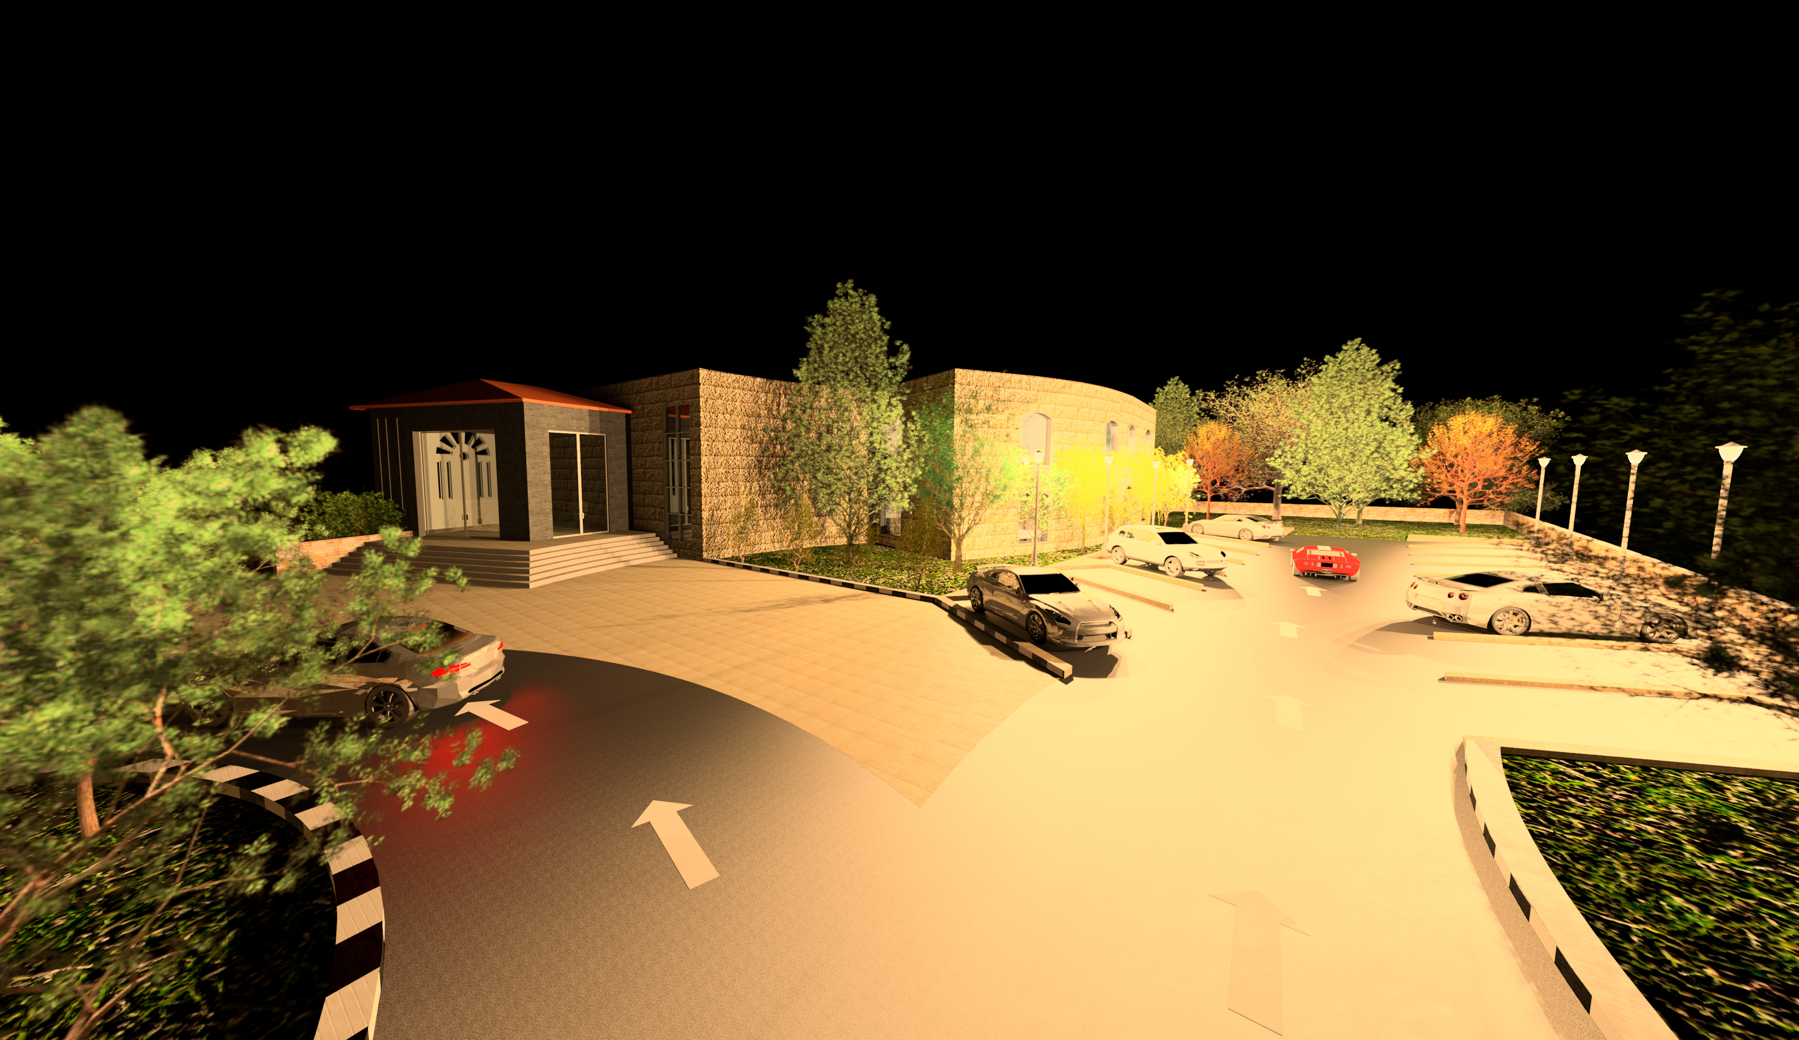
INTRODUCTION

Slide 4
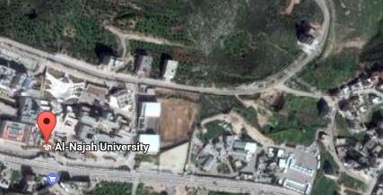
SITE LOCATION
Al junaid, Nablus – Palestine .
Total area of 5000m².

Slide 5
ARCHITECTURAL DESIGN
The total area of restaurant = 2346 m², It divided in to three floors .
The area of each floor is shown in the following table :
Floor | Area (m²)
Basement floor | 246
Ground floor | 1180
First floor | 920
Total | 2346

Slide 6
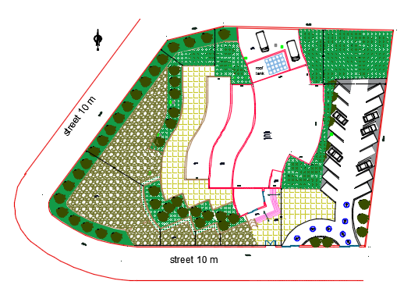
ARCHITECTURAL DESIGN
Site Plane:

Slide 7
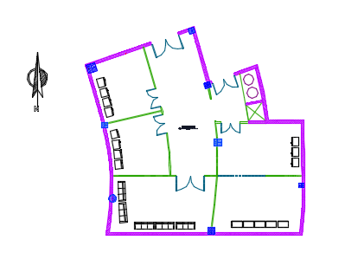
ARCHITECTURAL DESIGN
Basement Plane:

Slide 8
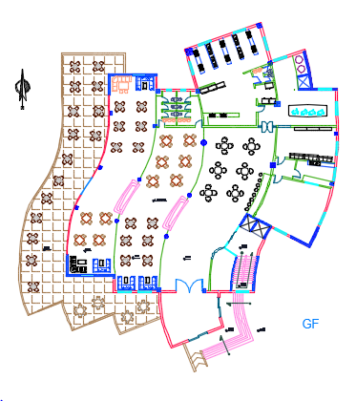
ARCHITECTURAL DESIGN
G.F Plane:

Slide 9
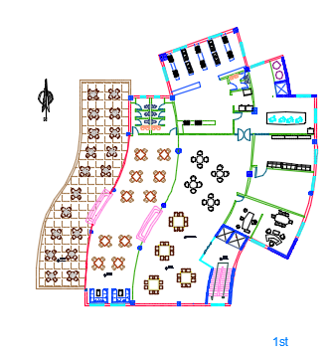
ARCHITECTURAL DESIGN
1st Plane:

Slide 10
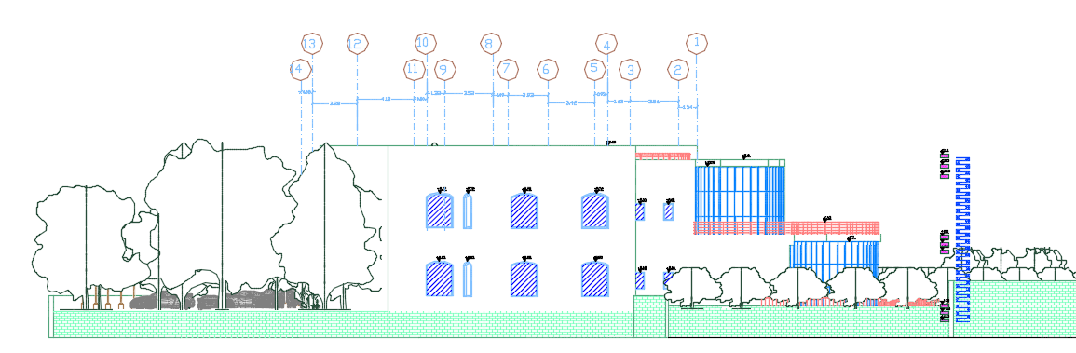
ARCHITECTURAL DESIGN
North Elevation:

Slide 11
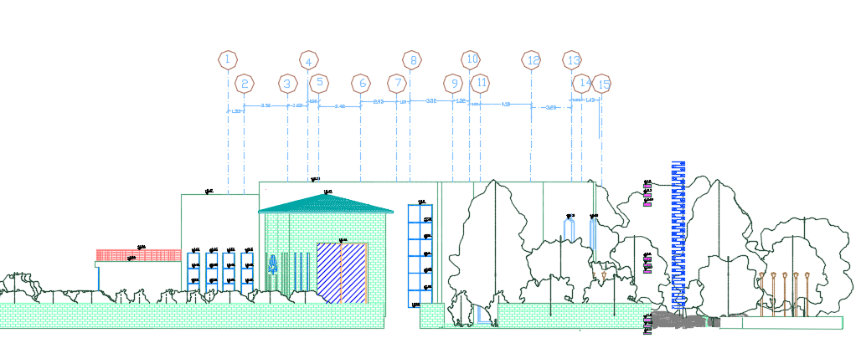
ARCHITECTURAL DESIGN
South Elevation:

Slide 12
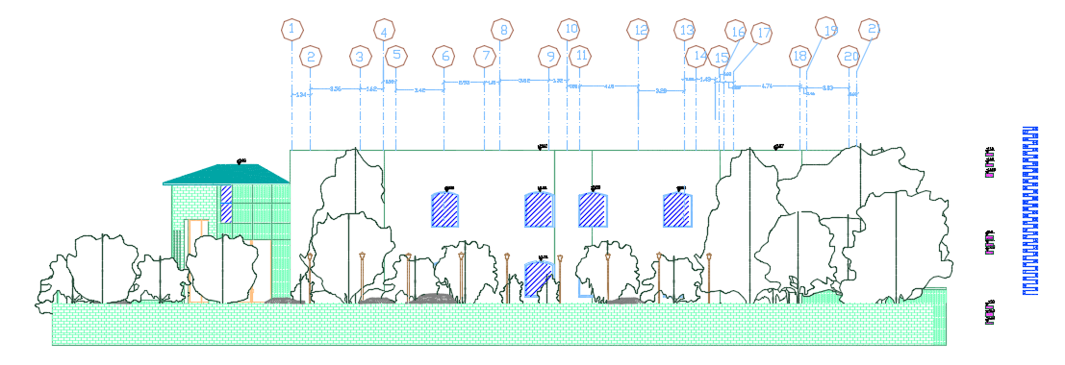
ARCHITECTURAL DESIGN
East Elevation:

Slide 13
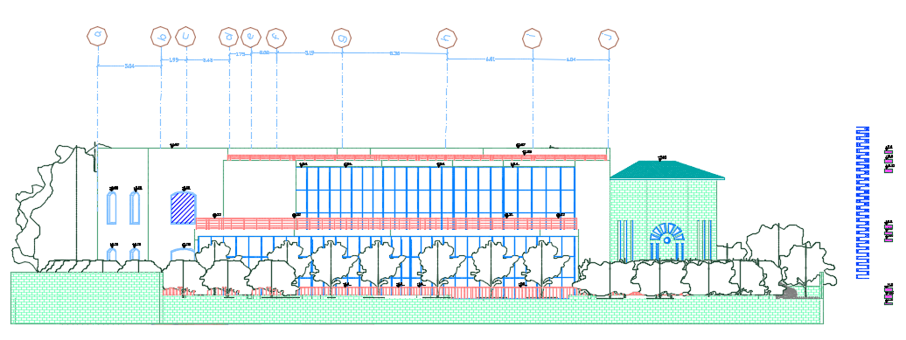
ARCHITECTURAL DESIGN
West Elevation:

Slide 14
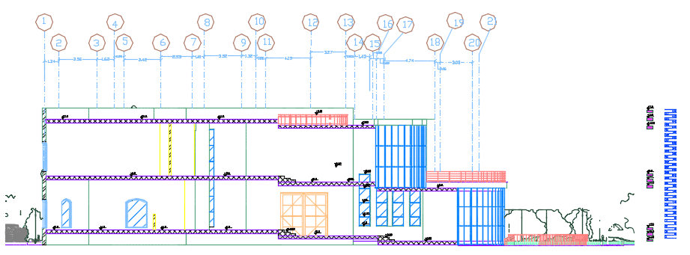
ARCHITECTURAL DESIGN
Section A-A:

Slide 15
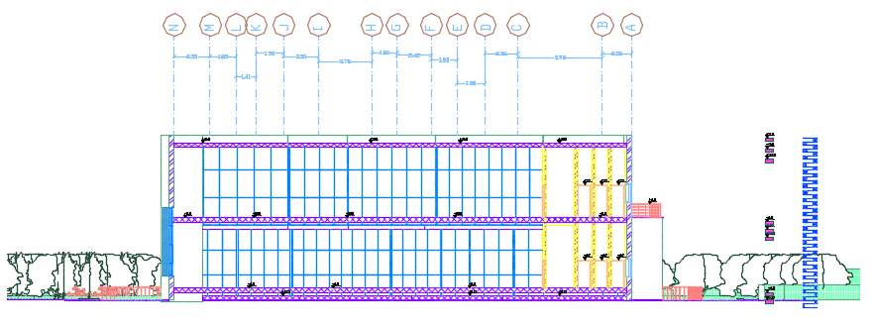
ARCHITECTURAL DESIGN
Section B-B:

Slide 16
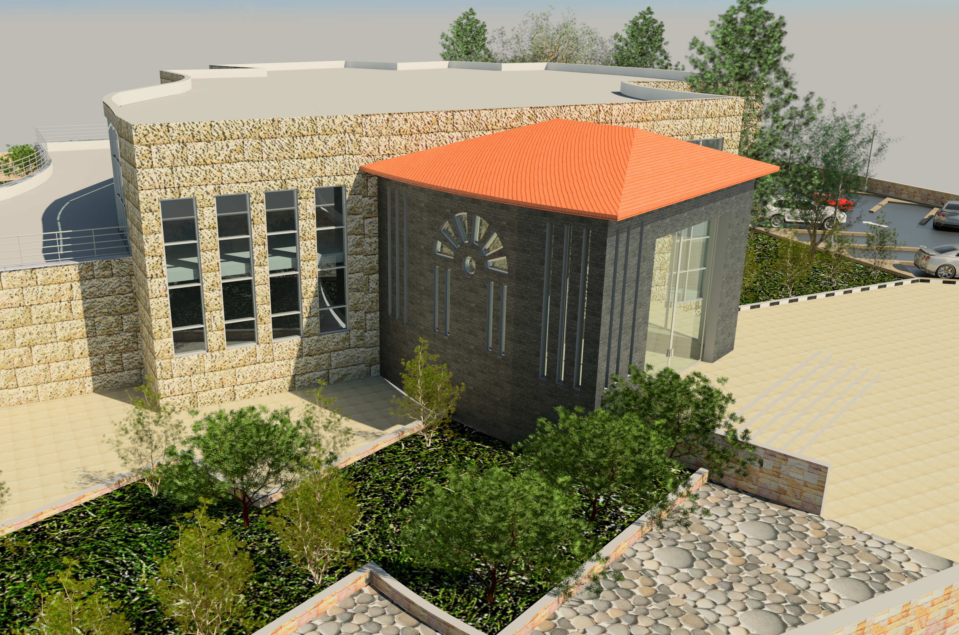
ARCHITECTURAL DESIGN
3D View:

Slide 17
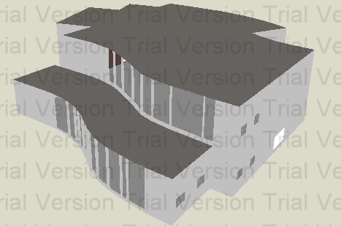
Environmental design

Slide 18
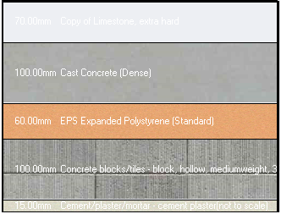
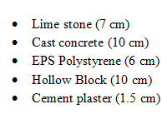
Environmental design
U value for external wall = 0.525 W/m².K

Slide 19
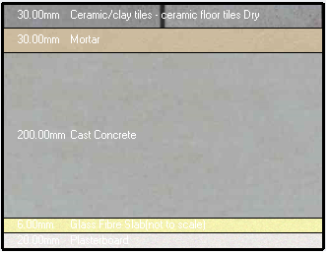
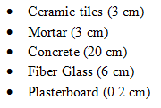
Environmental design
U value for ceiling= 1.229 W/m².K

Slide 20
Environmental design
Glasses:
Double glass with 13 mm air
The Outer → generic ECABS
The inner →AGC Glass
U value = 1.75
Light transmission= 0.12
Direct solar transmission = 0.1

Slide 21
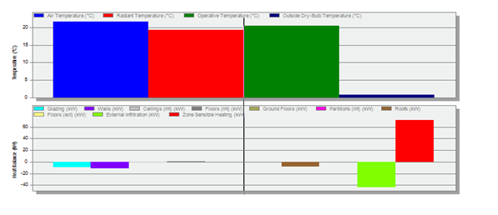
Environmental design
Heating Design:

Slide 22
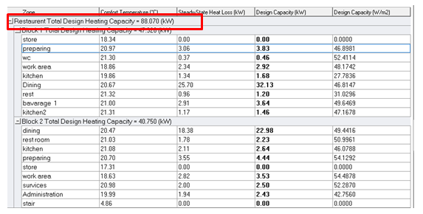
Environmental design
The total Heating Capacity = 88.07 KW

Slide 23
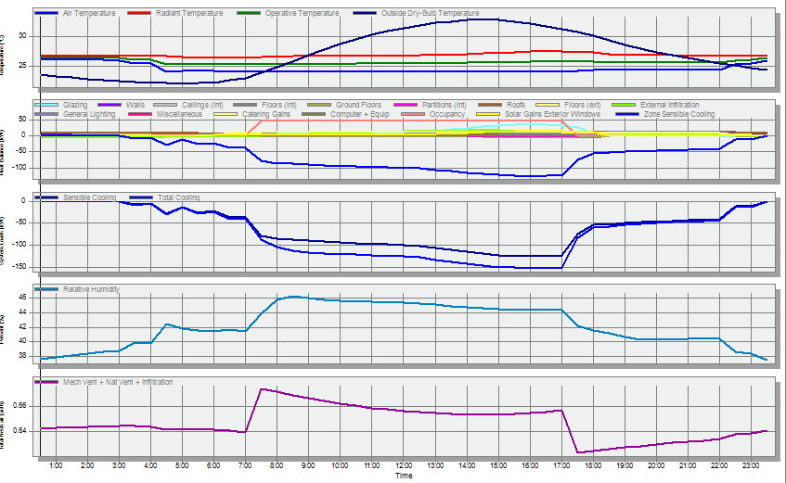
Environmental design
Cooling Design:

Slide 24
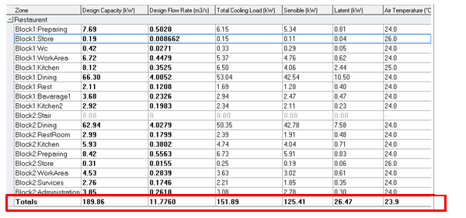
Environmental design
Total cooling capacity= 189.86 KW

Slide 25
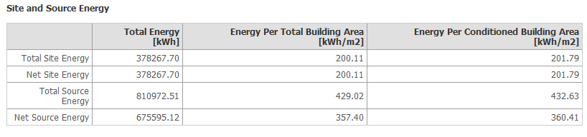
Environmental design
Site and source energy:
The standard max power intensity= 415.4 kW\m²

Slide 26
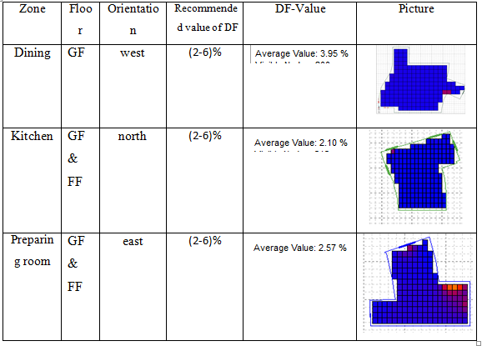
Environmental design
Daylight factor:

Slide 27
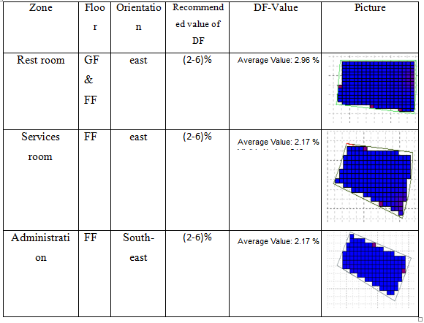
Environmental design

Slide 28
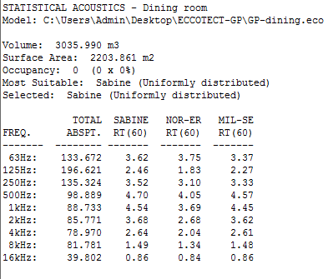
Environmental design
Acoustics Design:
Results of RT60 from Ecotect (before modification)
According to specifications of restaurants the required RT60 is ( 0.8 – 1.2 ) s

Slide 29
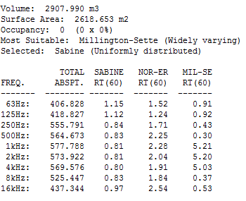
Environmental design
Results of RT60 from Ecotect (after modification)

Slide 30
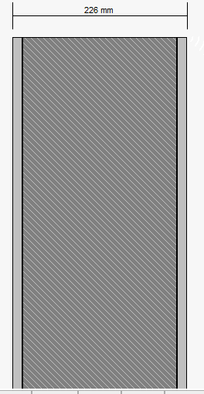
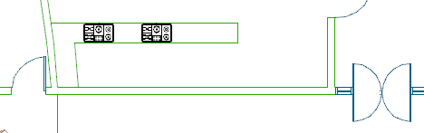
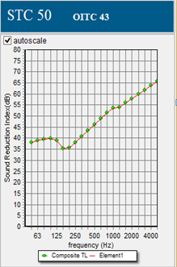
Environmental design
STC Calculations:
For inner wall ( between the kitchen and dining hall ):
required STC 50-54

Slide 31
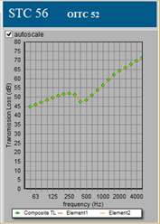
Environmental design
STC for external wall:
Required STC level (50-55)

Slide 32
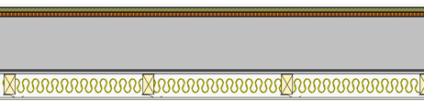
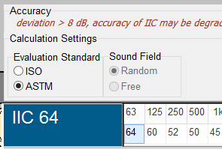
Environmental design
IIC for ceiling:
Required IIC level (55-58)

Slide 33
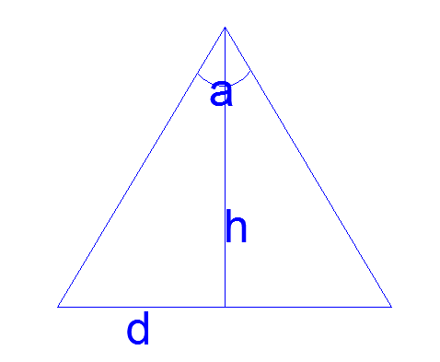
Environmental design
Speakers:
α= 130º
H= 4 m
D= 4.76 m
A=71.14 m²
#of loudspeakers for GF= 10 speakers

Slide 34
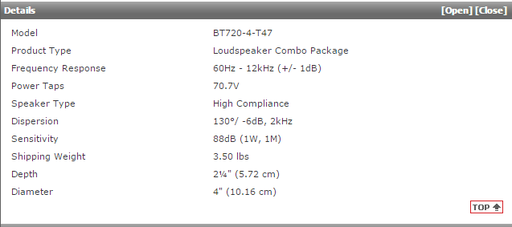
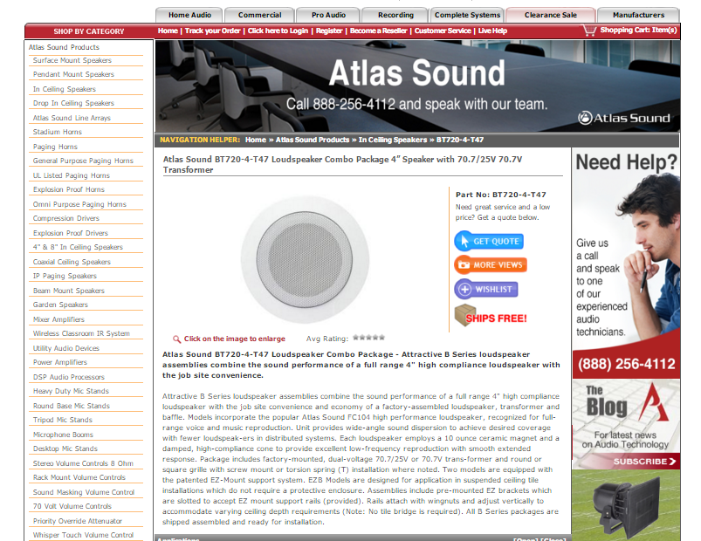
Environmental design
Acoustical Design:
Speakers:
Sound system calculations for the restaurant were only made for the dining halls

Slide 35
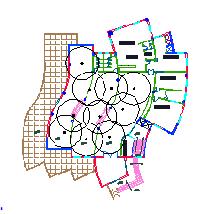
Environmental design
Distribution of speakers:

Slide 36
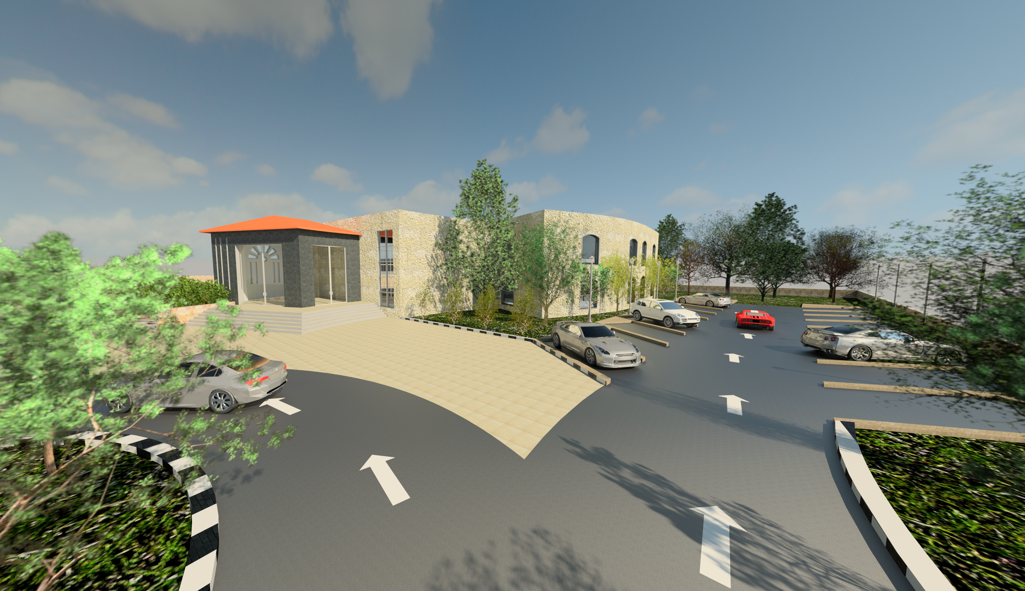
STRUCTURAL DESIGN

Slide 37
STRUCTURAL DESIGN
Codes and Standards:
ACI -318-11 for reinforced concrete structural design.
UBC -97 for earthquake design.
ASCE 7 2010 for load combinations

Slide 38
STRUCTURAL DESIGN
Design data:
Concrete strength for slabs and beams, f’_{c}=24 MPa.
Concrete strength for columns and shear walls ,f’_{c}=28 MPa.
Steel yield strength f_{y}=420 MPa.
Bearing capacity for soil = 350 kN/m²

Slide 39
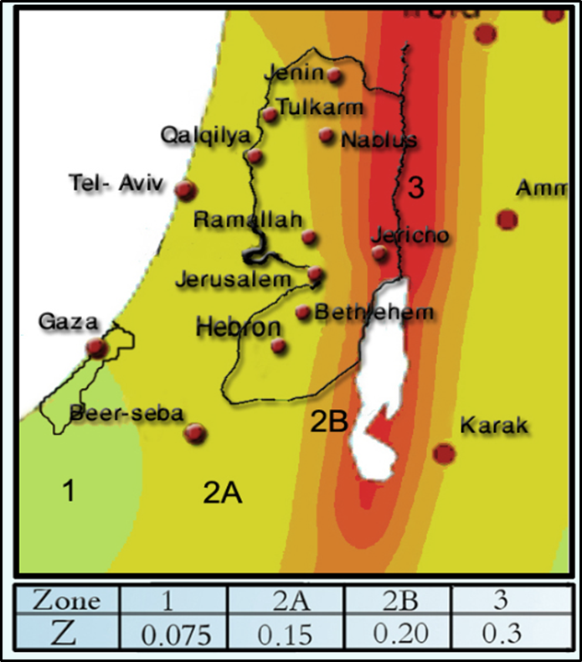
STRUCTURAL DESIGN
Lateral loads:
The city of structure is Nablus.
The seismic zone factor. Z=0.2.
The soil profile is type Sc.
The acceleration seismic coefficient Ca=0.24
The velocity seismic coefficient Cv=0.32.
The Seismic importance factor is 1.
The structural design type is intermediate, R=5.5

Slide 40
STRUCTURAL DESIGN
Loads:
Load type | Ribbed slab
Live | 5(kN/m²)
S.I.D | 4(kN/m²)

Slide 41
Preliminary design
Ribbed slab with 37 cm thickness.
Dropped beams with dimensions 850*500 mm
square & circular columns

Slide 42
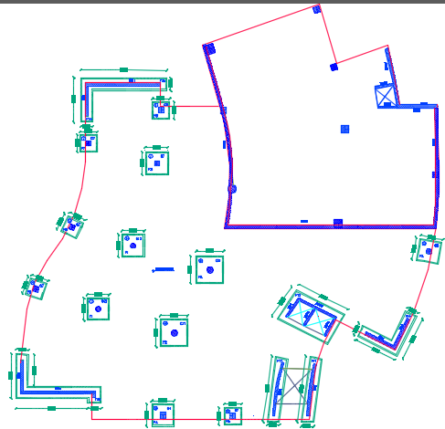
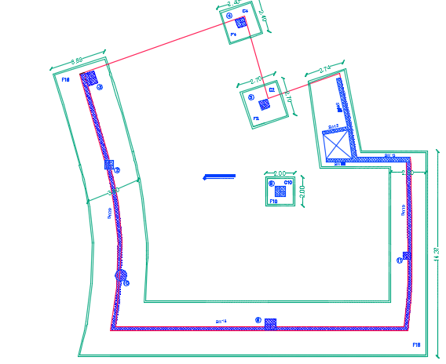
Columns and footings

Slide 43
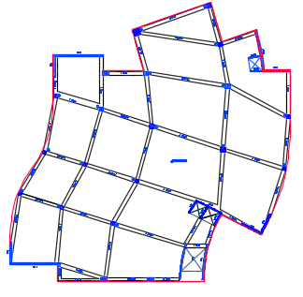
beams

Slide 44
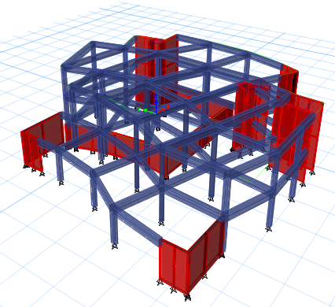
modeling

Slide 45
Verification of model
Compatibility check
Equilibrium check
Internal force check
Drift check
Period check
Model participating mass ratio check

Slide 46
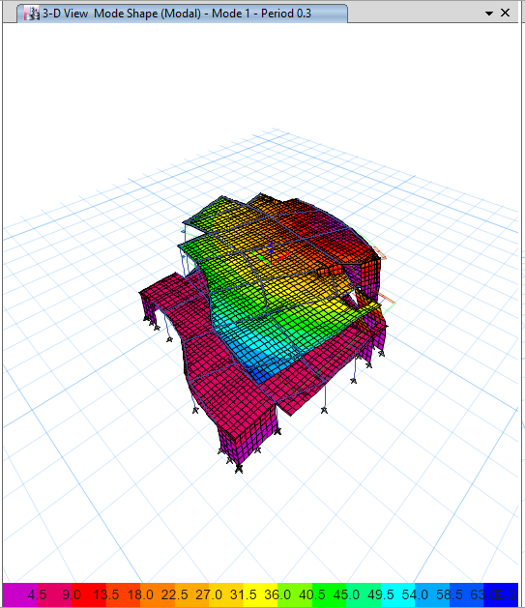
STRUCTURAL DESIGN
Compatibility check:

Slide 47
STRUCTURAL DESIGN
Equilibrium check:
Loads | ETABS results | Manual Results | % of error
Live | 12320.6 | 12380 | 0.5
Dead | 26418.7 | 27410 | 3.7
SID | 17948 | 17800 | 0.8
Error = ( ( Manual – ETABS Load ) / Manual Load ) * 100% < 5%

Slide 48
STRUCTURAL DESIGN
Internal forces Check:
For column 18:
Manual Pu (KN) | ETABS Pu (KN) | % error
3620 | 3913 | 7

Slide 49
STRUCTURAL DESIGN
Drift check:
Story | dis_X | dis_Y | delta_X | delta_Y | delta_M_X | delta_M_Y | story height | delta limit
0 | 0 | 0 | _ | _ | 0 | 0 | 4000 | 80
1 | 1.726 | 1.772 | 1.726 | 1.772 | 6.6451 | 6.8222 | 5000 | 100
3 | 6.97 | 9.69 | 5.244 | 7.918 | 20.1894 | 30.4843 | 5000 | 100
Since all delta_M_X and delta_M_Y is less than delta limit the check is OK.

Slide 50
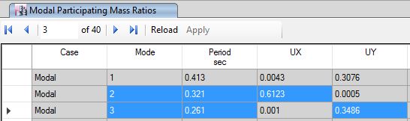
STRUCTURAL DESIGN
Period check:
T standard = 0.0.353 sec
From ETABS:

Slide 51
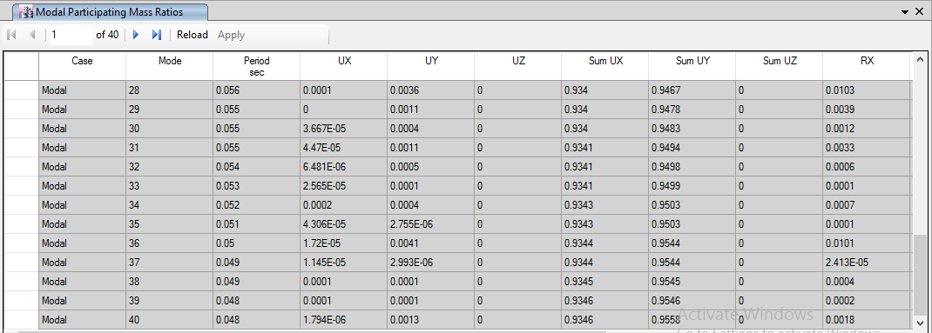
STRUCTURAL DESIGN
Modal participating mass ratio:

Slide 52
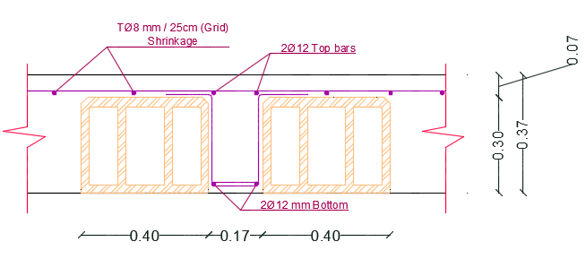
Slab reinforcement

Slide 53
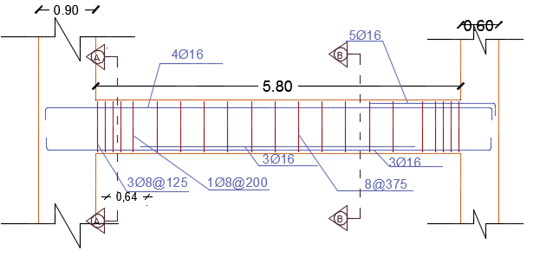
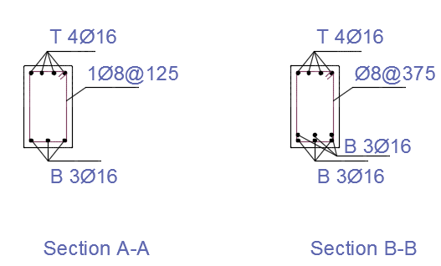
Beams reinforcement

Slide 54
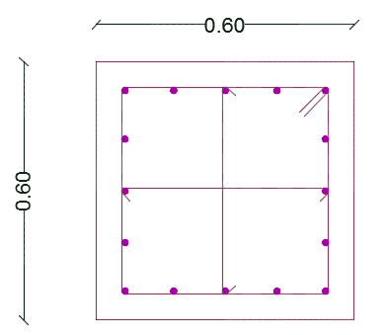




Columns reinforcement

Slide 55

Columns reinforcement

Slide 56


Footing reinforcement

Slide 57

Stair reinforcement

Slide 58
Electrical design

Slide 59

Electrical design
The table below shows the recommended lux for different spaces:

Slide 60

Electrical design
Artificial lighting for dining:

Slide 61

Electrical design

Slide 62

Electrical design

Slide 63


Electrical design
Work plane 1:

Slide 64


Electrical design
Work plane 2:

Slide 65


Electrical design
Work plane 3:

Slide 66

Electrical design
To check the uniformity, we make a visual task area on the surface of two tables:

Slide 67

Electrical design
Artificial lighting for dining:

Slide 68

Electrical design

Slide 69
Mechanical design
Drainage system
Water supply system
HVAC system

Slide 70

Mechanical design
Drainage system:
Distribution of manholes:

Slide 71

Mechanical design
Distribution of drainage pipe through ceiling:

Slide 72
Mechanical design
Water supply system:
Diameter of fresh water pipes for all stories shown in this table :
Diameter | Vertical | Horizontal | branch
Basement | 2 in | 1 in | 3/8 in
Ground Floor | 2 in | 1.25 in | 3/8 in
1st floor | 2 in | 1.25 in | 3/8 in
2 Pumps should be added to the first floor and second floor with 6psi and 12 psi respectively.

Slide 73


Mechanical design
Water supply system:

Slide 74
Mechanical design
HVAC system
In restaurant we used the variable refrigerant flow (VRF) system.
Main component of this system :
Out door unit
Collector
Fan coil unit
Diffusers

Slide 75

Mechanical design
Out door unit :
We used outdoor unit from TOSHIBA with cooling capacity = 135 KW and heating capacity = 150KW to cover the cooling capacity and heating capacity for dining and beverage area.

Slide 76

Mechanical design
Collector :
The total cooling load in dining area equal 69.98 KW so that, we used two single BC controller in each floor with 35.1KW nominal cooling capacity.

Slide 77

Mechanical design
Diffusers :
In restaurant we used the architectural linear slot diffuser (anemostat) so that it can fit with decoration of restaurant and it is sound level fit with the sound level with the restaurant.

Slide 78

Mechanical design
HVAC system:
Distribution of Diffusers:

Slide 79

Safety design
Distribution of sprinklers:

Slide 80


Safety design
Distribution of detectors:

Slide 81

Safety design
Distribution of extinguisher :
There is two types of fire extinguisher that used in restaurant:
1. Type K: It is located in kitchen.
2. Type A: It is located in the dining areas and corridors.

Slide 82


Safety design
Exit signs:

Slide 83

Safety design
Emergency exit :

Slide 84
Quantity Survey
 | Total cost (NIS) | Unit cost (NIS/m²)
Excavation works | 76489.2 | 19.8
Civil works | 1002963.3 | 427.5
Architectural works | 1273691 | 543
Mechanical works | 101823 | 43.4
Electrical works | 23735 | 10.1
Total cost | 2,478,702.7 | 1043.8
The upper cost did not include decoration, land scape and furniture costs.

Slide 85


