Slide 1
Intelligent Battery Charger
Al-Motasem Aqel
Ahmed dar hamdan
Submitted to :
Falah Mohammed

Slide 2
Presentation Outline
Introduction
Circuit Design
PIC Control
Successes and Difficulties
Future Work

Slide 3
Design Requirements
Charge AA NiMH, AAA NiCad, Li-Ion batteries according to charge algorithms
Voltage and temperature charge termination
Less than 5% battery voltage/current ripple
LCD voltage display

Slide 4
Original Design
Use a different circuit for each battery
Utilize switches to switch between battery circuits, as well as different charging stages
Problems with circuit size and complexity
Not a very “intelligent” design that utilized very little PIC control

Slide 5
Final Design
Added a buck converter
PWM output of PIC controlled duty cycle of buck converter
Control of battery current/voltage by varying duty cycle
Dynamic control in place of the static circuit of original design

Slide 6
Circuit Overview

Slide 7
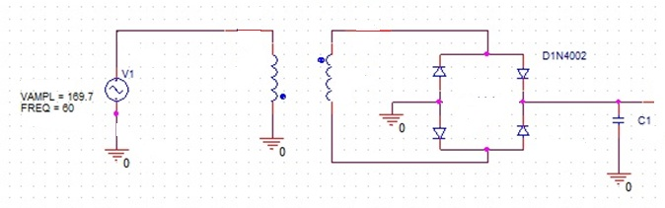
AC-DC Circuit
4:1 Step-down transformer
Full-wave bridge rectifier
Filter Capacitor

Slide 8
AC-DC waveforms
After transformer

Slide 9
After rectifier

Slide 10
After filter capacitor

Slide 11
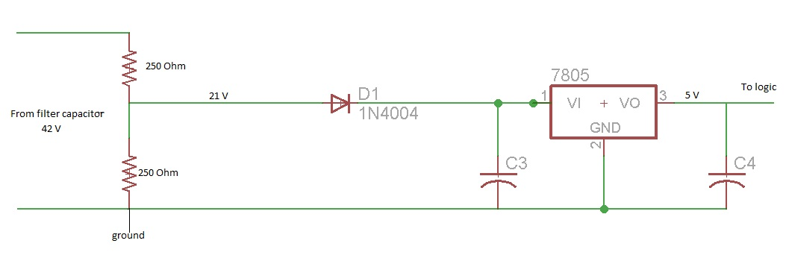
+5V Supply
Was needed to power logic-level components : PIC, LCD, Oscillator
Used a voltage divider on the rectified DC waveform to obtain 21V DC
Used 7805CT +5V regulator to step down voltage

Slide 12
+5V Supply

Slide 13
Buck Converter Design
Inductor Design:
L ≥ (Vin,max-Vout)x (Vout/Vin,max)x(1/fsw)x(1/(LIR x Iout,max))
For 1% ripple, Vin,max = 42 V , and Iout,max=3.5A, we obtain L ≥ 6.29 mH
Output capacitor Design:
C ≥ L(Iomax + ΔI/2)^2 / ((ΔV + Vo)^2 – Vo^2)
For 1% voltage and current ripple, we obtain C ≥ 44mF

Slide 14
PIC/Buck Converter Interface
Varying duty cycle from PIC directly correlates to the voltage/current provided by buck converter
MOSFET driver was necessary to supply enough current to drive the gate
20kHz PWM from PIC was consistent with switching limits of diode and was fast enough to keep ripple low

Slide 15
PIC Features
16F877A
40-PIN
Built in PWM
6 Analog Pins
10-bit ADC Conversion
FOX 1100E for 20MHz external clock
Powered using +5V DC

Slide 16
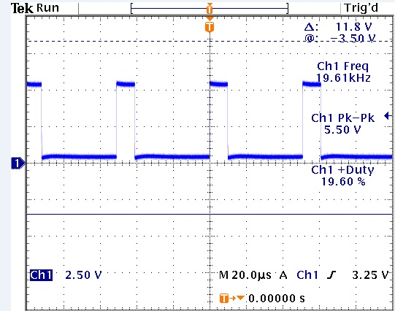
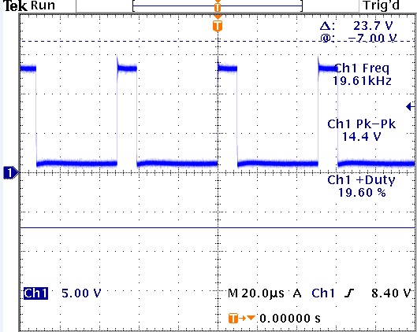
PIC PWM Output
PIC PWM output
MIC4424CN PWM output

Slide 17
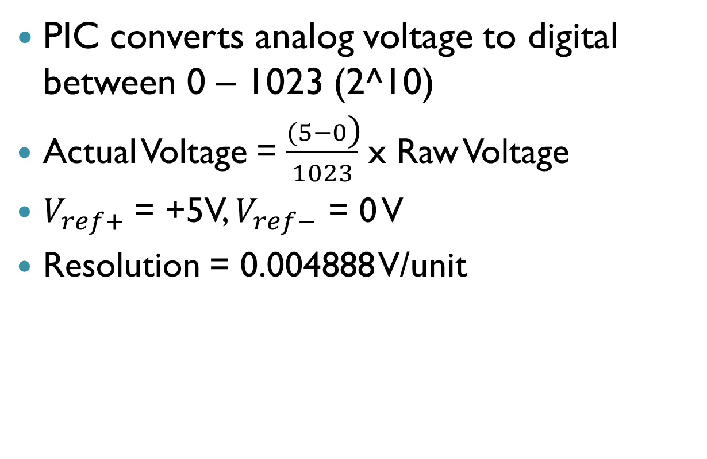
ADC Conversion
PIC converts analog voltage to digital between 0 – 1023 (2^10)
Actual Voltage = $\frac{(5−0\text{)}}{1023}$ x Raw Voltage
$V_{ref+}$= +5V, $V_{ref−}$ = 0 V
Resolution = 0.004888 V/unit

Slide 18
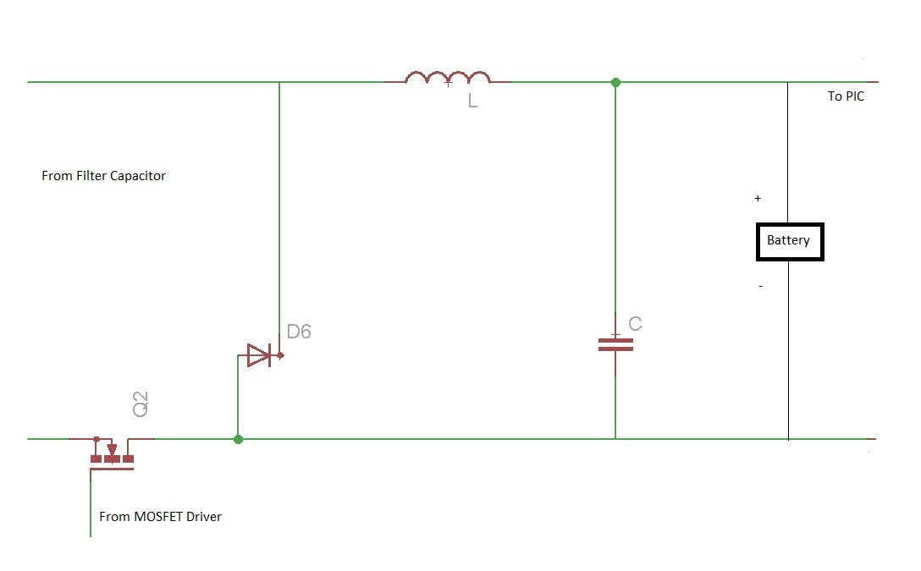
Original Choice – Low Side Driver
Pros: Low side driver was easier to use and more readily available in the power lab
Con: Had to ground drain side and therefore couldn’t ground the negative terminal of battery.
  This made it much harder to measure battery voltage using PIC

Slide 19
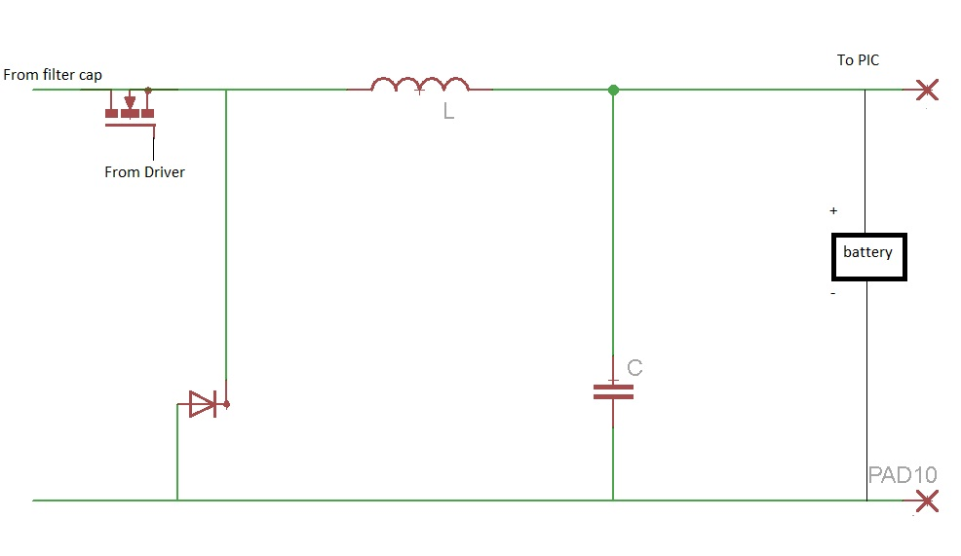
Final Choice – High Side Driver
Pros: Allowed us to measure battery voltage with PIC, which was crucial to the project
Cons: High side driver had a 9.5 V threshold for the PWM signal
  Required a low side driver acting as a voltage stepper to increase from 5 V to above 9.5 V
  Required extra 12 V and 15 V power supplies for the low side and high side drivers, respectively

Slide 20
LCD Panel
PHICO Panel
16x2 LCD w/HD44780 Controller
4 Push Buttons
3 LEDs

Slide 21
Charging Algorithm
Ni-MH:
Constant 1C =2.3 A - Fast charge until V >1.1V
Constant 0.1 C = 0.23 A for 30 minutes
Trickle 1/30 C = 7mA indefinitely
Ni-Cd
Constant 1C =0.35 A – fast charge until V >1.0 V
Constant 0.1 C = 3.5 mA for 30 minutes
Trickle 1/30 C = 1mA indefinitely
Li-ion
If V<2.8 V, trickle charge at 0.1 C = 0.35 A
Constant 1C = 3.5 A until V=4.2
Constant 4.2 V supplied until I< .25 A

Slide 22
Constant Voltage
For each charging stage, maintain a constant duty cycle
This duty cycle is predetermined via testing to output a set voltage.

Slide 23
Constant Current
Place a precision resistor in series with battery.
Measure the voltage across this resistor
Compare this to an expected voltage level, which is determined by multiplying the expected constant current value by the resistance of the precision resistor.
For all measured voltages within 1% below the expected value, keep duty cycle constant
For more than 1% below, increase the duty cycle by very small increments at each reading
For voltages above the threshold, drop the duty cycle by 10%, as this will only occur when transitioning to a lower current stage.

Slide 24
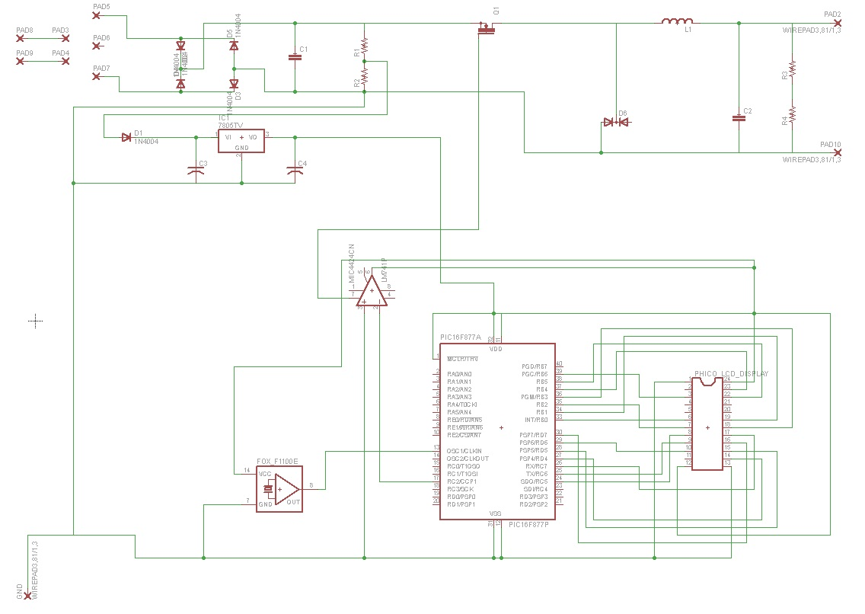
Full Schematic

Slide 25
Successes and Challenges
Successes
Measured battery voltage using PIC
AC-DC conversion
PIC-driven buck converter
Challenges
Inadequate testing equipment slowed our progress
Driving the buck converter with high side configuration
Overcoming time lost in following original design
Temperature sensing

Slide 26
Future Work
Fully developing and testing of charging algorithms
Developing +15 V and +12 V sources within circuit
Adding compatibility with other batteries
Improving accuracy of PIC voltage reading
Decrease overall circuit size and implement with PCB to improve accuracy
Add temperature detection for better stage transitions and charge termination

