Slide 1

cloud ++
Students:
Leena khaled haj yousef
Ata' Munther Hussni Refai
Supervisor:
Dr. Samer Arandi.
Notes:
NOTE:
To change the image on this slide, select the picture and delete it. Then click the Pictures icon in the placeholder to insert your own image.

Slide 2
Outline
1) Introduction
2)Scope of work
3) Cloud++ idea
4) The Frameworks and Languages
5) Tools
6) future work

Slide 3
Introduction
1)Cloud++ (online IDE) helps students to practice coding which supports many programming languages
2)courses,students,instructors registration
3) Homeworks management
4) Assessment.

Slide 4
Scope of work
Cloud++ Platform project allows the users to sign up and they are splitted according to their role, whether they are students or instructors or admin . The instructor can add his courses to the system so the Admin(third role) can append number of students to that course.
The users can use the editor to compile there written codes and see result, besides homework submission process.

Slide 5
Cloud++ idea
Our project is a platform to facilitate programming courses, homework of the Computer Engineering Department .This platform has some features of well known websites such as hackerrank

Slide 6
Cloud++ idea
1.Online IDE supports many programming languages like: C++ , java, Python,C#, HTML,CSS and JavaScript. Each student has a profile allows him to train and run simple programs . This also allows a student to store files within a project and retrieve them later, even more download projects and files on their device.
2.instructors create courses and home works within a course, they can specify dead line and test cases for a homework. The student later solve the homework and run it to check for errors then submit it against test cases .

Slide 7
Cloud++ idea
3. Admin: admin can add or remove students and doctors , even more modify information refers to users and courses. In addition , students can be added to a certain course and this process can be done manually or by selecting an excel sheet that contains student data.

Slide 8
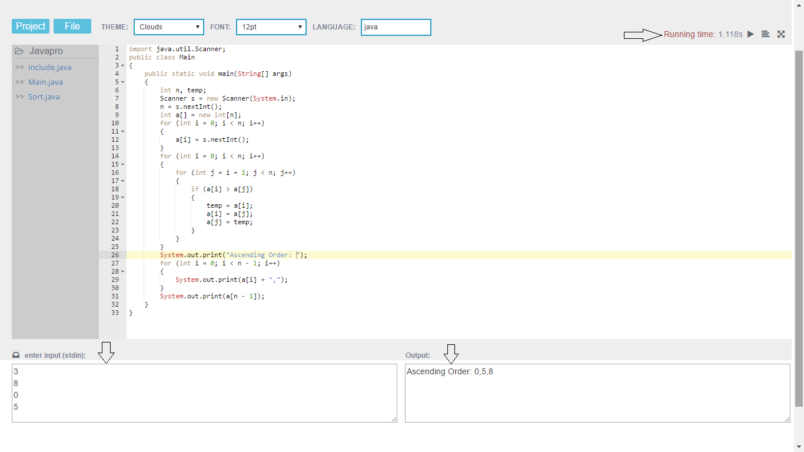
Cloud++

Slide 9
The Frameworks and Languages
Node.js ,compileX
MySQL database
Programming language :CSS ,HTML ,JAVASCRIPT

Slide 10
Tools
WebStorme
Xammp

Slide 11
future work:
1) Make our project more robust.
2) More features to the IDE by adding new supported languages
3) Making the system more secure and reliable
4)Upload the department courses files and manage them.
5)Adding more types of tasks such as “tasks with images, draw etc.”

