Slide 1
Graduation Project I
Analysis and Redesign of Water Distribution Network and Design of WasteWater Collection network for Asira AL-Shamaliyah Village
By:
Ayman Bdair
Karam Sawalha
Mohammad Odaily
Under supervision of Dr. Anan Jayousi

Slide 2
Outline
Project objectives
Study area
Questionnaire Analysis
Data collection and calculation
Results of the current water network
Future water consumption and demand needed
Redesign the water network
Design of wastewater collection network

Slide 3
Project objectives
Analyze the existing water distribution network in Asira AL-Shamaliyah Village.
Redesign the water network for the future demand.
Design the wastewater collection network for Asira AL-Shamaliyah Village
Determine the cost of constructing these networks.

Slide 4
Methodology

Slide 5
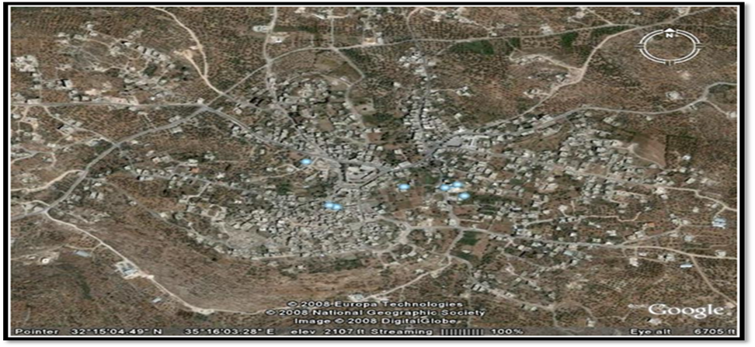
Study area
Asira AL-Shamaliyah Village
It is located to the north of the city of Nablus, at by some distance 7 kilometers away, and had an average height of (648 meters) above sea level.
It has an area of 29,033 denims and a population of about 9960 capita in 2017.

Slide 6
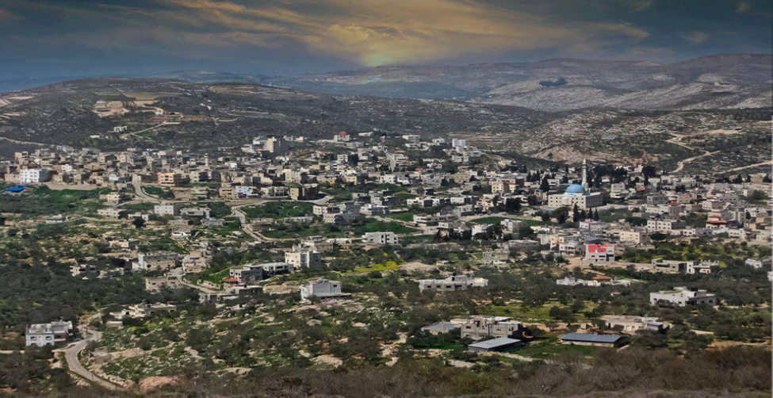
Study aria
AL-Shamaliyah Village
The lowest temperature reaches at average of 10.2 degrees in the month of January , the highest temperature reaches at average of 26.8 degrees in the month of August.
Average relative humidity in the year is 60.5
Average annual rainfall at 588.9 mm
Average speed of wind amounted to 5 kilometers per hour.
Asira ash Shamaliya is provided with water by Nablus Municipality through the public water network.

Slide 7
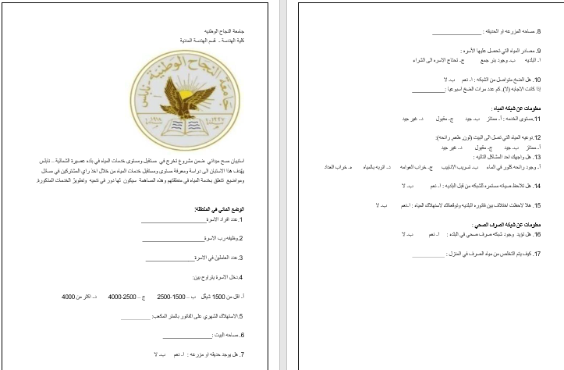
Questionnaire Analysis
The purpose of questionnaire:
Study the existing situation.
Knowledge the consumption of water bar month for each family.
Knowledge of the services provided to citizens.
Knowledge of the health, environment and social status in the village.
An important sources of information that can be used during the study.
The main component of the questioner is family size ,
consumption per family in cubic meter ,
water resources that the family use,
and common problems in the network.
35 questioners were been distribute. The distribution of the questioner were been unbiased and random.

Slide 8
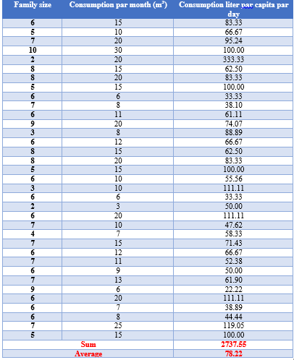
Questionnaire analysis
Average family size = 6.1 capita
water consumption =78.22 L/C/day

Slide 9
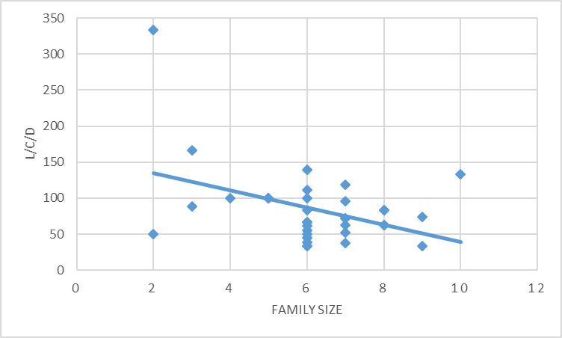
Questionnaire analysis
Consumption (L/C. d) vs Family size
when the number of family member’s increases, the consumption of water will decrease. So that, the demand on water will decrease.

Slide 10
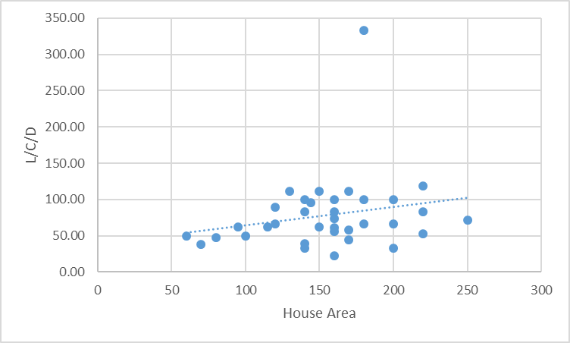
Questionnaire analysis
Consumption(L/c/day) vs house area.
when the area of house increases. Then, the consumption of water for capita will increase.

Slide 11
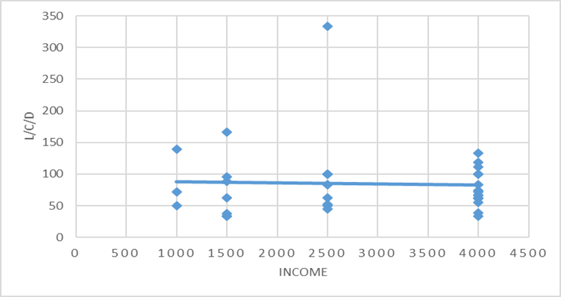
Questionnaire analysis
the Consumption (L/C/d) vs Income of family
when the income of family increase, the consumption of water will increase

Slide 12
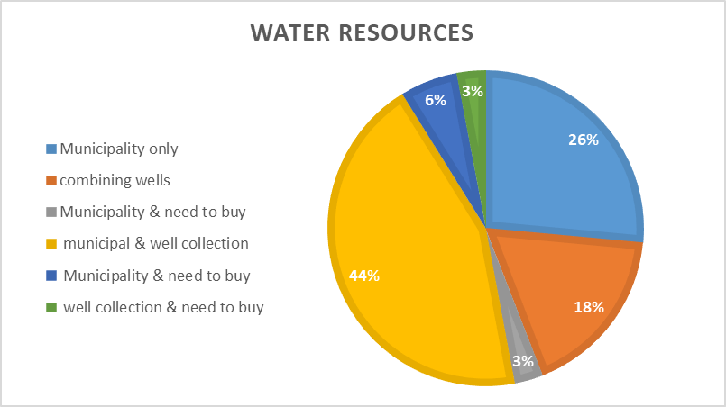
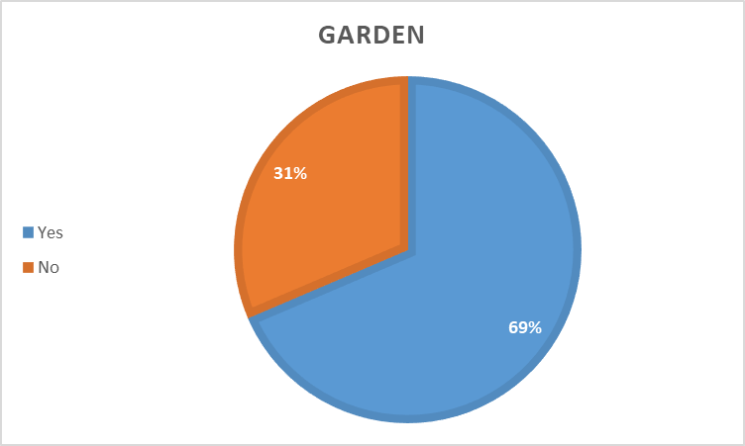
Questionnaire analysis

Slide 13
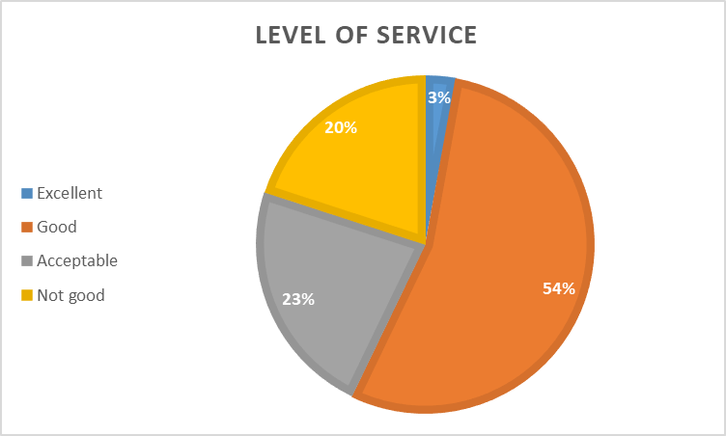
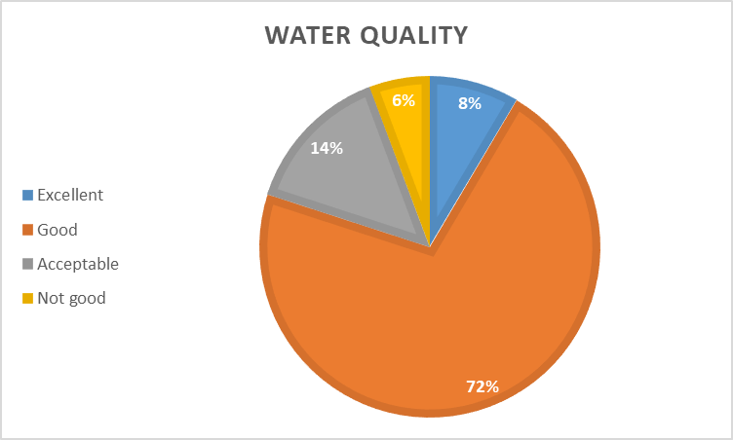
Questionnaire analysis

Slide 14
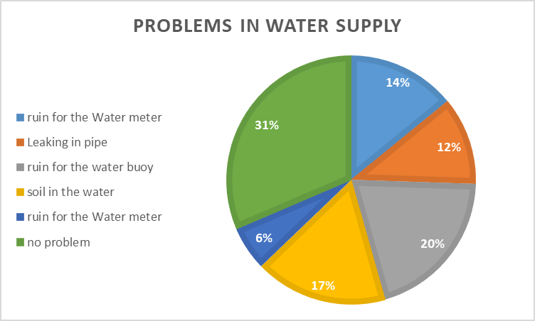
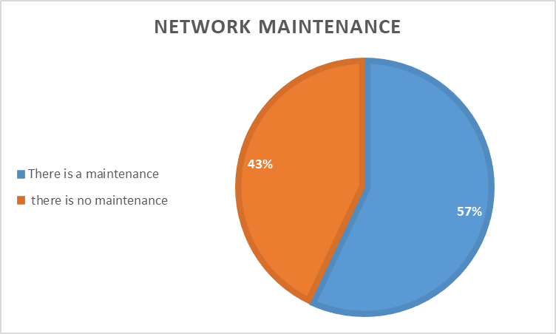
Questionnaire analysis

Slide 15
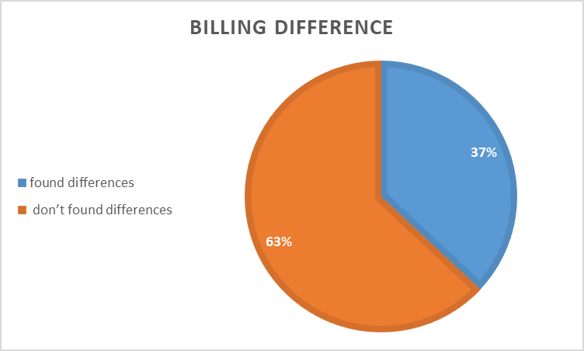
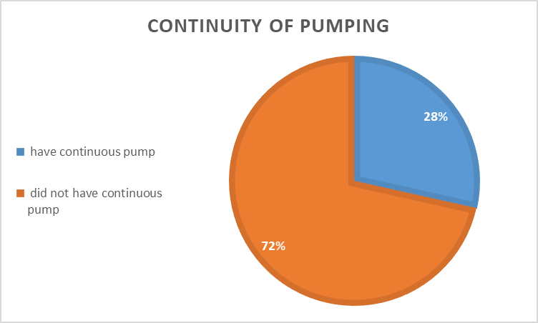
Questionnaire analysis

Slide 16
Analysis and Redesign of Water Distribution Network

Slide 17

Simulation Model (Water CAD)
WaterCAD which is the software program used for plane, design, analysis and optimize water distribution network.

Slide 18
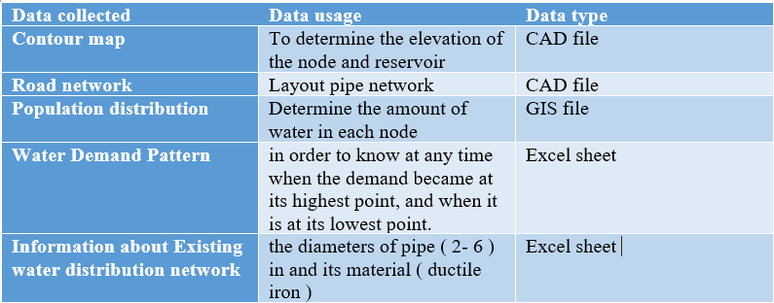
Data collection and calculation

Slide 19
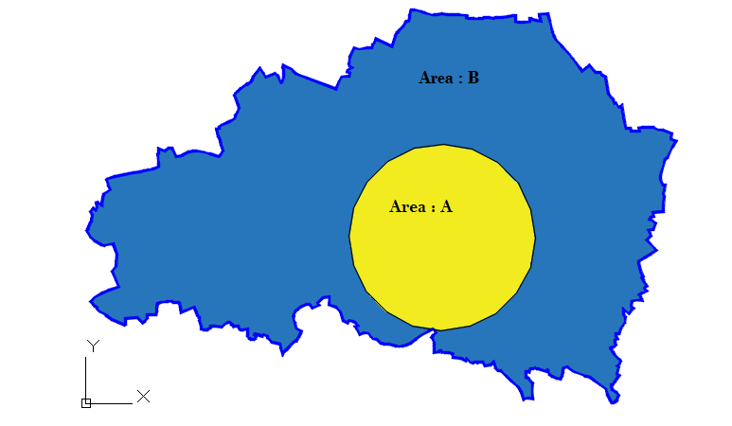

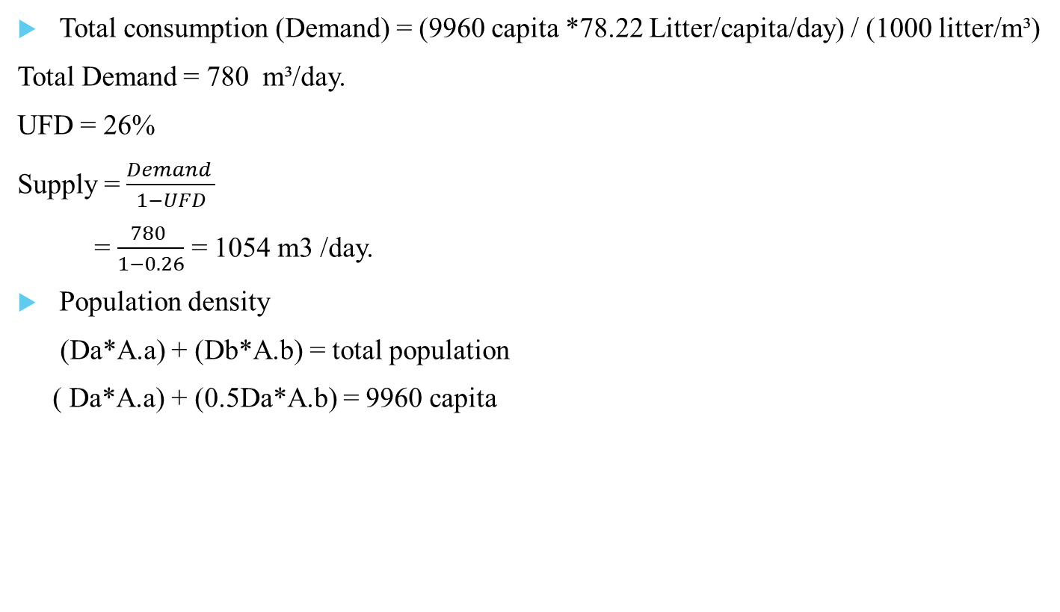
Data collection and calculation
Total consumption (Demand) = (9960 capita *78.22 Litter/capita/day) / (1000 litter/m³)
Total Demand = 780 m³/day.
UFD = 26%
Supply = $\frac{Demand }{1−UFD}$
= $\frac{780 }{1−0.26}$ = 1054 m3 /day.
Population density
(Da*A.a) + (Db*A.b) = total population
( Da*A.a) + (0.5Da*A.b) = 9960 capita

Slide 20
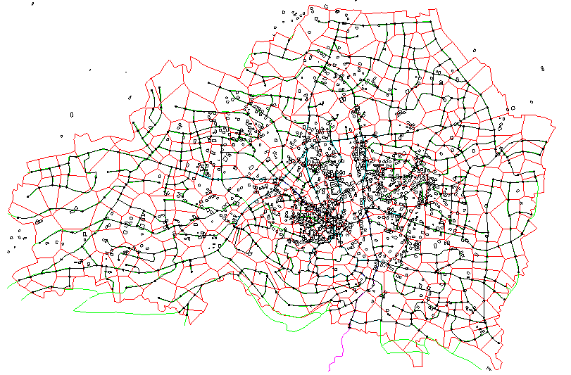
Data collection and calculation

Slide 21
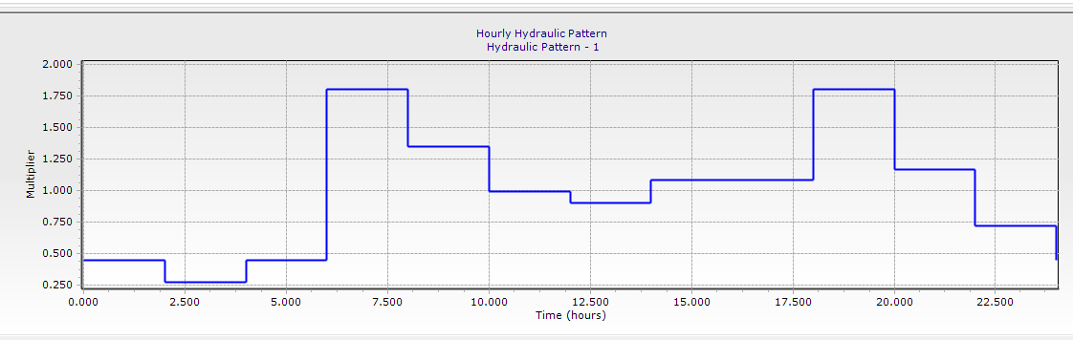
Data collection and calculation
Unsteady state case for Asira

Slide 22
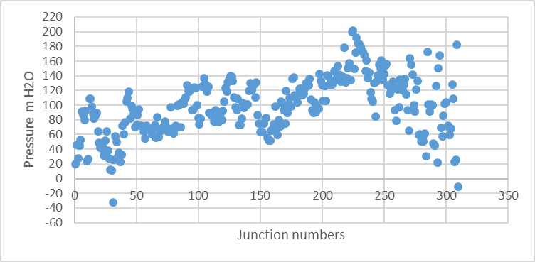
Result and discussion
Pressure at 6:00 am
According to specifications the allowable pressure is within the range (20-120 ) m H2O.

Slide 23
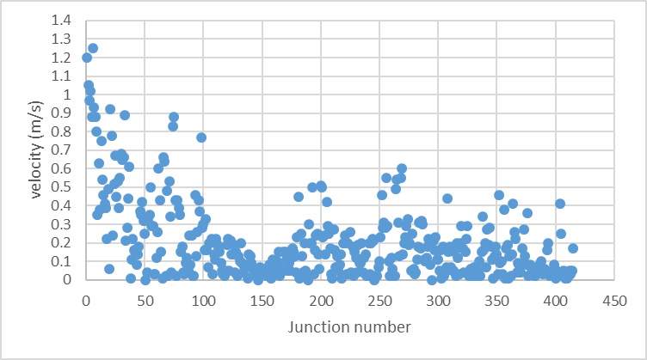
Result and discussion
Velocity at 6:00 am
The allowable range for velocity is (0.1-3.0)m/s, but there a many of pipes have a velocity under the range specifically

Slide 24
Future water distribution Network
Future population
The population in 2007 is 7556 capita
proportionality constant“ k “ is 2.8% by
the future population in Asira up year 2037 can be determined by this equation:
P(t)= P0 * e^{kt}
So the population in 2037 = 17503 capita.

Slide 25
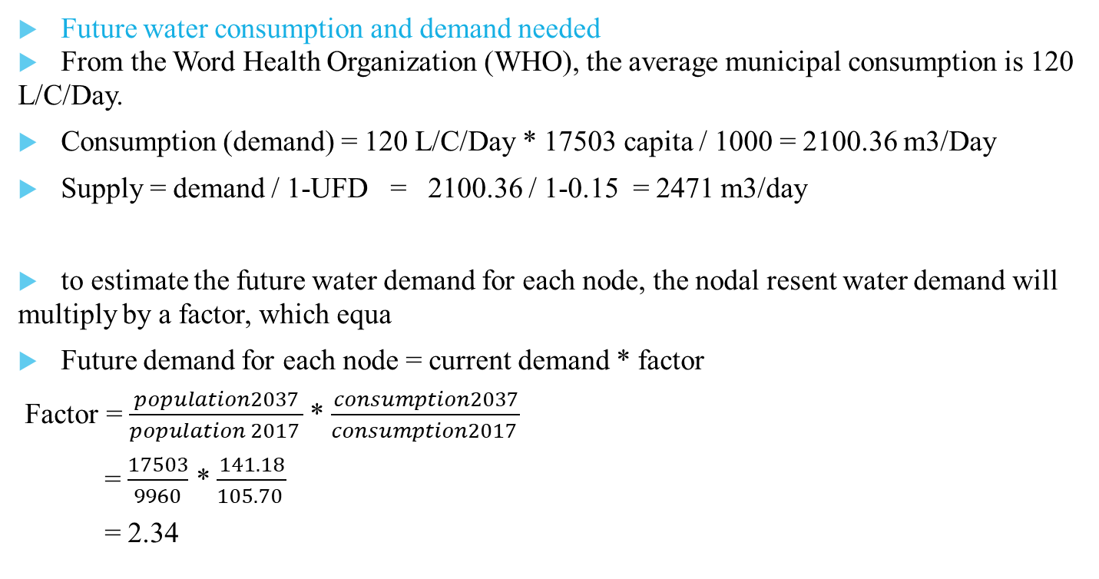
Future water distribution Network
Future water consumption and demand needed
From the Word Health Organization (WHO), the average municipal consumption is 120 L/C/Day.
Consumption (demand) = 120 L/C/Day * 17503 capita / 1000 = 2100.36 m3/Day
Supply = demand / 1-UFD = 2100.36 / 1-0.15 = 2471 m3/day
to estimate the future water demand for each node, the nodal resent water demand will multiply by a factor, which equa
Future demand for each node = current demand * factor
Factor = $\frac{population2037}{population 2017 }$* $\frac{consumption2037}{consumption2017 }$
= $\frac{17503}{9960}$ * $\frac{141.18}{105.70 }$
= 2.34

Slide 26

Future water distribution Network
Redesign the water network
replace the pipes in other diameters to dispense put a pump

Slide 27
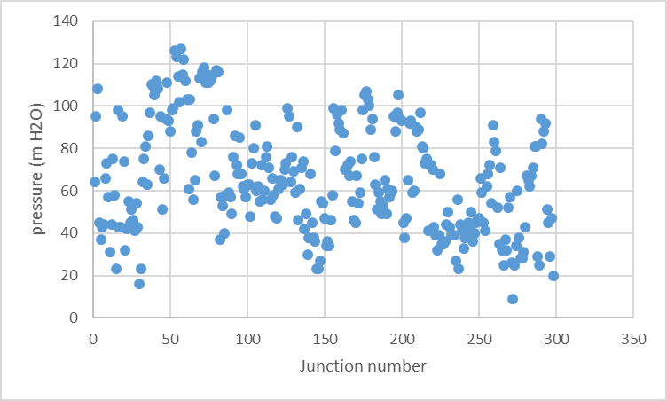
Result and discussion
Pressure at 6:00 am

Slide 28
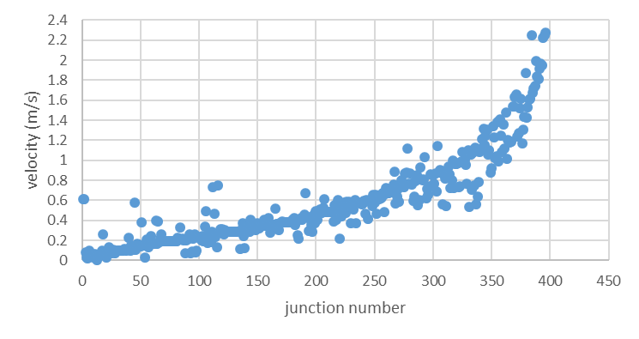
Result and discussion
Velocity at 6:00am

Slide 29
Design of water distribution and sewer collection systems

Slide 30

Simulation Model (sewerCAD)
This program is ideal for system design and the rehabilitation of sanitary sewers

Slide 31
Design criteria
Cover
According to PWA standards; the minimum cover for sewer pipes is 1 m and the recommended maximum depth for pipes is approximately 5.0 m
Slope of pipe
As per PWA standards, slop of pipes shall be within the limits 1% -15%.
Flow Velocities
As per PWA standards, flow velocities shall be within the limits 0.3- 3 m/s.

Slide 32
Data input(Sewercad)
Elevation from contour map
Water Consumption = 120 L /c.d
Wastewater generation coefficient= 0.8
For material: use PVC
Manning coefficient = 0.013
Section type = circular

Slide 33
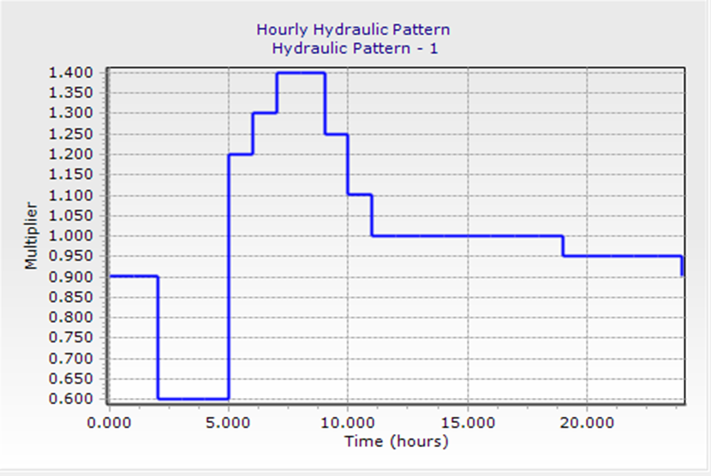
pattern

Slide 34
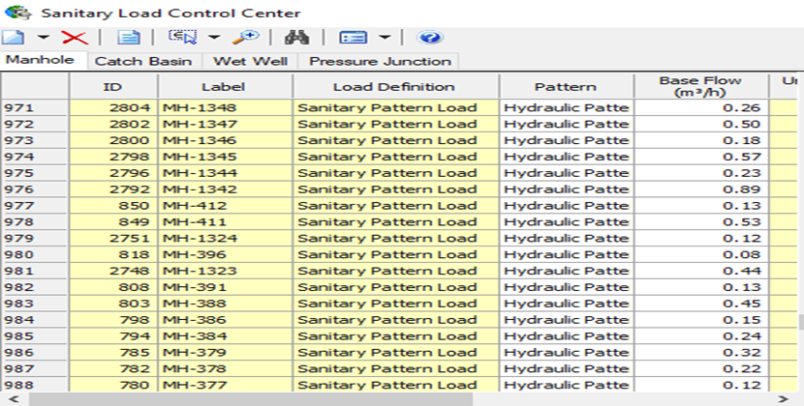
Load calculations

Slide 36
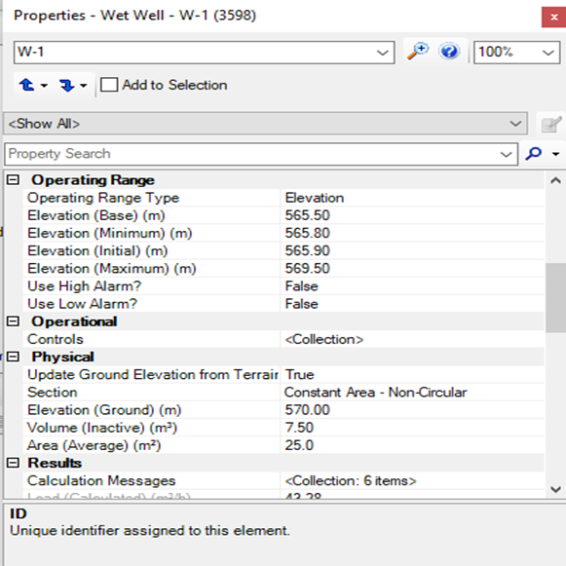
wet well

Slide 37
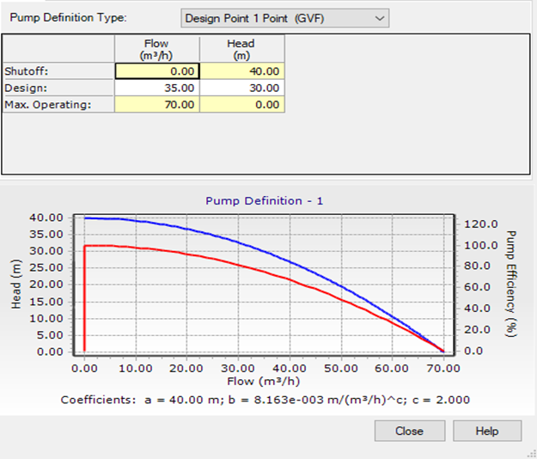
pump definition

Slide 38
Rebuild the model
Increase the infiltration
50%
Increase the dimeter for the main counduit

Slide 39


Slide 40
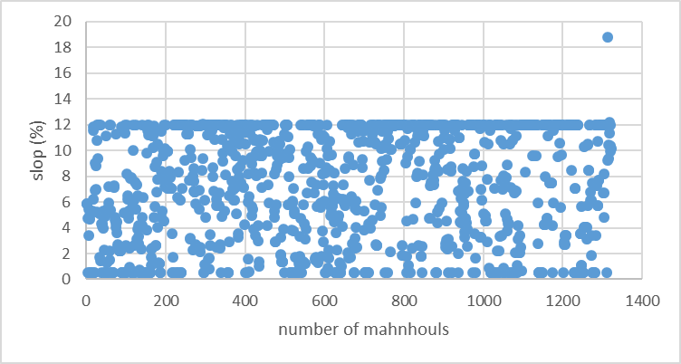
Slope (sewer network)

Slide 41
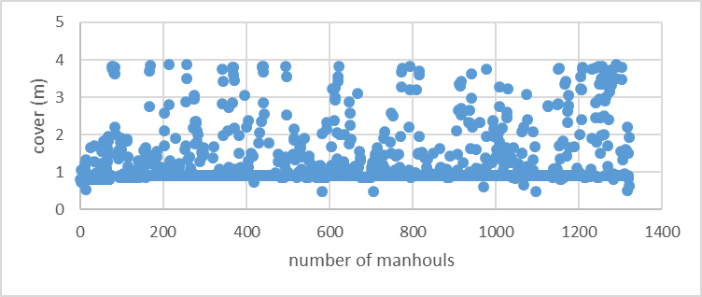
Average cover(sewer network)

Slide 42
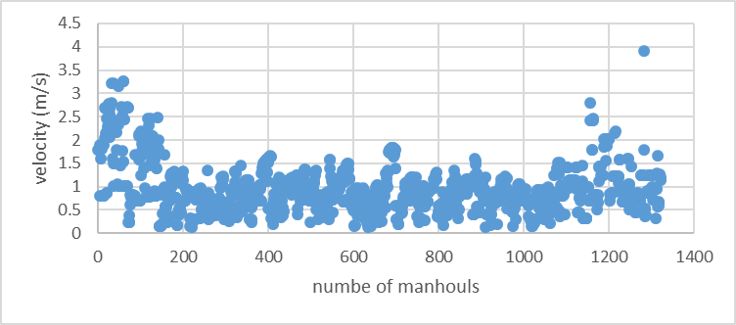
Velocity(sewer network)

Slide 43


Slide 44


