Slide 1
CODEVISION
SOURCE CODE PLAGIARISM DETECTION ENGINE
Saeed Anabtawi & Basil Hassan
Dr.Othman Othman

Slide 2
1.
INTRODUCTION

Slide 3
INTRODUCTION
The problem of code plagiarism
Code evaluation
Manual detection (time ,cost )

Slide 4
2.
LITERATURE REVIEW

Slide 5
LITERATURE REVIEW
Code plagiarism
Types of code plagiarism detection system attrubte structer
Research papers

Slide 6
Code Plagiarism
Source code plagiarism is the act of copying code from others without giving any credit to the original programmer .

Slide 7
Types of code plagiarism detection system
Attribute-counting based (feature-based)
Structure-based system

Slide 8
Feature-based
Counting number of operands , operators, control statements, loops
conditional statements,variables
Efficient , but low accuracy It ignores program structure
        two programs might share the same measures while they have completely different logic

Slide 9
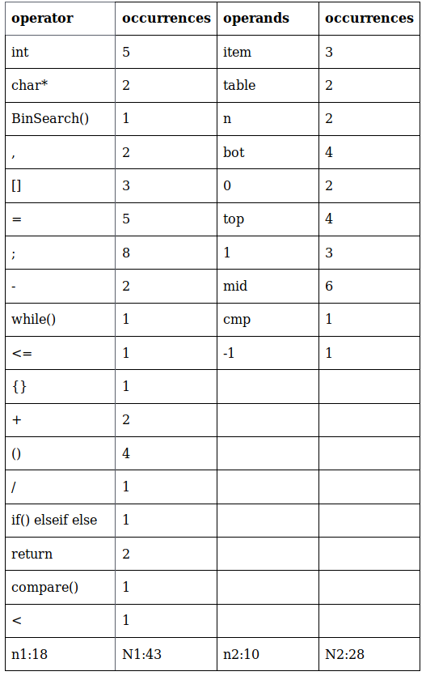
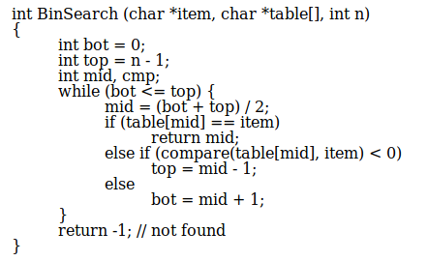
Feature-based

Slide 10
Structure-based
Better accuracy and are less efficient.
String matching, Abstract syntax tree, Program dependence graph, Tokenization.

Slide 11
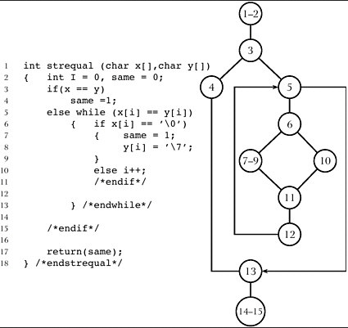
Structure-based (PDG)

Slide 12
Research papers
[1] PDetect: A Clustering Approach for Detecting Plagiarism in Source Code Datasets (2005)
[2] A Hybrid Method for Detecting Source-code Plagiarism in Computer Programming Courses (2013)

Slide 13
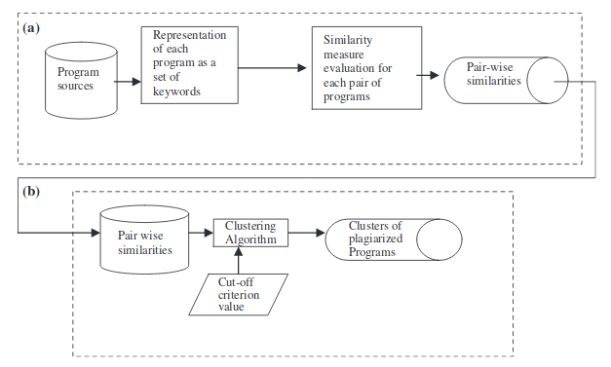
[1] PDetect: A Clustering Approach for Detecting Plagiarism in Source Code Datasets (2005)

Slide 14
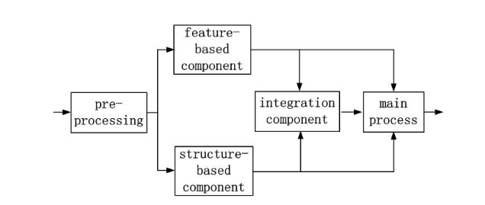
[2] A Hybrid Method for Detecting Source-code Plagiarism in Computer Programming Courses (2013)

Slide 15
3.
SYSTEM PIPELINE

Slide 16
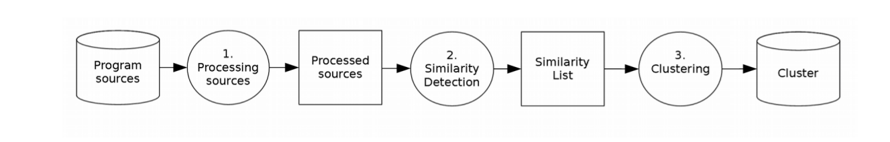

Slide 17
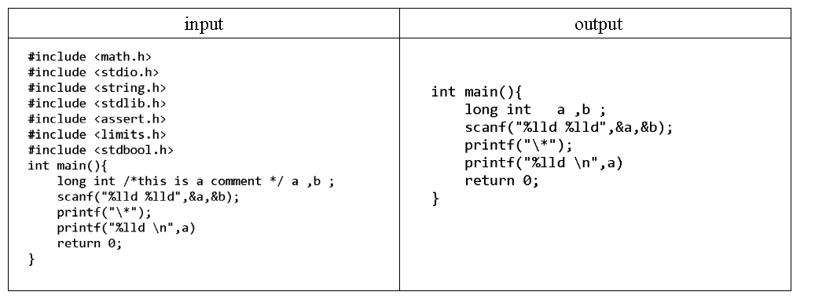
PROCESSING FILES
[2] Filtraition:(includes , comments )

Slide 18
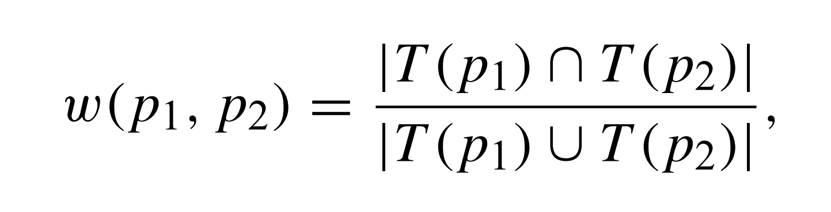
SIMILARITY DETECTION
[1] Keyword-based

Slide 19
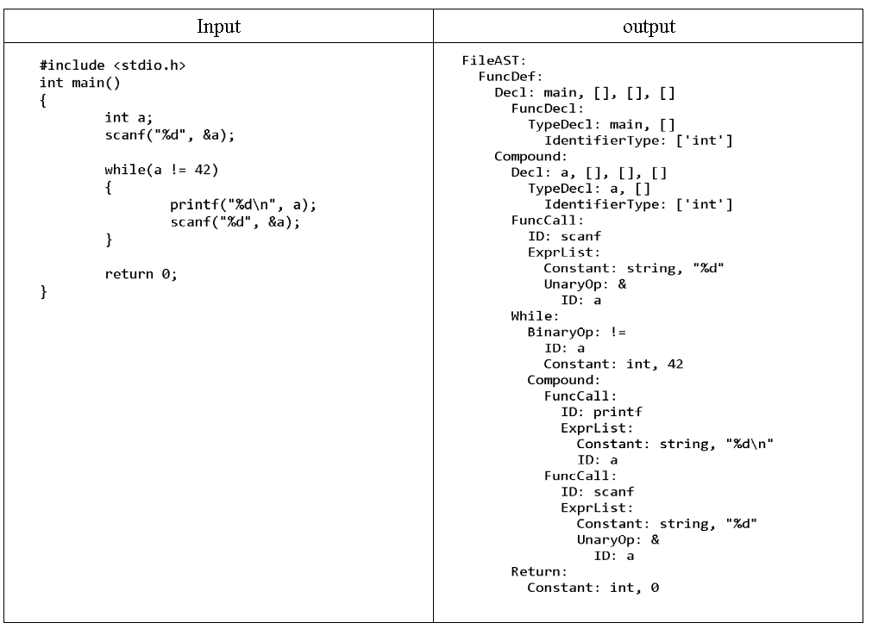
SIMILARITY DETECTION
[2] Hybrid (structer based)
Parsing : (AST)

Slide 20
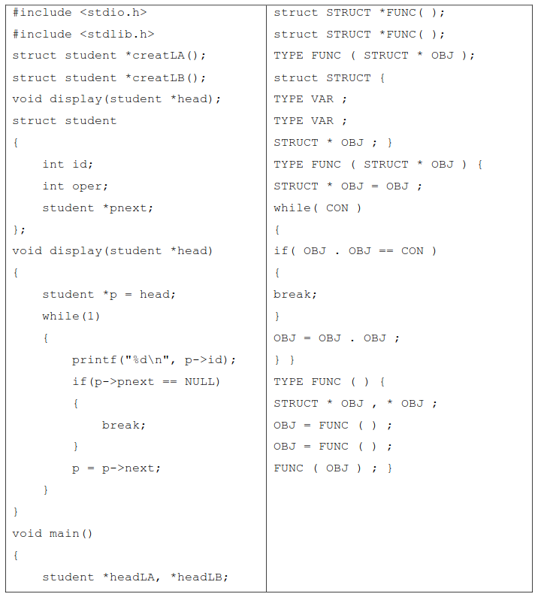
SIMILARITY DETECTION

Slide 21
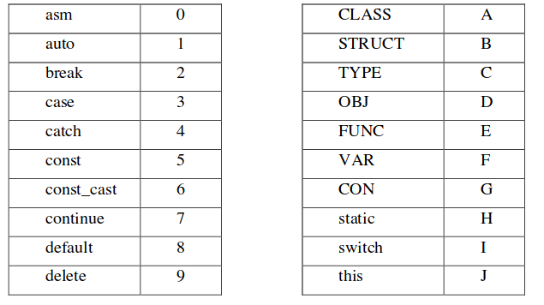
SIMILARITY DETECTION
[2] Hybrid (structer based)
Maping table

Slide 22
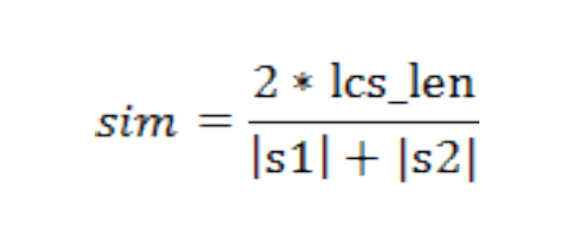
SIMILARITY DETECTION
[2] Hybird

Slide 23
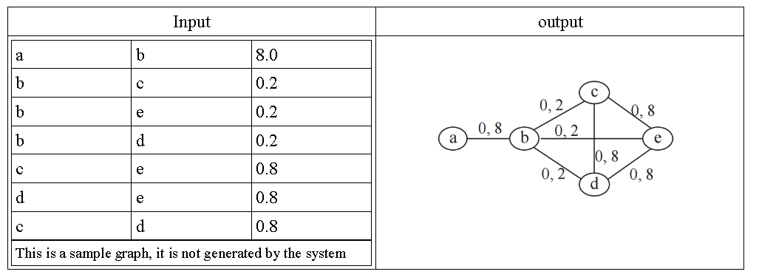
CLUSTRING
[1] Weighted Graph

Slide 24
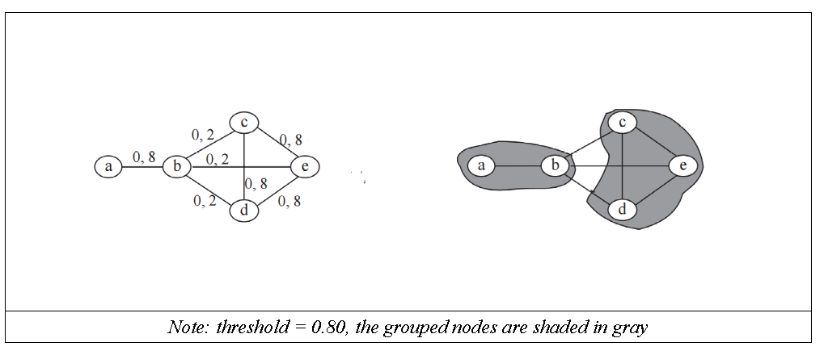
CLUSTRING
[1] Grouping

Slide 25
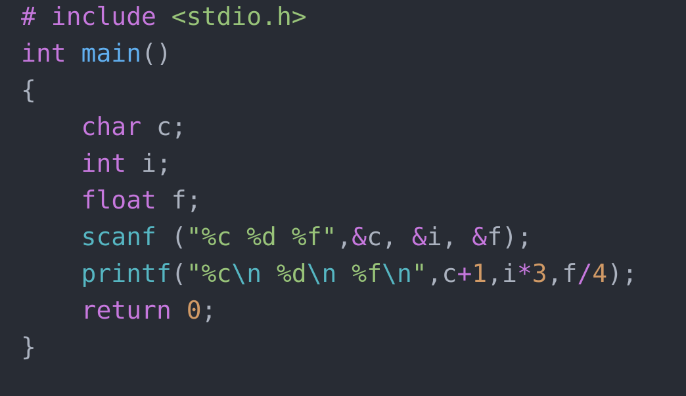
Threshold
90%<AVG

Slide 26
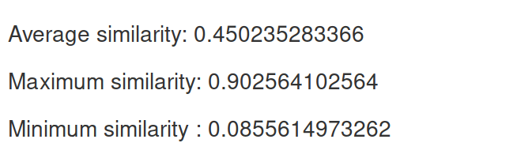
MMA MODEL
MMA (MIN-MAX-AVG) Model
MIN<Threshold<MAX
AVG<threshold makes sense

Slide 27
4.
EXPERIMENT

Slide 28
keyword vs Hybrid

Slide 29
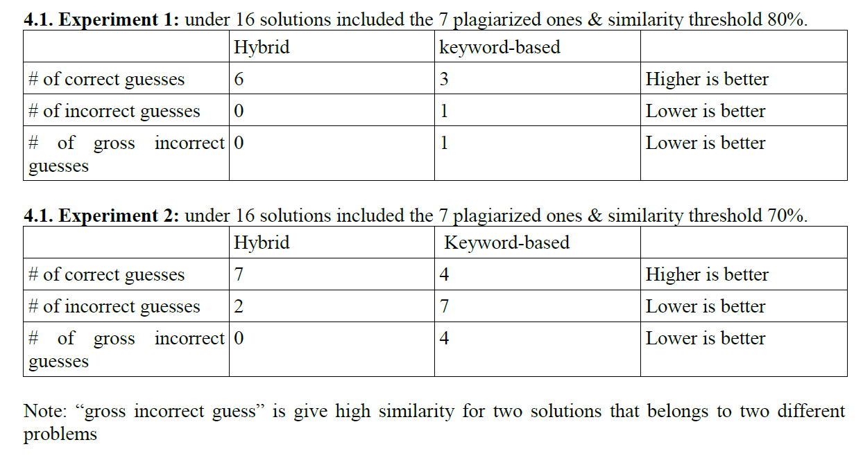

Slide 30
Codevision vs Jplag

Slide 31
Common Tools (Jplag)
very good plagiarism detection performance
Converting the programs into token strings
Comparing two token strings.

Slide 32
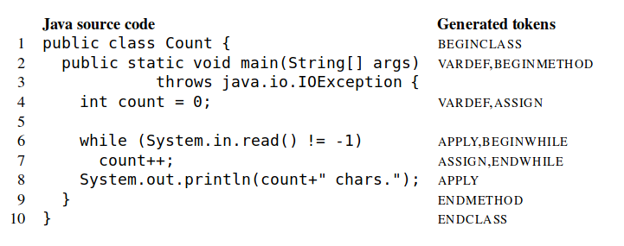
Program into token strings

Slide 33
Add and remove comments
original.cpp | 751 tokens, (has comments)
test.cpp | 751 tokens, (some comments are added and some are removed)
Code vision | Jplag
100% | 100%

Slide 34
Renaming idintefier names
ORIG_CODE:
int id_x = 10, id_y = 5;
id_x = id_x + id_y;
RES_CODE:
int id_abc = 10, id_cba = 5;
id_abc = id_abc + id_cba;

Slide 35
Renaming idintefier names
original.cpp | 751 tokens, (many of tokens are id names)
test.cpp | 751 tokens, (id names are refactored)
Code vision | Jplag
100% | 100%

Slide 36
Change data type
ORIG_CODE:
int id_x;
float id_y;
RES_CODE:
long id_x;
double id_y;

Slide 37
Change data type
original.cpp | 751 tokens, (32 "int" tokens )
test.cpp | 751 tokens, ("int" tokens replaced with "long")
Code vision | Jplag
96% | 0%

Slide 38
Changing the structure of iteration
ORIG_CODE:
for(PRE_STMT; COND; POST_STMT)
{
ORIGINAL_BODY
}
RES_CODE:
PRE_STMT;
while (COND)
{
ORIGINAL_BODY
POST_STMT;
}

Slide 39
Changing the structure of iteration
original.cpp | 751 tokens, (7 "for" loops )
test.cpp | 751 tokens, ("for" loops replaced with "while")
Code vision | Jplag
85% | 50%

Slide 40
Add redundant statements
ORIG_CODE:
int id_x = 10, id_y = 5;
id_x = id_x + id_y;
RES_CODE:
int XXX = 7 + 5;
int id_abc = 10, id_cba = 5;
int XXX = 7 + 5;
id_abc = id_abc + id_cba;
int XXX = 7 + 5;

Slide 41
Add redundant statements
original.cpp | 751 tokens,
test.cpp | 921 tokens, (add "long fake_id = 10 ;" statement 35 times in random positions)
Code vision | Jplag
83% | 20%

Slide 42
Re-ordering functions in source code
original.cpp | Before re-ordering
test.cpp | After re-ordering
Code vision | Jplag
82% | 90%

Slide 43
Demo

Slide 44
THANKS!
Any questions?

