Slide 1

Khalid Jabr & Noor Braik
Supervised by: Dr. Manar Qamhieh

Slide 2
Outline
Introduction
Problem statement
What makes us different
Goals
Solution
Hardware prototype
Technical and Components
Training Model
Software prototype
Flow of work
Raspberry Pi 4 Logic Flow
Arduino Logic FLow
Demo

Slide 3
Introduction

Slide 4
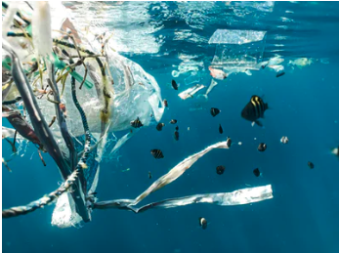
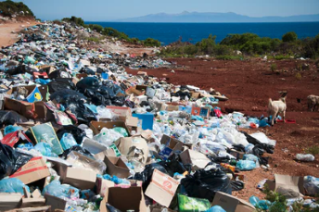
Problem Statement
Pollution is steadily increasing due to the significant amount of waste being disposed of in the local environment instead of their appropriate places.

Slide 5
What Makes Us Different ?

Slide 6



The GoaLs

Slide 7

Proposed Solution
Development of an eco-friendly collection bin where users can place designated trash inside.
Development of an application where users can track their progress.

Slide 8
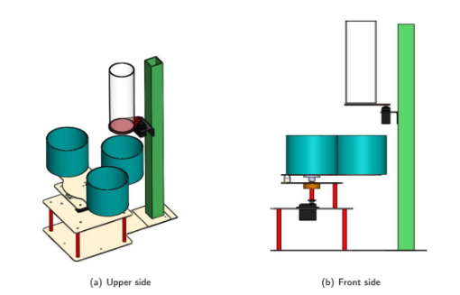
Hardware Prototype

Slide 9
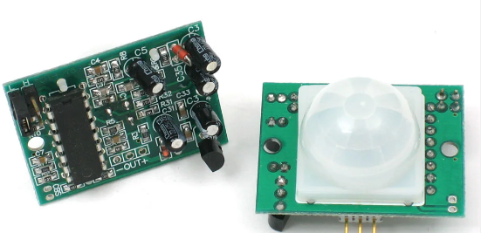
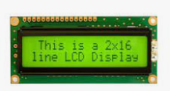
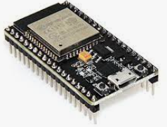
Technical Component
Motion sensor
Senses any movement to Sign
LCD 16*2 with I2C module
Show messages for user
ESP32
wireless communication and connectivity between
Rasspari bi and firebase and Arduino

Slide 10
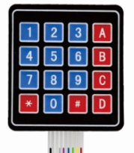
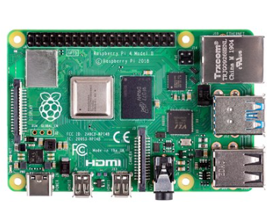
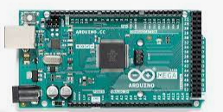
Technical Component
Keypad
Second way to sign user
Raspberry pi4
on classifying waste thrown by the user.
add the points to the user after the classification process is over.
Arduino
opening the main bin from both sides and triggering the motor
after classification is done.

Slide 11
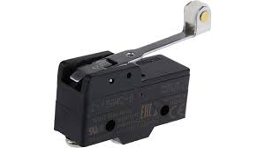

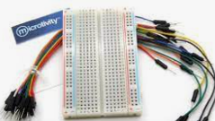
Technical Component
Limit Switches:
Used to trigger interrupt to stop the motor on specific bin
Ultrasonic sensor
detect the level of the appropriate bin.
Wires & Boards

Slide 12
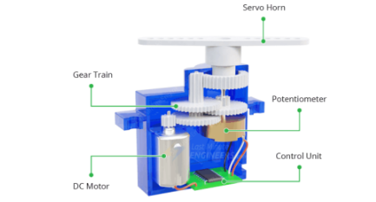
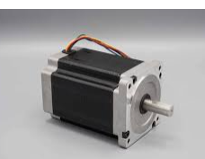
Technical Component
Servo Motor
implement a door that opens
the basic bin from top and down
L298N Stepper Motor Driver
rotate in specific range based on the
rubbish classification, and set an interrupt to drop
the rubbish in the bin

Slide 13

Training Model
Teachable Machine
is a machine learning model creation tool developed by Google. It is a web-based application that uses a browser-based interface to allow you to train machine learning models using your own data.
The System trained with 2400 images

Slide 14
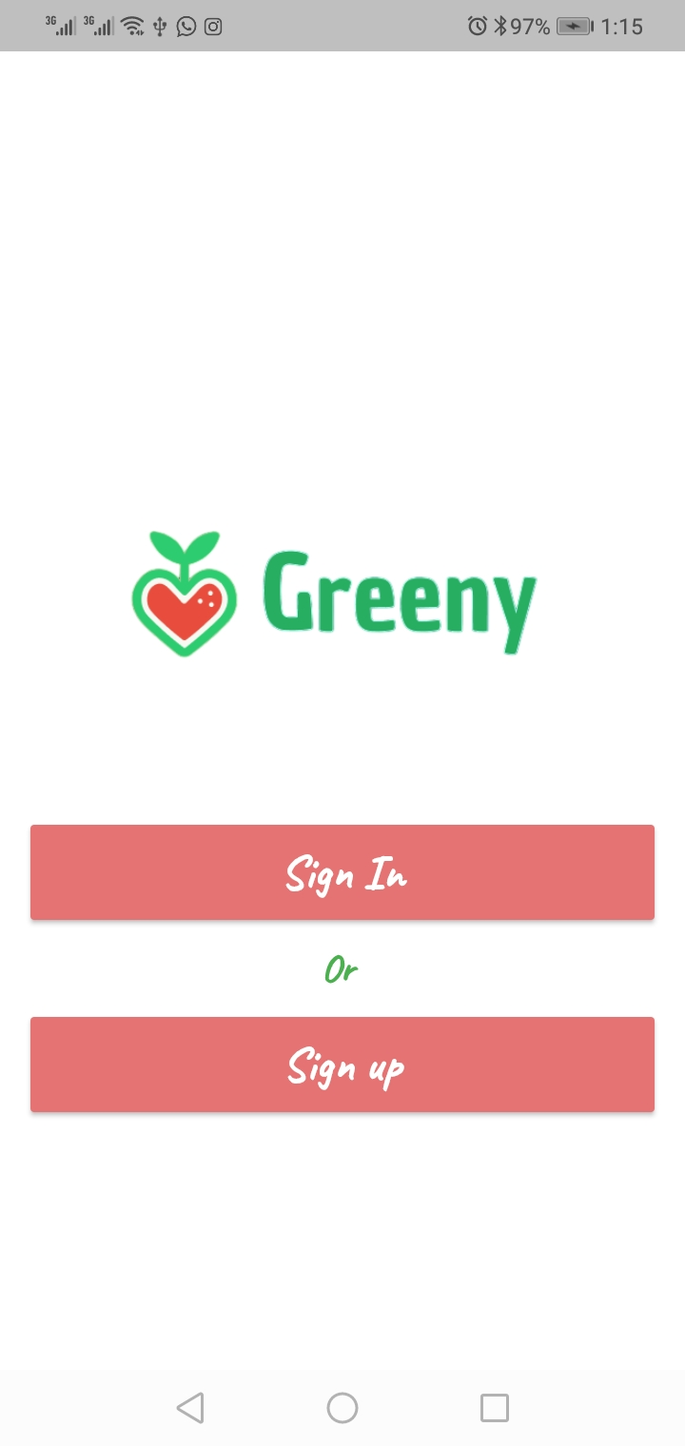
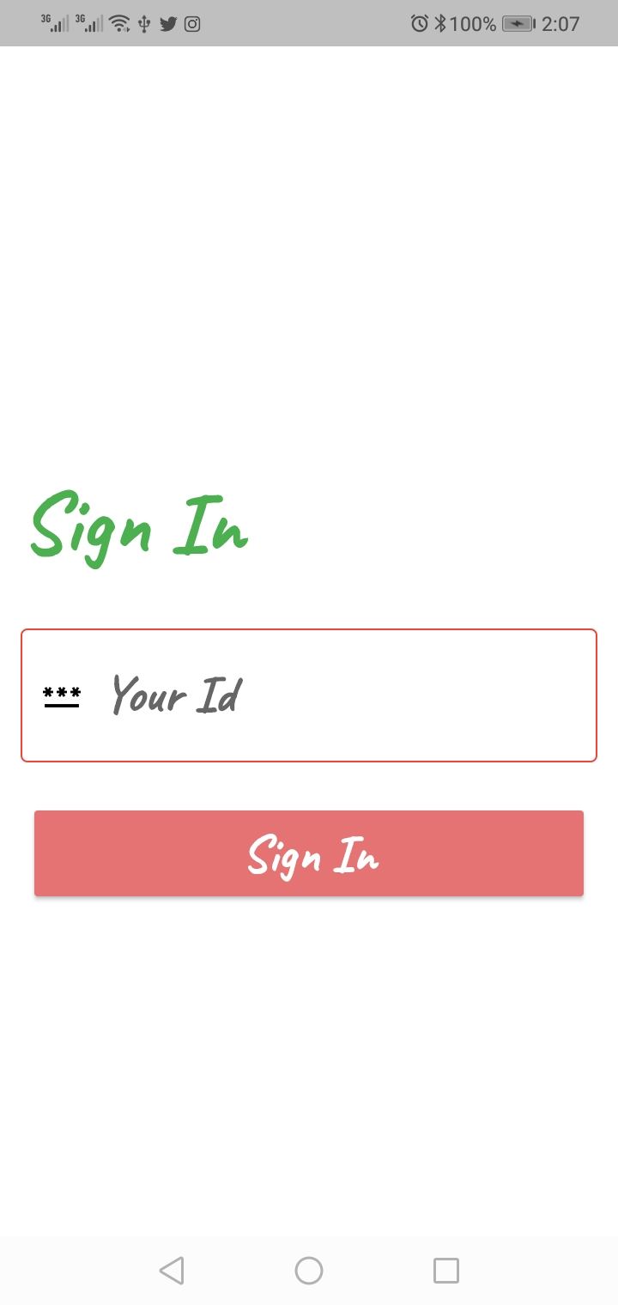
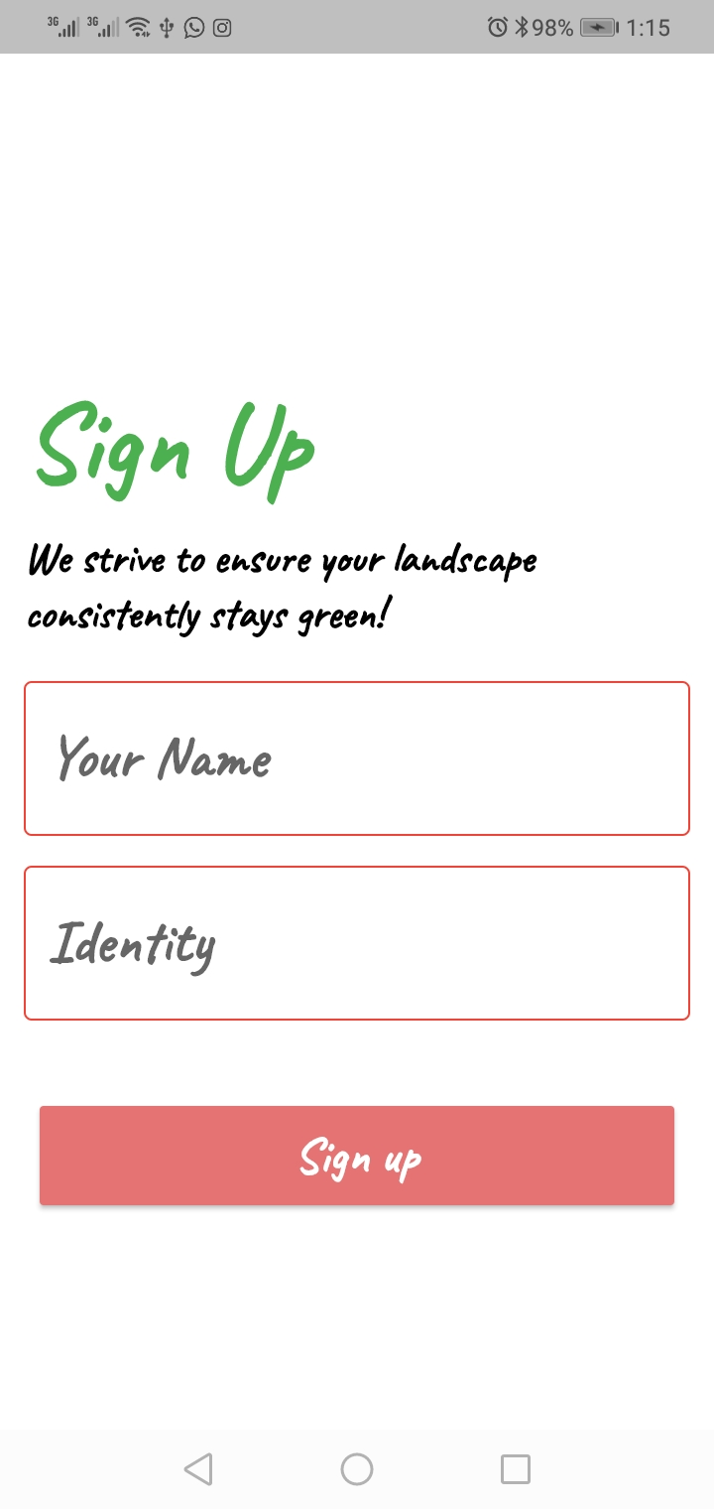
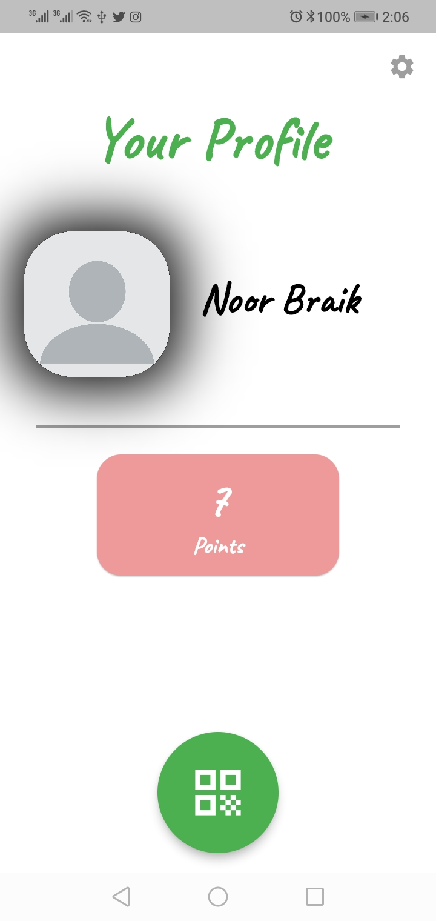
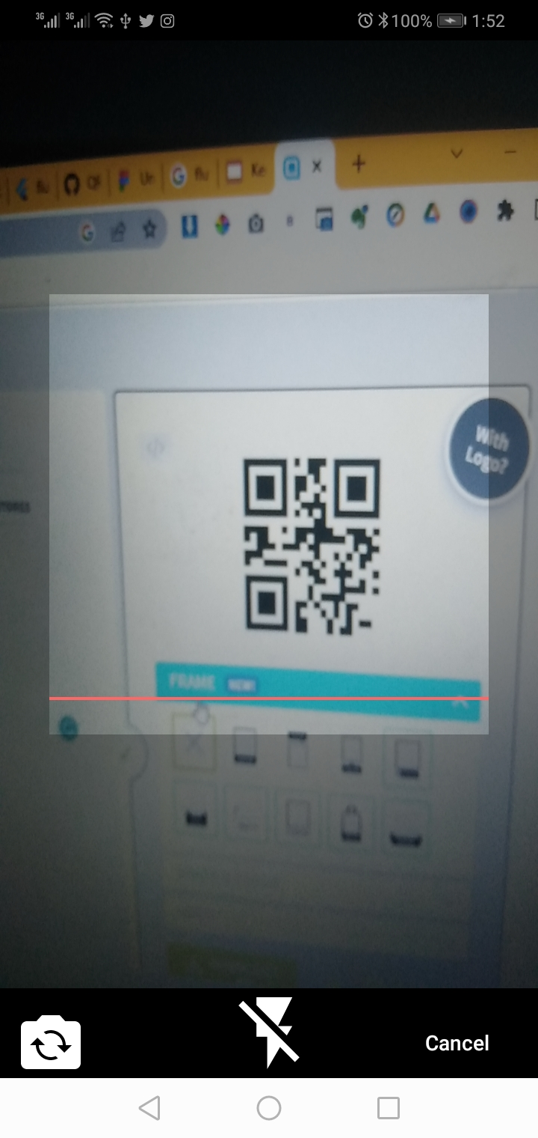
Application Prototype

Slide 15
Flow Of Work

Slide 16
Raspberry Pi 4 Logic Flow

Slide 17
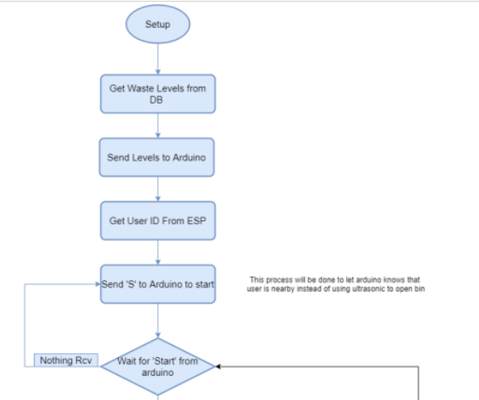
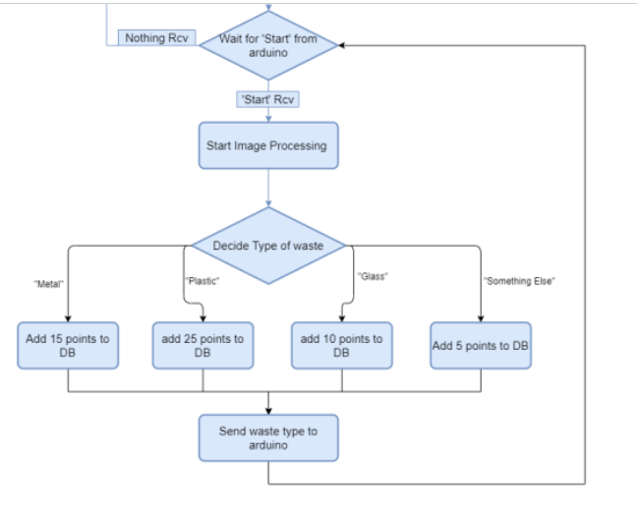

Slide 18
Arduino Logic Flow

Slide 19
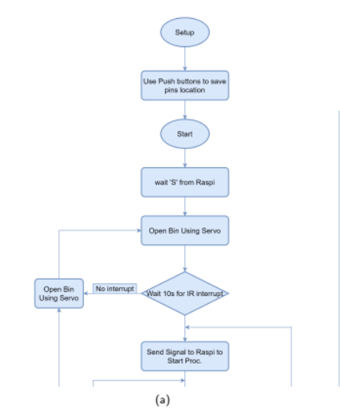
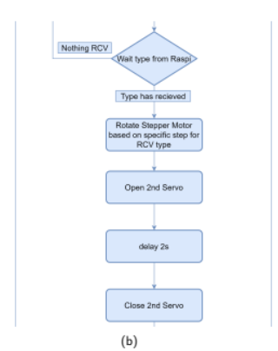
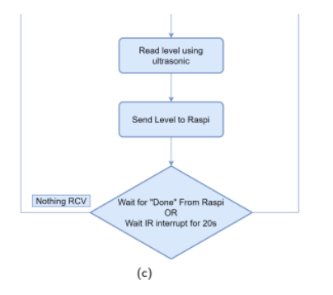

Slide 20
DEMO

Slide 21
Thank You!

