Slide 1
Graduation
Project
Design a
sanitary sewage
Network for
Arraba town
Jan 2013

Slide 2

Asmahan Abudhair
Prepared by:
Supervisor:
Dr. Numan Mizyed

Slide 3
Outline
Objectives
Introduction
Study Area
Methodology
Results & Recommendations

Slide 4
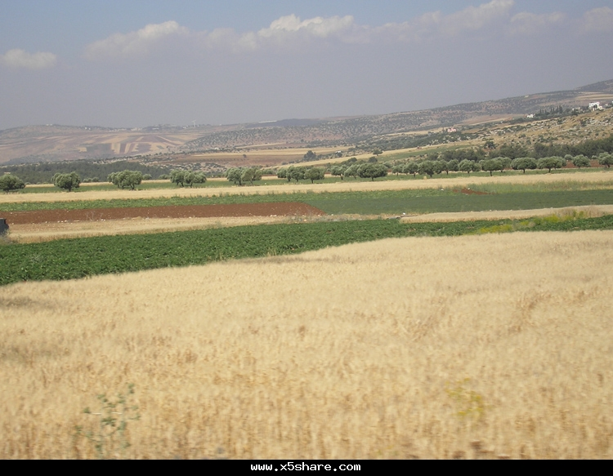
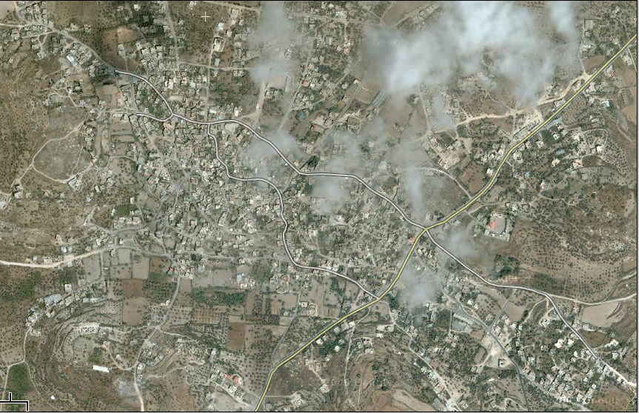
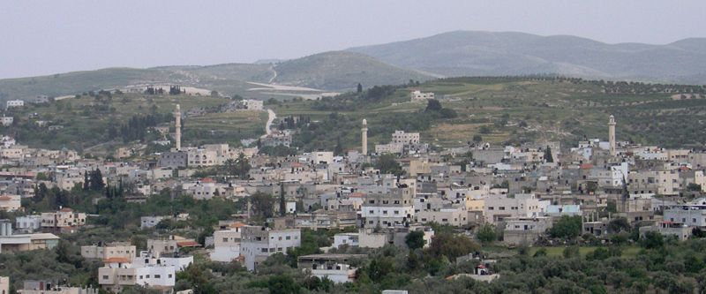
Arraba town

Slide 5
Objectives
Purpose1:
Improve of traditional methods of disposal sewage like cesspits.
Purpose 2:
Design a sanitary collecting network for Arraba town.
Purpose 3:
Determine
treatment station.
The location of the

Slide 6
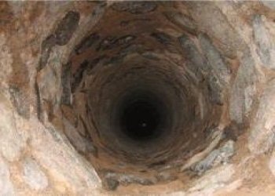
Introduction
The disposal of sewage in Arraba
nowadays is implemented in unhealthy practise (Cesspits.)
Cesspits are leaking to ground water by the time and causes side effects on agriculture and environment causing pollution ,also succession of cesspits smells unpleasant adore .
Sewage network system :
disposal of wastewater properly by a network, then it is transported to outlets in order to discharge properly to treatment plant

Slide 7
Methodology
2- Designing a
Questionnaire
3-Collecting of data
4-Analysis all the collected data & calculations
6-Develop a Sewer Cad model for the collection system
1- Site investigation
5-Training on Sewer Cad
7-
Giving Recommendations
Steps

Slide 8
Study Area
The Study covers:
Location
Topography
Social
& economic life
Climate
Population

Slide 9
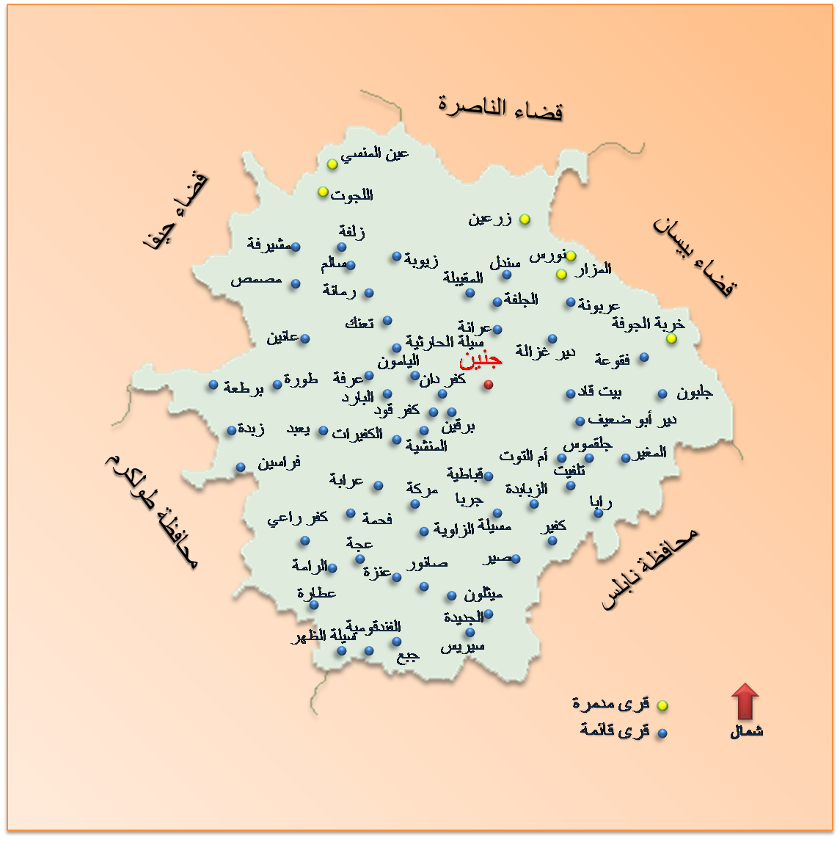
Location
It is located 15 km to the south-west of Jenin lies on hills & mounds

Slide 10
Population
Arraba`s population is increasing rapidly
Growth rate is increasing also
fluctuations are showed in following table:
Range of Year | 2007-2012 | 2012- 2026 | 2026-2037 (design year)
The Growth rate | Actually = 0.0127 | Predicted = 0.033 | Predicted= 0.036

Slide 11
Population- Growth rate
The growth rate (2026 - 2037 )
depending on the forecast population by the
(Palestinian Central Bureau Of Statistics).
Pn (Pop. in future ) = Po(Pop. in present)* ( 1+ i)^n
i = growth rate
n = number of years = 25 years
27694= 19444 (1+i)^10
i = growth rate = 0.036.
so

Slide 12
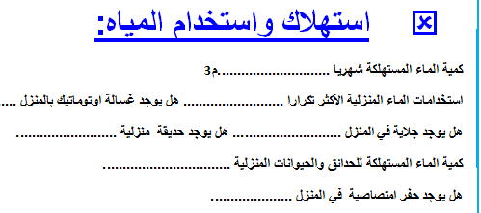
Questionnaire Analysis
A questioner was filled in
Arraba about
water consumption.
A random sample of 20 houses was studied
Some meetings were made and photos were taken.
The avg. monthly consumption of water by the
Family 8 m3 & avg. size of family 6 members.
The daily water consumption rate 44.4 L/C/d.
so

Slide 13
Previous Statistics Analysis & Results
Water consumption was calculated by
(2008 ,2009 ,2010)
Average consumption in ( 2008 ,2009 ,2010) :
(191809+190193+124520)/3 = 168840.6 m3/yr.
462.57 m3/day 42 L/capita/day.
Palestinian specifications
(min consumption=120 L/capita/d)
The considered consumption rate 150L/capita/day
was taken.
so

Slide 14
Calculation
&
Design

Slide 15
Expected Calculations For year 2037
Pop in 2037:
= pop2007*(1+(Growth rate /100))^(2037-2007)
Wastewater production (2037) (m3/d):
= 0.85* Water Consumption per capita per day * Future population in 2037 /1000

Slide 16
Expected Calculations For year 2037
Total wastewater flow (m3/d):
= Wastewater production (2037) (m3/d)+ Infiltration
PEAK design wastewater flow (m3/hr):
= Total wastewater flow (m3/d)* P.F (hourly)* P.F (Daily) / 24
The next table summarizes the calculation of the load for each manhole
Note: I assumed that total load equally distributed for each manhole

Slide 17
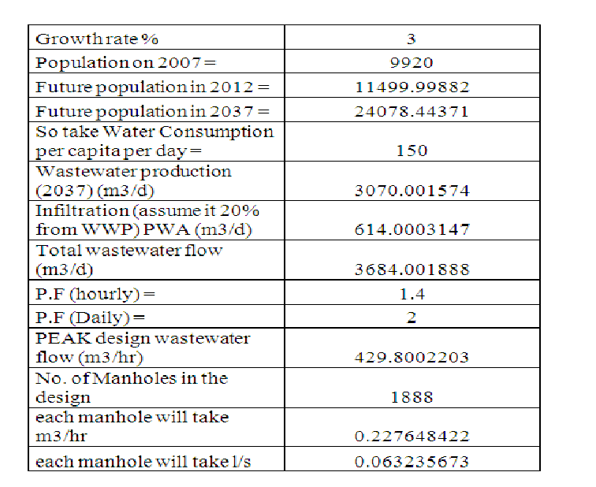

Slide 18
(Q. Design) for each manhole =
.063 l/s
This value is the critical value (wet weather flow)

Slide 19
Design Of The Network

Slide 20
PROCEDURES
Assign manholes loads and extract elevations
Define design constraints
Initial run
Solving warning messages
Final design

Slide 21
Network Assignment by Sewer Cad
Assignment of manholes is made by taking some specifications into consideration.
Inputs for Sewer Cad:
Contour map .
Separated layers for : Houses, street, grid points, elevations.
Some specifications about : Velocity (.3-6m/s), cover(.9-4m) , Slope(.005-.12) , Partial flow of pipes(75%-85%).
Outputs : General layout of manholes and their elevations, conduits and their lengths.

Slide 22
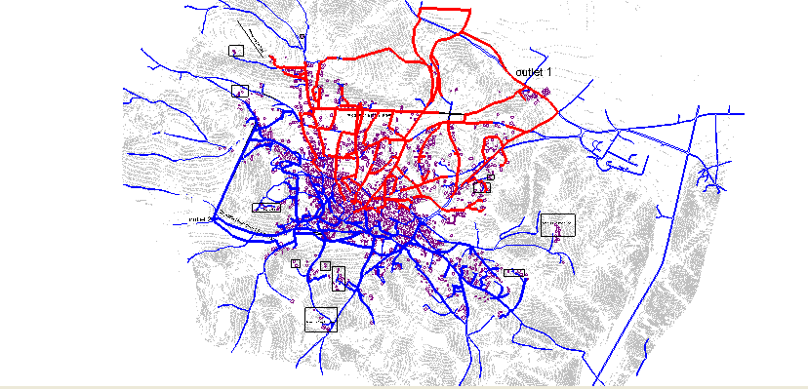
The Plan

Slide 23
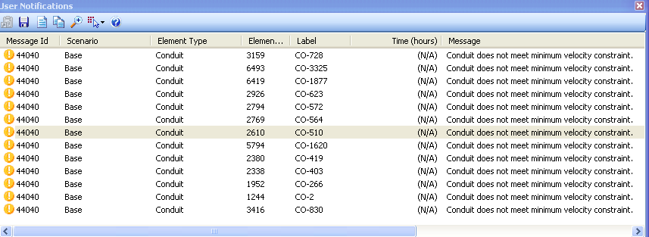
Warning messages

Slide 24
RESULTS:
Diameters
Velocity
Cover

Slide 25
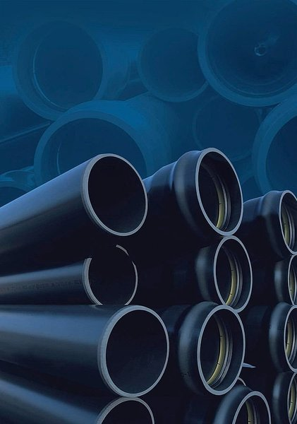
DIAMETERS
8 inch &
10 inch

Slide 26
For velocity :
All conduits velocities are within the ranges except the ones in the warning message.
For cover all manholes cover are within the range

Slide 27
Profiles:

Slide 29
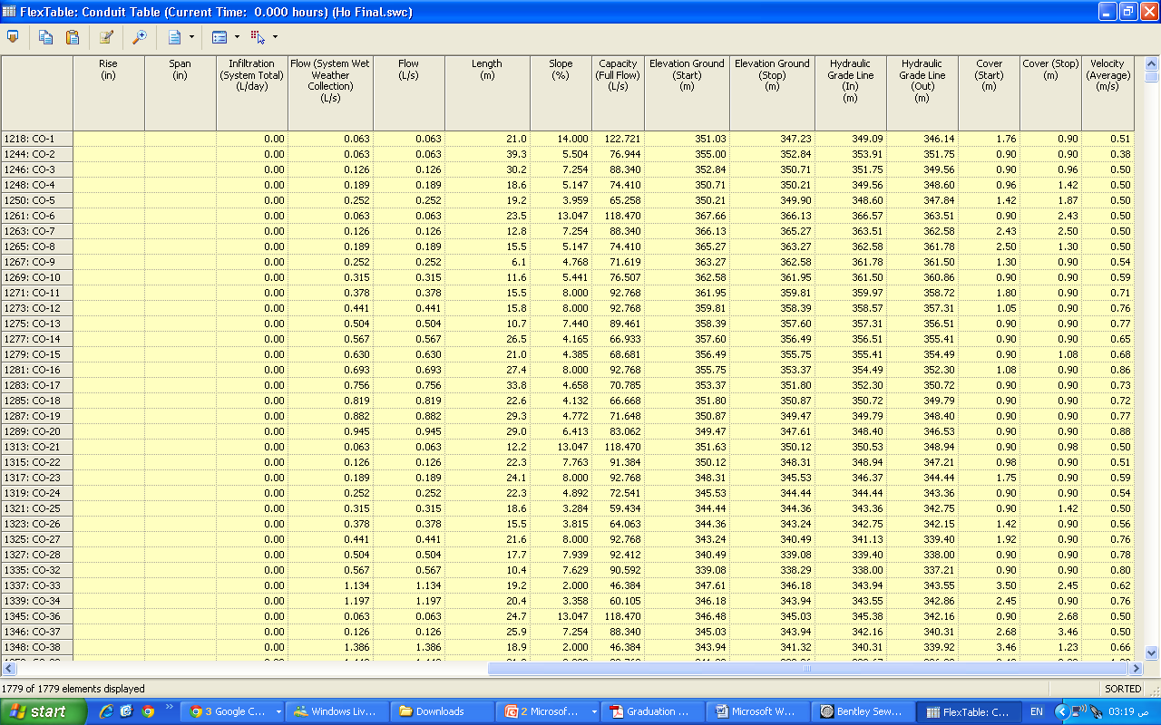

Slide 30
Conclusions
- all manholes are connected to the outlet - no loops found in the network -slopes % are within the ranges -max diameter for the pipe is 250mm -min diameter is 200mm (8 inches)

Slide 31
Recommendations
Due to irregular flow of Arraba, two outlets are proposed.
48 of widespread houses will not be served so the best suitable suggestion is Septic tanks.
Two main collector streets are needed
Realignment for local streets are needed .
Contour with higher accuracy is needed

Slide 32
Thank you

