Slide 1
Graduation Project Report II
Quantity Survey and Cost Estimate For Tulkarem Health Directorate
Made by:
Mohammad khayat
Nidal Qaffaf
Rasha Abu Lebdeh
Under supervision of
Eng. Reema Nassar

Slide 2

Project description
We will address the building of the Health Directorate in Tulkarm, where a calculation of specifications and quantities for the building will be made, and a cost calculation will be made for all parts and activities of the building and the final cost will be calculated.

Slide 3

Objectives
Identifying all types of project plans and how to read them.
Work on calculating specifications and quantities of raw materials needed to build the project.
Work on calculating the project costs of materials, machines, workers, contracts, etc.
Coming up with results similar to those of the engineers supervising the project.

Slide 4
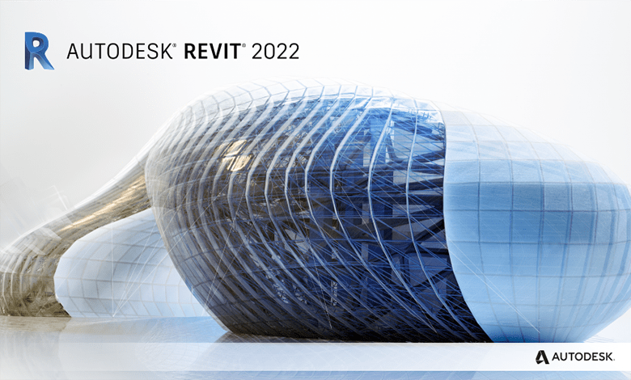
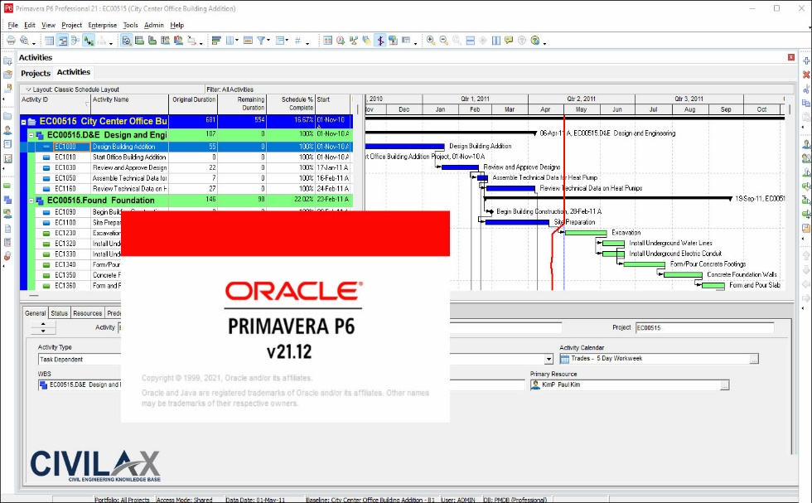
METHODOLOGY
REVIT SOFTWARE
Primavera P6 SOFTWARE

Slide 5
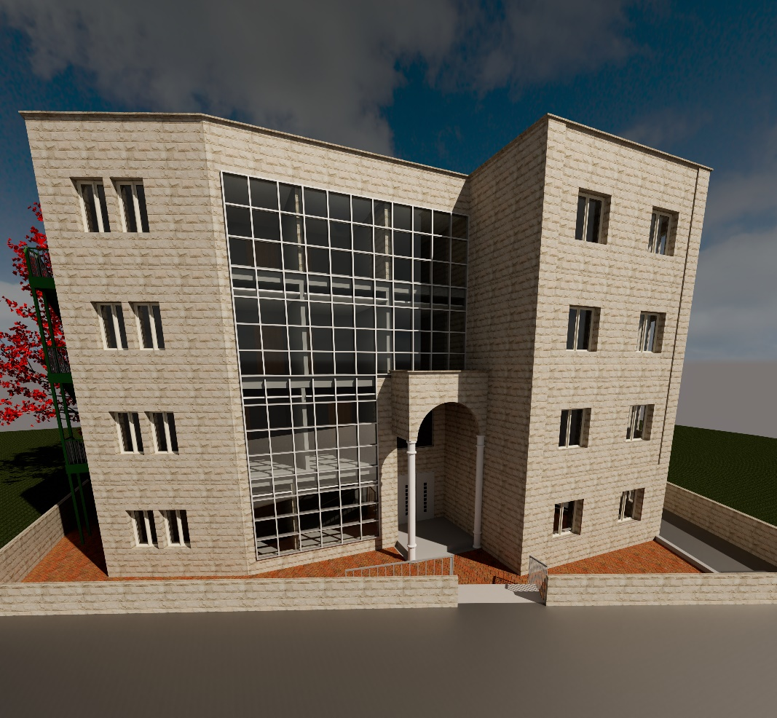
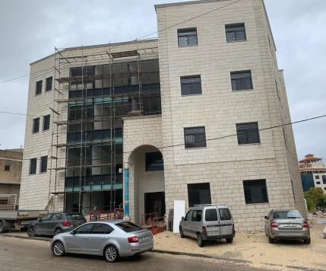
By REVIT SOFTWARE
3D Architectural view for the building using Revit

Slide 6
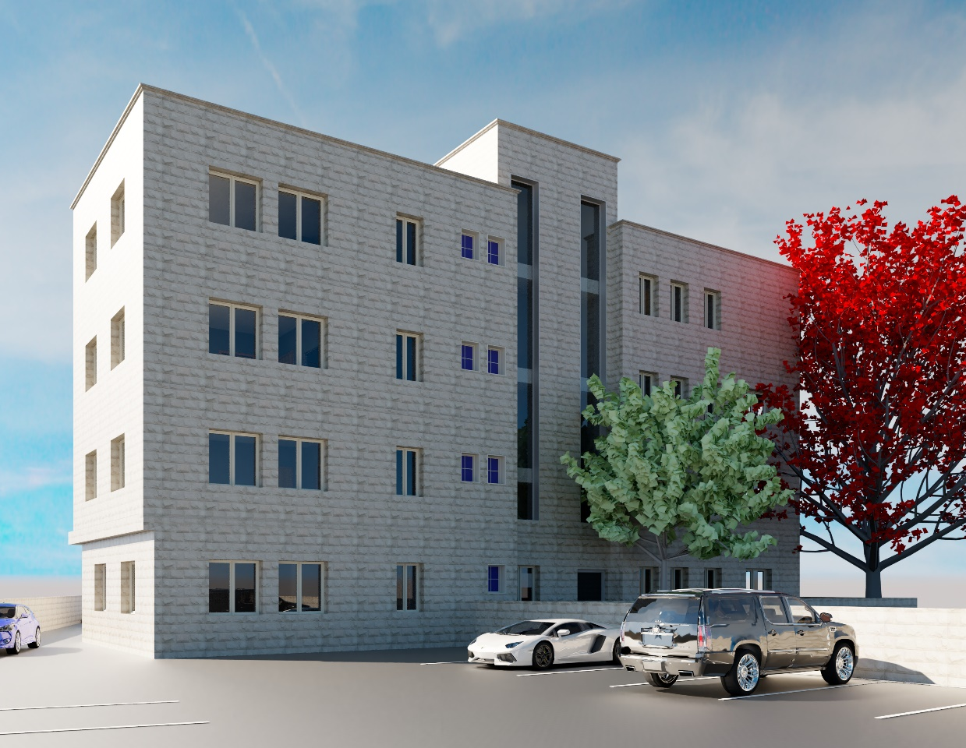
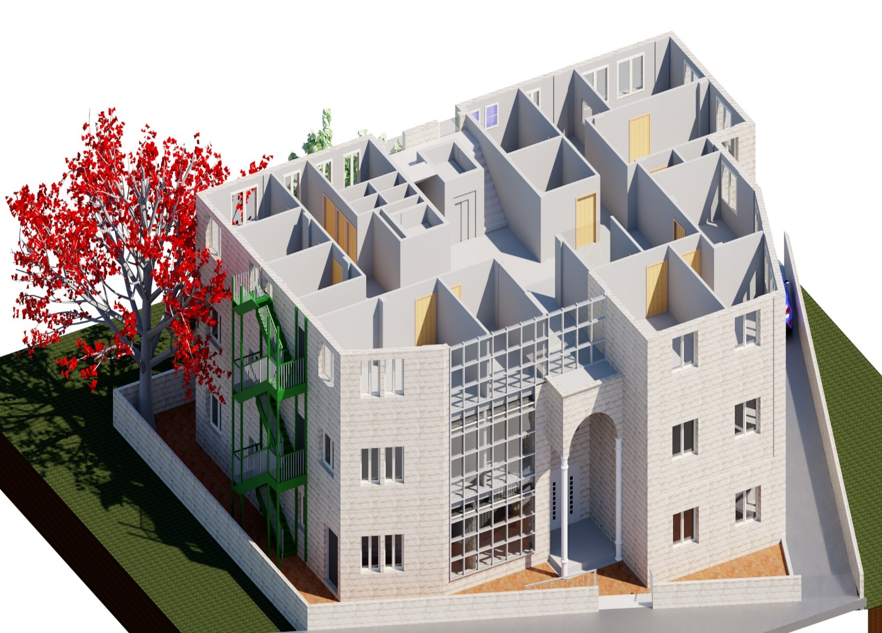
By REVIT SOFTWARE
3D Architectural view for the building using Revit

Slide 7
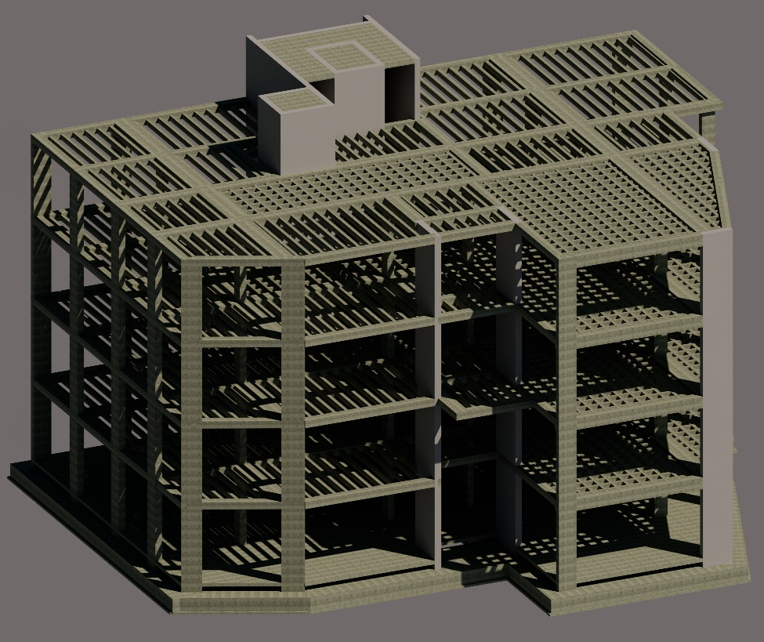
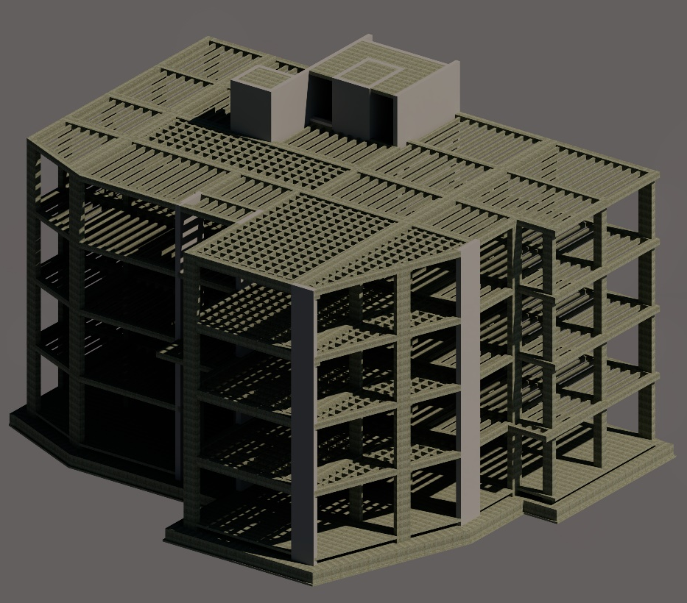
By REVIT SOFTWARE
3D Structural view for the building using Revit

Slide 8
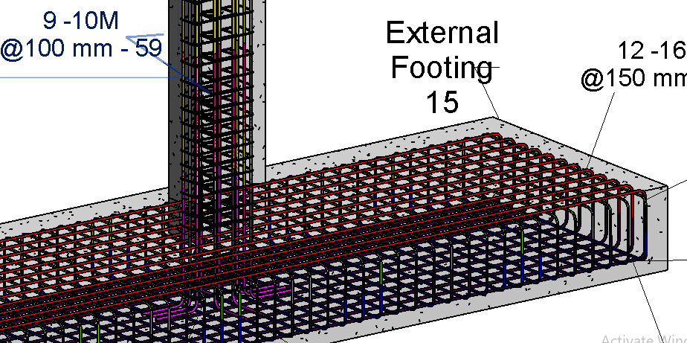
Sub Structure works
1. Blinding concrete
2. Foundation work
3. Slab on Grade
Footing and column details using Revit

Slide 9
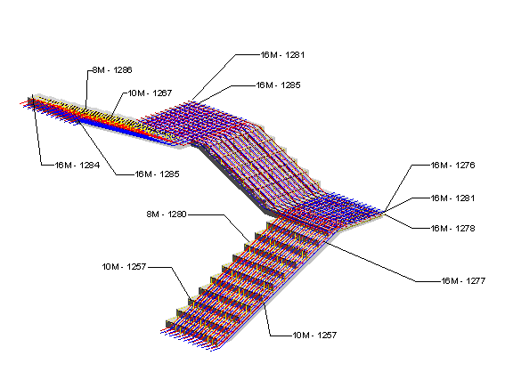
Super Structure works (Concrete Works)
Columns
Shear walls
Stairs
Stair slab
Ceiling slab
Stone walls
Stair details using Revit

Slide 10
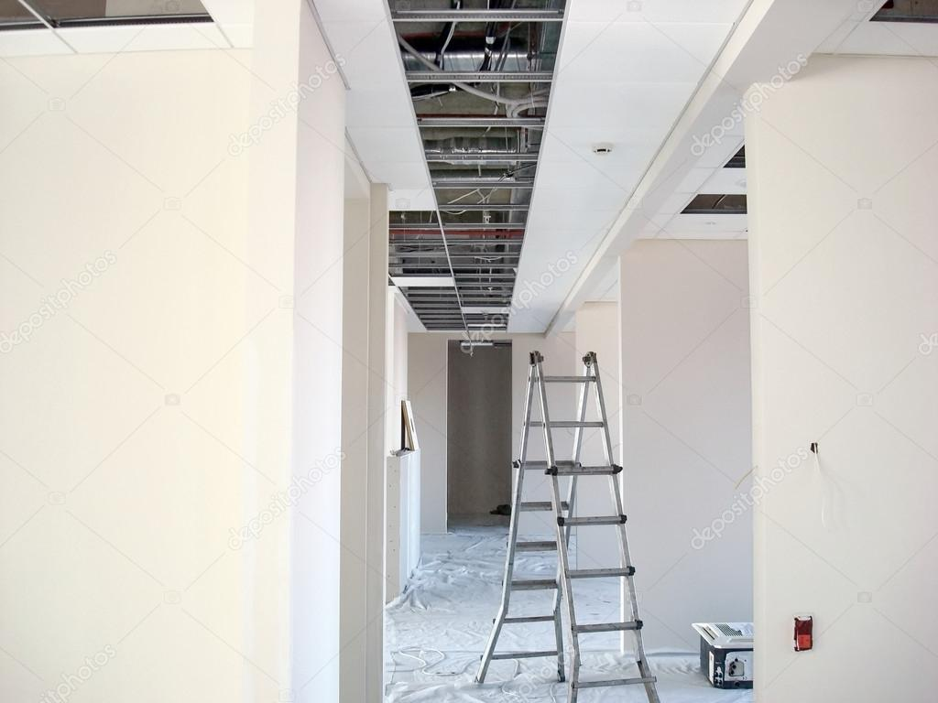
Super Structure works (Finishing Works)
Concrete 10cm
Concrete 15cm
Double Hollow block 10cm
Walls, ceiling and staircase walls plastering
Marble for windows
Doors, windows
Curtain panels
Glass partitions
Porcelain tiles
Glazed ceramic
Perlato marble for staircase walls
Stair landing
Wall, ceiling and staircase wall painting
Fall ceiling
parapet

Slide 11
Bill Of Quantity (BOQ)
Net Total Price is : 3,461,458.58₪

Slide 12
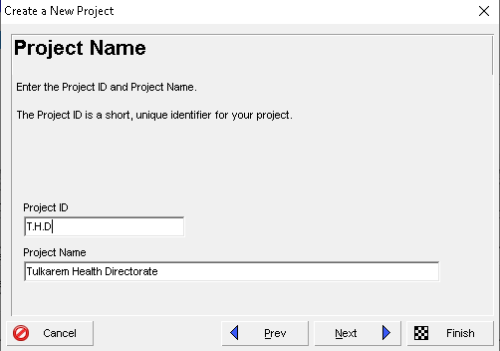
By Primavera P6 Software
Primavera input:
1. Activity of project.
2. Activity relation.
3. Duration for each activity.
Primavera Output:
1. Bar Chart
2. Time schedule
3. Budgeted cost Project ID and Project Name
4. S-curve

Slide 13

Input data
Enterprise project structure (EPS)
Organizational breakdown structure (OBS)
Calendar
Work Breakdown Structure (WBS)
Activity (Name of the activity, Original Duration, Relationship type,
Resources and Quantities)

Slide 14
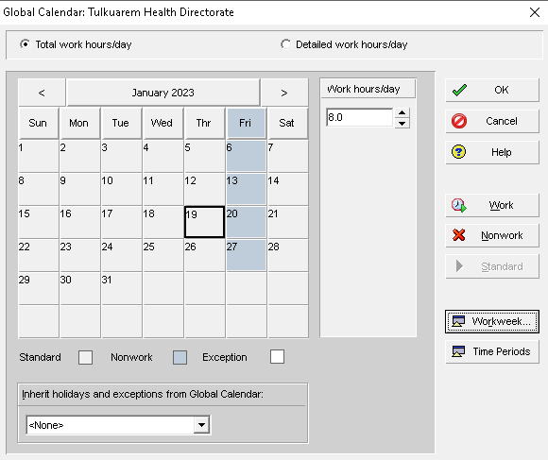
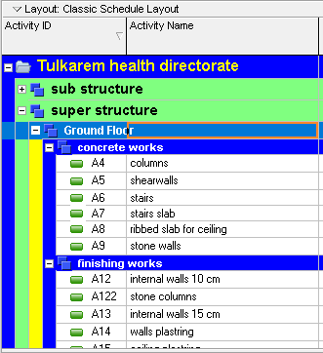
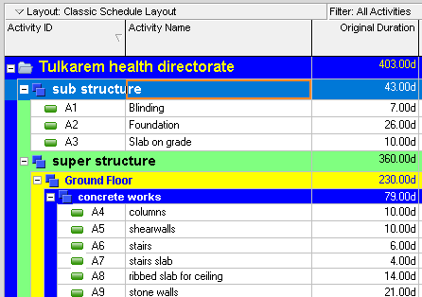
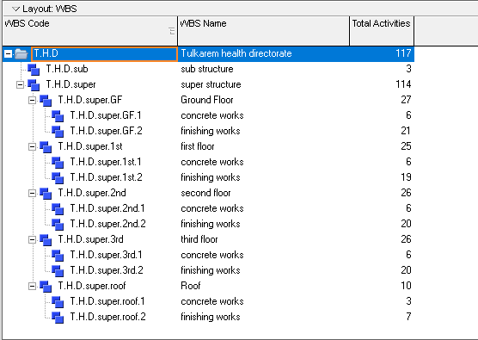
Calendar
Activity Name
Activity duration
WBS

Slide 15
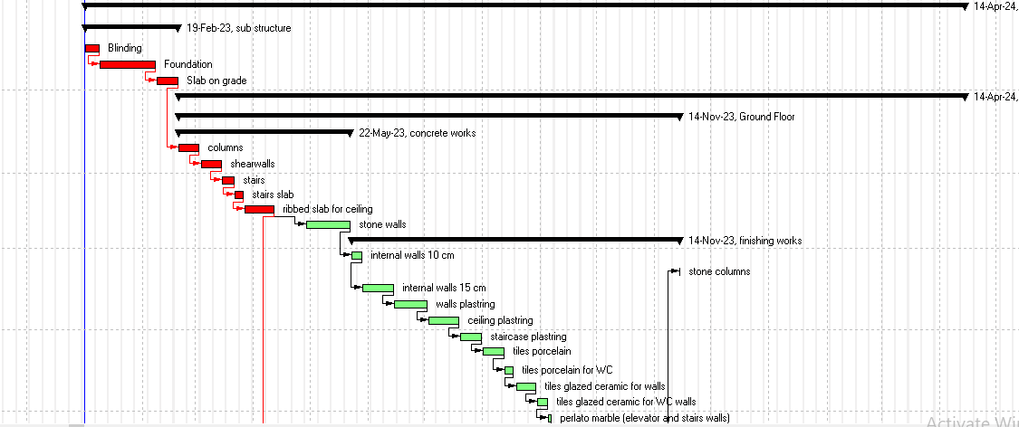
Output data
Time scheduling
Gant chart
Critical activities
Cost estimate
S-Curve
Gant chart

Slide 16
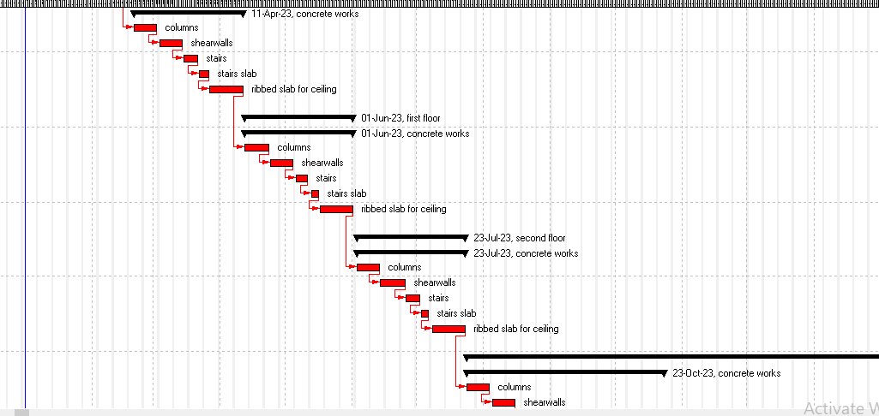
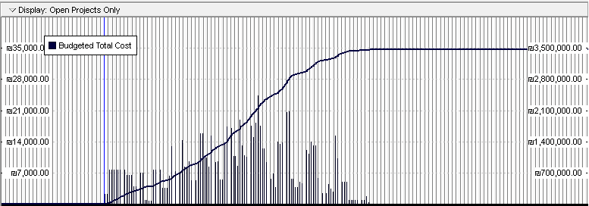
Critical Activities
S-Curve

Slide 17

Conclusion
1. The working days for the building was estimated to be (403) days.
2. The calendar days for the building was estimated to be (470) days.
5. The total price for this project was estimated to be (3,461,458.6) ₪.
6. Price per meter square (3461458.6/ 2002) = 1729 ₪.

Slide 18


