Slide 1

An-Najah National University Faculty of Engineering & Information Technology. Building Engineering Department. Graduation project (2) Re-evaluation Performance And Integrated
Design For a Commercial Building
Prepared By:
1. Afeef Jarrar 11715973.
2. Hammam Bouzia 11715025.
3. Mohammad Aysar Sholi 11715824.
Supervisor: Eng. Moayad Salhab.

Slide 2
CONTENTS
01
03
05
02
Structural Aspects
04
Cost Estimation
INTRODUCTORY
Architectural Aspects, Environmental Aspects
Electro-Mechanical Aspects

Slide 3
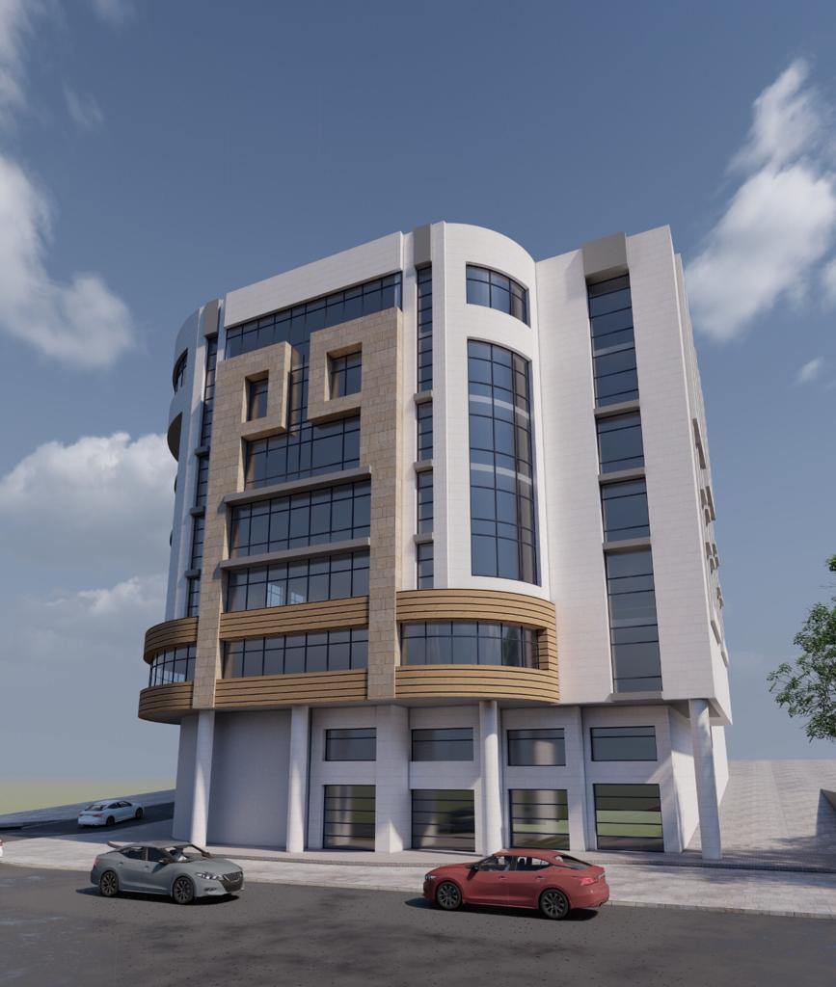
01
INTRODUCTORY
Introduction
The reason of choosing a commercial building
Project description.

Slide 4
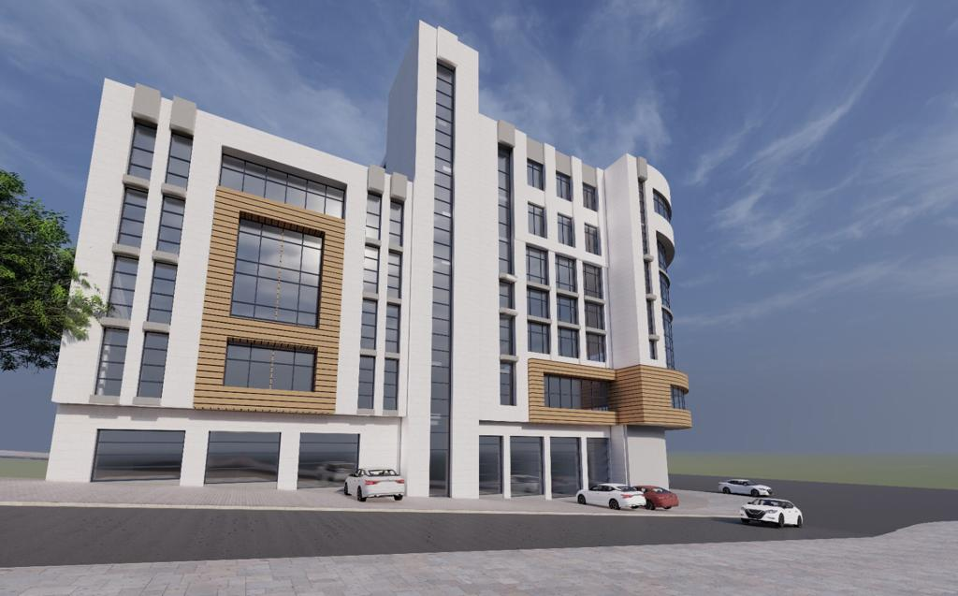
Introduction
Commercial buildings are considered one of the most important economic elements, as they provide customers with several services they need in one easily accessible place, and they have a good economic return.

Slide 5

The reason of choosing a commercial building
Popularity in Palestine.
Important element in developing the economy.
Diversity in design criteria due to variousity of spaces.
Challenge that there is an existing building in the site.

Slide 6
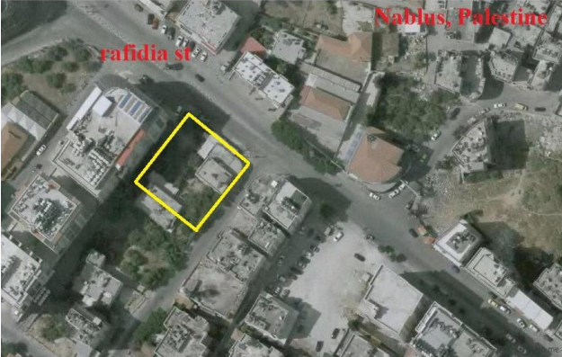
Project description
Located in Rafidia Neighborhood, Nablus.
Real and has a permission to implementation.
It contains 11 floors including 2 basements.
It has total area of 9540 SM.

Slide 7
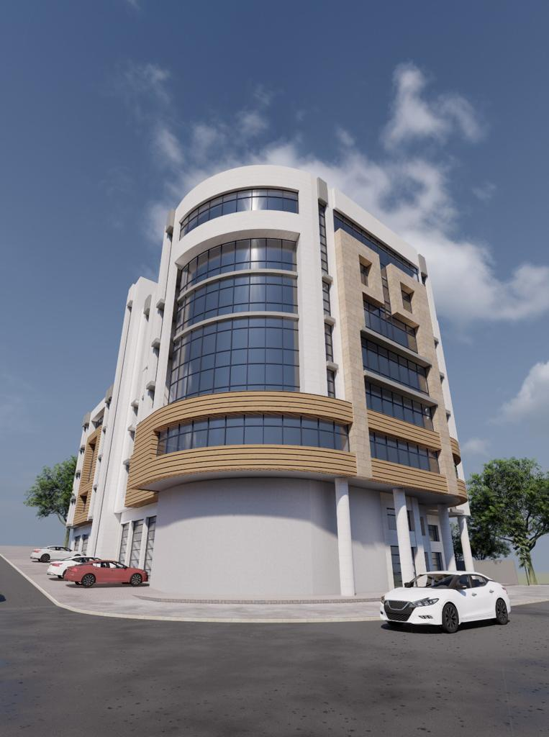
02
Architectural & Environmental Aspects
Site analysis.
Architecture drawings before and after modification.
Environmental analysis & drawings before and after modifications.

Slide 8
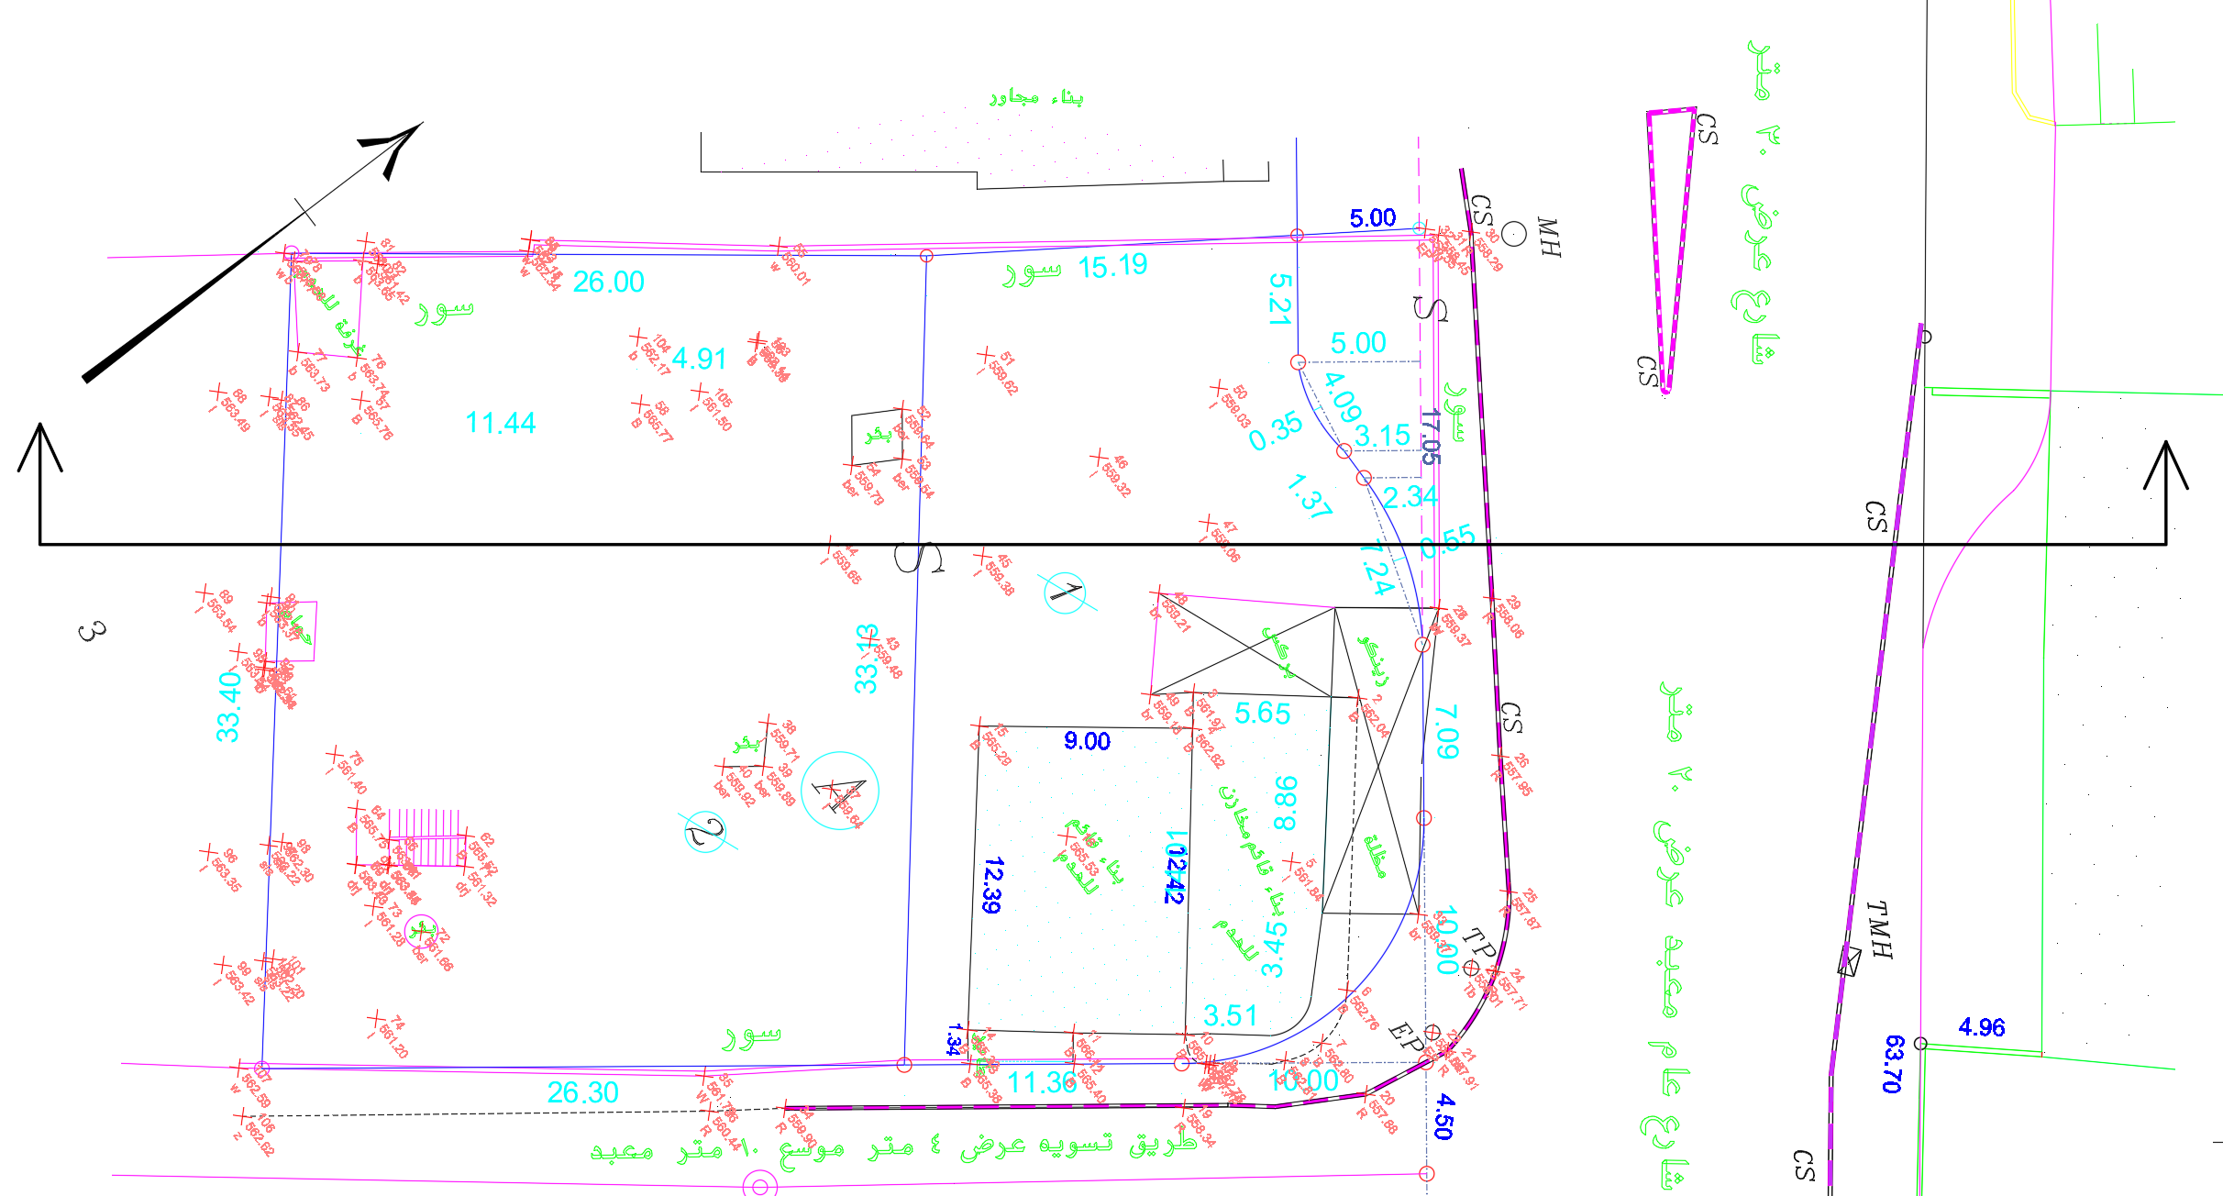
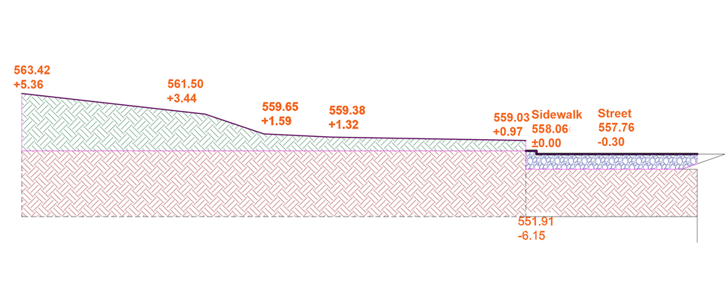
Site Analysis
Land analysis
Land Plan
Land Section

Slide 9
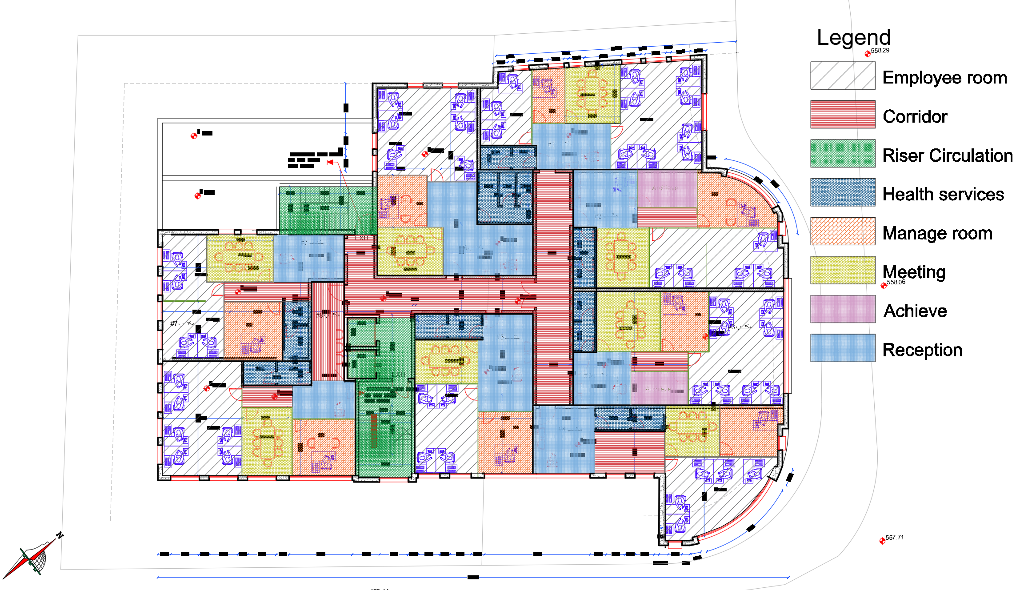
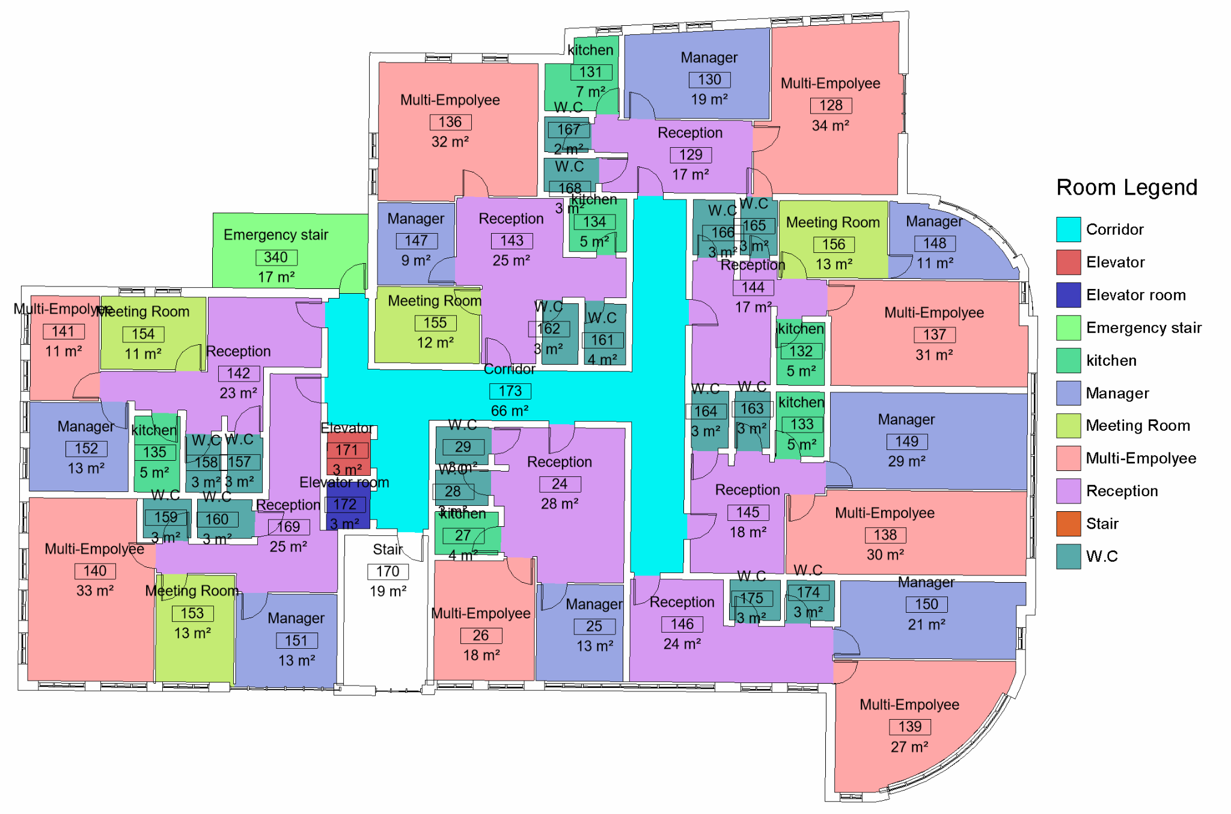
Architectural modifications
Second to fourth floor
Before Modification
After Modification

Slide 10
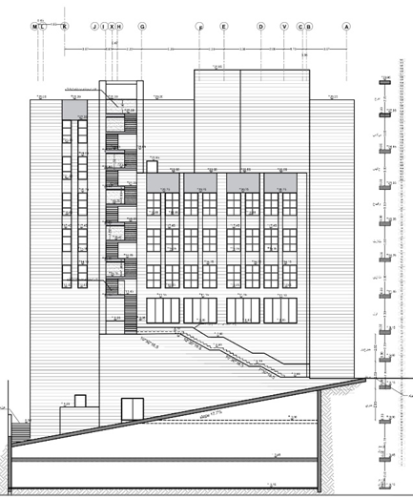
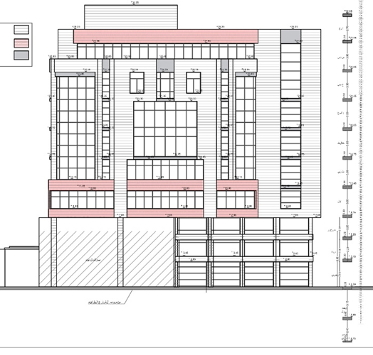
Architectural modifications
Elevations
South elevation
North elevation

Slide 11
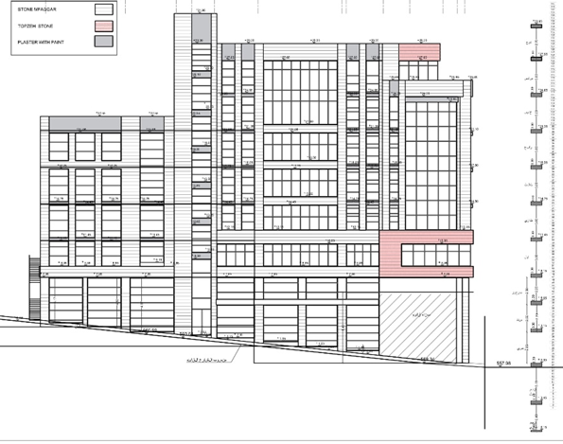
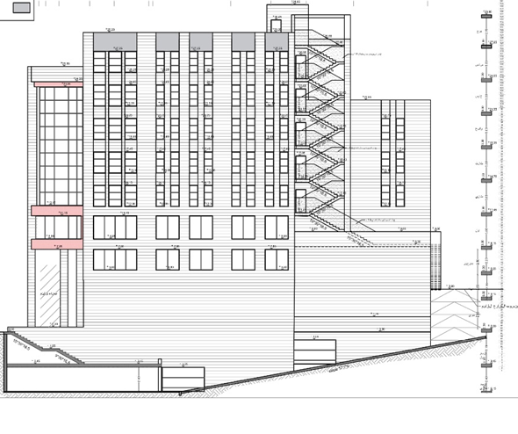
Architectural modifications
Elevations
East elevation
West elevation

Slide 12
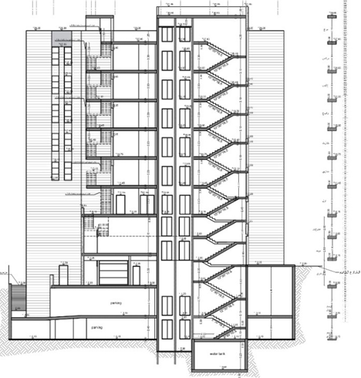
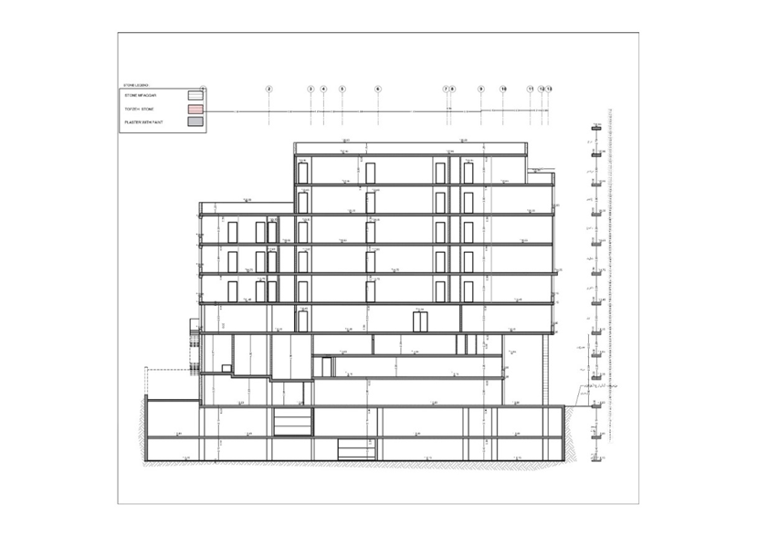
Architectural modifications
Sections
Section B-B
Section A-A

Slide 13
Environmental Aspects
1. Site Analysis
1. Daylight Analysis
1. Heating& cooling loads
1. Shading Analysis

Slide 14
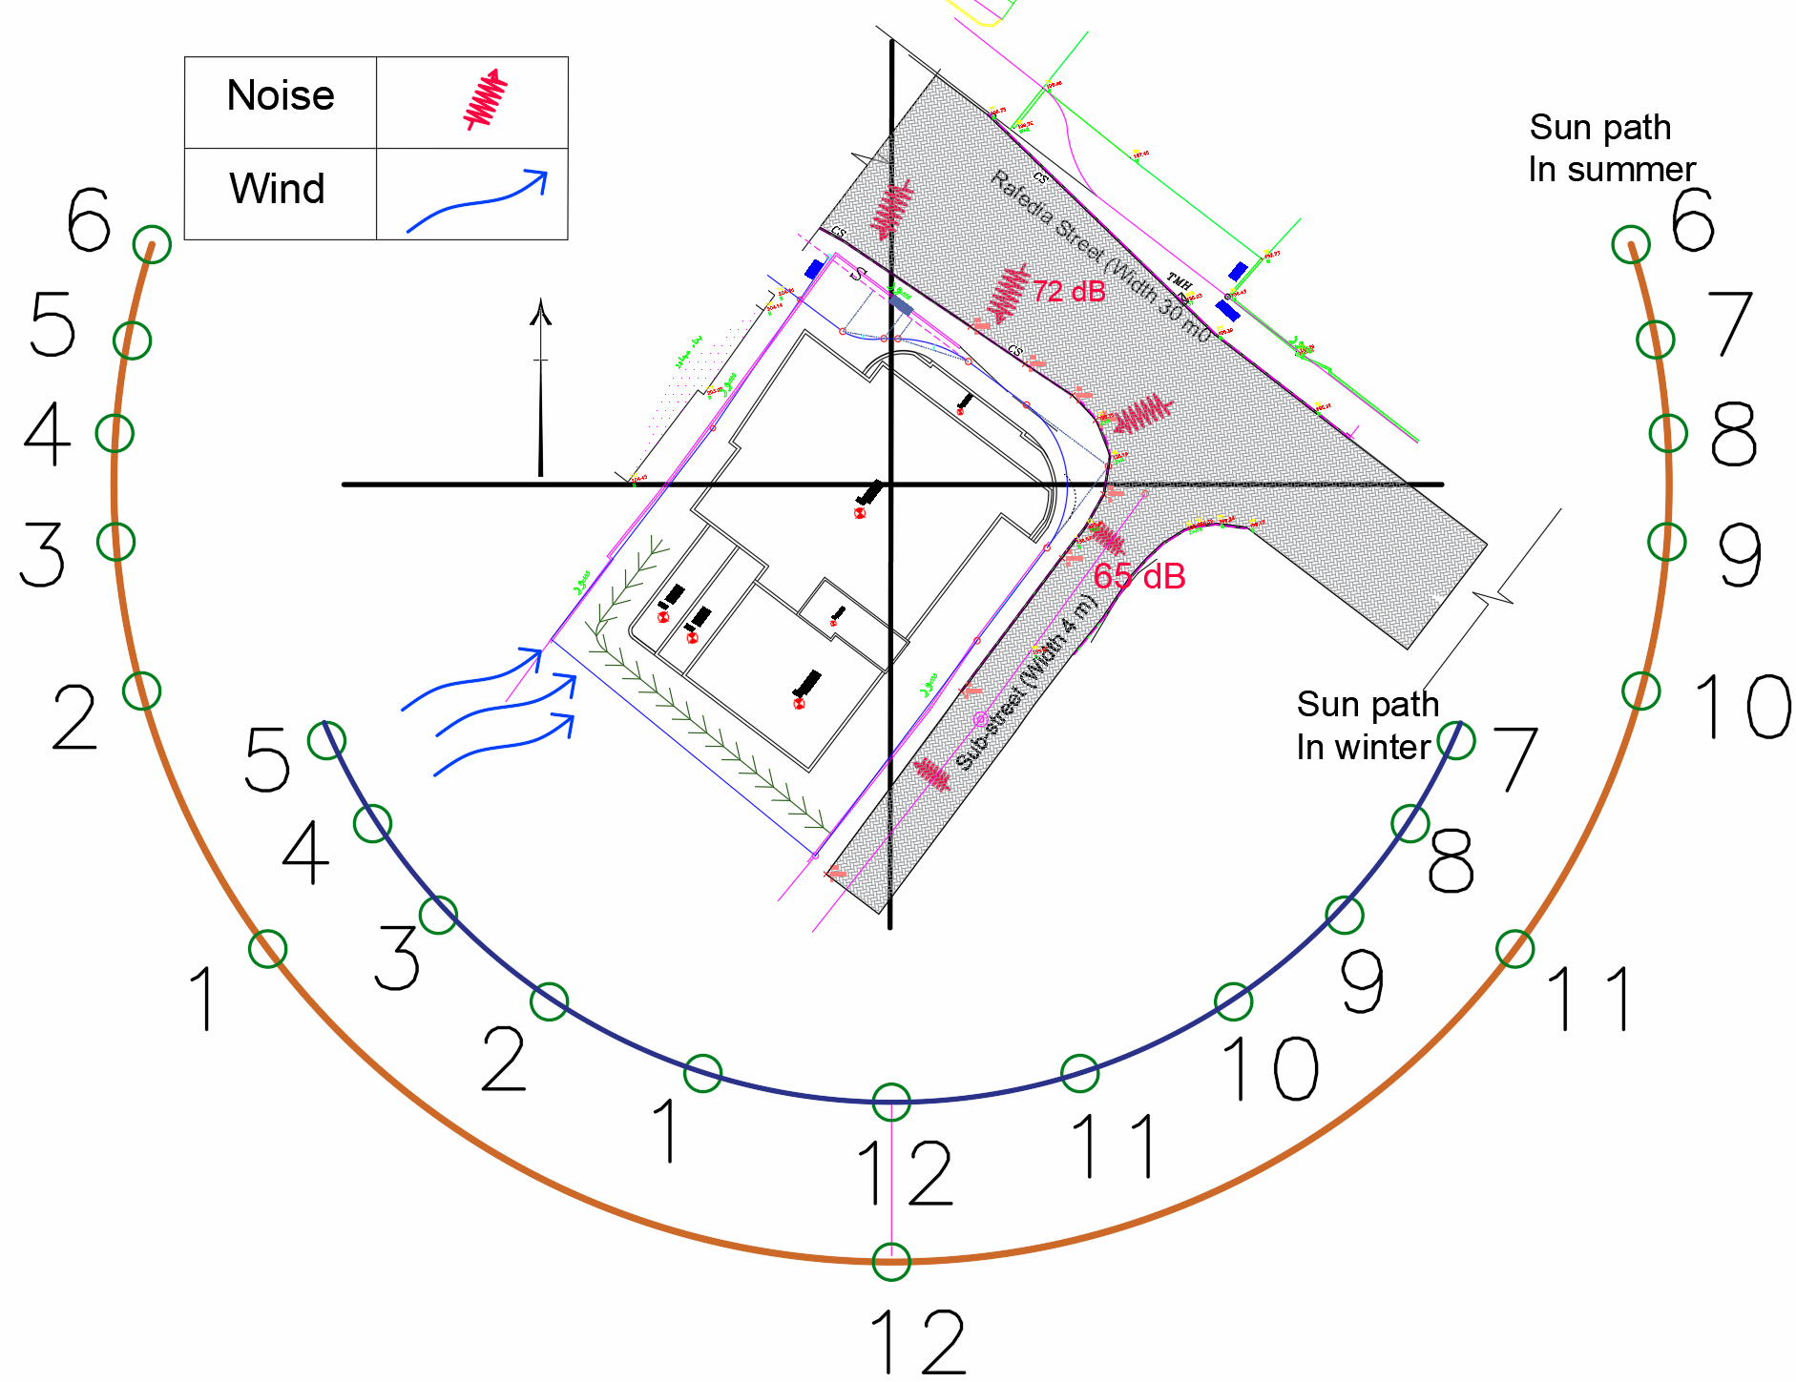
Site Analysis
Site and surrounding analysis

Slide 15
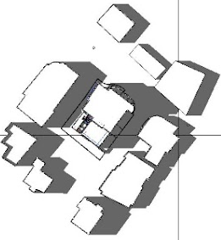
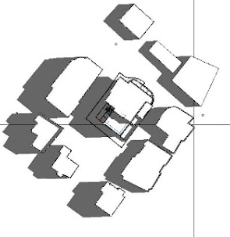
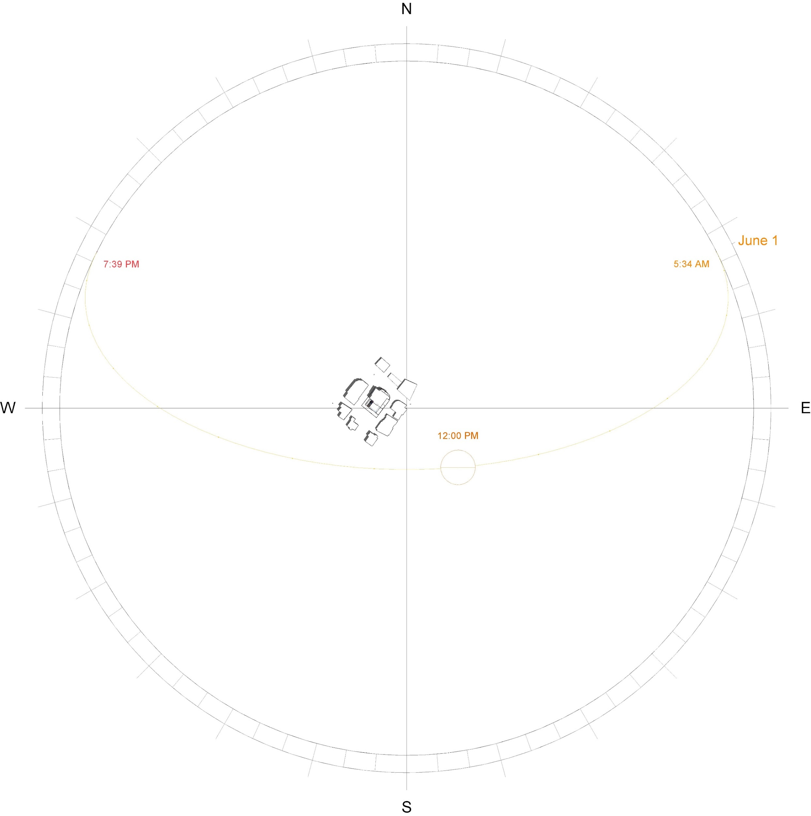
Shading Analysis
Shading in Summer
9:00 AM
12:00 PM
4:00 PM

Slide 16
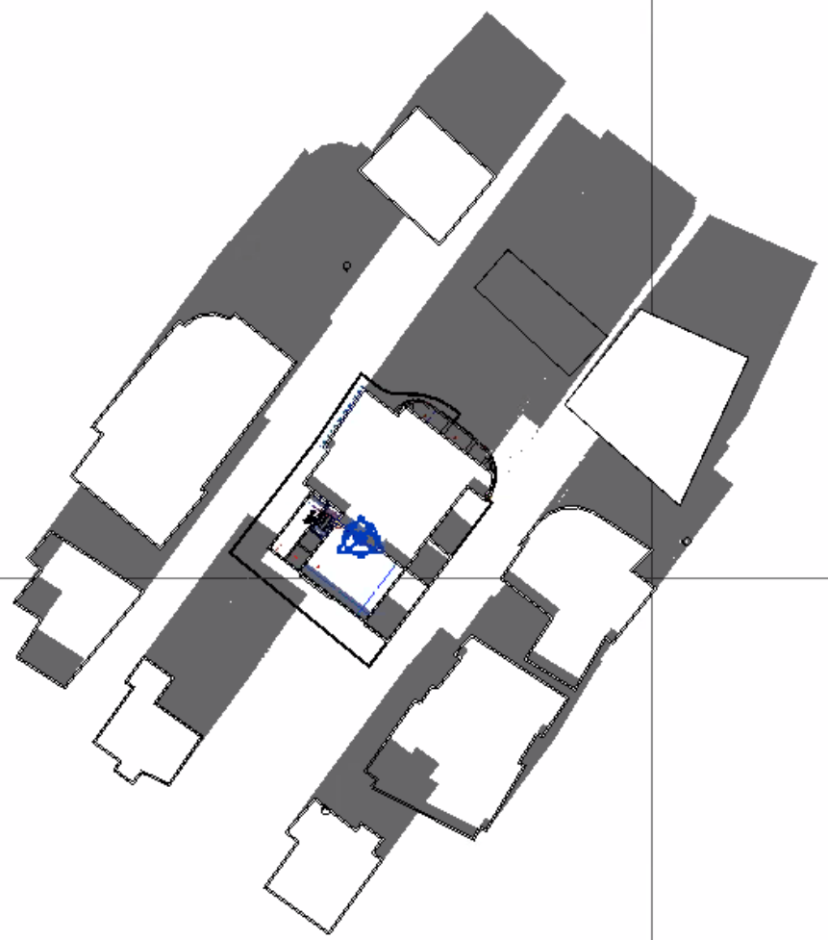
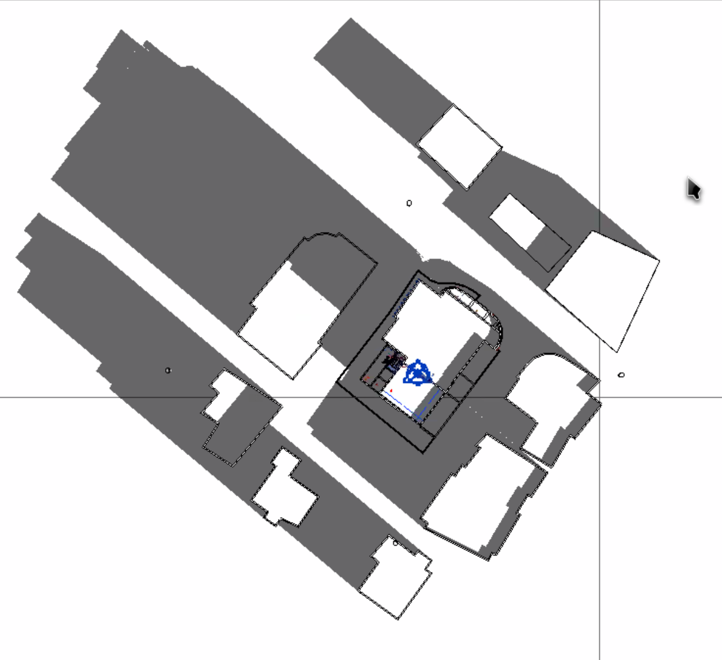
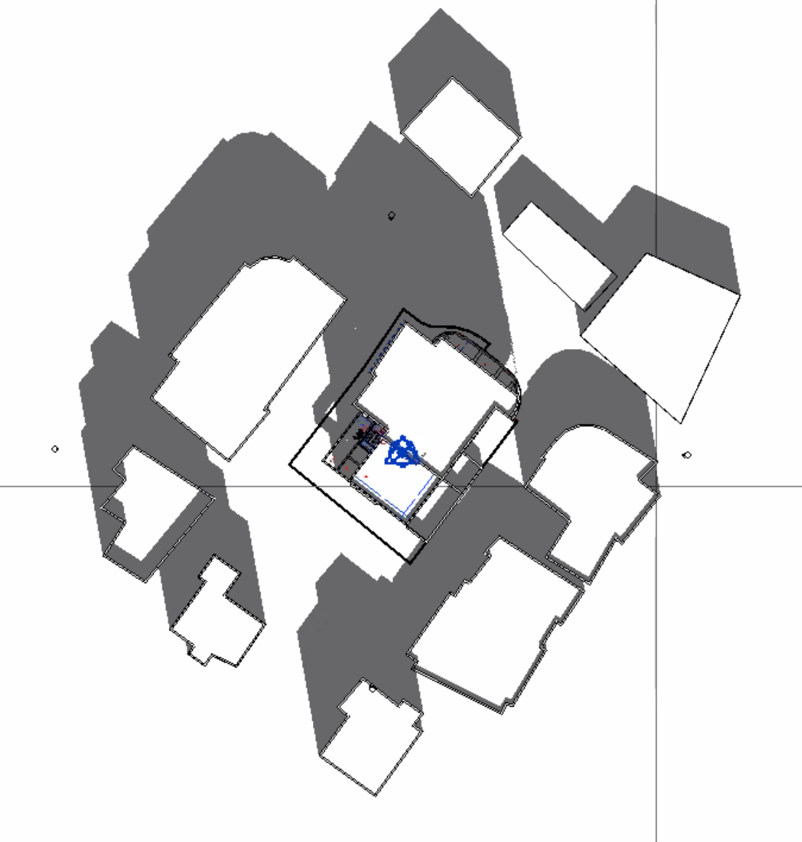
Shading Analysis
Shading in Winter
8:00 AM
12:00 PM
3:00 PM

Slide 17
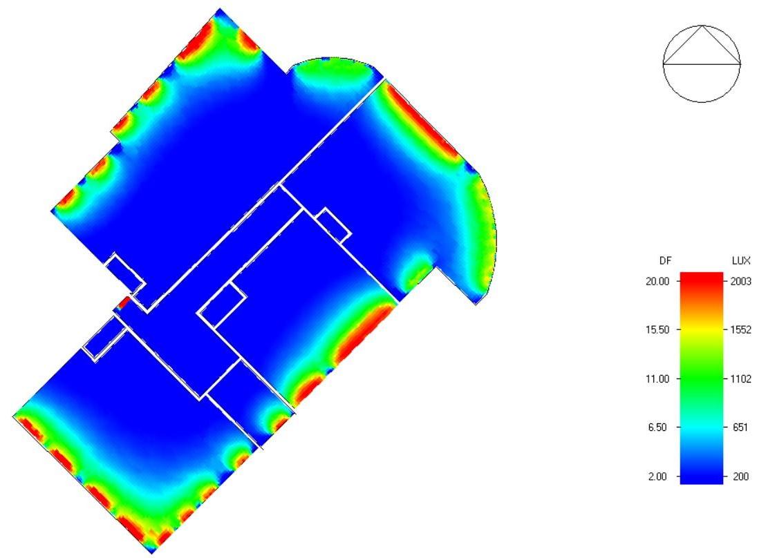
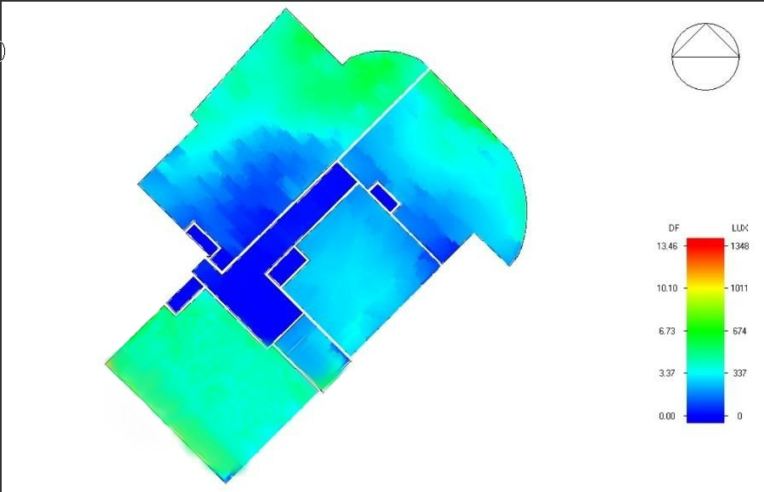
Daylight Factor Analysis
First Floor Before Modifications
First Floor After Modifications

Slide 18
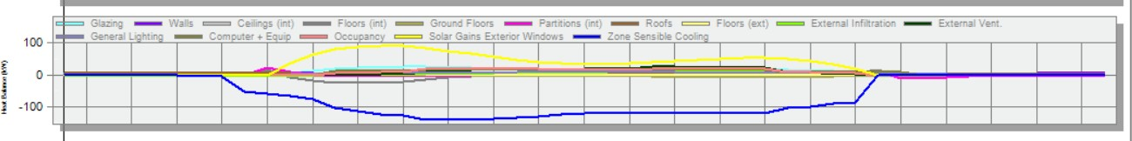
Heating and Cooling Loads
Heat gain sources before modification:

Slide 19
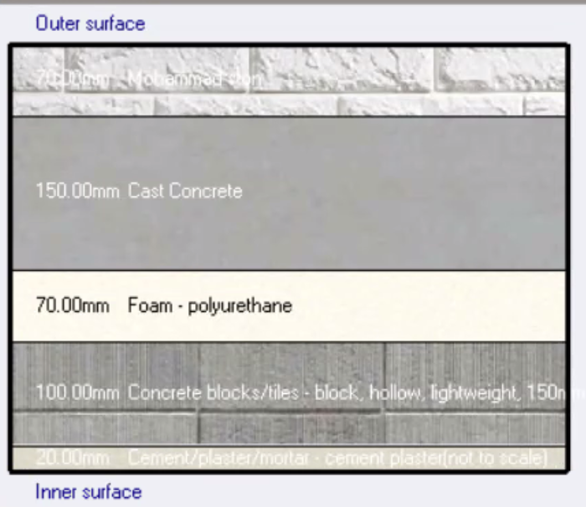
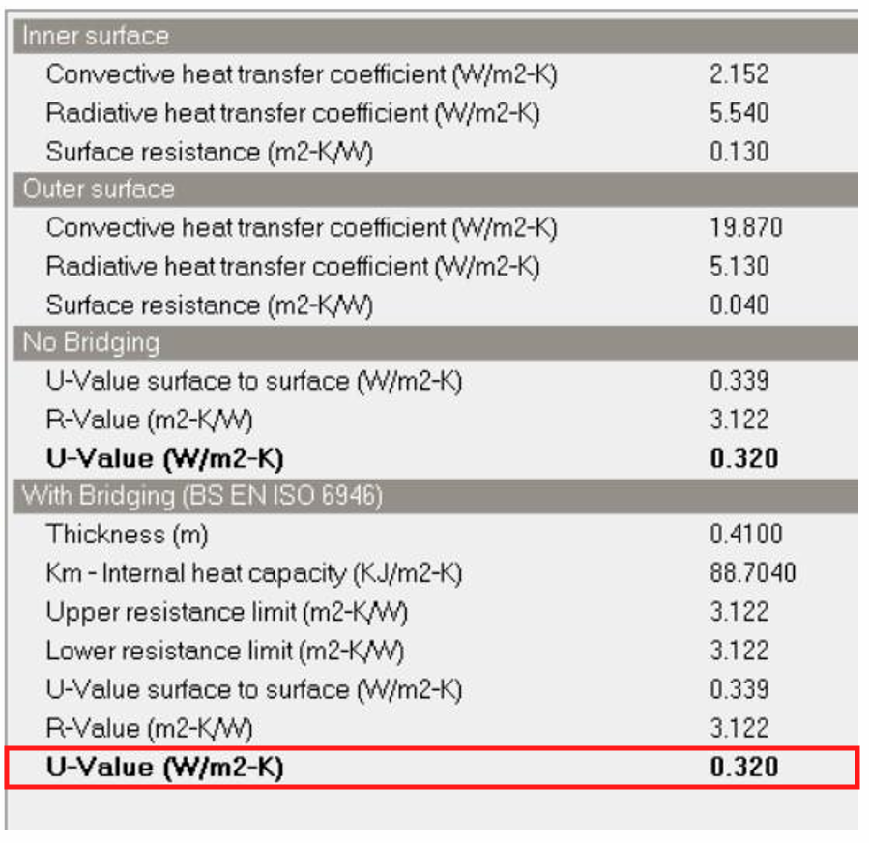
Heating and Cooling Loads
Thermal modification on exterior wall:

Slide 20
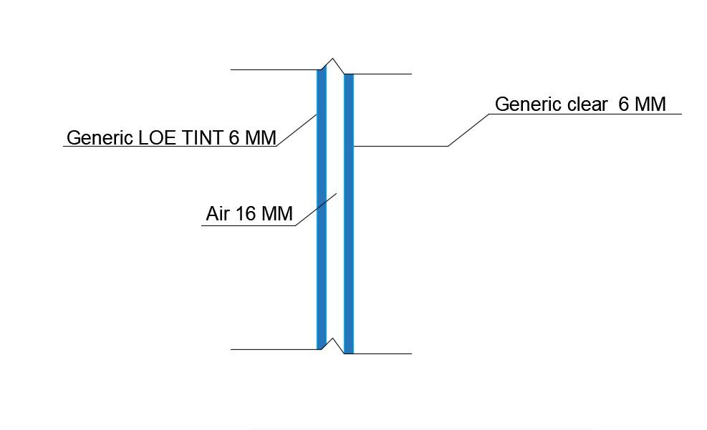
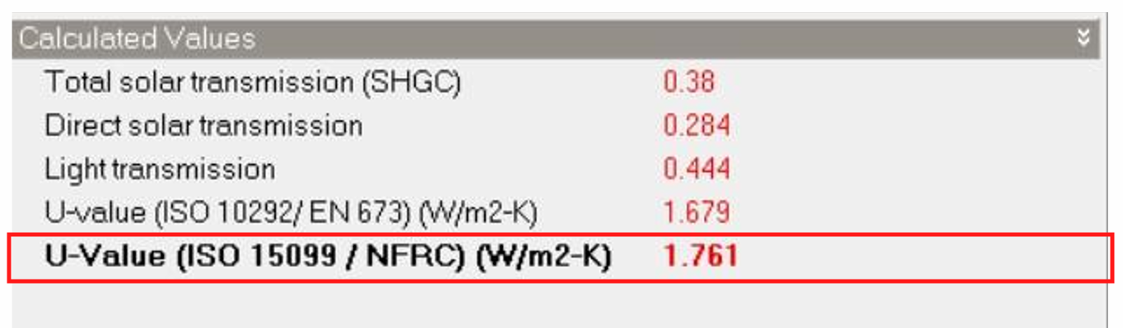
Heating and Cooling Loads
Thermal modification on Glazing:

Slide 21
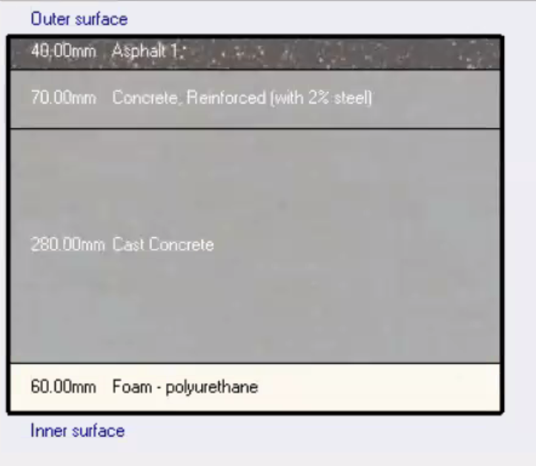
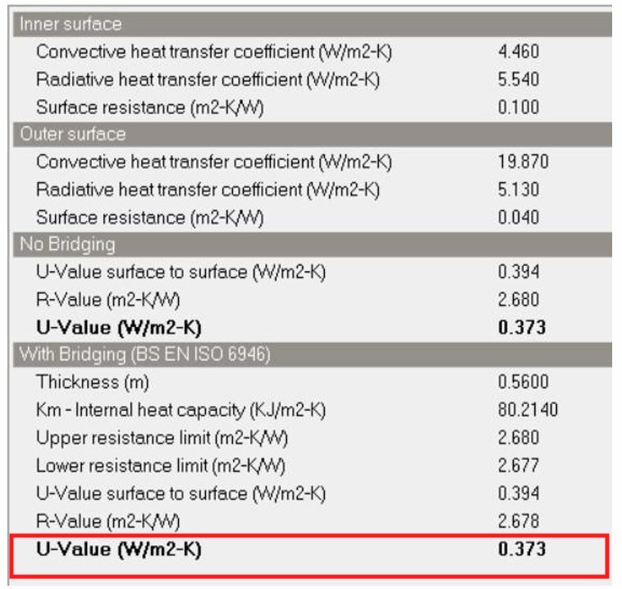
Heating and Cooling Loads
Thermal modification on Roof:

Slide 22
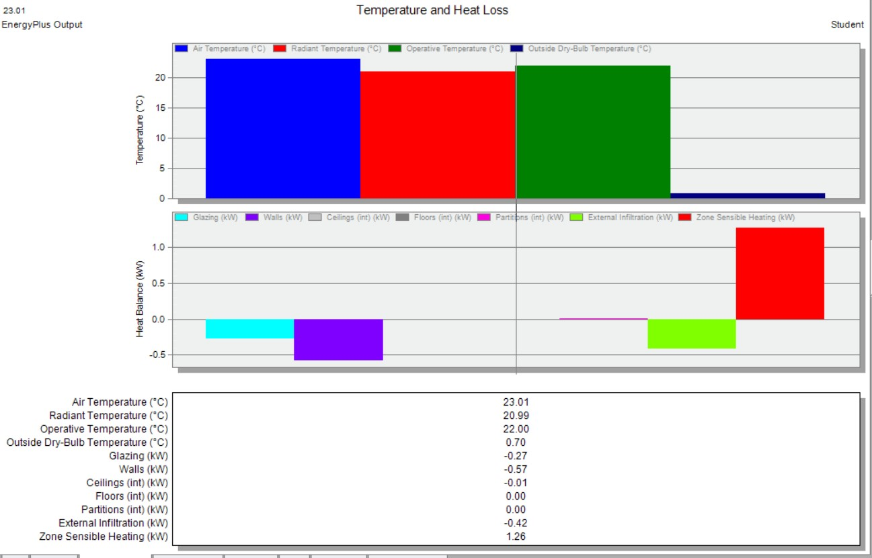
Heating and Cooling Loads
Heating load after modification:
The values of design cooling and heating load per floor area for the spaces are within (35-80) W/m².

Slide 23
Heating and Cooling Loads
Heat gain sources after modification:

Slide 24
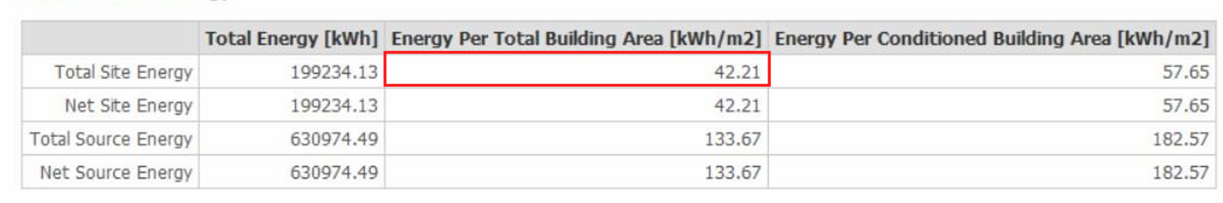
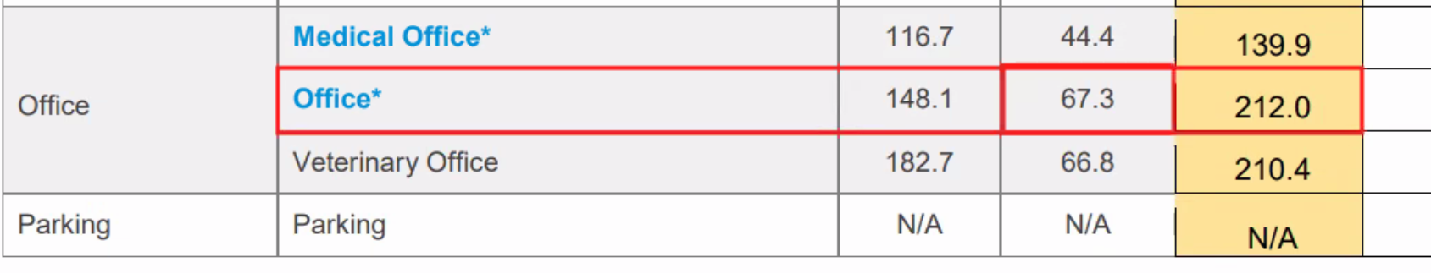
Heating and Cooling Loads
Site source Energy:

Slide 25
Heating and Cooling Loads
Summary
Total heating and cooling load in the building
Cooling load (KW) | 278.22
Heating load (KW) | 106.62
According to baseline from design-builder software, the saving for the building is 63.7%.
The predicted mean value (PMV) index is (0.75), which is within (-1 , 1)

Slide 26
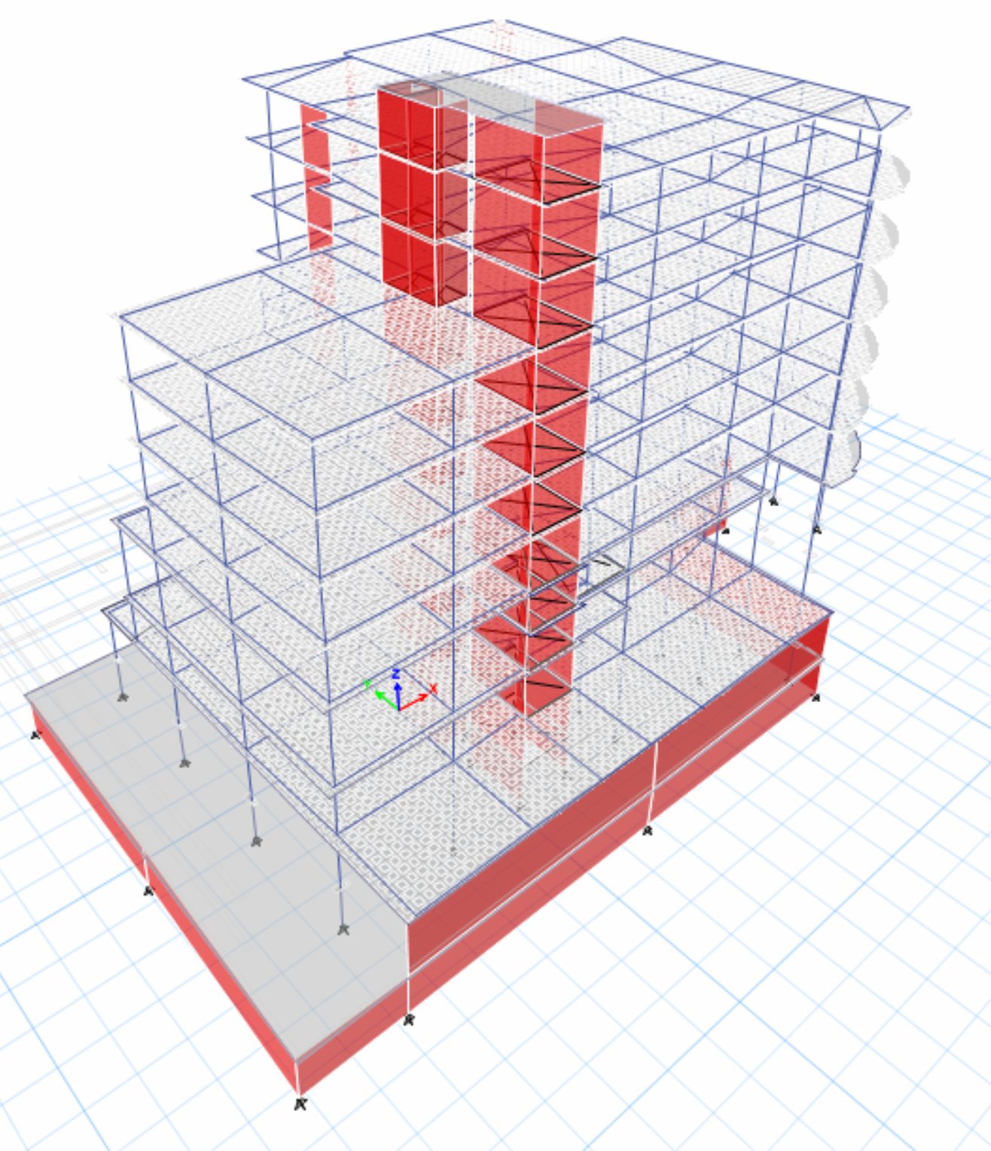
03
Structural Aspects
Structural materials
Load effect
Structural Systems
Columns and Beams dimensions
Structural Checks
Structural Detailing

Slide 27
Structural materials
Reinforced Concrete
Reinforcing steel
Structural Component | Compressive Strength (f’c)
Columns | 40 MPa
All other structural elements | 28 MPa
Specifications | Yield Stress (Fy)
Reinforcement Steel | 420 MPa

Slide 28
Loads effect on slabs
Load type | Load
Superimposed dead load | 5.2 KN/SM
External wall | 20 KN/M
Live load | 4.8 KN/SM
Dead load | From ETABS Software

Slide 29
Structural Systems
Element | Structural system | Thickness (cm)
Slabs | Two-way ribbed slab | 35
Footing (1) | Mat Foundation | 110
Footing (2) | Single Footing | 65

Slide 30
Columns and Beams dimensions
Column Name | Dimensions (cm)
 | Width (cm) | Depth (cm)
C1 | 80 | 50
C2 | 80 | 70
C3 | Diameter = 70 cm
C4 | 50 | 50
C5 | 55 | 20
Beam Name | Dimensions (cm)
 | Width (cm) | Depth (cm)
Main Beam | 80 | 35
Helping beam | 40 | 35
Drop beam 1 | 30 | 60
Drop beam 2 | 55 | 60

Slide 31
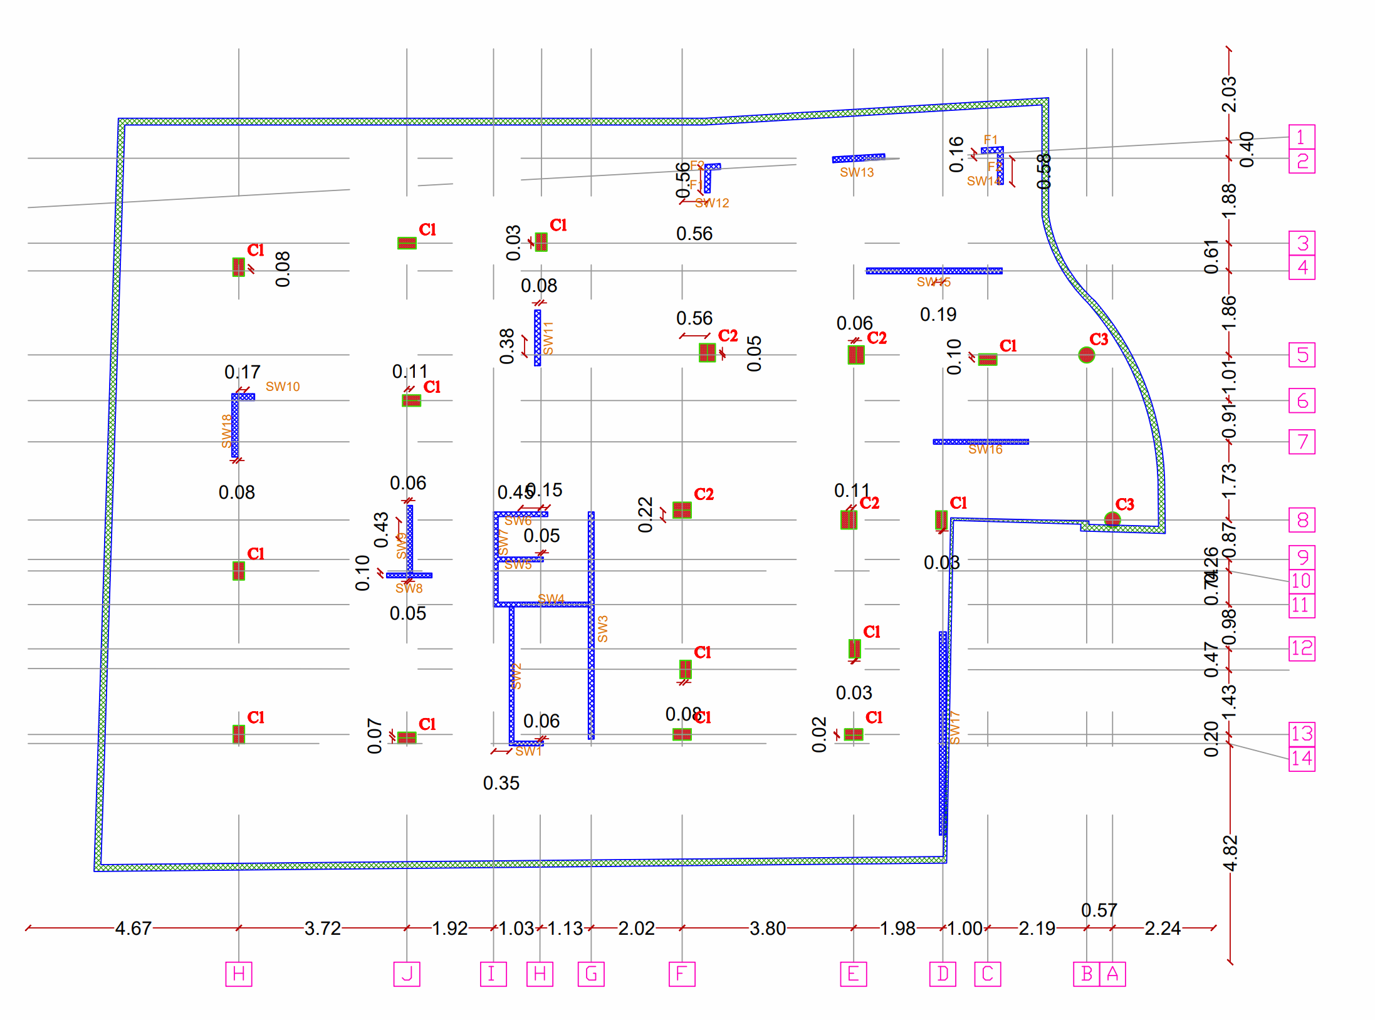
Columns and shear walls Distribution

Slide 32
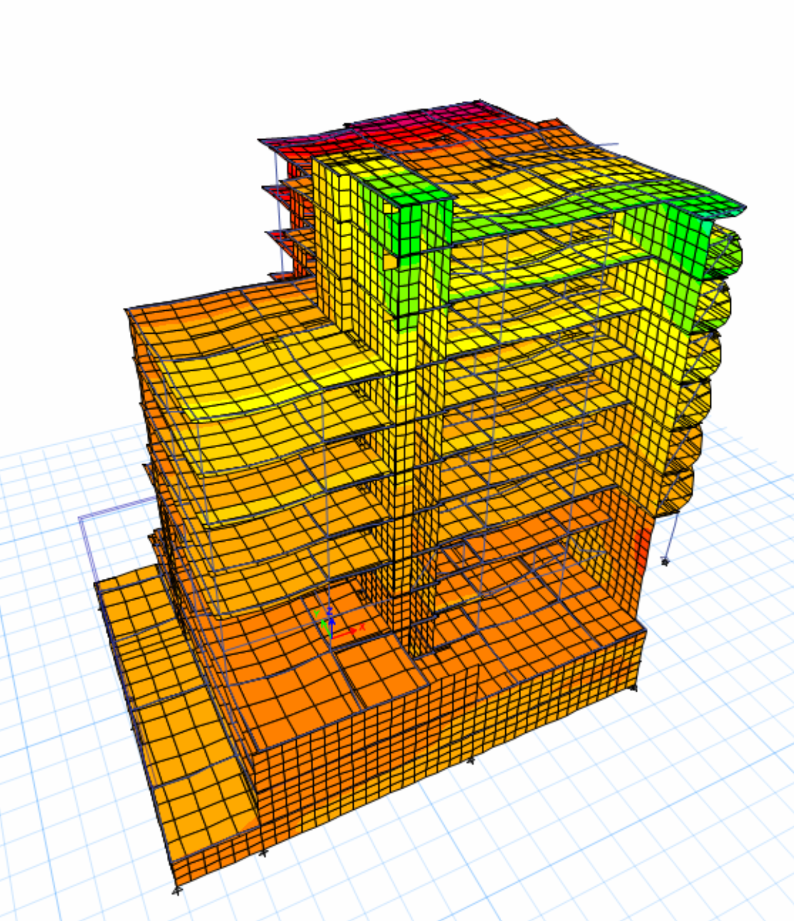
Structural Checks
Compatibility Check

Slide 33
Structural Checks
Equilibrium Check
Equilibrium Check
 | Manual (KN) | ETABs (KN) | Error% | Allowable Limit | Check status
Dead | 88082.96 | 88782.73 | 0.79 | 5% | OK
Live | 41898.18 | 41896.86 | 0.003 | 5% | OK
SID | 44073.01 | 44107.08 | 0.08 | 5% | OK

Slide 34
Structural Checks
Stress-Strain Check – Columns
Stress-strain check for columns
 | Manual (KN) | ETABs (KN) | Difference (%) | Allowable Limit | Check status
Edge | 7183.11 | 7681.2 | 6.93 | 10% | OK
Internal | 10093.71 | 9146.27 | 9.39 | 10% | OK
Corner | 5483.75 | 5311.67 | 3.14 | 10% | OK

Slide 35
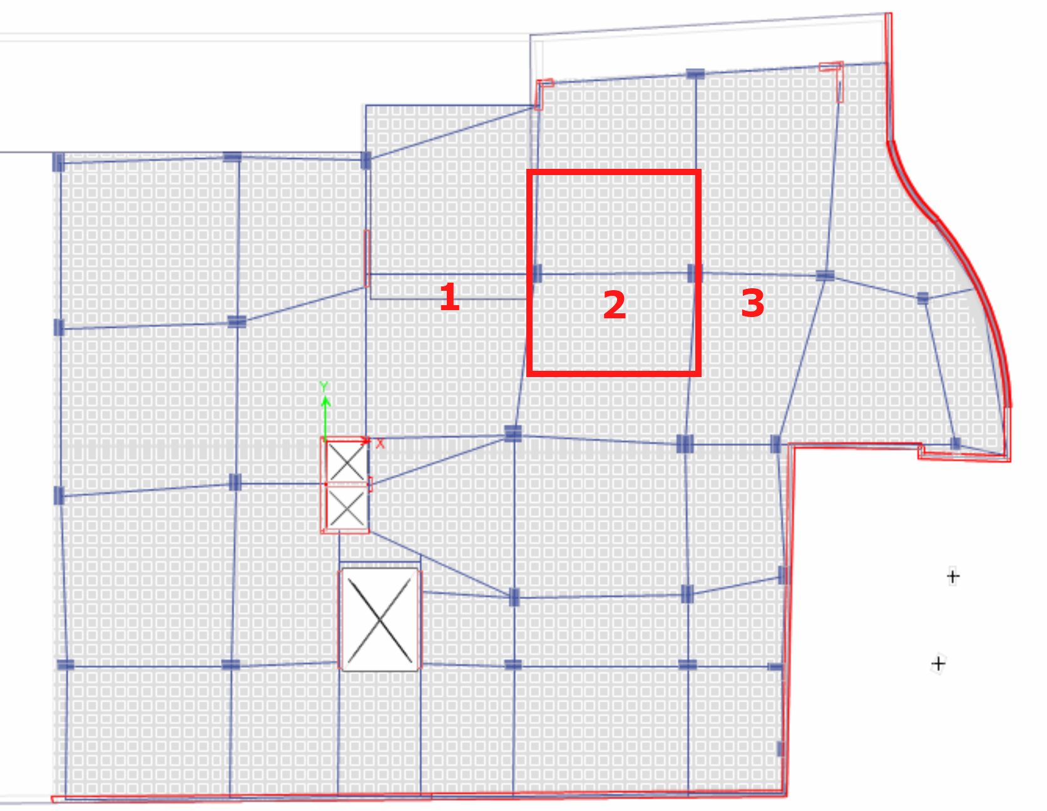
Structural Checks
Stress-Strain slab check – Frame
Frame
 | Manual (KN) | ETABs (KN) | Difference (%)
Negative | 535.92 | 503.5 | 6.05
Positive | 288.57 | 329.32 | 14.12
Negative | 535.92 | 473.3 | 11.68
Column strip (CS)
 | Manual (KN) | ETABs (KN) | Difference (%)
Negative | 395.5 | 370 | 6.45
Positive | 178.34 | 215 | 20.56
Negative | 395.5 | 354 | 10.49

Slide 36
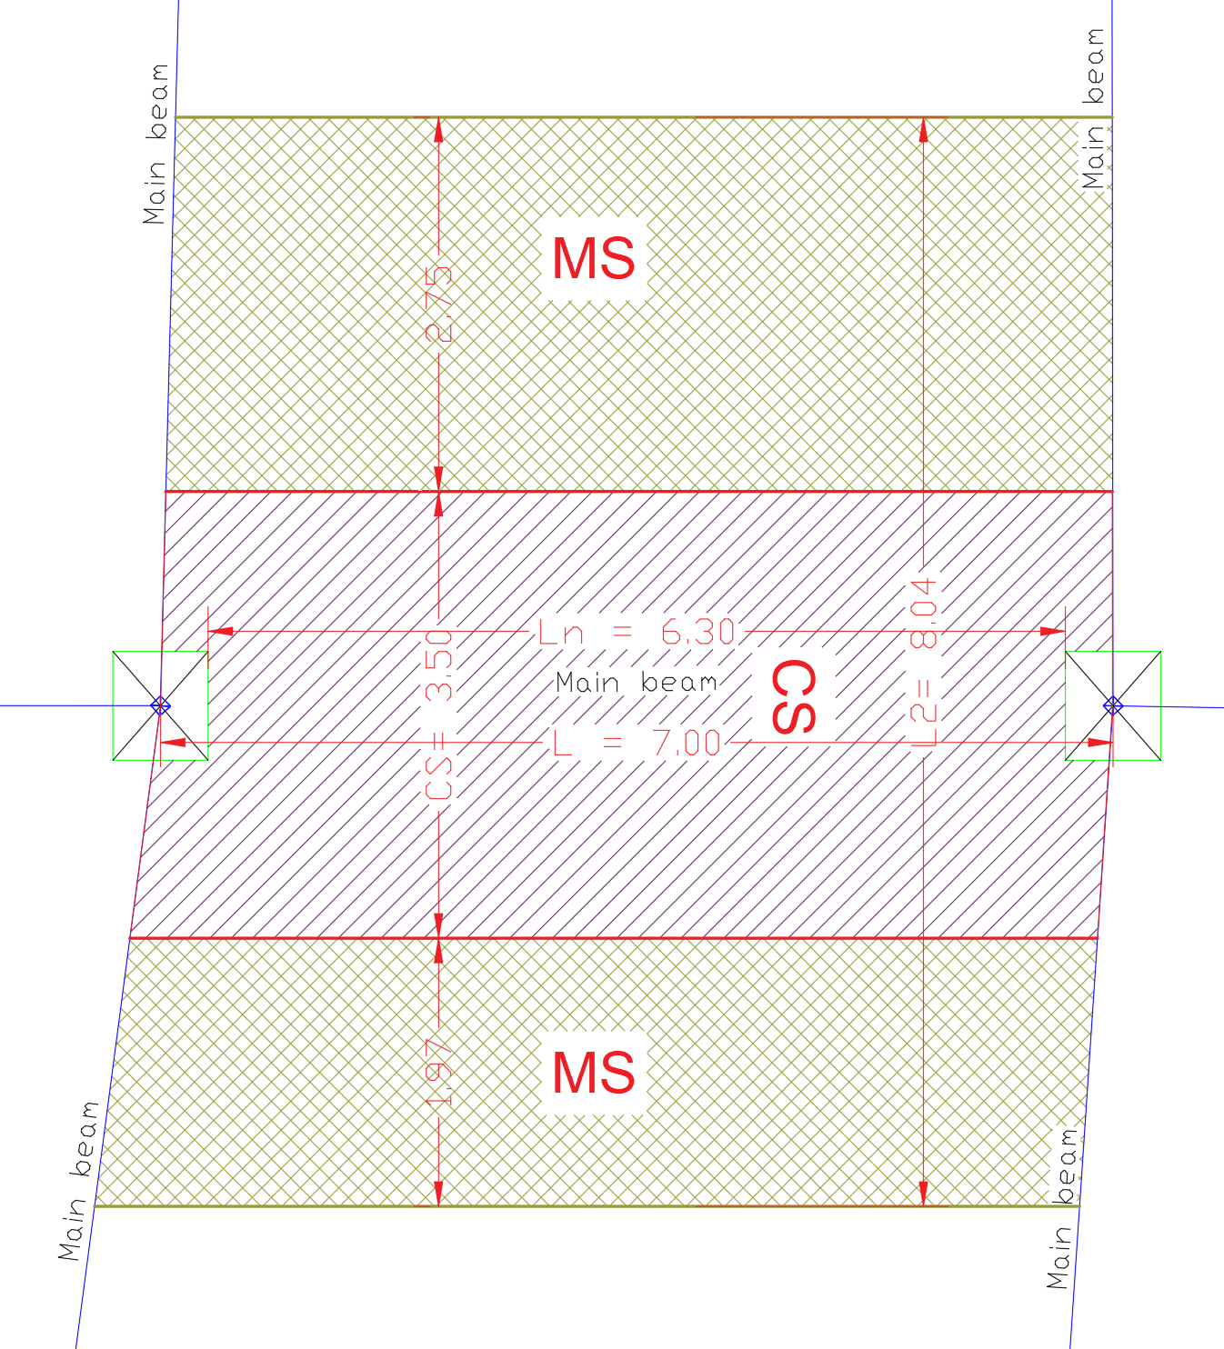
Structural Checks
Stress-Strain slab check – Middle strip
Middle strip (MS)
 | Manual (KN) | ETABs (KN) | Difference (%)
Negative | 140.4 | 133.5 | 4.91
Positive | 110.23 | 114.32 | 3.71
Negative | 140.4 | 119.3 | 15.03
Beam
 | Manual (KN) | ETABs (KN) | Difference (%)
Negative | 73.9602 | 87.7 | 18.58
Positive | 33.3489 | 41.46 | 24.32

Slide 37
Structural Checks
Other Designing Checks:
Check Name | ETABs results | Allowable limit | Check status
Immediate deflection of slab | 12.5 mm | 29.6 mm | OK
Shear check for slab | Vu ≤ 77.6 KN/m | ØVc = 77.6 KN/m | OK
Check doubly reinforcement for beam | Mu = 144.94 KN.m | ØMn = 376.76 KN.m | OK

Slide 38
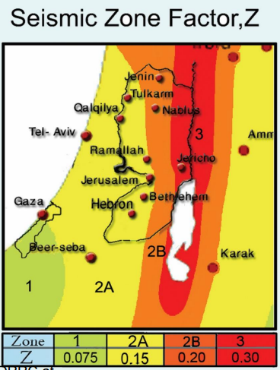
Seismic Data
UBC97 code was used for seismic data.
The seismic zone factor (Z)=0.2
The soil profile type is Sc.
Seismic coefficient factor (Cv) =0.32
Seismic coefficient factor (Ca) =0.24
The ductility factor (R) =5.5
The importance factor (I) = 1
The adopted used method is Response spectrum.
the structural system used is Building frame system shear walls concrete.

Slide 39
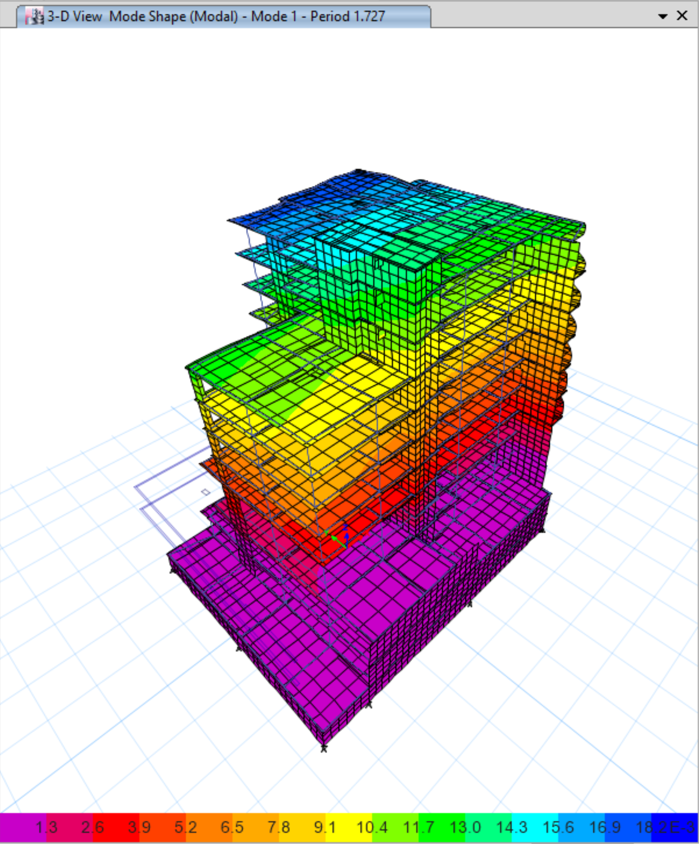
Seismic Checks
Period check

Slide 40
Seismic Checks
Check Name | ETABs results | Allowable limit / Manual limit | Check status
Modal participating mass ratio | 90.63% | 90% | OK
Base Shear | 9958.8 KN | 9942.68 KN | OK
Drift check | ΔMX= 27.55 mm | ΔMAll = 74 mm | OK
P delta check | 𝜃𝑥 =0.0695 | ≤ 0.1 | OK

Slide 41
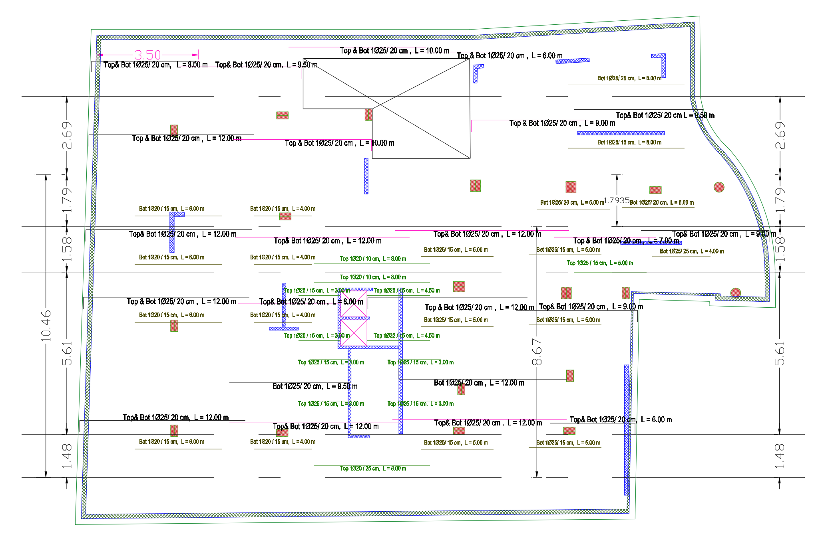
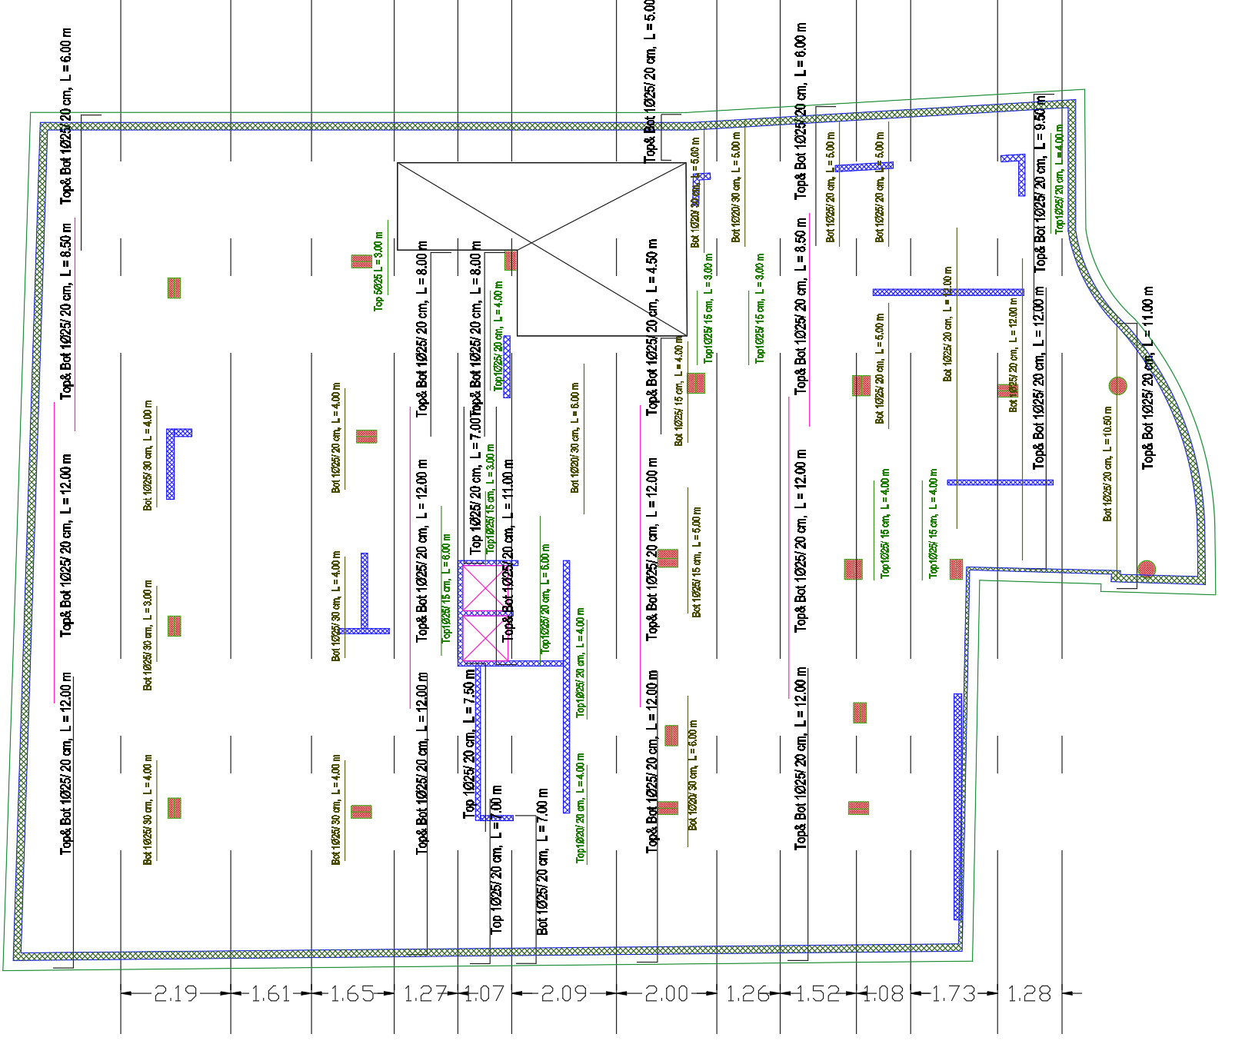
Structural Detailing
Mat Foundation
Mat reinforcement in X- Direction
Mat reinforcement in Y- Direction

Slide 42
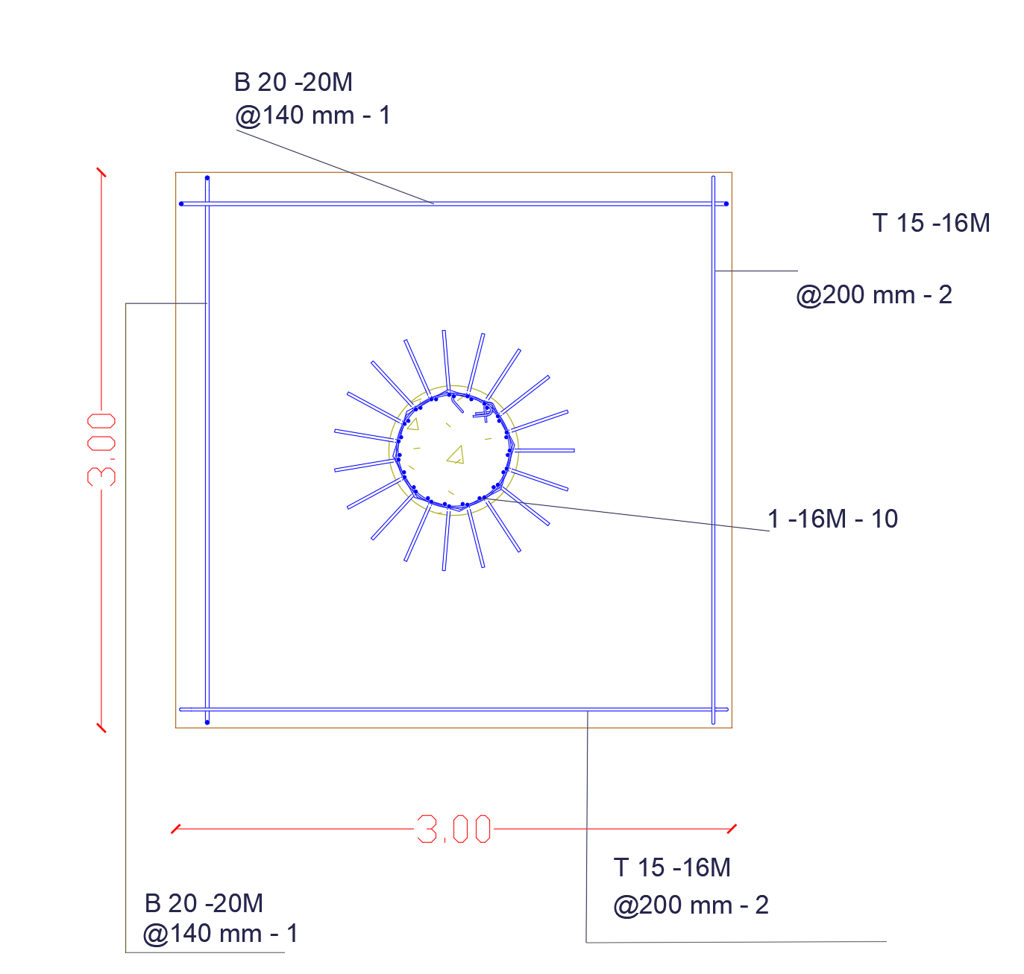
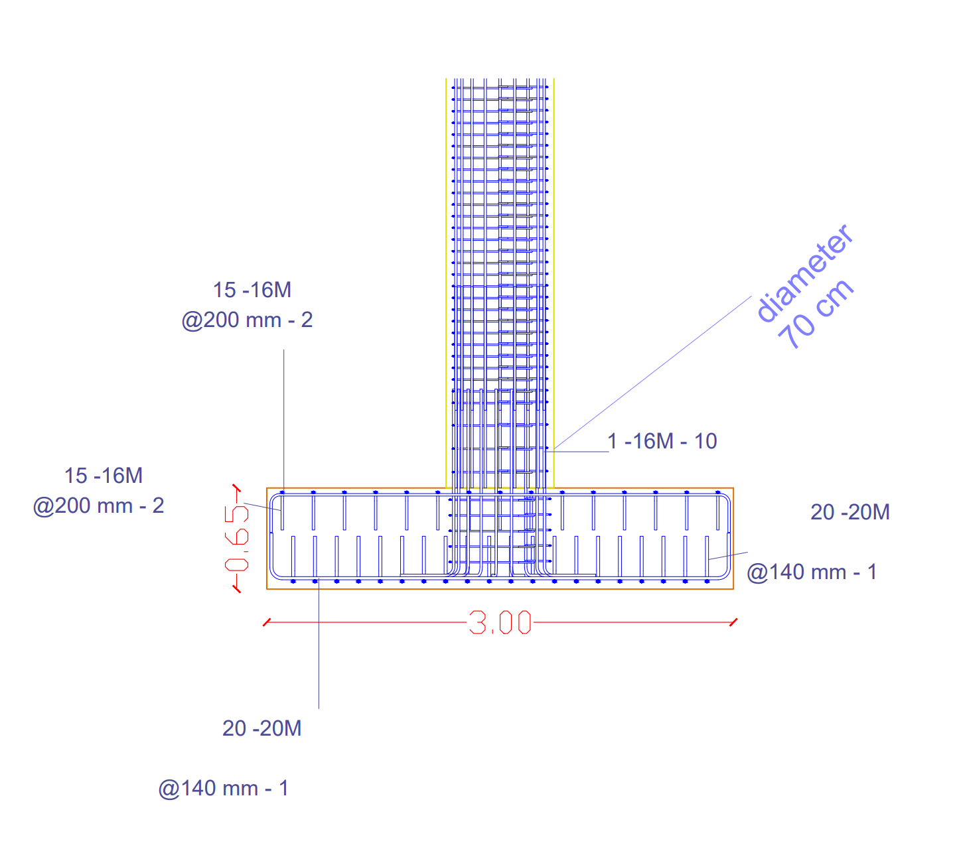
Structural Detailing
Single Footing details:

Slide 43
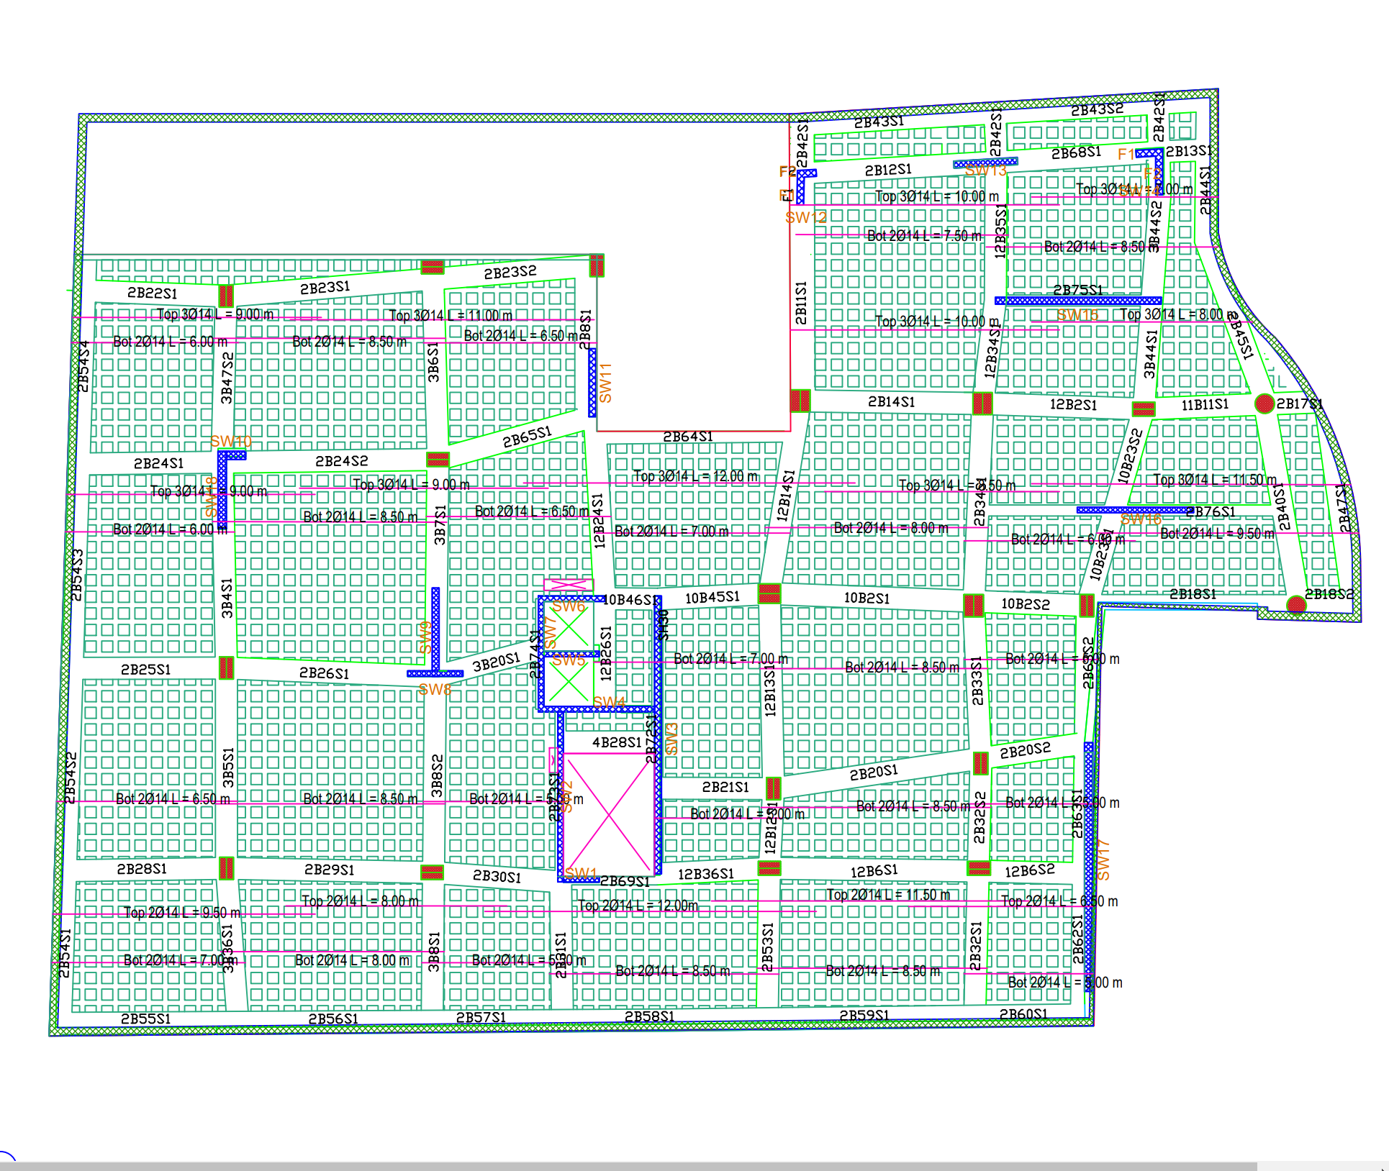
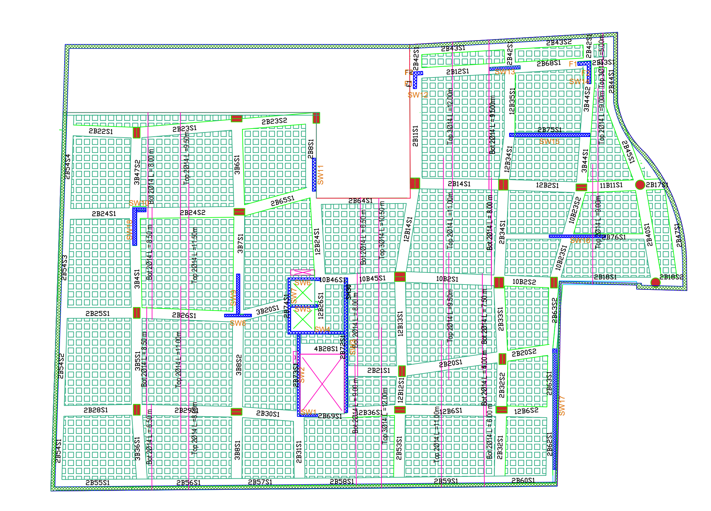
Structural Detailing
Slabs Detailing
Slab reinforcement in X- Direction
Slab reinforcement in Y- Direction

Slide 44
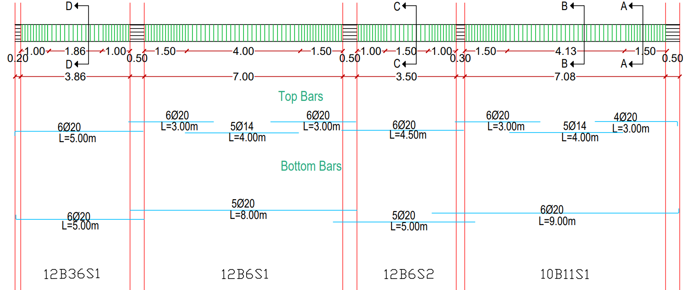
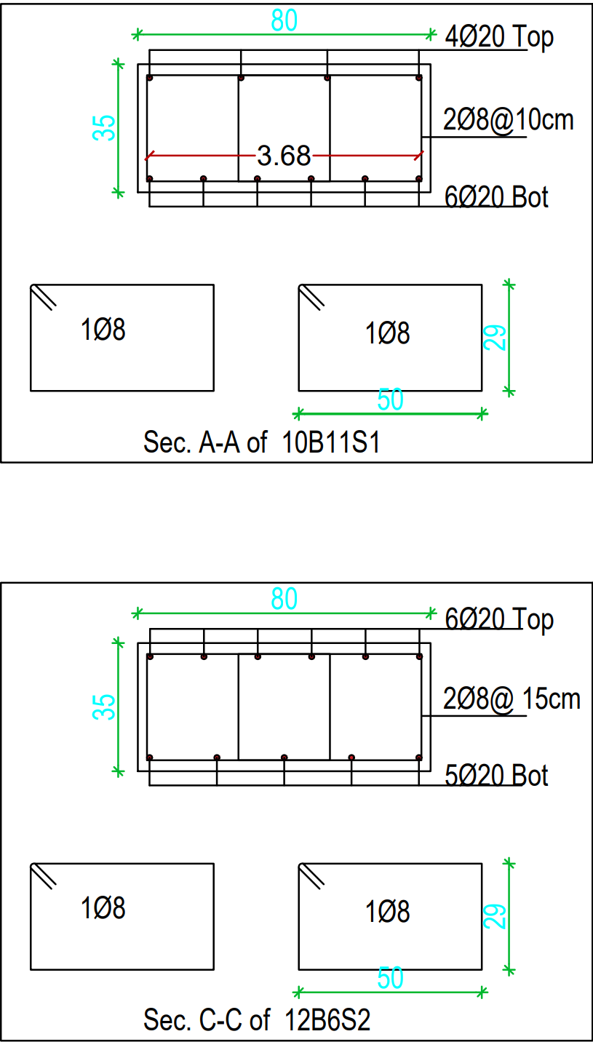
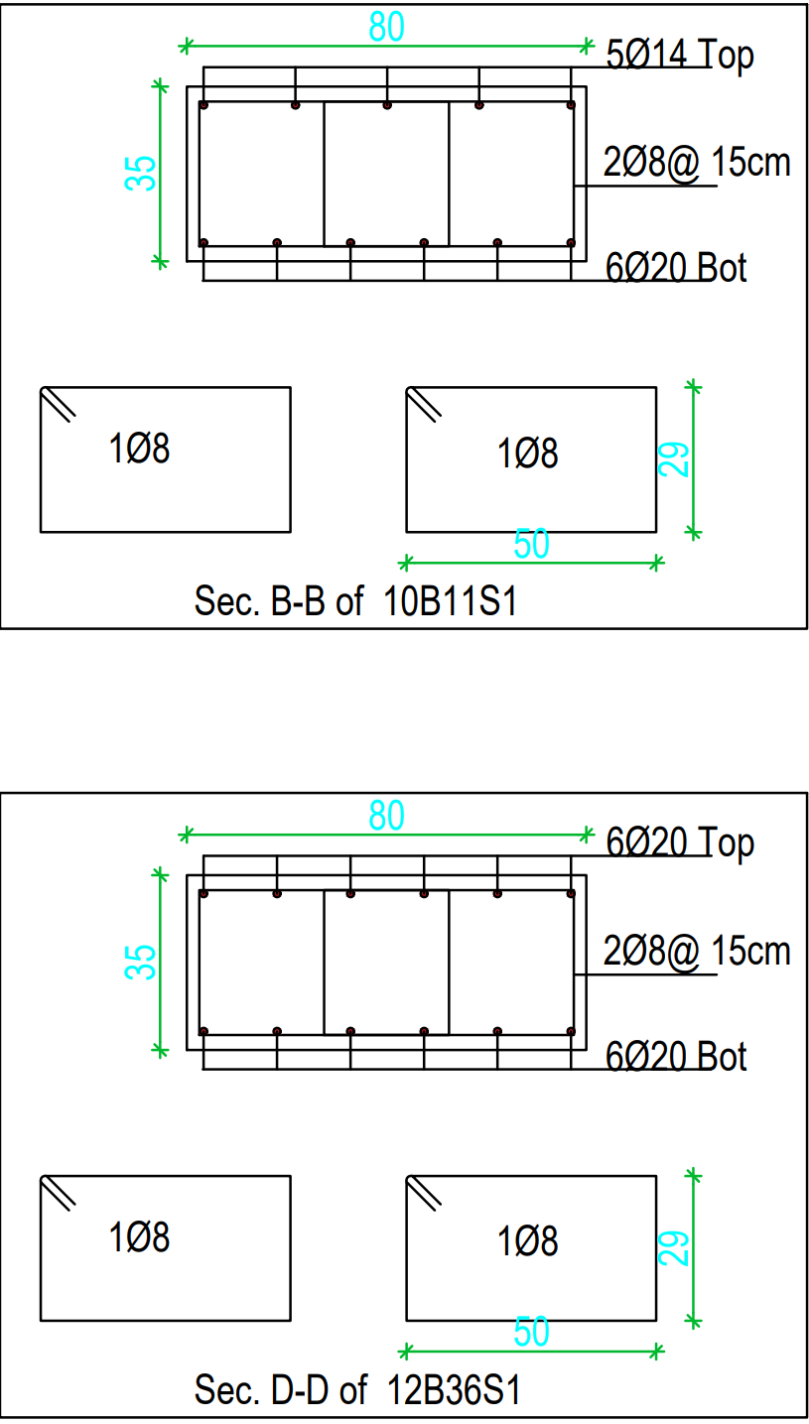
Structural Detailing
Beam details:

Slide 45
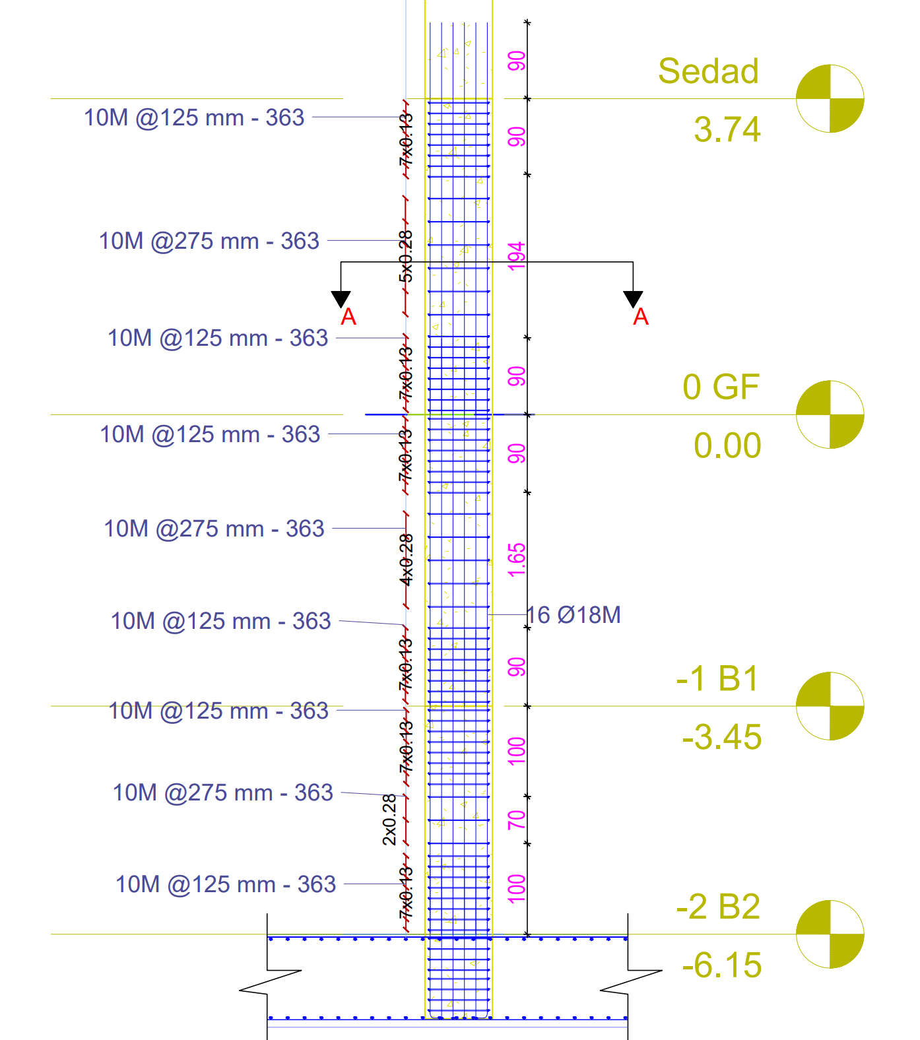

Structural Detailing
Column details:

Slide 46




Structural Detailing
Shear walls Details:

Slide 47


Structural Detailing
Basement wall details :

Slide 48

Structural Detailing
Stair details :

Slide 49


Structural Detailing
Ramp details :

Slide 50
04
Electro-Mechanical Aspect
Acoustical design.
Artificial lighting.
HVAC Design.
Water supply and drainage system.

Slide 51



Acoustical design
Acoustical Insulation:
Composite transmission class

Slide 52

Acoustical design
Acoustical Insulation:

Slide 53


Acoustical design
Stores acoustical design
RT 60 (sec) | SPL (dB) | STI | Alcons | NC (dB) | S/N
1.1 - 1.7 | 55 | > 0.6 | < 10% | 40 | > 30 dB

Slide 54



Acoustical design
Loudspeaker design:

Slide 55

Artificial Lighting
Basic Information:
DIALUX EVO software was used in the designing process.
IESNA was used as standard in designing process.
The designing method used was (AAA): Architectural Activity and Atmosphere.

Slide 56


Artificial Lighting

Slide 57


HVAC Design

Slide 58

HVAC Design

Slide 59

Power design
Total Power (KW) | Generator Power (KW)
663.3 | 700

Slide 60

Drainage System
Number | Type of pip | Diameter (inch) | slope %
1 | Gary water Branches | 2 | 2%
2 | Black water Branches | 4 | 1%
3 | Sewer | 4 | 2%
4 | Stack | 4 | Vertical
5 | vent | 4 | Vertical
6 | Horizontal suspended sewers | 4 | 1%
7 | Drain | 6 | 1%
8 | Manholes | 8 | 1%

Slide 61

Drainage System

Slide 62



Water supply system

Slide 63

Vertical transportation
After Calculations it was found that
2 Elevators were needed in the building
With speed of 2500Ib, 350 fpm
(1100 Kg, 105 m/min)
With capacity 13 person

Slide 64




Fire fighting system
Fire prevention elements
Heat Detector
Flame Detector
Fire Suppression elements
Sprinkler
Fire Extinguisher
Fire Hose

Slide 65
05
Cost Estimation
Cost Estimation of the commercial building has been conducted based on the Bottom-up estimating method.

Slide 66
Cost Estimation
The Total Cost | Unit Cost
17,896,267 NIS | 1876 NIS/SM
The total cost for the project around 17.9 million NIS

Slide 67
Thank you
Any questions?

