Slide 1


Housewares
Housewares
A Web/Mobile Application to Management Housewares Stores
by: Essa Abbadi
& Ahmad Qorom
Supervisor:
Eng.Haya Samaana

Slide 2
CONTENTS
01
Problem Statement
02
Objectives and Scope
03
Architecture & Technologies
04
Results and Future Work

Slide 3

01
Problem Statement

Slide 4

Housewares
Problem Statement
Every Housewares Store Faces 2 Main Problems:
Custemer Reach
Reputation

Slide 5

Housewares
Problem Statement
Customers also gets 2 Main Advanages:
Having Products in one place
Choosing the best product

Slide 6
02
Objectives & Scope

Slide 7
Housewares
Objectives & Scope
The goal of this application is to build competitive environment that provide values to both Customers and Stores. Using Different Features like:
Different Variations of Product
Chat and Notification
Filtering and Statistics

Slide 8
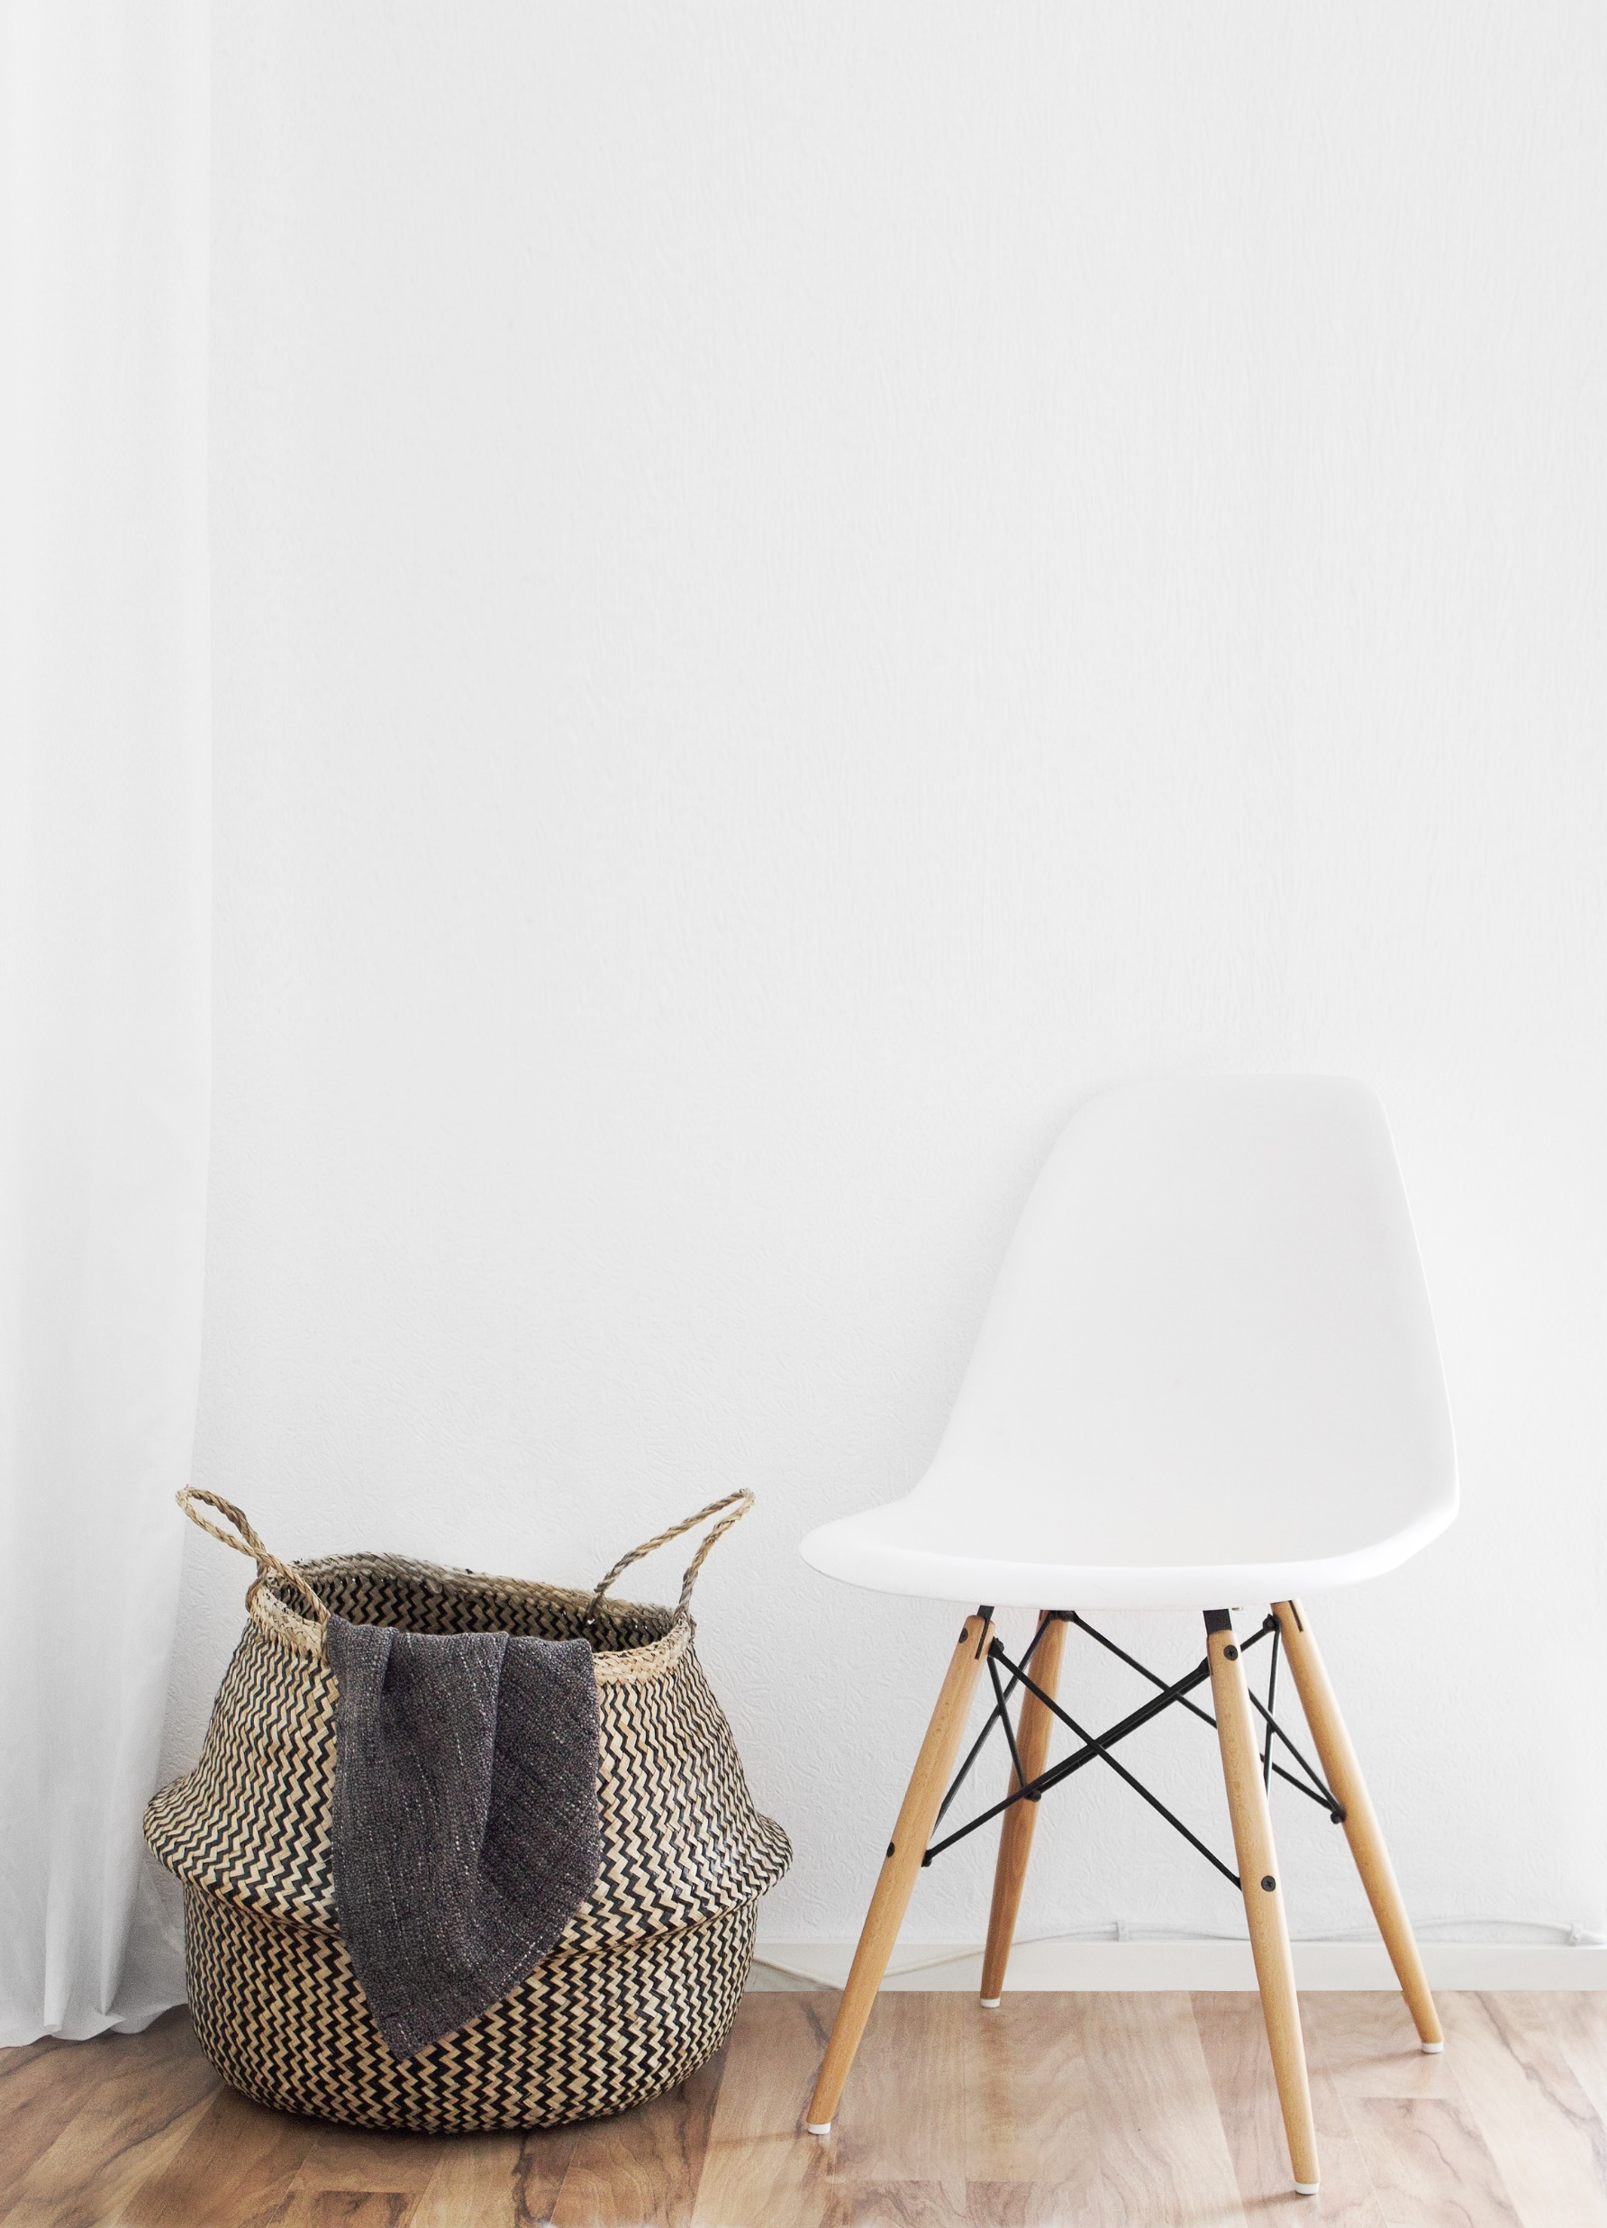
Housewares
Other applications
There are other applications that are:
One Store applications
Other fields applications

Slide 9
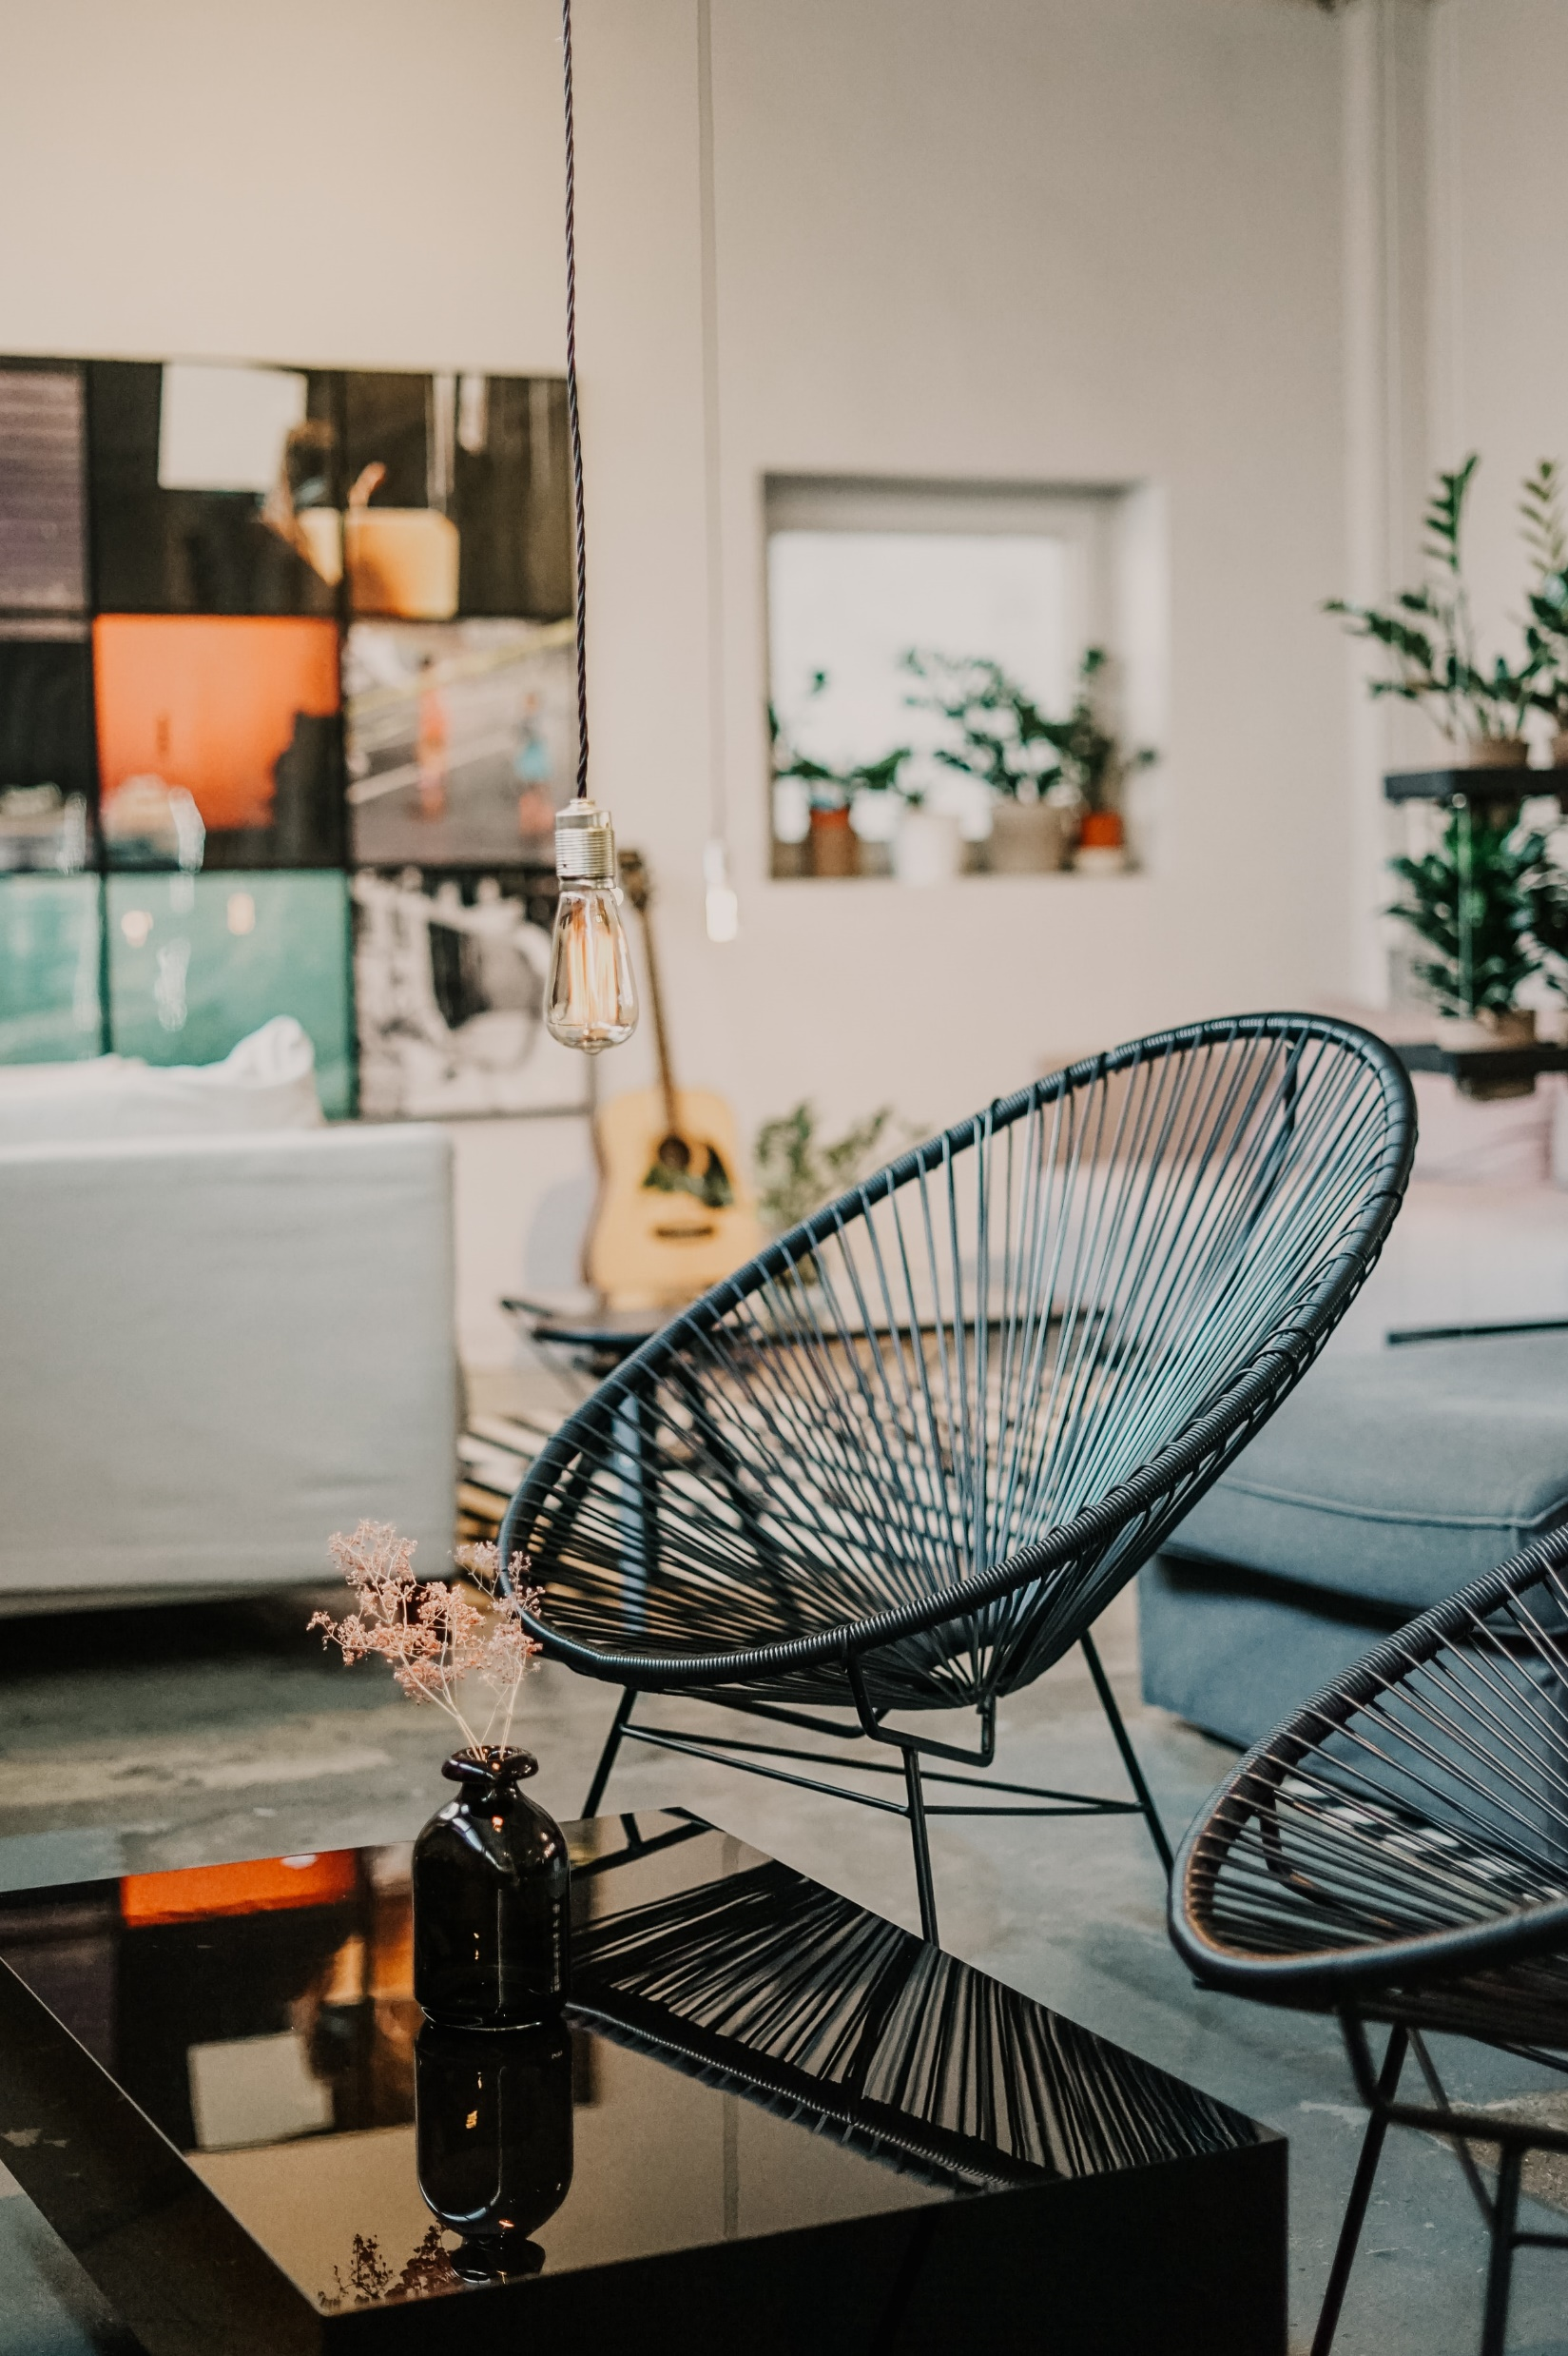
Housewares
How is Housewares Better?
It focus on Housewares field.
Provide Charts and Ratings of Stores.
Focus on the most important features.

Slide 10
03
Architecture & Technologies

Slide 11
Housewares
Architecture & Technologies
ReactJS
ExpressJS
MongoDB
Firebase

Slide 12
04
Results & Future Work

Slide 13
Housewares
Results
This application will:
Management the different Housewares Stores in it.
Make a competitive environment between different Housewares Stores.
Allow Customers to get the best value for price products.

Slide 14
Housewares
Future Work
There are some aspects that Housewares could be improved in. that includes:
Make the competition more active.
Allow Stores to make discounts on products at certain times automatically.
Adding a reporting system to report extra information to the Housewares Stores.

Slide 15
Housewares
THANK YOU

