Slide 1
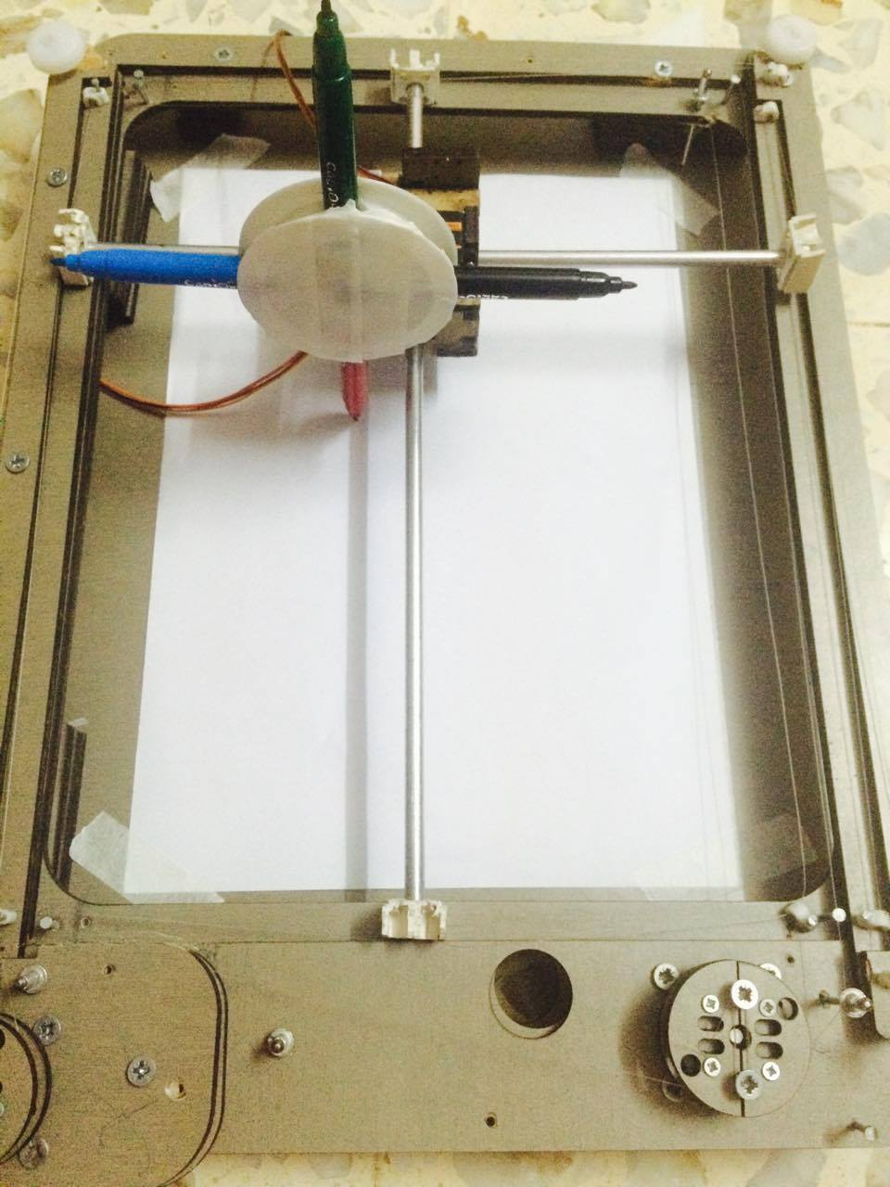
RoboPaint
Rabab Saleh
Shayma Abu Zahra

Slide 2
Outline
What is RoboPaint?
Tools used in our project
Main parts of the project
How RoboPaint work?
Demo

Slide 3
Definition
  RoboPaint is a CNC machine that uses four different colors to print a drawing that follows along as user sketch in real time using tablet.

Slide 4


Tools used in RoboPaint
Languages
      Android
      Arduino
Tools
      Arduino C
      Android Studio

Slide 5
Parts of RoboPaint
Our project consists of two parts:
The hardware part
The software part

Slide 6
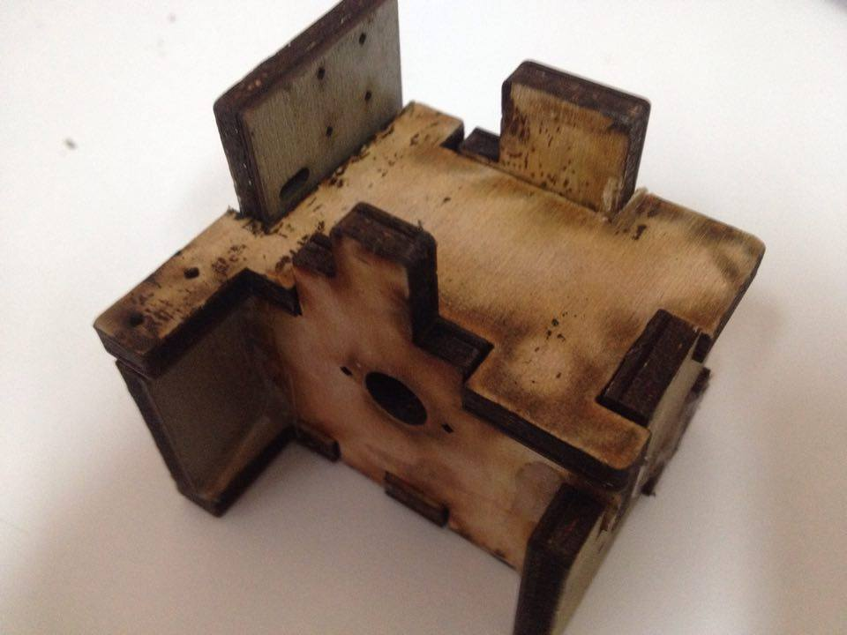
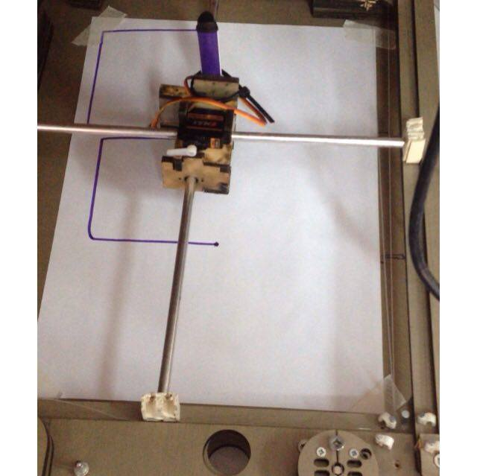
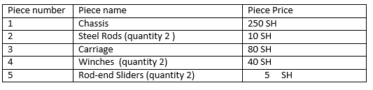
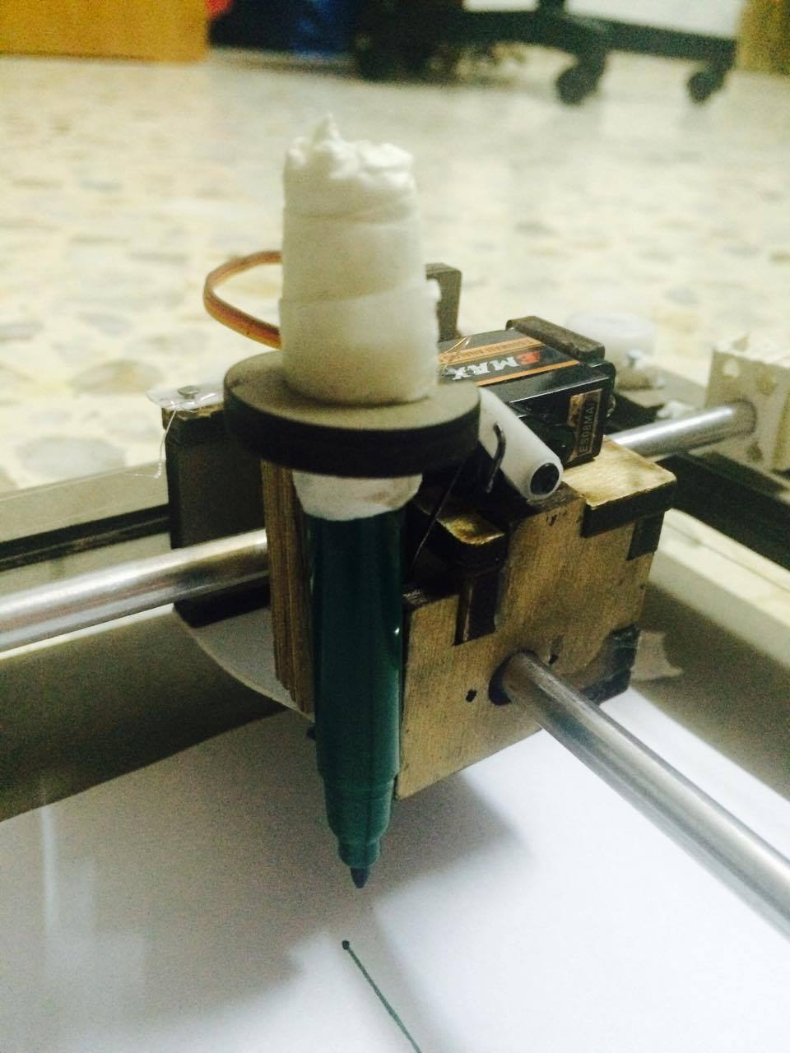
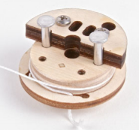
The hardware part
The RoboPaint Kit

Slide 7
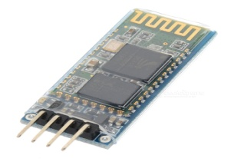
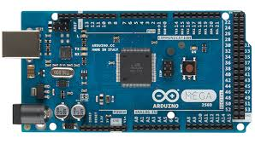
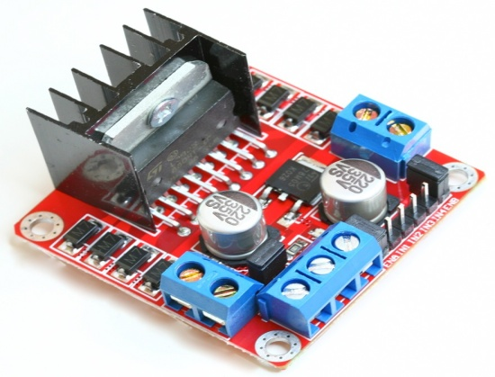
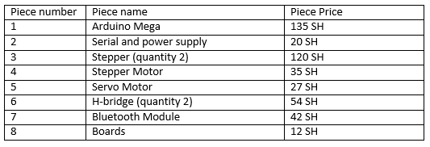
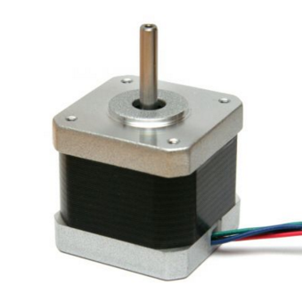
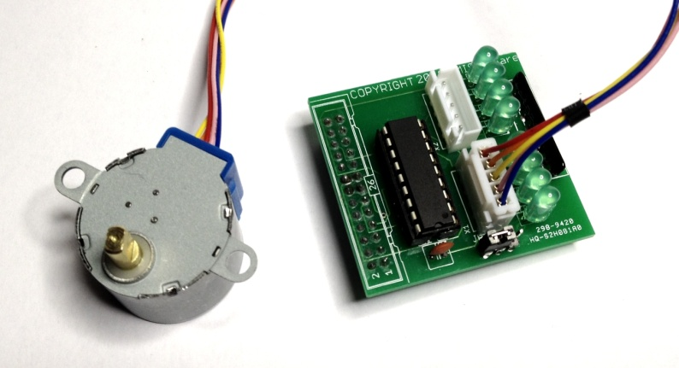
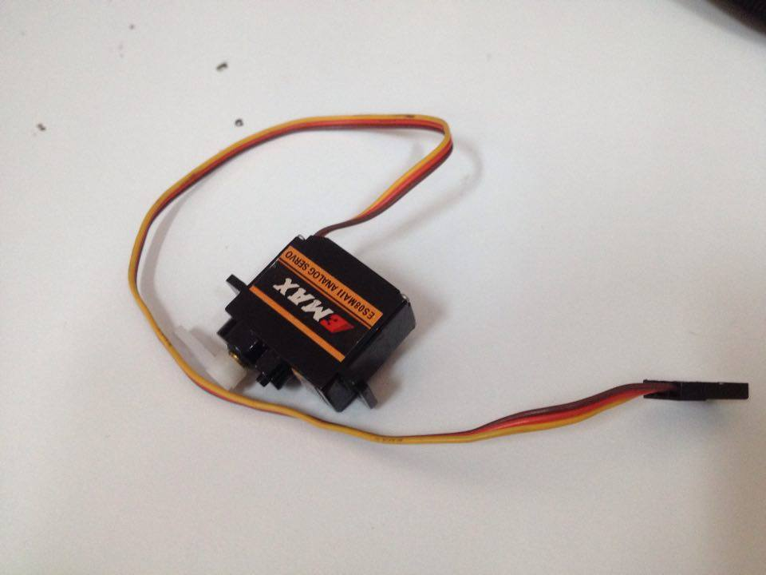
The hardware part
The Arduino/Electronics part

Slide 8

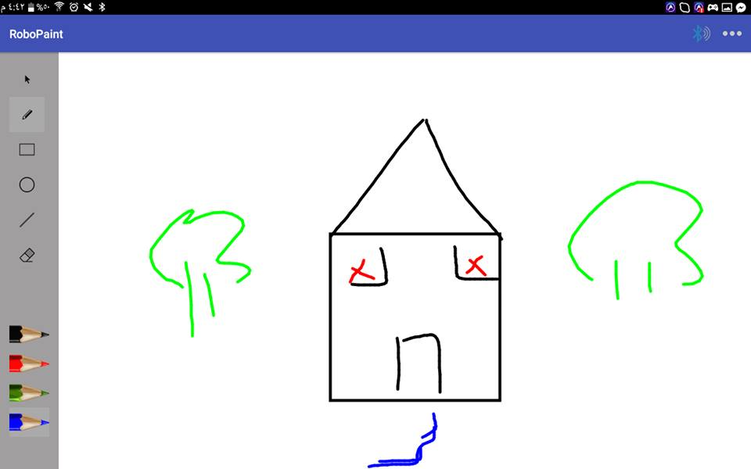
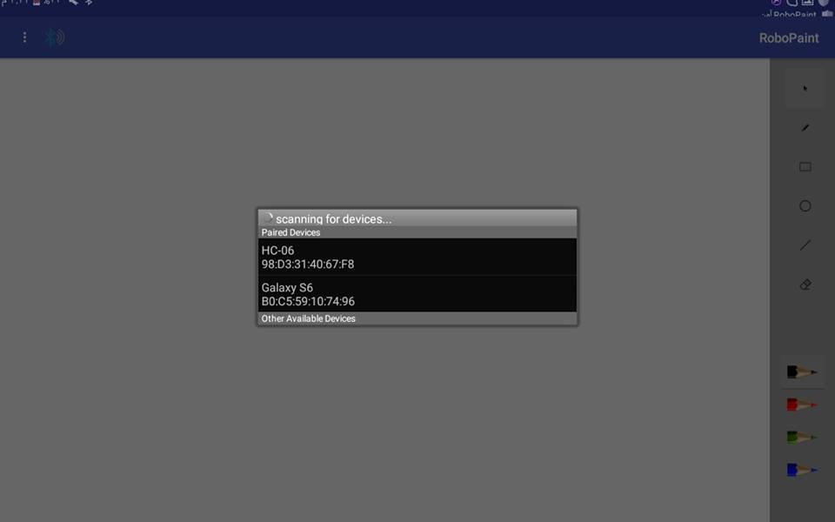
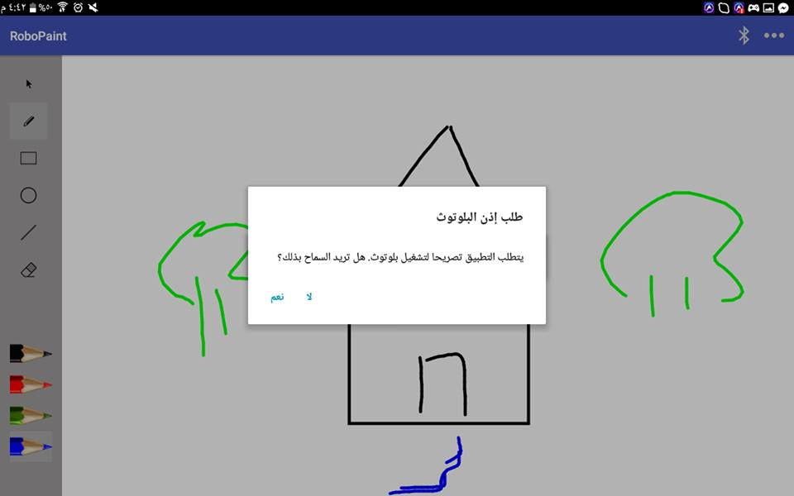
The software part
RoboPaint Software, is an android application that is similar to any painting application

Slide 9
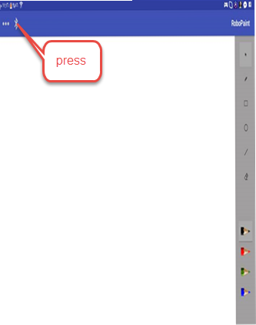
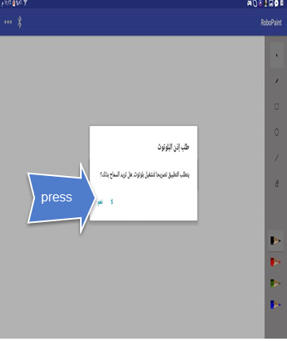
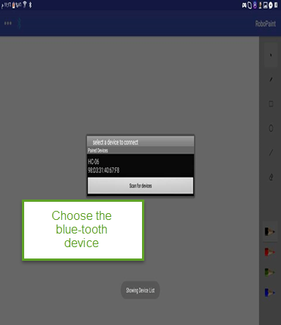
How RoboPaint work
Connect to the Bluetooth

Slide 10
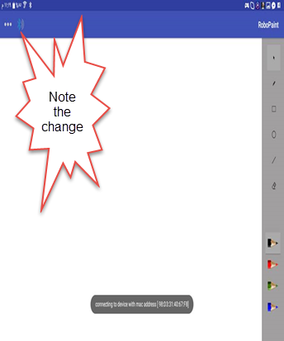
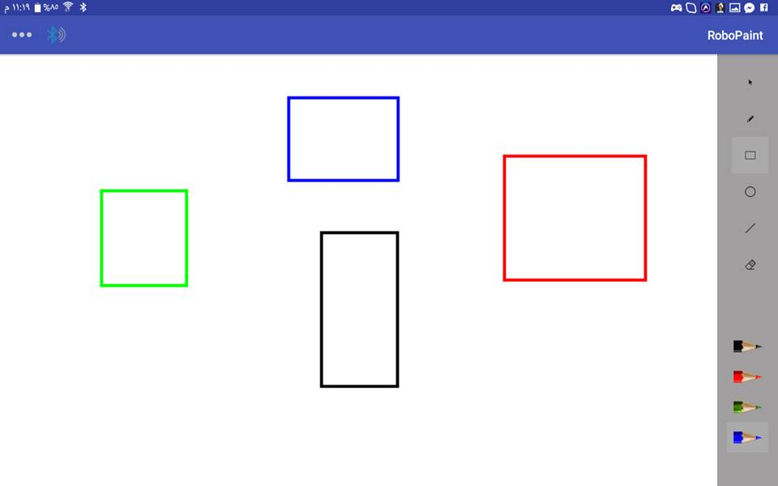
How RoboPaint work

Slide 11
How RoboPaint work
Send the image

Slide 12
How RoboPaint work
RoboPaint draw the image

Slide 13
How RoboPaint work

Slide 14
How RoboPaint work
The Demo

Slide 15


