Slide 1
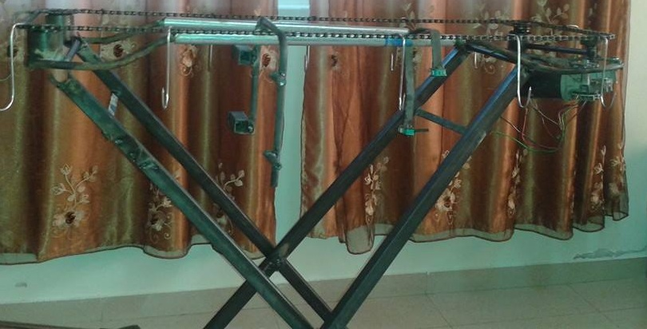
AZIZA POULTRY COUNTER
Prepared By :
Nahid Assaf
Shrooq Rashid
Nebal Metani
Rana Omair
Motaz Mlitat
SUPERVISOR:
Dr.
Osaid Abdul-Fattah

Slide 2
Outline…
Introduction
Objectives
Mechanical & Electrical components
Control system
Future work
Conclusion

Slide 3
INTRODUCTION
In our project the counter is used to count the hanged pieces on the conveyor.
If hanger or piece is absent ,there is no count.

Slide 4



OBJECTIVES
.
.
count the number of items passes a production line using two different methods
get the reading from two different applications
Increasing the accuracy of counting system

Slide 5
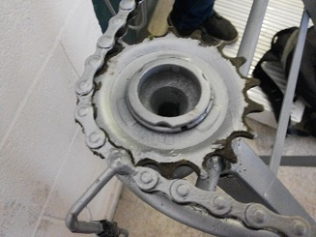
mECHANICAL & eLECTRICAL cOMPONENTS
sprocket gear

Slide 6
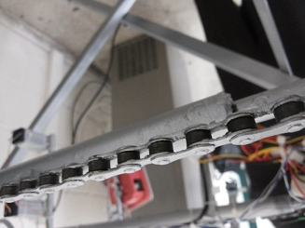
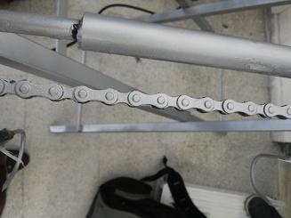
Solid bearing pin chain
suitable for more arduous conveyor applications.

Slide 7
Limit Switch
the limit switch here is the first counter .
A count will be given when there is signal resulted from mechanically contact with a hanger and a hanged piece.

Slide 8

calculating speed of conveyor
.
.
The total length of the chain = 264 cm
The radius of the sprocket = 3.75 cm
The total time for one revolution = 17.8 seconds.
The linear velocity of the chain =V =L/T= 264/17.8=14.831cm/s
The angular velocity of the motor =ω = V/R=14.831/3.75 = 3.9 rad/s.
.

Slide 9
DC Motor
A DC motor is any of a class of electrical machines that converts direct current electrical power into mechanical power

Slide 10
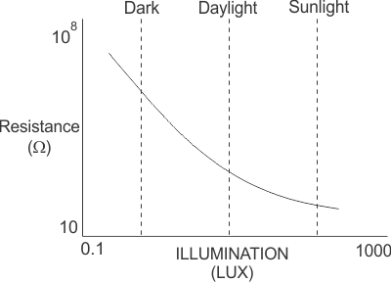
LDRS SENSORS
A Light Dependent Resistor (LDR) or a photo resistor is a device whose resistivity is a function of the incident electromagnetic radiation

Slide 11
Laser pointer
The laser pointer laser beam is used to control the resistance of the sensors .

Slide 12
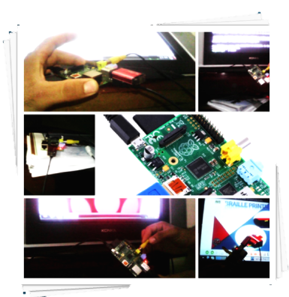
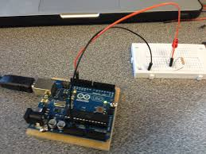

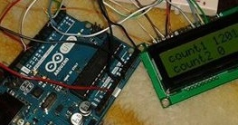
CONTROL SYSTEM

Slide 13

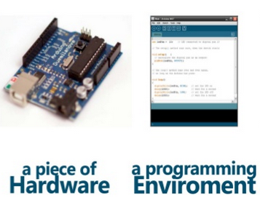
CONTROLLING DEVICES

Slide 14
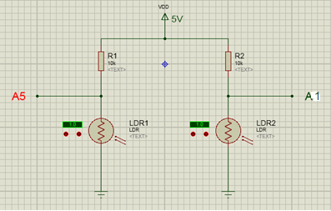
Connection of LDRs to UNO?

Slide 15
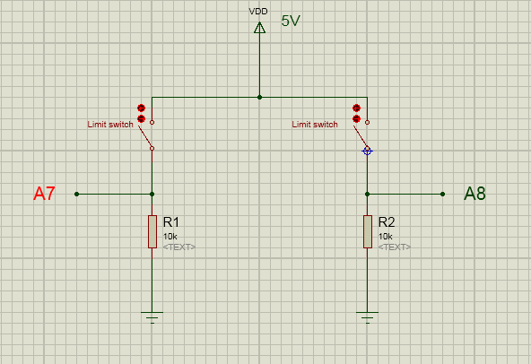
Connection of Limit Switches to UNO?

Slide 16
Why Aurduino UNO?
It is an open-source project, both in terms of hardware and software.
It is flexible, offers a variety of digital and analog inputs.
It is simple and easy to use.
It is more suitable for controlling models.

Slide 17
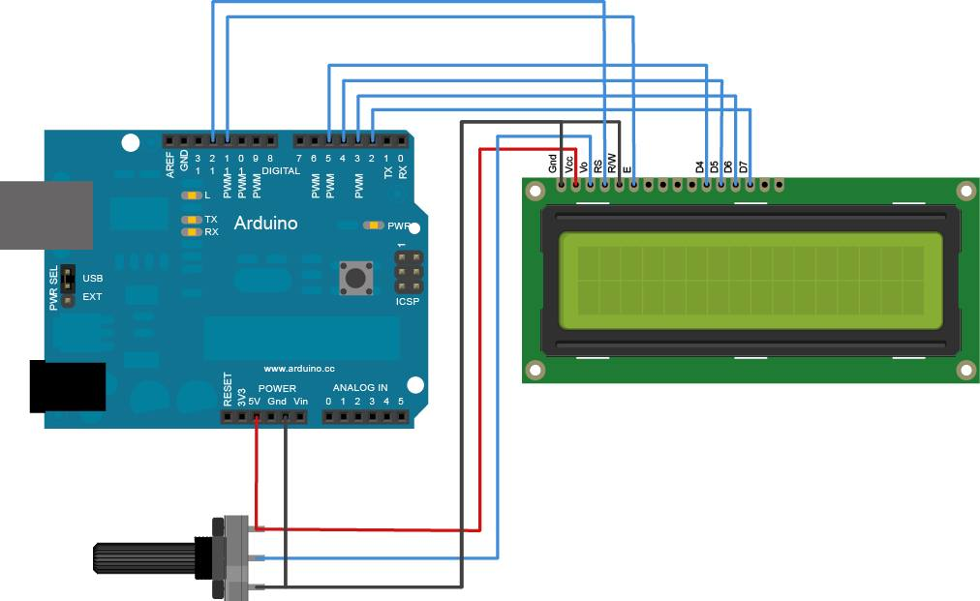
LCD Connection

Slide 18

Future work
Programmable logical controller PLC will be used instead of the aurduino because its more suitable to control industries and production lines.
Ultra sonic sensor will be used instead of LDRs.
It can Resist moisture, water, blood and dirt .

Slide 19
conclusion
use of double counters counting system could make it easy to discover whether there was a mistake in the count.
especially in large production lines because it can be difficult to count the hanged pieces manually.
if one of them is broken down the other will give a value.

Slide 20
THANK YOU
FOR LISTENEING

