Slide 1
Wood Shaving Machine
(WSM)

Slide 2
Students and Supervision
Performed by: Qusay Sayed
Ahmad Hamdan
Hasan Abdul Qader
Motaz Al-Ali
Sameh Hantole
Under Supervision of: Dr. Osayed Abdul Fattah

Slide 3
Outline
Introduction
Objectives
Design and analysis
Discussion
Future work

Slide 4
Introduction
Wood shavings machine is a machine that produce wood shavings which used in animal bedding, it’s important because in our country animal farming is one of the main income source is farming.
For chicken farms as an example, as in statistics done in October, 2010, the area of chicken farms in Palestine reached 1,432,697 m­² , and this is large.
The main source of wood shavings now is from occupied Palestinian territories, and we hope to make integrated plant to get rid of importing.

Slide 5
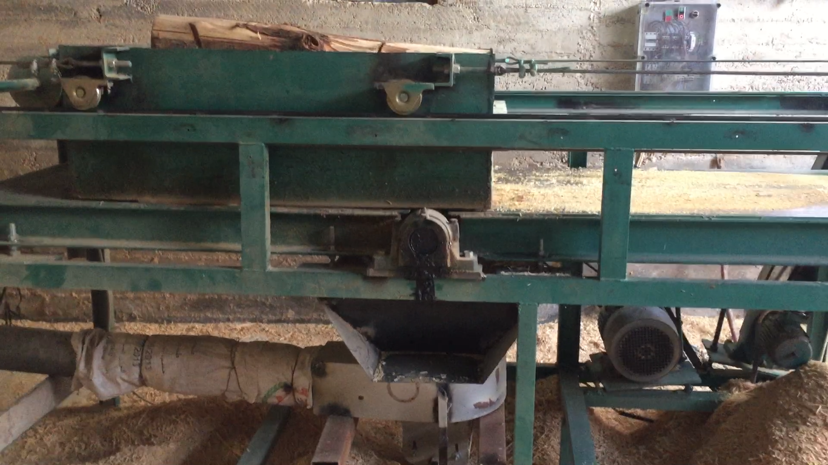
Wood Shaving Machine

Slide 6
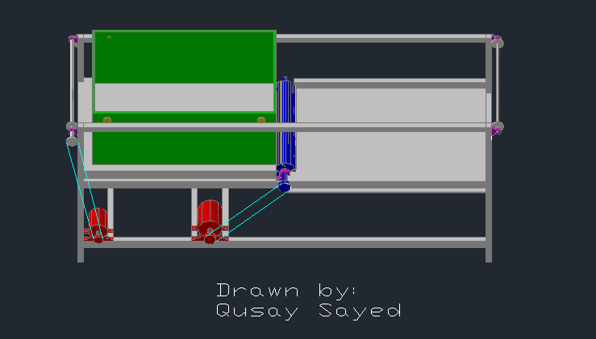
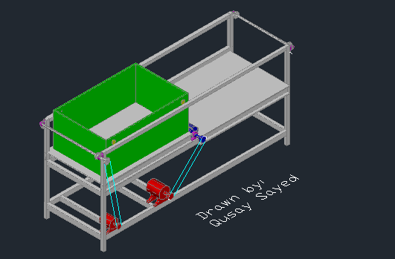
Wood Shaving Machine

Slide 7
Objectives
To produce wood shavings for different purposes such as Agricultural uses.
Encourage national industry instead of importing it from other countries.
From this project we can improve the function of wood-shaving machines in the market and develop them.
produce wood shavings with better quality and less costs, so that saving farmers money.

Slide 8
Design and Analysis
Blades and cutting force.
Power and electrical calculation.
Electrical motor.
Circuit breaker.
Belts design.
Bearings design.
Gear box design.
Controlling.

Slide 9
Blades & Cutting cylinder
Cutting cylinder & blades are the mean & important part in our project, since it use to produce wood shavings.
The blade material is High speed steel & and the number used 4 blades in our project; the blade dimension 80 cm long, 2.2 cm width & 3 mm thickness.
The cutting cylinder is used to fixed the blades, it produced from galvanized steel, dimension of the cylinder: 9 cm diameter & 1.10 m length.

Slide 10
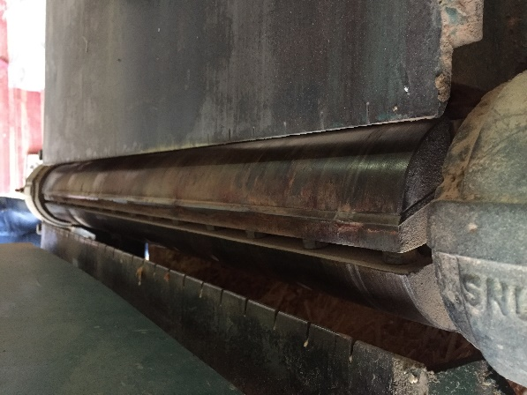
Blades & Cutting cylinder

Slide 11
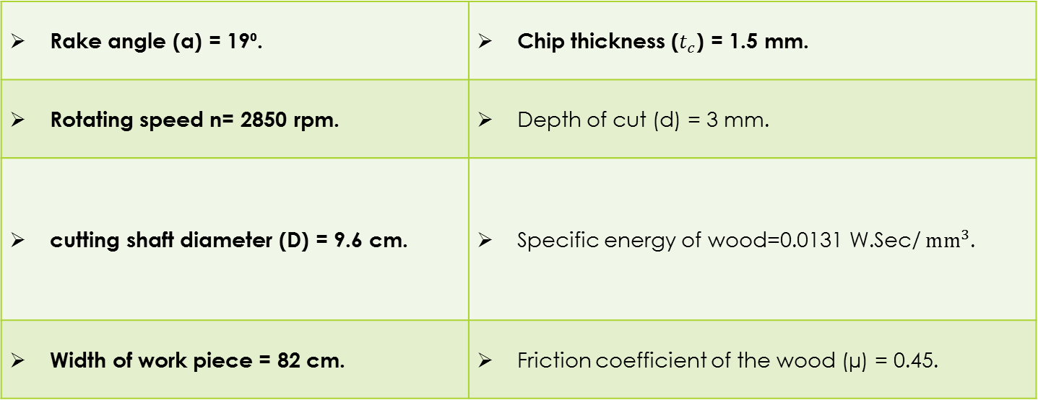
Force Analysis
Rake angle (α) = 19⁰. | Chip thickness ($t_{c}$) = 1.5 mm.
Rotating speed n= 2850 rpm. | Depth of cut (d) = 3 mm.
cutting shaft diameter (D) = 9.6 cm. | Specific energy of wood=0.0131 W.Sec/$mm^{3}$.
Width of work piece = 82 cm. | Friction coefficient of the wood (µ) = 0.45.
:

Slide 12
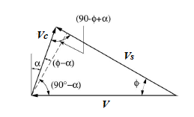
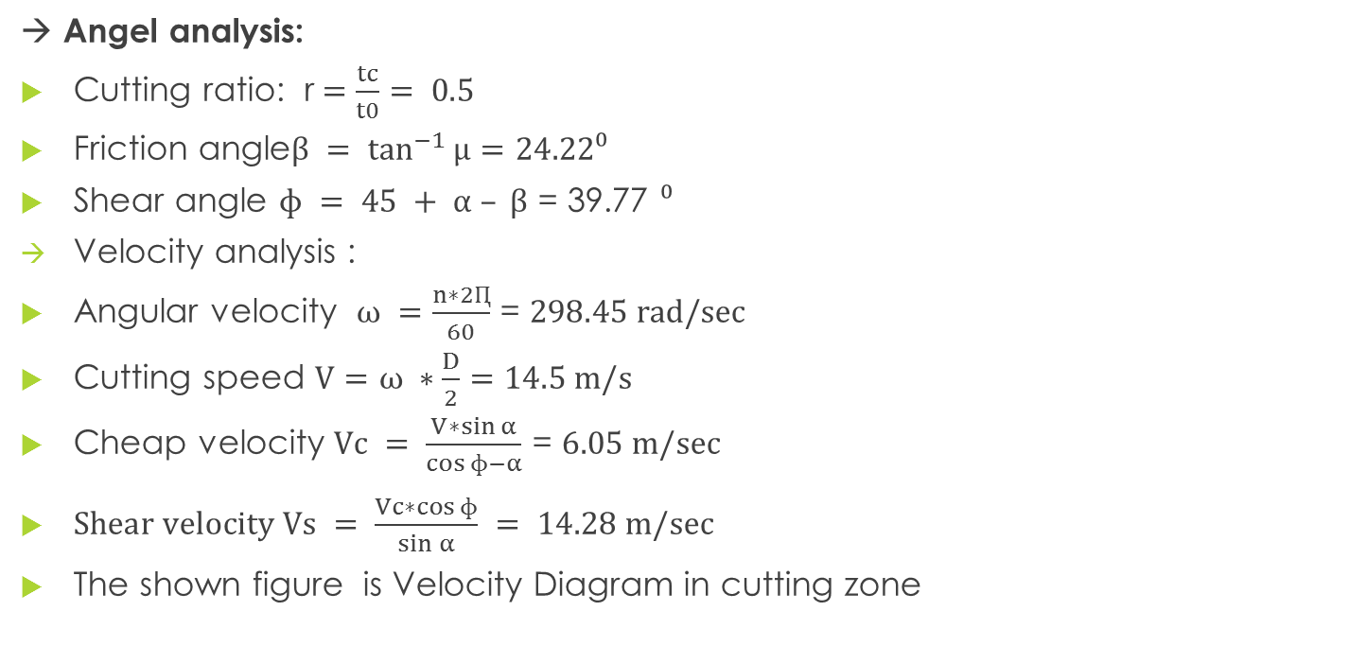
Force Analysis
→ Angel analysis:
Cutting ratio: r$=\frac{tc}{t0}= 0.5$
Friction angle$β = \tan^{−1}{µ}=24.22⁰$
Shear angle $ɸ = 45 + α – β$ = 39.77 $⁰$
Velocity analysis :
Angular velocity $ω =\frac{n∗2Ԥ}{60}$ = $298.45 rad/sec$
Cutting speed $V=ω ∗\frac{D}{2}=14.5 m/s$
Cheap velocity $Vc = \frac{V∗\sin{α}}{\cos{ɸ−α}}$ = $6.05 m/sec$
$Shear velocity Vs = \frac{Vc∗\cos{ɸ}}{\sin{α}} = 14.28 m/sec$
The shown figure is Velocity Diagram in cutting zone

Slide 13
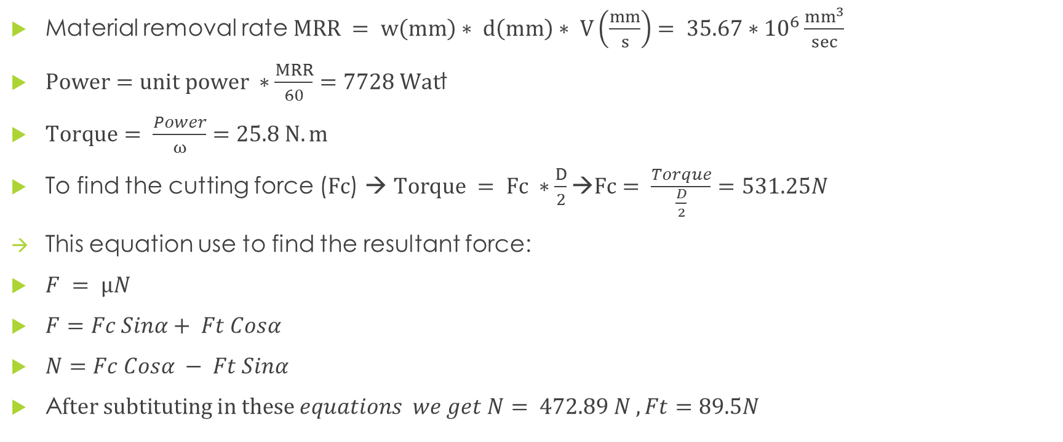
Force Analysis
Material removal rate $MRR = w\left(mm\right)∗ d\left(mm\right)∗ V\left(\frac{mm}{s}\right)= 35.67∗{10}^{6}\frac{mm^{3}}{sec}$
$Power=unit power ∗\frac{MRR}{60}=7728 Wat$t
$Torque= \frac{Power}{ω}=25.8 N.m$
To find the cutting force ($Fc$) → $Torque = Fc ∗\frac{D}{2}→Fc= \frac{Torque}{\frac{D}{2}}=531.25N$
This equation use to find the resultant force:
$F = µN$
$F=Fc Sinα+ Ft Cosα$
$N=Fc Cosα − Ft Sinα$
A$fter subtituting in these equations we get N= 472.89 N , Ft=89.5N$

Slide 14
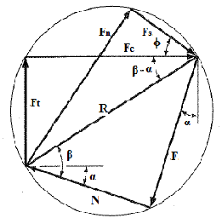
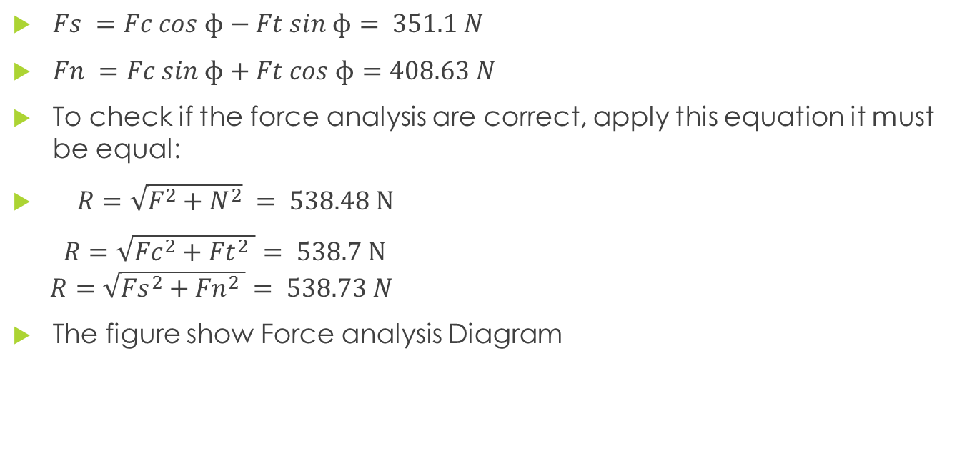
Force Analysis
$Fs =Fc cos ɸ−Ft sin ɸ= 351.1 N$
$Fn =Fc sin ɸ+Ft cos ɸ=408.63 N$
To check if the force analysis are correct, apply this equation it must be equal:
$R=\sqrt{F^{2}+N^{2}} = 538.48 N$
$R=\sqrt{{Fc}^{2}+{Ft}^{2} }= 538.7 N$ $R=\sqrt{{Fs}^{2}+{Fn}^{2} }= 538.73 N$
The figure show Force analysis Diagram

Slide 15
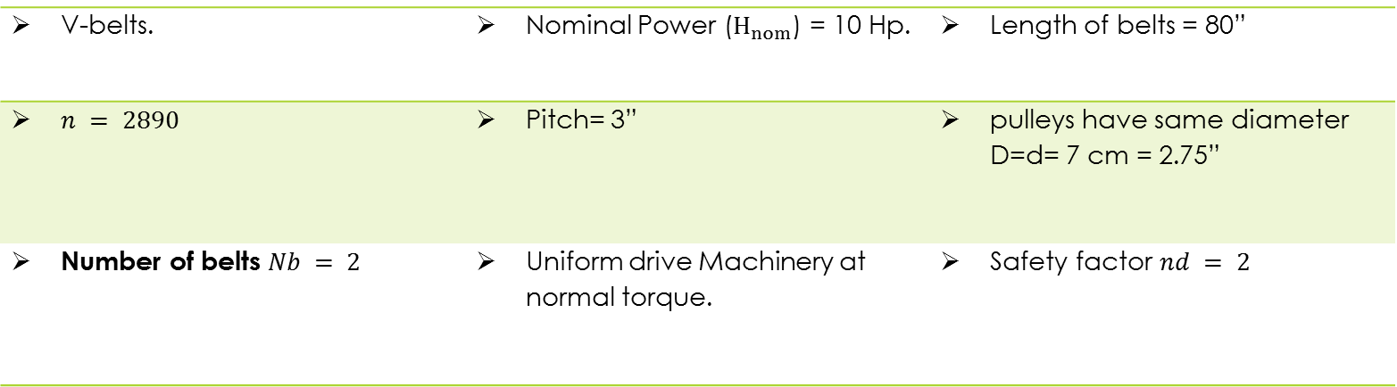
Belts Design
cutting shaft belts
In the machine there is 3 V-Belts, two of them are used to transmit the power to cutting shaft, and the other use to transmit the power to the container.
Some variables should be assumed for cutting shaft belts , which are:
V-belts. | Nominal Power ($H_{nom}$) = 10 Hp. | Length of belts = 80”
$n = 2890$ | Pitch= 3” | pulleys have same diameter D=d= 7 cm = 2.75”
Number of belts $Nb = 2$ | Uniform drive Machinery at normal torque. | Safety factor $nd = 2$

Slide 16
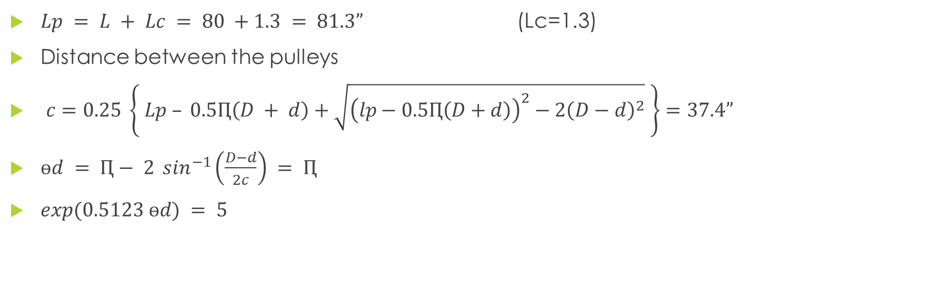
Tension Force analysis for cutting shaft belts
$Lp = L + Lc = 80 +1.3 = 81.3”$ (Lc=1.3)
Distance between the pulleys
$c=0.25 \left\{ Lp – 0.5Ԥ\left(D + d\right)+\sqrt{{\left(lp−0.5Ԥ\left(D+d\right)\right)}^{2}−2{\left(D−d\right)}^{2}} \right\}=37.4”$
$ɵd = Ԥ− 2 \sin^{−1}\left(\frac{D−d}{2c}\right) = Ԥ$
$exp(0.5123 ɵd) = 5$

Slide 17

Tension Force analysis for cutting shaft belts
Velocity:
$V= \frac{Ԥnd}{12} = 1417.64 Ft/min$
Allowable power:
$Ha= K1∗K2∗Htab$ =$1.26 Hp$
$K1= 0.75 , K2=1.05,Htab = 0.8$
Design power:
$Hd = nd∗Ks∗Hnom= 20 Hp$, $Ks = 1$

Slide 18
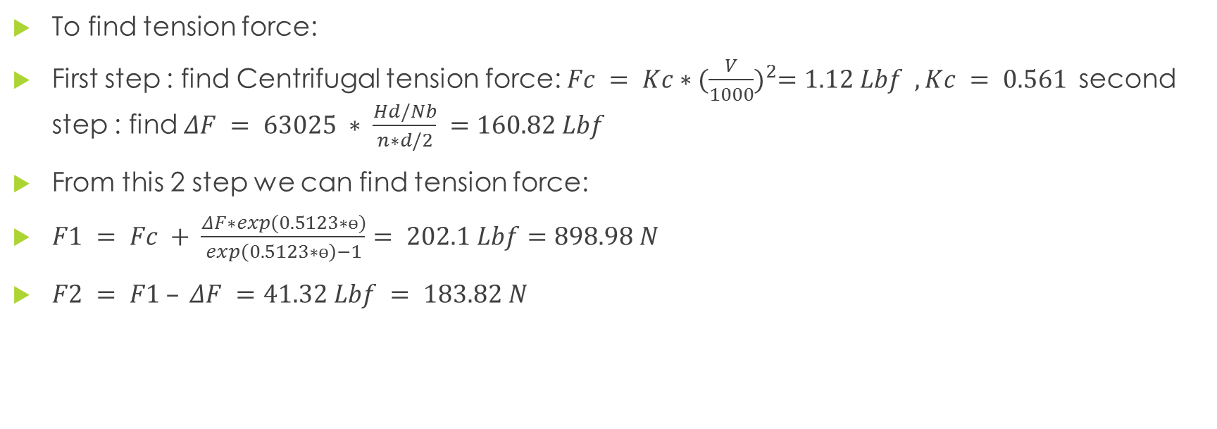
Tension Force analysis for cutting shaft belts
To find tension force:
First step : find Centrifugal tension force: $Fc = Kc∗{(\frac{V}{1000})}^{2}=1.12 Lbf , Kc = 0.561$second step : find $ΔF = 63025 ∗ \frac{Hd/Nb}{n∗d/2} =160.82 Lbf$
From this 2 step we can find tension force:
$F1 = Fc + \frac{ΔF∗exp(0.5123∗ɵ)}{exp\left(0.5123∗ɵ\right)−1}= 202.1 Lbf=898.98 N$
$F2 = F1 – ΔF =41.32 Lbf = 183.82 N$

Slide 19
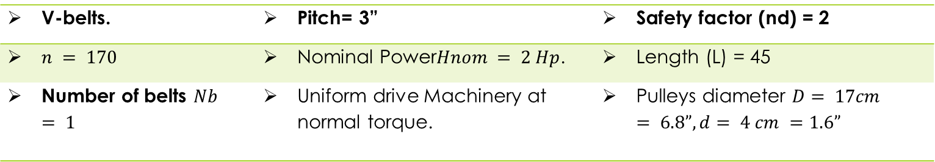
Belt design
container belt
Some variables should be assumed for container belt, which are:
V-belts. | Pitch= 3” | Safety factor (nd) = 2
$n = 170$ | Nominal Power$Hnom = 2 Hp$. | Length (L) = 45
Number of belts $Nb = 1$ | Uniform drive Machinery at normal torque. | Pulleys diameter $D= 17cm = 6.8”, d= 4 cm =1.6”$

Slide 20

Tension Force analysis for Container belt
By the same way:
$Lp = 46.3”$
$c=18.88” =48cm$
$ɵd=2.86 rad$
$exp(0.5123 ɵd) = 4.32$
Velocity: $V = 341 Ft/min$
Allowable power: $Ha =$0.46 Hp

Slide 21
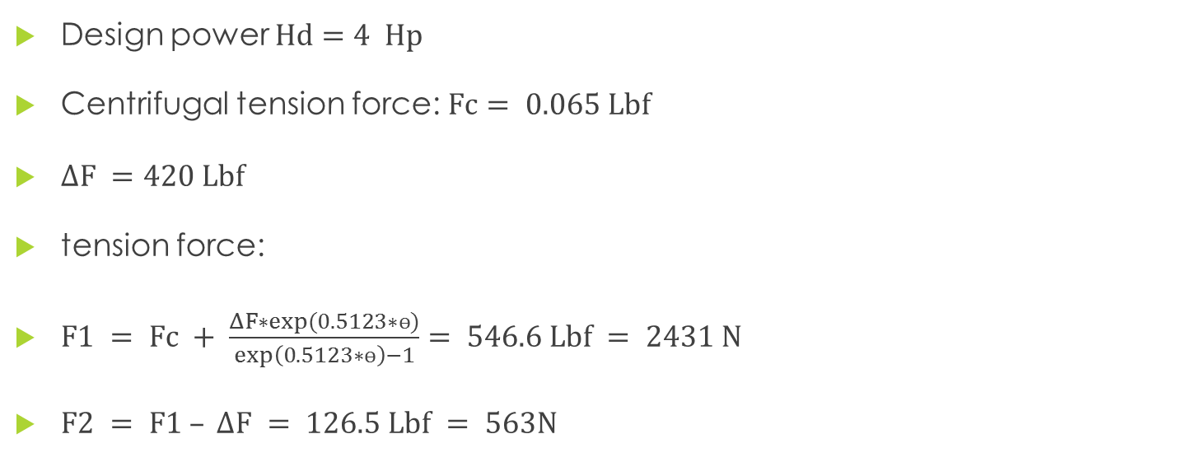
Tension Force analysis for Container belt
Design power $Hd=4 Hp$
Centrifugal tension force: $Fc= 0.065 Lbf$
$ΔF =420 Lbf$
tension force:
$F1 = Fc + \frac{ΔF∗exp(0.5123∗ɵ)}{exp\left(0.5123∗ɵ\right)−1}= 546.6 Lbf = 2431 N$
$F2 = F1 – ΔF = 126.5 Lbf = 563N$

Slide 22
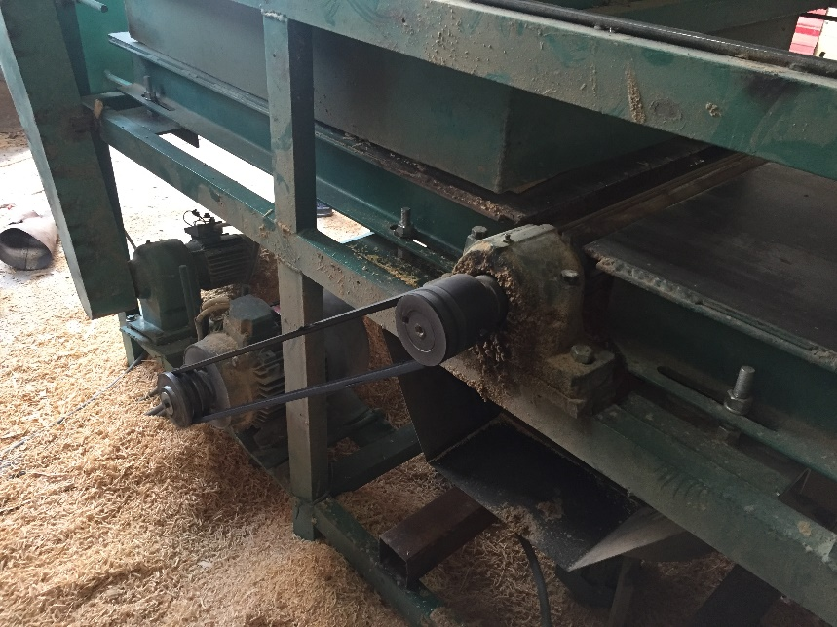
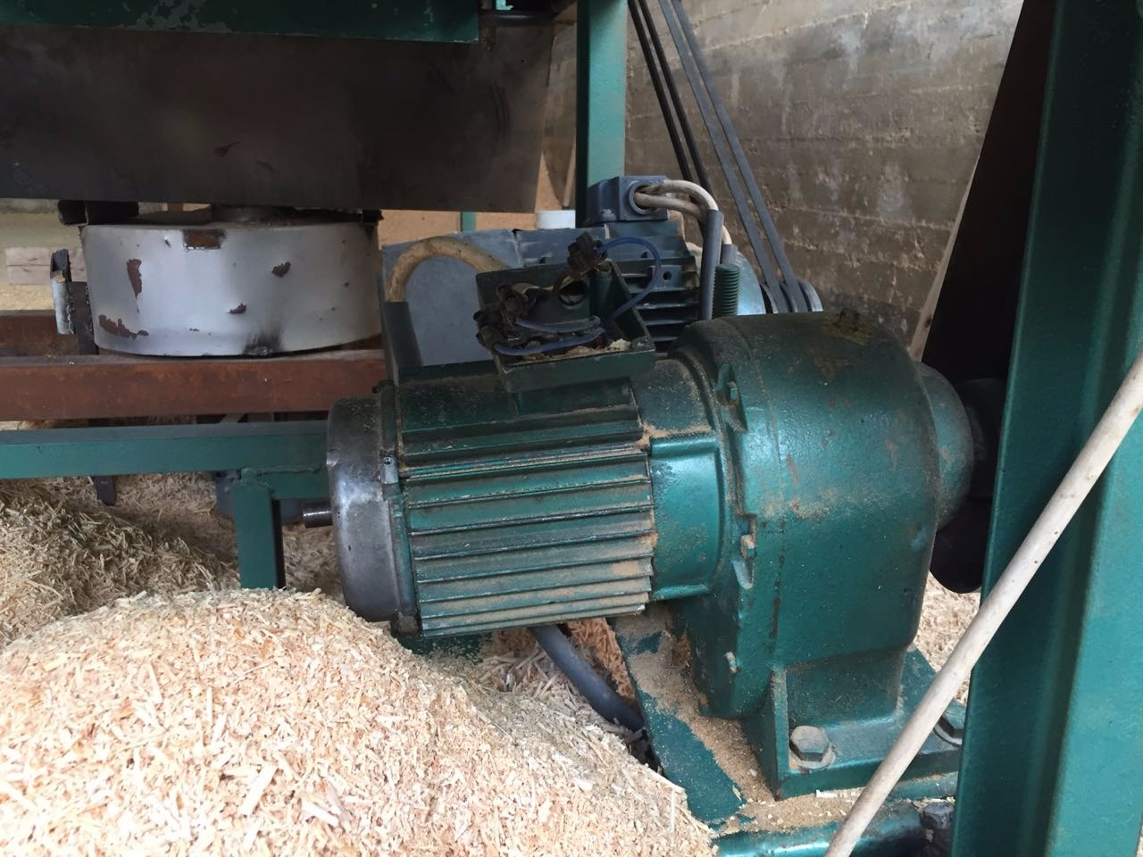
Motor :
In our project; we use two synchronous motor, the aim of use this type since is run at the same speed when the load is change.
the first motor used to rotate the cutting shaft.
Second motor used to move the container.

Slide 23
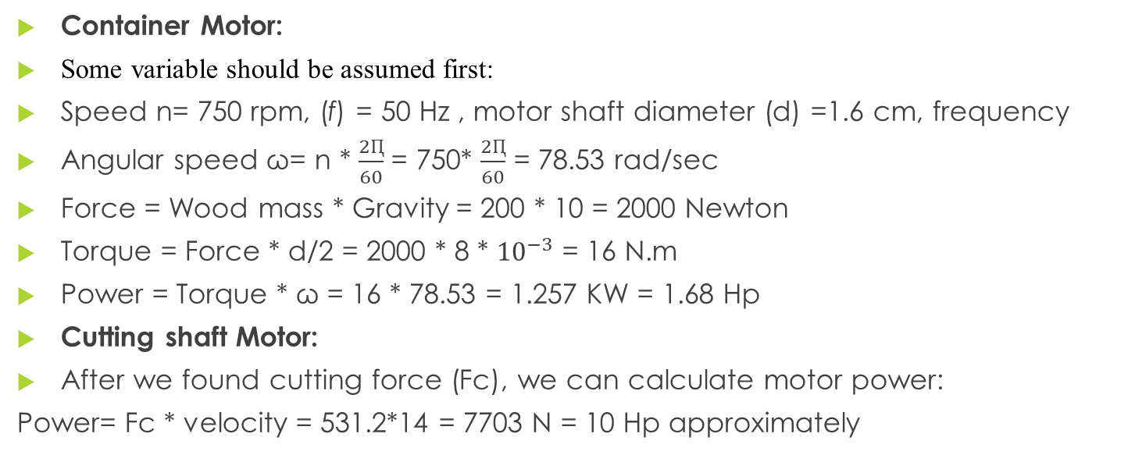
Electrical Motors calculation
Container Motor:
Some variable should be assumed first:
Speed n= 750 rpm, (f) = 50 Hz , motor shaft diameter (d) =1.6 cm, frequency
Angular speed ω= n * $\frac{2Ԥ}{60}$ = 750* $\frac{2Ԥ}{60}$ = 78.53 rad/sec
Force = Wood mass * Gravity = 200 * 10 = 2000 Newton
Torque = Force * d/2 = 2000 * 8 * ${10}^{−3}$ = 16 N.m
Power = Torque * ω = 16 * 78.53 = 1.257 KW = 1.68 Hp
Cutting shaft Motor:
After we found cutting force (Fc), we can calculate motor power:
Power= Fc * velocity = 531.2*14 = 7703 N = 10 Hp approximately

Slide 24
Selected motor
We use eff2 company catalog to select appropriate motor
The selected container motor is M112 M8 with 2 Hp and rotational speed 690 Rpm.
The selected cutting shaft motor is MA 132 SX 2 with 10 Hp and rotational speed 3000 Rpm.

Slide 25
Circuit Breaker
Breaker:
In our machine we will use three circuit breakers:
Main breaker connected with all electrical circuit.
Two secondary breaker connected with container motor.
And another secondary breaker connected with cutting shaft motor

Slide 26
Circuit Breaker
From the last calculation we found that : ${P_{r}}_{1}$=7700 watt, ${P_{r}}_{2}$ =1500 watt
line current : Ir1= $\frac{Pr1}{\sqrt{3}∗\left(Vl\right)∗(p.f)}$ =2.68A , Ir2= $\frac{Pr2}{\sqrt{3}∗\left(Vl\right)∗(p.f)}$ =13.76A
Total current: $I_{rated}$=Ir1+Ir2= 16.4A
max current for circuit breaker of container motor: Ic.B1=1.25*Ir1=1.25*2.68=3.35A
max current for circuit breaker of rotating motor : Ic.B2=1.25*Ir2= 17.2A
max current for main circuit breaker: Ic.B=1.25*$I_{rated}$= 20.5A
Where : p.f: power factor , VI: drop voltage

Slide 27
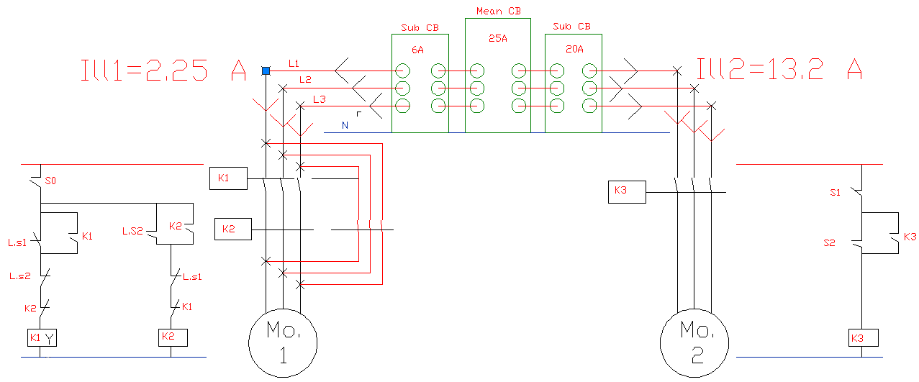
Electrical circuit diagram

Slide 28
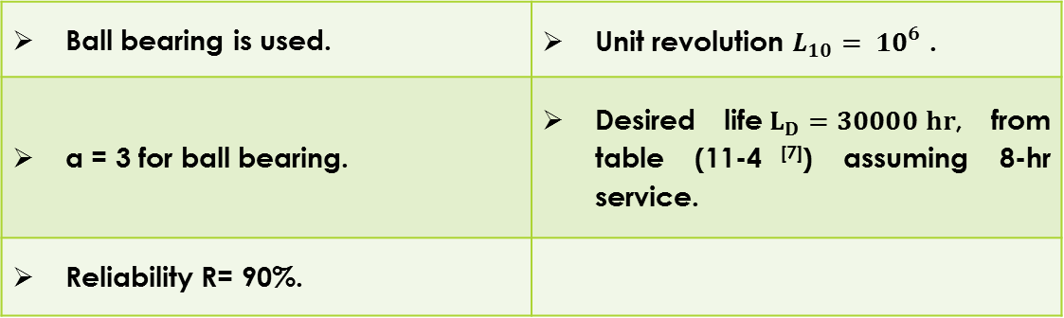
Bearings design
In the machine there is 6 bearings, two of them holding the cutting shaft and the other holding the shaft carrying wire rope pulleys’.
the two bearings are assumed to be identical, the design will done on the bearing which exhibits the largest force.
First, some variables should be assumed, which are:
Ball bearing is used. | Unit revolution $L_{10}= {10}^{6}$ .
a = 3 for ball bearing. | Desired life$L_{D}=30000 hr$, from table (11-4 ^{[7]}) assuming 8-hr service.
Reliability R= 90%.

Slide 29
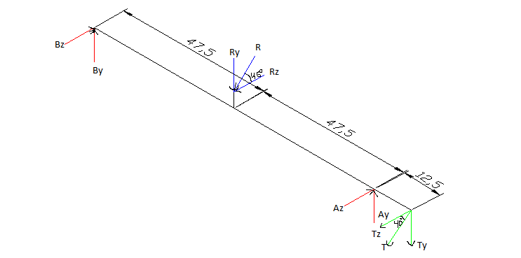
Bearings design
Force analysis
Free body diagram for cutting shaft bearings.

Slide 30
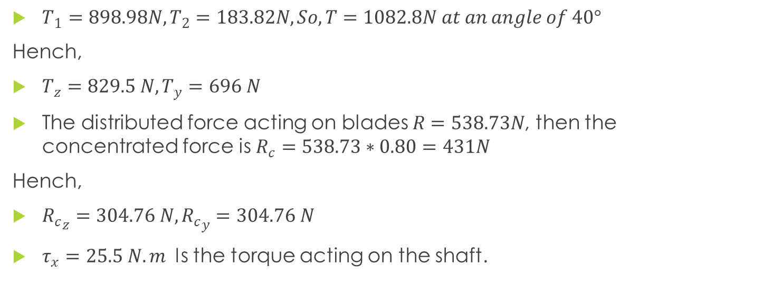
Bearings design
Force analysis
$T_{1}=898.98N, T_{2}=183.82N, So, T=1082.8N at an angle of 40°$
Hench,
$T_{z}=829.5 N, T_{y}=696 N$
The distributed force acting on blades $R=538.73N$, then the concentrated force is $R_{c}=538.73∗0.80=431N$
Hench,
${R_{c}}_{z}=304.76 N, {R_{c}}_{y}=304.76 N$
$τ_{x}=25.5 N.m$ Is the torque acting on the shaft.

Slide 31
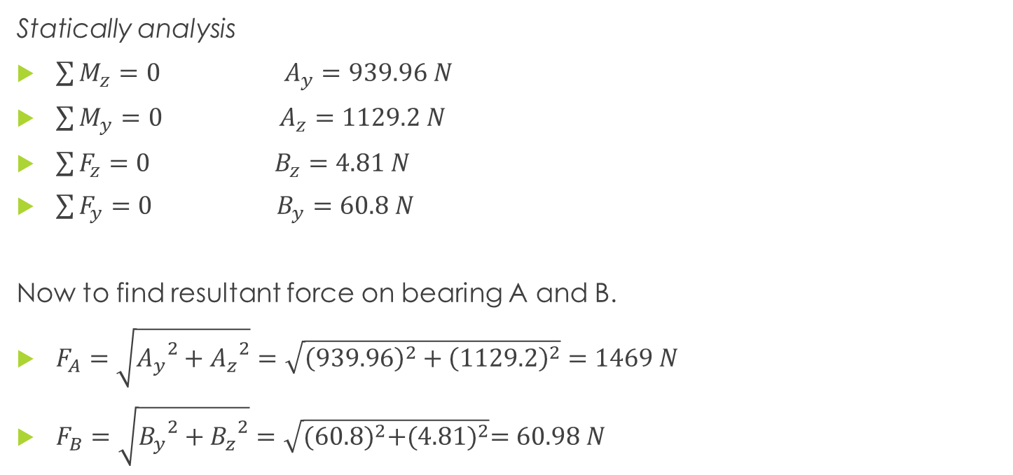
Bearings design
Force analysis
Statically analysis
$\sum{M_{z}=0}$ $A_{y}=939.96 N$
$\sum{M_{y}=0}$ $A_{z}=1129.2 N$
$\sum{F_{z}=0}$ $B_{z}=4.81 N$
$\sum{F_{y}=0}$ $B_{y}=60.8 N$
Now to find resultant force on bearing A and B.
$F_{A}=\sqrt{{A_{y}}^{2}+{A_{z}}^{2}}=\sqrt{{\left(939.96\right)}^{2}+{\left(1129.2\right)}^{2}}=1469 N$
$F_{B}=\sqrt{{B_{y}}^{2}+{B_{z}}^{2}}=\sqrt{{(60.8)}^{2}+{(4.81)}^{2}}=60.98 N$

Slide 32
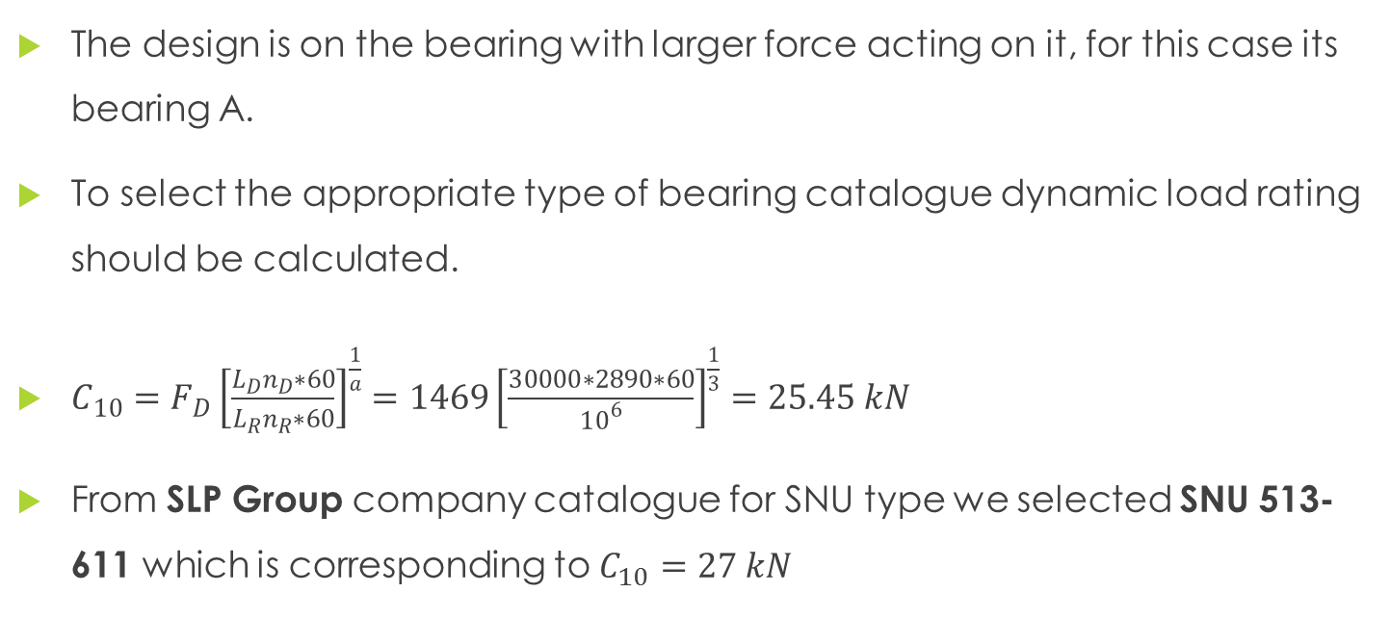
Bearings design
Force analysis
The design is on the bearing with larger force acting on it, for this case its bearing A.
To select the appropriate type of bearing catalogue dynamic load rating should be calculated.
$C_{10}=F_{D}{\left[\frac{L_{D}n_{D}∗60}{L_{R}n_{R}∗60}\right]}^{\frac{1}{a}}=1469{\left[\frac{30000∗2890∗60}{{10}^{6}}\right]}^{\frac{1}{3}}=25.45 kN$
From SLP Group company catalogue for SNU type we selected SNU 513-611 which is corresponding to $C_{10}=27 kN$

Slide 33
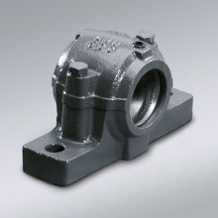
Bearings design
Force analysis
SNU 513-611

Slide 34
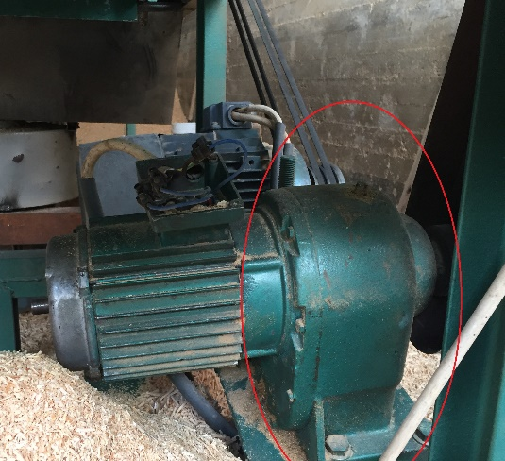
Gear box design

Slide 35
Gear box design
Spur gear what will be used in our project, the need of gear in our project is basically to reduce the speed of the motor that moves the wood container.
Spur gears have tooth in straight & parallel to the axis of the shaft. These gears are also used to transmit the power in gearbox of automobiles. The decision is using the type because it’s inexpensive, easy to manufacture and availability.

Slide 36
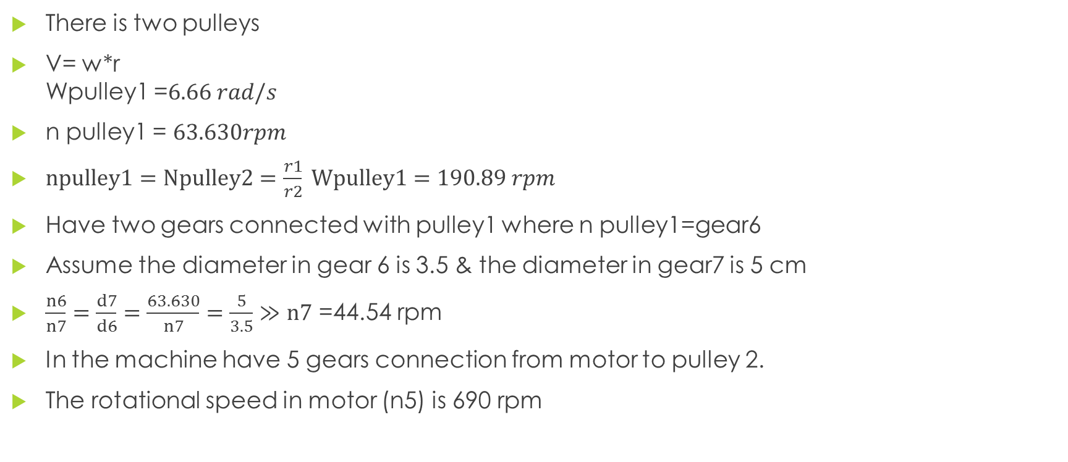
Gear box design
There is two pulleys
V= w*r Wpulley1 =$6.66 rad/s$
n pulley1 = $63.630rpm$
$npulley1=Npulley2=\frac{r1}{r2} Wpulley1=190.89 rpm$
Have two gears connected with pulley1 where n pulley1=gear6
Assume the diameter in gear 6 is 3.5 & the diameter in gear7 is 5 cm
$\frac{n6}{n7}=\frac{d7}{d6}=\frac{63.630}{n7}=\frac{5}{3.5}≫n7$ =44.54 rpm
In the machine have 5 gears connection from motor to pulley 2.
The rotational speed in motor (n5) is 690 rpm

Slide 37
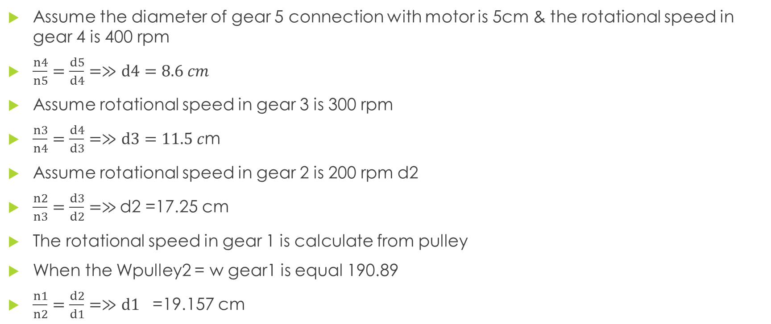
rotational speed & diameter of the gears
Assume the diameter of gear 5 connection with motor is 5cm & the rotational speed in gear 4 is 400 rpm
$\frac{n4}{n5}=\frac{d5}{d4}=≫d4=8.6 cm$
Assume rotational speed in gear 3 is 300 rpm
$\frac{n3}{n4}=\frac{d4}{d3}=≫d3=11.5 c$m
Assume rotational speed in gear 2 is 200 rpm d2
$\frac{n2}{n3}=\frac{d3}{d2}=≫$d2 =17.25 cm
The rotational speed in gear 1 is calculate from pulley
When the Wpulley2 = w gear1 is equal 190.89
$\frac{n1}{n2}=\frac{d2}{d1}=≫d1$ =19.157 cm

Slide 38
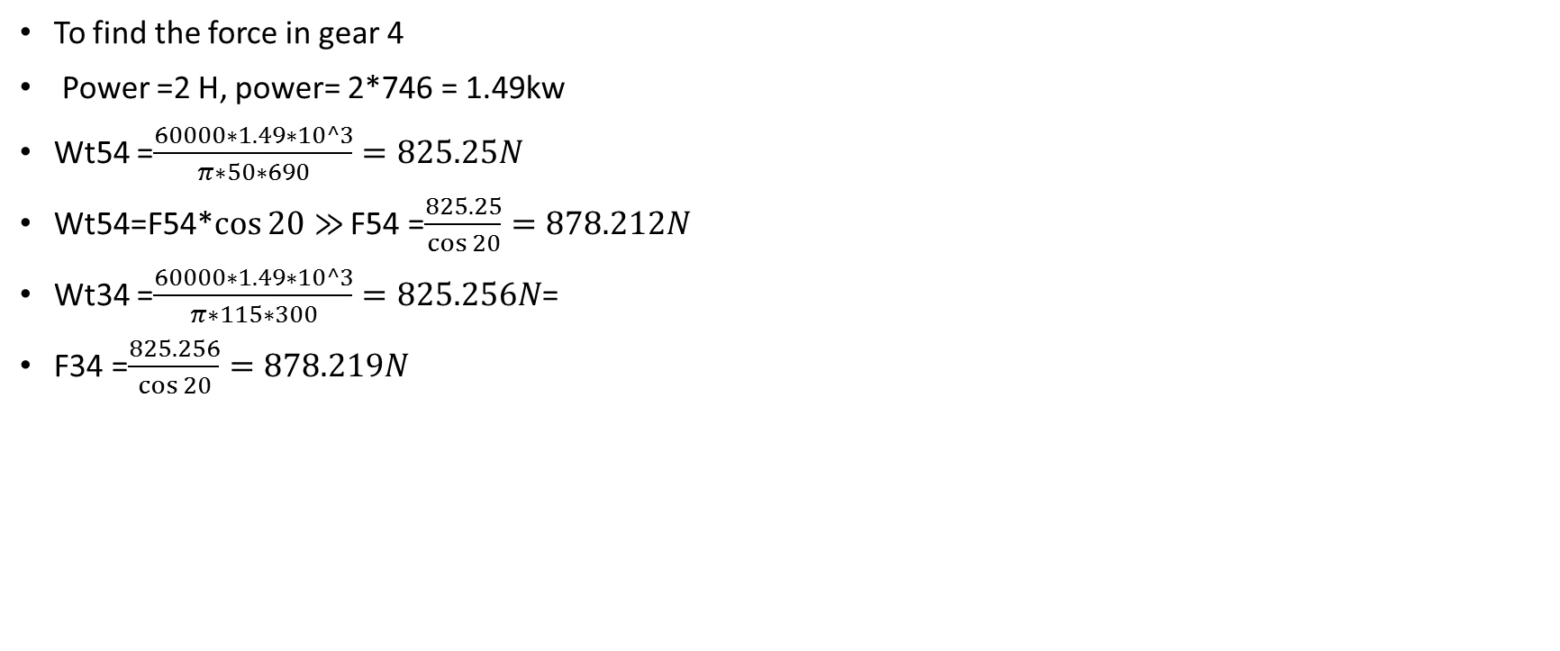
Force analysis of gear box
To find the force in gear 4
Power =2 H, power= 2*746 = 1.49kw
Wt54 =$\frac{60000∗1.49∗10^3}{π∗50∗690}=825.25N$
Wt54=F54*$\cos{20}≫$ F54 =$\frac{825.25}{\cos{20}}=878.212N$
Wt34 =$\frac{60000∗1.49∗10^3}{π∗115∗300}=825.256N$=
F34 =$\frac{825.256}{\cos{20}}=878.219N$

Slide 39
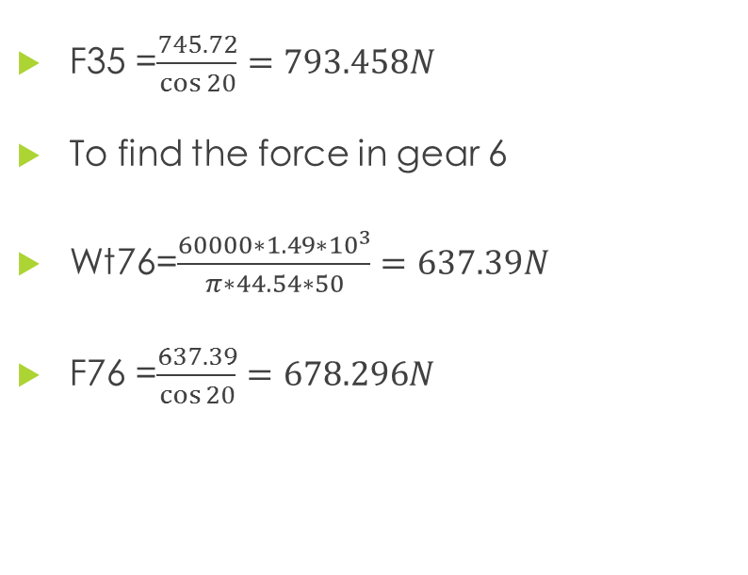
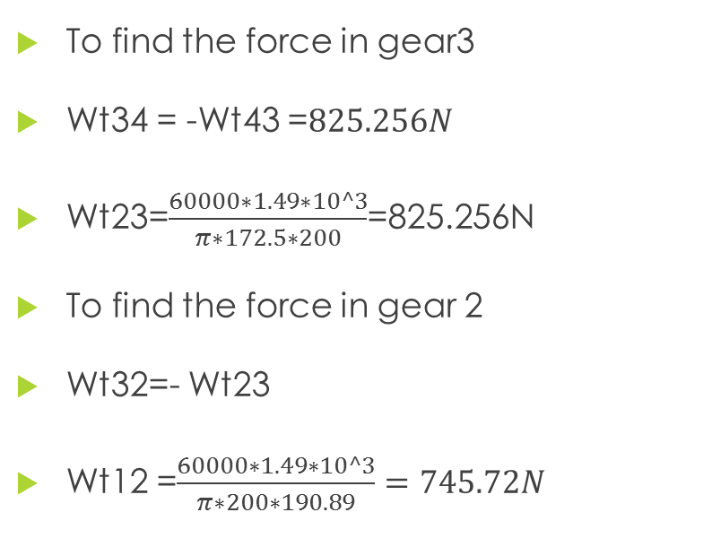
Force analysis of gear box
To find the force in gear3
Wt34 = -Wt43 =$825.256N$
Wt23=$\frac{60000∗1.49∗10^3}{π∗172.5∗200}$=825.256N
To find the force in gear 2
Wt32=- Wt23
Wt12 =$\frac{60000∗1.49∗10^3}{π∗200∗190.89}=745.72N$
F35 =$\frac{745.72}{\cos{20}}=793.458N$
To find the force in gear 6
Wt76=$\frac{60000∗1.49∗{10}^{3}}{π∗44.54∗50}=637.39N$
F76 =$\frac{637.39}{\cos{20}}=678.296N$

Slide 40
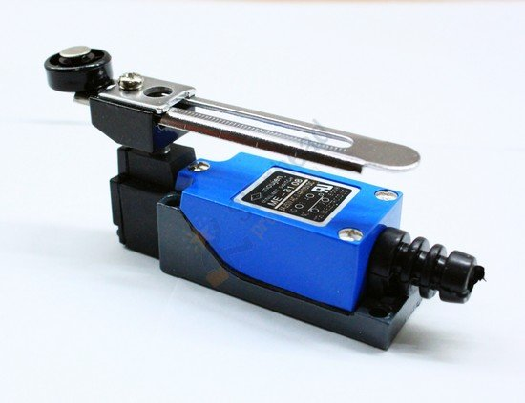
Reversing the rotation of the Container motor

Slide 41
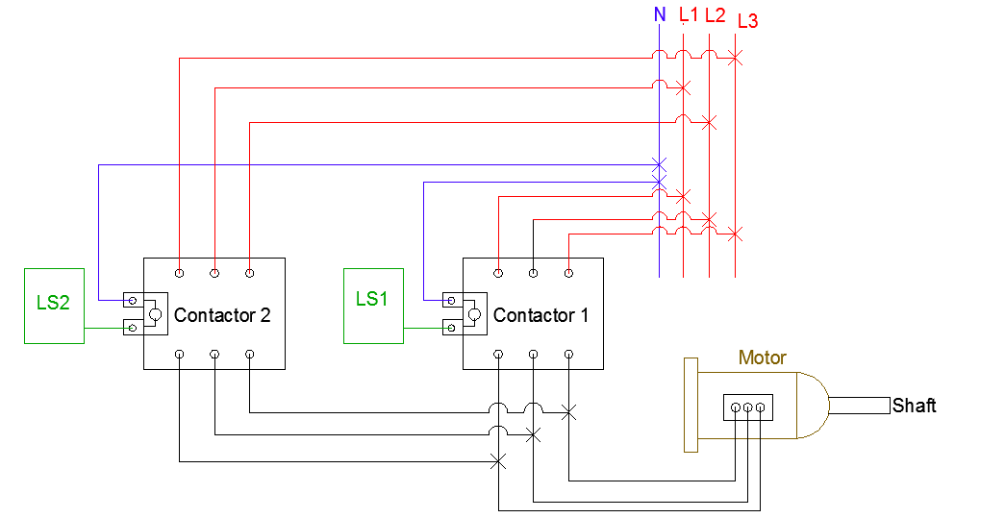
The connection between limit switches and the motor

Slide 42
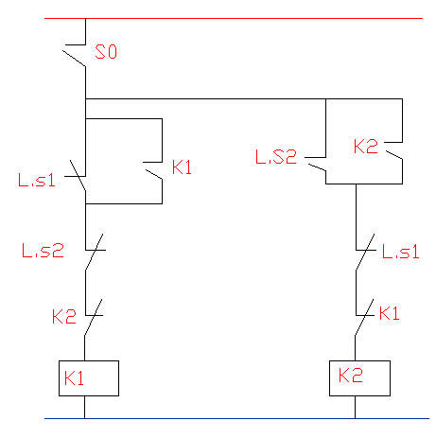
Principle of operation

Slide 43
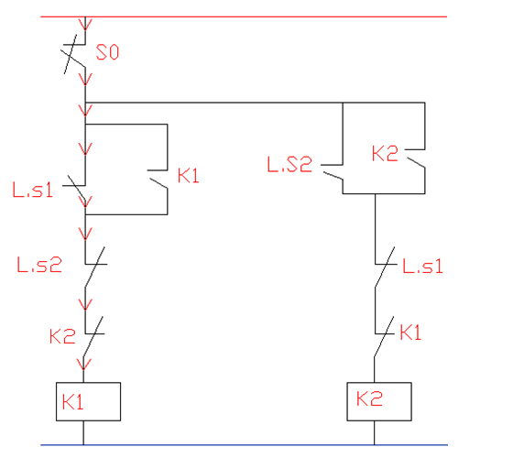
State no.1

Slide 44
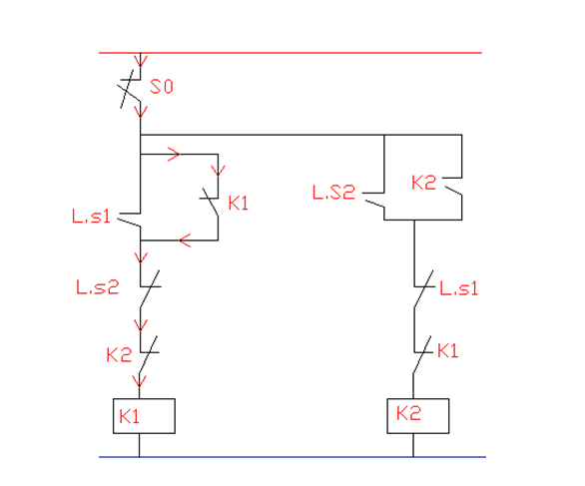
State no.2

Slide 45
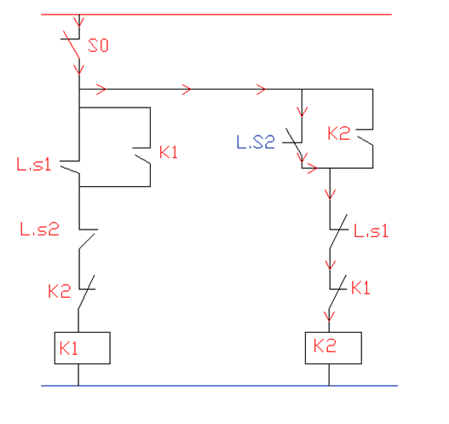
State no.3

Slide 46
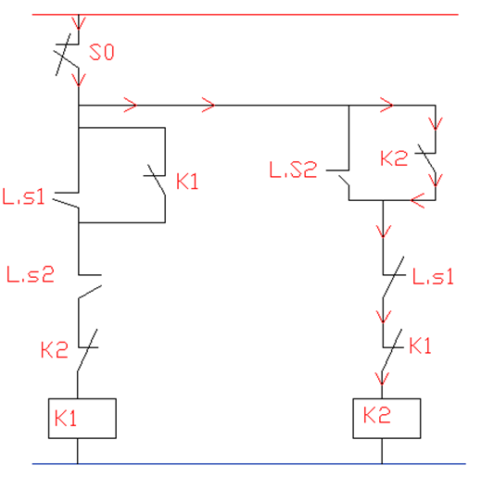
State no.4

Slide 47
Discussion
The machine was design with a 3 stainless steel cutting shaft, and 4 high speed steel blade was fixed in every shaft, then fixed it under the container, but the cutting shaft is not available in our country and the only way to get it to get a galvanized steel rod and lathe it to install the blades, but this process is very expensive, so instead to use three we used one cutting shaft. The following fig show the ideal and model cutting shaft

Slide 48
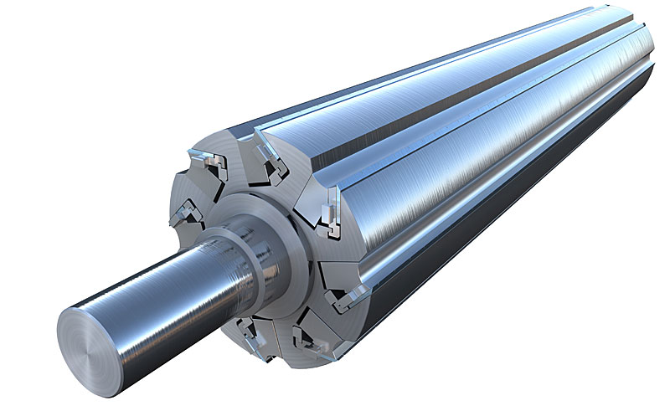
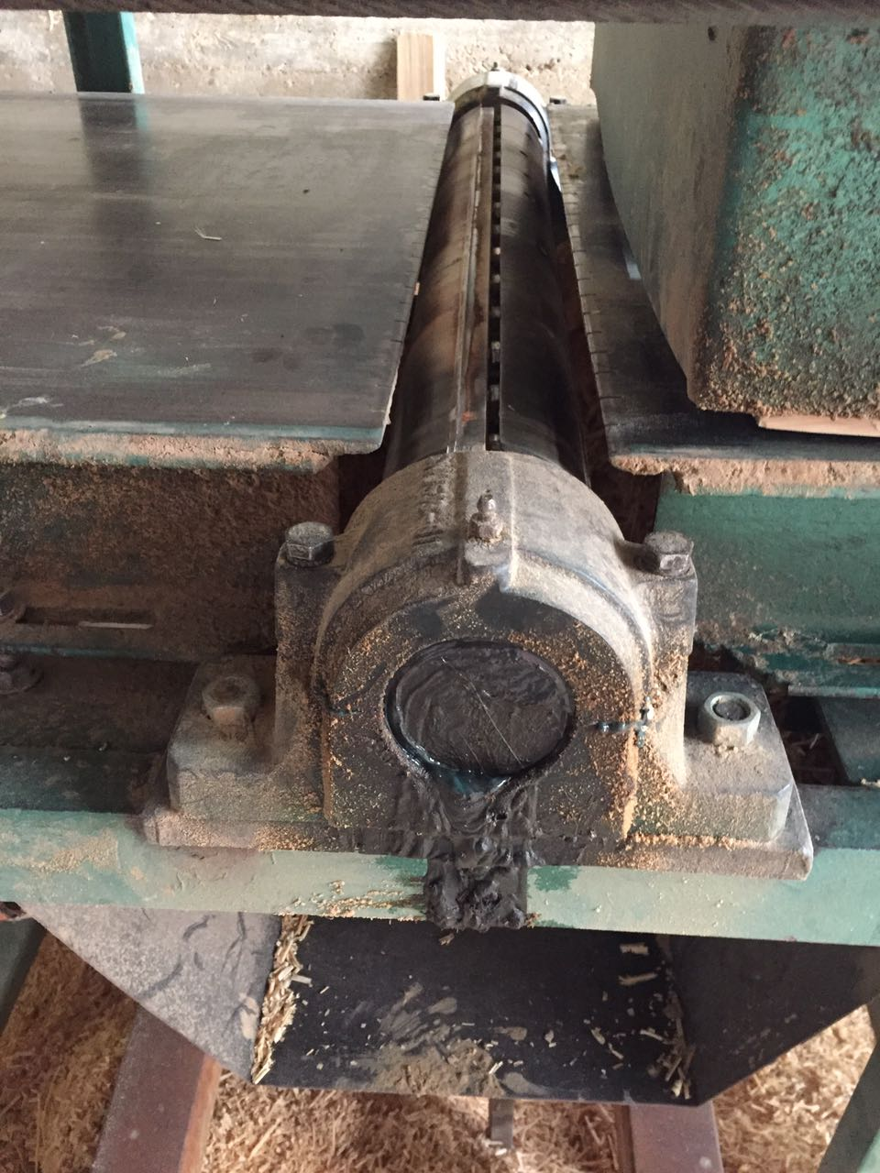
Discussion

Slide 49
Discussion
The following is a comparison between our machine and an ideal machine, the machine is produced by Jackson Lumber Harvester Company, model 16D4.
This comparison is shown in table:
 | Ideal design machine | our design machine
Number of cutting shaft | 3 | 1
Number of blade in the cutting shaft | 3 | 4
Cylinder material | Stainless Steel | Galvanized Steel
Cylinder Price | Expensive | Cheaper than 3 cutting shaft
Motor power of the cutting shaft (Hp) | 50 Hp | 10Hp
Mass of wood fill in the container (kg) | 2700 kg | 200 Kg
Motor power of the container (Hp) | 15 Hp | 2 Hp
Rated Output Per Hour | 4.5 mᶟ | 2.4 mᶟ
cost | $80000 | $3200

Slide 50
Future Work
In future, the intention is to develop the project and turn it into an integrated production line by adding some features to make our machine more efficient:
Adding a blowing machine at the outlet of wood shaving that remove sawing dust from wood shavings.
Adding a machine to fill the wood shavings in bags and then wrapped and placed in boxes to become ready for shipment
So, when we add this features; the project becomes integrated and support the national product features to quality and low cost.

Slide 51


The End
Thanks for Your Attention
😍
Ready for Your Questions

