Slide 1

An-Najah National University
Faculty of Engineering & Information Technology
Chemical Engineering and Energy & Environment Engineering Departments
Plastic Waste Management through Making New Beneficial Products
GRADUATION PROJECT 2
Supervised By:
Dr-Mohammed Alsayed
Prepared By:
Celina Semaan (Energy)
Nimat Saher (Chem.)
Saja Asaira (Energy)

Slide 2
Outlines
Introduction and Background.
Objectives.
Methodology.
Design of Experiment.
Quality Tests on Concrete.
Results.
Cost Analysis.
Comparison between concrete and our products.

Slide 3
Introduction and Background
Population growth which has accompanied this economic growth has generated high amounts of solid waste.
Today in Palestine, the organic waste accounted for 65.1% compared to the plastic and paper waste which accounted for 16.7%.[1]
Recycling process of the generated plastic solid waste is facing a lot of problems including: plastic is not homogeneous, different physical properties and may contain some dirt that damage the equipment.[2]

Slide 4
Objectives
1. Determine a suitable method to recycle the local generated plastic waste.
2. Mitigate undesirable effects from common waste disposal methods.
3. Produce beneficial products from plastic waste.

Slide 5
Methodology
Literature Review
Design of experiment
A suitable heat source was applied to melt the plastic, mix it with sand and ensure a homogeneous mixture
Melted samples were poured into predefined molds and left for 24 hours for cooling
Weight, Density ,compressive strength and water absorption percent were measured

Slide 6
Design of Experiment
The product was achieved through:
1. Plastic bags, because it’s:
a. Low cost.
b. Weather proof and low water absorption.
c. Good chemical resistance.
d. Melting point equals 116 Celsius degrees.
2. Fine sand (building sand): to indirectly increase the strength of sample, reduce the voids and provide bulk
to the concrete sample.
3. Heat source: to melt the plastic waste bags with sand at temperature of 250 Celsius degrees, mixing was
done to ensure the ingredients are homogeneous

Slide 7
Quality tests on concrete
Compression test
Compression test is the most widely used test to measure the concrete compressive strength, at a particular period of time, from the time of casting the concrete cubes.
The most common age at testing is 28 days, but test can be made at 1, 3, 7&14 days also
The purpose of this test is:
To give us the information of the potential strength of the concrete mix from which it is sampled.
To determine whether correct mix proportions of various mix proportions of various materials were used to get the desired strength.

Slide 8

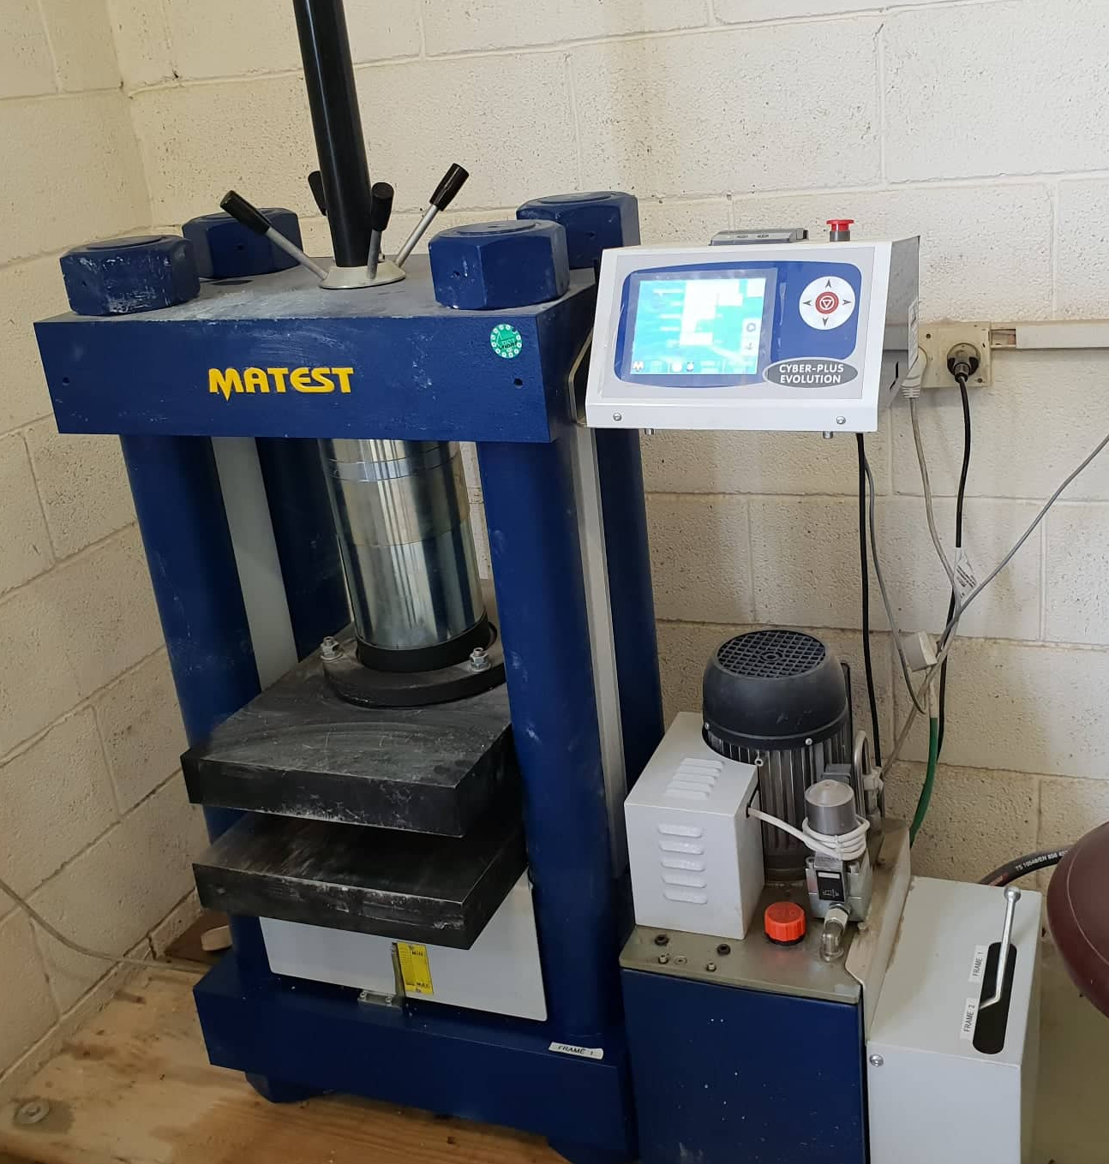
Quality tests on concrete
Compression Test:

Slide 9
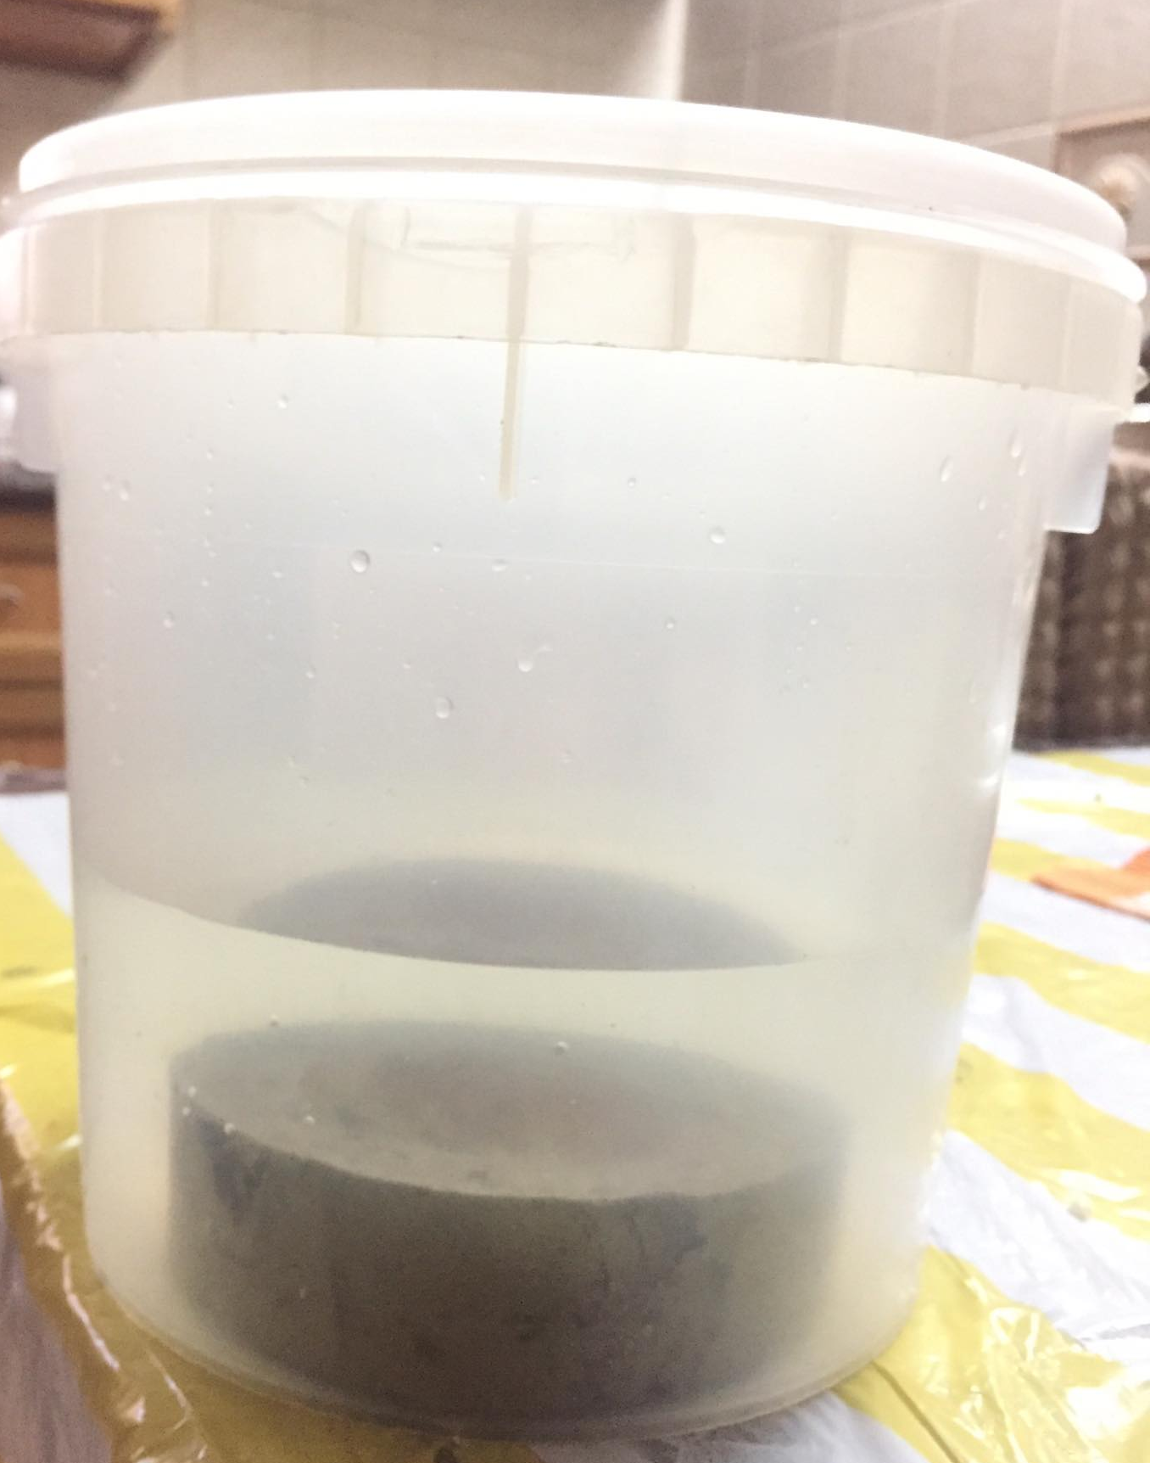
Water Absorption Test
Absorption testing is a popular method of determining the water-tightness of concrete.
Determination of Water Absorption, measures the amount of water that penetrates into concrete samples when submersed. The lower the absorption, the better the result.
Absorption test is done by drying the concrete sample, measure its initial weight and then submersed it in water for 48 hours.

Slide 10
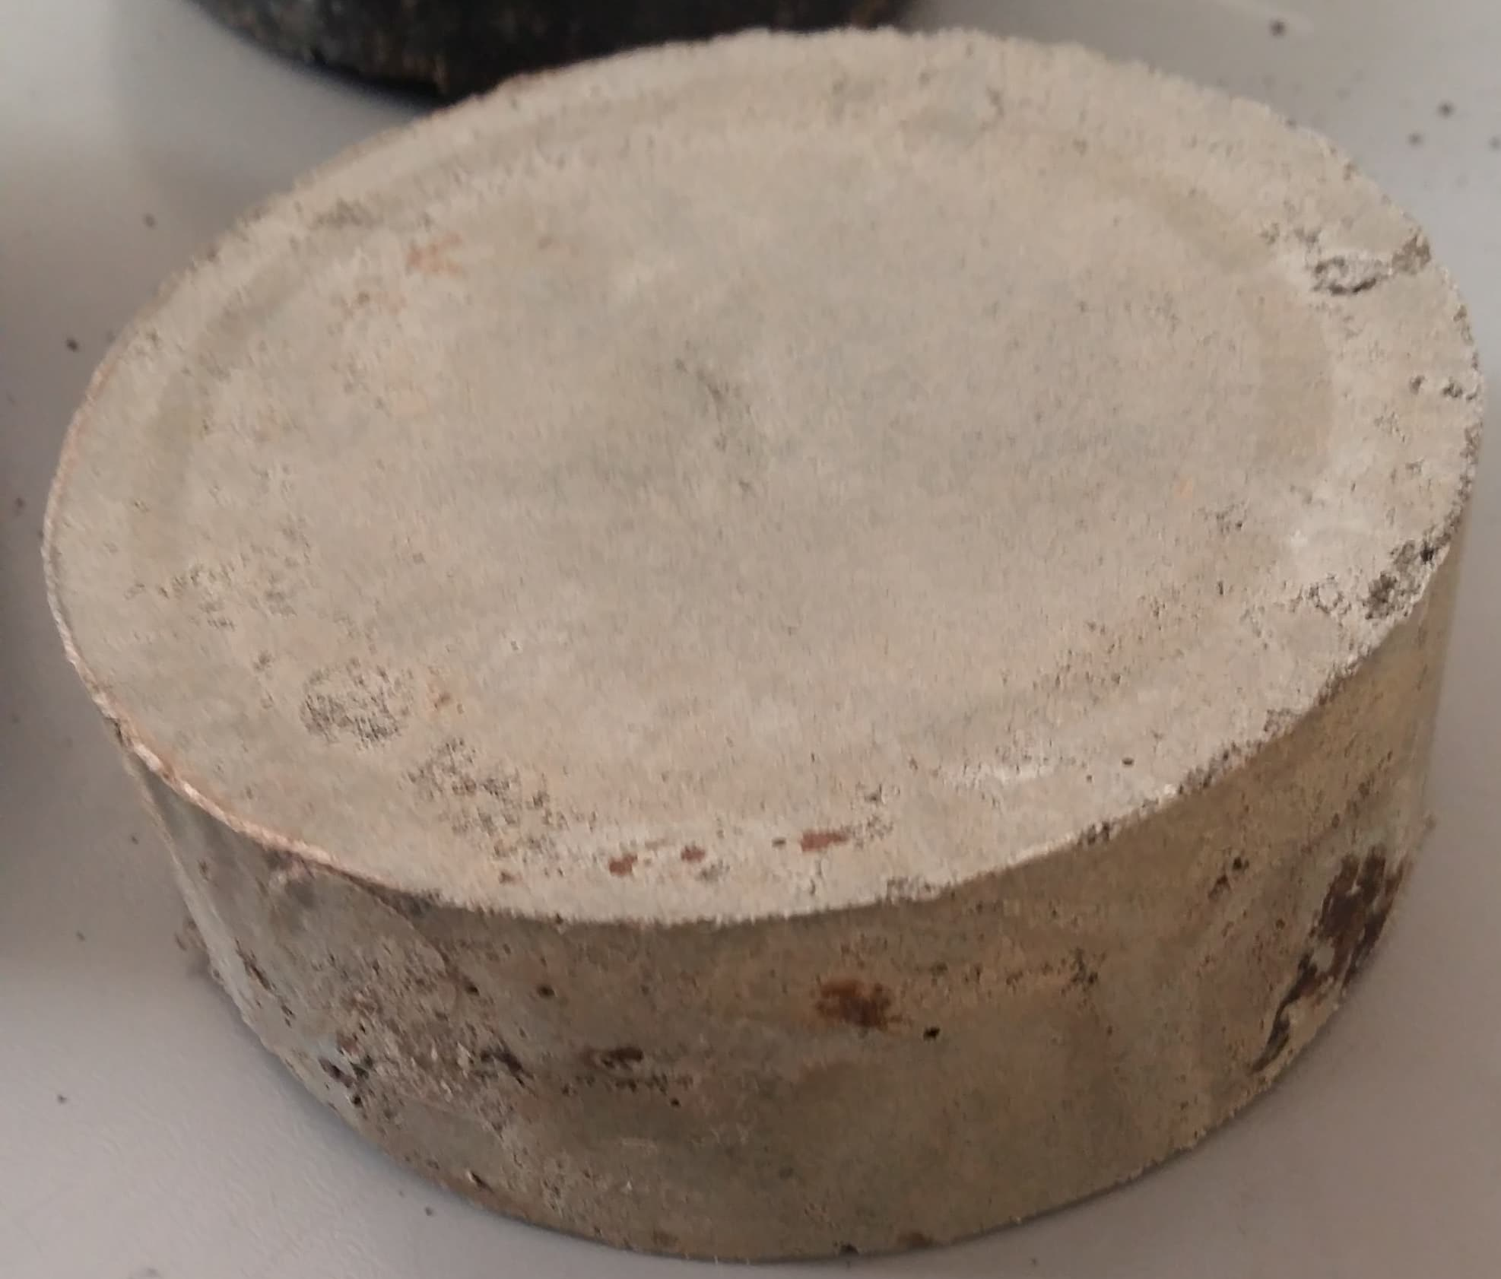
Results
There are three samples produced as follow:
Sample P50:
50% by weight plastic and the remaining 50% was sand, with density of 1718 kg/m³

Slide 11
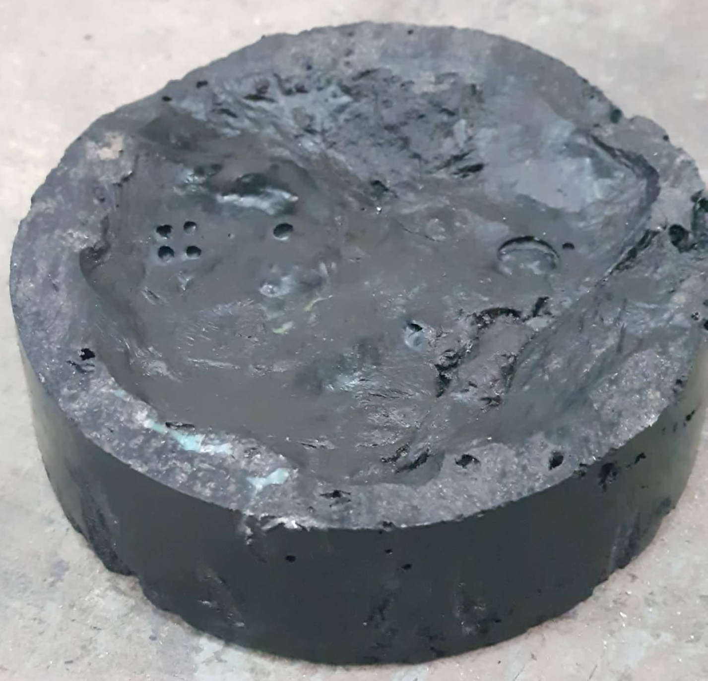
Sample P60:
60% by weight plastic and the remaining 40% was sand, with density of 1363 kg/m³

Slide 12
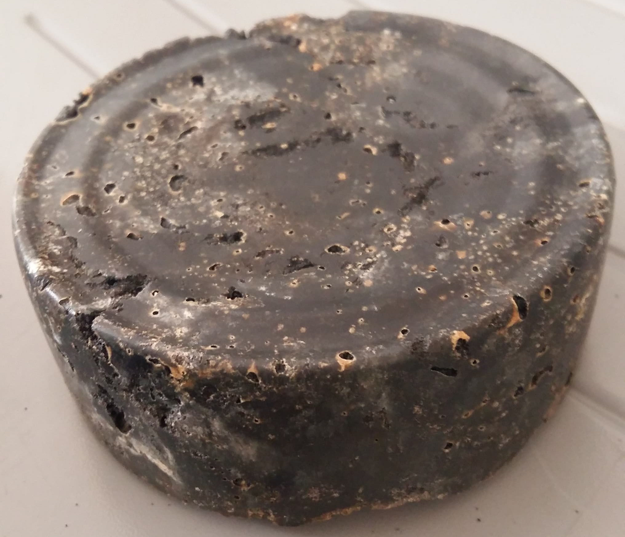
Sample P40:
40% by weight plastic and the remaining 60% was sand, with density of 1414 kg/m³

Slide 13
Quality tests result
Compression test was applied to sample P50, compressive strength was 178 kg/cm².
Water absorption test was shown that the sample P50 have a water absorption of 2%.

Slide 14


Slide 15
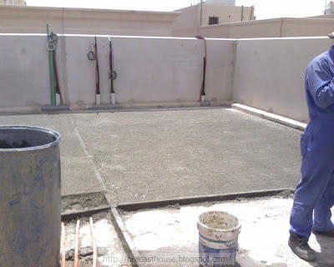
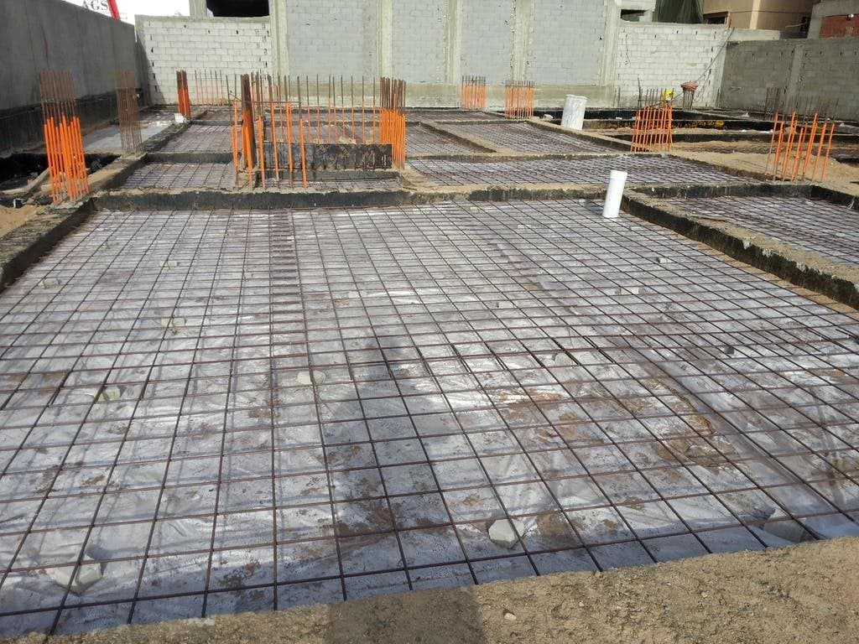

Uses of our product
Screed
Blinding
Between the outer stone wall and internal concrete wall

Slide 16
Cost Analysis
The following calculations were done for 500 kg plastic with 500 kg sand
Assume efficiency of the heat source = 75%
Initial temperature = 25 C
Final temperature = 135 C
Heat out from the system = 292 MJ → Heat in = 389 MJ
Energy content of the gas = 25 MJ/m³ → Volume of gas = 15.568 m³
Cost of gas = 2.5 x 15.568 = 38.92 → Total cost = 38.92 + 50 = 89 NIS

Slide 17
Comparison between ordinary concrete and our product
Parameter | Concrete | Sample P50
Density (kg/m³) | 2400 | 1718
Compressive strength (kg/cm²) | 150 | 178
Water absorption (%) | 13 | 2
Cost (NIS/ton) | 200 | 89

Slide 18
References
1- Al-Khatib, I.A., et al., Solid waste characterization, quantification and management practices in developing countries. a case study: Nablus district - Palestine. J Environ Manage, 2010. 91(5): p. 1131-8.
2-Plastic Moulding. Available from: http://www.plasticmoulding.ca/polymers/polyethylene.htm.

Slide 19
Thanks For Listening !

