Slide 1

Real Time Baby Monetor
An-Najah National University
Telecommunications Engineering Department
Prepared by : Leen Qasim.
Sawsan Shlabi.
Haya Alian.
Supervisor: Dr.Saed Tarapieh.

Slide 2
Outline:
Introduction.
Objectives.
Project Description.
WebIOpi.
Video and Audio streaming.
Temperature Monitoring.
LED controlling.
Results.

Slide 3
Introduction:
  Previous Work at Project 1:
  1. The main goal .
  2. A survey .
  3. Created a wireless add-hoc network .
  4. Streaming a video .
  5. The cost of the project .

Slide 4
Objectives:
Stream Audio & Video
Control LED Lighting
Monitor Temperature
From Ad-Hoc to Infrastructure

Slide 5
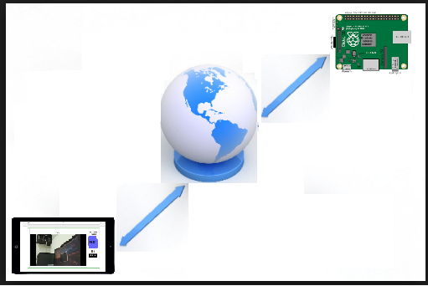
Infrastructure Network
Parents can see their baby from the same home or
anywhere round the world.

Slide 6
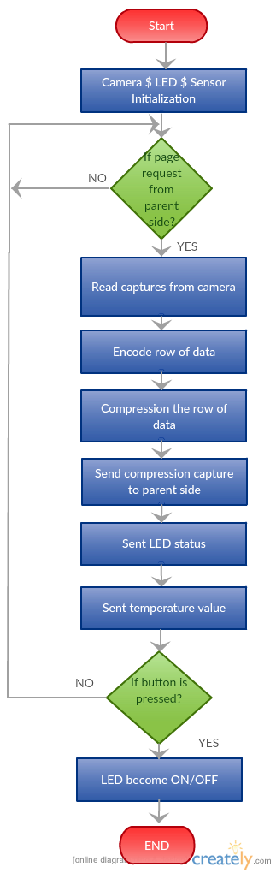
Project
Description
Baby side.

Slide 7
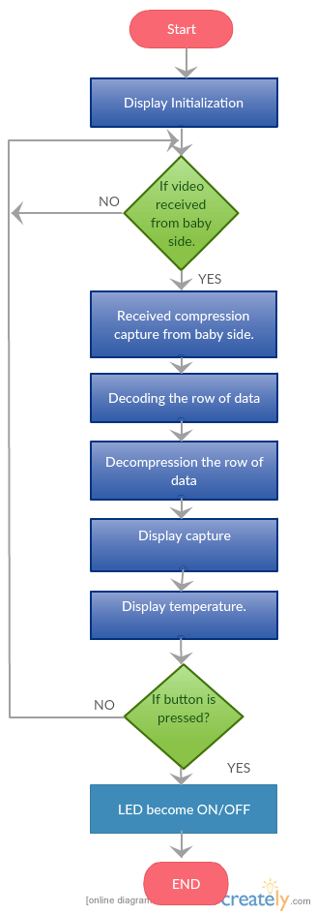
Project
Description
Parent side.

Slide 8
WebIoPI
WebIOPi is a web application which allows to control the Raspberry Pi’s GPIO .
WebIOPi has PYTHON LIBRARY , JAVASCRIPT CLIENT ,SPI and HTTP Servers with both HTML resources and REST API to control the devices.
Notes:
Here the browser load the HTML file at the initial stage and then the JavaScript will initiate the asynchronous call to REST API in order to control and update the status of the device to the user interface and it doesn't require to download the pages again and again on every refresh.

Slide 9
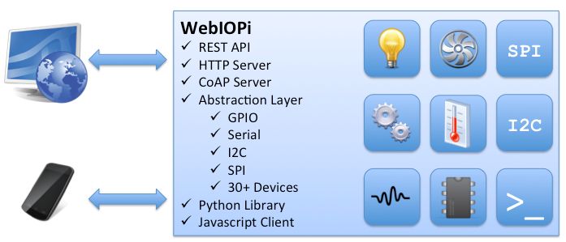
Notes:
*****Javascript/HTML client library to make Web UI
Python/Java clients, to make Pi-to-Pi systems or Android applications
*****CoAP support brings the best Internet of Things protocol on the Pi, as a future proof of Pi possibilities

Slide 10
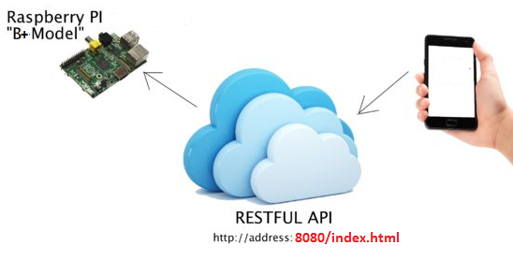
API(Application programming interface)
Notes:
is a group of subroutine definitions, protocols, and tools for building application programming and programming interface using rest.
It depends on a stateless, client-server, and in virtually all cases, the HTTP protocol is used. REST is an architecture style for designing networked applications.

Slide 11
3 types of delivery methods of streaming media:
Video & Audio Streaming
A technique for transferring data such that it can be processed as a steady and continuous stream .
Streaming Stored Audio and Video
Streaming Live Audio and Video
Real-Time Interactive Audio and Video

Slide 12
Protocols
RTSP: Real Time Streaming Protocol
RTP : Real-time transfer Protocol

Slide 13
RTSP Features
RTSP works in the conjunction with RTP to deliver streaming audio & video content
RTSP maintains a server state during transmission unlike HTTP
Client-Server architecture
Overcome the limitations of HTTP ,RTSP enhance HTTP functions
RTSP provides the synchronization of events

Slide 14
RTSP Diagram
Web
Browser
HTTP request/response
Client
Web
Server
meta file
RTSP Streaming Command
Media
Player
Streaming
Server
RTP Audio / Video Content
HTTP is insufficient for user interaction. With streaming server
audio/video file can be sent over UDP.

Slide 15
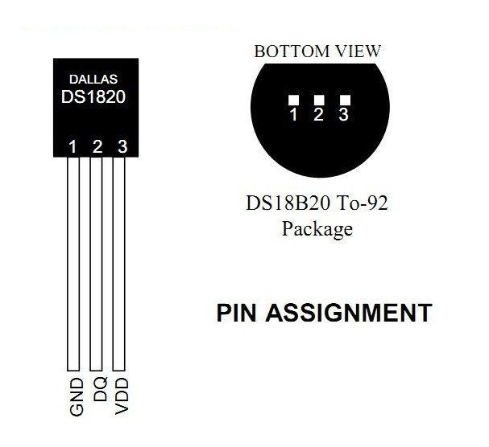
Temperature Monitoring
About DS18B20:
Digital temperature sensor
Has DAC.
Is perfect for projects like weather stations
“One-Wire” communication protocol.

Slide 16
DS18B20 Features:
Measure temperature from -55°C to 125°C range
Power supply range : 3.0V to 5.0V operating voltage
750 ms sampling
This sensor has a unique 64-Bit unique address
Requires no external components

Slide 17
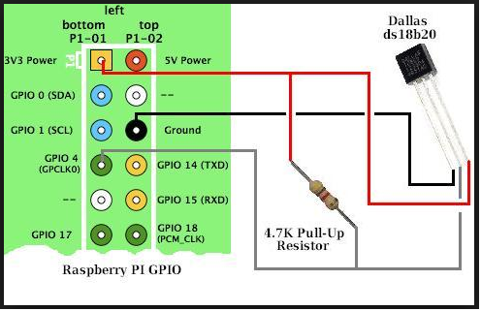
Reading temperature :
Add OneWire support
sudo modprobe w1-gpio
sudo modprobe w1-therm
cd 28-xxxx
Pushing data to the RPi.
sudo nano /etc/webiopi/config
temp2 = DS18B20
This configures the sensor in the REST API and it should be accessible from the webiopi page being hosted by your pi.

Slide 18
Controlling LED Lighting
Tow Subsystems :
The actual device ( LED ) .
Controller (web application) .

Slide 19
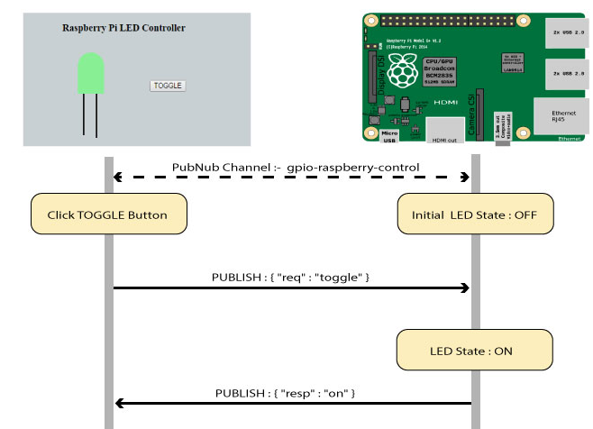

Slide 20
Results :
Measure the temperature and display it on a web page.
Control LED lighting.
Stream audio and video.

Slide 21
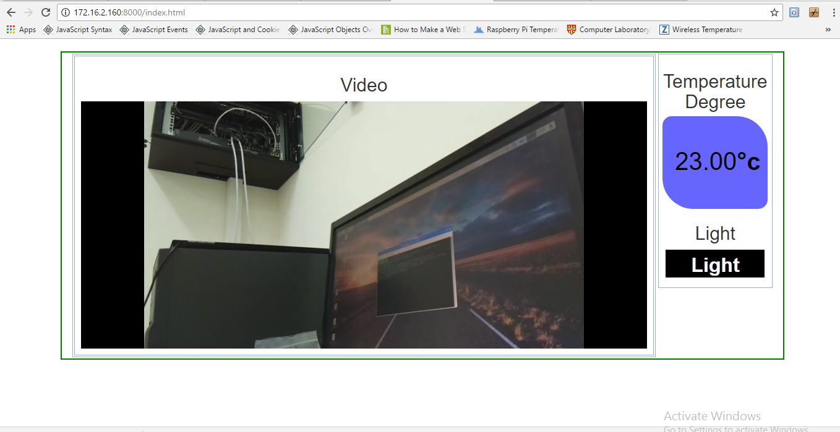

Slide 22
Thank You

