Slide 1

An-Najah National University
Faculty of Engineering & Information Technology.
Industrial Engineering Department
Graduation Project ⅠI
The Degree of Application of Total Quality Management (TQM) Standards in the Northern Distribution Electricity Company

Slide 2


Prepared by:
    Adulmajeed Ghanem
    Renad Tayel
    Ibrahim Abed
    Sabeeh Nasif
    Yousuf Thaher
Supervised by:
Eng. Tamer Haddad

Slide 3
Abstract
Identify the impact of implementing TQM in the company (Sarra area).
It improved general performance and reduced size of problems, which enhanced reputation and competitiveness.
The company used three management pillars; guidelines, processes, and routine management.
The study relied on several methods: Control Chart, PDCA cycle, Pareto, Ishikawa, 5W1H, and Standard Operating Procedure (SOP).
TQM implementation in the company is high, and the performed methodology allowed a reduction in orders after deadline (OAD).

Slide 4
Introduction - Background
TQM is a new trend that pays attention to quality from ground up.
Application of TQM increases productivity and customer satisfaction, and so profits.
One of the biggest obstacles is anomaly or non added value activities.
Activity standardization is required through routine management.
Electricity companies are suited for TQM application studies:
Electricity sector is very important.
Increase of demand for electricity.

Slide 5
Introduction -Research Importance
Lack of studies concerned with TQM application within the electricity companies.
Building a general framework for TQM that can be applied on the ground.
An attempt to find possible solutions to raise the efficiency of the company and to identify the problems and challenges facing the institution.
The scientific and practical benefit from the application of total quality standards.
To identify the extent of the ability of the employees to adopt TQM.

Slide 6
Introduction -Hypothesis
There is a relationship between the application of TQM standards and the following:
Improvement of the general performance.
Increase in customer satisfaction.
Reducing the size of the problems facing the company.
Improvement of other processes within the electricity company.

Slide 7
Introduction -Search Limitations
The methodology was implemented only in one sector of the company.
The research does not address in detail the components and technical aspects of TQM except what serves the purpose of the study.
The evaluation of the application of TQM standards is limited to the estimated time period between January and June of 2020.

Slide 8
Introduction – Methodology
To achieve the objectives of this study, researchers will use the following methods:
The theoretical method.
Application method.
The study was based on indicators like OAD.

Slide 9
Introduction – Methodology
Three pillars of management used:
Management by guiding principles: having an evaluation of a set of indicators and targets that are spread from senior management to factory floor.
Management by processes: continuous evaluation of operations, aiming to maintain control and stay within standards.
Routine management: determines the goal and procedures, respectively end and means, for carrying out the activities, so that each employee has awareness of the responsibility for the results of his work.

Slide 10

Constraints and Standards

Slide 11

Constraints and Standards

Slide 12
Similarities between TQM and ISO 9001
TQM and ISO are not contradicting, but complementary and of one fabric.

Slide 13
Methodology
Establishment of the company.
Object of the study.
Procedures & Results.

Slide 14
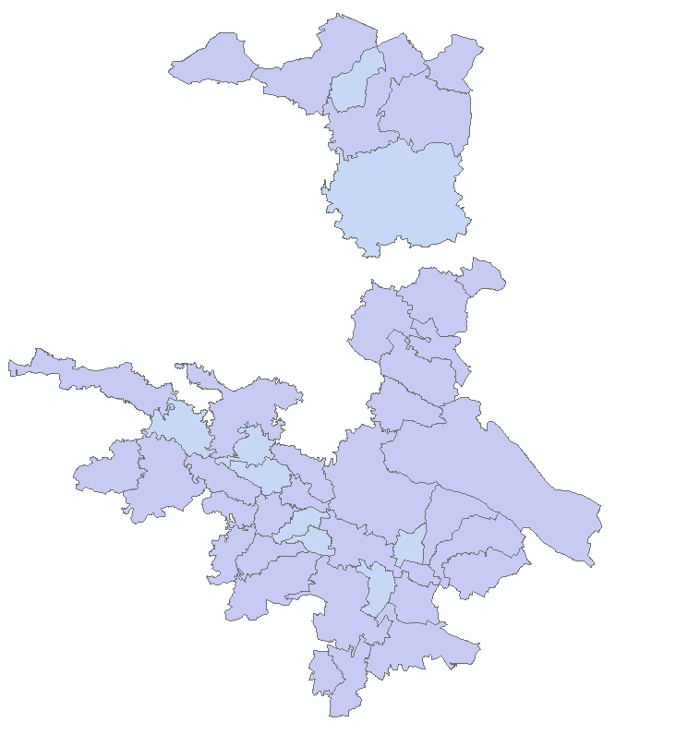
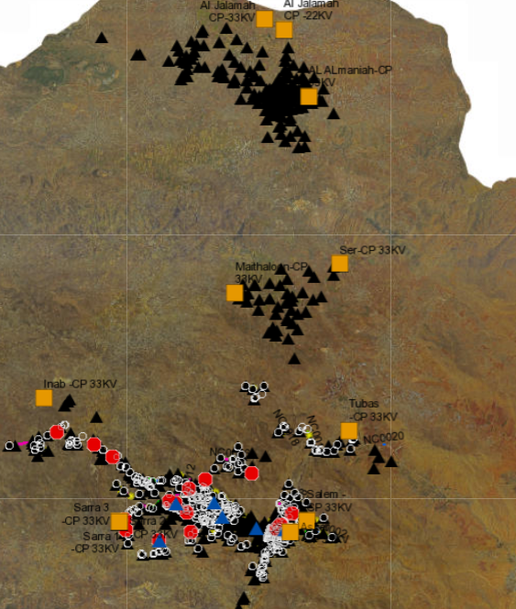
Establishment of the company

Slide 15
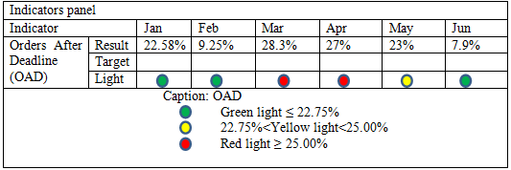
Object of the study
This dashboard contains the objectives set by top management for KPIs.
data collection was between months January and June 2020 and data from the same period from the next year 2021 was used to allow comparison and analysis of the results obtained.
“Order After Deadline (OAD)” are services provided to customers outside the time specified by the Company.

Slide 16
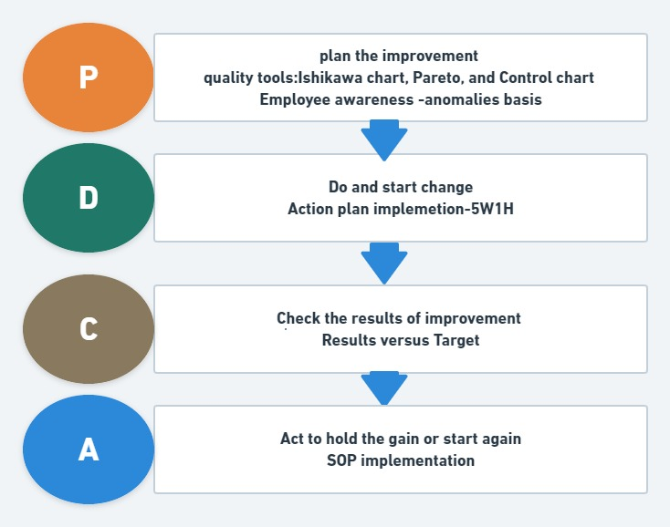
Procedures & Results
1- PDCA cycle

Slide 17
Anomalies basis
collect all the anomalies arising(OAD) from the executed transactions, This database Described as the 'basis of anomalies'
It should be done within 3 hours
Anomalies basis
Month | Affected indicator | Occurrence | Cause | Consequence
Jan | OAD | lighting |  | follow up
Feb |  | blackouts |  | follow up
Mar |  | counters |  | follow up
Apr |  | Weak electric current |  | follow up
May |  | Networks |  | follow up
Jun |  | others |  | follow up

Slide 18
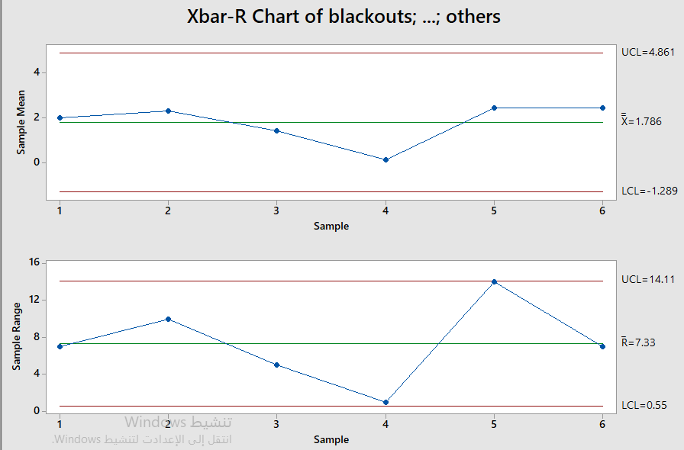
Control Chart Analysis
Then, the problems were analyzed using a control chart for main problems and root causes respectively.

Slide 19
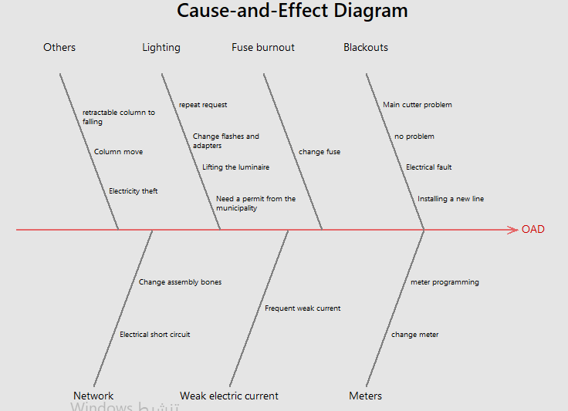
Ishikawa Diagram
Ishikawa diagram allows you to show all problems and reasons recorded by employees.

Slide 20
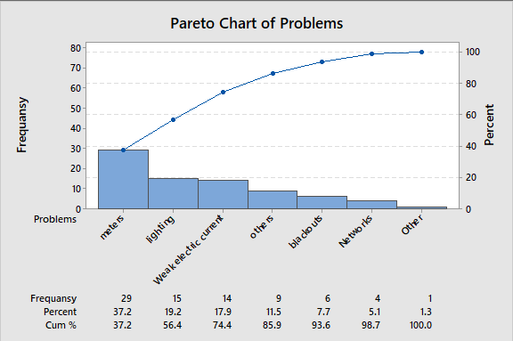
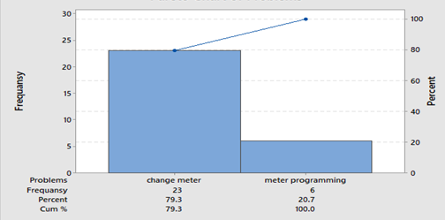
PARETO
the problems were analyzed using the Pareto diagram In order to identify the main problem and, respectively, Root causes,

Slide 21
5W1H
Based on the data analysis, an action plan has been developed to solve problems that affected the indicators using 5W1H Tool.
Action plan
What | When | Who | Why | Where | How
change counter | 23/12/2021 | students | To reduce the changing of the counter | Counter supplier | Buy counter with specific specifications with a long-term warranty

Slide 22
A Standard Operating Procedure (SOP)
From the results, a standardization of activity that removes the ' change counter', has been suggested. A Standard Operating Procedure (SOP).
Standard Operating Procedure (SOP)
Date: 23/12/2021 | PREPARATION: | APPROVAL:
WHERE THE SOP IS PERFORMED
In the purchasing department.
WHO PERFORMS THE SOP
Suppliers.
WHEN THE SOP IS PERFORMED
At the time of registering the purchase orders for counters.
RESOURCES FOR COMPLIANCE WITH CONDITIONS OF SOP
Quality system in the company.
ACTIVITIES DESCRIPTION
When ordering the purchase of counters, the specifications of the counters must be in accordance with the provisions of the specification set by the company regarding the counters.
PROBLEM
Counters.
CAUSE
Change counters.
EXPECTED RESULTS
Reduction in orders after deadline (OAD) for change counter.
IN CASE OF ABNORMALITY WHAT TO DO
Quality Supervisor Report.

Slide 23
Comparative analysis of the OAD indicator

Slide 24
Conclusion
The study concluded that there is an important effect of implementing TQM standards by improving the general performance of the company, increasing customer satisfaction, reducing the size of the problems facing the company.
impact on the TQM process during continuous improvement on all operations of the Northern Electricity Distribution Company, based on three management pillars: guidelines, processes, and routin

Slide 25
Recommendations
The importance of the company developing informal relations with workers .
Identify the problems that workers face so that they can overcome these problems and not happen again.
Work to take all measures required by the company to reduce breakdowns in the electric current of the company.
For the company to make a questionnaire to determine the desires and needs of customers and employees, whether they are current clients or prospective clients, to increase customer satisfaction.
The necessity to activate the participation of workers in decision-making in the Northern Electricity Distribution Company.
Paying attention to ensuring the effectiveness and efficiency of good work procedures in order to ensure a high level of quality and conducting any corrective operations to correct any deviations.

