Slide 1

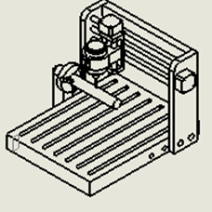
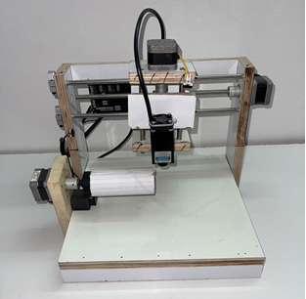
An Najah National University
Faculty of Engineering and Technology
Department of Mechatronics engineering
Three axis Laser engraver CNC Machine
Students:
Tha’er Dwikat
Abd Alhameed Bahish
Supervisor:
Dr. Bahaa Shaqour
7-6-2023

Slide 2
Outline
  Introduction
  Mechanical Design
  Electrical Components
  Software and Programing
  Tests and Results
  Conclusions

Slide 3
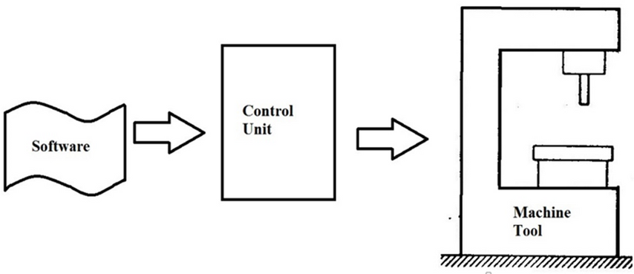
WHAT IS COMPUTER NUMERIC CONTROL CNC ?
CNC is a manufacturing method that automates the control, movement and precision of machine tools through the use of preprogrammed computer software.
Figure 1.1: CNC Operation Components

Slide 4
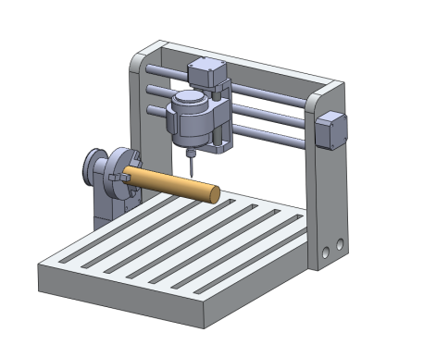

Mechanical Design
Body Structure
SolidWorks design
Plywood

Slide 5
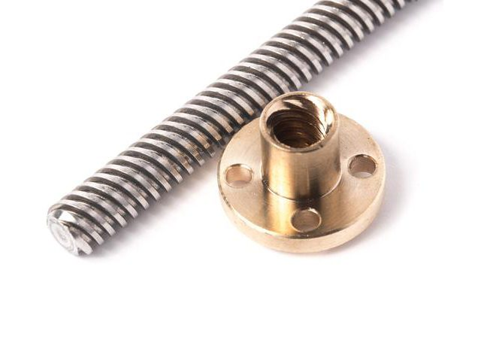
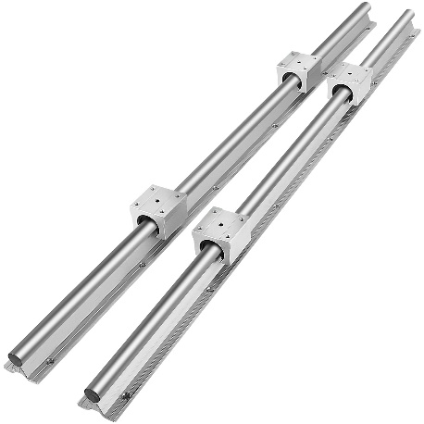
Transmission System
Convert motor rotation to linear motion
8mm lead ,2 mm pitch ACME thread lead screw
Linear guide rails with bearings

Slide 6
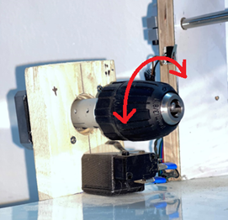
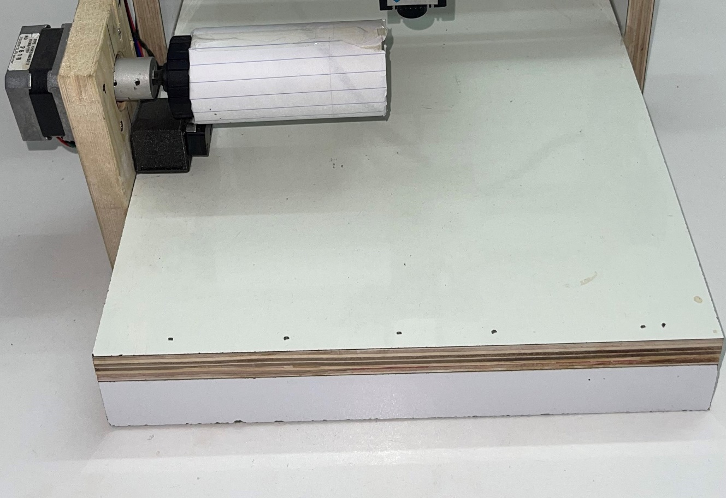
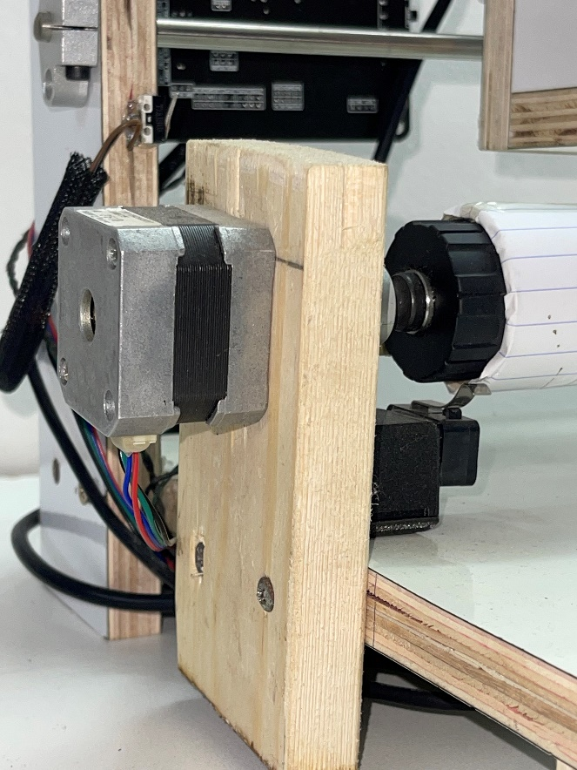
MACHINE STRUCTURE
Rotation Y axis with table

Slide 7
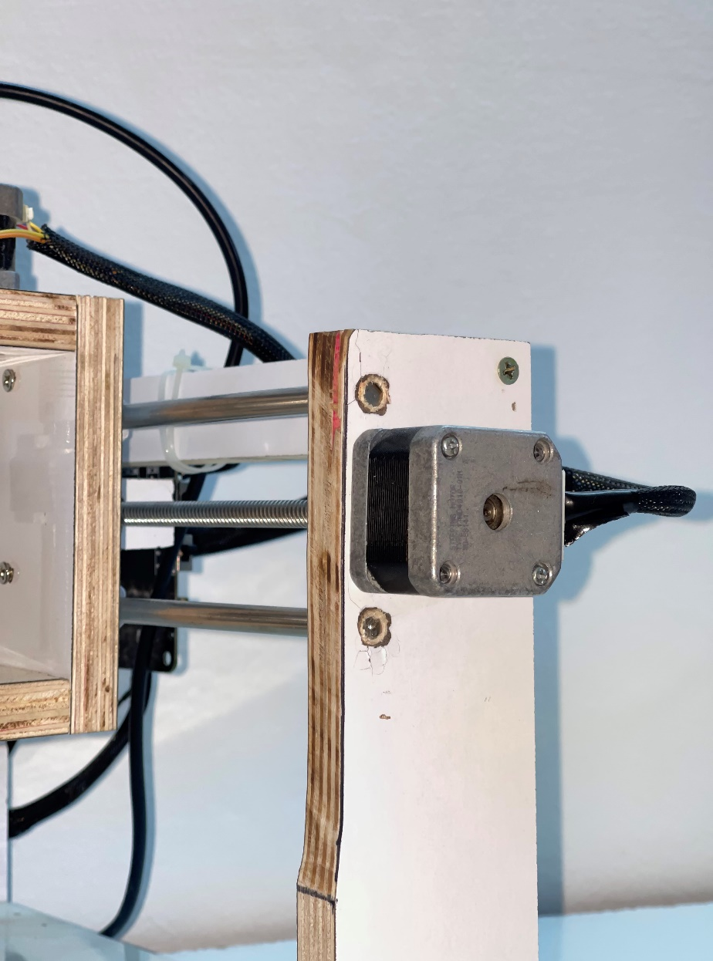
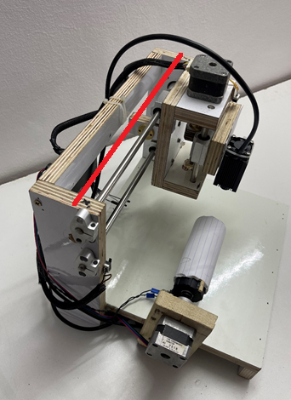
MACHINE STRUCTURE
X Axis

Slide 8
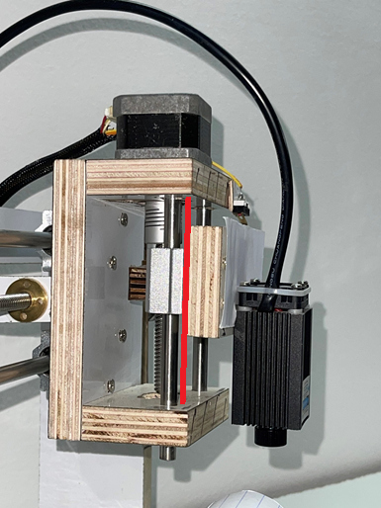
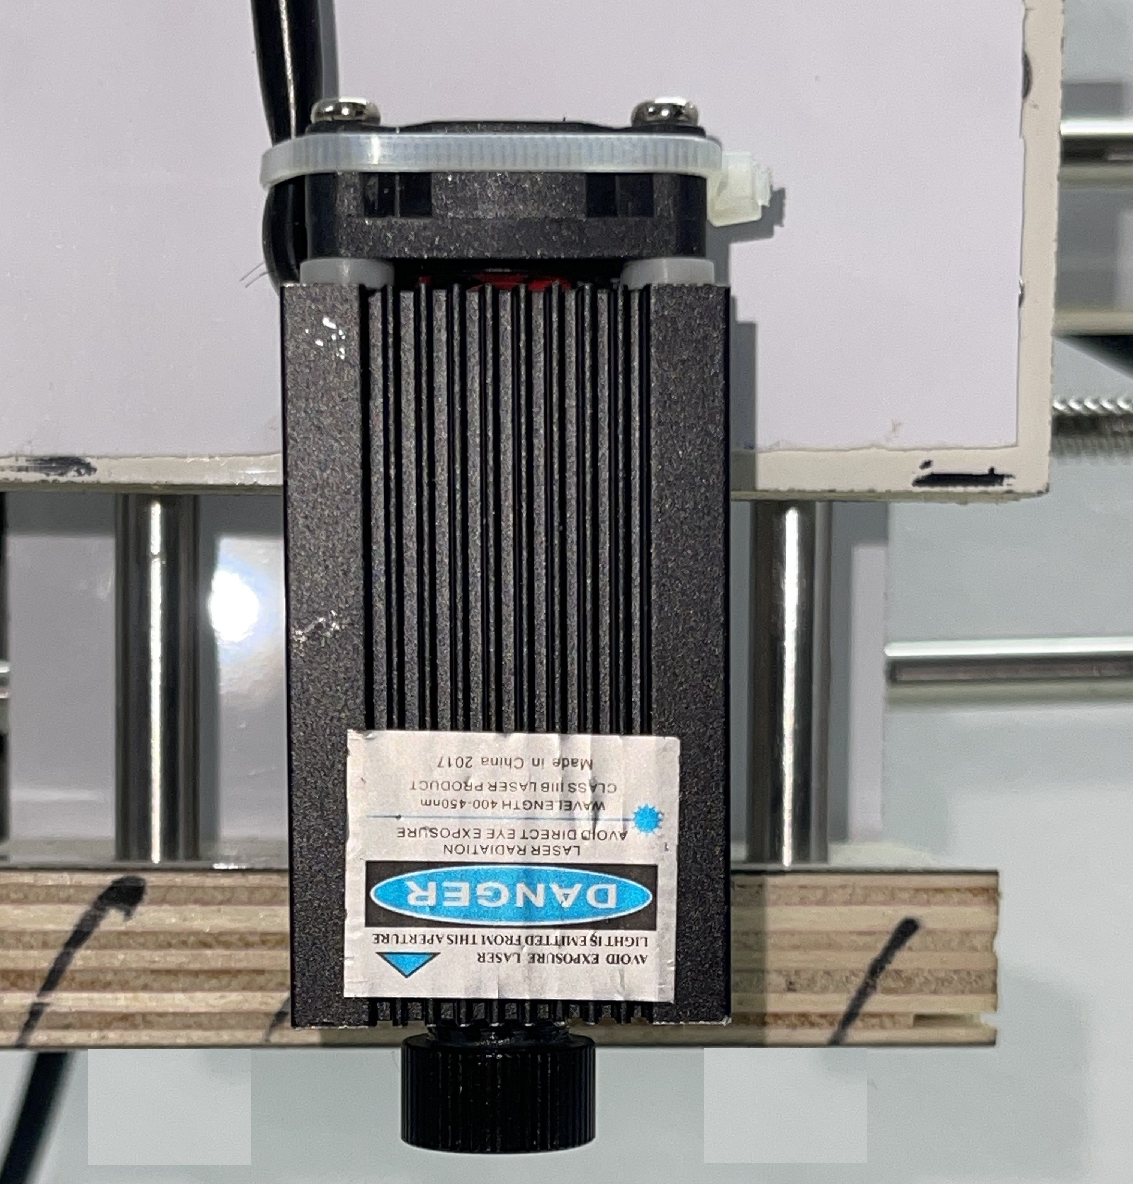
MACHINE STRUCTURE
Z Axis will tool

Slide 9
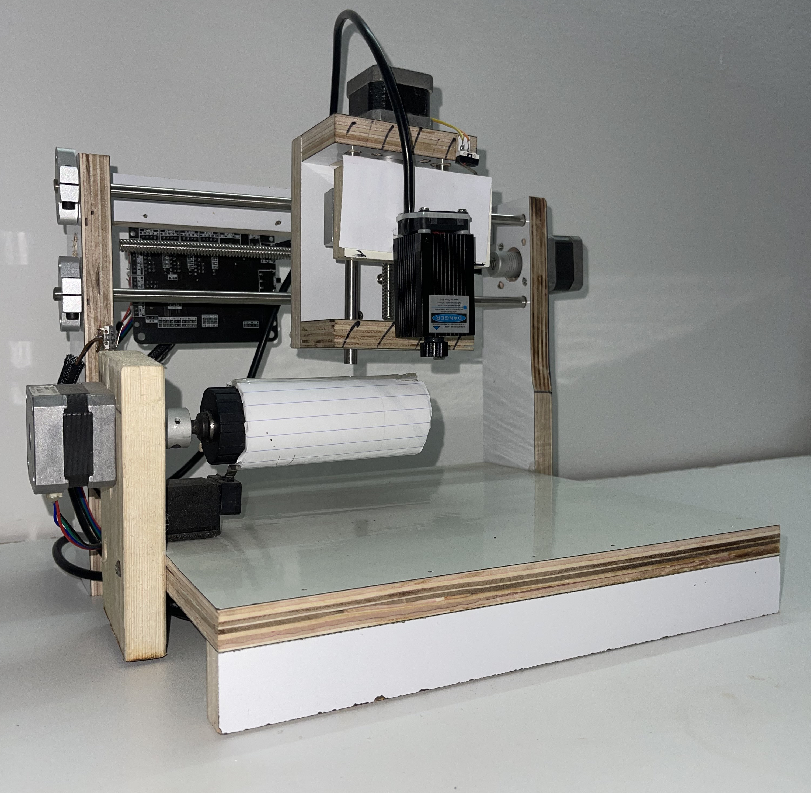
MACHINE STRUCTURE
Final assembly
Figure 2.9: Final Design

Slide 10
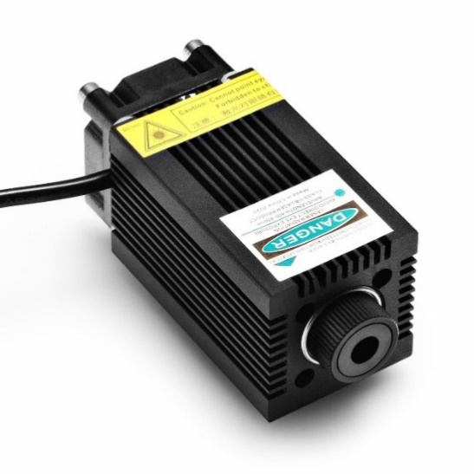
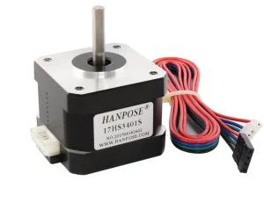
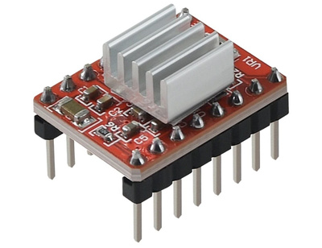
Electrical components
NEMA 17 1.2A
25 N.CM stepper motor
Laser Engraver 1W
Wavelength: 450nm
DC 12V,1-3A
Focusable
A-4988 with heatsink

Slide 11
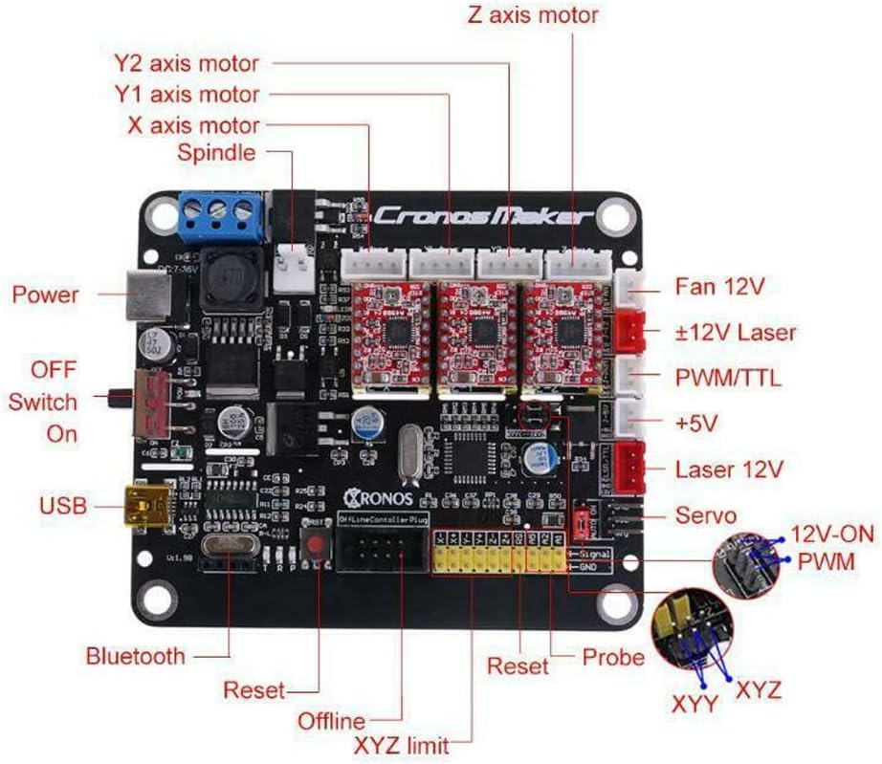
CONTROLLER
GRPL 4.0 CNC

Slide 12
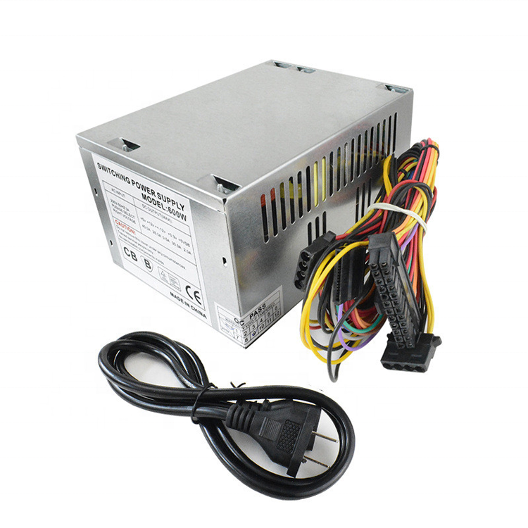
PC POWER SUPPLY
INPUT VOLTAGE : 240 VAC 50HZ
OUTPUT VOLTAGE : 12 VDC
MAX. OUTPUT CURRENT: 15A
HIGH EFFICIENCY
SHORT-CIRCUIT PROTECTION
OVER-CURRENT PROTECTION OVERLOAD PROTECTION

Slide 13
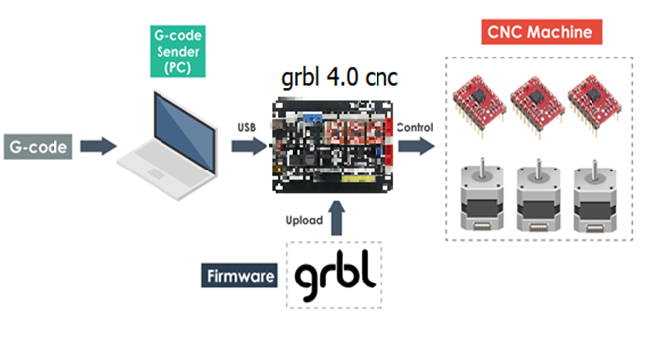
SOFTWARE
Connecting overview

Slide 14
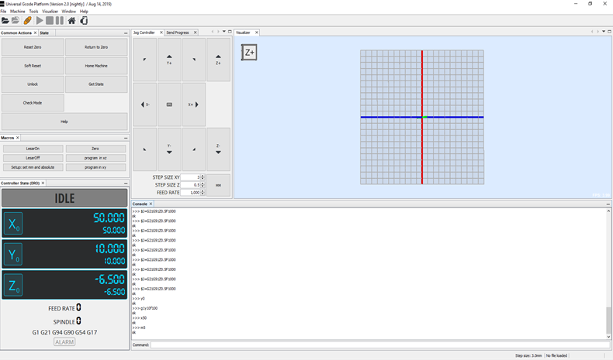
UNIVERSAL G-CODE SENDER
Figure : UGS User Interface

Slide 15
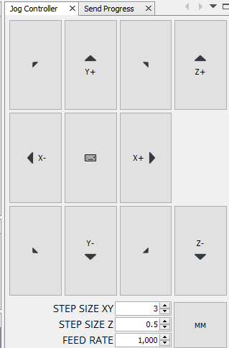
JOG CONTROLLER
Figure : Jog Controller

Slide 16
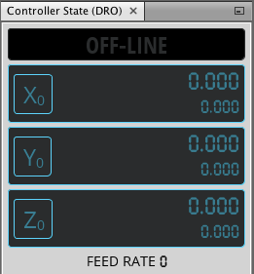
CONTROLLER STATE MONITOR
Figure : Controller State Monitoring

Slide 17
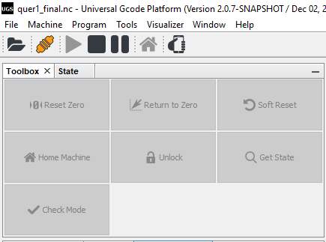
TOOLBOX
Figure : Toolbox and state

Slide 18
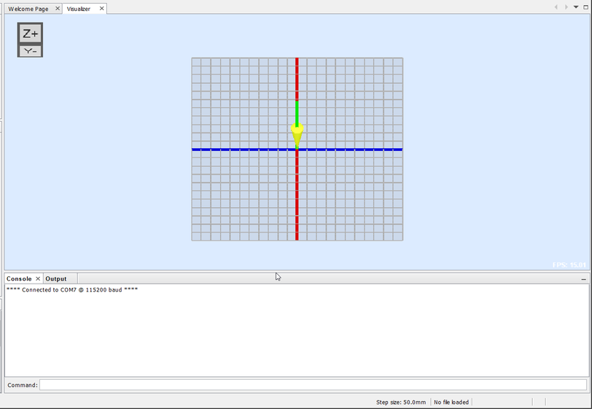
COMMAND BOX AND VISUALIZATION
Figure : Command Box And Visualization

Slide 19
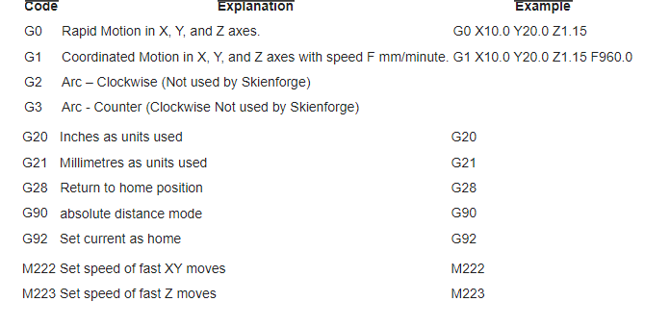
G code instructions

Slide 20
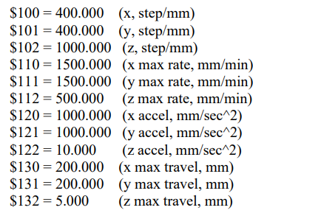

RECOMMENDED SETTINGS

Slide 21
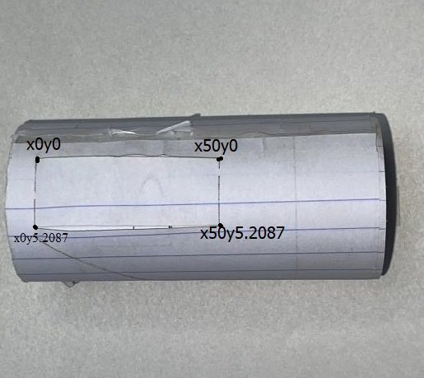
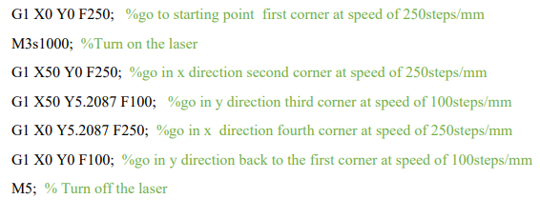
Test and Results
Straight lines

Slide 22
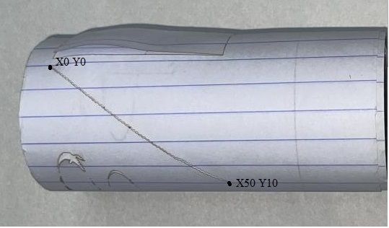
Angled lines

Slide 23
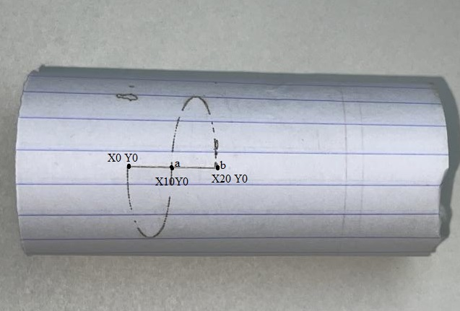
ARCS AND CIRCLES
G1 X0 Y0 F250;
M3s1000;
G2 X10 Y0 I5 J0 F85;
G3 X20 Y0 I5 J0 F85;
m5;

Slide 24
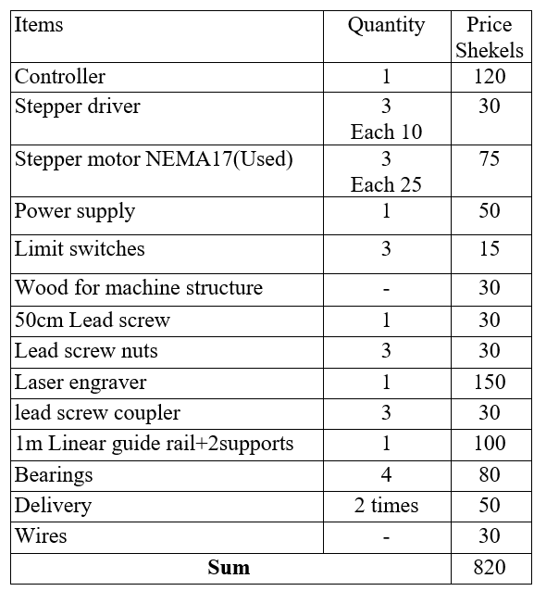
Overall cost of machine

Slide 25
THANKS FOR WATCHING

Slide 26
Appendix and extra slides

Slide 27
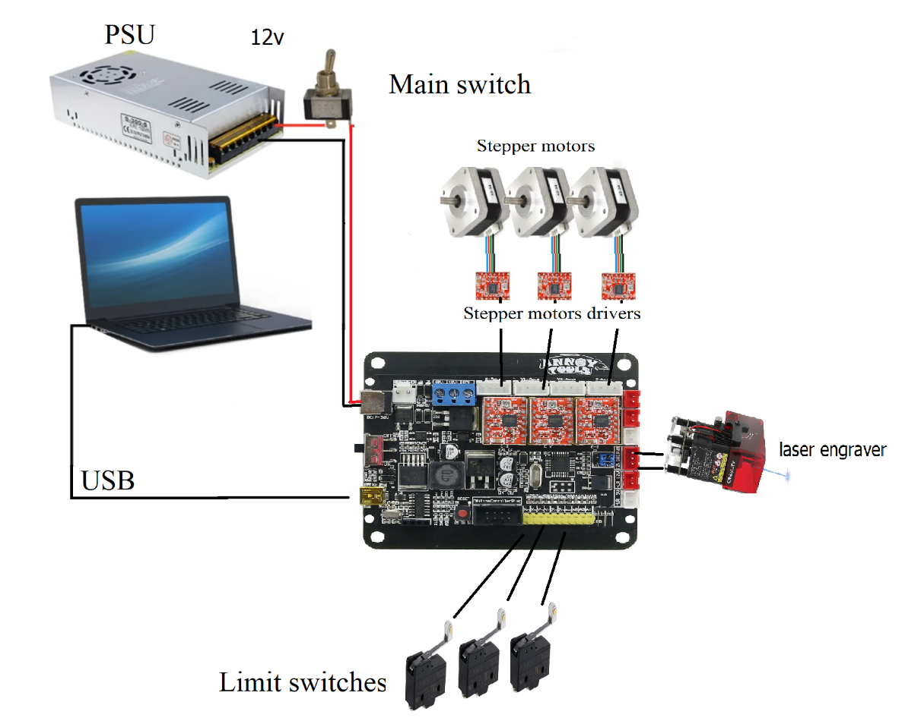
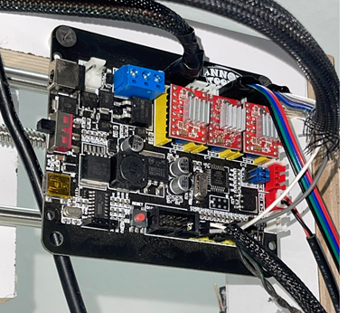
ACTUAL CONNECTION

Slide 28
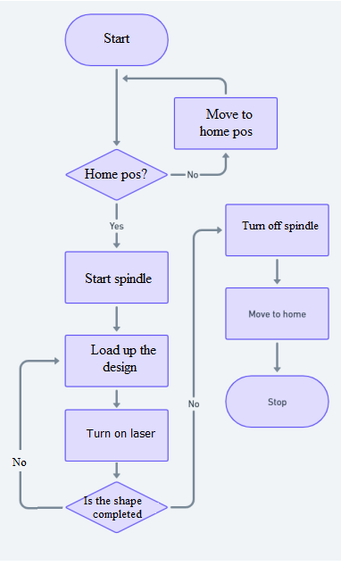
Work flow chart of CNC

Slide 29
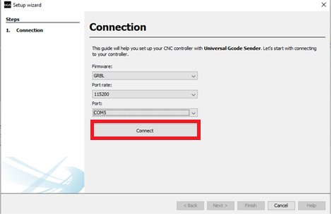
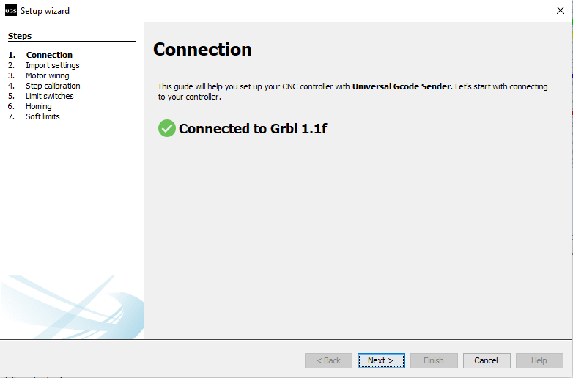
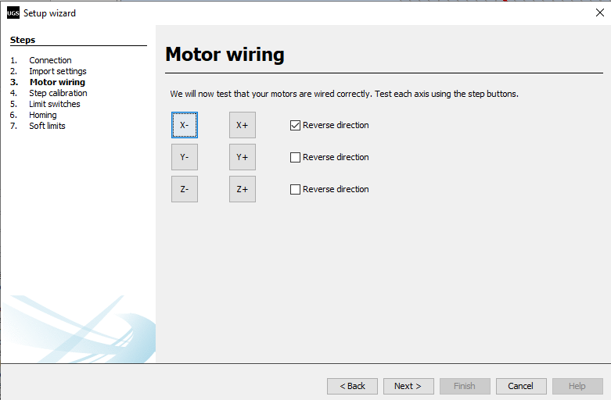
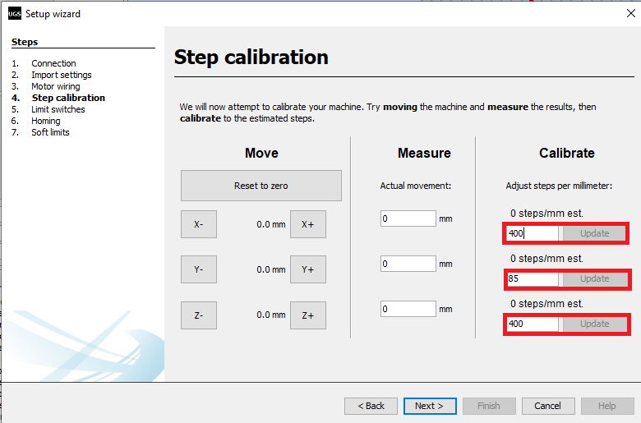

Slide 30
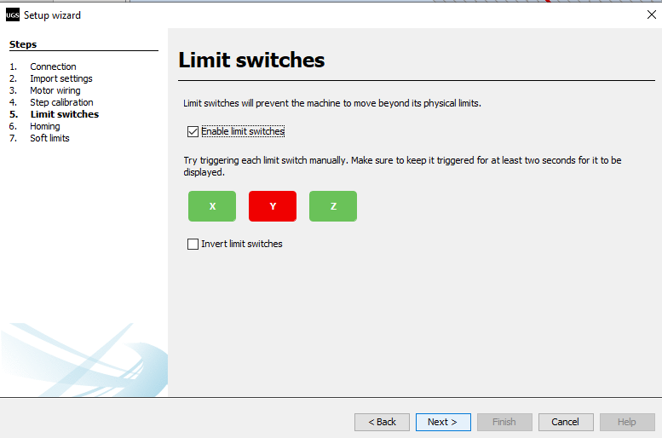
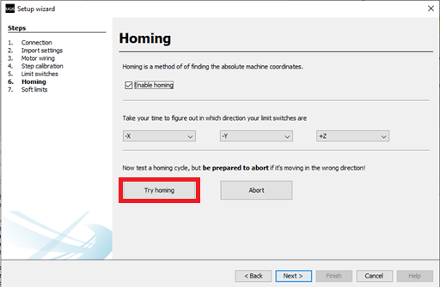
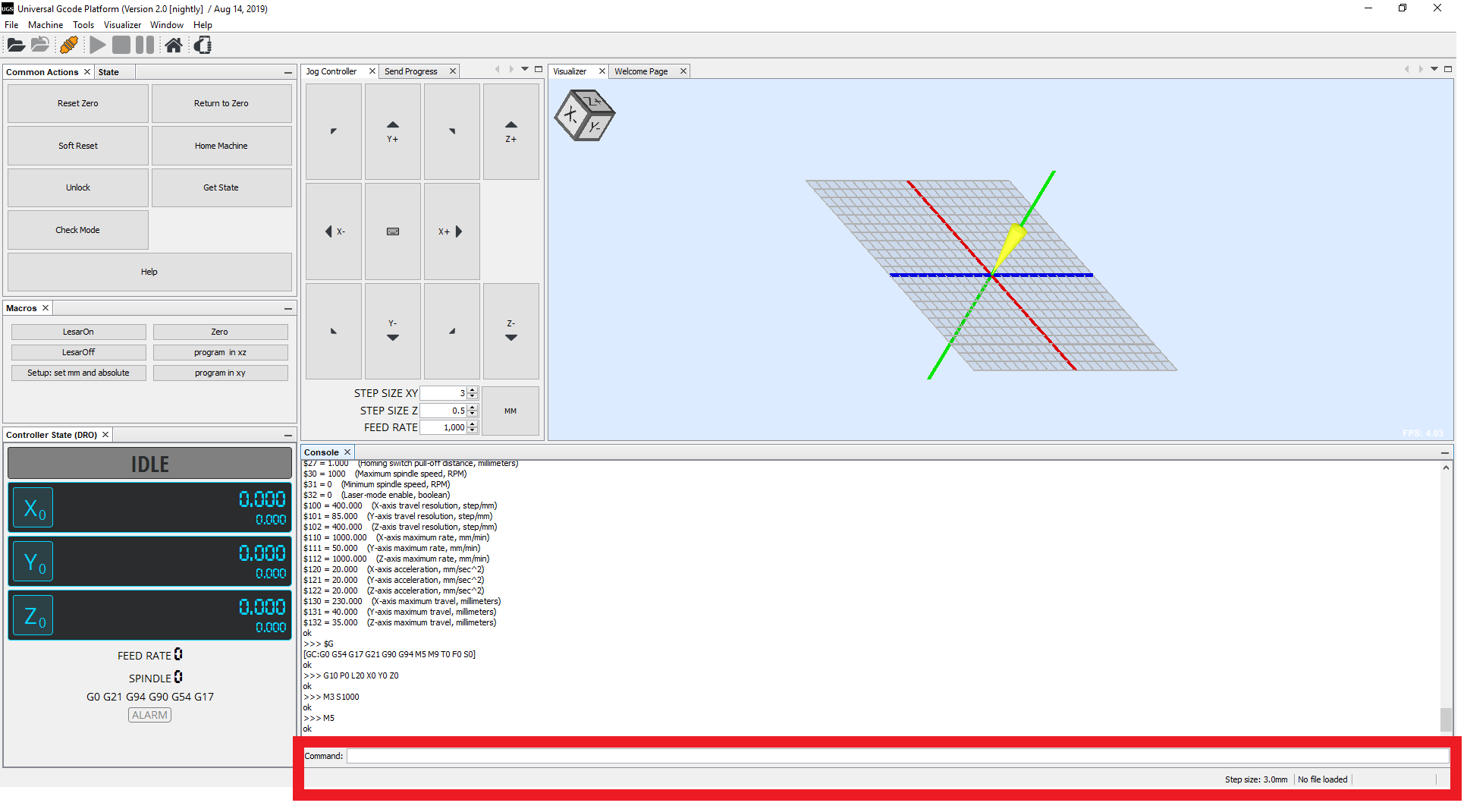

Slide 31
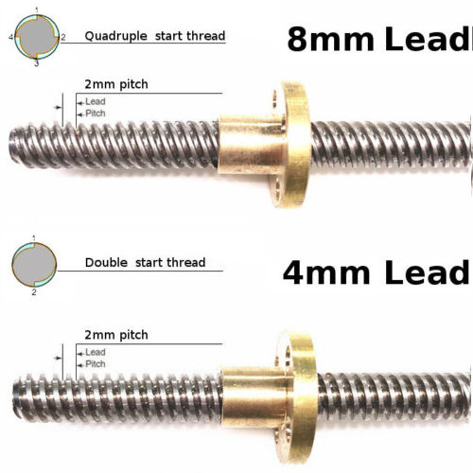
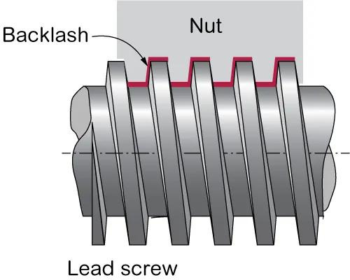
LIMITATIONS
LEAD AND RESOLUTION
BACKLASH

