Slide 1
Welcome

Slide 2
Traffic Analysis & Design for Al-Biereh City Network
Prepared By:
Supervised By:
Mahfouz Hassoun
Amjad Khuffash
Fadi Jarraraa
Dr. Khalid Al-Sahili

Slide 3
Presentation Contents:
Introduction
Data Collection & Analysis
Definition of the Problem sources
Design inputs
Area Description
Design Alternatives & Description of the Best Alternative
Recommendations

Slide 4
Introduction:
Transportation Systems: In order to meet the human need of travelling from one place to another including goods transfer.
Transportation Modes: The different types of transportation methods based on the median of movement:
Air Transport
Sea Transport
Rail Transport
Highway Transport

Slide 5
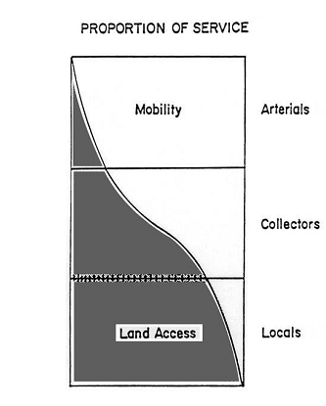
Introduction:
Highway Efficiency:
Level Of Service: What % of the capacity is used.
Mobility & Accessibility

Slide 6
Introduction:
Transportation System Management: Is a range of potential improvement strategies, focusing on short range, low cost, and quick to implement measures.
By adding new facility or improving the existing ones.

Slide 7
Description:
Al-Biereh City CBD area.
Major Intersections.
Street Classification
Major Arterials
Major Collector
Local Streets

Slide 8
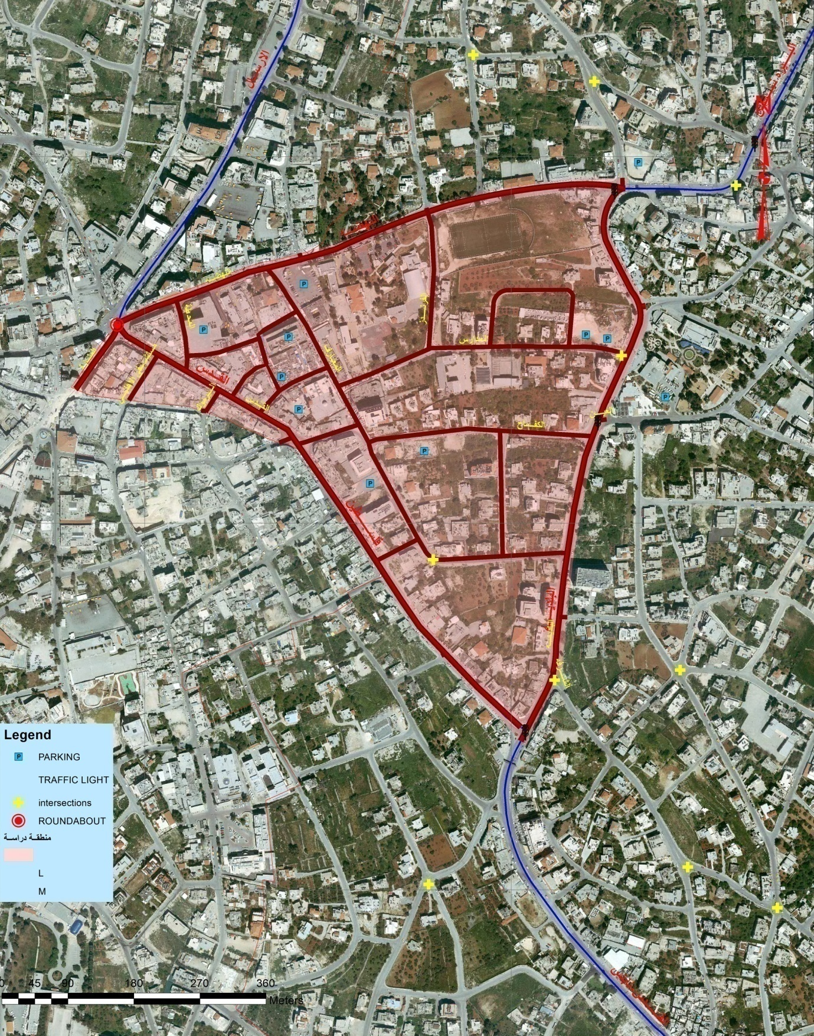

Slide 9
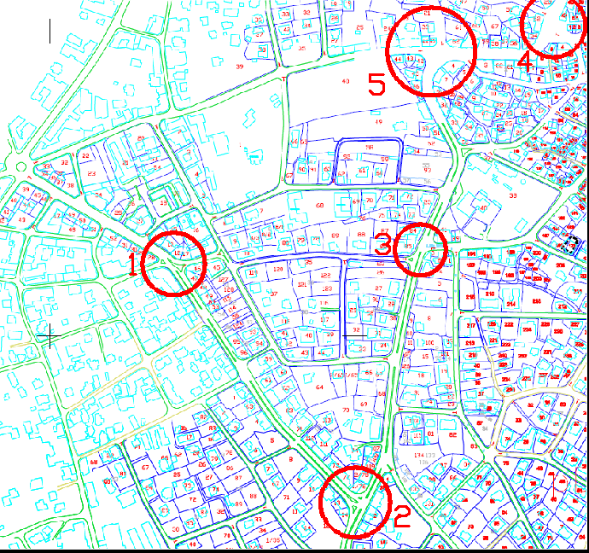

Slide 10
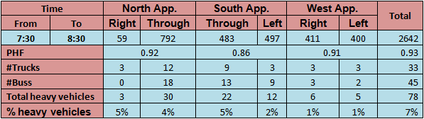
Data Collection & Analysis:
Data Collection:
Geometric Data: Inventory Study, Maps & Auto CAD drawings.
Traffic Data: Manual – Intersection Count, with vehicular classification.
Al-Shurafa Intersection Count Summery:

Slide 11
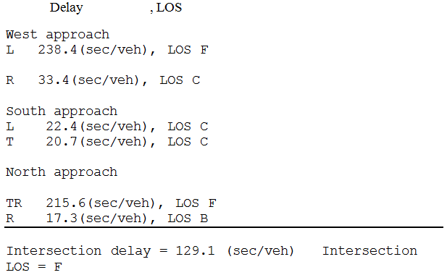
Data Collection & Analysis:
Data Analysis:
HCS: Intersections are separated from the network.
Al-Shurafa Intersection LOS HCS Results:

Slide 12
Data Collection & Analysis:
SYNCHRO Software: Intersections as part of the network.
Intersection | LOS
Al-Shurafa | F
Al-Biereh - Nablus - Al-Rawda | F
Al-Biereh - Nablus - Al-Nahda | F
Al-Baladia - Al-Ain | D
Palestine - Ameen Al-Hussaini | C

Slide 13
Definition of the problem Sources:
Al-Nahda Street.
Al-Biereh – Nablus Street.
Al-Baladia Street.
Al-Quds Street.
Palestine Street.

Slide 14
Design Inputs:
Design hour volume (DHV).
DHV = PHV / PHF
Design vehicle (DV).
The vehicle of highest percentage on the way.
5% or more for heavy vehicles to lead.

Slide 15
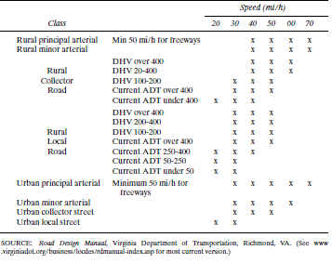
Design Inputs:
Design speed.

Slide 16
Design Inputs:
LOS
Functional classification of the streets.
Growth rate.
V_{n} = V_{o} (1 + r)^{n}
From previous study r = 5%

Slide 17
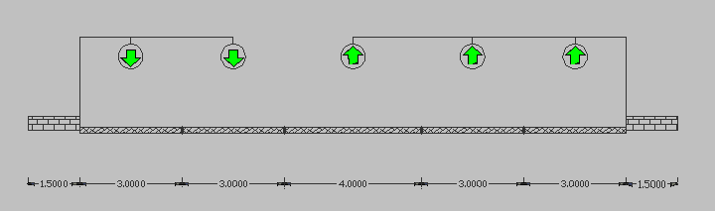
Design Alternatives
Alternative (1):
Prevent On Street Parking At Palestine, Al-Baladia and Al-Biereh – Nablus Streets.
Installation of traffic signal at Al-Friends Intersection
Installing reversible lane at Al-Baladia Street.

Slide 18
Design Alternatives
Installing pavement marking Al-Quds Street to provide two lanes:
Lane of through shared with right
Lane of through shared with left

Slide 19
Design Alternatives
Improve the EA of Al-Rawda Street to carry about 30 % of the through traffic away from the congested points.
SYNCHRO Results are:
Intersection | LOS
Al-Shurafa | D
Al-Biereh - Nablus - Al-Rawda | D
Al-Biereh - Nablus - Al-Nahda | F
Al-Baladia - Al-Ain | C
Palestine - Ameen Al-Hussaini | B
Al-Nahda - Al-Friends | C

Slide 20
Design Alternatives
Alternative (2):
Prevent on street parking
Al-Biereh – Nablus Street
Al-Baladia & Al-Ain Streets
Palestine Street
Improve the EA of Al-Rawda Street to carry about 30 % of the through traffic away from the congested points.

Slide 21
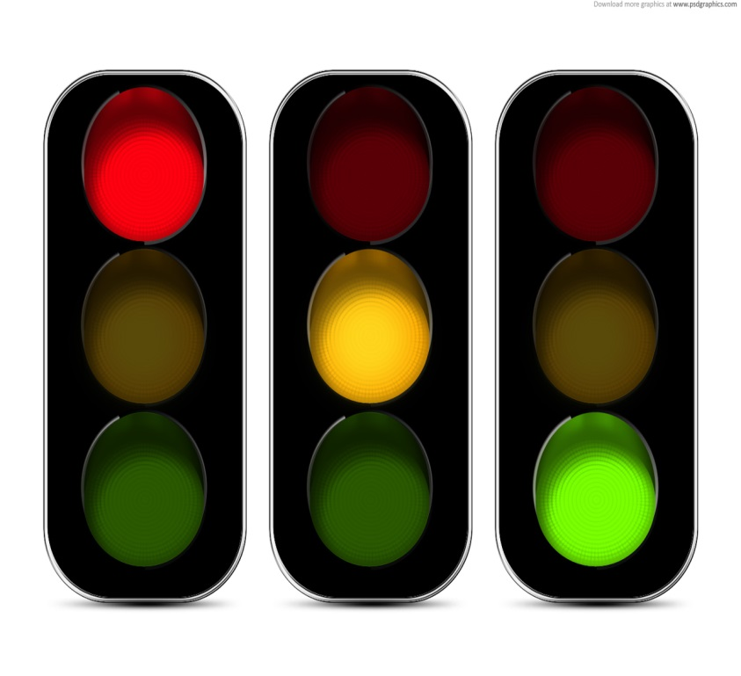
Design Alternatives
Install traffic signal at Al-Friends Intersection, with the following timing:
The same previous channelization for Al-Quds Street
Al-Nahda - Al-Friends Intersection (Total split)
NA | 20 sec
SA | 20 sec
WA | 70 sec
EA | 70 sec

Slide 22
Design Alternatives
Add exclusive turning lanes:
Right turn lane:
SA at Al-Biereh – Nablus – Al-Rawda Intersection.
NA at Al-Biereh – Nablus – Al-Rawda Intersection.
EA at Al-Baladia – Al-Nahda Intersection.
EA at Al-Ain Intersection.
SA at Al-Ain Intersection but shared with through.
EA at Palestine – Ameen Al-Hussaini Intersection.

Slide 23
Design Alternatives
LOS results for Alternative (2) is the same as Alternative (1), by the economic comparison; Alternative (2) will be used as the best Alternative.
year | Intersection number (LOS)
 | 1 | 2 | 3 | 4 | 5 | 6
current | F | D | F | F | D | C
1 | D | B | F | D | B | B
2 | D | B | F | D | B | B
3 | D | B | F | D | B | B
4 | D | B | F | D | B | B
5 | D | C | F | D | C | B

Slide 24
Design Alternatives
As, 1- Al-Shurafa Intersection
2- Al-Ain Intersection
3- Al-Biereh – Nablus – Al-Nahda Intersection
4- Al-Biereh – Nablus – Al-Rawda Intersection
5- Al-Nahda – Al-Friends Intersection
6- Palestine – Ameen Al-Hussaini Intersection

Slide 25
Recommendations
Expand Study Area (Escape Streets).
Public transport & Parking Study.
Improve the law Enforcement (Municipality Police).

