Slide 1

An Najah National University
Automatic Blood Determination Using Image Processing Techniques
Prepared by: 1- Sajeda Hasan
2-Deema AL-Athmah
Supervised by: 1- Dr. Ahmed Masri.
2-Inst. Nuha Odeh.

Slide 2
Outlines:
Definition of the problem.
Scope of work.
Requirements.
Results.
Application.

Slide 3
Definition of the problem:
In emergency situations, we don't have a lot of time to detect the blood type before transfusion it to another body using the technical methods which done manually at the laboratory.

Slide 4
Scope of work:
Our project is to develop a new method that can be effective and also at the same time reduce the time for detecting the blood type , this can be done by using image processing techniques for blood type determination.

Slide 5
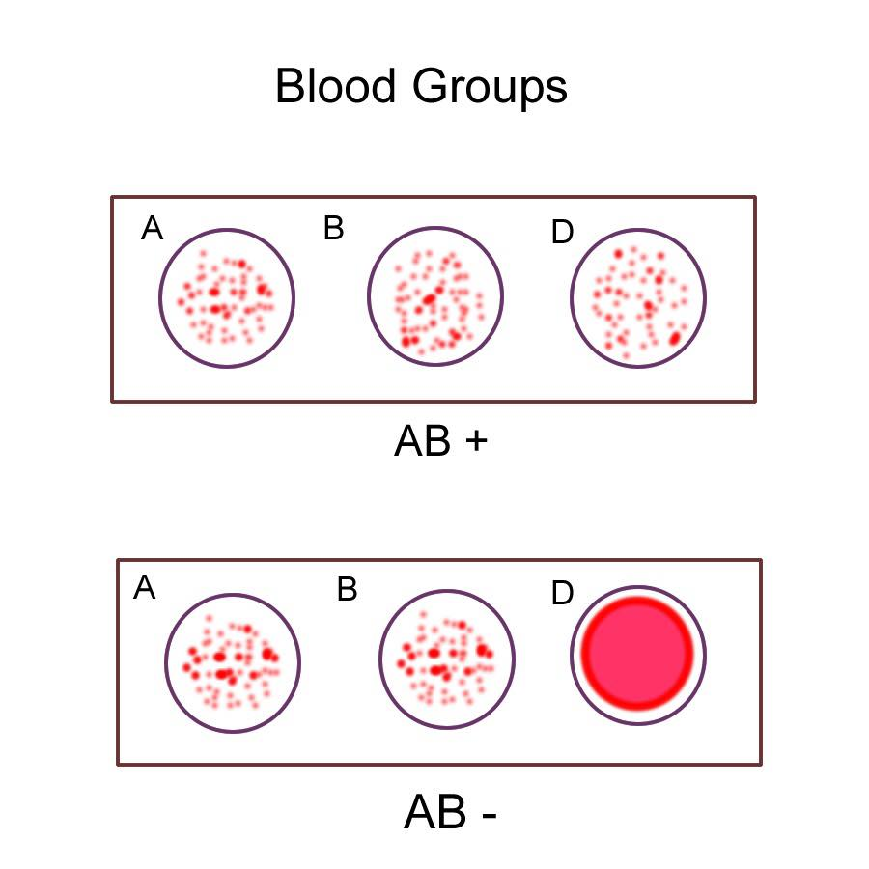
Human blood groups are determined according to the following table:
Reagent | Anti-A | Anti-B | Anti-D | Blood groups
Agglutination | √ | × | √ | A +
 | √ | × | × | A -
 | × | √ | √ | B +
 | × | √ | × | B -
 | √ | √ | √ | AB +
 | √ | √ | × | AB -
 | × | × | √ | O +
 | × | × | × | O -

Slide 6
Requirements:
Hardware and software used :
Software required: MATLAB.
Hardware required:1- Cell phone camera of 12MP, resolution 540 x 960 pixels.

Slide 7
Steps of blood types determination:
1- Database collection.
2- Color plane extraction.
3- Thresholding.
4- Morphological operations.
5- Feature extraction.

Slide 8
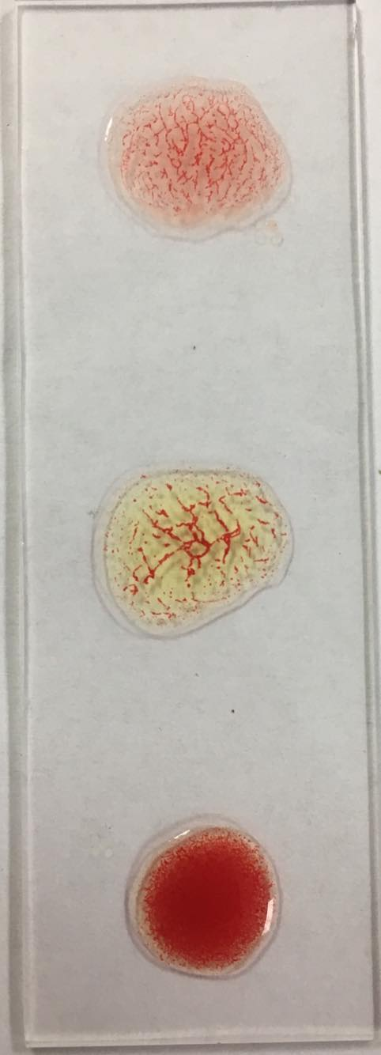
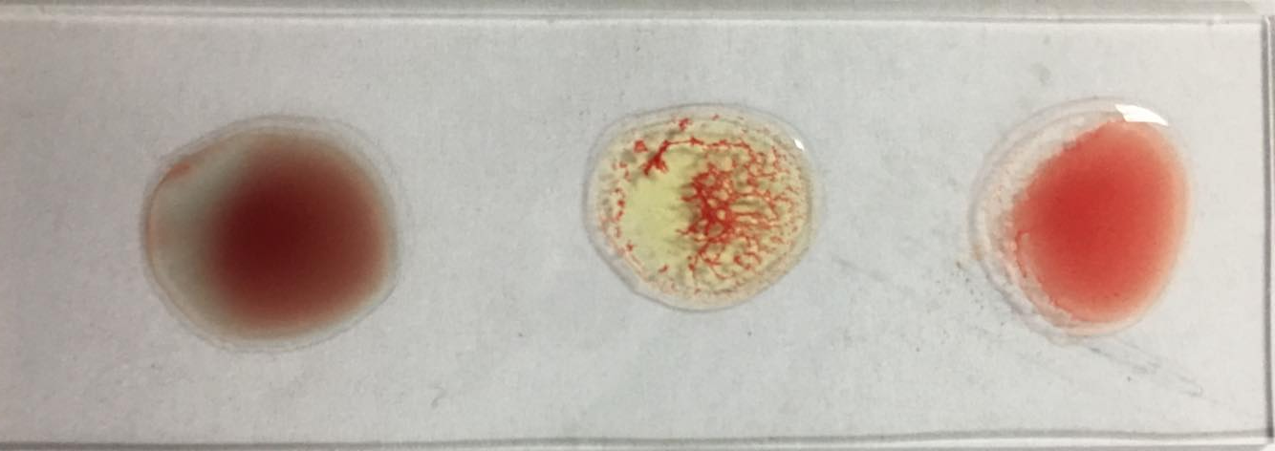
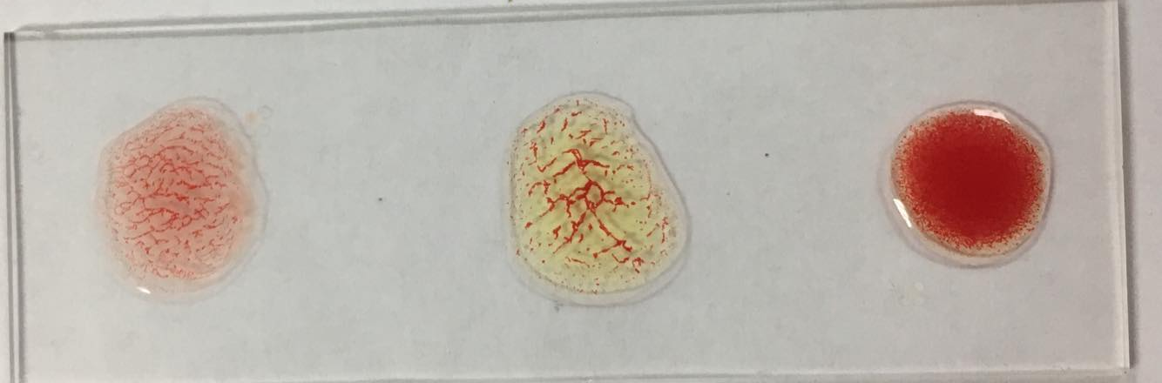
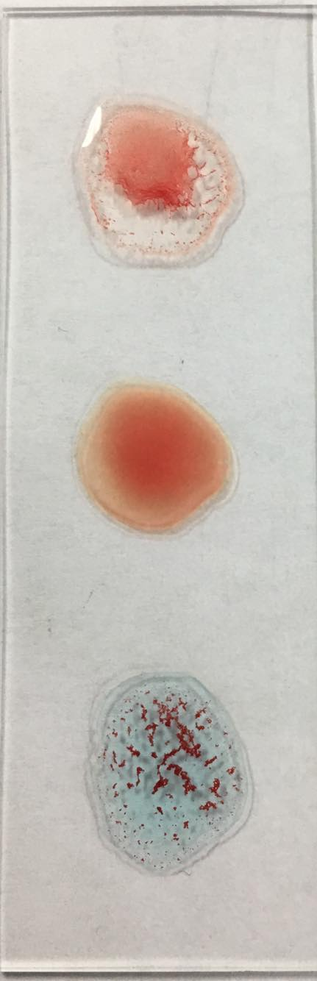
1- Database Collection:
Blood samples are obtained from the laboratory consisting of a color image composed of three samples of blood and reagent.

Slide 9
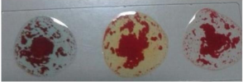
Input image:
The images were obtained from laboratory are digital images stored in JPEG format.

Slide 10
2- Color Plane Extraction :
The color plane contains color information in images. The foreground and background color of each image has different values. In this work only green color component is extracted because it contains maximum value in the RGB color plane.

Slide 11
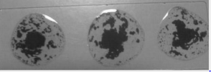
2- Color Plane Extraction : (cont…)
Ruselt of green plane extraction

Slide 12
3-Thresholding:
Is used to extract the light objects from the dark background.
-Global thresholding:
Used in Images with uniform contrast distribution of background and foreground. We used it in project 1.
-Variable thresholding:
Used in cases where there is more than one dominant object intensity. We used variable threshold because global threshold methods we used in project 1 failed when the background illumination is highly non uniform

Slide 13
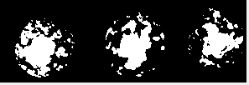
3-Thresholding: (cont…)
Result of thresholding

Slide 14
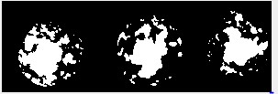
4- Morphological Operations:
A-Closing operation, it’s the erosion followed by dilation, used to fill the holes and gaps.

Slide 15

4- Morphological Operations: (cont…)
B- Opening operation, it is dilation followed by erosion, used to eliminate noise and small object.

Slide 16
5- Features Extraction:
Feature extraction using SURF (-Speeded-Up Robust Features) algorithm.
SURF algorithm steps:
1. Detection:
Automatically identify interesting features.
2. Description:
To provide a unique and robust description of an image feature, e.g., by describing the intensity distribution of the pixels within the neighborhood of the point of interest, hence a description is obtained for every point of interest identified previously.

Slide 17
5- SURF features: (cont…)
3. Matching:
By comparing the descriptors obtained from different images, matching pairs can be found.
interest points are found at blob-type structures.
the sign of the Laplacian distinguishes bright blobs on dark backgrounds from the reverse situation.
In the matching stage, we only compare features if they have the same type of contrast.
minimal information allows for faster matching, without reducing the descriptor’s performance
If the contrast between two interest points is different, the candidate is not considered a valuable match.

Slide 18
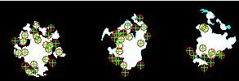
5- SURF features: (cont…)
1- Matching the original image with AB+.

Slide 19
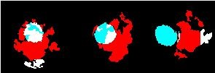
5- SURF features: (cont…)
2- Matching the original image with O-.

Slide 20
Thanks for your listening

