Slide 1
Ahmad Daraghmeh.
Asem Mayyaleh.
Mustafa Fashafsha
Abdassalam Najim.
Building Engineering Department
An-Najah National University
Graduation Project II
Multi-Purpose Commercial Building
Supervisor :
ENG.Ameer Aker

Slide 2
Outline
Introduction
Methodology
Project Design
Summary اسال ميالة شو القصد بالسامري

Slide 3
  Introduction
  Why??
There is commercial building in jenin city ,it has a lot of problems , our objective in this graduation project is focusing on studying & solving the problems by redesigning process
The redesign include Architectural , Environmental ,Structural ,Electrical and Mechanical aspects

Slide 4
Methodology
Methodology
Project Redesign
Summary
Standards
Analyzing Case study
Tubas commercial center
Makkah mall
Architectural Redesign
Structural Redesign
Enviromental Redesign
Mechanical Redesign
Electrical Redesign
Notes:
Methodology divided into two phases :
phase one in project 1 and include spec. ,standard and analyzing of case study
phase twoin project 2 and include redesign (اذكر خطوات التصميم المعمارية والانشائية .... الخ )

Slide 5
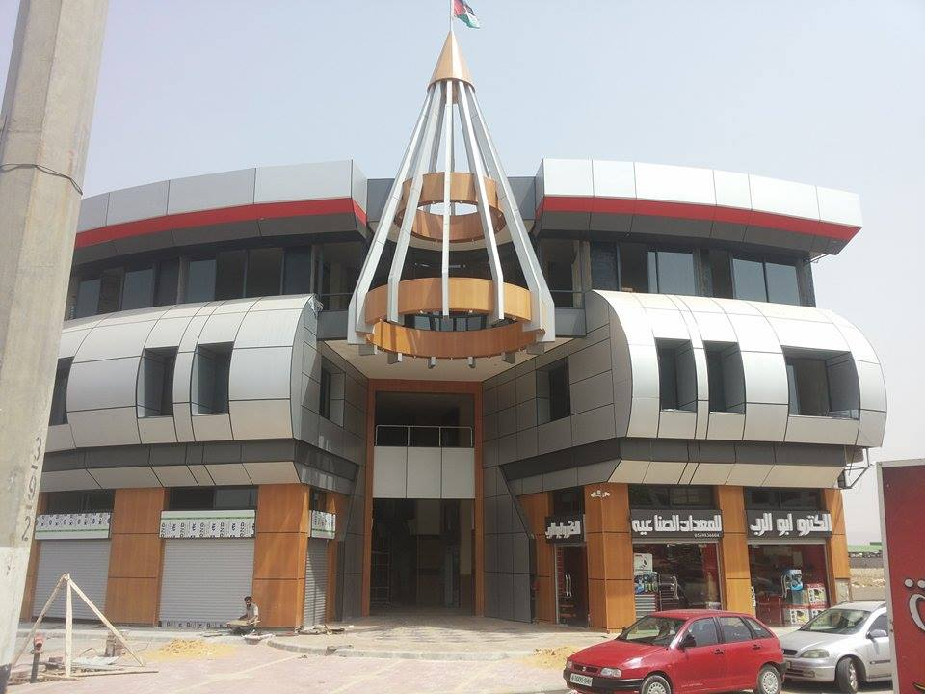
Project Design
The Project to Be Redesigned
Zyad Snan Mall

Slide 6
Project Design
Architectural Redesign
Architectural Design
comparison
Building Description
Notes:
We start Project Redesign by Architectural aspect.
And we show this by description site plane , and comparison with old design

Slide 7
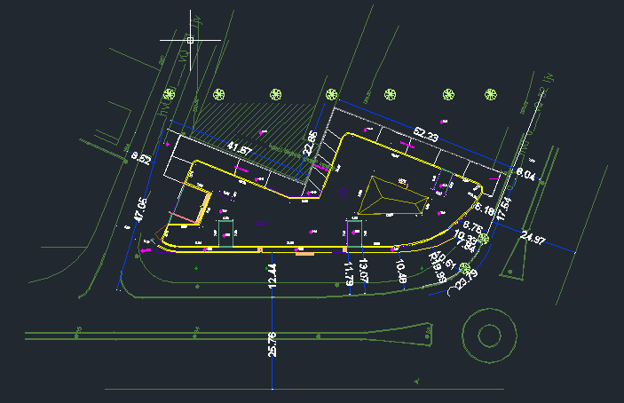
Project Design
Architectural Redesign
architectural Design
comparison
Building Description
Notes:
The municipality of Jenin city is applying green belt law, therefore the bounce off the main street is to be 15m
(اسال عاصم ليش طالع بالصورة 12.44 متر مش 15 متر )

Slide 8
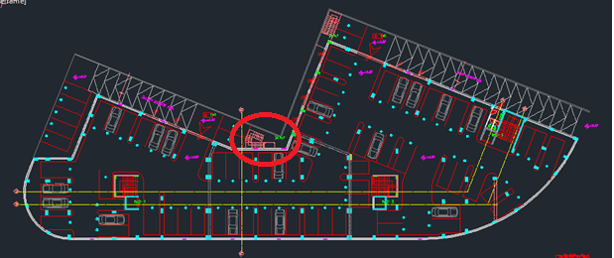
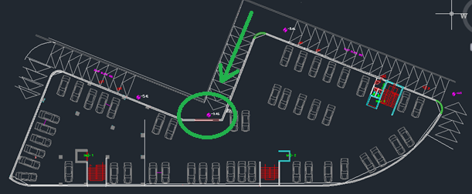
Project Design
Architectural Redesign
architectural Design
Comparison
Description
Notes:
When we calculated the required number of parking we needed an additional basement floor, and, therefore, we need to remove the emergency staircase to open the entrance to the new floor.

Slide 9
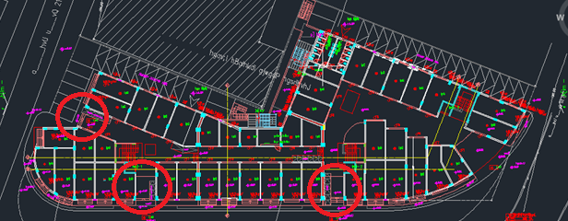
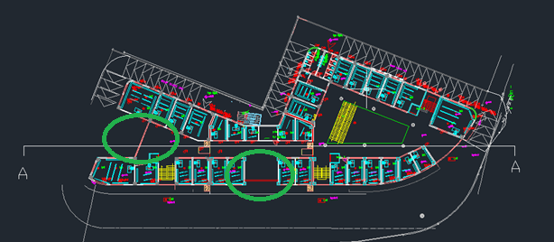
Project Design
Architectural Redesign
architectural Design
Comparison
Description
Notes:
For the entrance to the building
We have increase the dimensions of the main entrance, and replaced the two entrances by one wide entrance

Slide 10
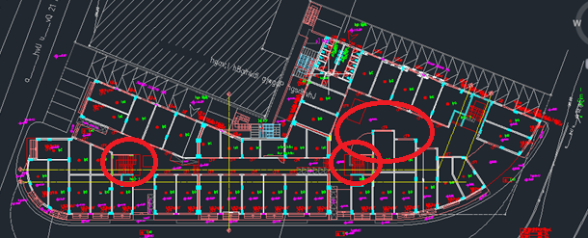
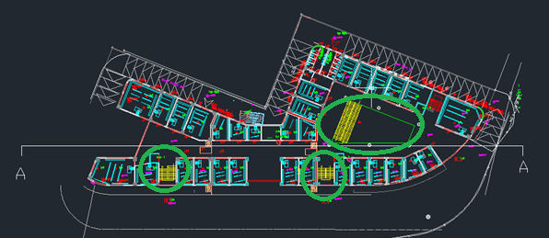
Project Design
Architectural Redesign
architectural Design
Comparison
Description
Notes:
We improved the circulation in building by adding Courtyard and escelator
And we replaced the old entrance by stairs

Slide 11
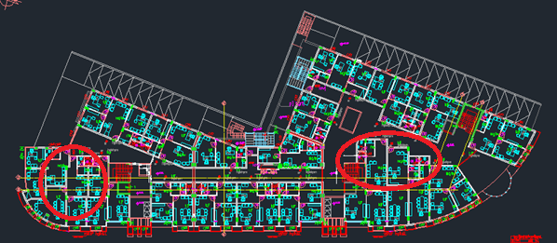
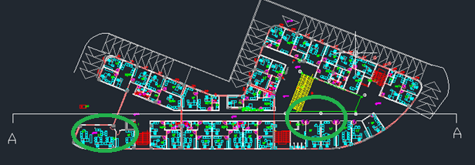
Project Design
Architectural Redesign
architectural Design
comparison
Description
Notes:
احذف هذه الشريحة

Slide 12
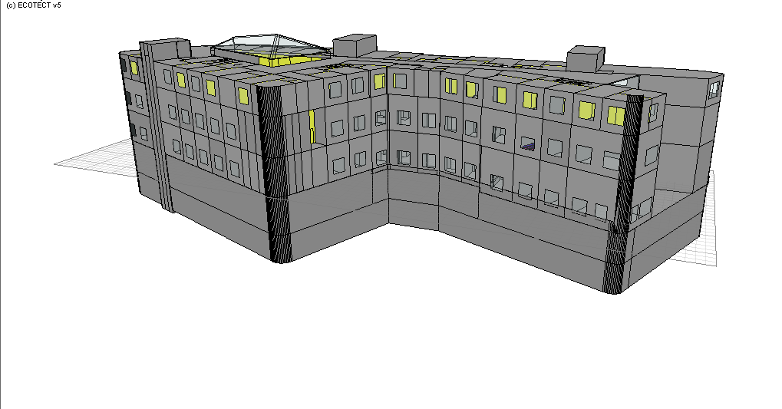
Project Design
Environmental Design
Environmental Analysis
Acoustics Analysis
Lighting Analysis
Thermal Analysis
ECOTECT
Notes:
We made a Model of the building in ecotect program as shown

Slide 13
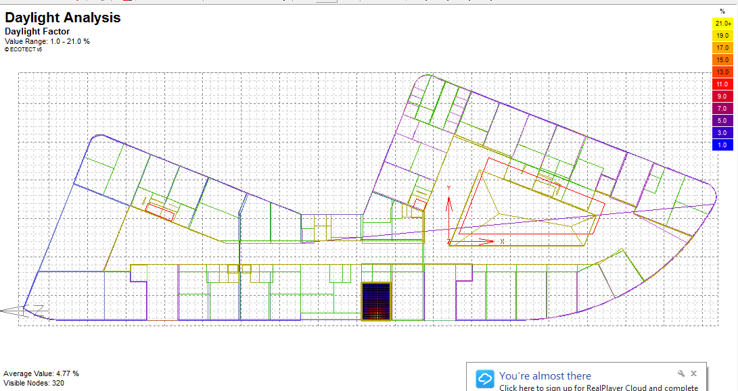
Project Design
Environmental Analysis
Environmental Analysis
Acoustics Analysis
Lighting Analysis
Thermal Analysis
Daylight factor
Notes:
We take the colored zone as example to explain daylight factor
we note that avg. value of daylight factor fore this zone about 5 percent and this value lies in the range

Slide 14
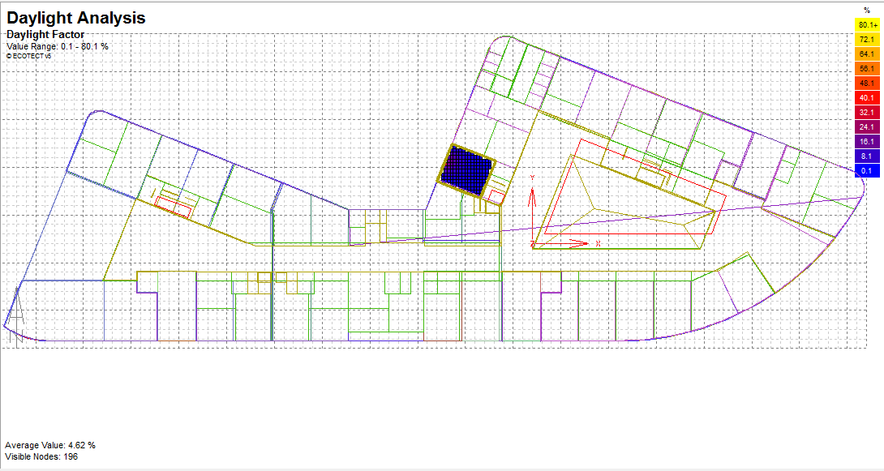
Project Design
Environmental Analysis
Environmental Analysis
Acoustics Analysis
Lighting Analysis
Thermal Analysis
Notes:
As previous zone , daylight factor for this zone lies in rang

Slide 15
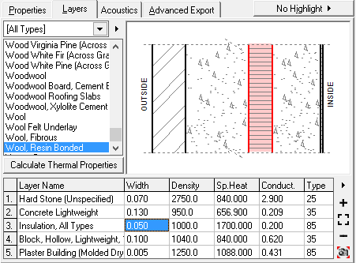
Project Design
Environmental Analysis
Environmental Analysis
Acoustics Analysis
Lighting Analysis
Thermal Analysis
Thermal analysis
U value for external walls = 0.80
U value for floor=0.92
U value for roof = 0.71
U value for windows = 2.71
U value for doors=2.31
Notes:
we inter u value for walls ,floor ,roof , windows and doors in program

Slide 16
Project Design
Environmental Analysis
Environmental Analysis
Acoustics Analysis
Lighting Analysis
Thermal Analysis
Total(KWHR) | Heating(KWHR) | Cooling(KWHR) | MONTH
5425.72 | 5425.72 | 0 | Jan
5407.55 | 5407.55 | 0 | Feb
4884.84 | 4863.24 | 21.6 | Mar
3372.22 | 2194.62 | 1177.6 | Apr
3893.17 | 1613.97 | 2279.2 | May
3643.41 | 109.81 | 3533.6 | Jun
5355.2 | 0 | 5355.2 | Jul
5182.4 | 0 | 5182.4 | Aug
3397.92 | 164.32 | 3233.6 | Sep
3436.77 | 318.37 | 3118.4 | Oct
3417.7 | 2962.5 | 455.2 | Nov
4980.16 | 4980.16 | 0 | Dec
52397.06 | 28040.26 | 24356.8
Total loads (Heating and Cooling), 31.56 KWh per meter square
Notes:
We made a heating and cooling calculation for office floor and Total loads (Heating and Cooling), 31.56 KWh per meter square

Slide 17
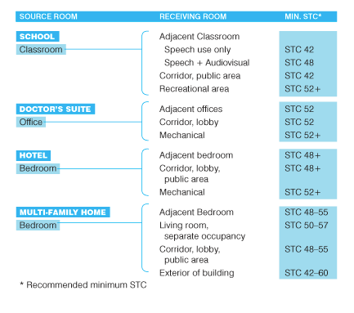
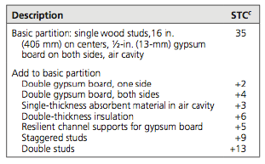
Project Design
Environmental Analysis
Environmental Analysis
Acoustics Analysis
Lighting Analysis
Thermal Analysis
STC=35 +13+4=52dB
Notes:
Stc from calculation large or equal code value

Slide 18
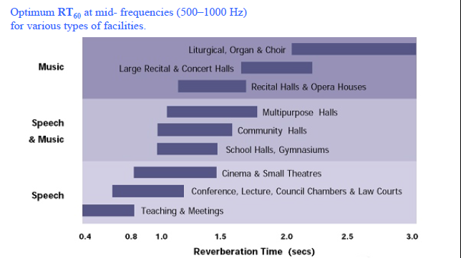
Project Design
Environmental Analysis
Environmental Analysis
Acoustics Analysis
Lighting Analysis
Thermal Analysis
Reverberation Time RT60:
RT₆₀ =0.78seconds
Notes:
Rt60 lies in this range so its ok

Slide 19
Project Design
Structural Design
Structural Design
Structural modeling
Structural Results
Description

Slide 20
Project Design
Structural Design
Structural Design
Structural modeling
Structural Results
Description
Site investigation
Bearing | 200 mpa
ϒ | 18KN/m3
Z | .2
Ca | .28
Cv | .40
Loads
L.L com. | 5KN/m2
L.L off. | 3KN/m2
SID | 4KN/m2
Wall WT | 30KN/m
Material Properties
f’c | 24 mpa
f’c (footing) | 28 mpa
Fy | 420 mpa
Notes:
We used these values in structural design….. اقرأها

Slide 21
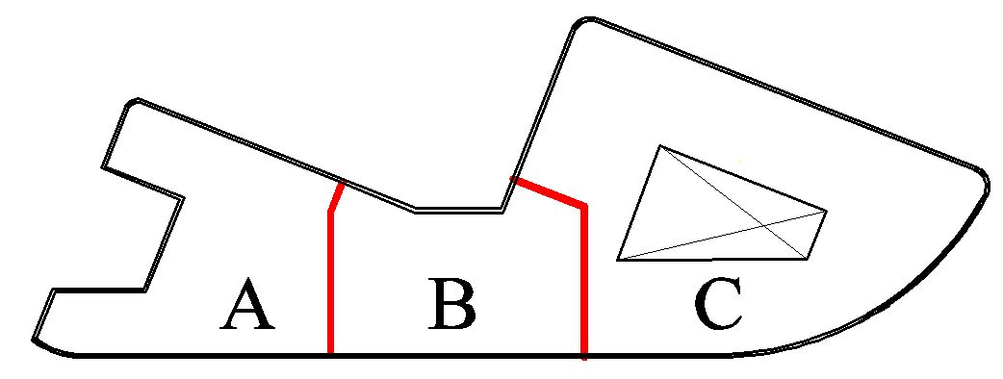
Project Design
Structural Design
Structural Design
Structural modeling
Structural Results
Description
The project blocks
Notes:
We divide the building to zones A B C and take zone A as an example to explain the structural desing

Slide 22
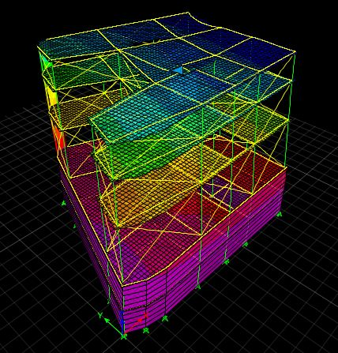
Project Design
Structural Design
Structural Design
Structural modeling
Structural Results
Description
Model Checks
Compatibility
Notes:
We simulated the building on etabs program , then we made the required checks
compatibility check is ok

Slide 23
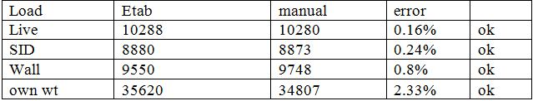
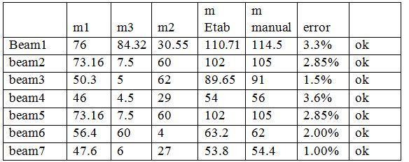
Project Design
Structural Design
Structural Design
Structural modeling
Structural Results
Description
Model Checks
Global Equilibrium
Internal Forces
Notes:
Equilibrium checks (L ,SD ,D ) is ok
In Internal forces check we take 7b , 3c (internal ,edge ,corner) , 2s ……… is ok

Slide 24
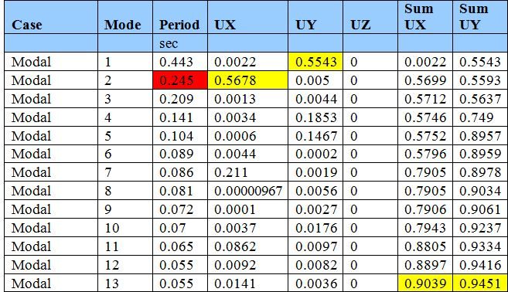
Project Design
Structural Design
Structural Design
Structural modeling
Structural Results
Description
Modal mass participation ratio &
Time period
Drift
Max Drift | Dmax
11mm | 618mm
V | BlockA
Vx | 4534.8
Vy | 4534.5
Vmanual | 4533.5
Base shear
Notes:
Response spectrum check include participation ratio &
Time period and drift and base shear
and all of these are ok

Slide 25
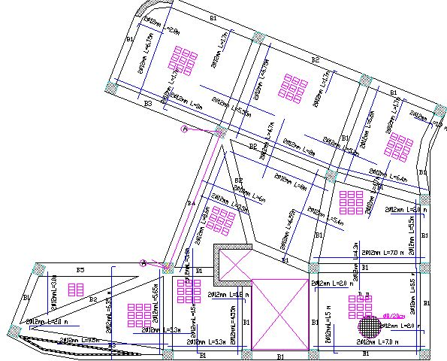
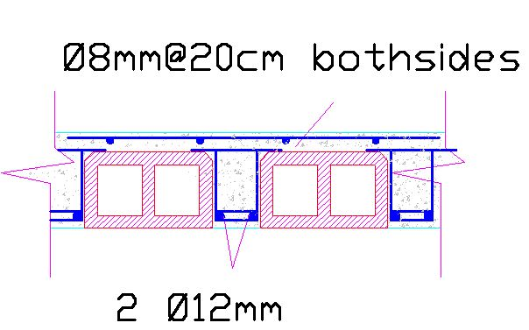
Project Design
Structural Design
Structural Design
Structural modeling
Structural Results
Description
Slab Design
Notes:
This is plane of steel for slabs (number and length of steel )
steel for rib as shown (2 bars phi 12 mm at bottom ) اقرأ من الرسمة

Slide 26
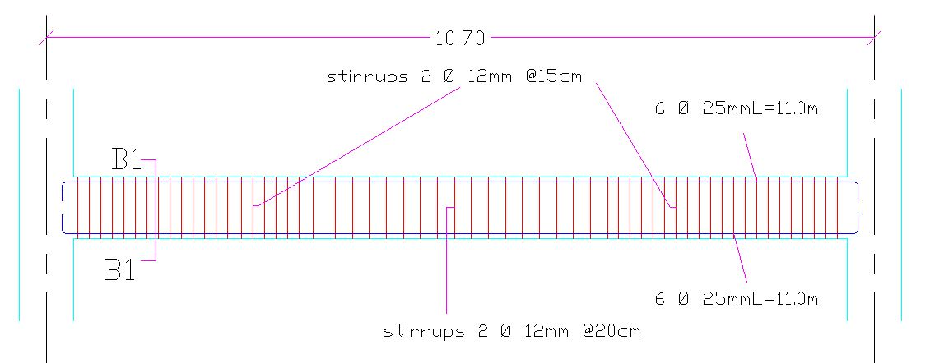
Project Design
Structural Design
Structural Design
Structural modeling
Structural Results
Description
Beam Design
Notes:
This plane of steel for beam

Slide 27
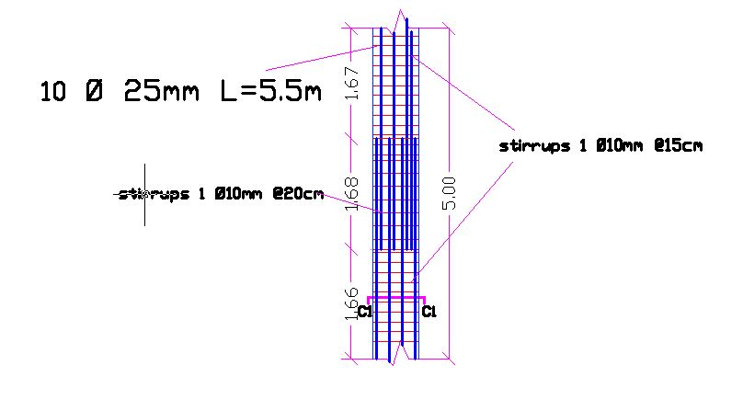
Project Design
Structural Design
Structural Design
Structural modeling
Structural Results
Description
Column Design

Slide 28
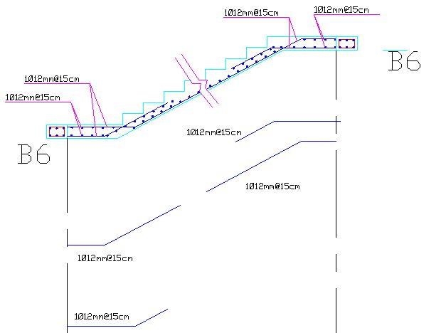
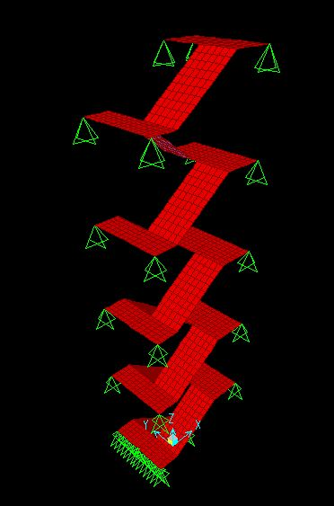
Project Design
Structural Design
Structural Design
Structural modeling
Structural Results
Description
Stair Design

Slide 29
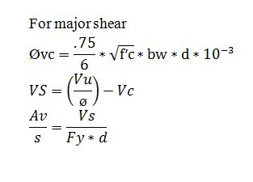
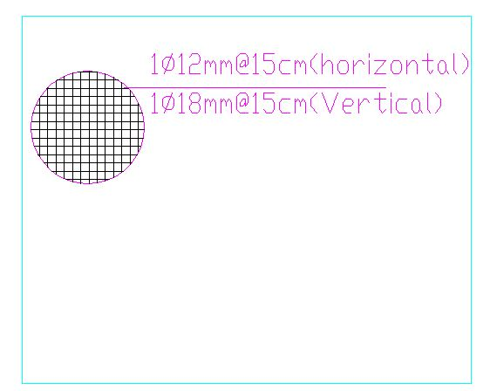
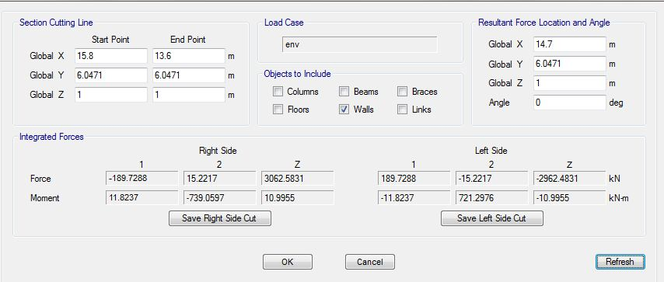
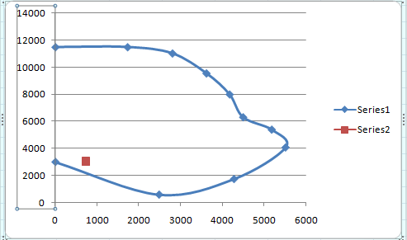

Project Design
Structural Design
Structural Design
Structural modeling
Structural Results
Description
Shear Wall Design
Notes:
We made section cut in the shear wall and result as shown
we assume ro 1% , then by major axial and major moment check that the point lies in side interaction diagram
then we design steel for minor shear and minor moment by equ.

Slide 30
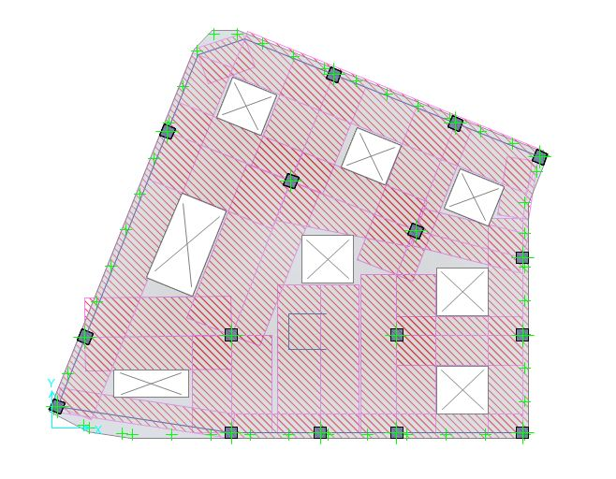
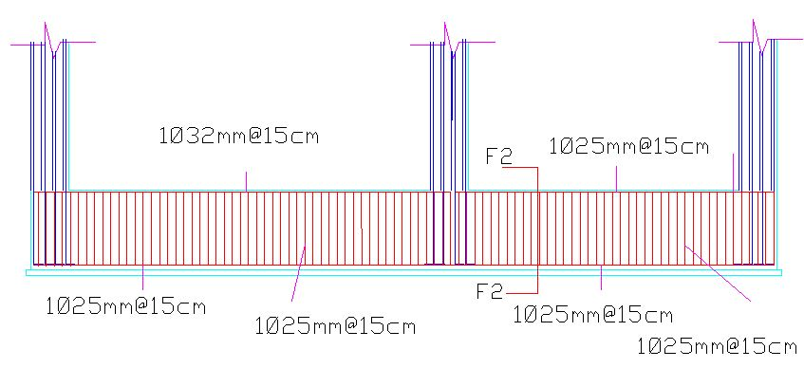
Project Design
Structural Design
Structural Design
Structural modeling
Structural Results
Description
Footing Design
Notes:
Type of footing is matt foundation and a height of 1.5 m
we take this zone
And plane of steel as shown

Slide 31
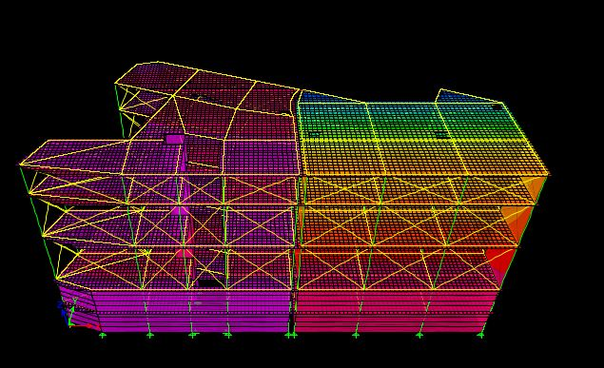
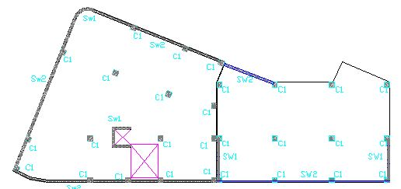
Project Design
Structural Design
Structural Design
Structural modeling
Structural Results
Description
Seismic Joint Design
D=11mm
D=8mm
Notes:
Seismic Joint Design equal drift block 1 + block2 +20 mm = 39 mm
type of drift is elastic

Slide 32
Project Design
Electrical Design
Electrical Design
Lighting &socket
Description

Slide 33
Project Design
Electrical Design
Electrical Design
Lighting & socket
Circuit breaker
Description
Area | Average Lux
General Office | 500
Shopping stores | 500
W.c | 150
Corridor | 100
Amp | Area of wire mm²
15 | 2.5
20 | 4
30 | 6
40 | 10
50 | 16
Notes:
اسال احمد عن مصدرهم كمان
احكي هذا السلايد يبين بعض قيم التصميم المطلوبة ()

Slide 34
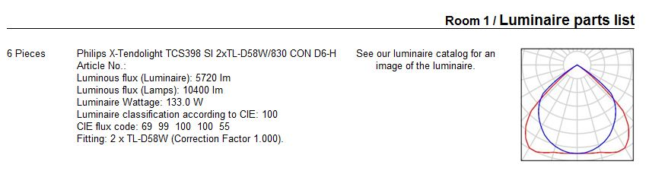
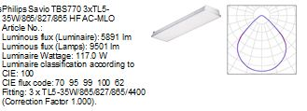
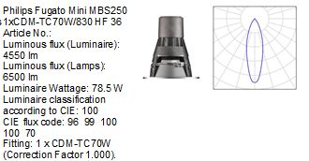
Project Design
Electrical Design
Structural Design
Lighting & socket
Circuit breaker
Description
Luminaries
Shoping
Offices & parking
Corridors & W.c
Notes:
Philips lamps us ed in lighting spaces as follow : يساعدك عرض الشرائح التدريجي في ذكر الانواع
shoping >>>>>

Slide 35
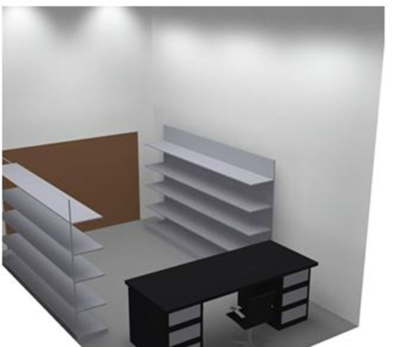
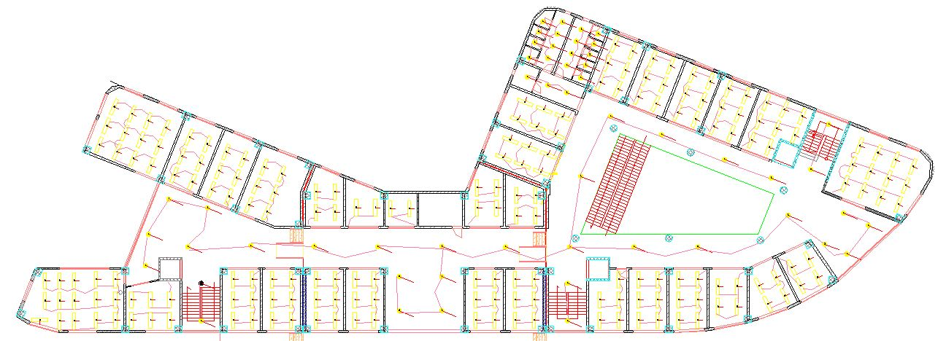
Project Design
Electrical Design
Structural Design
Lighting & socket
Circuit breaker
Description
Ground floor
Notes:
In the Specific zone the result as shown
ابدأ بذكرها
Avg. lux ………….. Uniformity
القيم ضمن الرينج

Slide 36
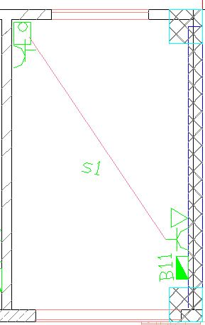
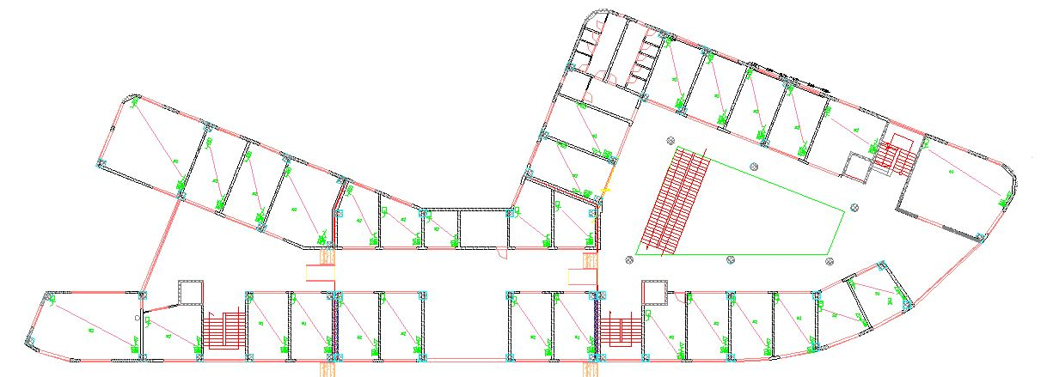
Project Design
Electrical Design
Structural Design
Lighting & socket
Circuit breaker
Description
Ground floor
Notes:
This slide explain distribution of the socket in the space

Slide 37
Project Design
Mechanical Design
Mechanical Design
Water supply system
Drainage system
Safety System

Slide 38
Project Design
Mechanical Design
Mechanical Design
Water supply system
Drainage system
Safety System
      Black water: W.CS & Kitchen sink
      Grey water: Lavatory.
      Storm Water
Diameters of the pipes =4" (for stack).
Diameters of the pipes = 2 " , 4 " , 6 " and 8 " (horizontal).
Notes:
We have 3 types of water ( black >>>> grey >> storm )
by calculation for Diameters of the pipes (4" (for stack)……. 2 " , 4 " , 6 " and 8 " (horizontal)

Slide 39
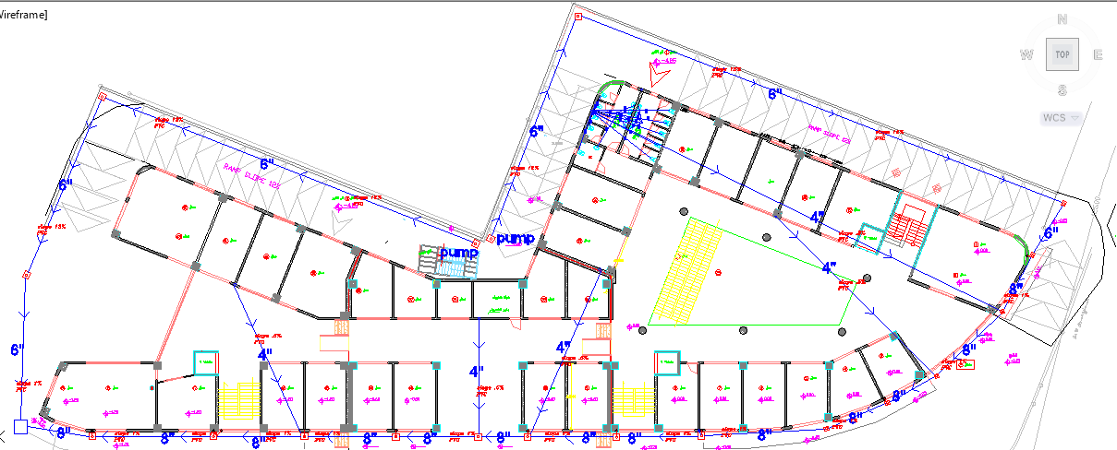
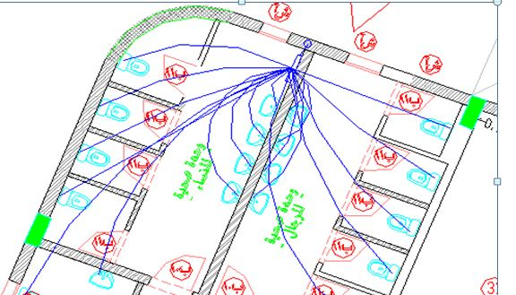
Project Design
Mechanical Design
Mechanical Design
Water supply system
Drainage system
Safety System
Notes:
This slide explain distribution of Drainage line (أكمل الشرح على السلايد )
(من المرحاض الى الستاك ثم الى خط المجاري خارج البناية )

Slide 40
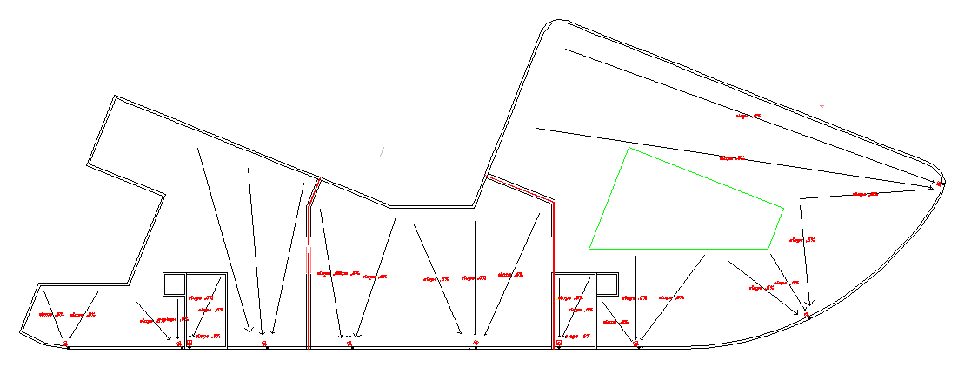
Project Design
Mechanical Design
Mechanical Design
Water supply system
Drainage system
Safety System
Notes:
This slide shows the dranaige water from the roof through red points

Slide 41
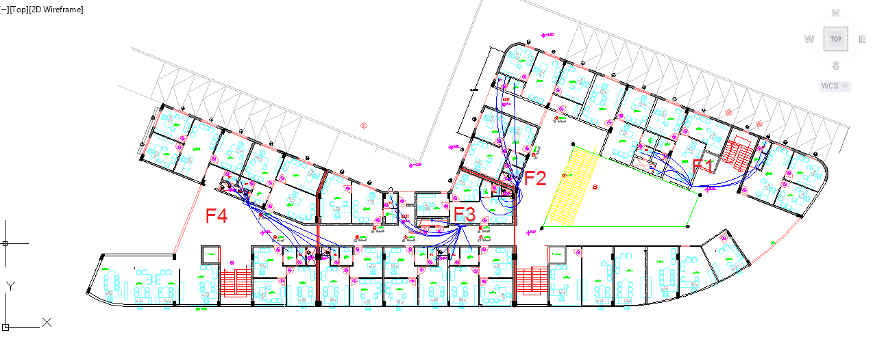
Project Design
Mechanical Design
Mechanical Design
Water supply system
Drainage system
Safety System
Notes:
اسال دراغمة عن طريقة تزويد المبنى بالماء عشان نضعها هون

Slide 42
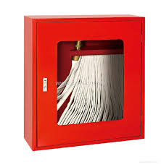
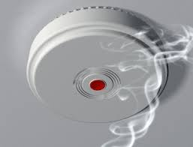

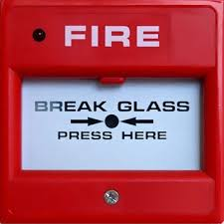
Project Design
Mechanical Design
Mechanical Design
Water supply system
Drainage system
Safety System

Slide 43

Project Design
Mechanical Design
Mechanical Design
Water supply system
Drainage system
Safety System
Notes:
This plane shows the distribution of sprenkuler and fire hose station on the office floor
fire hose station near the stairs
good circulation on the building provide escape from fire and smoke

Slide 44

Project Design
Mechanical Design
Mechanical Design
Water supply system
Drainage system
Safety System
Notes:
In ground floor

Slide 45

Project Design
Mechanical Design
Mechanical Design
Water supply system
Drainage system
Safety System
Notes:
Basement floor

Slide 46
Project Design
HVAC Design
HVAC
Design
HVAC
Results
Description

Slide 47

Project Design
HVAC Design
HVAC
Design
HVAC
Results
Description
Notes:
We take this zone as example for explain HVAC Design

Slide 48


Project Design
HVAC Design
HVAC
Design
HVAC
Results
Description
Notes:
This plane explain distribution of ducts ( blue ducts for supply air and red for return air )

Slide 49
Project Design
HVAC Design
HVAC
Design
HVAC
Results
Description
Notes:
From ecotect and rivet programs we take values for loads and we use it to calculate volumetric flow rate .

Slide 50


Project Design
HVAC Design
HVAC
Design
HVAC
Results
Description
Notes:
We calculated dimension of duct .

Slide 51

Project Design
HVAC Design
HVAC
Design
HVAC
Results
Description
Notes:
This plane show dimensions of duct

Slide 52
Quantity survey and proposed cost
The total cost of the project skeleton materials is about 2.3 million NIS.
The cost per meter square is about 230 NIS

Slide 53
Summery
Architectural Redesign
Environmental Design
Structural Design
Electrical Design
Mechanical Design
Quantity survey and proposed cost

