Slide 1
An-Najah National University
Redesign of The Administrative Building of Hisham Hadid
Prepared by:
Tahani Al-Masri
Adan Abubaker
Alma Eid
Haneen Ahmad
Under Supervisor:
Monther Dwaikat

Slide 2
Contents:
1. Introduction
2. Site Analysis
3. Architectural design
4. Structural Design
5. Environmental Design
6.Mechanical Design
7.Electrical Design
8.Safety Design
9. Cost Estimation

Slide 3
Introduction
*In this project, an integrated building design was created that keeps pace with the development of the times and meets basic needs.

Slide 4
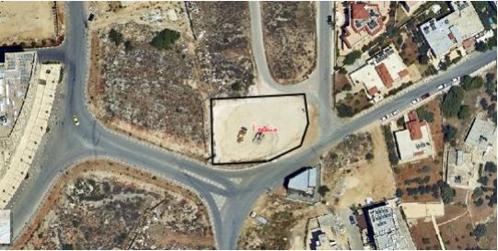
Site Analysis our building is located in Albalou near Police station in Ramallah.
Areas
Area of land which the building is built on equals to (1153) m².
Figure(1):location of Hisham Hadid building.

Slide 5
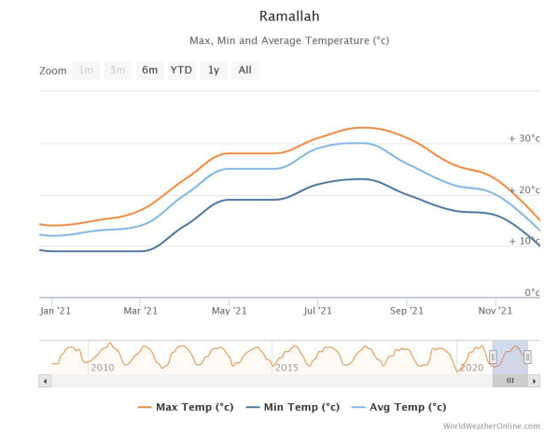
Site Analysis
Temperature
The average maximum temperature in the last year is 30 °C and minimum temperature is 12°C.
Figure(2): Annual temperature for Ramallah city in 2021.

Slide 6
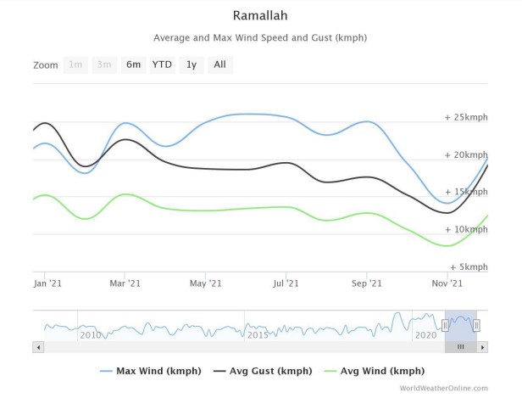
Wind speed and its direction
Wind speed at Ramallah in general is southwest with annual mean speed 18.6 Kmph in last year.
Figure(3)Annual wind speed for Ramallah city in 2021.

Slide 7
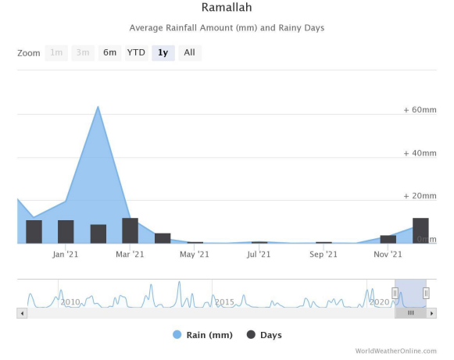
Rainfall
The wettest month (with the highest rainfall) is February
(63.2mm).
Figure(4): Annual rainfall for Ramallah city in 2021.

Slide 8
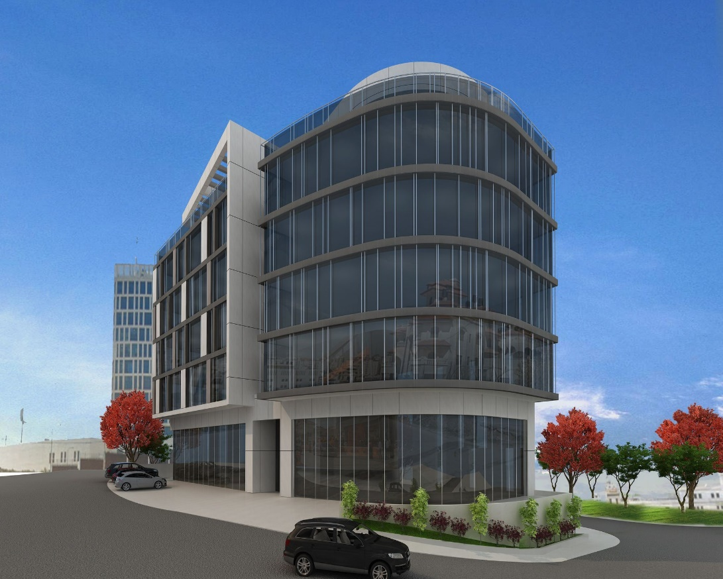
Architectural Aspect
* General Information.
* Floors , Elevations and Sections.

Slide 9
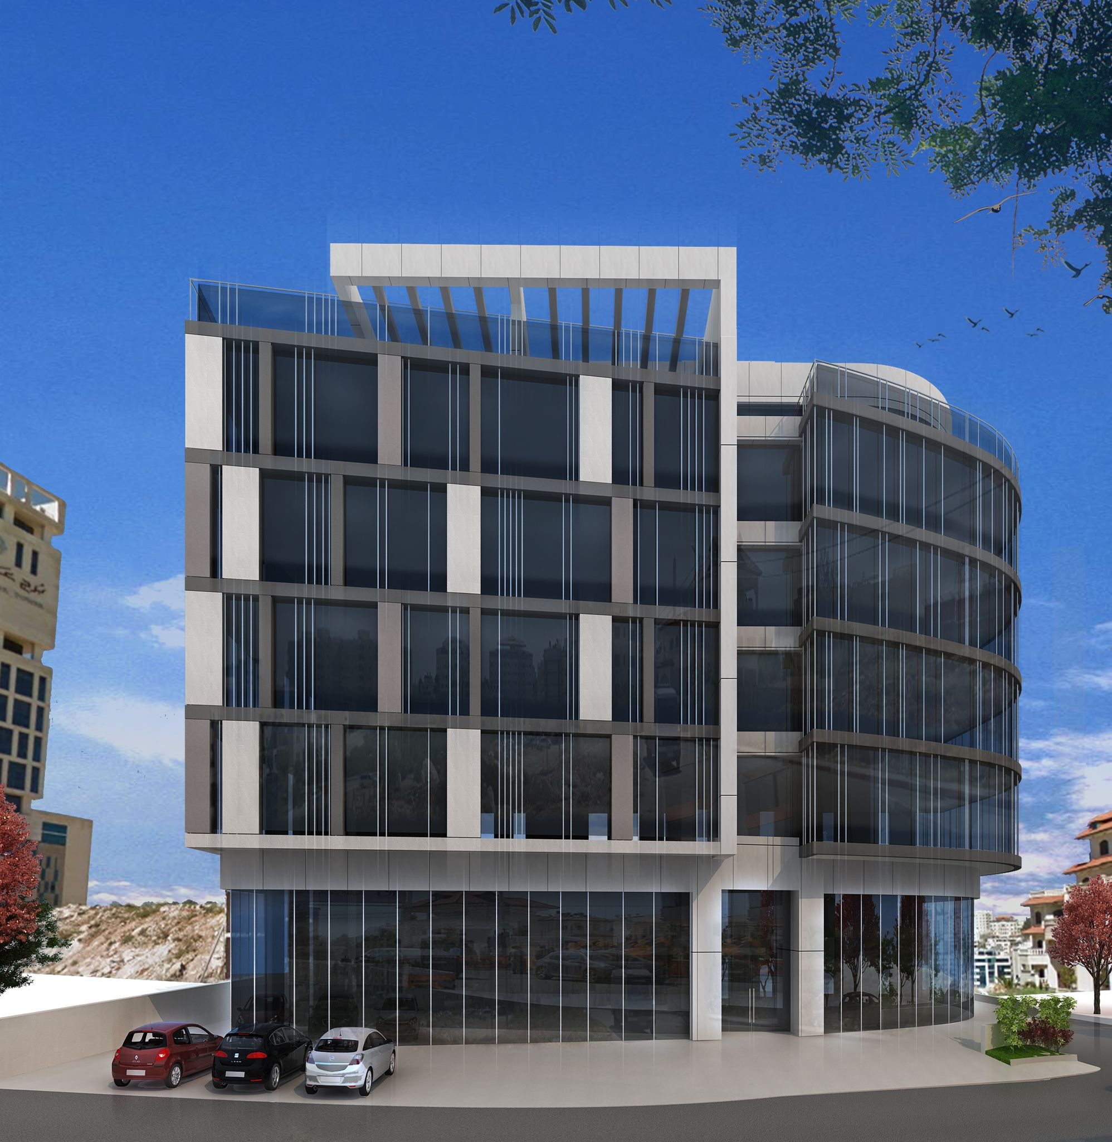
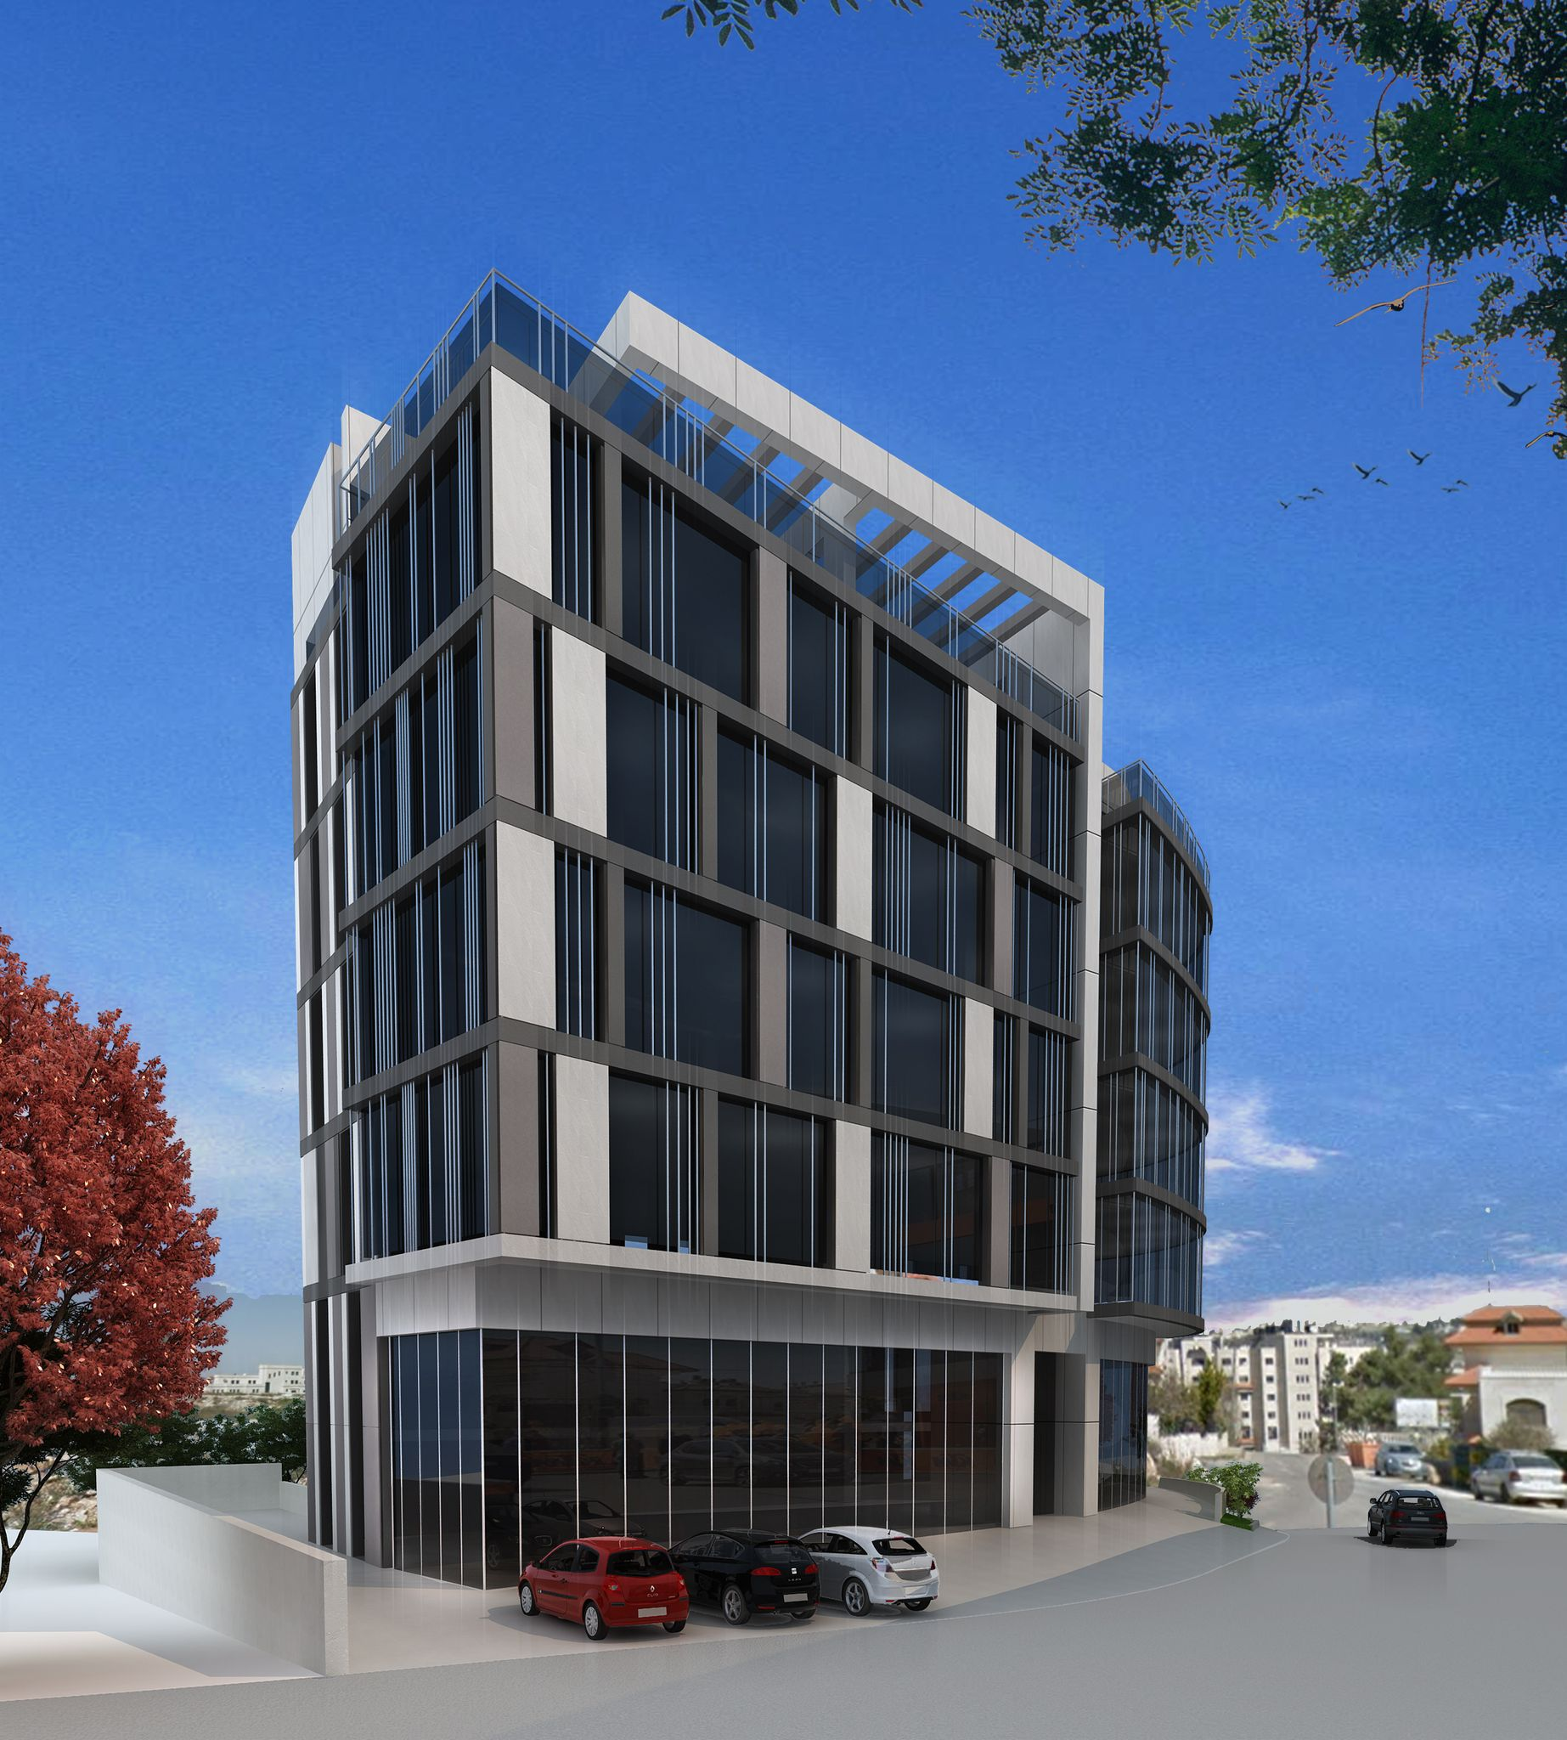
General Information
The Building includes eleven story.
Total area equals to7007 m2.

Slide 10
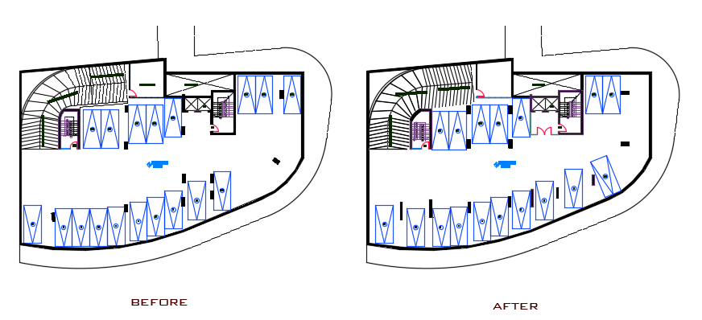
Basement
The improvement is make the ramp works according to the standards.
Figure 5: Basement floor plan

Slide 11
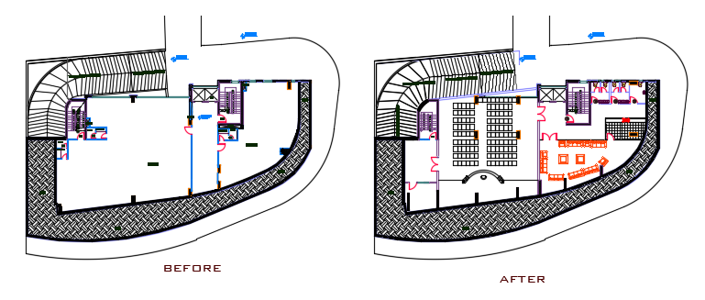
Architectural Aspect
First basement
Figure 6: first Basement floor plan

Slide 12
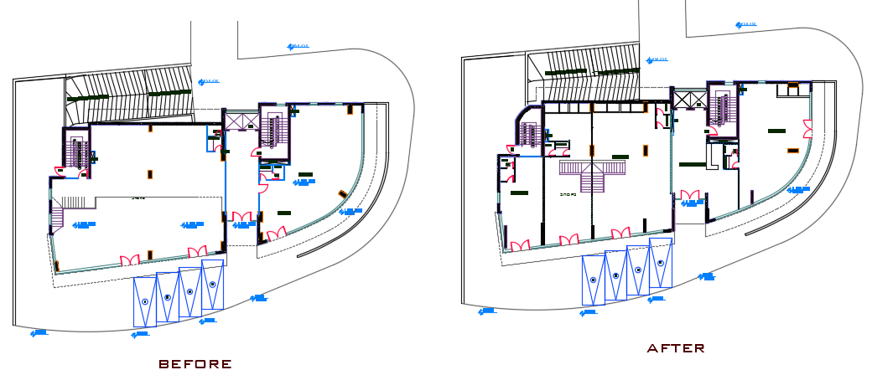
Ground floor
Figure 7: ground floor plan

Slide 13
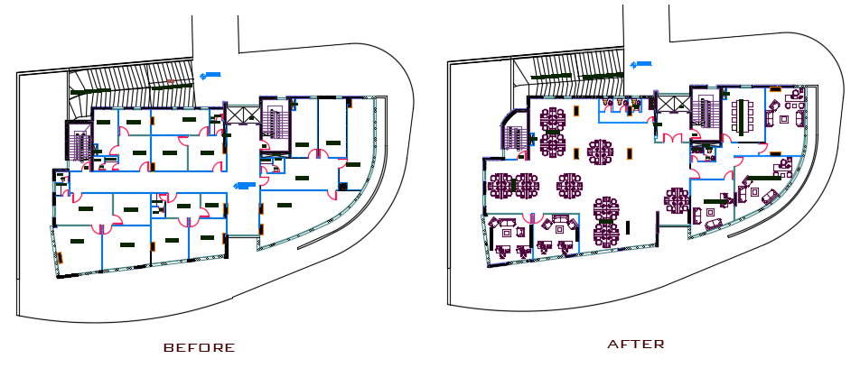
First floor
Figure 8: first floor plan

Slide 14
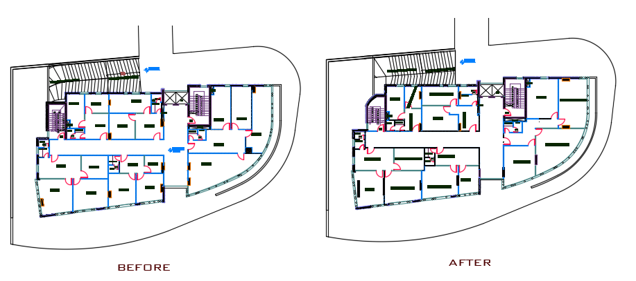
Offices floor
From the second to the fourth floor, the same division of floors.
Figure 9: office floor plan

Slide 15
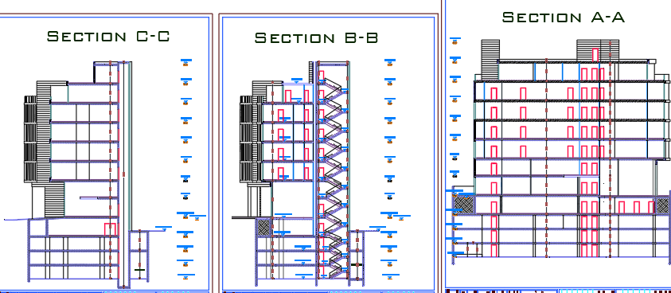
Sections After Re-design
Figure10 : sections

Slide 16
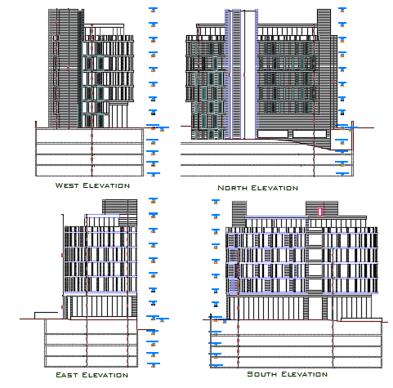
Elevations After Re-design
Figure : elevations

Slide 17
4. Structural Analysis

Slide 18
Assumptions:
Codes Design:
Materials:
1. Building Code Requirements for Structural Concrete ACI 318-14.
2. ASCE-16 for load computations.
3. Uniform Building Code (UBC 97)
The materials that used in the design have the following properties:
1. Compressive strength for the concrete fʹc equals to 28 Mpa.
2. Yielding strength of the steel fy equals to 420 Mpa.
3. The concrete unit weight equals to 25 KN/𝑚3.

Slide 19
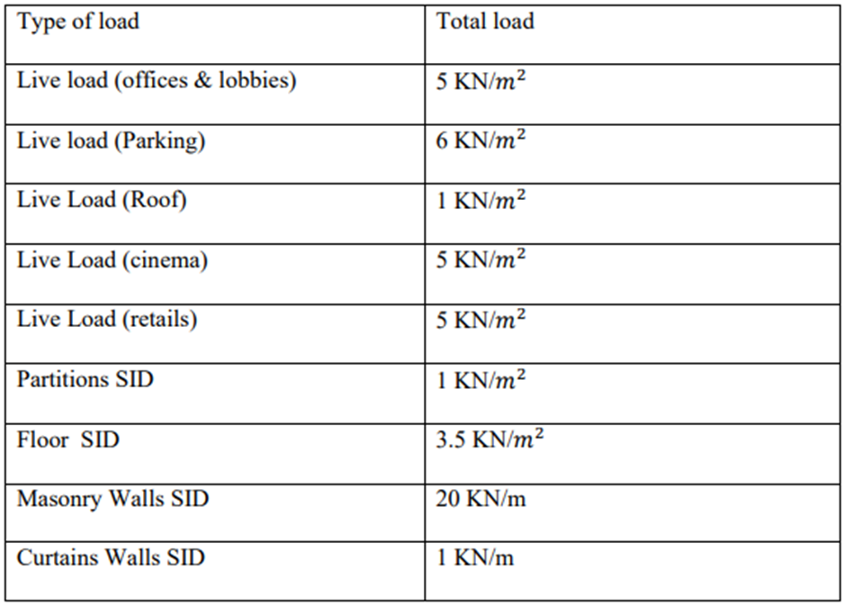
Loads:

Slide 20
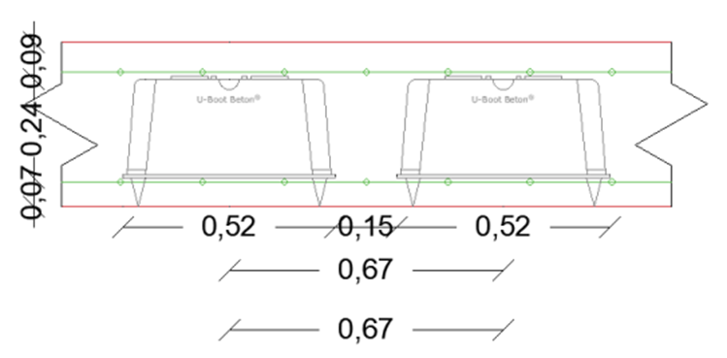
Design:
* Slab System: U-Boot System Slab
Weight of the voided slab = 6 KN/𝑚2
* Beams: vertical (400×600) and horizontal (400×500)
* Columns: The dimensions of the columns = 1200mm & 500mm

Slide 21
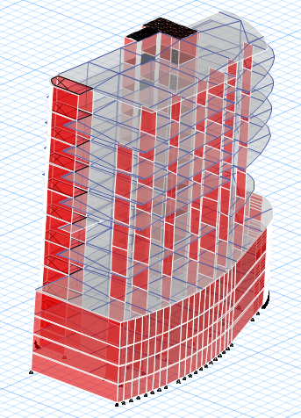
ETABS Structural Model:

Slide 22
ETABS Checks
To ensure that the calculation is done correctly and to adopt the design results from ETABS; some checks are required::
compatibility check
Equilibrium check
Stress-strain check check
period check
Modal mass participate ratio check (MPMR)
Base shear Check:
drift check
All checks were done for the building and all were acceptable.

Slide 23
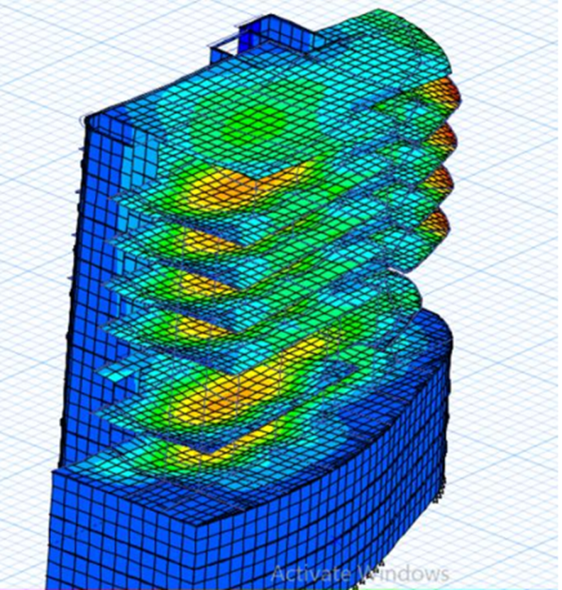
Compatibility Check:

Slide 24
* Equilibrium check:
Load Types | Manual (KN) | ETABS (KN) | Error (%)
Dead | 69209.07 | 68556.76 | 0.95
Live | 30433.66 | 30433.26 | 0.0013
SID | 22425.61 | 22190.30 | 1.06

Slide 25
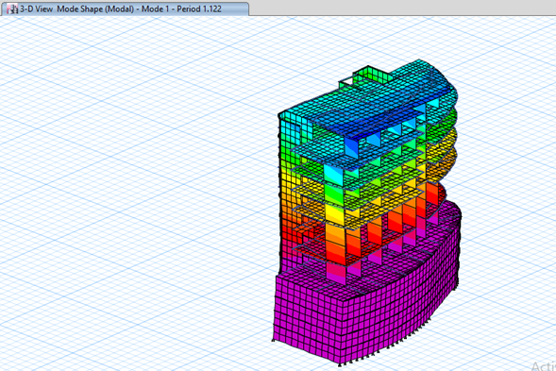

Period check
T = 0.0488×$h^{\frac{3}{4}}$ = 0.702 sec

Slide 26
Mass participation check sum y = 93% sum x = 95% both are more than 90%
Sum UZ | Sum UY | Sum UX | UZ | UY | UX | Period | Mode | Case
 |  |  |  |  |  | sec
0 | 0.899 | 0.9049 | 0 | 0.0003 | 0.0005 | 0.054 | 30 | Modal
0 | 0.9038 | 0.9137 | 0 | 0.0049 | 0.0088 | 0.054 | 31 | Modal
0 | 0.906 | 0.9193 | 0 | 0.0022 | 0.0056 | 0.052 | 32 | Modal
0 | 0.9081 | 0.9196 | 0 | 0.0021 | 0.0003 | 0.051 | 33 | Modal
0 | 0.9167 | 0.9403 | 0 | 0.0086 | 0.0207 | 0.048 | 34 | Modal
0 | 0.9205 | 0.9411 | 0 | 0.0038 | 0.0009 | 0.048 | 35 | Modal
0 | 0.924 | 0.9447 | 0 | 0.0035 | 0.0035 | 0.046 | 36 | Modal
0 | 0.9265 | 0.9456 | 0 | 0.0025 | 0.001 | 0.044 | 37 | Modal
0 | 0.9267 | 0.9526 | 0 | 0.0002 | 0.007 | 0.043 | 38 | Modal
0 | 0.927 | 0.9546 | 0 | 0.0004 | 0.002 | 0.041 | 39 | Modal
0 | 0.9355 | 0.9546 | 0 | 0.0084 | 3.03E-05 | 0.041 | 40 | Modal

Slide 27
Base reaction check
Output case | FX(KN) | FY(KN) | FZ(KN)
Dead | -0.0002 | -0.0001 | 64086.6537
Live | -0.0001 | -4.89E-05 | 30431.6593
SID | -0.0001 | 0.0003 | 22030.9859
EQX | 2460.0245 | 863.8805 | 0.0001
EQy | 888.2514 | 3708.6964 | 0.0002

Slide 28
Drift check
Drift-limitation | Delta-y | Delta-X | Drift-y | Drift-X | Dis-Y | Dis-X | Height | Story
0 | 0 | 0 | 0 | 0 | 0 | 0 | 0 | 0
47 | 0.28105 | 0.16555 | 0.073 | 0.043 | 0.073 | 0.043 | 2350 | 1
47 | 0.64295 | 0.2926 | 0.167 | 0.076 | 0.24 | 0.119 | 2350 | 2
47 | 1.6324 | 0.6776 | 0.424 | 0.176 | 0.664 | 0.295 | 2350 | 3
66 | 3.25325 | 3.11465 | 0.845 | 0.809 | 1.509 | 1.104 | 3300 | 4
66 | 4.79325 | 13.22475 | 1.245 | 3.435 | 2.754 | 4.539 | 3300 | 5
66 | 7.58835 | 18.1258 | 1.971 | 4.708 | 4.725 | 9.247 | 3300 | 6
66 | 6.8838 | 21.7833 | 1.788 | 5.658 | 6.513 | 14.905 | 3300 | 7
66 | 7.86555 | 24.28965 | 2.043 | 6.309 | 8.556 | 21.214 | 3300 | 8
66 | 8.03495 | 26.86145 | 2.087 | 6.977 | 10.643 | 28.191 | 3300 | 9
66 | 8.05035 | 27.0809 | 2.091 | 7.034 | 12.734 | 35.225 | 3300 | 10
66 | 7.2149 | 26.4803 | 1.874 | 6.878 | 14.608 | 42.103 | 3300 | 11

Slide 29
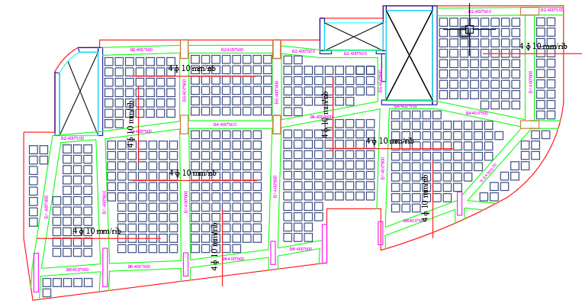
Column-beam-slab layout

Slide 30
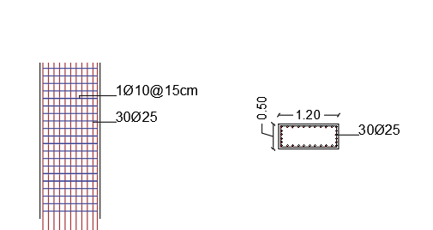
Column C1 detailing

Slide 31
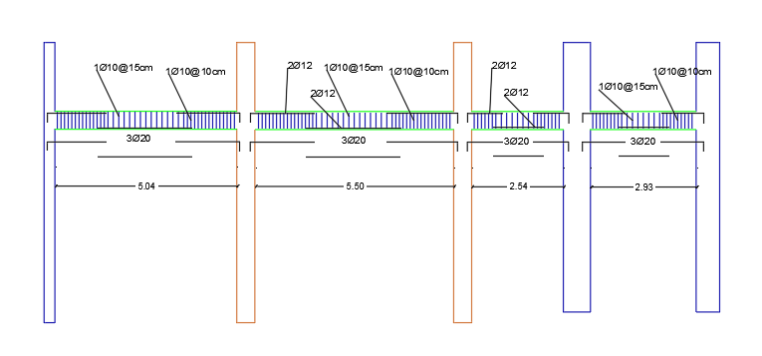
Beams design

Slide 32
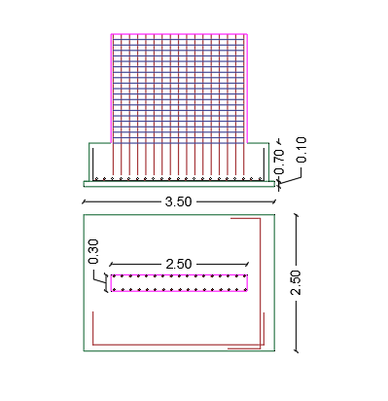
Shear wall design

Slide 33
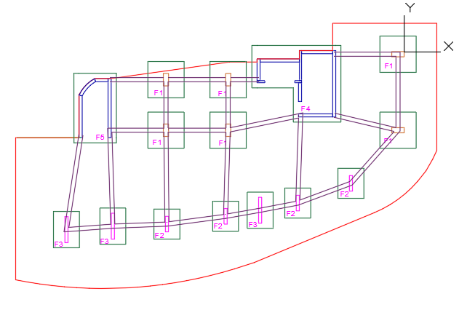
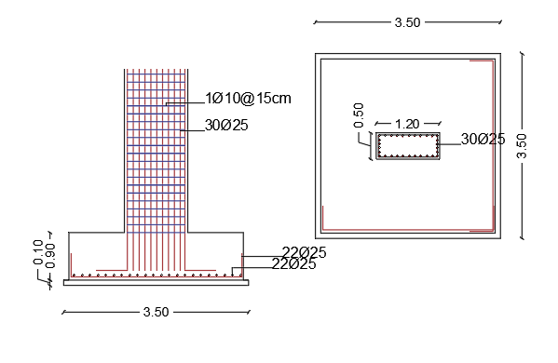
Footing Design

Slide 34
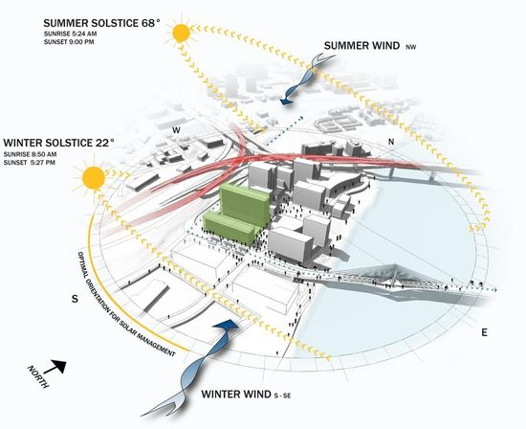
Environmental analysis and Design.

Slide 35
Environmental analysis and Design
This section provides full details and analysis of Environmental Simulation and Design, including topics shown
Shading analysis
Sun path analysis
Daylight analysis
Energy Conservation measure(ECM)
Heating and cooling loads
Thermal comfort

Slide 36
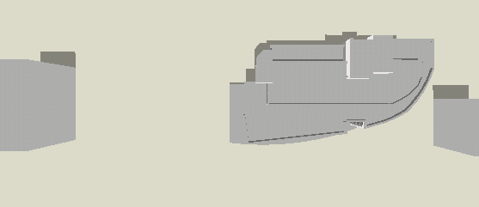
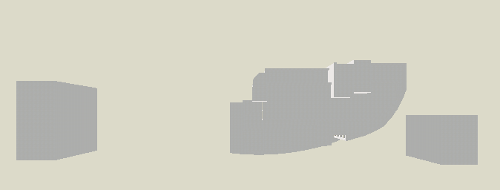
Shading analysis
The Shading Analysis was done for two periods, summer and winter, each case was evaluated in three different times for all building’s elevations to get accurate and detailed analysis.
Sun shading simulation in summer at 8:00A.m.
Summer shading analysis:
Sun shading simulation in summer at 12:00 p.m.

Slide 37
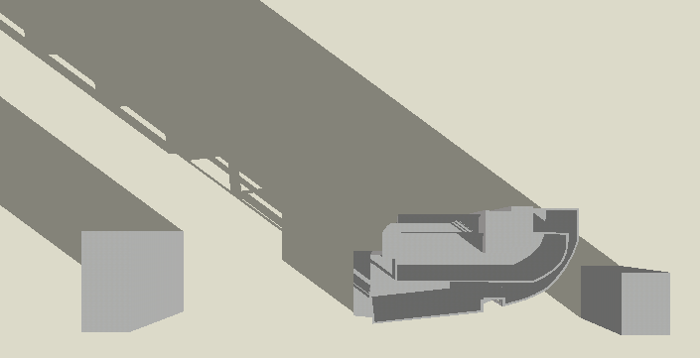
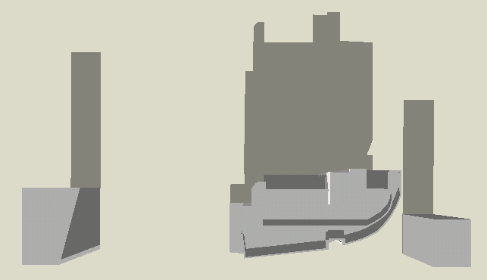
Sun shading simulation in summer at 2:00 p.m.
Winter shading analysis:
Sun shading simulation in winter at 8:00A.m.
Sun shading simulation in winter at 8:00A.m.

Slide 38
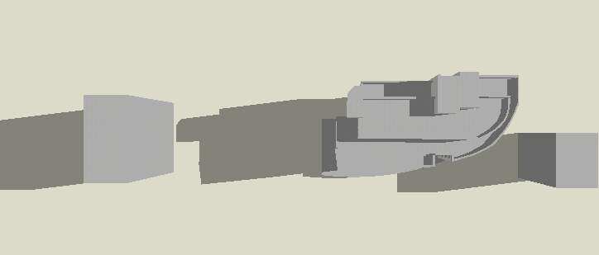
Sun shading simulation in winter at 12:00 p.m.
Sun shading simulation in winter at 2:00 p.m.

Slide 39
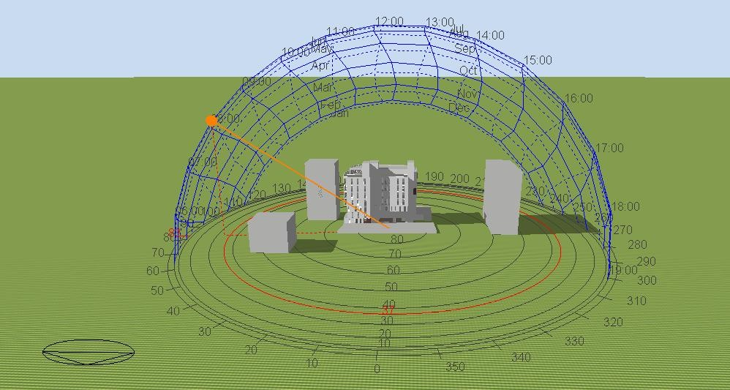
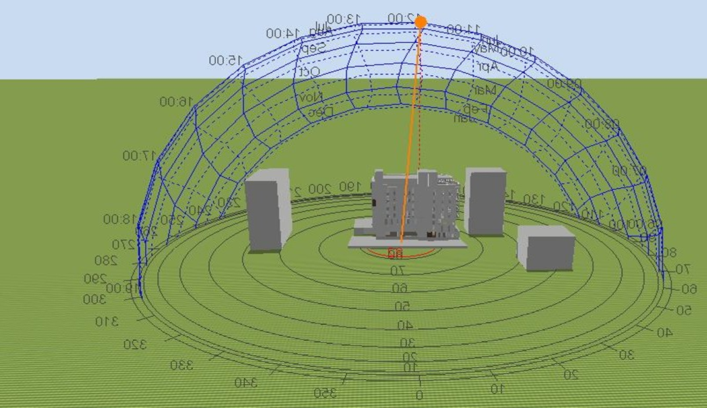
Sun path analysis:
Sun path diagram illustrate how the sun impact our building through the day in both seasons, summer and winter.
sun path diagram at 8:00 a.m.in summer
sun path diagram at 12:00 p.m.in summer

Slide 40
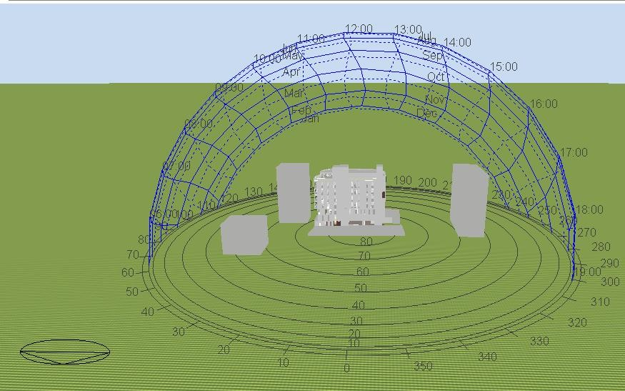
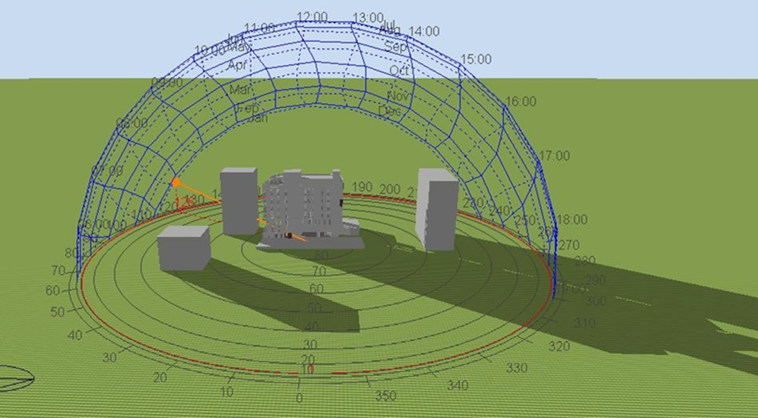
sun path diagram at 2:00 p.m.in summer
sun path diagram at 8:00a.m. in winter.

Slide 41
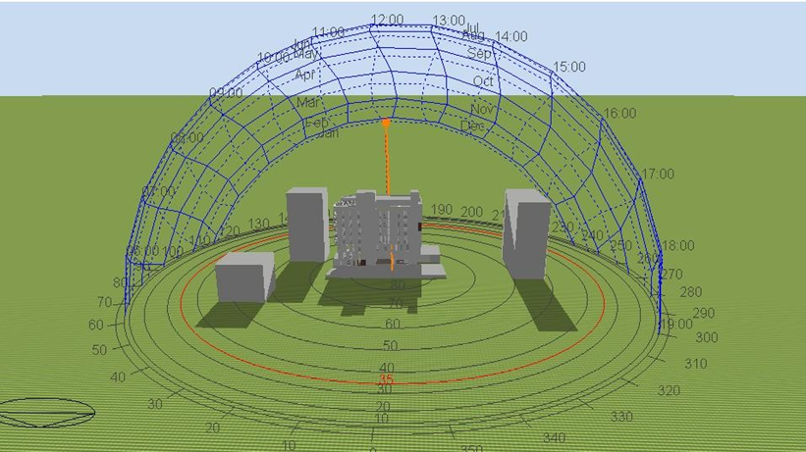
sun path diagram at 12:00pm.in winter
sun path diagram at 2 :00 p.m.in winter.

Slide 42
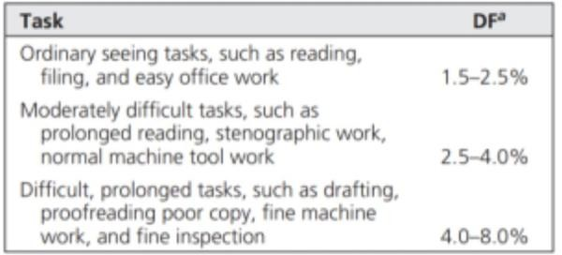
Daylight analysis:
This analysis calculates the Daylight Factor - the ratio between the interior and exterior illuminance levels of natural lighting. This factor is calculated under a CIE overcast sky model.
recommended daylight factors.
The daylight factor (DF%) values for each space in each floor was calculated, the results were compared with the standard range which is 2% - 5%.

Slide 43
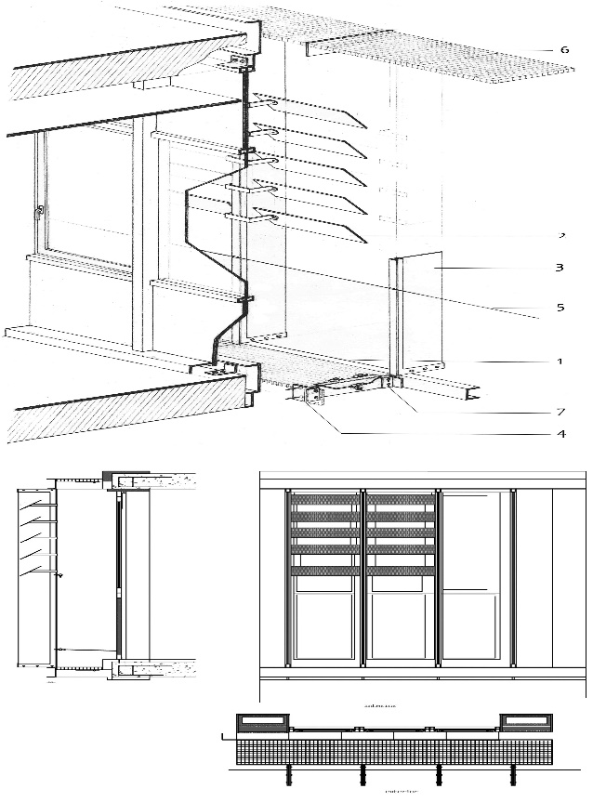
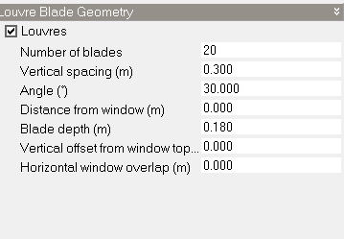
Passive design used to improve daylight factor inside the building
Using of horizontal louvers On all facades:
Treatment and improve
a window blind or shutter with horizontal slats that are angled to admit light and air, but to keep out rain and direct sunshine. The angle of the slats may be adjustable, usually in blinds and windows, or fixed
louver balde geometry

Slide 44
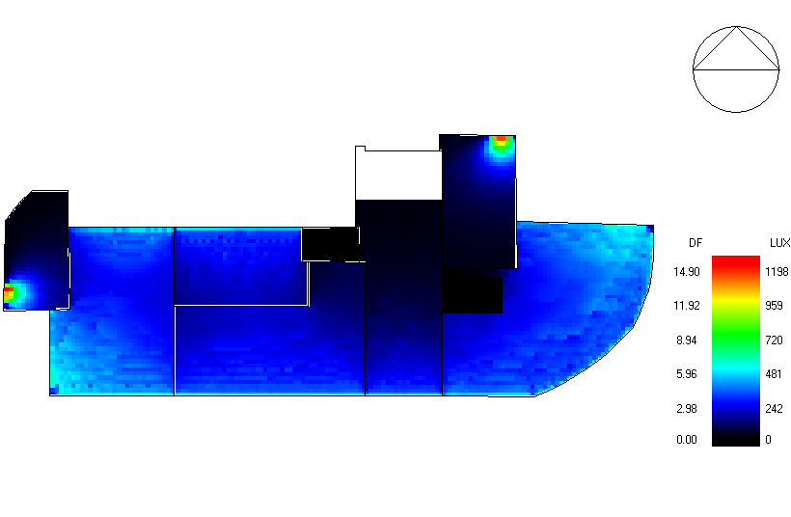
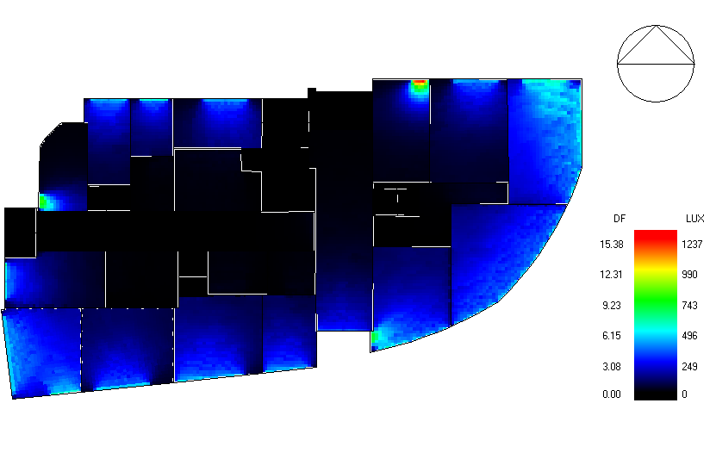
Daylight analysis after trewas done by using design builder, and the following results were obtained:
daylight analysis in roof floor.
daylight analysis fourth floor.

Slide 45

daylight analysis third floor.
daylight analysis second floor

Slide 46
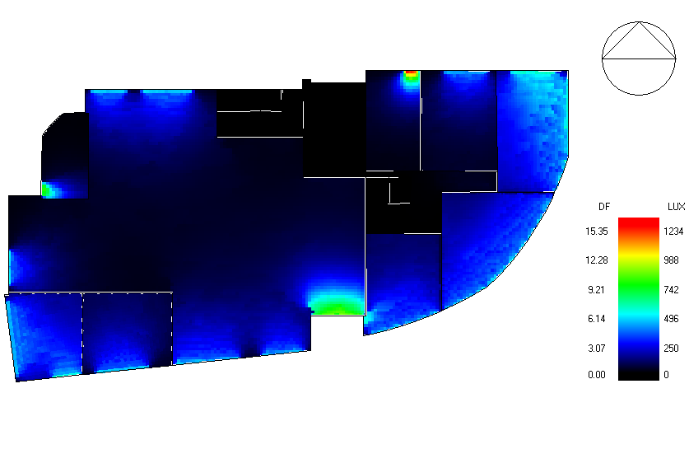
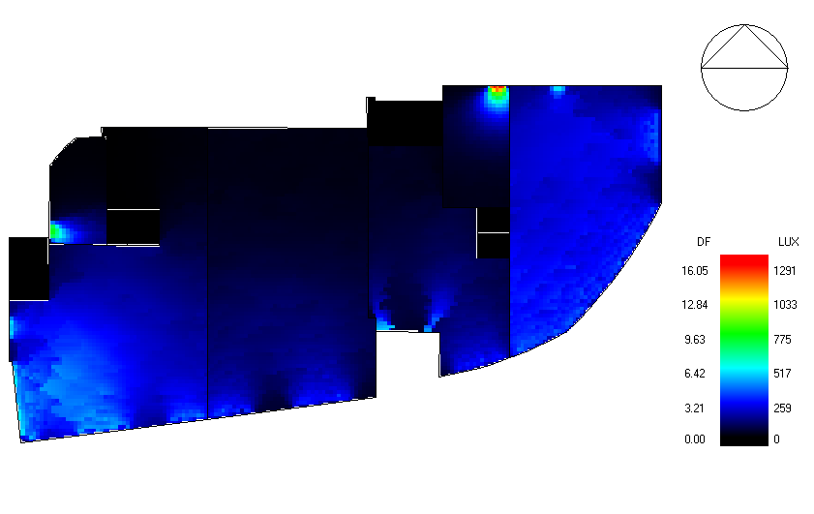
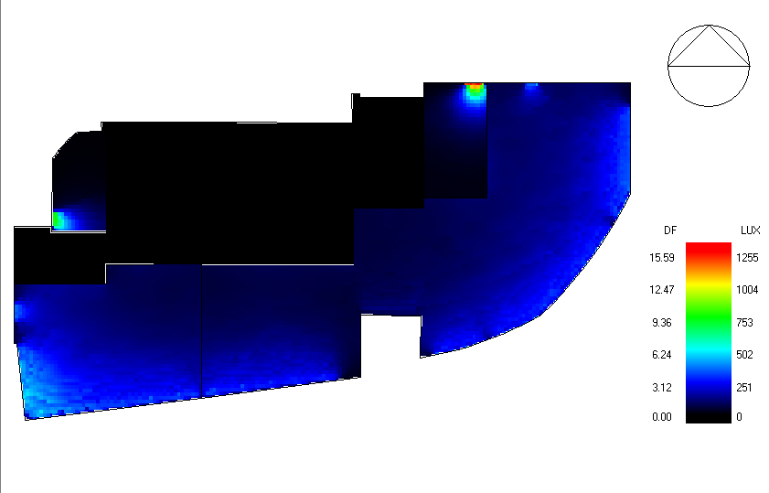
daylight analysis ground floor
daylight analysis first floor

Slide 47
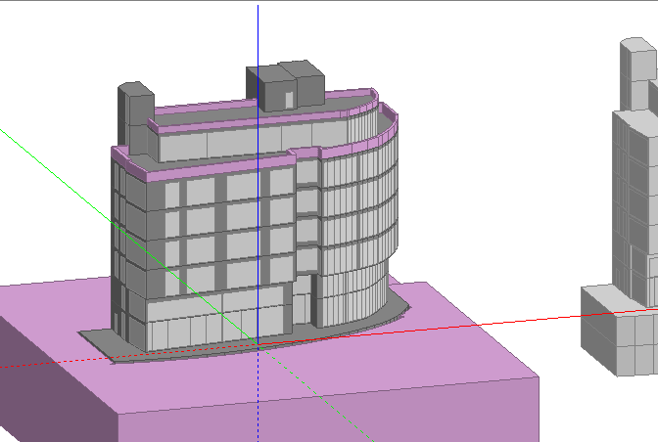
Energy Conservation measure(ECM)
means a measure designed to reduce energy use, including alternative energy systems which replace conventional fuels with renewable resources.
Design builder simulation:

Slide 48
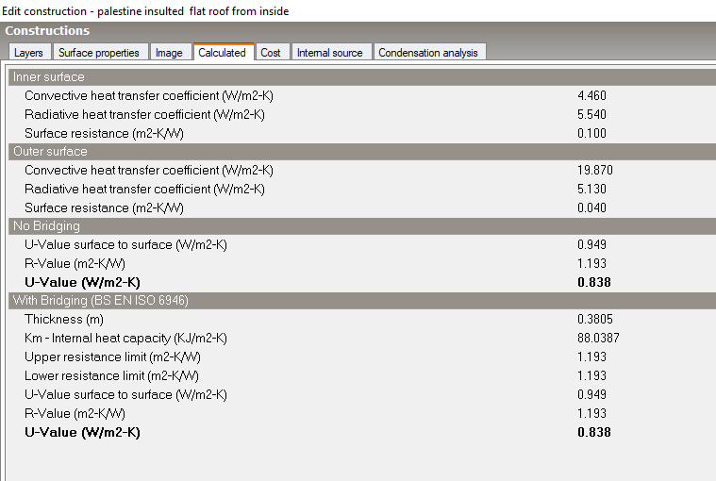
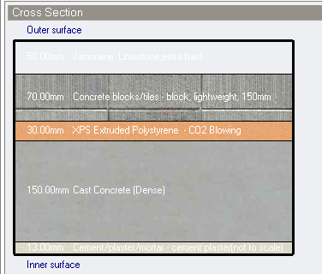
Material used in office building constructions:
Wall layer :
external wall layers of the base model
material properites of external wall layers

Slide 49
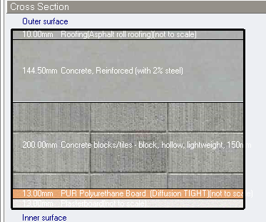
Roof layers:
: roof layers of the base model
roof layers of the base model
material properites of roof layers.

Slide 50
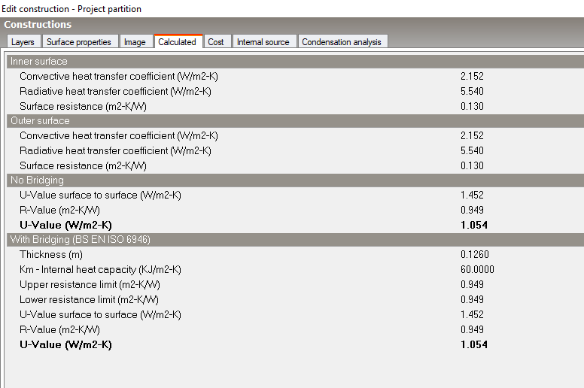

Internal wall layers:
internal wall layers of the base model
material properites of internal wall.

Slide 51

internal floor layers of the base model

Slide 52


windows material
material properites of windows

Slide 53
Artificial lighting:
-We use led with linear control lamp:
The most economical lighting template.
-We use infiltration of constant rate(ac/h)=0.3
-Fresh air(I/s-person)=6
-Change the size of windows
-In opening the revel of windows=0.3
-In HVAC we use VRF (Air-cooled).Heat Recovery,DOAS
We use horizontal louvers

Slide 54


horizontal louvers in windows

Slide 55


Simulation heat gain.
Site and source energy

Slide 56

Heating and cooling loads :
Heating loss
This figure shows the temperature values and heat loos ,In addition
show the air ,radiant and operative temperatures in new design.
Total heating loads in buildings=90 kw

Slide 57

Cooling load
Total cooling loads=150kw
Foor cooling load, this figure shows temperature ,heat gain ,sensible and latent cooling ,relative humidity ,ventilation and infiltration .As appear in the figure air temprrature and operative temperature have approximately the same value that is indicator a good insulation that used in external wall construction.

Slide 58

Thermal comfort
project comfort results
The PMV SET value which expresses the expected average Vote for the amount of thermal comfort for building users, should be between (-0.5-0.5) and as shown in the graph above, the average Vote between this period, so we can conclude that the thermal design results are satisfactory during Months of the year

Slide 59
Comparing between thermal analysis for current office building and new design
 | Original building | New building
Total heating load (kw) | 277.89 | 90
Total cooling load (kw) | 304.2 | 150
Energy Consumption(KWh/m²) | 236.85 | 61.31
thermal analysis for office building and new design

Slide 60


Acoustical design
Room acoustics design:
Spaces taken for acoustics design:
2.MULTIPURPOSE HALL
1.office
OFFICE ROOM PLANE
MULTIPURPOSE HALL PLANE

Slide 61


4.Shops
3.meeting room
MEETING ROOM PLANE
Shops PLANE

Slide 62
Literature review:
Articulation loss %
AL | Person satisfied with speech privacy(%) | Open-Office Speech Privacy Descriptor
0-0.5 | 95-92% | confidential
0.06-0.2 | 90-80% | Normal
0.21-0.3 | 79-65% | Minimal
>0.3 | <65% | Unacceptable
Recommended Noise Criteria(NC)is:NC35-NC40
Minimum STC required is40 dB.
The minimum impact insulation class required is 50 dB.

Slide 63

Reverberation time
Recommended reverbertation time
Sound transmission index(STI)
STI Range | case
0-0.3 | Bad
0.3-0.45 | poor
0.45-0.6 | Fair
0.6-0.75 | Good
0.75-1.0 | Excellent
Sound transmission index cases

Slide 64


Design
Normal partition
Normal partition layers and its stc

Slide 65


glazed partition
Glazed partition layers and its stc

Slide 66


exterior wall
STC and OTIC of the exterior wall

Slide 67



IIC of Internal floor
STC of the ceiling
Internal floor

Slide 68


Surface mount speaker design
:
wall speaker specifications
ATEO6
WALL SPEAKER WITH CLEVERMOUNT™ 6"

Slide 69

reverbertation time design
Finishing materials used in rooms and its sound absorption coefficient.

Slide 70


Meeting room
reverbertation time is within standard(0.60-1.20)sec

Slide 71


office room
reverbertation time is within standard(0.40-0.70)sec.

Slide 72


multipurpose hall.
reverbertation time is within standard(0.80-1.90)sec.

Slide 73


SPL in multipurpose hall.
AL % value in multipurpose hall

Slide 74


shop.
reverbertation time in shop.

Slide 75



SPL in shop.
Direct sound pressure level in shop.
AL % value in shop

Slide 76
HVAC System Design
VRF means VARABLE REFRIGERANT FLOW SYSTEM. This System consists of one Condenser Unit with multiple Indoor Units
Advantages:
1.no need to install ducts, cost reduction of installation
2.Power saving
3. mainly useful in public areas
Dis - Advantages
1.System is complicated when compare to Split units
2.this system required qualified / skilled man power

Slide 77




Outdoor unit specification catalogue
Based on total cooling load we need two outdoor VRF unit with cooling capacity 106.5,61.5
Capacity cooling load required =61.5+106.5=218.5KW>150kw

Slide 78

Indoor Unit
Fan Coil
Fan coil unit was combined with a duct and a diffuser used in the internal spaces where the Toshiba fan coil units were used (AP0724H-E, AP0274H-E) with the capacity flow rate 1320 m3 /h and 3600m3/h

Slide 79

We use split unit in other floors

Slide 80

Selecting Diffuser:
Diffuser calculation from the catalog MultiPurposeHall:
Vs= 1.88(m3/sec)
length room = 14.5m
width room = 14m
N(diffuser) = 1.88/(225/1000) ≈ 9.

Slide 81


Basement floor
Return design:

Slide 82
Main Return duct design
the (main return ducts) are designed for each room (use assume velocity =5 m/s):

Slide 83

Duct & diffusers distribution in basement floor.

Slide 84


Split unit in ground floor.

Slide 85


Split unit in first floor.
Split unit in second floor

Slide 86

Split unit in roof floor.

Slide 87


FIREFIGHTING SYSTEM
the most common system used in the office building:
Fire hose station:
Fire extinguishers system
The chosen type is dry powder chemical they can be used for class A,class B &class c and electrical fire.

Slide 88



DETECTION AND NOTIFICATION SYSTEAM
manual fire alarm
smock detector
Heat detector

Slide 89

EMERGENCY STAIR
The following figure shows the emergency stair:

Slide 90


Emergency sign and lighting design

Slide 91



Emergency Lighting:
In the figure bellow show type of emergency lighting
VISOR LED
For use EM12 corridor 0B LED2S EL3 WH
Emergency rout sign

Slide 92

Egress Route
Egress route for basement floor

Slide 93


Egress route for ground floor

Slide 94

Egress route for first floor

Slide 95

Egress route for second floor

Slide 96


Egress route for third floor
Egress route for fourth floor

Slide 97

Egress route for roof floor

Slide 98


Fire protection system for ground floor.
Fire protection system for basment floor.

Slide 99


Fire protection system for first floor.
Fire protection system for second floor.

Slide 100

Fire protection system for roof floor.

Slide 101


Electrical Design
DIALux program was used to design lighting system
Some of spaces in the building
Figure : Mayor room Figure : Meeting room

Slide 102


Figure : Malty purpose hall Figure : clothing's shop

Slide 104
Electrical Design
Outlets design
For Ground Floor
special load
I load= 7.6 Amp.
I cable = I Design *1.15*1.15 =7.6*1.15*1.15=11 A.
Copper wire is used with 2.5 mm²

Slide 105
The allowable voltage drops in the wire= (3-5) % × 220V
Table 1: Check for Drop voltage for each floor
Name | D.B.N | Drop voltage% | Cheek
B4 | D.B.1 | 1.2 % | Ok
B3 | D.B.2 | 1.2 % | Ok
B2 | D.B.3 | 1.2 % | Ok
B1 | D.B.4 | 0.4% | Ok
GF | D.B.8 | 0.6% | Ok
First Floor | D.B.12 | 0.46% | Ok
Second Floor | D.B.14 | 0.4% | Ok
Third Floor | D.B.16 | 0.4% | Ok
4TH Floor | D.B.18 | 0.4% | Ok
Roof Floor | D.B.20 | 0.066% | Ok

Slide 106
Normal load:
The Table below has shown the calculation first Floor:
Table 2 : Current calculation for normal outlets
Normal load
Power Watt | V | Power Factor | I load (A)
Watt | Volt |  | Amp
600 | 220 | 0.9 | 3
.
I design =I load *1.15*1.15=3*1.15*1.15=3.96 Amp.

Slide 107
Table 5: Wire Drop voltage calculation for normal outlets for each floor
Name | D.B.N | Drop voltage% | Cheek
B4 | E.D.B.1 | 0.13% | Ok
B3 | E.D.B.2 | 0.13% | Ok
B2 | E.D.B.3 | 0.13% | Ok
B1 | E.D.B.4 | 0.24% | Ok
GF | E.D.B.6 | 0.26% | Ok
1st | E.D.B.12 | 0.36% | Ok
2nd | E.D.B.14 | 0.36% | Ok
3rd | E.D.B.16 | 0.36% | OK
4th | E.D.B.18 | 0.36% | Ok
Roof | E.D.B.20 | 0.24% | Ok
We will use the wire between the circuit breaker and a normal loads with an area of cross section 2.5 mm and can be implemented 18 amps

Slide 108
Lighting calculation:
D . B .12 the First floor, the critical room is offices 40 m, contains 8 lamps (35 watt).
Table 6: Current calculation for lighting
lighting load
Power Watt | V | Factor | I load (A)
Watt | Volt |  | Amp
280 | 220 | 0.9 | 1.41

Slide 109
Table 9 :Drop voltage wire calculation for lighting for each floor
Name | D.B.N | Power | I | ρ | Max length | Area wire | resistance wire | Drop voltage % | check
B4 | E.D.B.1 | 280 | 1.41 | 1.68E-08 | 100 | 1.5 | 1.12 | 0.5% | ok
B3 | E.D.B.2 | 280 | 1.41 | 1.68E-08 | 100 | 1.5 | 1.12 | 0.5% | ok
B2 | E.D.B.3 | 280 | 1.41 | 1.68E-08 | 100 | 1.5 | 1.12 | 0.5% | ok
B1 | E.D.B.5 | 210 | 1.4 | 1.68E-08 | 30 | 1.5 | 0.34 | 0.22% | ok
G.F | E.D.B.9 | 475 | 3.17 | 1.68E-08 | 27 | 1.5 | 0.3 | 0.4% | ok
1ST Floor | E.D.B.12 | 280 | 1.86 | 1.68E-08 | 40 | 1.5 | 0.45 | 0.84% | ok
2nd Floor | E.D.B.14 | 210 | 1.4 | 1.68E-08 | 36 | 1.5 | 0.4 | 0.25% | ok
3rd Floor | E.D.B.16 | 210 | 1.4 | 1.68E-08 | 36 | 1.5 | 0.4 | 0.25% | ok
4th Floor | E.D.B.18 | 210 | 1.4 | 1.68E-08 | 36 | 1.5 | 0.4 | 0.25% | ok
Roof Floor | E.D.B.20 | 315 | 1.7 | 1.68E-08 | 12 | 1.5 | 0.13 | 0.1% | ok
We will use the wire to connect the lighting distribution panel in the cross-sectional area of 1.5 mm2

Slide 110

Circuit breaker and distribution board
Power calculation:
Calculation for Single -phase equation:
Total current in EDB-20 (1Φ) = total power / (V × D.F)
= 4279.2 / (220 × 0.90)
= 22 Amp
The current load for the circuit breaker is = 1.15 × I
= 25Amp.
The current in the circuit breaker cable = 1.15 × I C.B
= 28 Amp.
Total current in the cable that connects the main E.D.B.20 panel distribution is 25, and will be used with the cable cross-section 6 mm2 area and can implement 31 amps.

Slide 111
Table 12:Distribution board calculation for E.D.B
Name | Power Lighting | Normal | Special loads | total power load | Phase Type
E.D.B.1 | 1804 | 400 | 8000 | 9563 | one Phase
E.D.B.2 | 1804 | 400 | 8000 | 9563 | one Phase
E.D.B.3 | 1808 | 400 | 8000 | 9566 | one Phase
E.D.B.4 | 574 | 2400 | 1500 | 2679.2 | one Phase
E.D.B.5 | 1288 | 3200 | 1500 | 3490 | one Phase
E.D.B.6 | 670 | 2000 | 3000 | 4136 | one Phase
E.D.B.7 | 245 | 1200 | 0 | 556 | one Phase
E.D.B.8 | 975 | 2000 | 3000 | 4380 | one Phase
E.D.B.9 | 825 | 1800 | 3000 | 4200 | one Phase
E.D.B.10 | 565 | 2400 | 1500 | 2672 | one Phase
E.D.B.11 | 1008 | 3200 | 1500 | 3266.4 | one Phase
E.D.B.12 | 2058 | 17200 | 1500 | 8306.4 | one Phase
E.D.B.13 | 1295 | 4200 | 1500 | 3796 | one Phase
E.D.B.14 | 2520 | 12800 | 4000 | 9856 | one Phase
E.D.B.15 | 1295 | 4200 | 1500 | 3796 | one Phase
E.D.B.16 | 2520 | 12800 | 4000 | 9856 | one Phase
E.D.B.17 | 1295 | 4200 | 1500 | 3796 | one Phase
E.D.B.18 | 2520 | 12800 | 4000 | 9856 | one Phase
E.D.B.19 | 686 | 1800 | 1500 | 2588.8 | one Phase
E.D.B.20 | 924 | 6800 | 1500 | 4279.2 | one Phase

Slide 112
D.B.N | total power load | Phase Type | I load | I C.B | I Cable | cross-sectional area
E.D.B.1 | 9563 | one Phase | 48.30 | 55.54 | 63.87 | 25 mm2
E.D.B.2 | 9563 | one Phase | 48.30 | 55.54 | 63.87 | 25 mm2
E.D.B.3 | 9566 | one Phase | 48.31 | 55.56 | 63.89 | 25 mm2
E.D.B.4 | 2679.2 | one Phase | 13.53 | 15.56 | 17.90 | 2.5 mm2
E.D.B.5 | 3490 | one Phase | 17.63 | 20.27 | 23.31 | 4 mm2
E.D.B.6 | 4136 | one Phase | 20.89 | 24.02 | 27.63 | 6 mm2
E.D.B.7 | 556 | one Phase | 2.81 | 3.23 | 3.71 | 2.5 mm2
E.D.B.8 | 4380 | one Phase | 22.12 | 25.44 | 29.26 | 6 mm2
E.D.B.9 | 4200 | one Phase | 21.21 | 24.39 | 28.05 | 6 mm2
E.D.B.10 | 2672 | one Phase | 13.49 | 15.52 | 17.85 | 2.5 mm2
E.D.B.11 | 3266.4 | one Phase | 16.50 | 18.97 | 21.82 | 4 mm2
E.D.B.12 | 8306.4 | one Phase | 41.95 | 48.24 | 55.48 | 16 mm2
E.D.B.13 | 3796 | one Phase | 19.17 | 22.05 | 25.35 | 6 mm2
E.D.B.14 | 9856 | one Phase | 49.78 | 57.24 | 65.83 | 25 mm2
E.D.B.15 | 3796 | one Phase | 19.17 | 22.05 | 25.35 | 6 mm2
E.D.B.16 | 9856 | one Phase | 49.78 | 57.24 | 65.83 | 25 mm2
E.D.B.17 | 3796 | one Phase | 19.17 | 22.05 | 25.35 | 6 mm2
E.D.B.18 | 9856 | one Phase | 49.78 | 57.24 | 65.83 | 25 mm2
E.D.B.19 | 2588.8 | one Phase | 13.07 | 15.04 | 17.29 | 2.5 mm2
E.D.B.20 | 4279.2 | one Phase | 21.61 | 24.85 | 28.58 | 6 mm2

Slide 113



Slide 114


Slide 115


Slide 116


Slide 117


Slide 118
Mechanical design
Mechanical system is one of the most important systems that is required to be carefully designed for any building
According to table1, the average daily water consumption per person in offices is 57 liters (0.057 m³/day).
Volume of water needed for firefighting= (0.5 × 0.057 × 360 person) = 10.26 m³/day.
Total water demand/day= 20.52 + 10.26 = 30.78 m³/day.

Slide 119
The amount of rainwater failing on the roof = 519 × 0.7 = 363.3 m³/year.= 1m³/day
The rainwater tank volume will be used = 364 m³
Volume of gray water tank
Volume = 360 person × 0.002 m 3 /day = 0.72 m 3 /day.
Municipality provides the water for the building every days.
10 tanks are used on roof with radius 0.75 m and 1.80m height.
The volume of one roof tank= (0.75 2 × 3.14 ) × 1.80 = 3.18 m 3 .

Slide 120



Slide 121



Slide 122



Slide 123


Figure 10 Plan for water drainage
Figure 11 Plan for water drainage 2

Slide 124
Total cost of building (NIS)=9599000
Total cost of building (NIS/m2)=1370
Table : Summary of cost estimation
activity | Cost (Nis)
Earth work | 626,500
structural work | 2913920
Architectural work | 4643340
mechanical work | 998340
Electrical work | 416900

