Slide 1
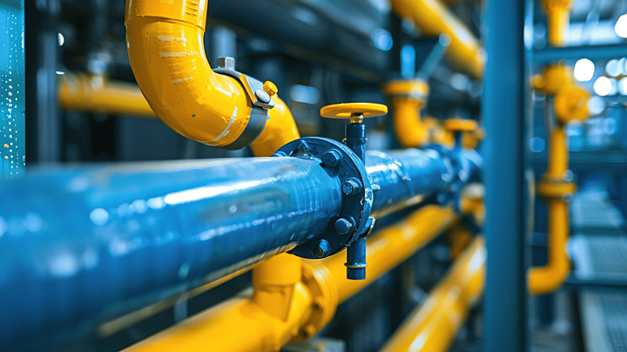
Designing of water supply network for Balata Al Ballad

Slide 2
Table of Contents
1
Project Objectives & Methodology
2
Introduction & Advantage of water-CAD:
3
Water-CAD Model Development and Refinement
4
Water-CAD Analysis: Input Data & Results and Discussion
5
Future Water Supply Network
6
Design of New Water Distribution Network
7
Question and Answers

Slide 3

Introduction

Slide 4

Project Objectives
Hydraulic analysis of the Balata Al Balad water distribution network.
1
Redesign of the water distribution network and improvement of hydraulic properties.
2

Slide 5

Introduction
Water CAD is a hydraulic software and water quality modeling application for water distribution systems. Water CAD helps engineers and users to analyze, design and optimize water distribution systems. It is developed by the Bentley company and has the following capabilities; Building a network and performing a steady state analysis, Extended period simulations (EPS), Interface and graphical editing, Streamlined model building, Water quality analysis, Automated Fire flow analysis, reporting results, Pressure dependent demand, designer to optimize a pipe network, Critical and segmentation and Comprehensive scenario management.
Advantage of water-CAD:
Comprehensive Hydraulic Modeling
Design & Optimization Tools.
Integration & Compatibility.
User-Friendly Interface.
Advanced Analysis Features.

Slide 6
Methodology
Collect all information and data needed for the project, area of balata Albalad, population and several data of Balata.
1
Begins with Auto CAD and GIS, we used the existing network to help me building the model to simplify data and distribute nodes and pipes in network. From this map, we can know elevations of nodes, pipes diameter, length of pipes and then draw closed polygons to calculate demand.
2
Second step is to make excel sheets showing data from AutoCAD and GIS, first sheet represent nodes has elevation and demand for each node. The second sheet shows information about pipes, it has name, length, location, diameters and Hazen-William coefficient for each pipe.
3
Make analysis and check for network, obtained GIS shape files to waterCad and make analysis.
4

Slide 7
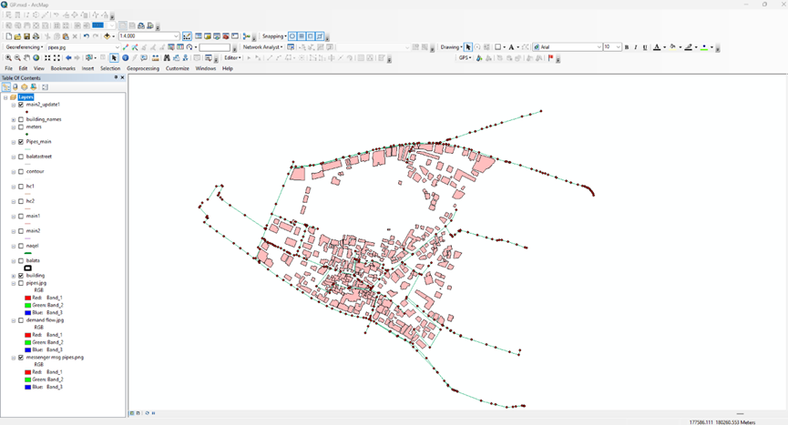
Drawing WDN in ArcMap GIS Software
WaterCAD Model Development and Refinement.
This section details the process of building and refining the WaterCAD model, starting from drawing the network in ArcMap, importing GIS data, and subsequently addressing initial validation issues and making necessary modifications to parameters such as Hazen-Williams coefficients, pump definitions, and pipe diameters to achieve optimal results.
Drawing WDN in ArcMap GIS Software

Slide 8
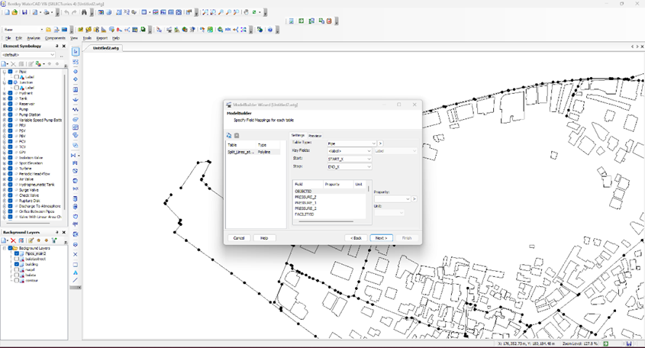
Importing Pipes and Junctions Shapefiles using Module Builder

Slide 9
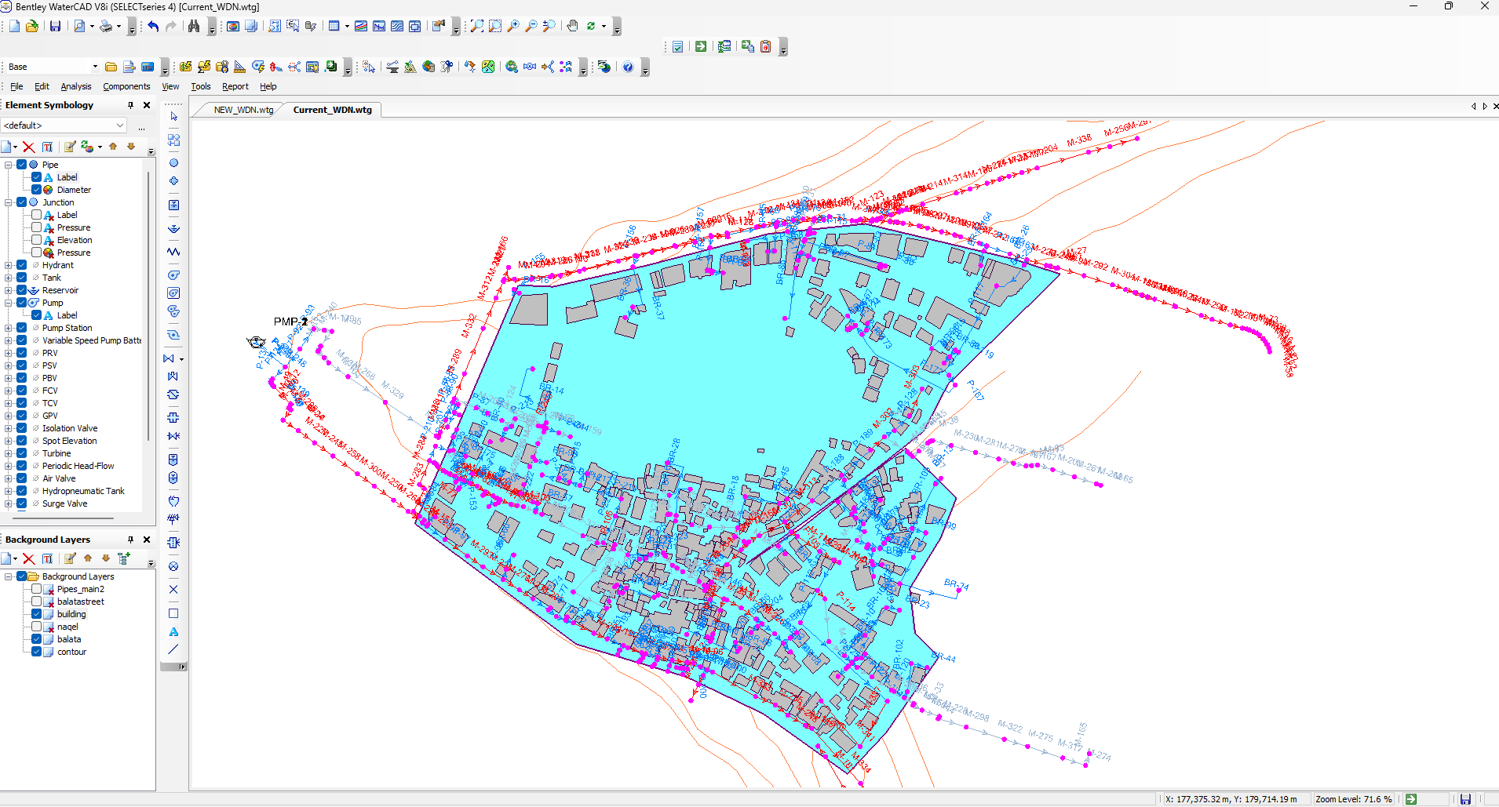
Final Layout of the Current Water Distribution Network (WDN) drawn in Arc Map.

Slide 10
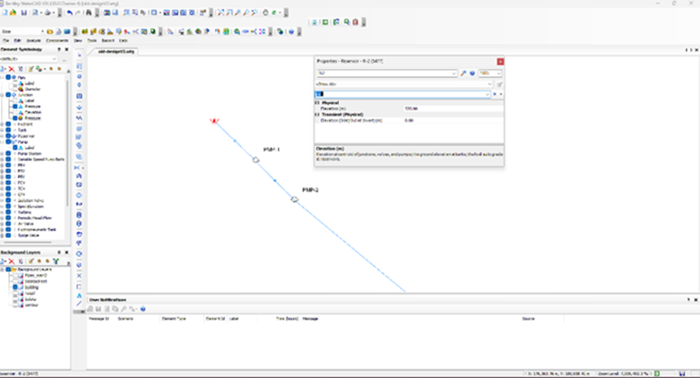
WaterCAD Analysis: Input Data
This section outlines the essential input data required for setting up the WaterCAD hydraulic model, including detailed information for nodes (junctions), pipes, and pumps. Accurate data input is crucial for a reliable simulation of the water distribution network's behavior.
Reservoir Elevation: The reservoir elevation was set to match the pump elevations to ensure consistent hydraulic head.
Reservoir Elevation Definition

Slide 11
Node Data
To accurately set up the WaterCAD model, detailed node data was entered, encompassing base demand, elevation, and coordinates.
Base Demand: The total demand was calculated as follows: Total Demand = (6300 capita × 70 L/capita/day) / (1 - 0.33 loss percent) × 5 peak days ÷ 1000 L/m³ = 3291 m³/day. This calculated demand was assigned to junctions within the control demand unit in WaterCAD.
Elevation: Elevations for each node were obtained from the contour map.
Coordinates (X, Y): The X and Y coordinates for each node were defined, illustrating their placement within the network.

Slide 12
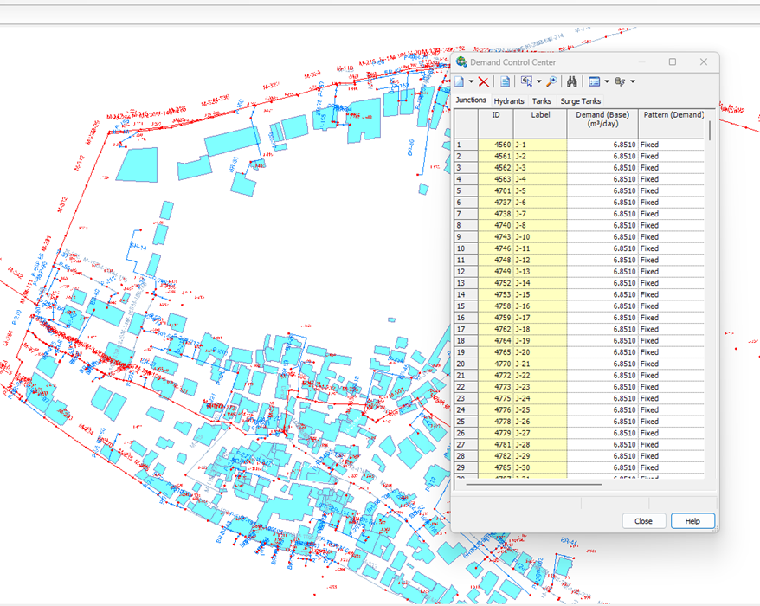
Defining Uniform Junction Demand

Slide 13
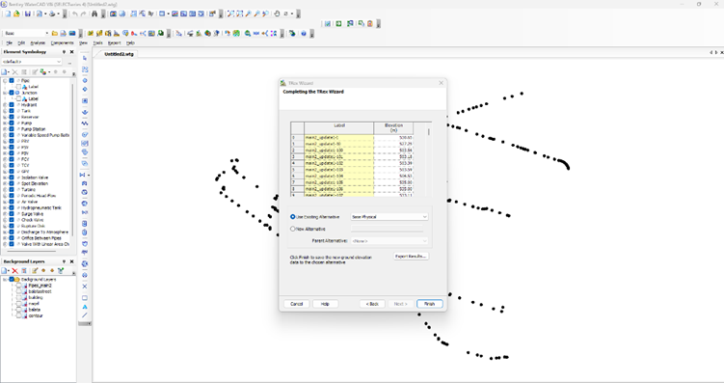
Importing Junction Elevations: Junction elevations were imported from the contour shapefile into WaterCAD using the Trex Wizard.
Importing Junction Elevations using Trex Wizard

Slide 14
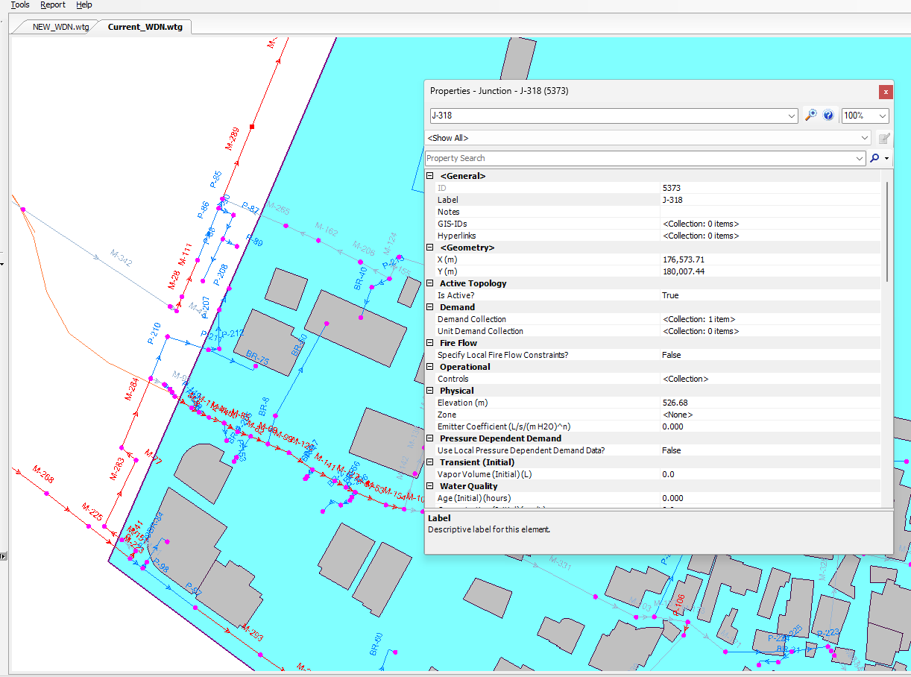
Node Coordinates and Junction Control Demand Assignments

Slide 15
Pipe Data
Pipe data is critical for the hydraulic model and includes length, diameter, connected nodes, and the Hazen-Williams Coefficient.
Length of Pipe: Extracted directly from the AutoCAD map.
Diameter of Pipe: Sourced from the GIS map.
Connected Nodes: Each pipe connects two specific nodes.
Hazen-Williams Coefficient: This coefficient varies based on the pipe material and its age, and these details were captured in the pipe flex tables. (PVC= 150,Steel=140,Ductil iron=130, Galvanized Steel=120, HDPE=150) → we used (PVC=130,Steel=120,ductil iron=110,Galvanized Steel=100,HDPE=130).

Slide 16
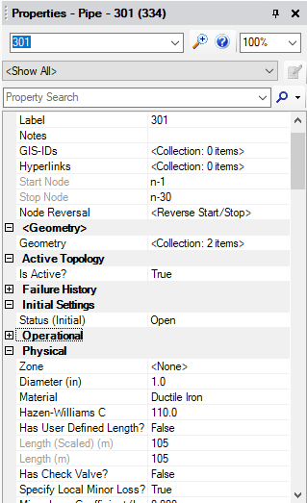
pipe data in Water CAD

Slide 17
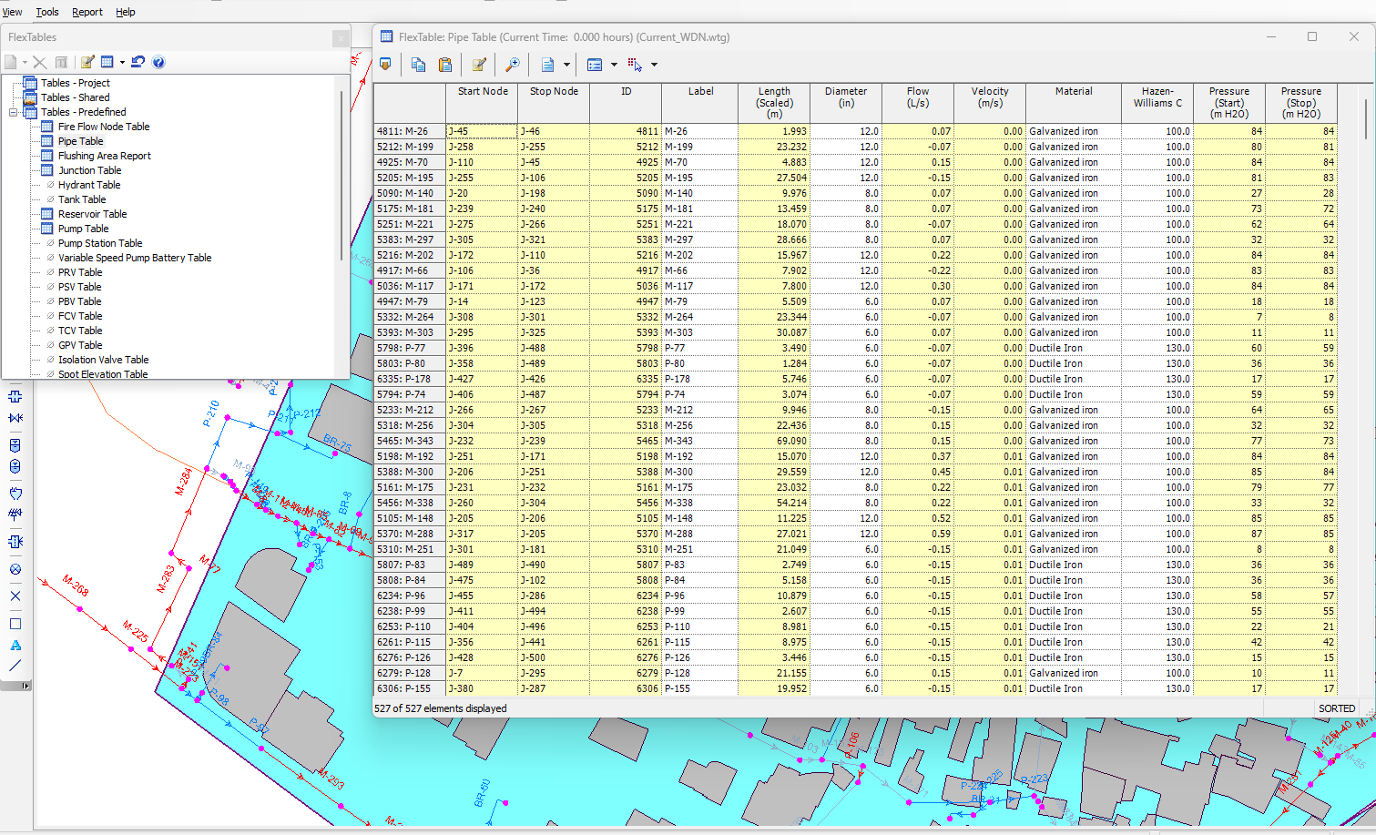
Pipe Flex Tables

Slide 18
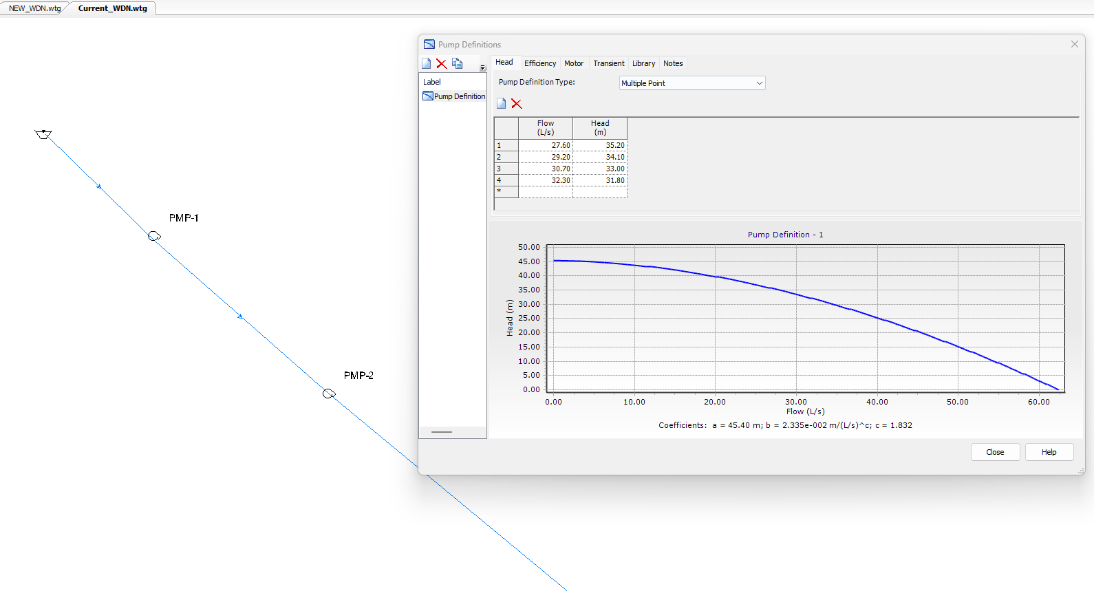
Pump Data
Two pumps are defined in the model with specific characteristics, including their pump curves and operational settings. These definitions are crucial for simulating the energy input into the system.
Pump Definitions

Slide 19
Point Description | Flow | Head
Shutoff | 0.0 | 44.0
Design | 30.7 | 33.0
Max operating | 61.4 | 0.0
Sample Pump Definition Values.

Slide 20
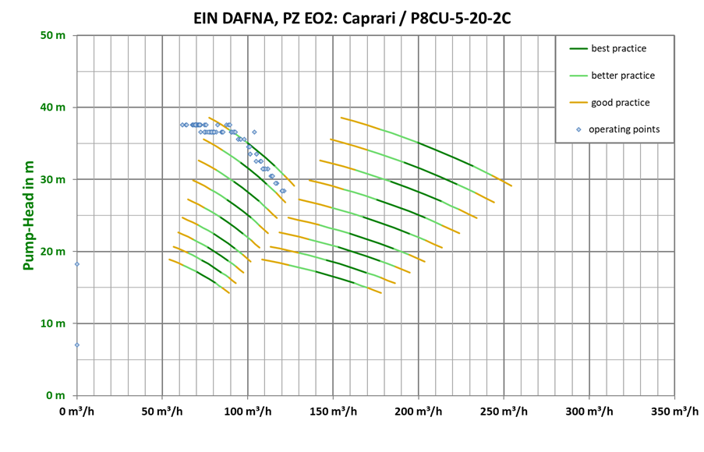
Obtained Pump Characteristic Curve (S-Curve)

Slide 21
WaterCAD Analysis: Results and Discussion
This section presents the key hydraulic parameters obtained from the WaterCAD model analysis, including pipe velocities, junction pressures, and pipe diameters. These results are critically compared against established design criteria to evaluate the network's performance and identify areas of compliance or concern.
The WaterCAD model analysis provides key hydraulic parameters, including pipe diameters, velocities, and junction pressures. These results are compared against the following design criteria:
Velocity: Minimum 0.3 m/s, Maximum 3 m/s.
Pressure: 20–80 m H₂O

Slide 22
Velocity Analysis
The velocity analysis shows the distribution of flow velocities throughout the network. High velocities can indicate potential pipe stress and failure risks, while low velocities might suggest stagnation or water quality issues. The results are assessed against the specified minimum (0.3 m/s) and maximum (3 m/s) velocity criteria.

Slide 23
Pressure Analysis
Junction pressures are a critical indicator of network performance, reflecting the water availability at different points in the system. The analysis compares the calculated junction pressures against the required range of 20–80 m H₂O. Deviations from this range can indicate areas with insufficient pressure for adequate service or excessive pressure leading to pipe stress.

Slide 24
Analysis Results (Pressures at Junctions)

Slide 25
Analysis Results (Velocities)

Slide 26
Future Water Supply Network
In this chapter, we want to redesign the existing water supply network to be serve for about years. In these years the number of people will increase, so we want to estimate number of people in 2050, and calculate the increase of demand at each node. Redesign of the network include mainly change the diameters of pipes.
Estimate of people
we apply the following equation: P_{f}= P_{o}* (1 + i )^{n}
Where: P_{f}: future population. P_{o}: present population. i: growth factor. n: design period.
i: to estimate the growth rate, using the years of 2007 and 1995 as a datum for the calculation.
Number of population in years of 1995 and 2007 equal 5000 and 5500 respectively.
Growth rate are found about 0.8% using eqn.
n: 43 years
P_{o}= 5500 capita
P_{f}= 7748 capita

Slide 27
Future liter per capita
According to PWA, we take the liter per capita per day 120 L/(C-d), 120 is the consumption, we want to calculate demand:
To estimate future water demand for each node, the nodal water demand shall be multiplied by the future demand factor
Future multiplication factor= (future demand/present demand) * (future population/ present population)
Present demand= 70 l/c/day
Future demand= 120 l/(c-d)
Present population= 6300 capita
Future population= 7748 capita
Future multiplication factor= 2.108

Slide 28
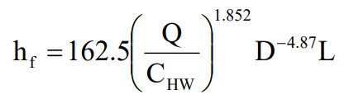
Future liter per capita
Hydraulic equation:
Head loss Equation
The basic relation that is used in a hydraulic design of a pipeline system is the one that describing the dependence of discharge Q (m³/s) on a head loss of h_{f} (m) caused by a friction between h_{f} the flow of fluid and the pipe wall. In my project I use the Hazen-Williams equations. This equation can be seen as shown below:
h_{f}: head loss (m)
L: pipe length (m)
D: pipe diameter (in)
Q: flowrate in the pipe (m³/h)
C_{HW}: Hazen Williams coefficient (-)

Slide 29
Future liter per capita
Continuity equation: A1*V1 = A2*V2
A₁ = Cross-sectional area at point 1 (m²)
V₁ = Fluid velocity at point 1 (m/s)
A₂ = Cross-sectional area at point 2 (m²)
V₂ = Fluid velocity at point 2 (m/s)
Sum head loss around close loop = zero.

Slide 30
Design of New Water Distribution Network
This section details the strategic redesign of the water distribution network to meet future demands, focusing on optimizing network performance for long-term sustainability. The design process incorporates the insights gained from the existing network analysis and addresses the projected population growth and increased water demand.
This water distribution network design project focuses on a comprehensive approach: first, assessing and enhancing the performance of an existing network to optimize current pressure and velocity conditions. Strategically redesigning it to accommodate a projected 25-year future demand, incorporating a new population of 7748 capita and a total new demand of 6938.5 m³/day across 514 junctions, leading to an average nodal demand of 13.449 m³/day. This dual-phase methodology, heavily reliant on WaterCAD for hydraulic modeling, ensures both immediate operational efficiency and long-term sustainability by proactively addressing the evolving water supply needs of the community.

Slide 31
Design of New Water Distribution Network
After the initial model runs and subsequent adjustments to pump heads, network layout, material definitions, and other parameters, optimum results were obtained. These results demonstrate the successful design modifications that address the identified issues and prepare the network for future demands.
For the pipes, the same information was used as in the existing network (length, diameter), and specific materials were chosen for the design, each with its own Hazen William coefficient.

Slide 32
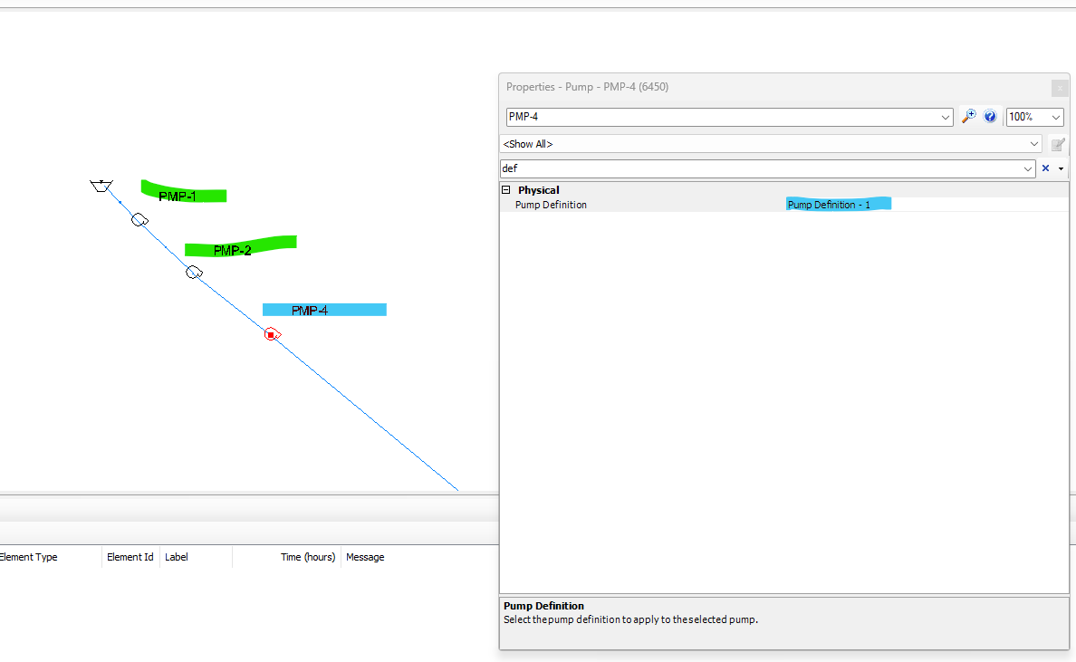
New Pump

Slide 33
Design of New Water Distribution Network
For the pump, we added another pump, the specific pump model under consideration for this analysis is the Caprari P8CU-5-20-2C, with its performance derived from its manufacturer's characteristic curve.
Point Description | Flow (Q in m³/h) | Head (H in m)
Shutoff | 0 | 48
Design | 200 | 30
Max Operating | 290 | 15

Slide 34
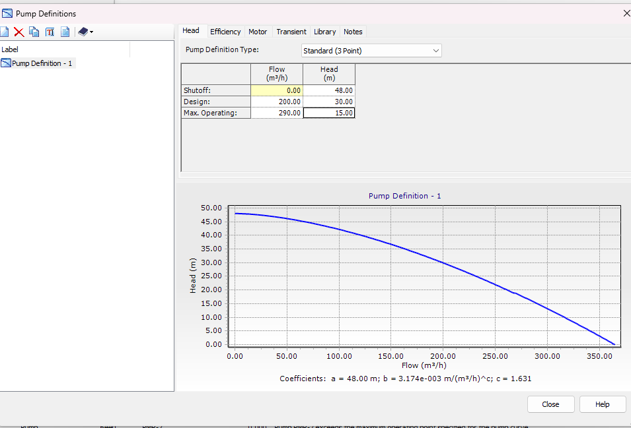
New Pump Definition (S-Curve)

Slide 35
Analysis Results (Velocitie)

Slide 36
Analysis results (Pressure at junction)

Slide 37
P-247 | 7 | 8
P-246 | 2 | 6
P-245 | 2 | 6
P-244 | 1 | 3
P-241 | 6 | 6
P-239 | 7 | 8
P-238 | 1 | 3
P-237 | 1 | 4
P-236 | 1 | 4
P-235 | 1 | 3
P-234 | 1 | 4
P-228 | 1 | 4
P-227 | 1 | 4
P-226 | 2 | 3
P-225 | 1 | 4
P-224 | 4 | 6
Sample for Old – New diameter for pipes

Slide 38
P-223 | 3 | 6
P-222 | 1 | 4
P-221 | 2 | 3
P-220 | 2 | 3
P-219 | 2 | 3
P-218 | 1 | 4
P-217 | 1 | 4
P-215 | 1 | 3
P-214 | 1 | 4
P-213 | 1 | 4
P-212 | 1 | 4
P-211 | 2 | 3
Sample for Old – New diameter for pipes

Slide 39
A good water distribution network should meet the following requirements:
Every consumer should get sufficient water at desired pressure.
The design and layout should be economical.
It must afford easy maintainability
Deliver water of correct quality and quantity on a continuous basis with minimum service interruptions.

Slide 40
Q&A

