Slide 1
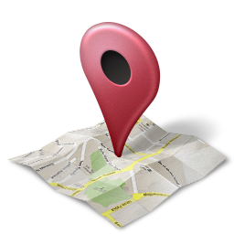
LoCus
Supervisors:
Mona Dmaidi
Manar Qamhieh
By :
Emad Aghbar
Mohammad Abdalraziq

Slide 2
Outline:
Motivation
What is Locus
How Locus works
Locus, business wise
Technologies and implementation
Challenges
Constraints
Future work

Slide 3

Motivations:
Sharing Information
  Is very easy these days
  But limited by connections and subscriptions
Effort needed to get Information
  Most services require searching.
  Many people struggle finding search keywords
Not easy to get on-the-go information about certain place.

Slide 4
Locus
No need for subscription or searching.
Location is all needed to get information
Tends to relate places with time, memories and events.
Provides useful rating and review service.
Locus makes users know more than their eyes can see.

Slide 5

How Does it work …
Relies basically on location and maps.
Ability to add/ view different kind of posts on map
Makes users more aware of the surrounding
Supports events sharing among people
Explore shops’ menus and offers even before entering

Slide 6




Posts types
Memories
Events
Information
Reviews, offers and menus of shops

Slide 7
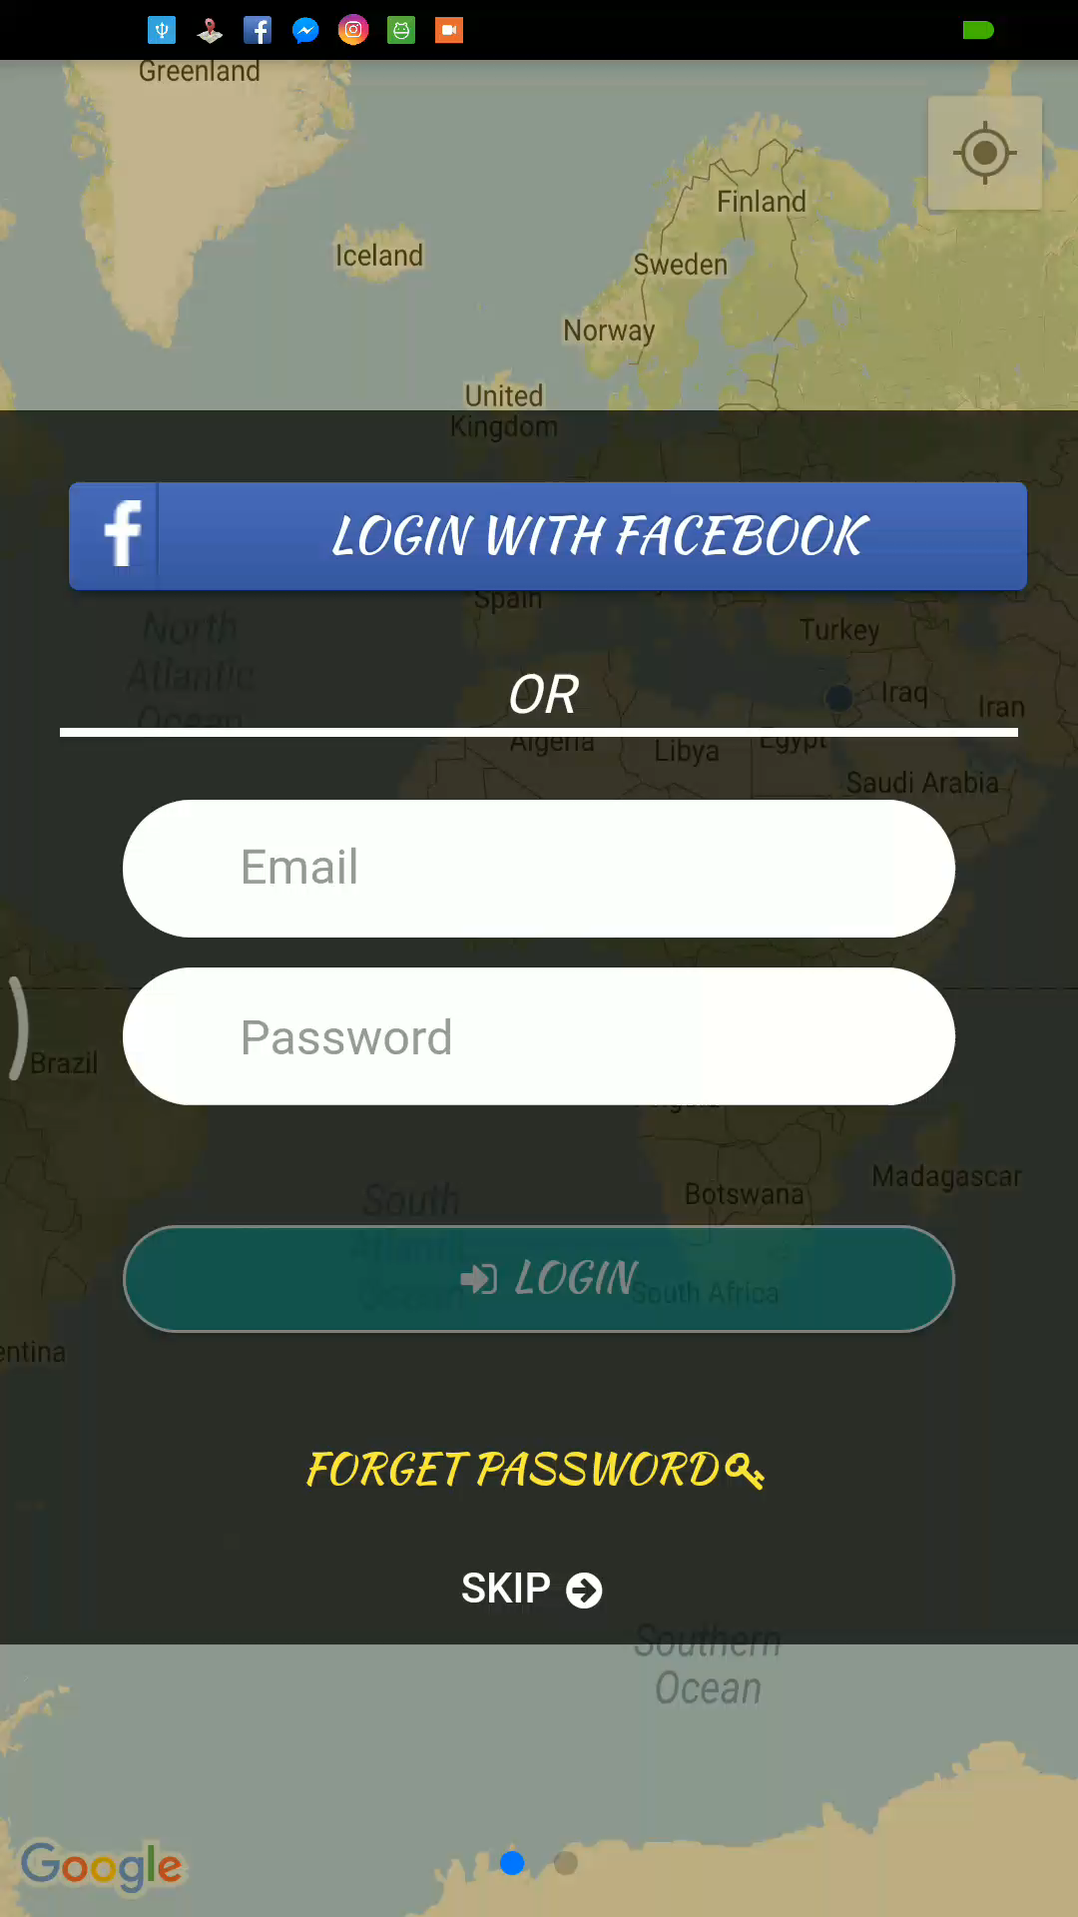
Login & signup
Login page.
Signup page.
Filter and Buttons
Navigating

Slide 8
Memories
Pin memories to where they have happened
Anyone can view them when visiting the place.
Satisfies people curiosity
Makes memories become landmarks
Notes:
Whenever u return to the place u still can see ur fingerprint there .
peoples’ passion to know more is more than enough reason for people to Locus.

Slide 9
Information posts
Give useful information about the place
Used it as tourist guide to discover historical places
Endorsing system to insure information accuracy
Notes:
Mostly historical info,

Slide 10
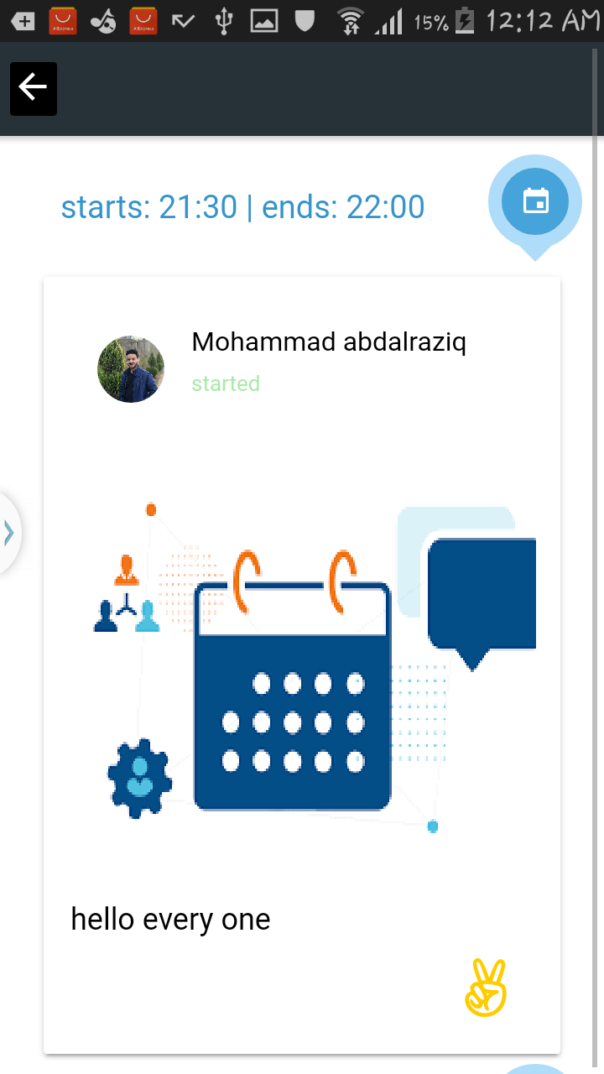
Events
Publish events easily
Notify users around.

Slide 11
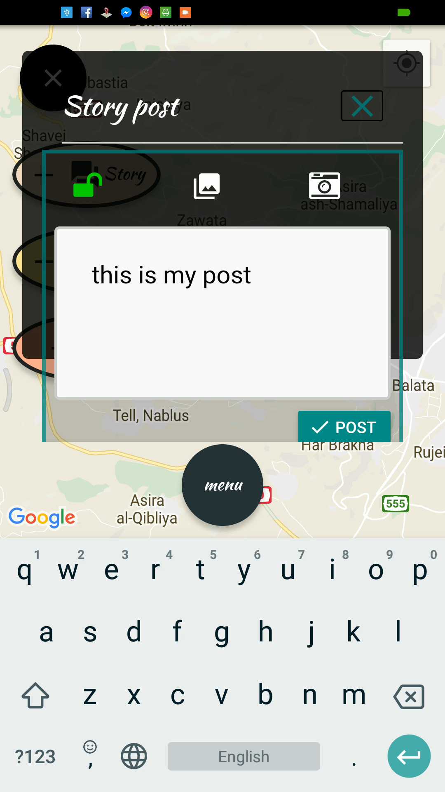
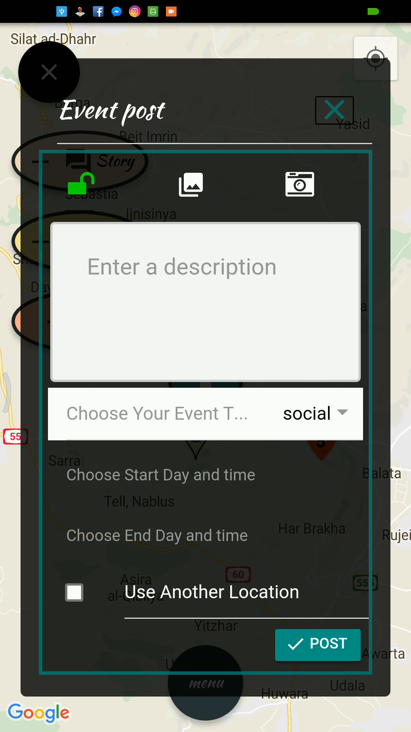
How to add posts

Slide 12
Shops & Restaurants
This is a focused feature in Locus
Know more about shop before trying it
Confident decisions.
Includes: Menus&Offers, Rating&Reviews, Owner Dashboard

Slide 13
Menus & Offers
User can view menus and offers before entering the place.
Choose the best place around to get the service from.
Sorts places according to shortest distance, and best offers.
Notify users about offers around.
Notes:
Easy to decide between Close restaurants

Slide 14
Rating & Reviews
Provide regular rating of the place.
View others feedback posted in the place page.
User can take decision upon peoples’ experience.

Slide 15
Place Owner dashboard
A website to enable places owners from adding their place to the application map.
Picture of the website.

Slide 16
Place Owner dashboard
Manage the place
Add, delete and edit Menus, lists of prices and offers
Monitoring customers’ feedback and ratings.

Slide 17
Options & Settings
Customize range of viewed posts.
Choose what notifications to show.
Choose type of the map (Satellite/Normal)
GIF

Slide 18
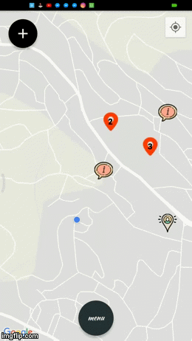
Privacy
Following users mechanism.
Search for friends to follow
Ability to show posts only to followers for more privacy

Slide 19
Users Profiles
Edit and remove posts.
View and response to following requests
Edit user information

Slide 20
Locus Business wise:
Can make revenue by adding fees to show a shop or a restaurant on application map.
Apply small fees on users to advertise events.
General advertisement depending on location

Slide 21








Technologies and implementation
Mobile application
Dashboard website
Server

Slide 22
Challenges
Too many posts

Slide 23
Challenges
Server – application interaction
  Send only the needed data
  Range of posts
No internet connection
  Offline posts

Slide 24
Constraints:
Internet connection ( 3G )
Time

Slide 25
Future work
Data mining.
Adapt other social websites events.
Improve owner capabilities on dashboard

Slide 26
Thanks

