Slide 1
PAL ASSETS
Presented by:
Shareef Alawneh &
Lina Ennab
Supervisor: Dr. Muhnnad Al-Jabi
Presentation for graduation project

Slide 2
Outlines:
Introduction
The main idea
Our project in details
Tools
Future work

Slide 3
Introduction:
These days, technology is around us, you can see it every where.
The legacy of technology now is phones and computers,
which can bring the world in your hands by mobile apps and websites.
Everything now goes easier and more valuable when it relates to a software,
People communications, shopping, money transactions and etc.
So, can we make our life easier by a software that helps us to find a home?

Slide 4
The main idea:
Finding a home is not that easier thing, there is three possibilities:
Trying to find out by yourself, which is something hard.
Asking people, and you may find nothing.
Delegate a broker, who is usually a matchstick.
Therefore, the main idea came from finding a reliable link between buyers
and sellers by providing an easy way for the buyers to find what they want
while they are comfort and happy.

Slide 5
Project in details:
Our project is a web application that provides users to navigate all assets that
Shown on our website for sale or for rent in their area. They also can navigate
all the assets anywhere else.
It is also allow sellers to advertise their assets for sale or for rent on our website.

Slide 6
Buyers:
Buyers or ordinary users, can navigate the advertises, search for a specific one
They also can add what they like to their wish list, since each user has its own
Profile.
When a user decide that this is what I want, he can e-mail the seller to agree
And making a deal.

Slide 7
Sellers:
Sellers have the advantages of buyers in addition to that they can add their
Own advertises
Sellers given a full control of their advertises, they can update the full record,
Update part of it, or completely delete it.

Slide 8
Advertises:
Advertises have the full information that can tell you if this is what you want or
Not.
Advertise page provide a table that contains the hot info that people ask
about, like where? Price? Who is the seller?
Beneath that, users given a full description about this asset,
the seller is responsible about giving his advertise the full information that
Make him guaranteed from the buyers side.

Slide 9
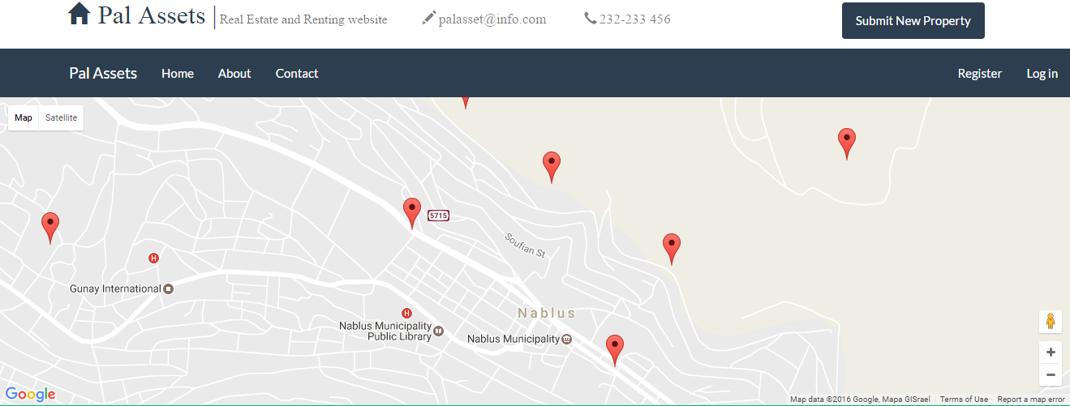
Two search mechanisms:
1) Google maps

Slide 10

2) Searching box

Slide 11
Tools:
We used a unified programming language for our website, and mobile app.
Yes ! Its C#
So, in our website we used ASP.NET specifically MVC pattern
In our mobile app, we used Xamarin framework, which is a free cross platform
Framework provided by Microsoft

Slide 12
Why c#?
We love Microsoft
It was advice from Dr. Muhannad to unified the language
as a good programming style.
3) C# came with a huge libraries and programming shortcuts that makes
programmers life easy.
4) Xamarin is a crossplatform framework, which means “write your code once
and run it on all devices”

Slide 13
Future work:
Adding additional features to our website like a 360 degree videos for ads.
Improving our app since we are still learning the framework.
Adding features that allow users to pay by their own credit/debit cards.

