Slide 1

Slide 1
Notes:
Supervisor: Dr.Khalid Dauod Made by: Mohammad Badawi Ammar Mohammad

Slide 2
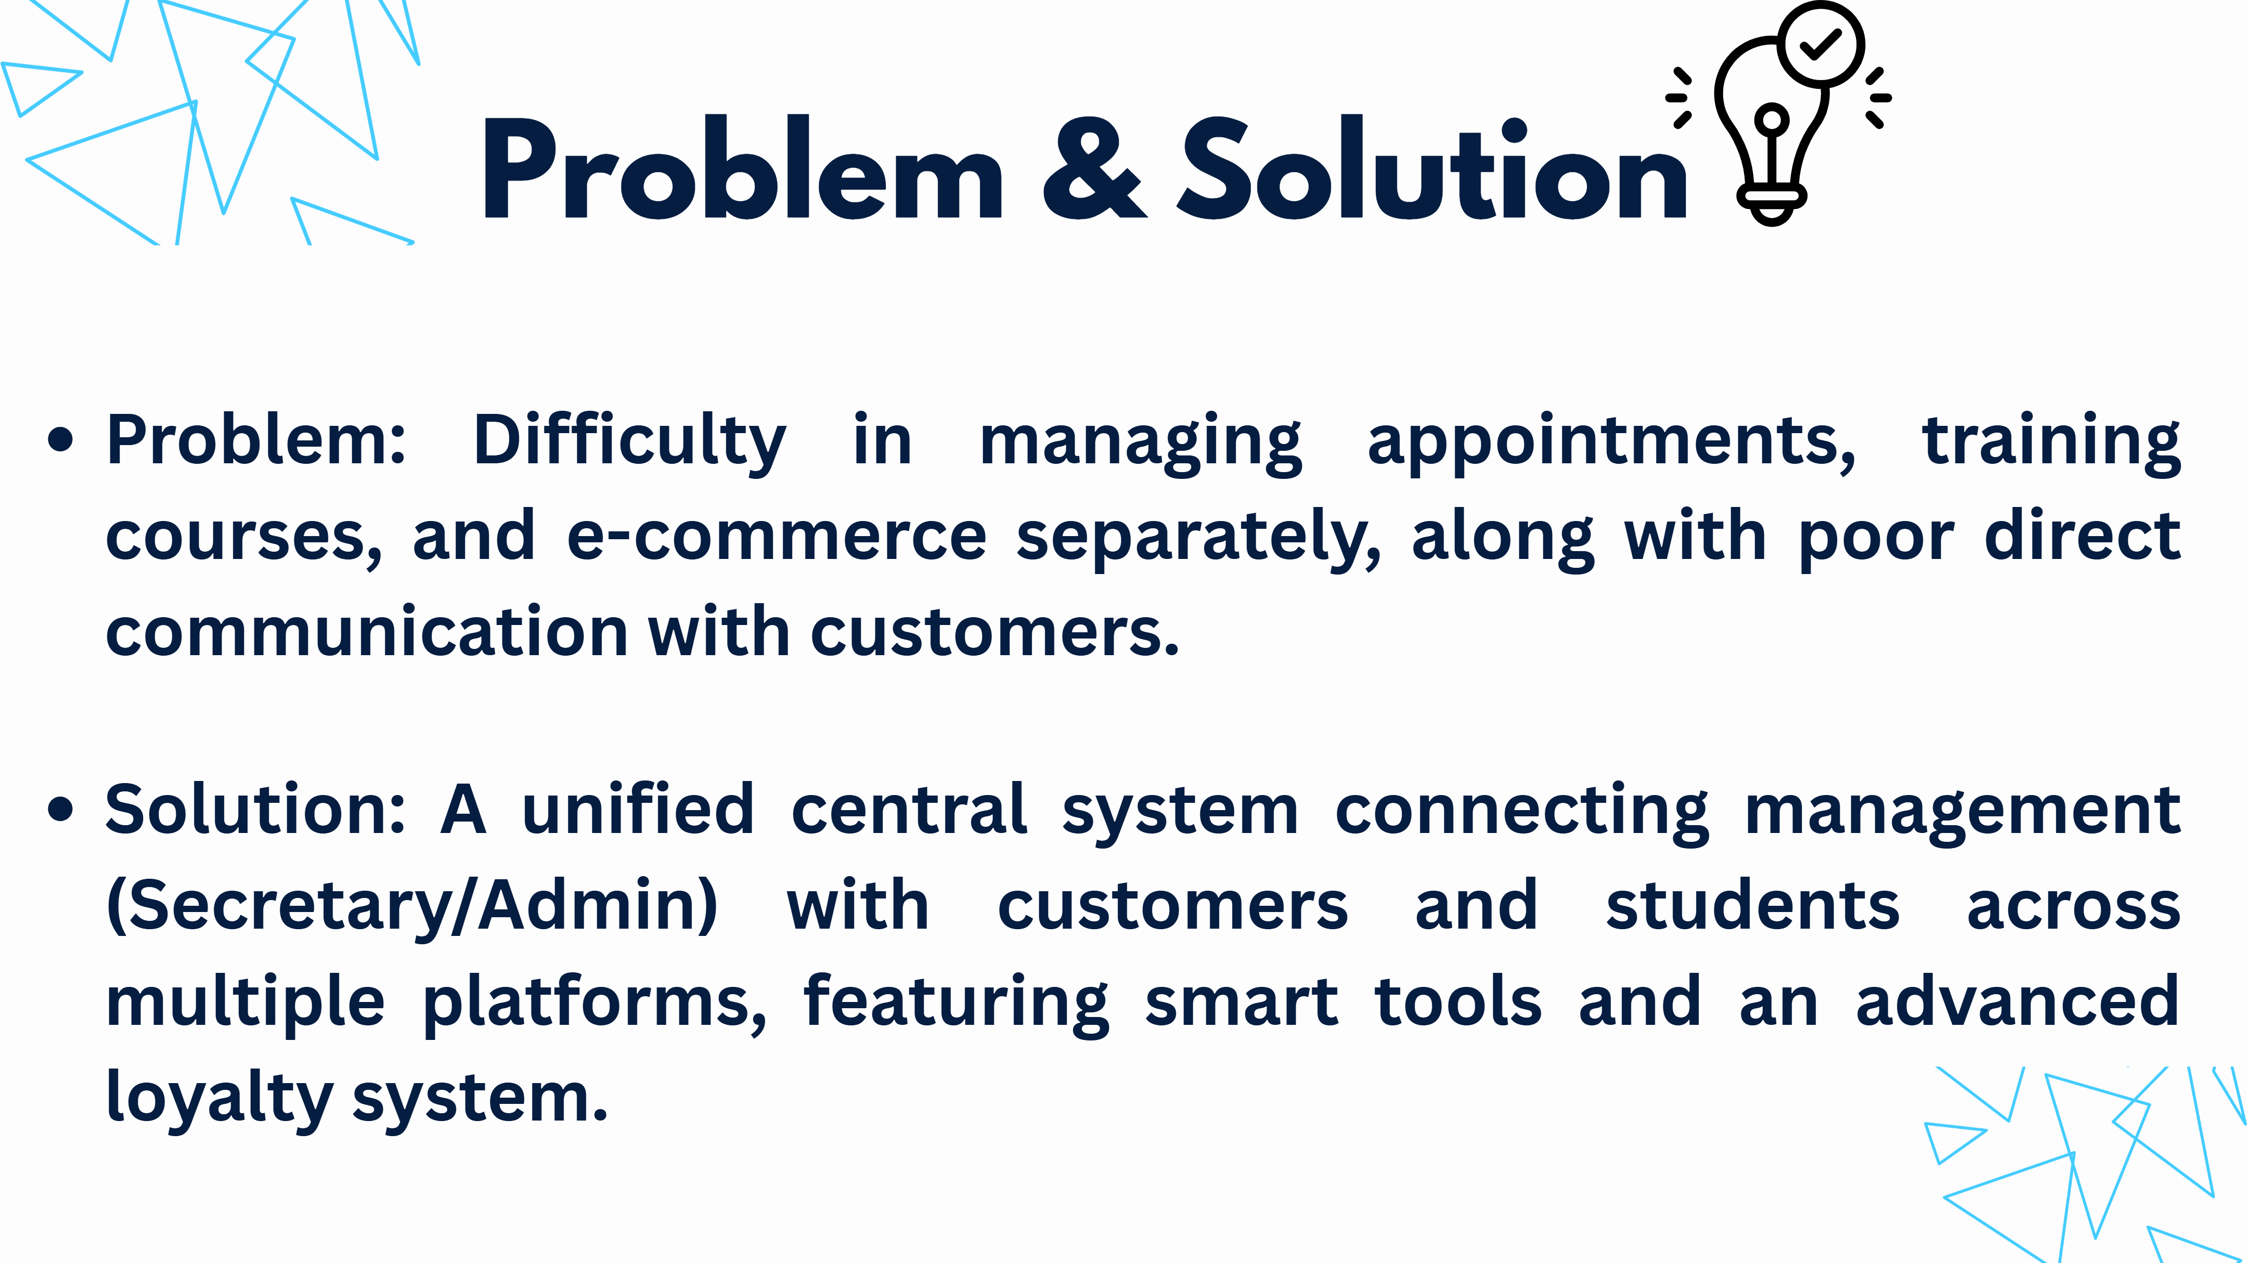
Slide 2
Notes:
Problem: Difficulty in managing appointments, training courses, an d e-commerce separately, along with poor direct communication with customers. Solution: A unified central system connecting management (Secretary/Admin) with customers and students across multiple platforms, featuring smart tools and an advanced loyalty system. Problem & Solution

Slide 3
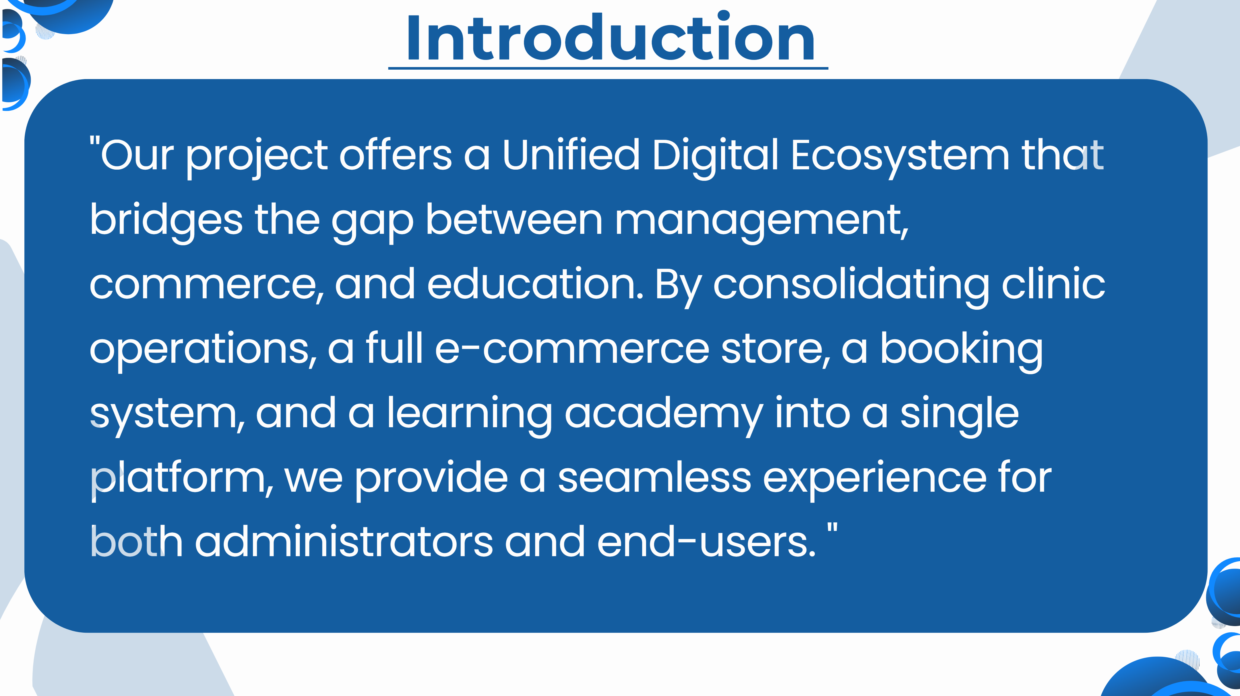
Slide 3
Notes:
" Our project offers a Unified Digital Ecosystem that bridges the gap between management, commerce, and education. By consolidating clinic operations, a full e -commerce store, a booking system, and a learning academy into a single platform, we provide a seamless experience for both administrators and end-users. " Introduction

Slide 4
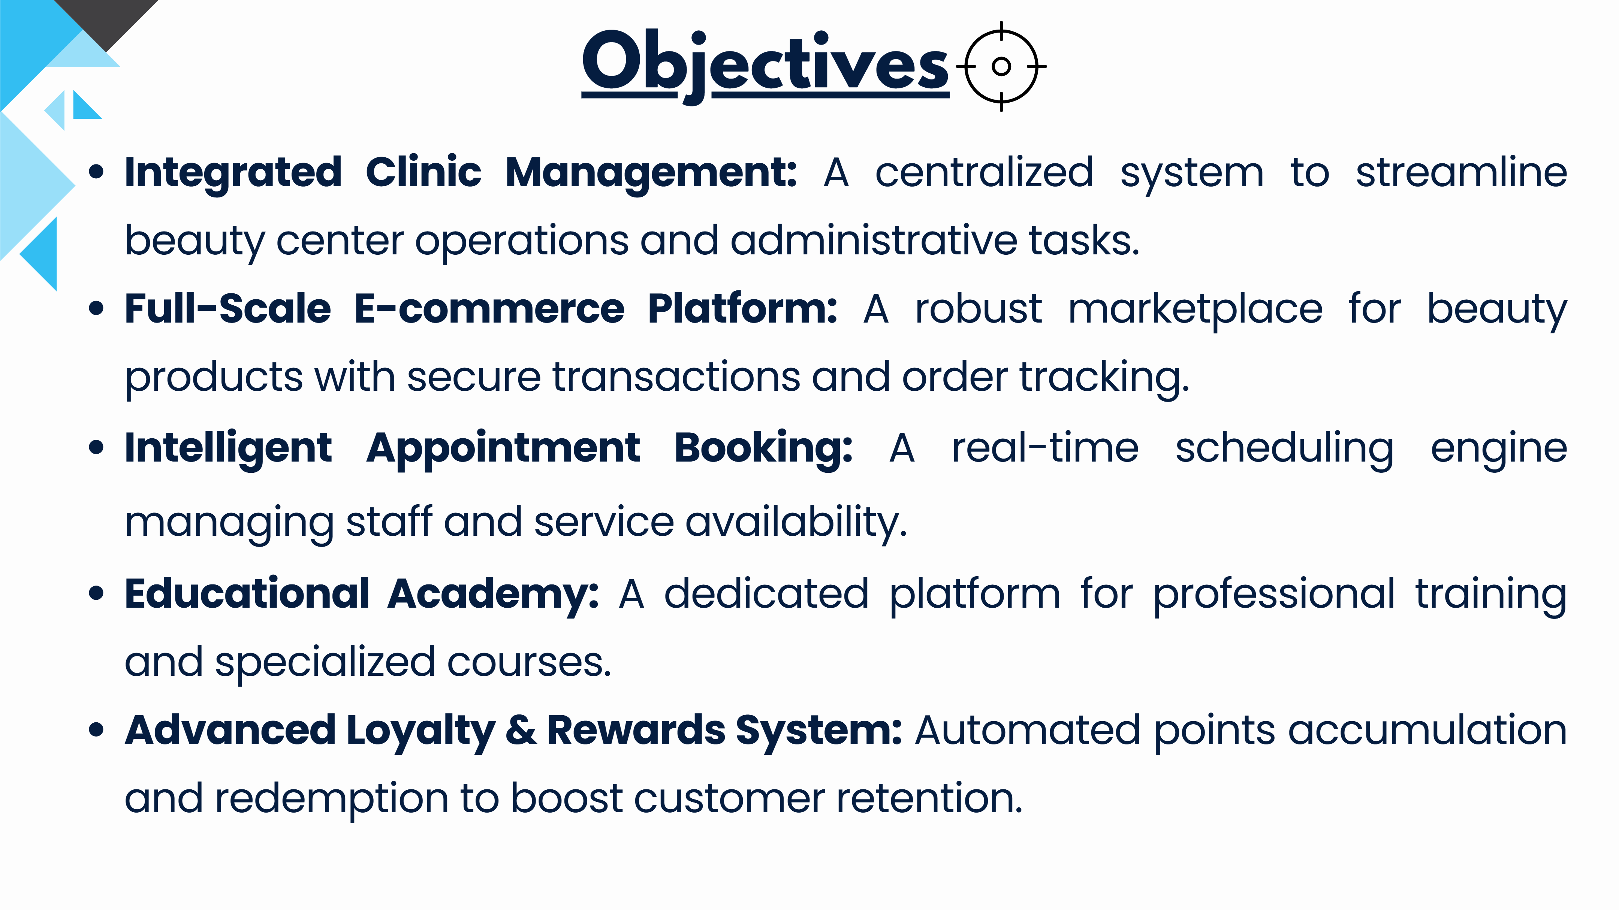
Slide 4
Notes:
Integrated Clinic Management: A centralized system to streamline beauty center operations and administrative tasks. Full-Scale E-commerce Platform: A robust marketplace for beauty products with secure transactions and order tracking. I ntelligent Appointment Booking: A real-time scheduling engine managing staff and service availability. Educational Academy: A dedicated platform for professional training and specialized courses. Advanced Loyalty & Rewards System: Automated points accumulation and redemption to boost customer retention. Objectives

Slide 5
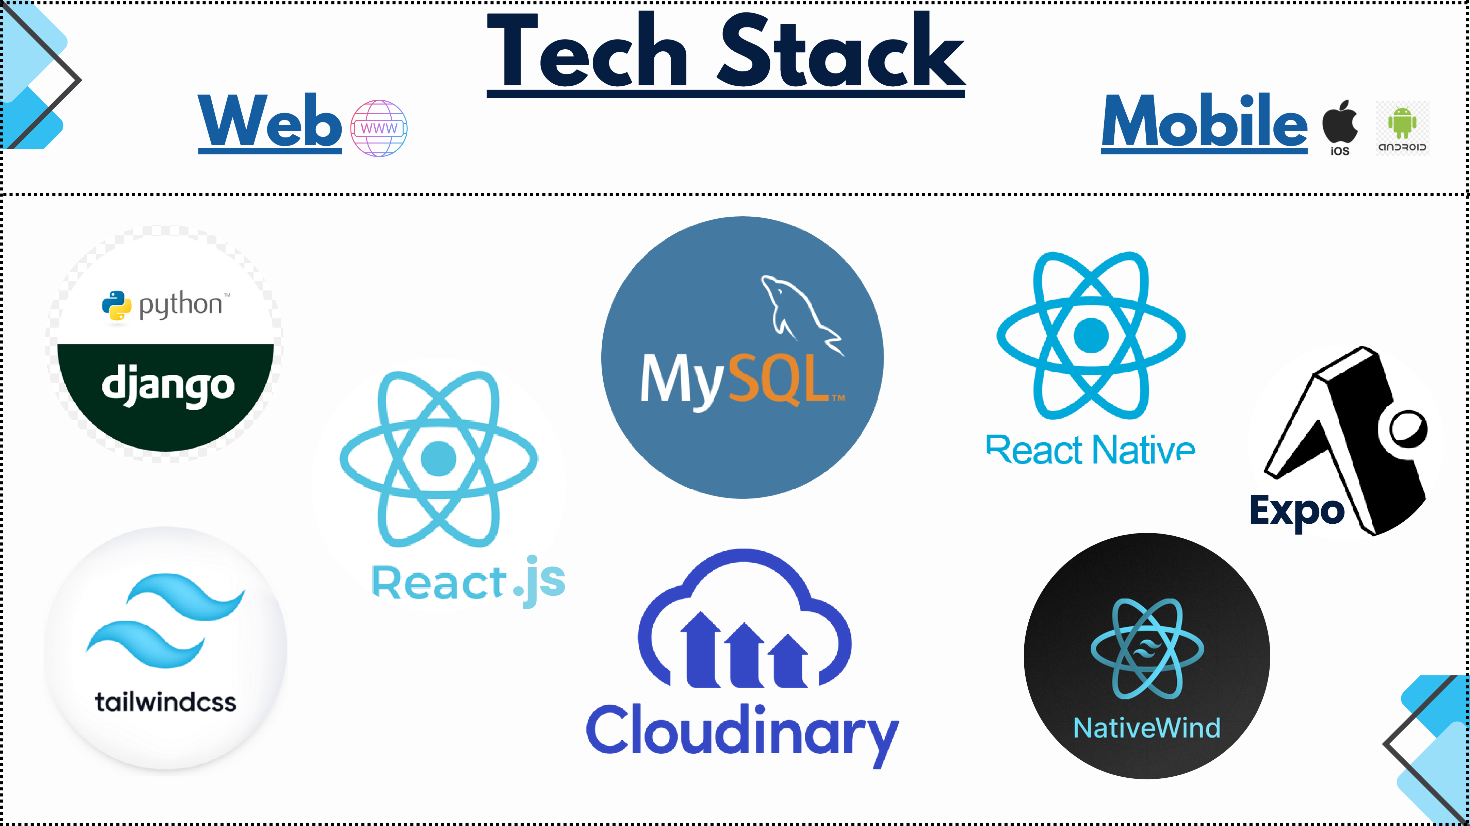
Slide 5
Notes:
Tech Stack Web Mobile .js Expo

Slide 6
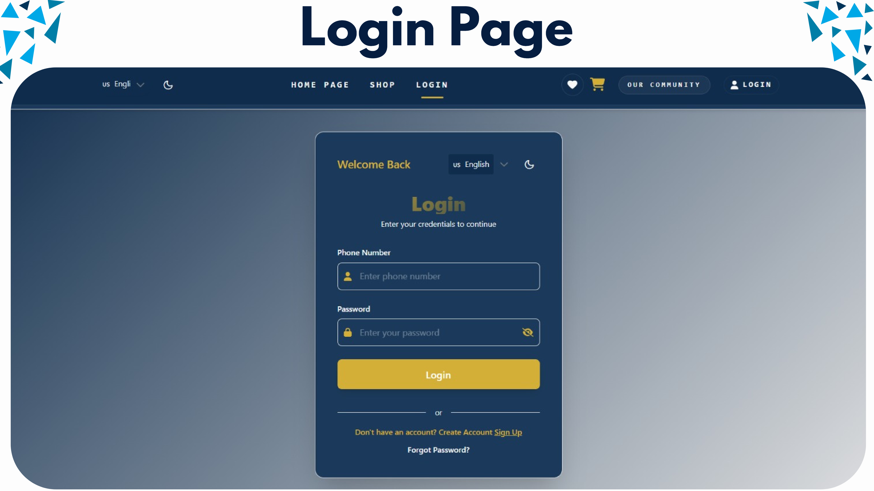
Slide 6
Notes:
Login Page

Slide 7
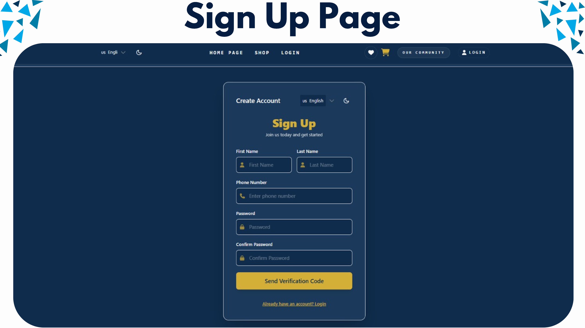
Slide 7
Notes:
Sign Up Page

Slide 8
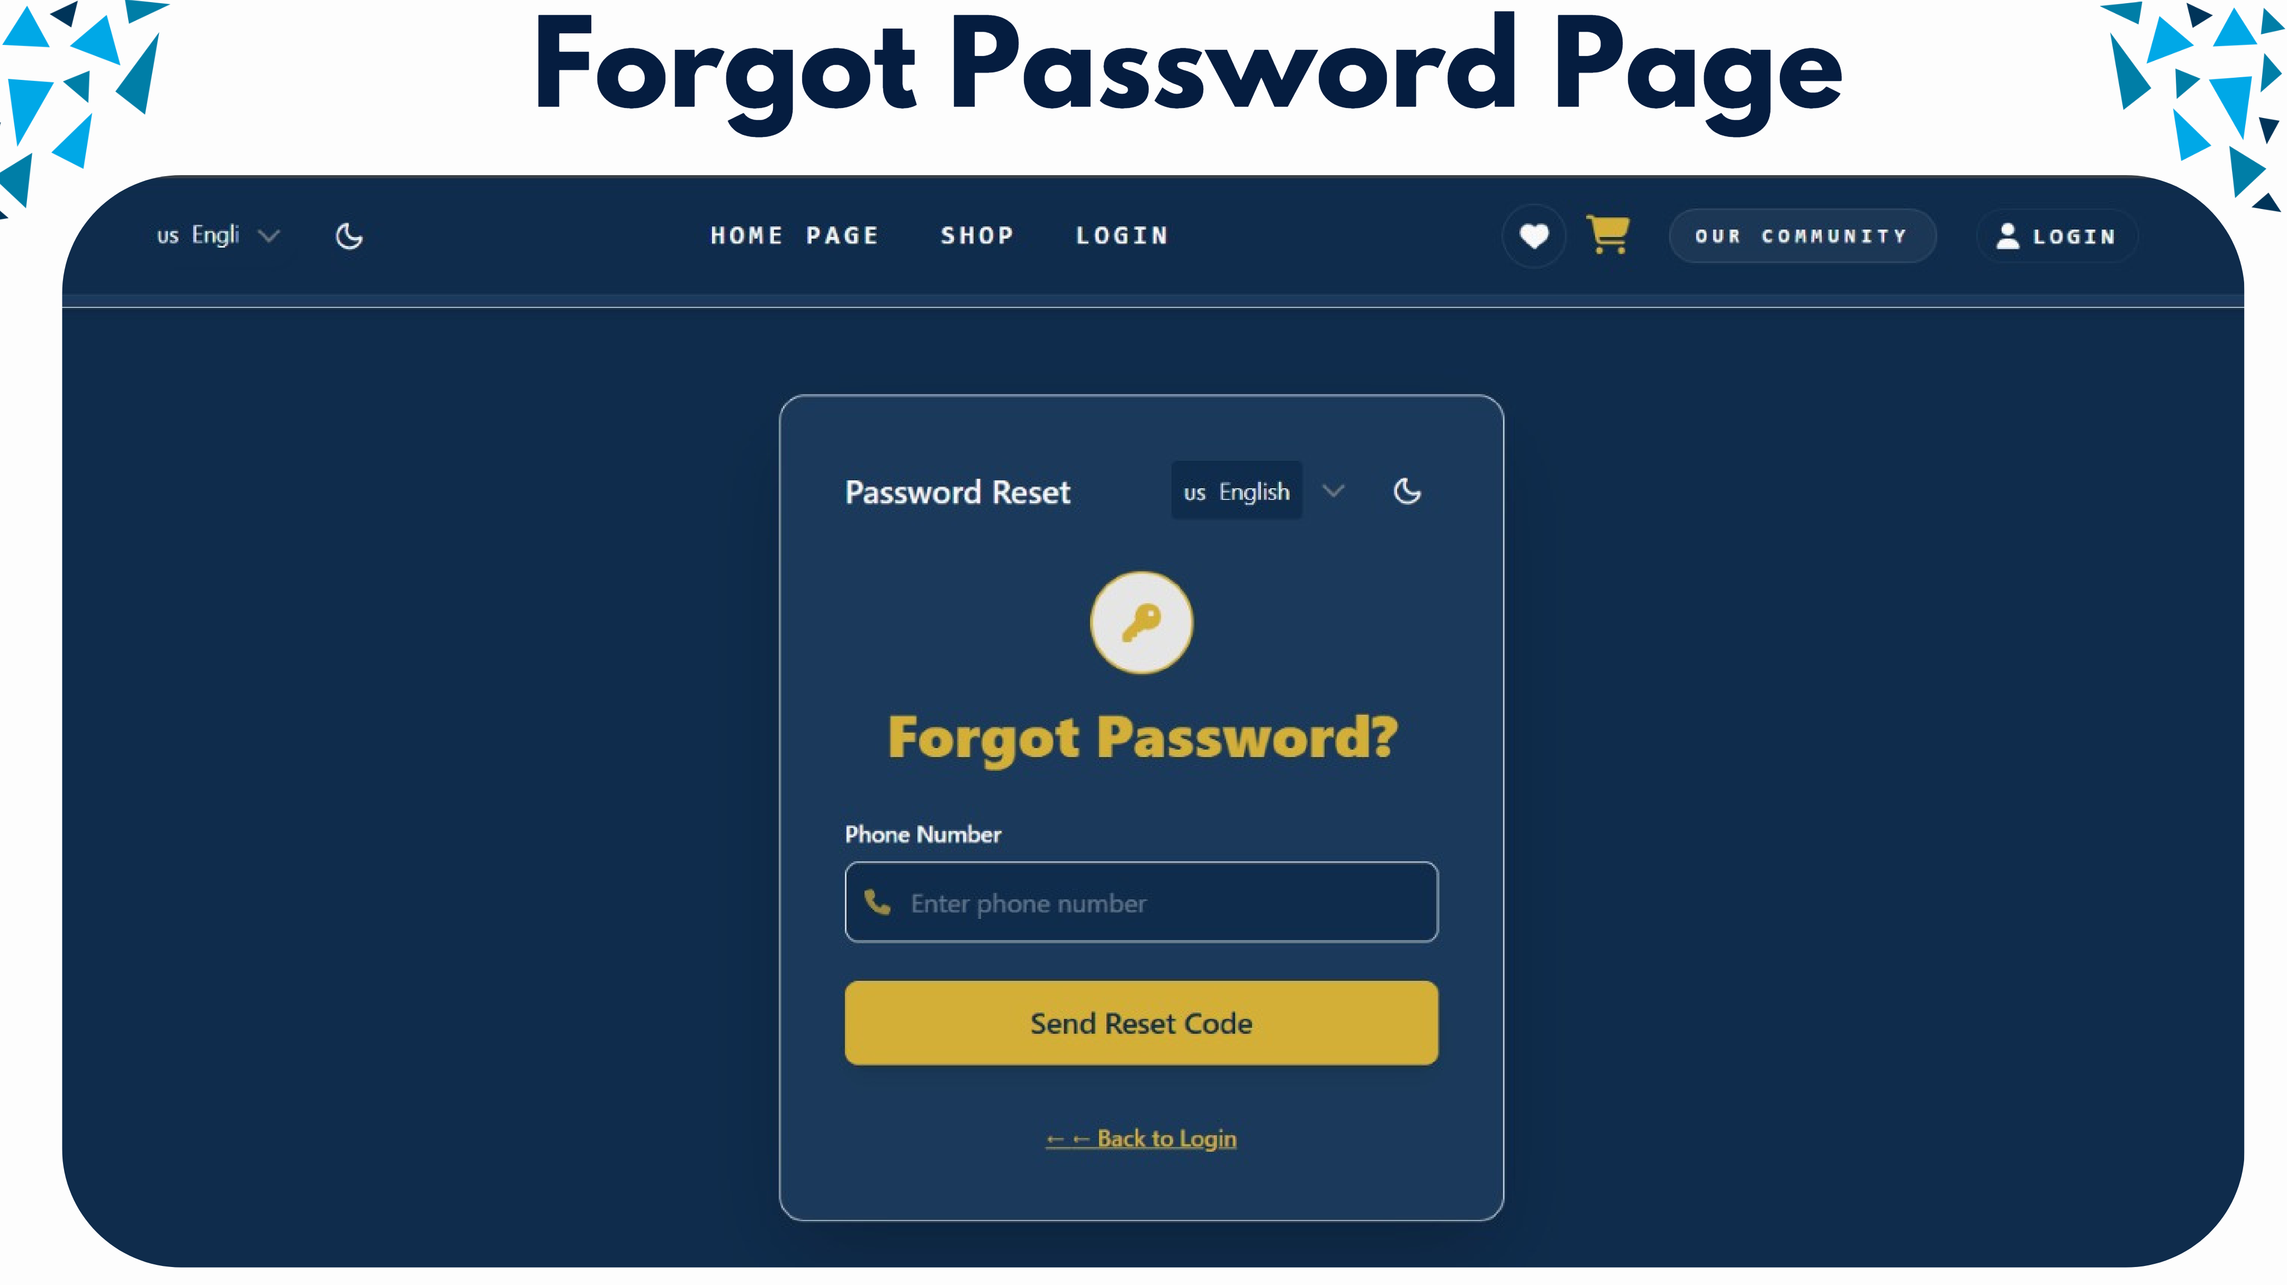
Slide 8
Notes:
Forgot Password Page

Slide 9
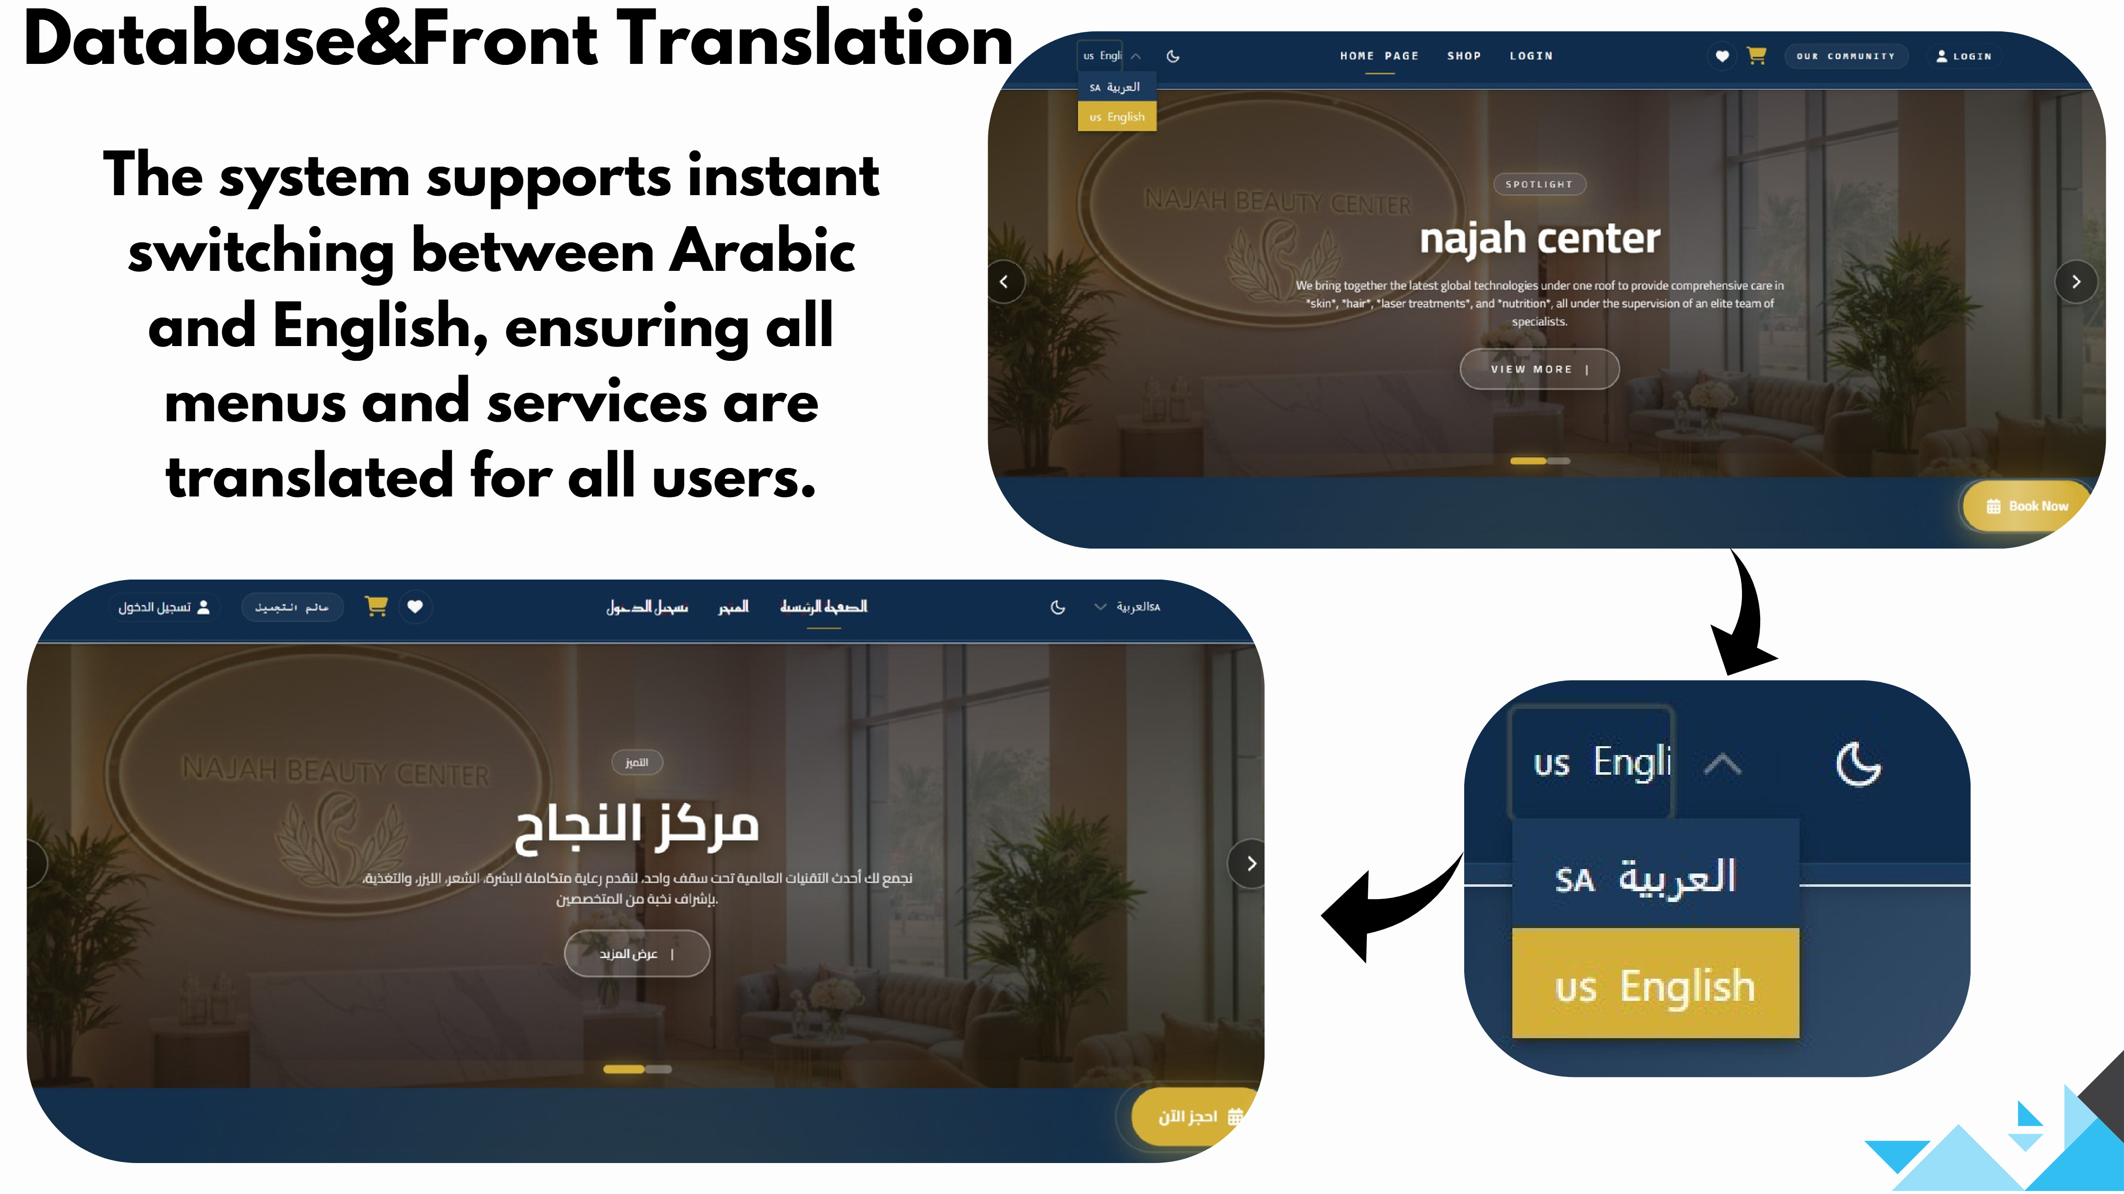
Slide 9
Notes:
Database&Front Translation The system supports instant switching between Arabic and English, ensuring all menus and services are translated for all users.

Slide 10
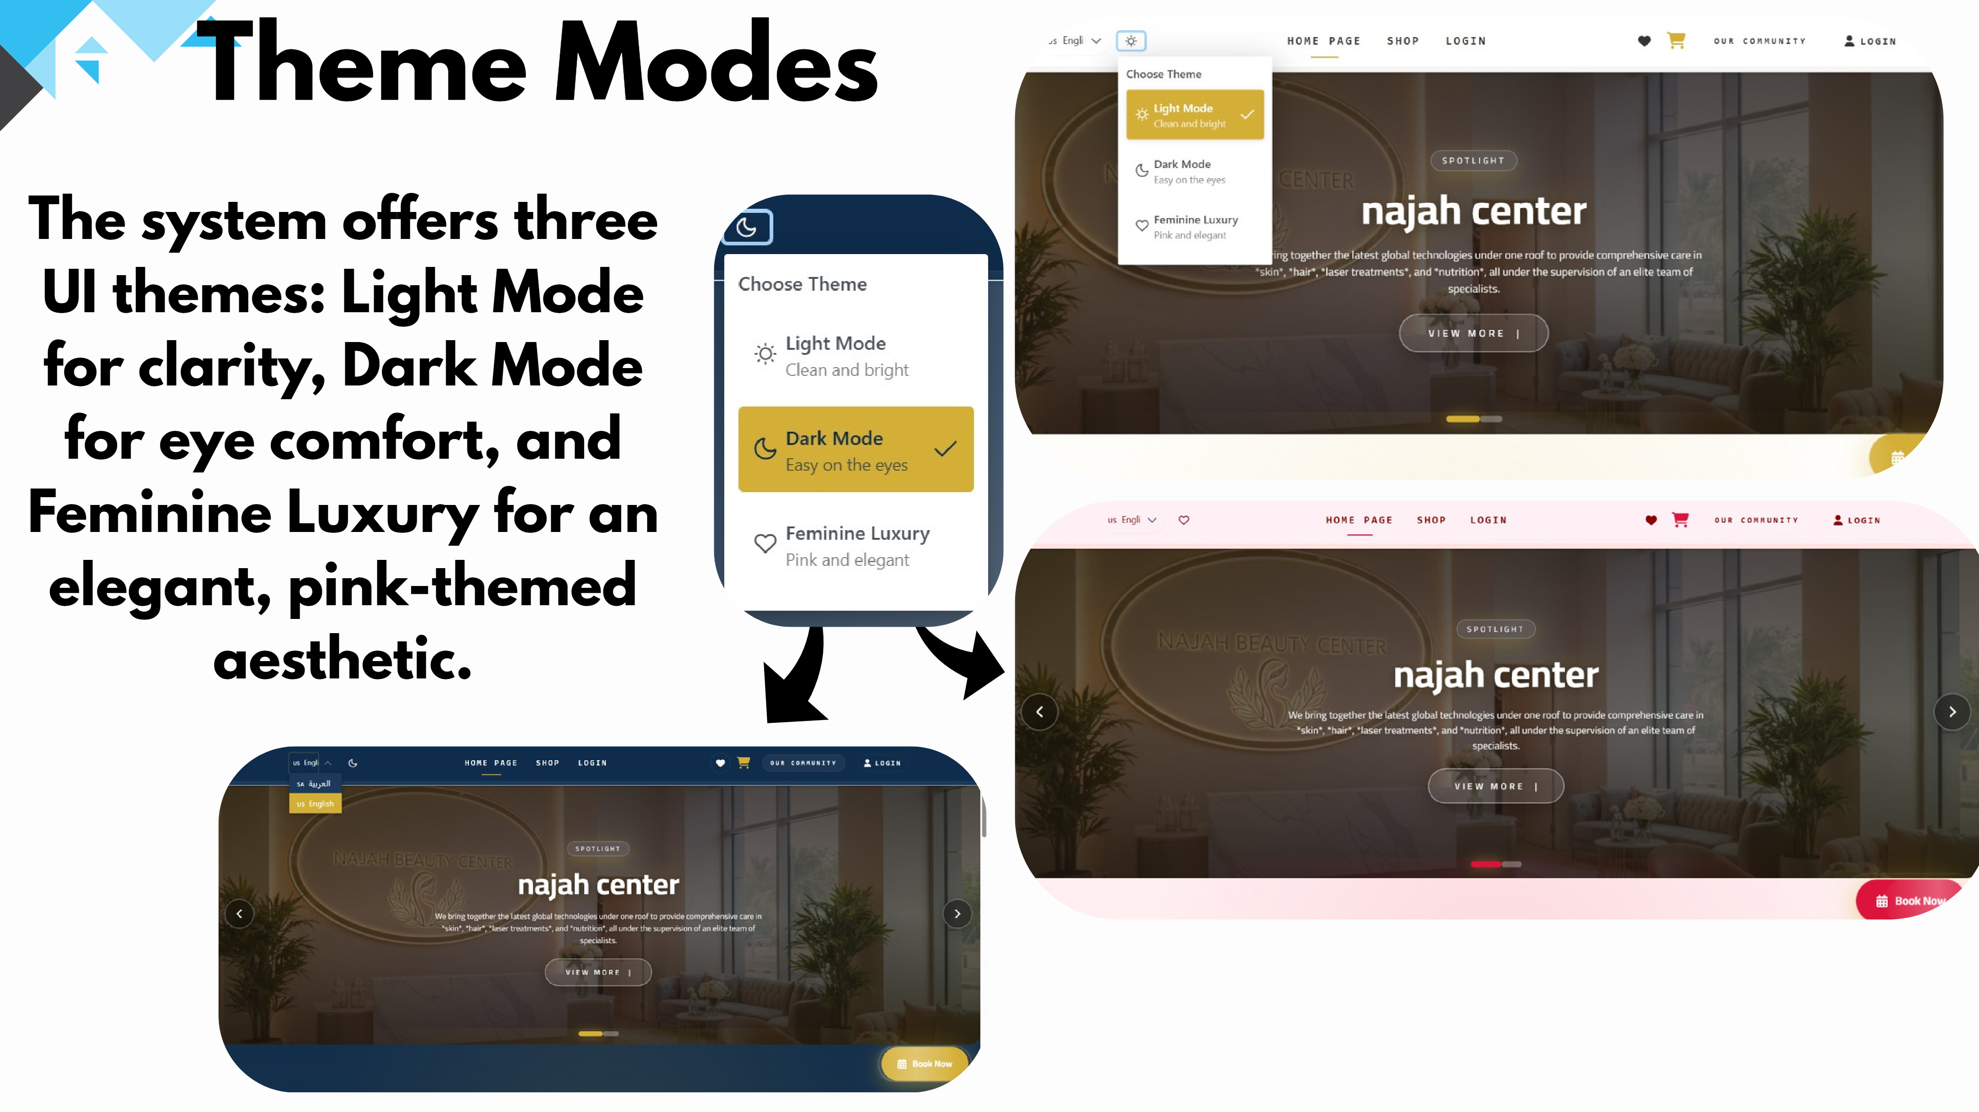
Slide 10
Notes:
Theme Modes The system offers three UI themes: Light Mode for clarity, Dark Mode for eye comfort, and Feminine Luxury for an elegant, pink-themed aesthetic.

Slide 11
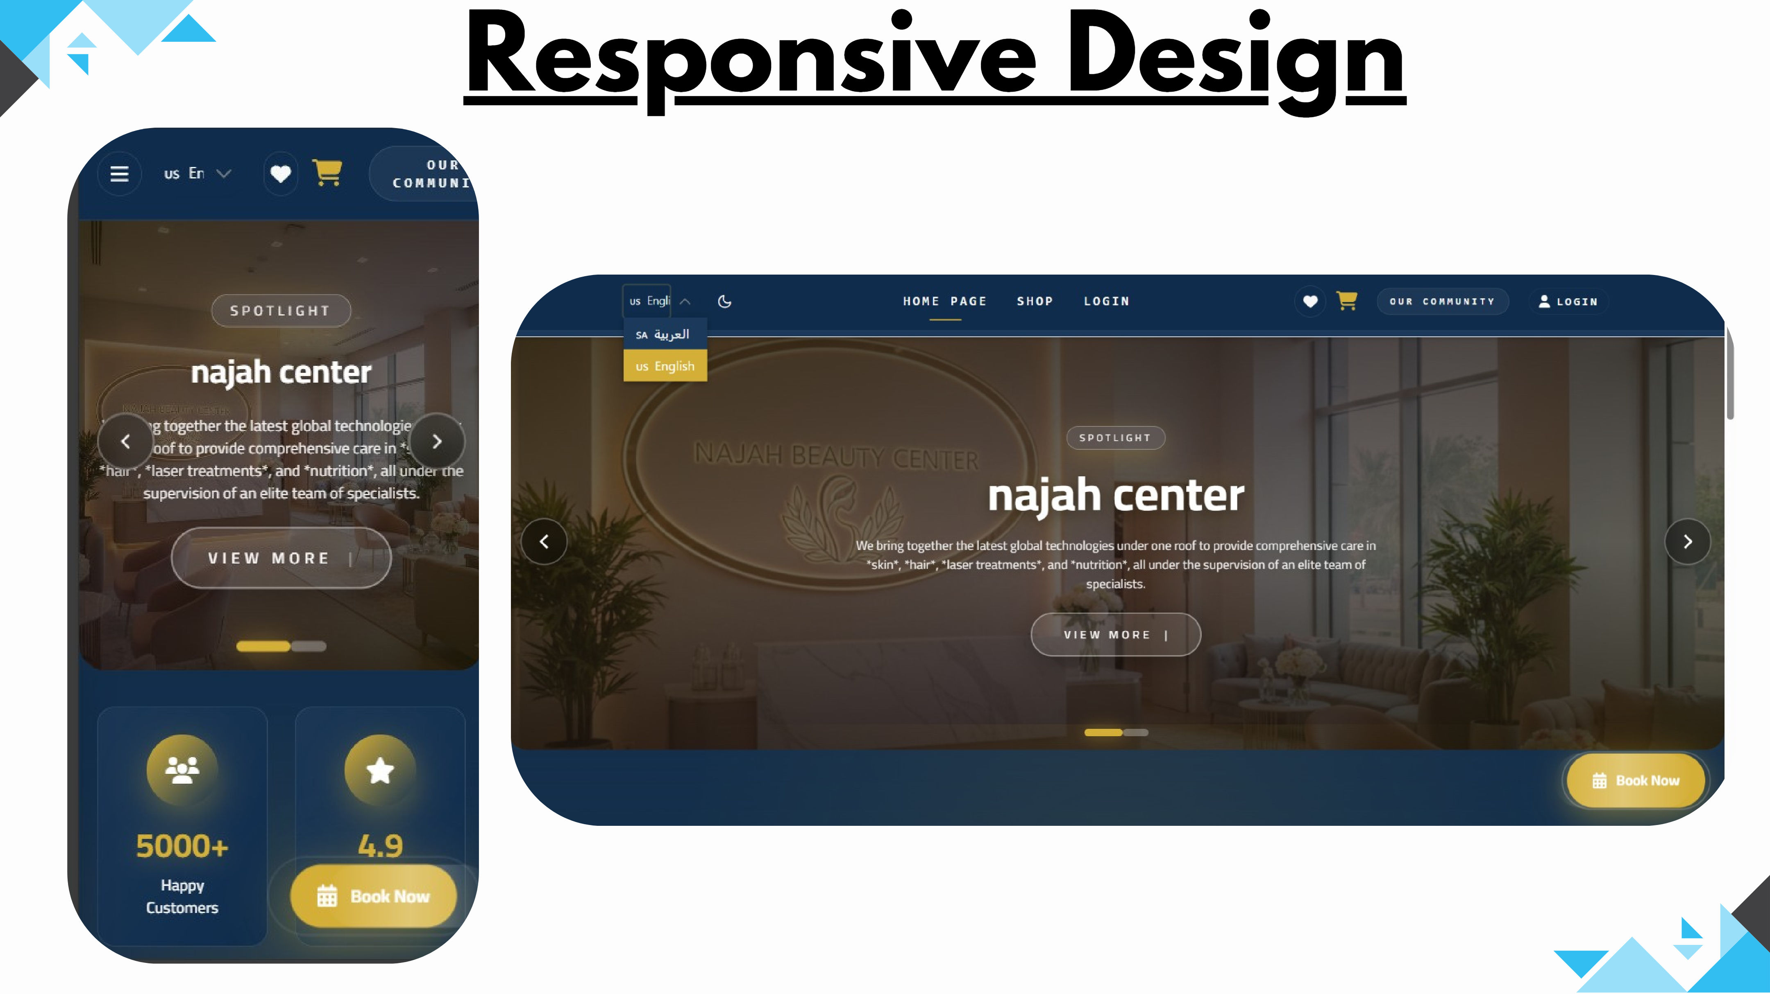
Slide 11
Notes:
Responsive Design

Slide 12
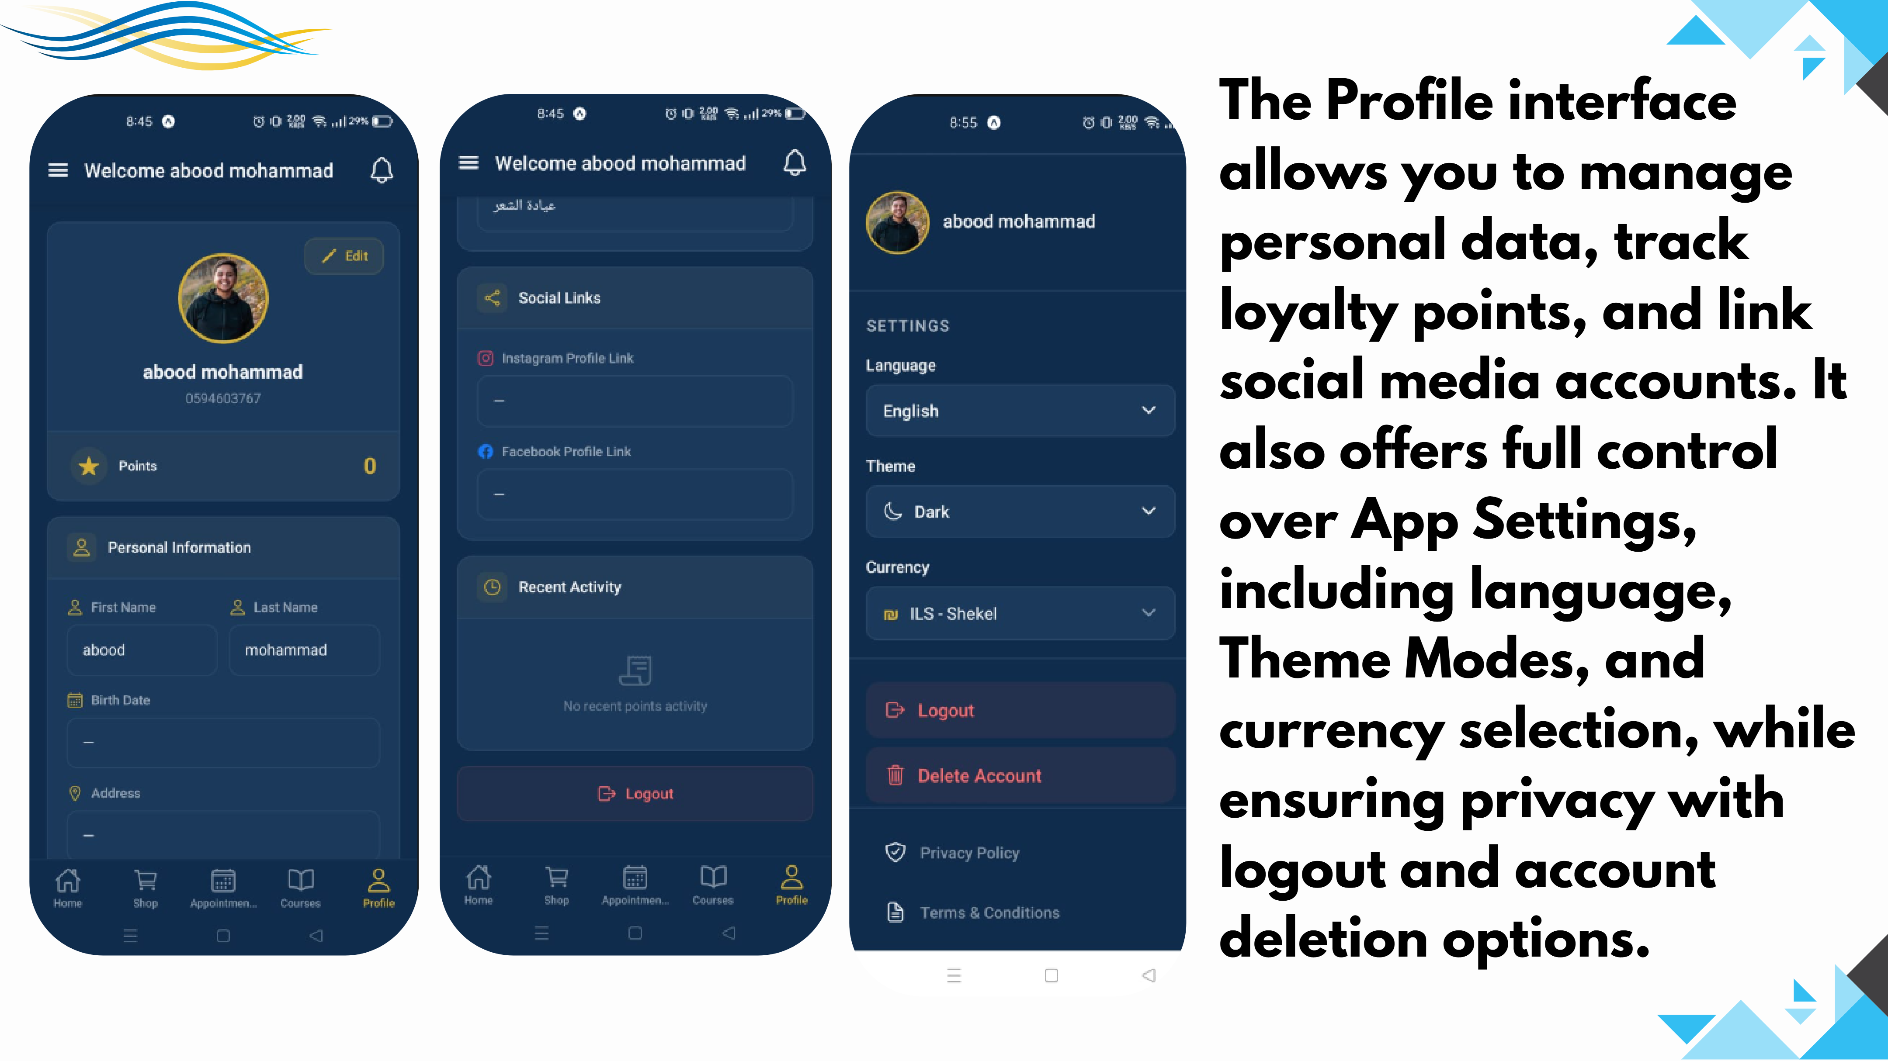
Slide 12
Notes:
The Profile interface allows you to manage personal data, track loyalty points, and link social media accounts. It also offers full control over App Settings, including language, Theme Modes, and currency selection, while ensuring privacy with logout and account deletion options.

Slide 13
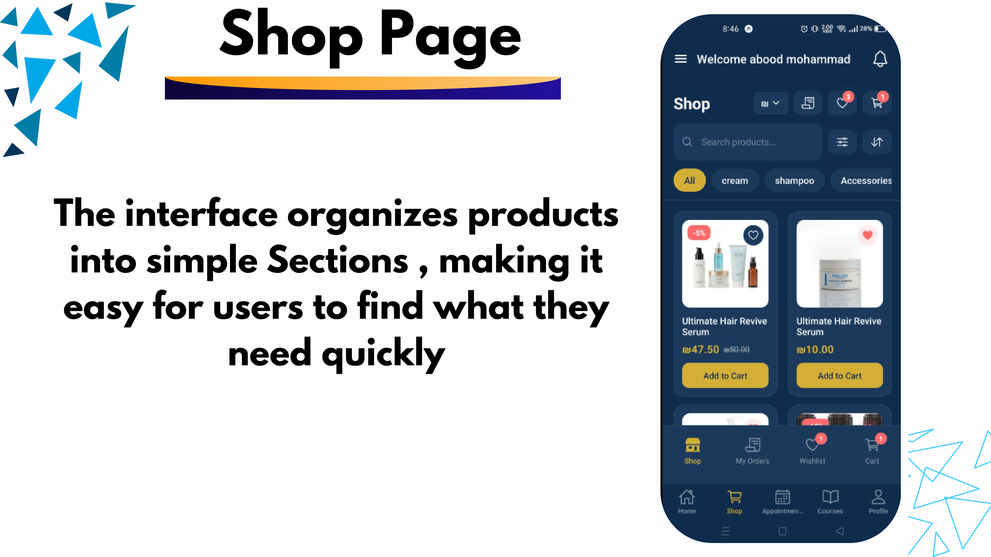
Slide 13
Notes:
The interface organizes products into simple Sections , making it easy for users to find what they need quickly Shop Page

Slide 14
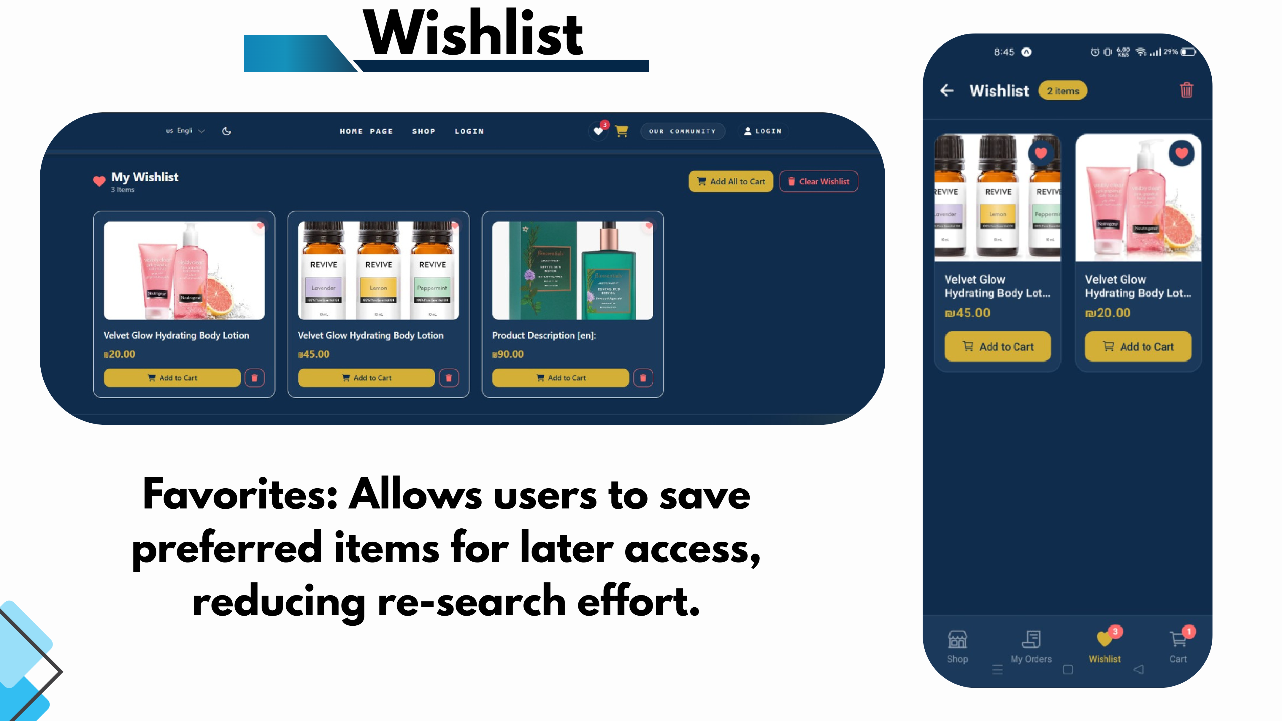
Slide 14
Notes:
Favorites: Allows users to save preferred items for later access, reducing re-search effort. Wishlist

Slide 15
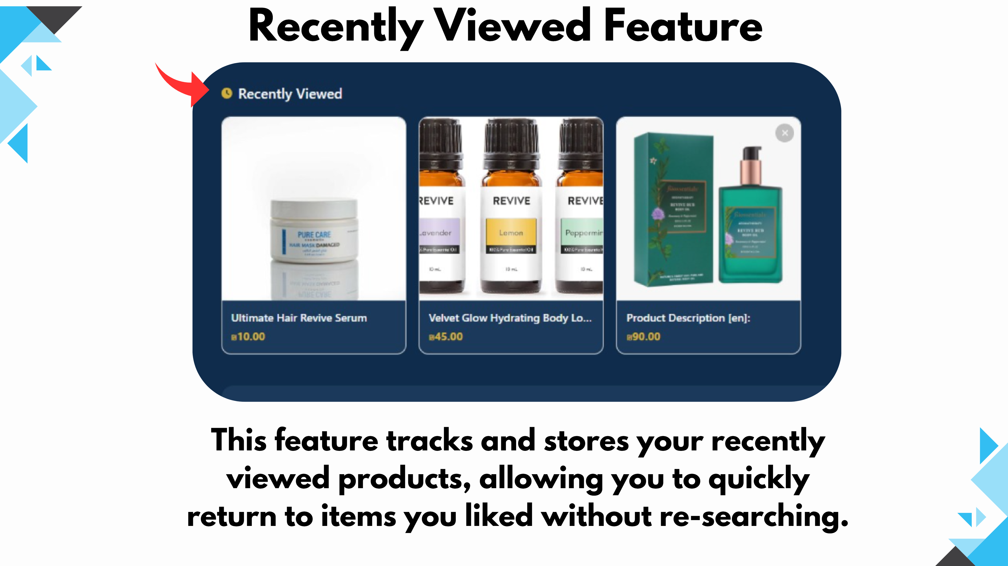
Slide 15
Notes:
Recently Viewed Feature This feature tracks and stores your recently viewed products, allowing you to quickly return to items you liked without re-searching.

Slide 16
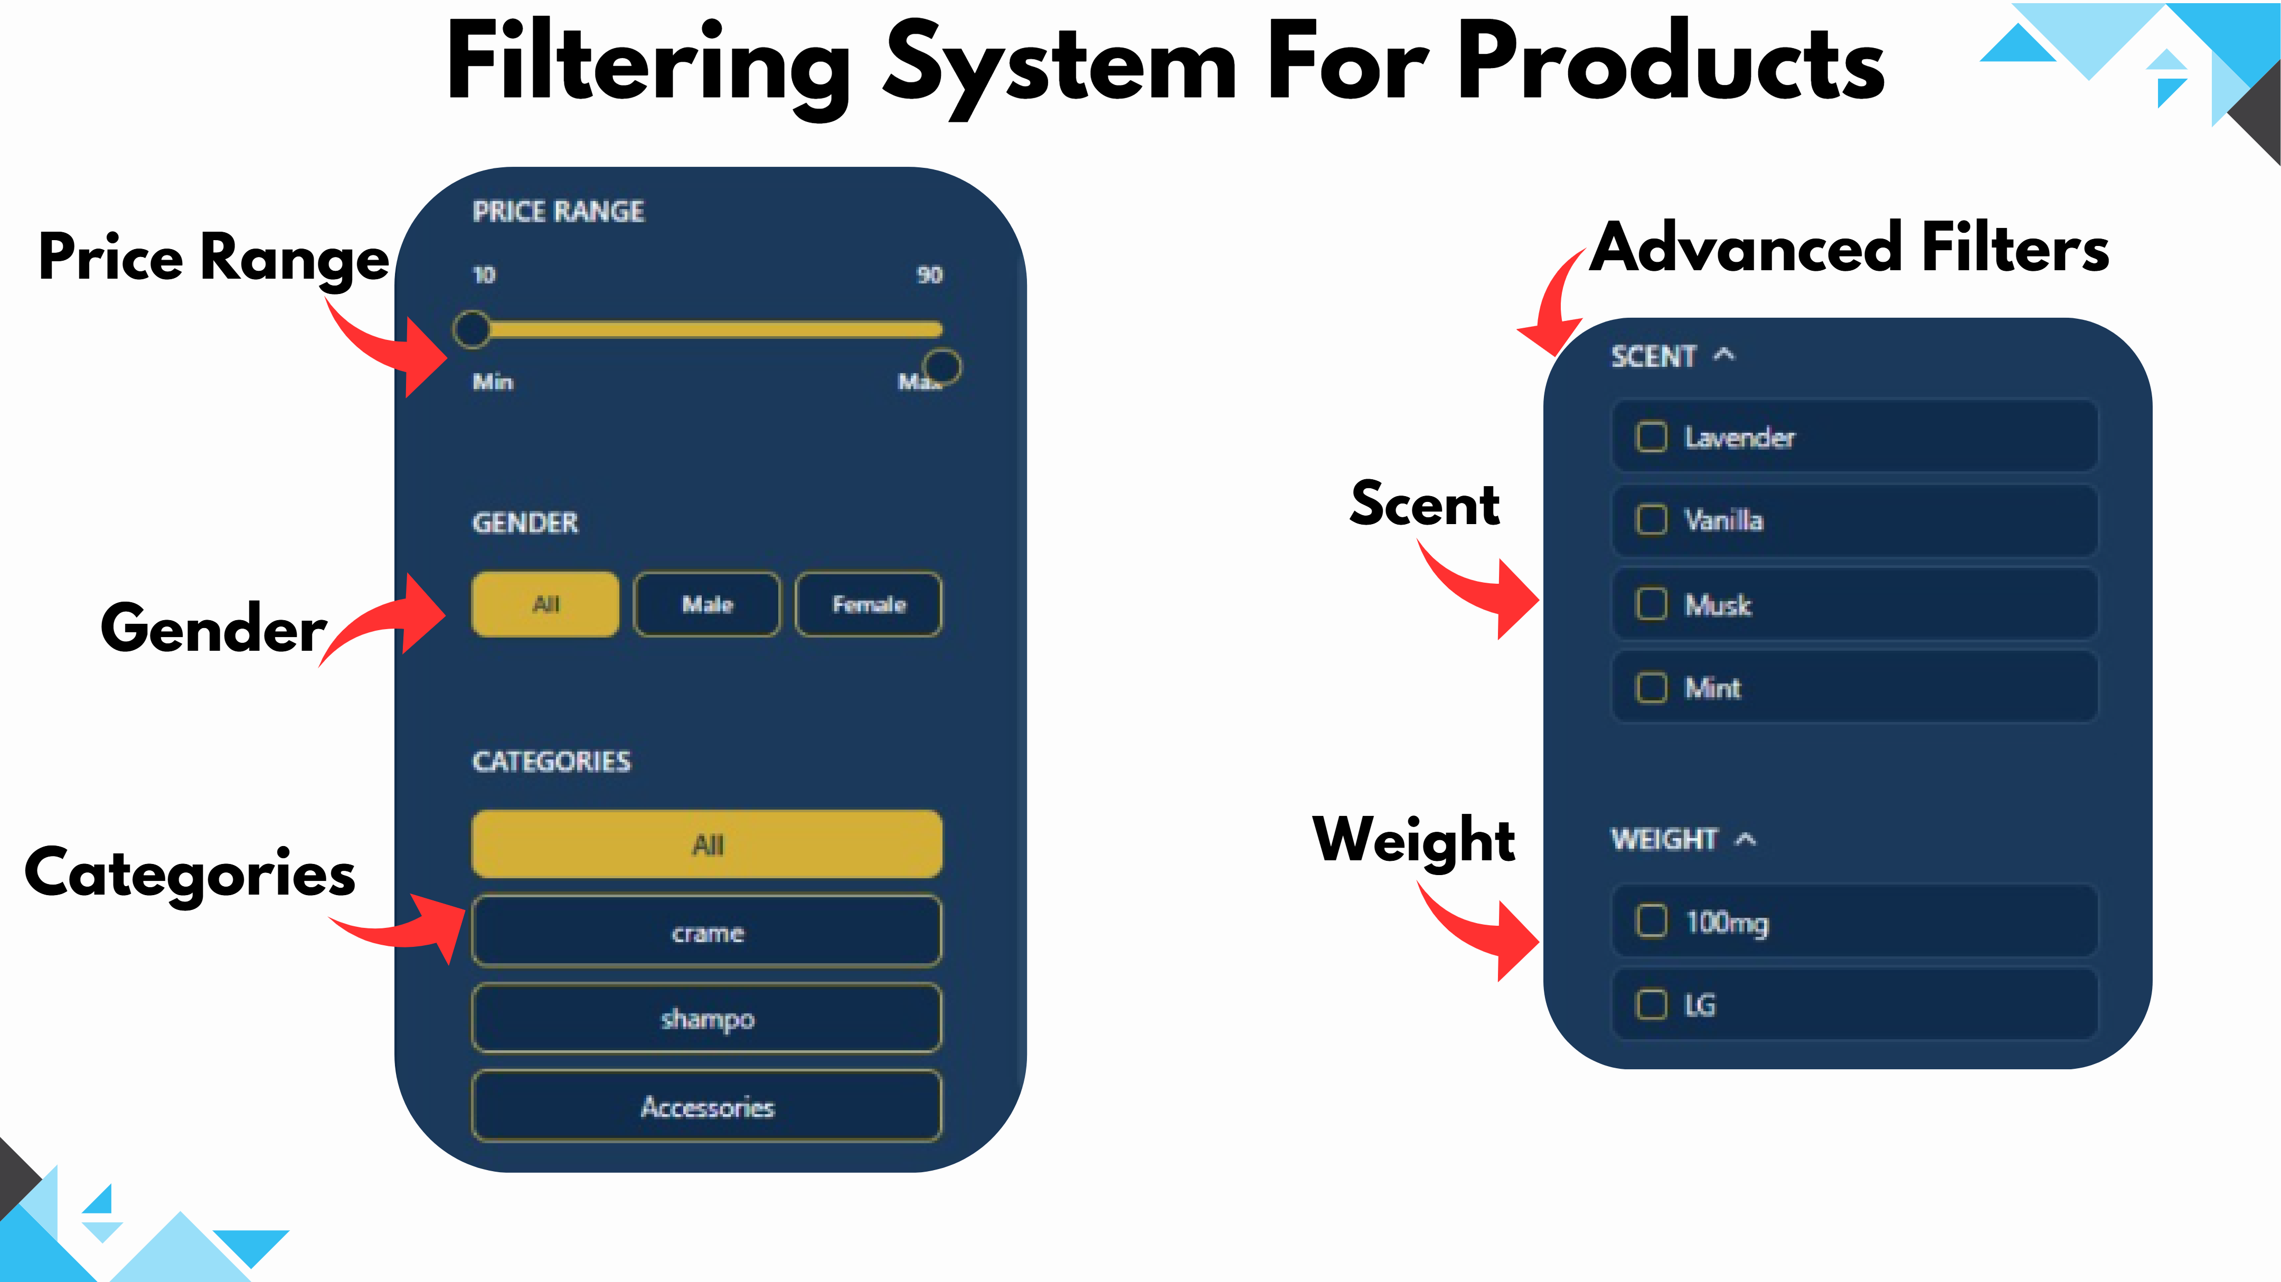
Slide 16
Notes:
Price Range Gender Categories Advanced Filters Scent Filtering System For Products Weight

Slide 17
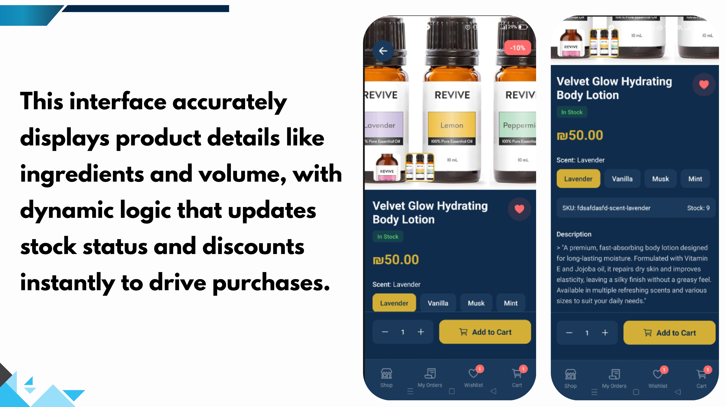
Slide 17
Notes:
This interface accurately displays product details like ingredients and volume, with dynamic logic that updates stock status and discounts instantly to drive purchases.

Slide 18
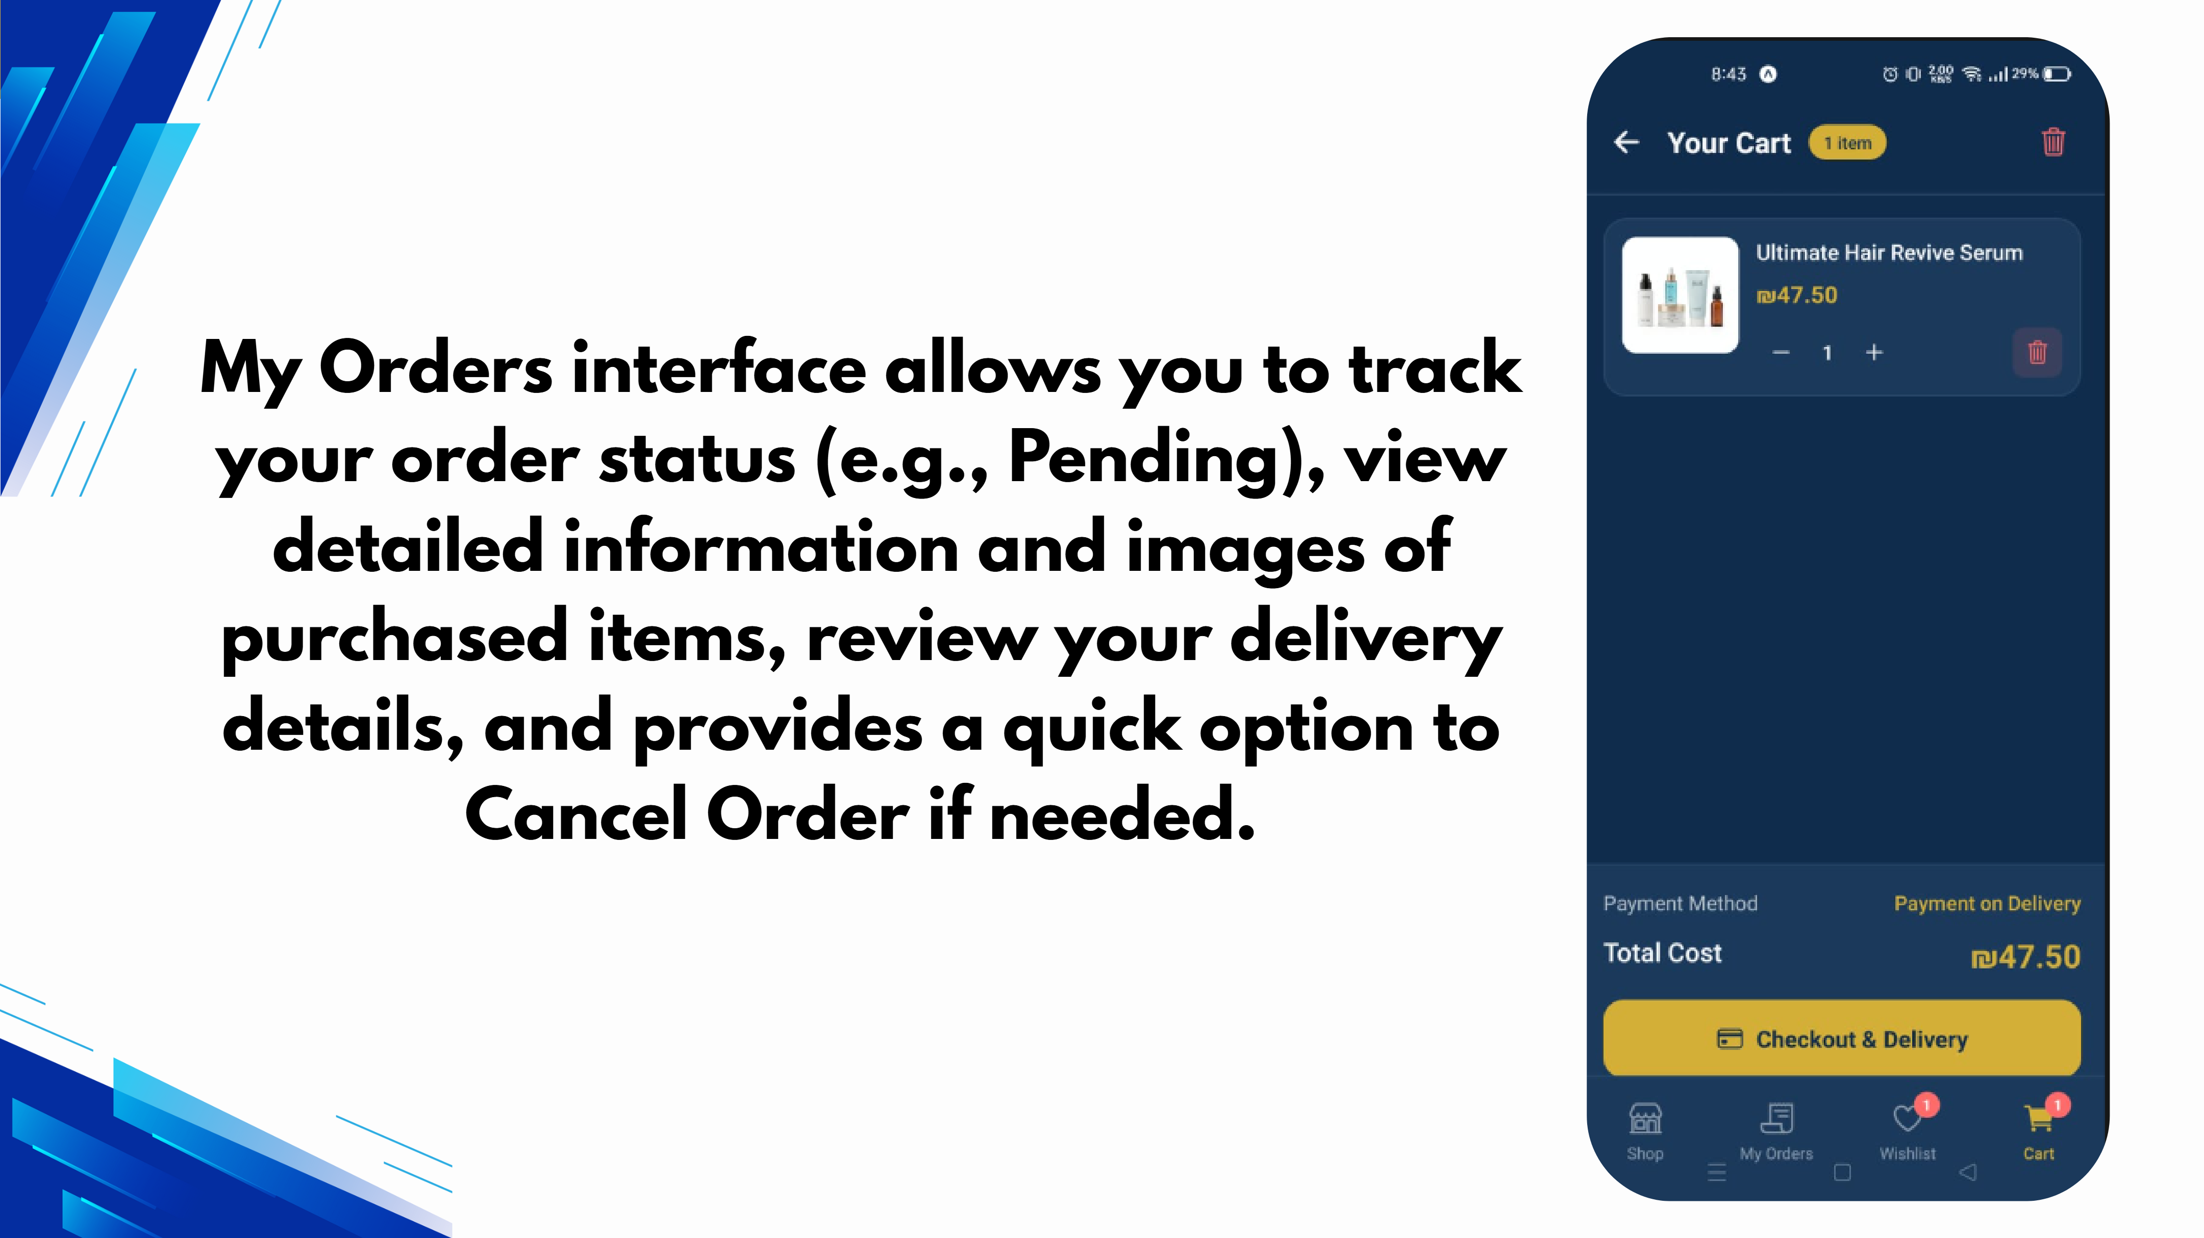
Slide 18
Notes:
My Orders interface allows you to track your order status (e.g., Pending), view detailed information and images of purchased items, review your delivery details, and provides a quick option to Cancel Order if needed.

Slide 19
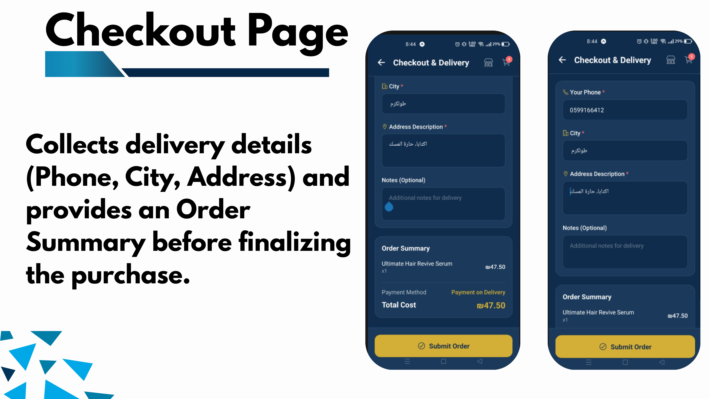
Slide 19
Notes:
Collects delivery details (Phone, City, Address) and provides an Order Summary before finalizing the purchase. Checkou t Page

Slide 20
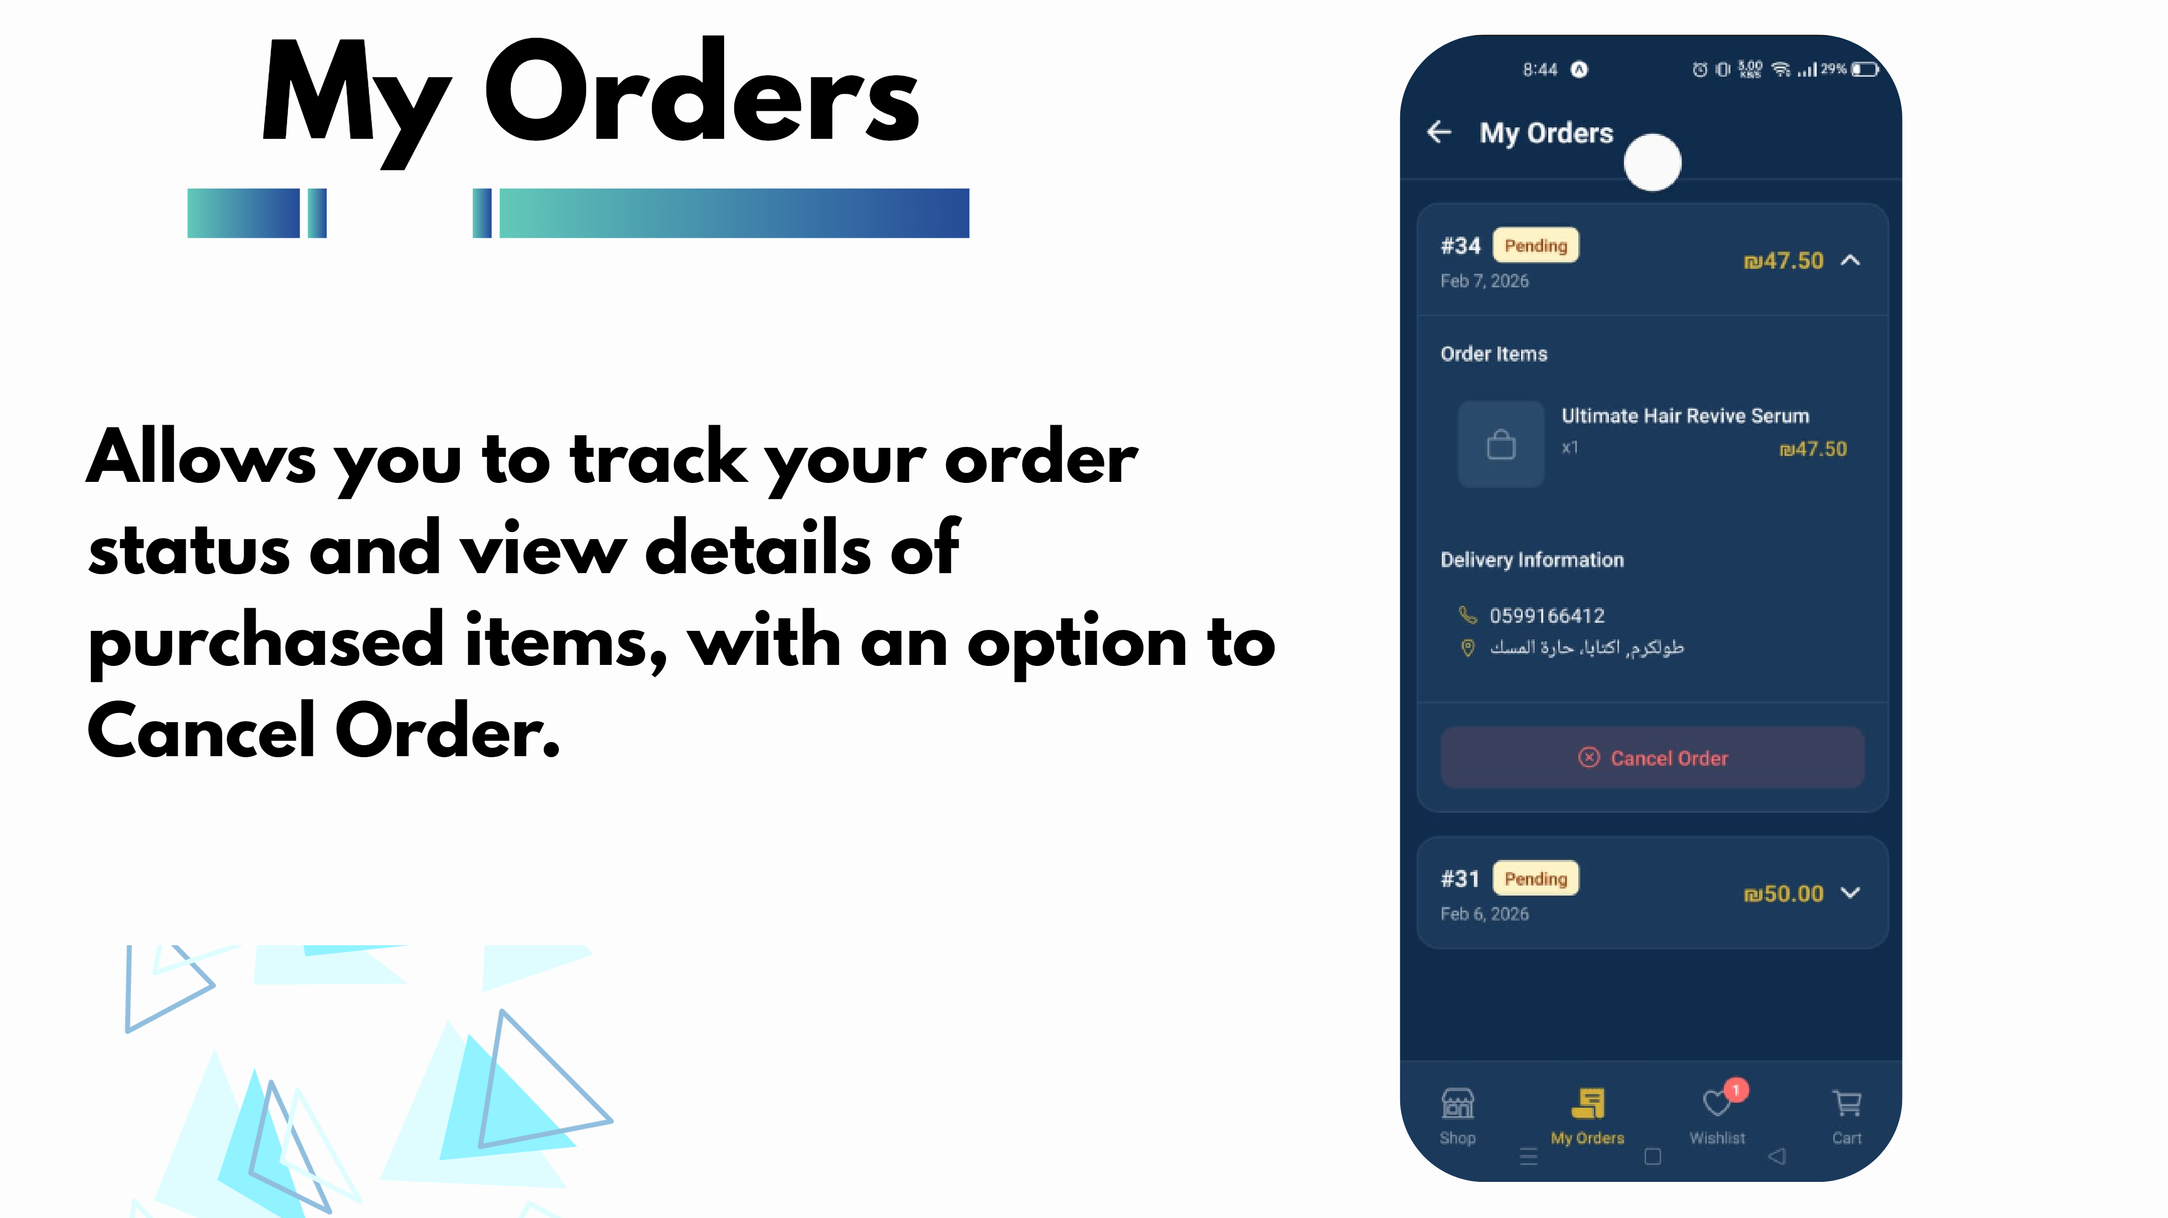
Slide 20
Notes:
Allows you to track your order status and view details of purchased items, with an option to Cancel Order. My Orders

Slide 21
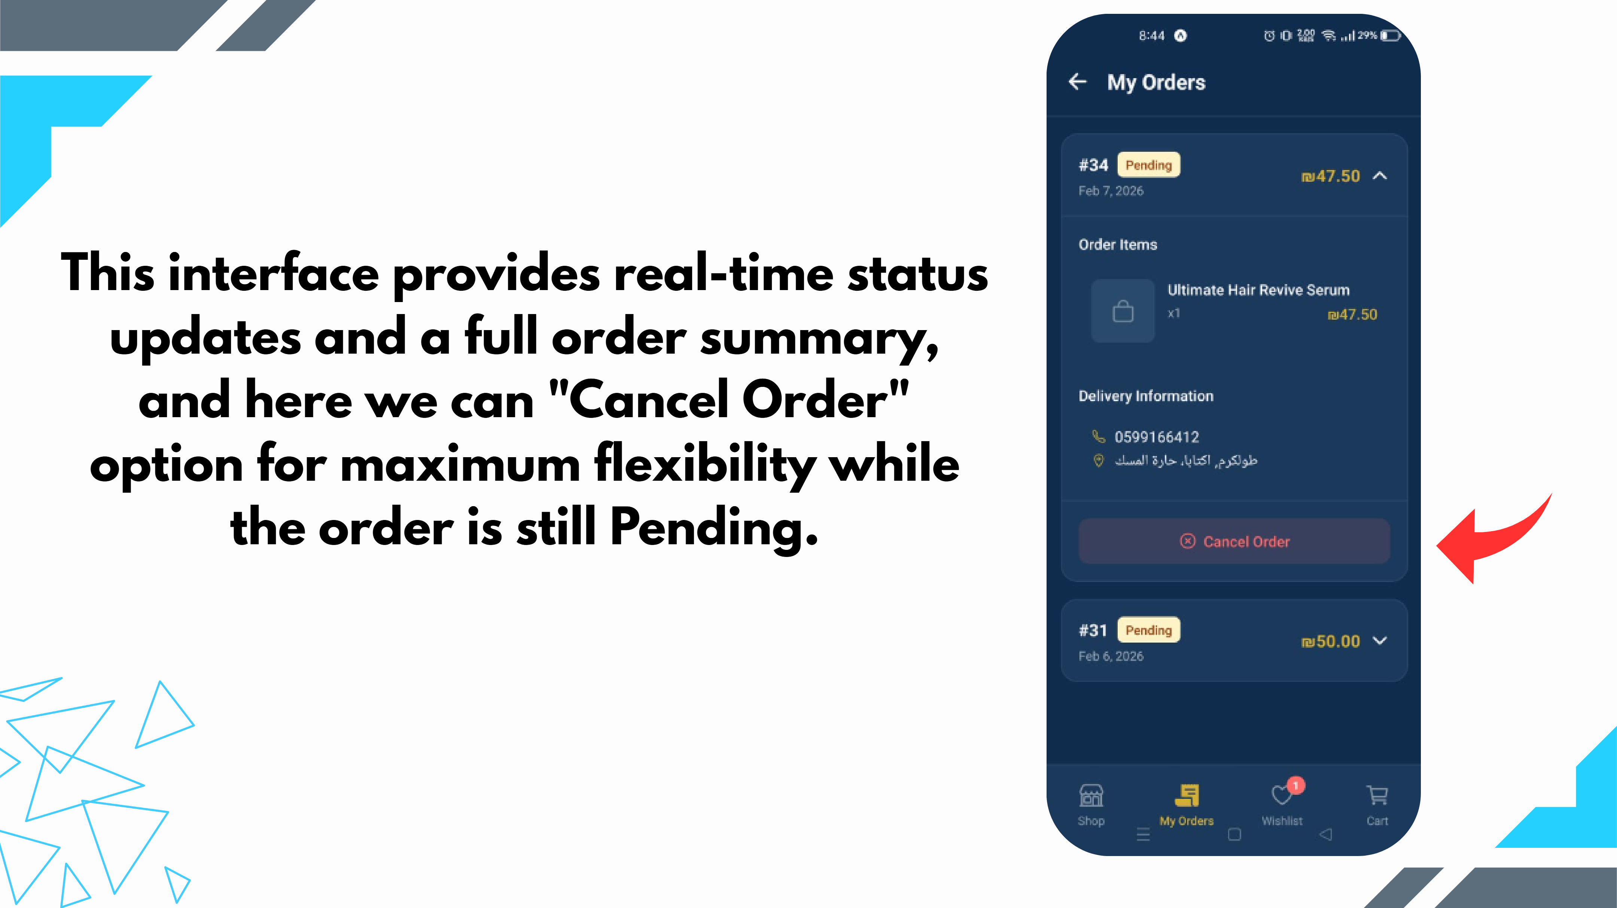
Slide 21
Notes:
This interface provides real-time status updates and a full order summary, and here we can "Cancel Order" option for maximum flexibility while the order is still Pending.

Slide 22
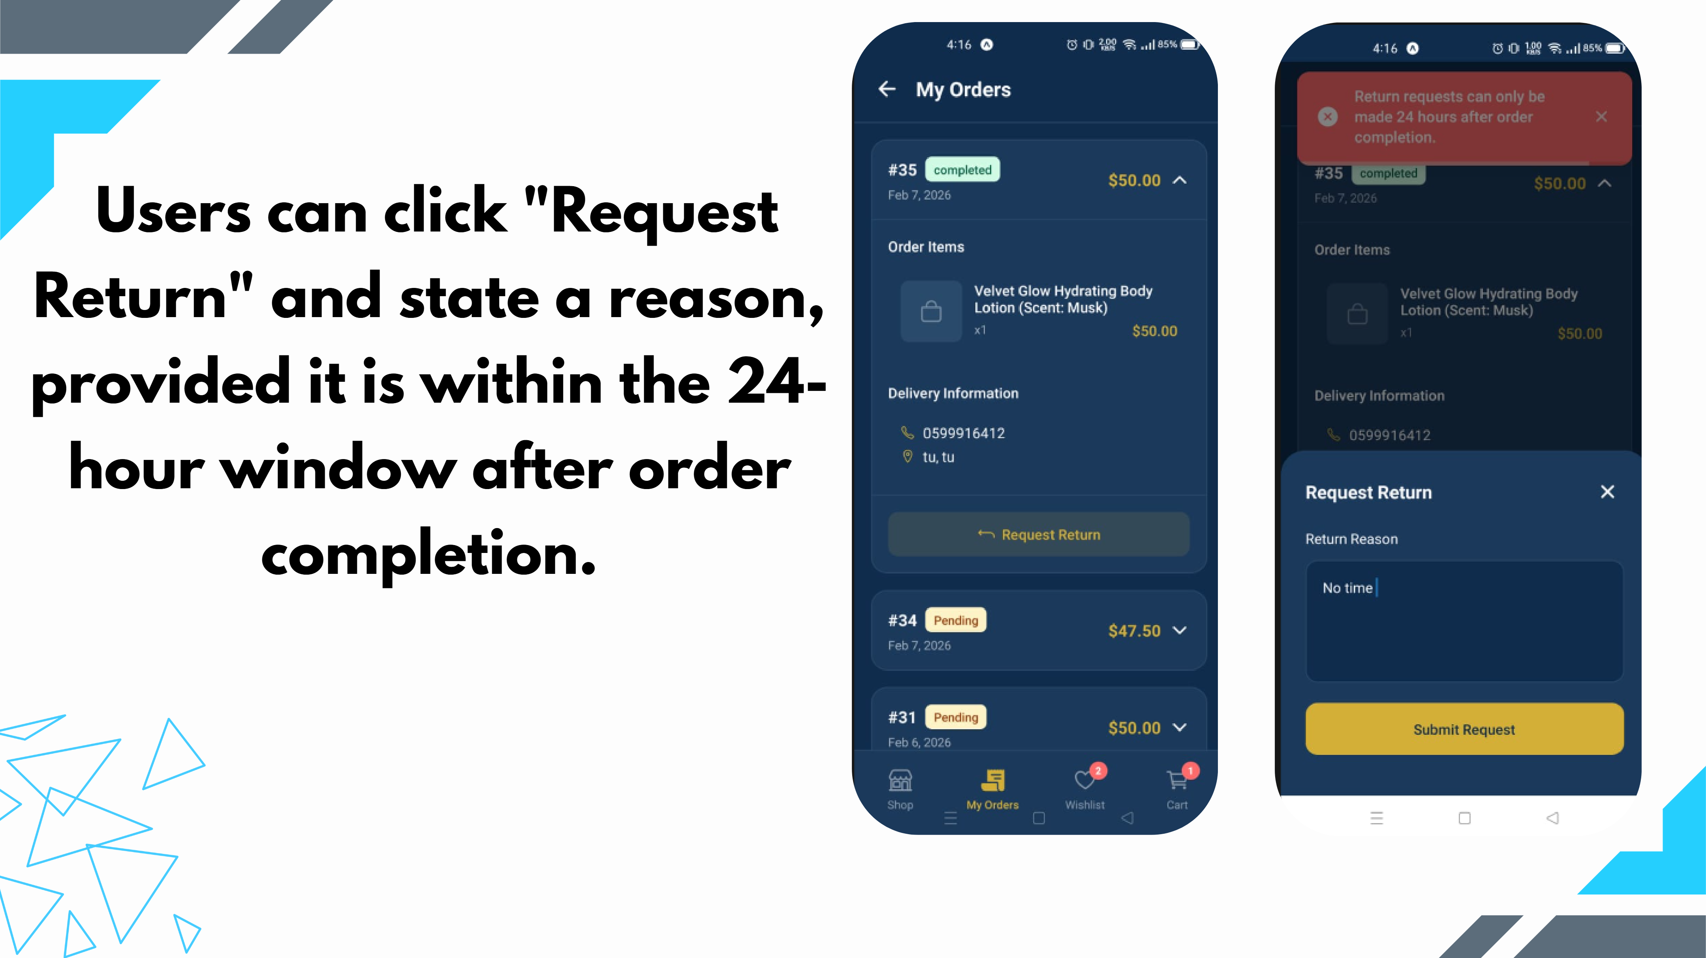
Slide 22
Notes:
Users can click "Request Return" and state a reason, provided it is within the 24- hour window after order completion.

Slide 23
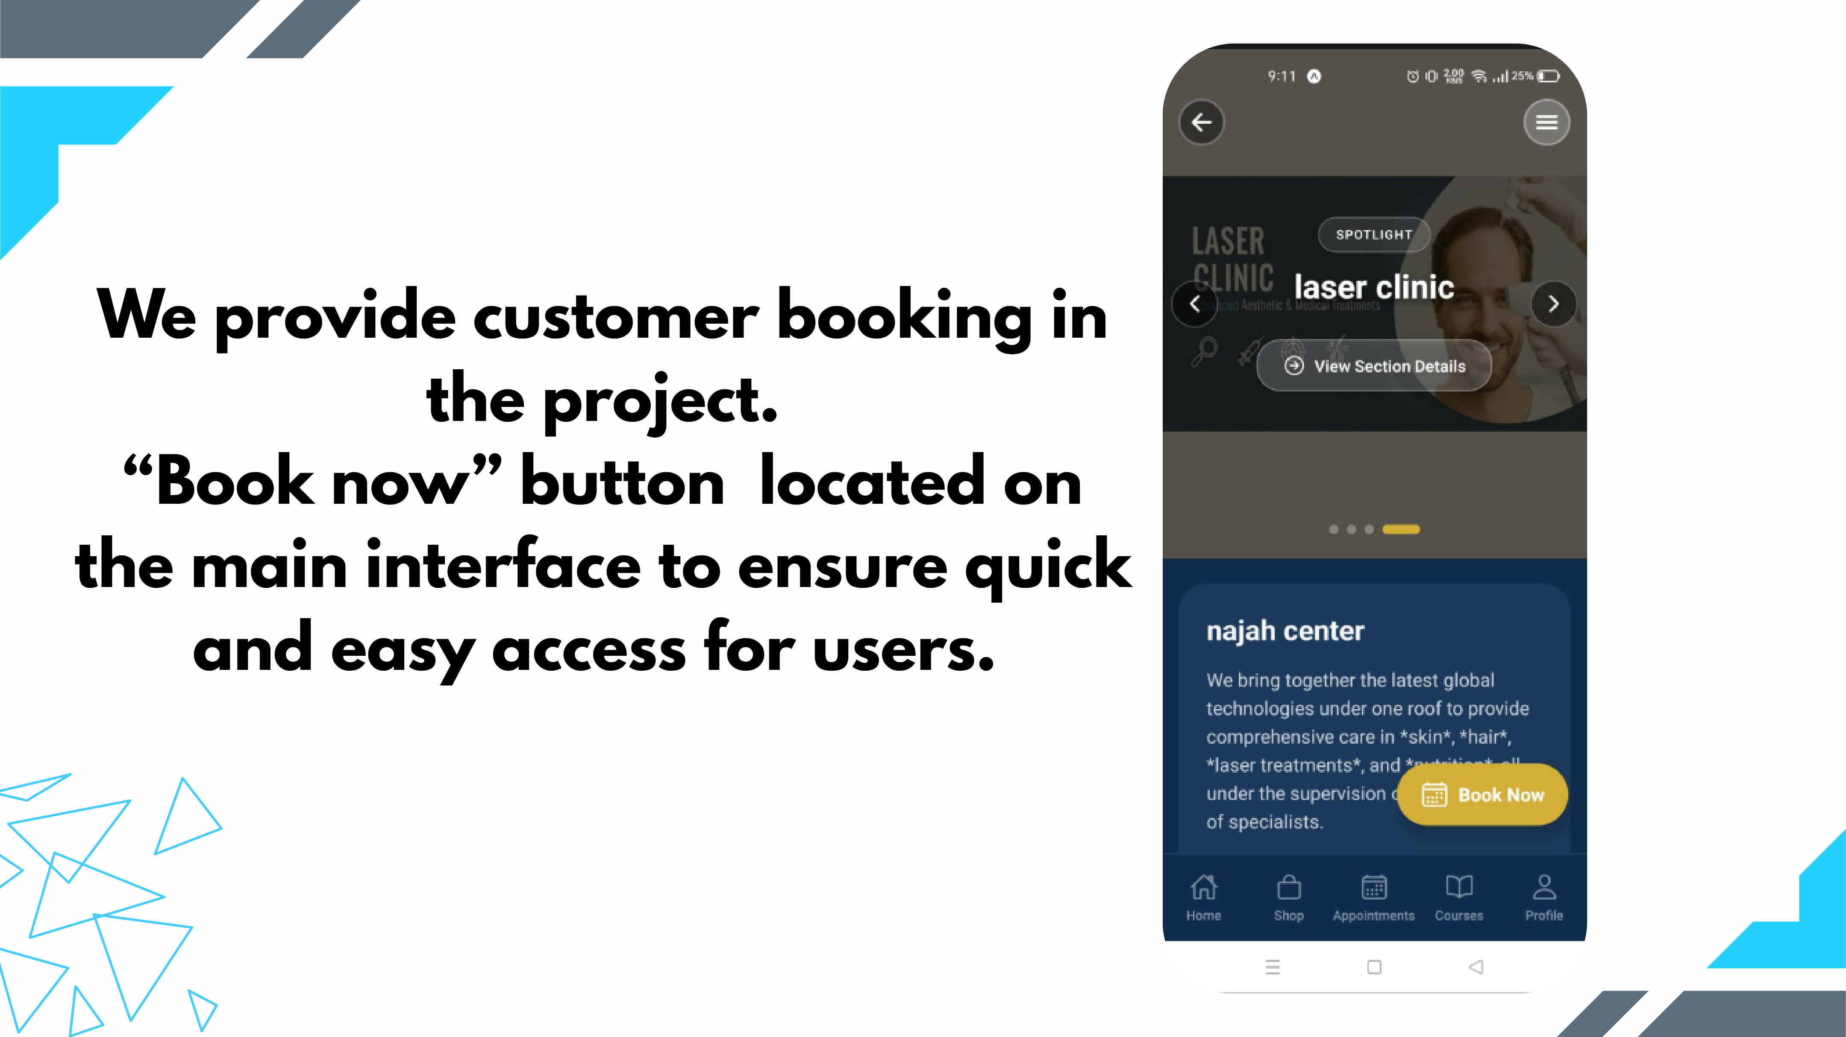
Slide 23
Notes:
We provide customer booking in the project. “Book now” button located on the main interface to ensure quick and easy access for users.

Slide 24
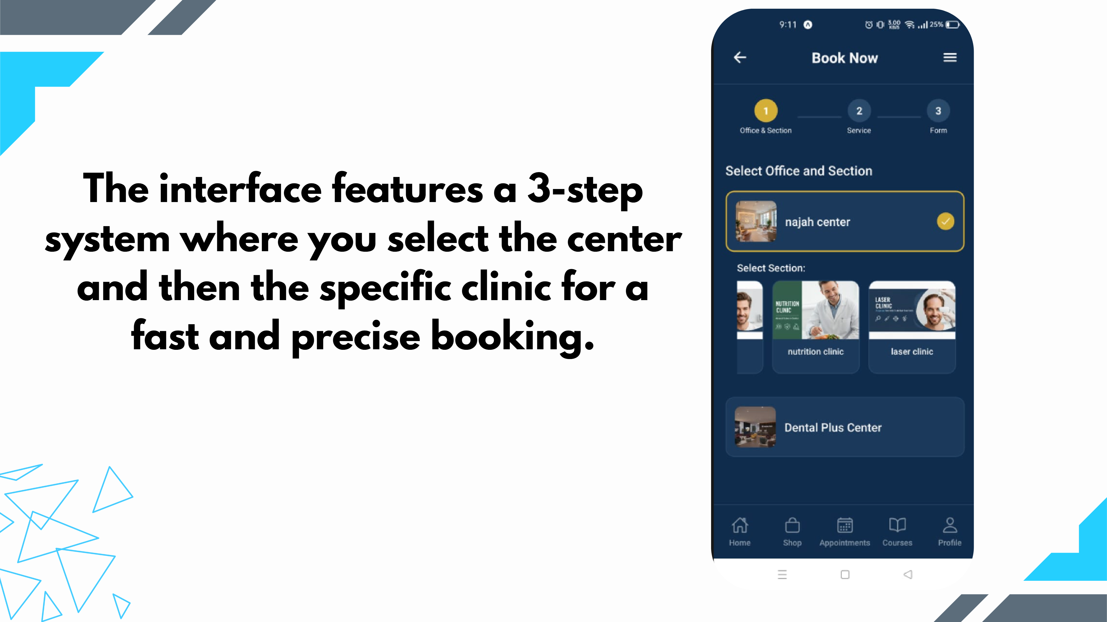
Slide 24
Notes:
The interface features a 3-step system where you select the center and then the specific clinic for a fast and precise booking.

Slide 25
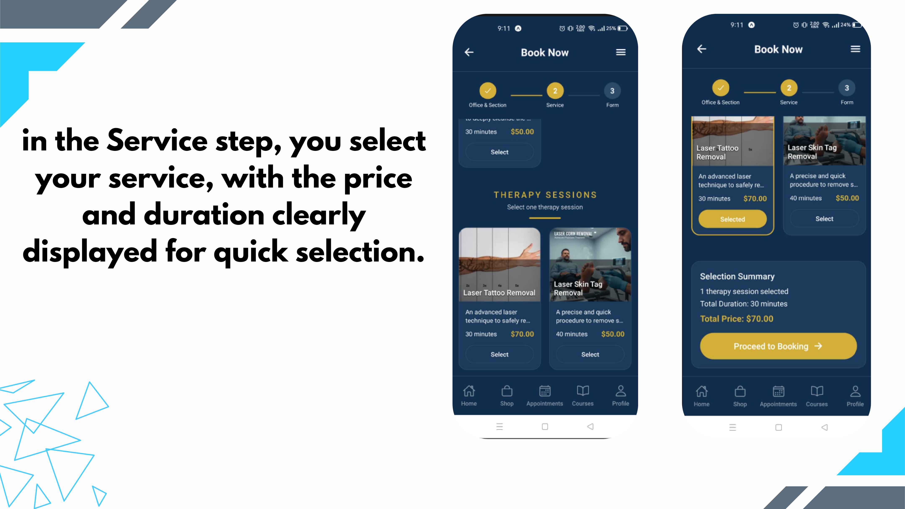
Slide 25
Notes:
in the Service step, you select your service, with the price and duration clearly displayed for quick selection.

Slide 26
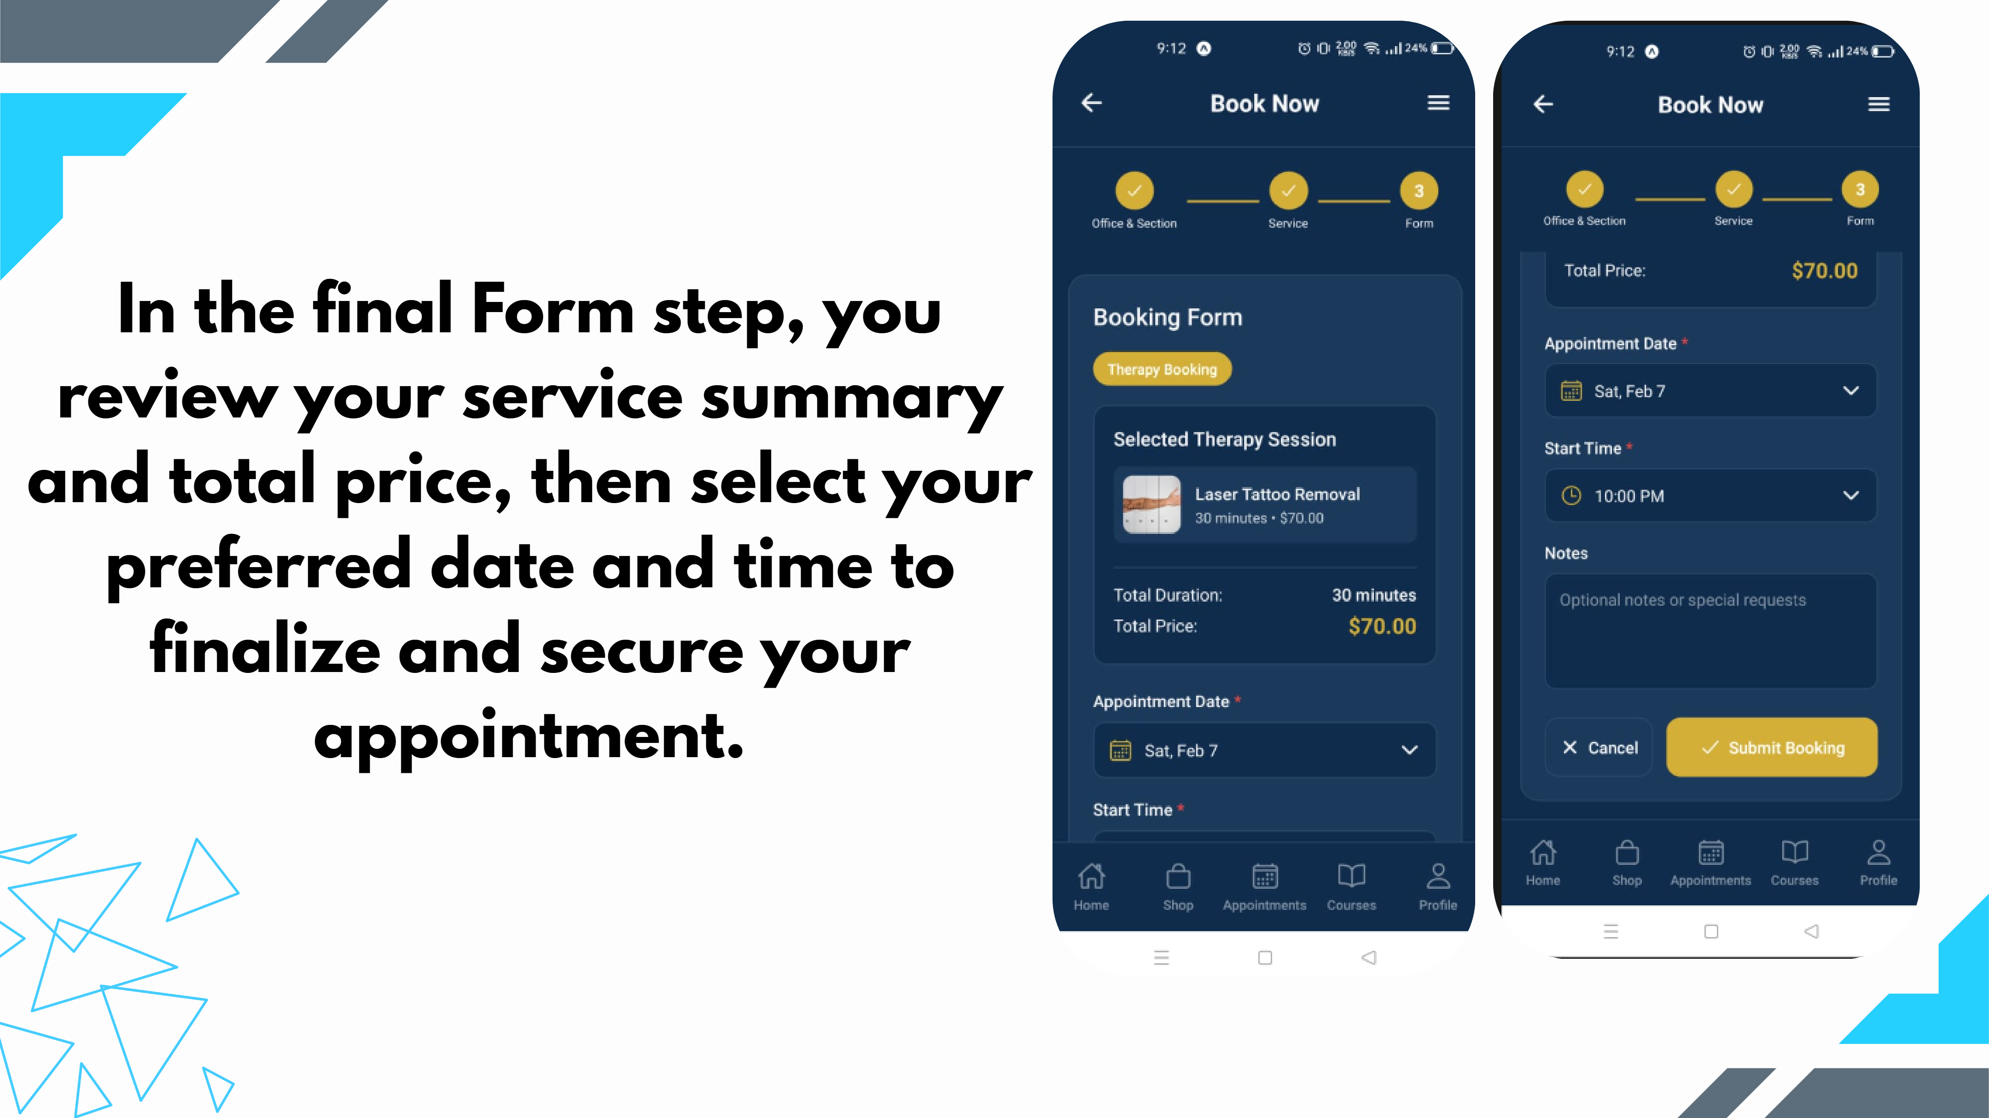
Slide 26
Notes:
In the final Form step, you review your service summary and total price, then select your preferred date and time to finalize and secure your appointment.

Slide 27
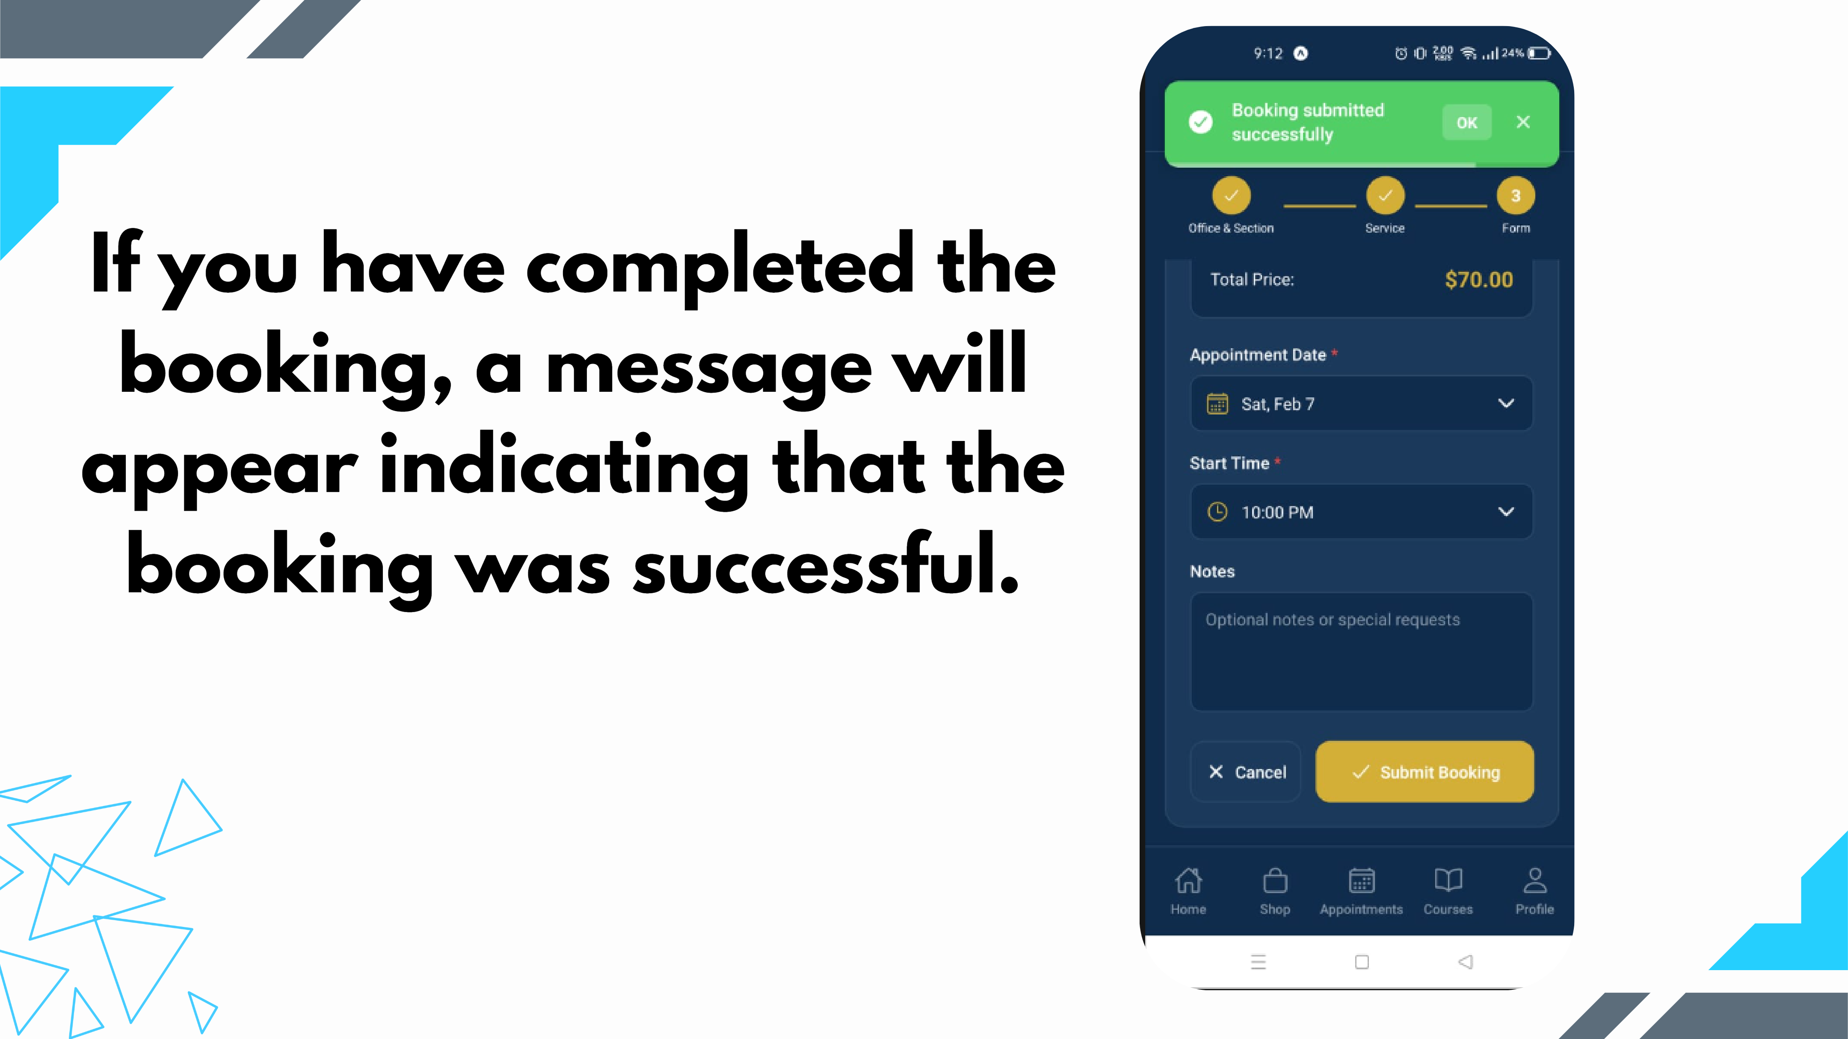
Slide 27
Notes:
If you have completed the booking, a message will appear indicating that the booking was successful.

Slide 28
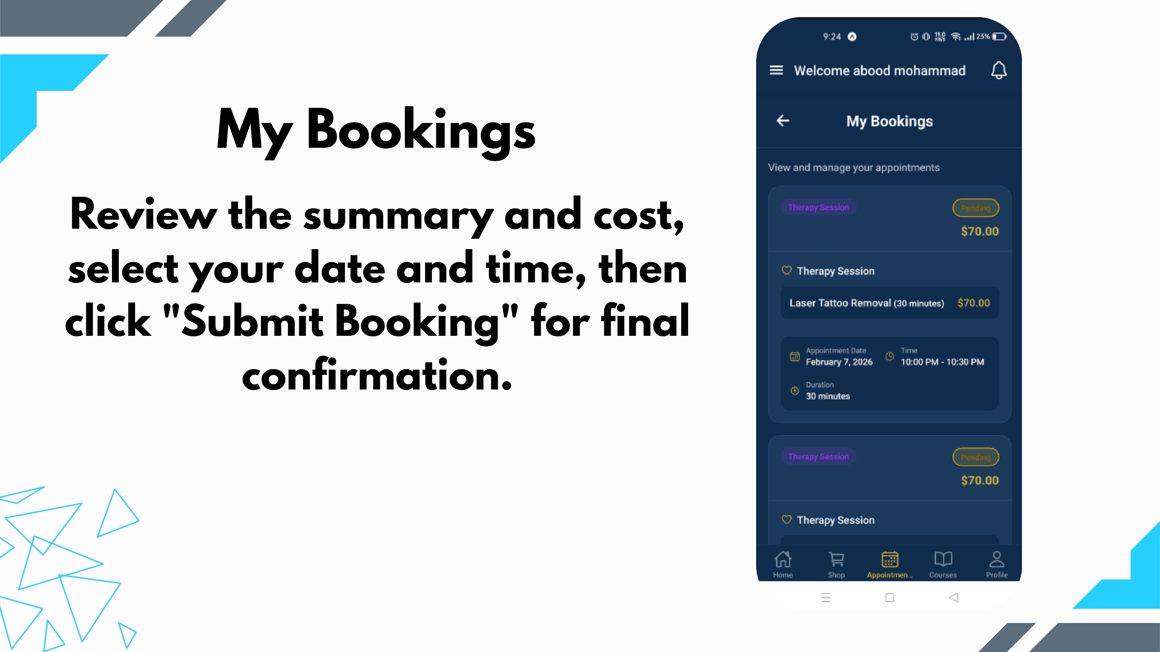
Slide 28
Notes:
Review the summary and cost, select your date and time, then click "Submit Booking" for final confirmation. My Bookings

Slide 29
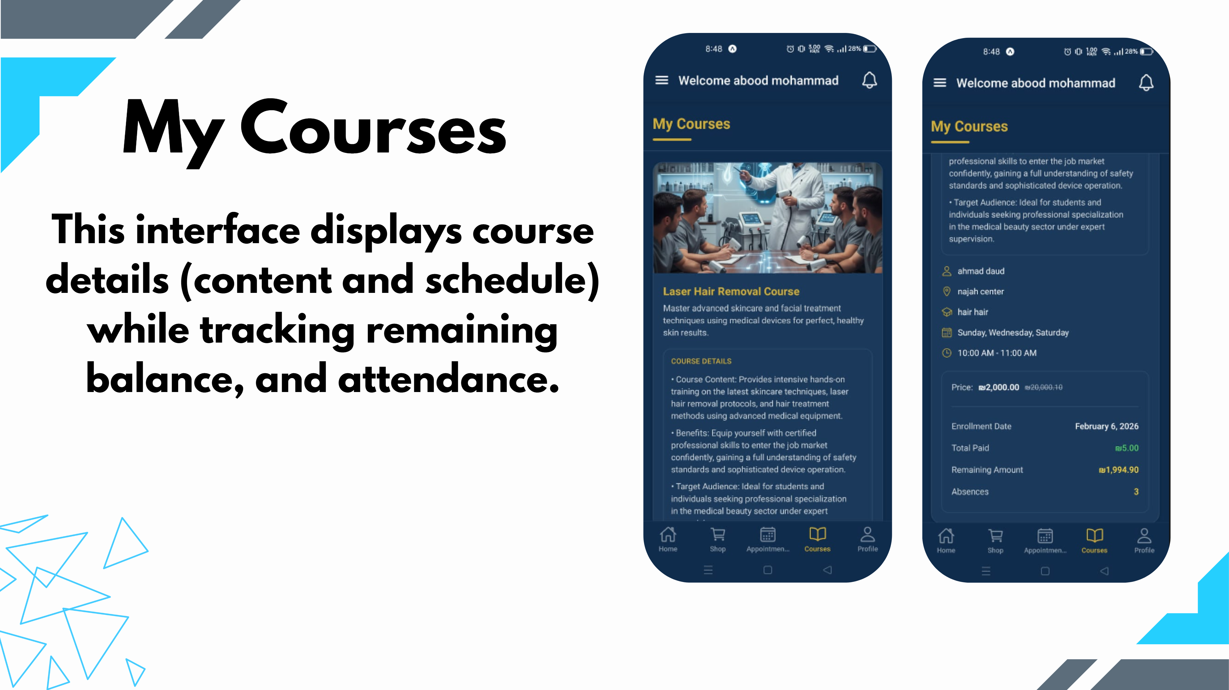
Slide 29
Notes:
This interface displays course details (content and schedule) while tracking remaining balance, and attendance. My Courses

Slide 30
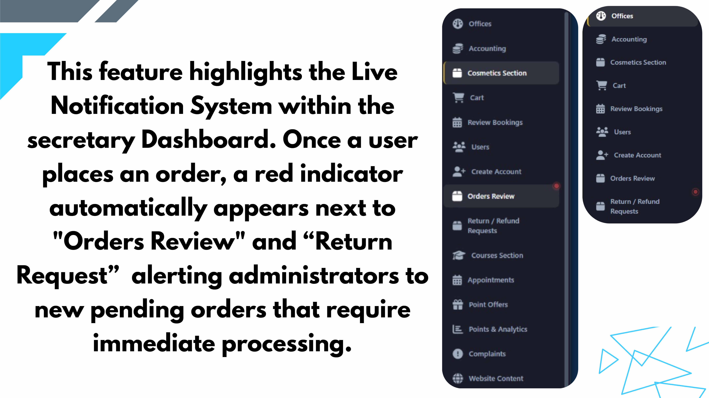
Slide 30
Notes:
This feature highlights the Live Notification System within the secretary Dashboard. Once a user places an order, a red indicator automatically appears next to "Orders Review" and “Return Request” alerting administrators to new pending orders that require immediate processing.

Slide 31
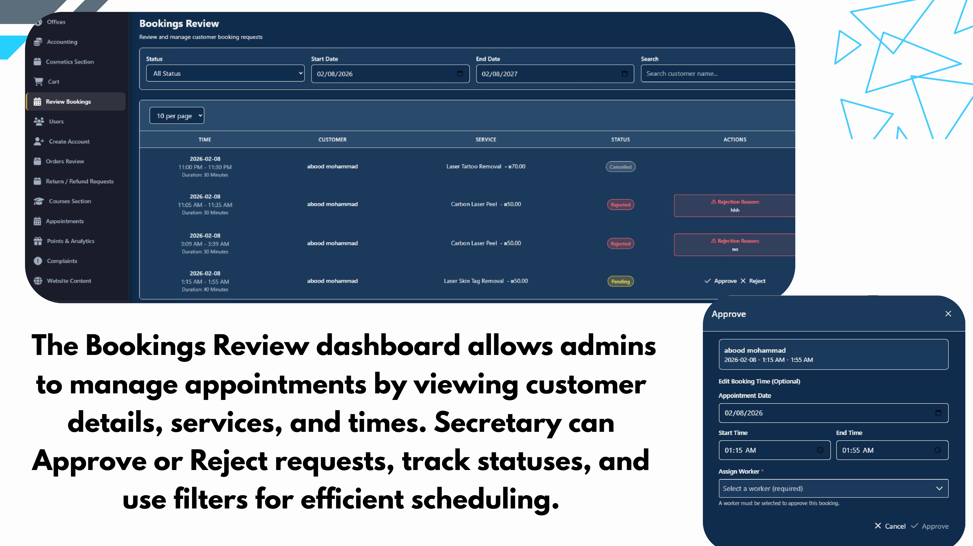
Slide 31
Notes:
The Bookings Review dashboard allows admins to manage appointments by viewing customer details, services, and times. Secretary can Approve or Reject requests, track statuses, and use filters for efficient scheduling.

Slide 32
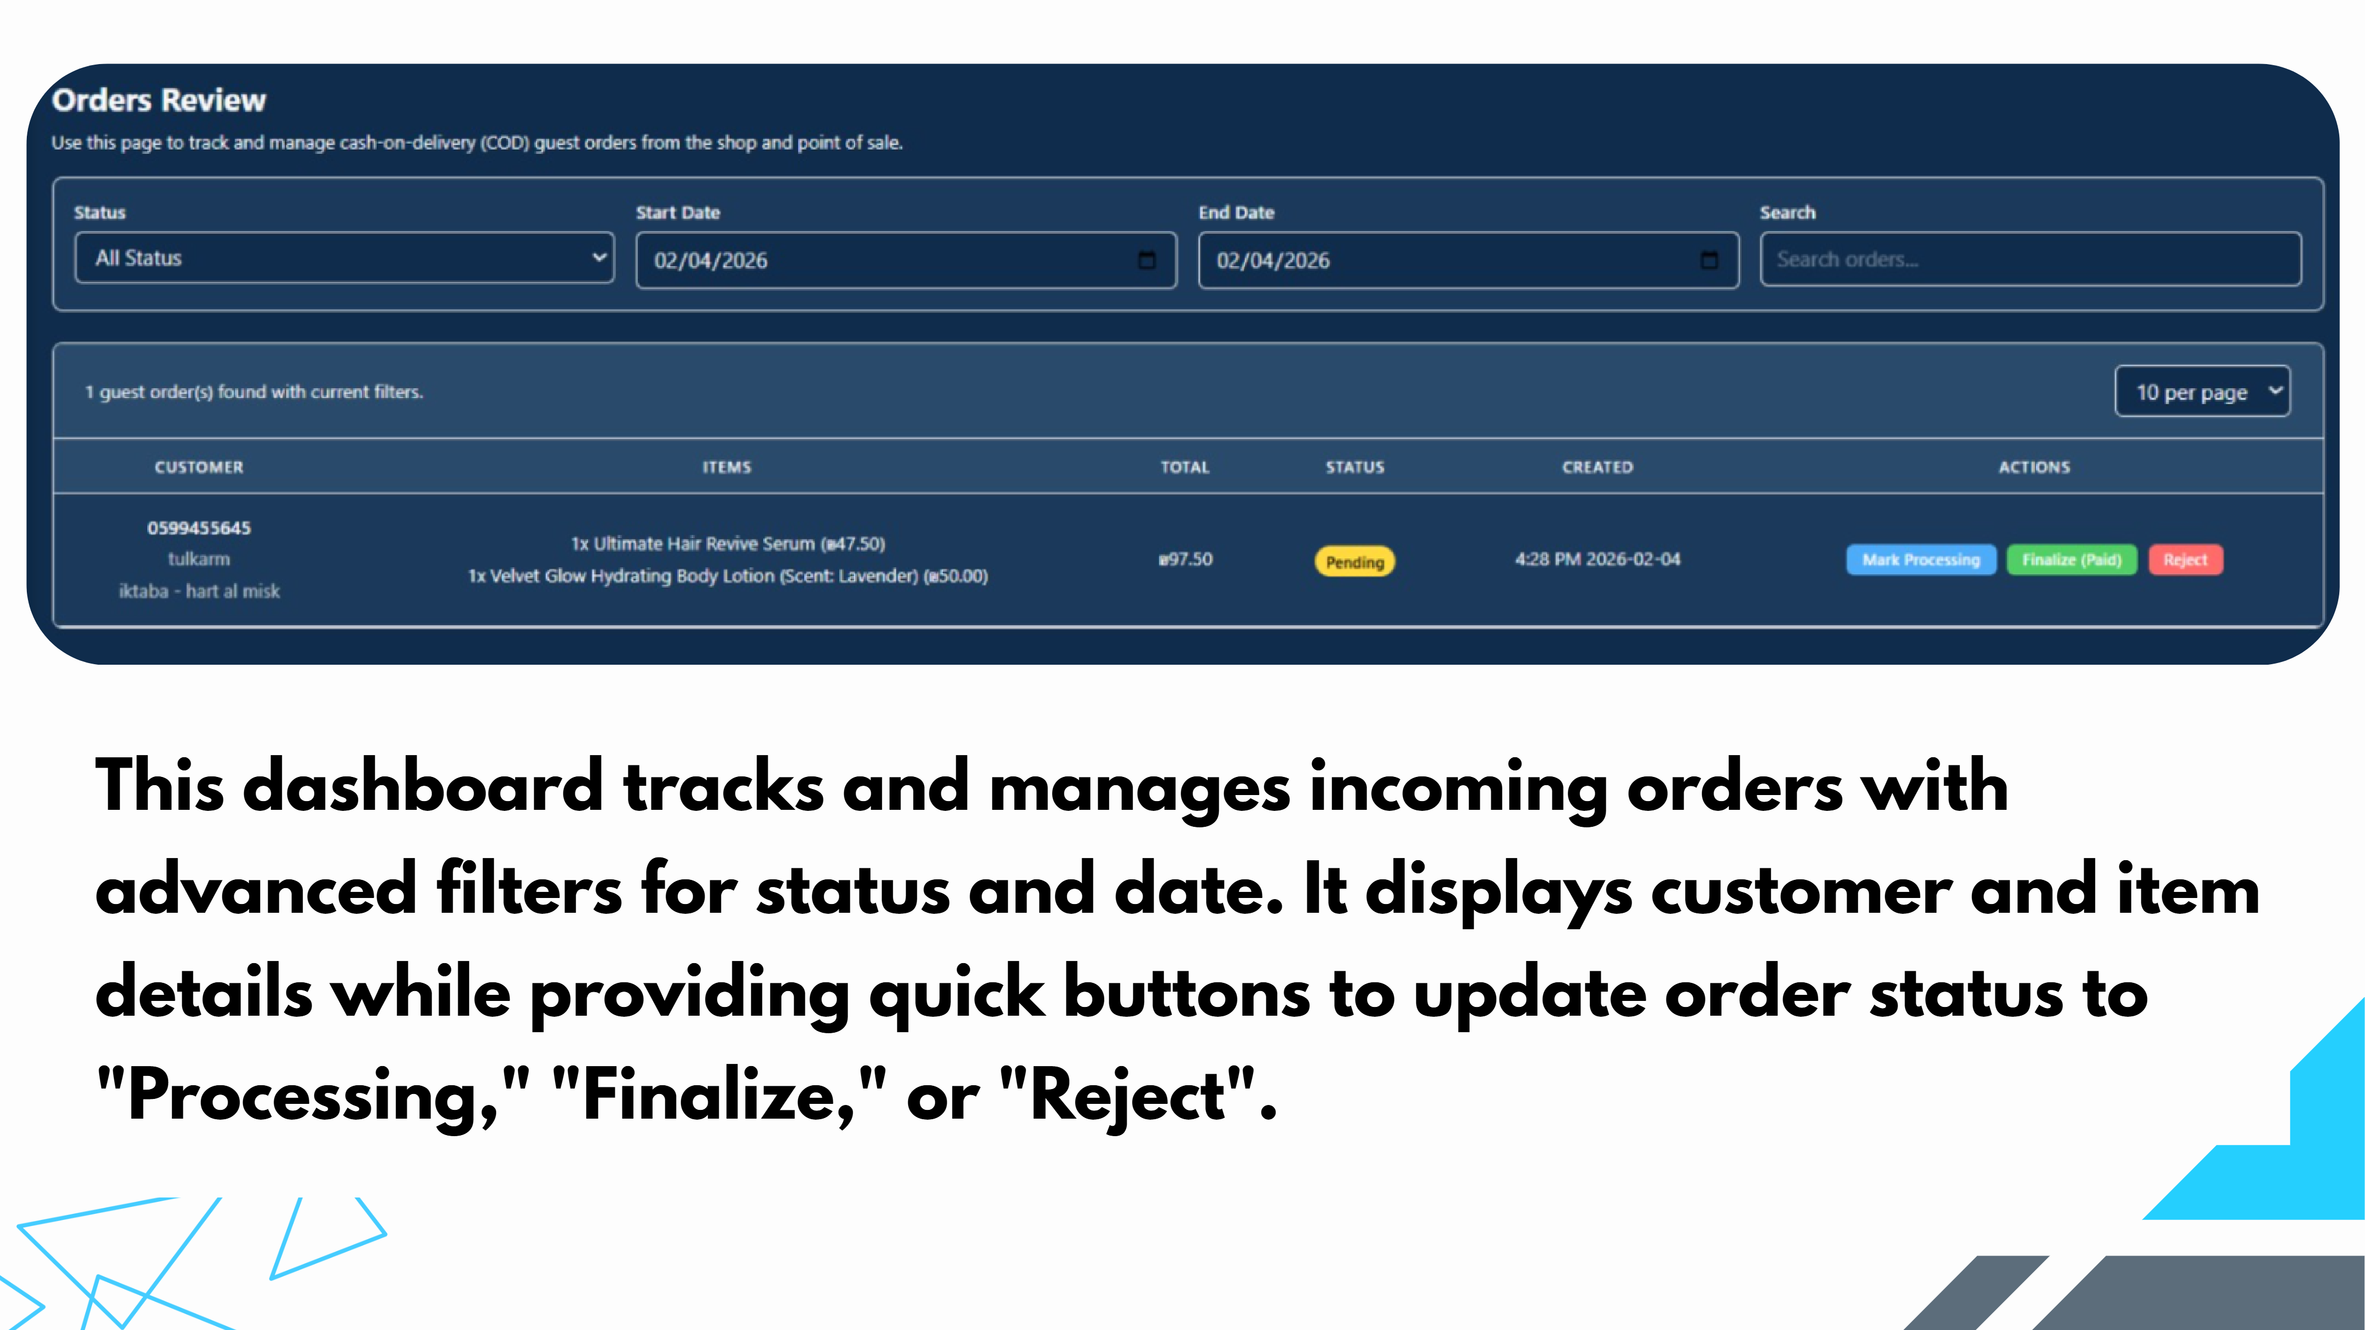
Slide 32
Notes:
This dashboard tracks and manages incoming orders with advanced filters for status and date. It displays customer and item details while providing quick buttons to update order status to "Processing," "Finalize," or "Reject".

Slide 33
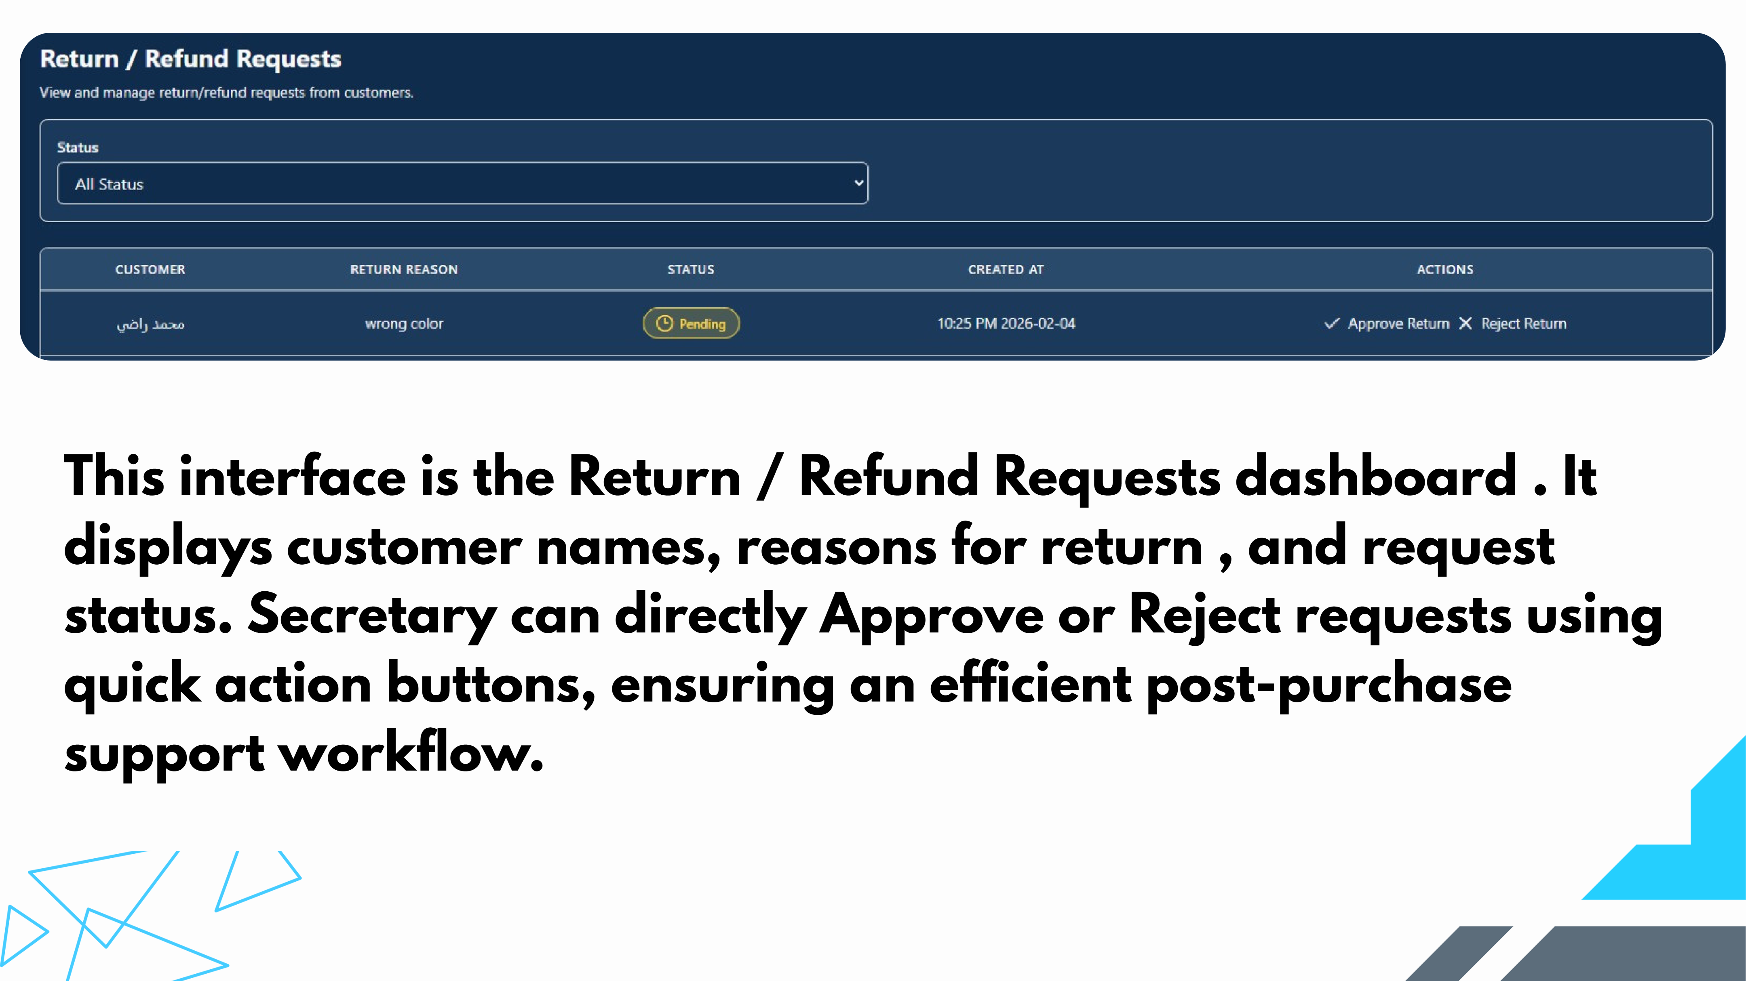
Slide 33
Notes:
This interface is the Return / Refund Requests dashboard . It displays customer names, reasons for return , and request status. Secretary can directly Approve or Reject requests using quick action buttons, ensuring an efficient post-purchase support workflow.

Slide 34
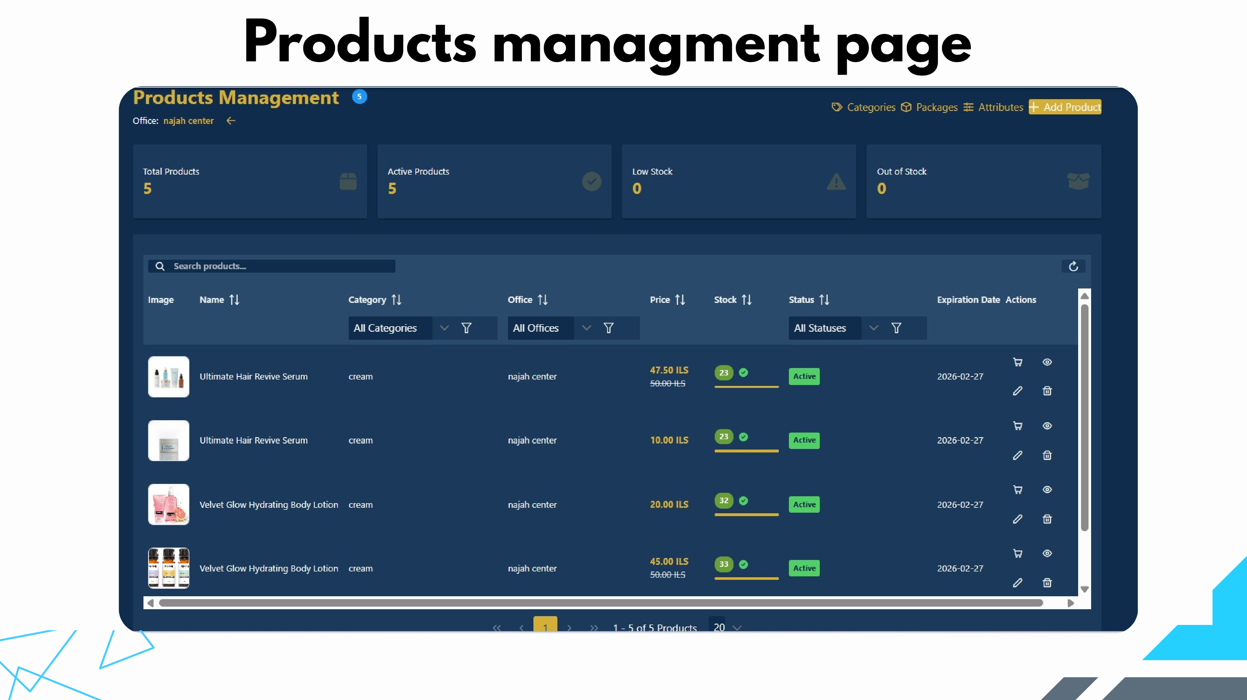
Slide 34
Notes:
Products managment page

Slide 35
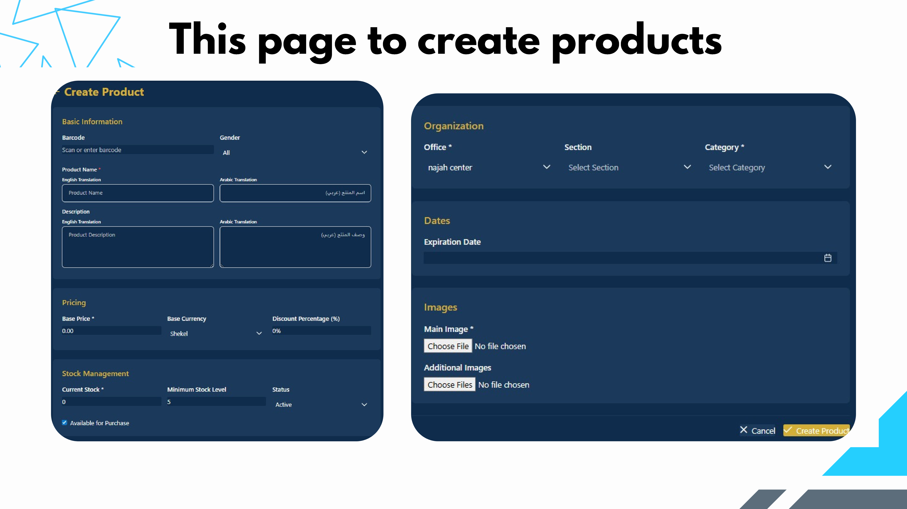
Slide 35
Notes:
This page to create products

Slide 36
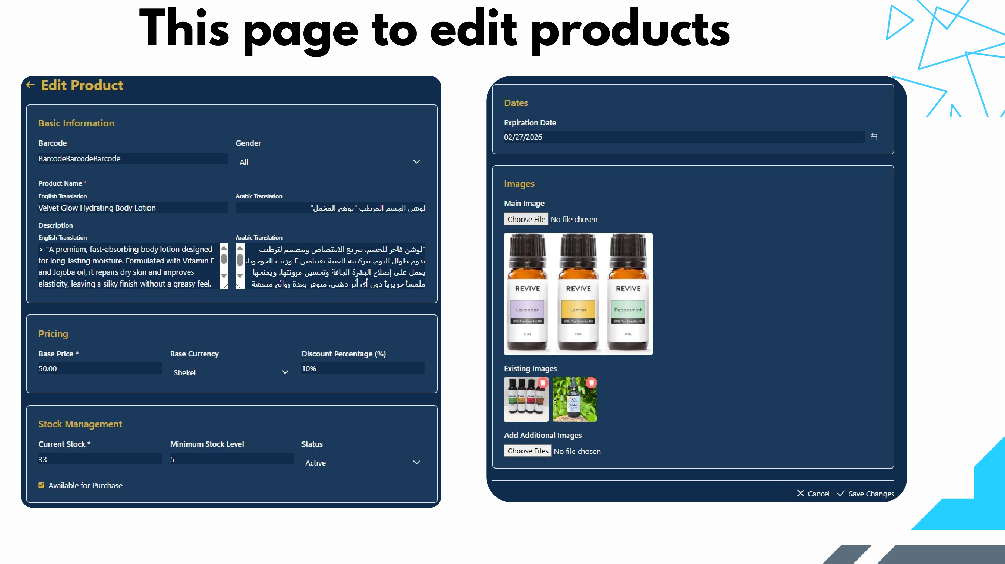
Slide 36
Notes:
This page to edit products

Slide 37
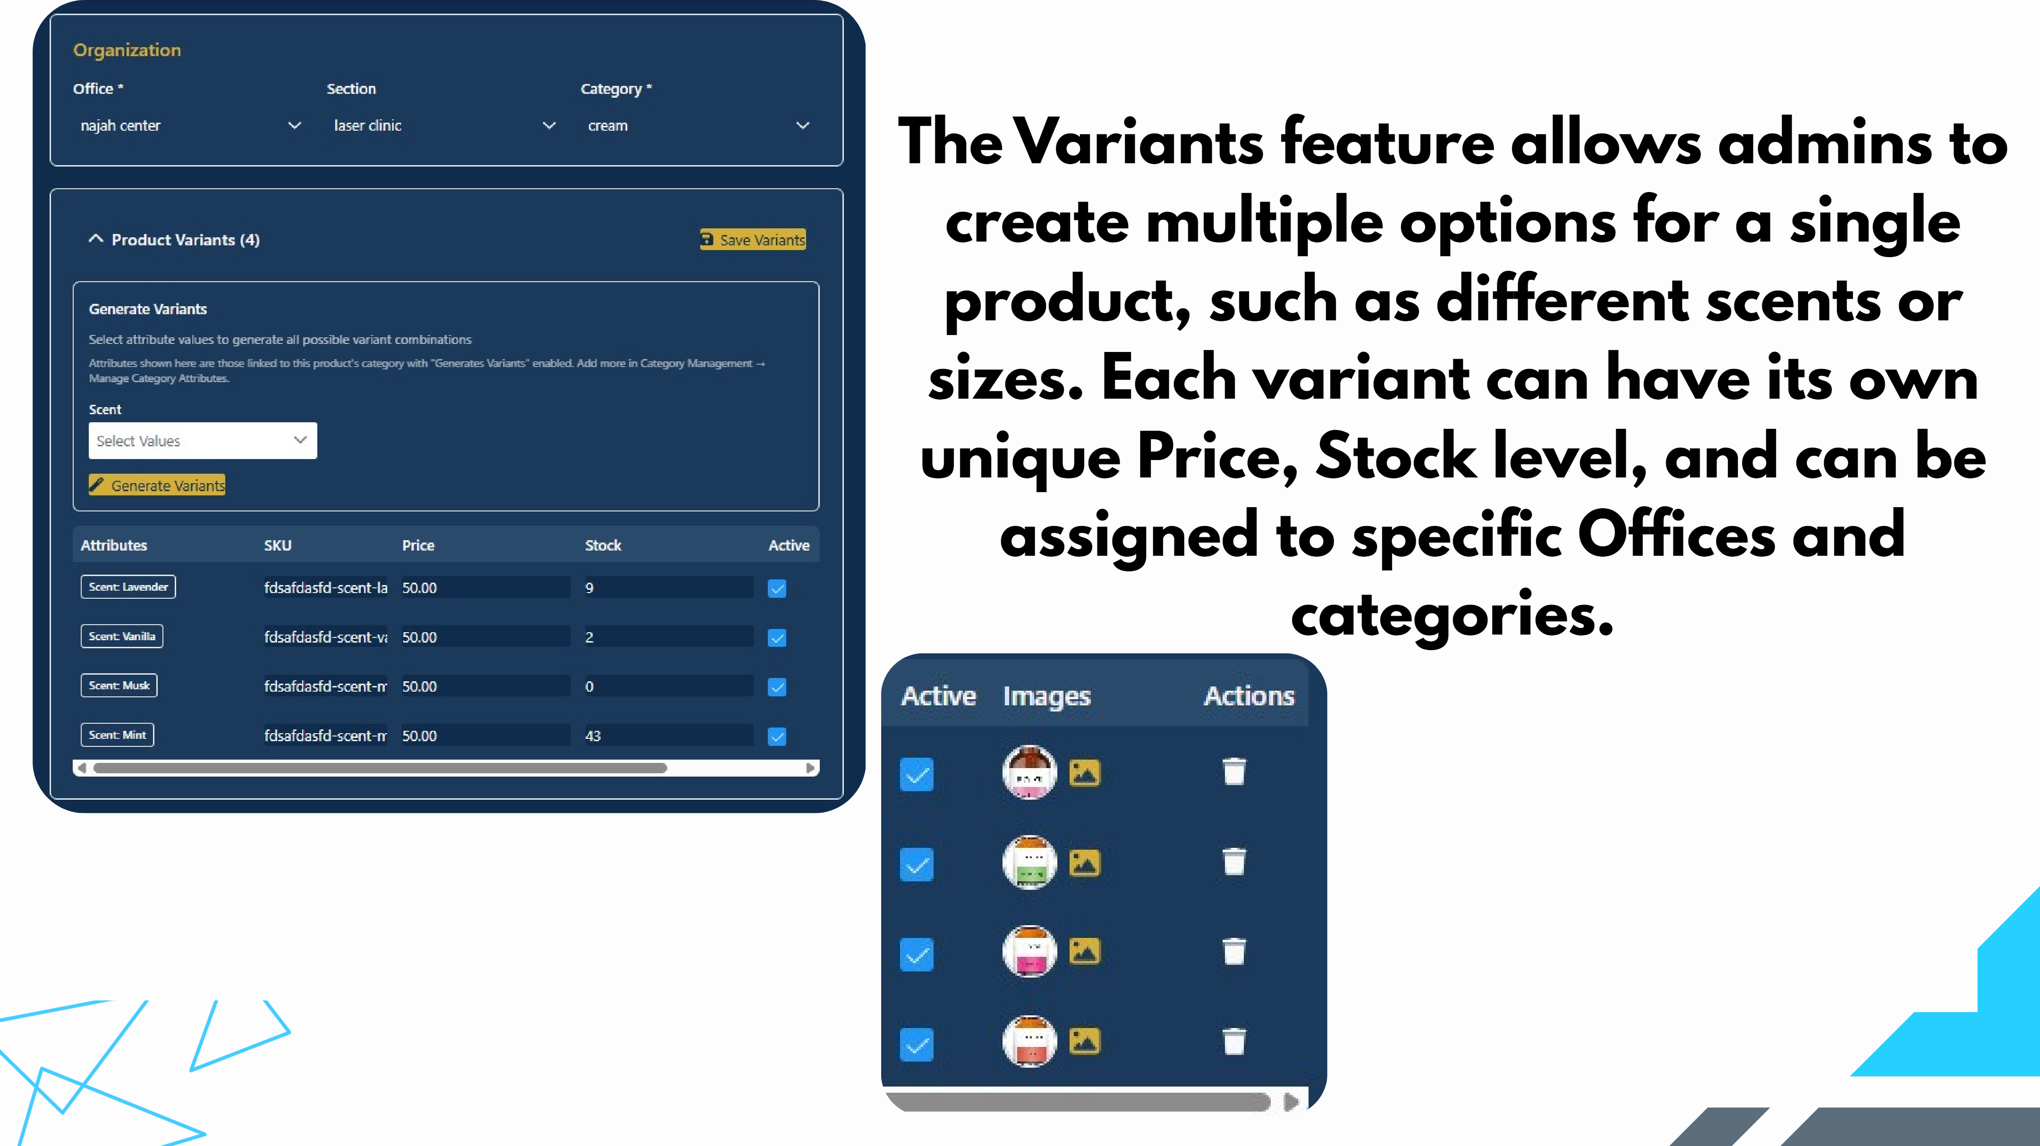
Slide 37
Notes:
The Variants feature allows admins to create multiple options for a single product, such as different scents or sizes. Each variant can have its own unique Price, Stock level, and can be assigned to specific Offices and categories.

Slide 38
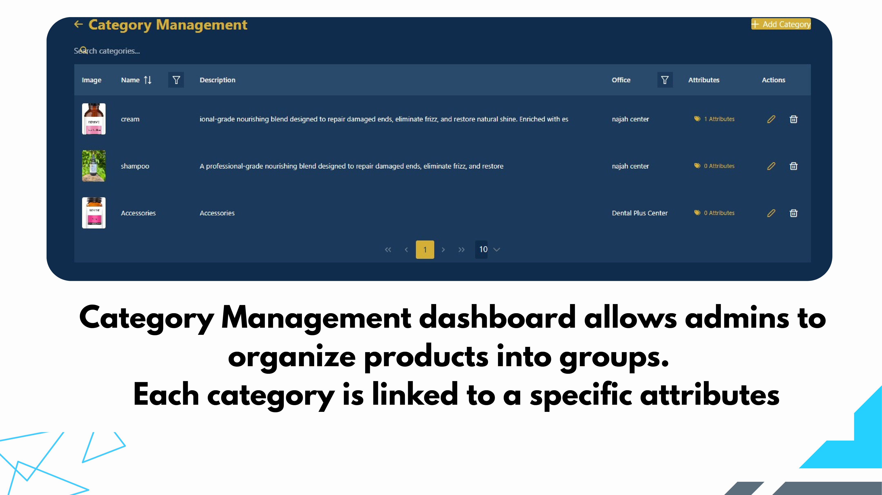
Slide 38
Notes:
Category Management dashboard allows admins to organize products into groups. Each category is linked to a specific attributes

Slide 39
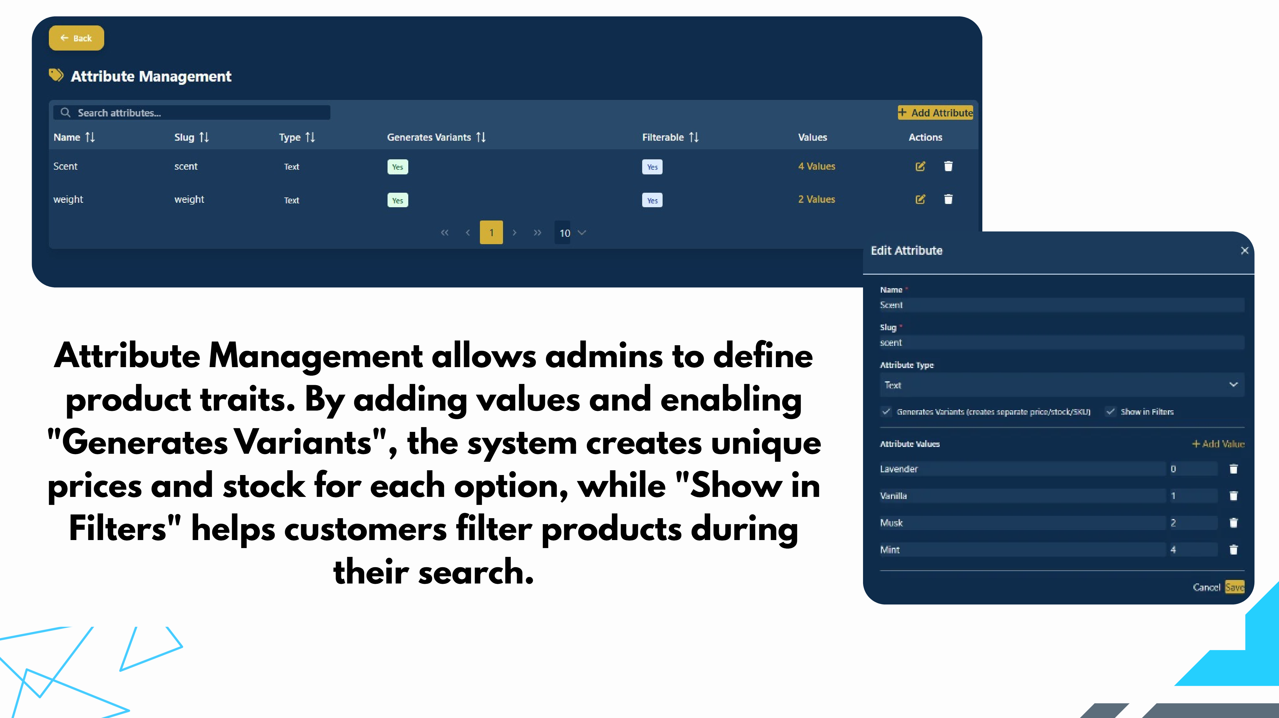
Slide 39
Notes:
Attribute Management allows admins to define product traits. By adding values and enabling "Generates Variants", the system creates unique prices and stock for each option, while "Show in Filters" helps customers filter products during their search.

Slide 40
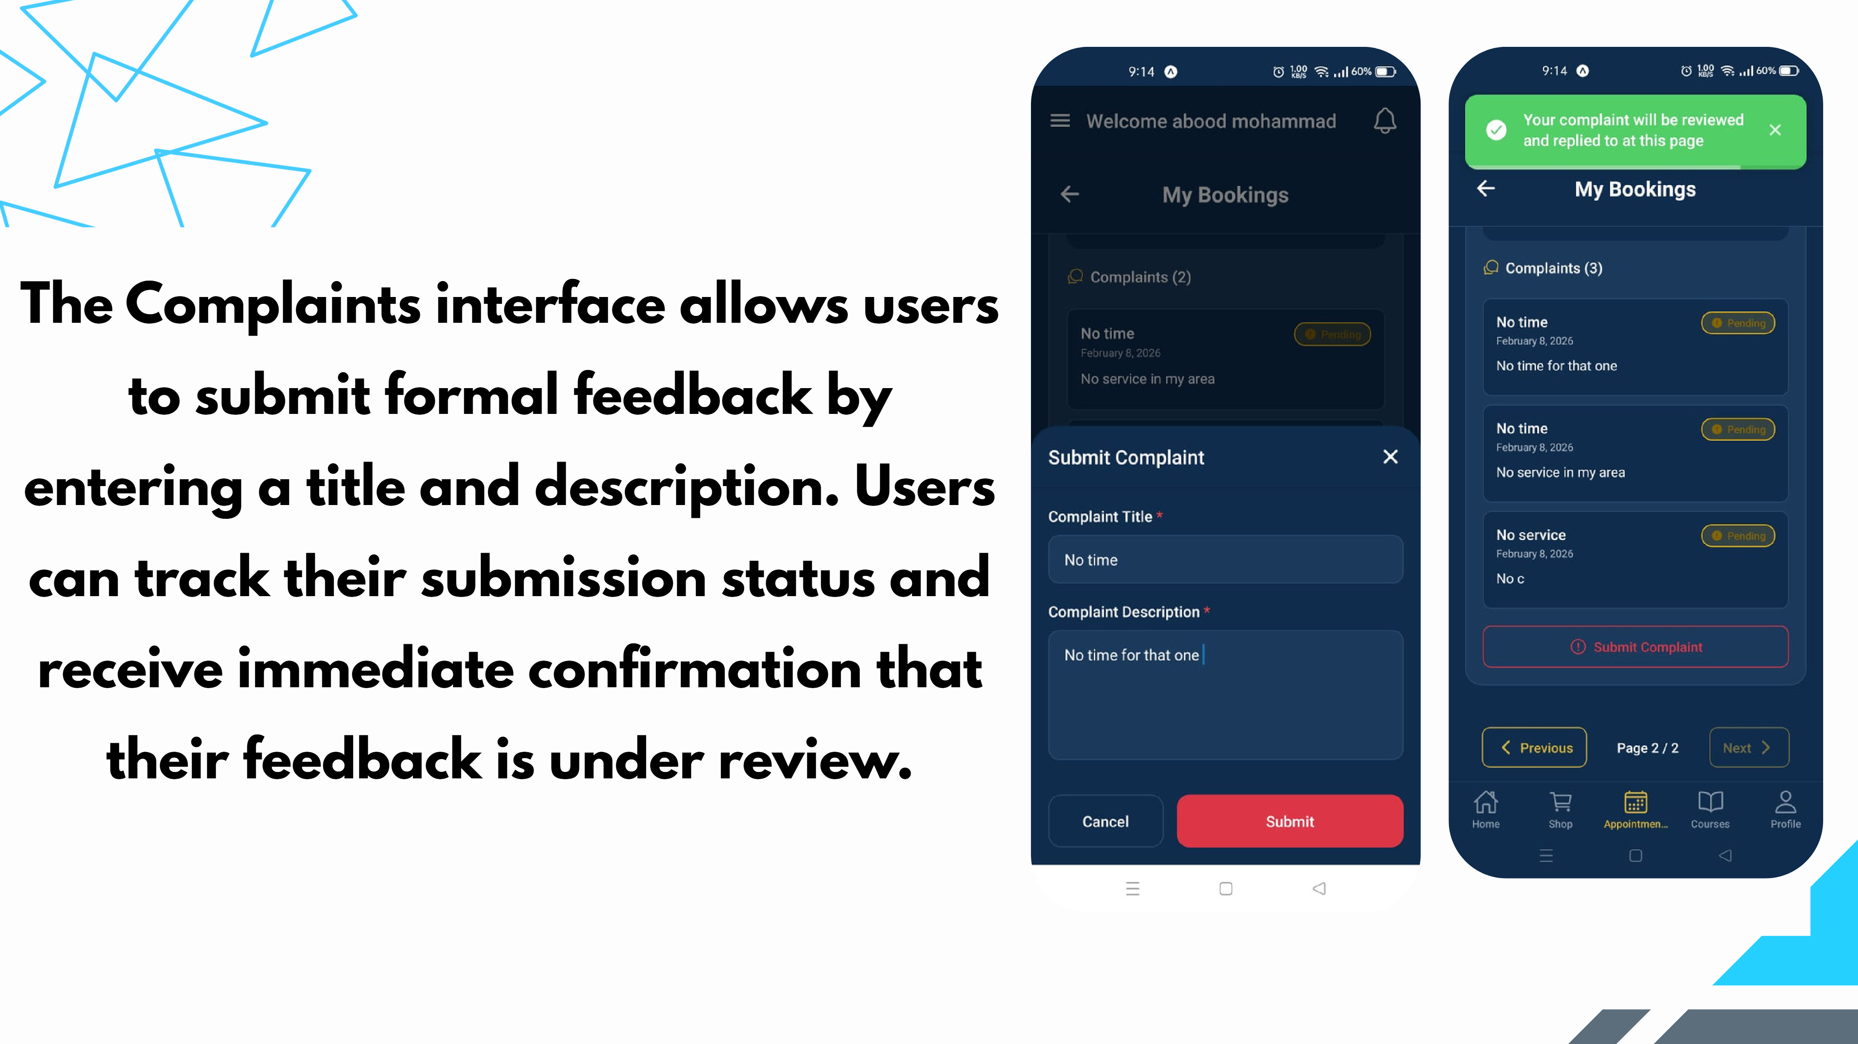
Slide 40
Notes:
The Complaints interface allows users to submit formal feedback by entering a title and description. Users can track their submission status and receive immediate confirmation that their feedback is under review.

Slide 41
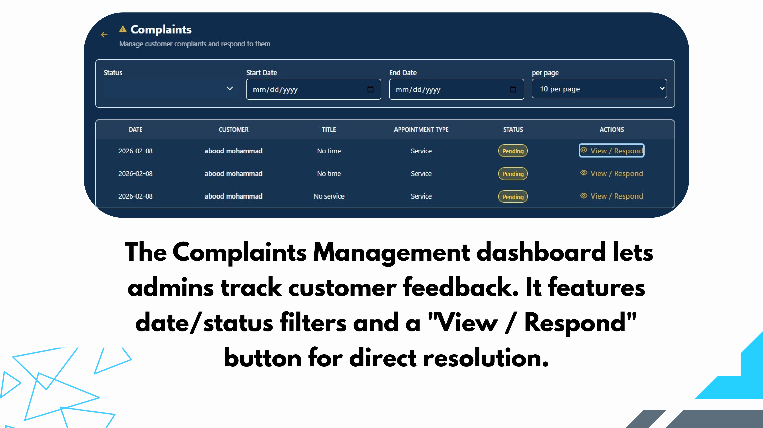
Slide 41
Notes:
The Complaints Management dashboard lets admins track customer feedback. It features date/status filters and a "View / Respond" button for direct resolution.

Slide 42
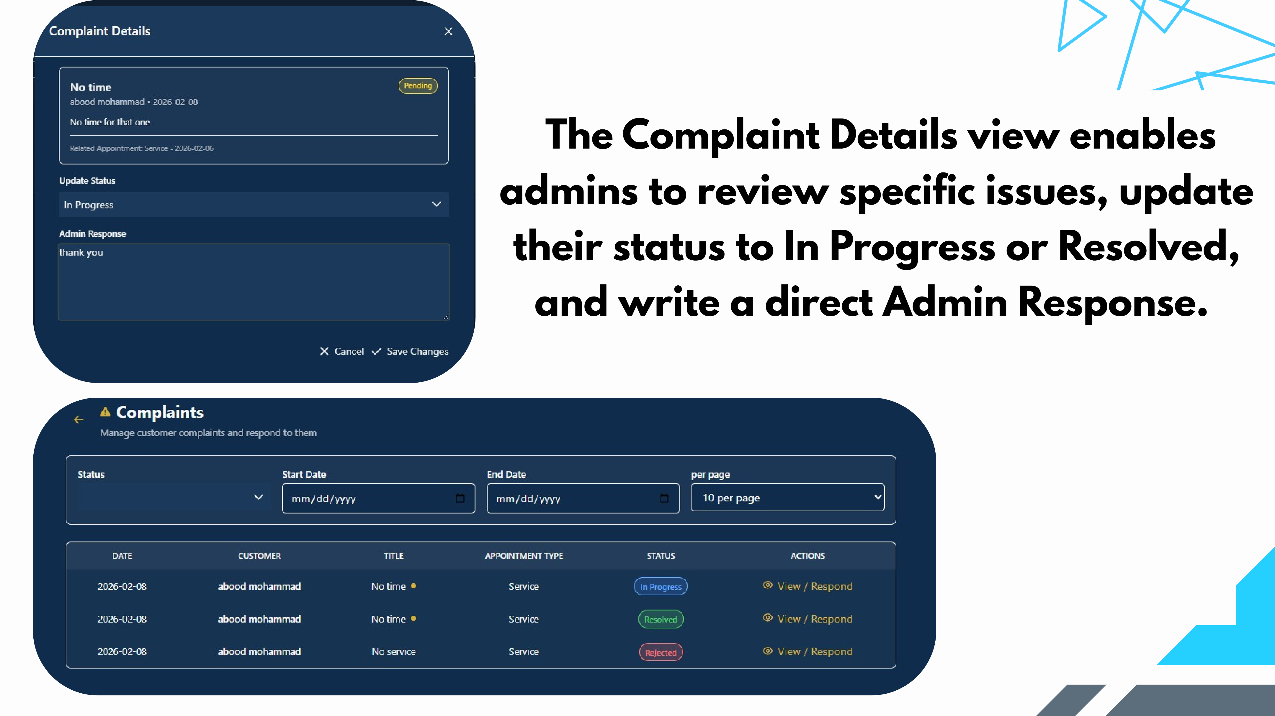
Slide 42
Notes:
The Complaint Details view enables admins to review specific issues, update their status to In Progress or Resolved, and write a direct Admin Response.

Slide 43
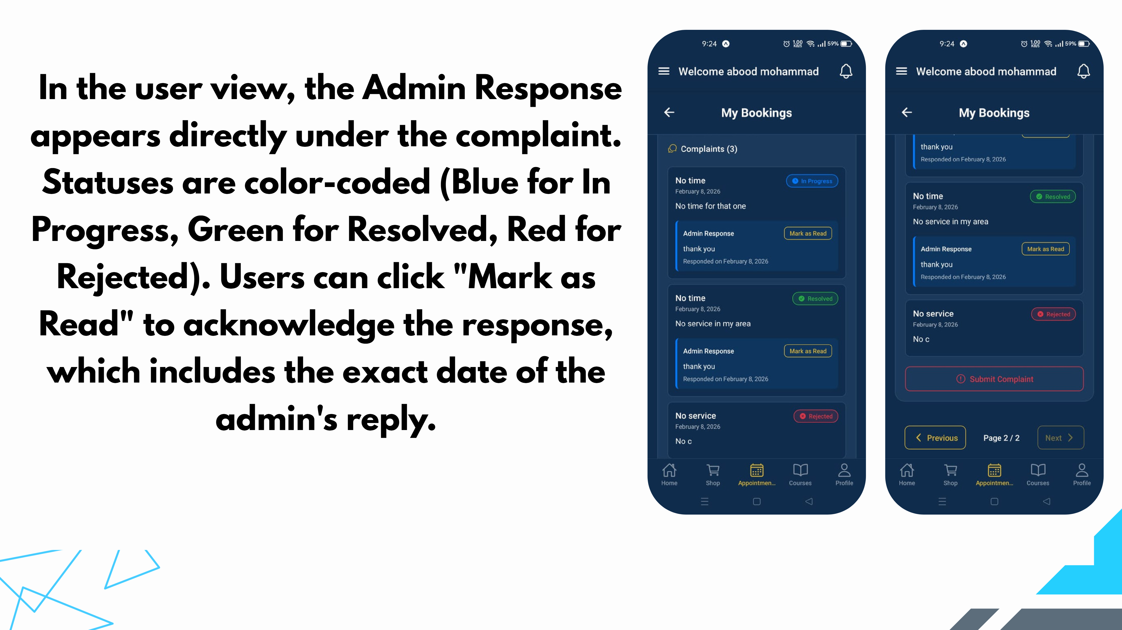
Slide 43
Notes:
In the user view, the Admin Response appears directly under the complaint. Statuses are color-coded (Blue for In Progress, Green for Resolved, Red for Rejected). Users can click "Mark as Read" to acknowledge the response, which includes the exact date of the admin's reply.

Slide 44
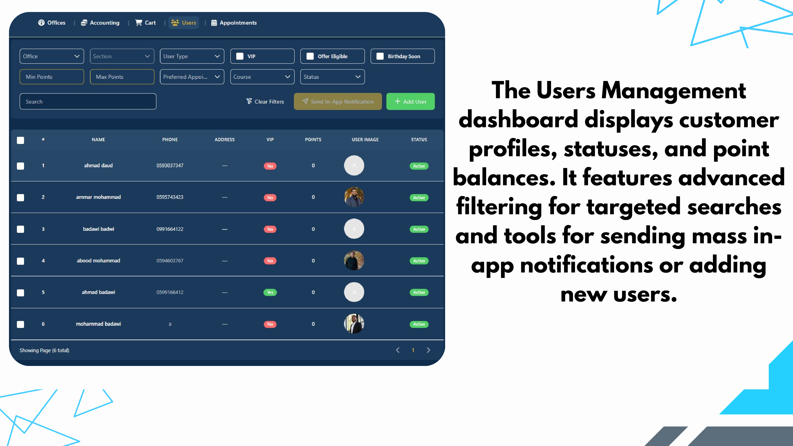
Slide 44
Notes:
The Users Management dashboard displays customer profiles, statuses, and point balances. It features advanced filtering for targeted searches and tools for sending mass in- app notifications or adding new users.

Slide 45
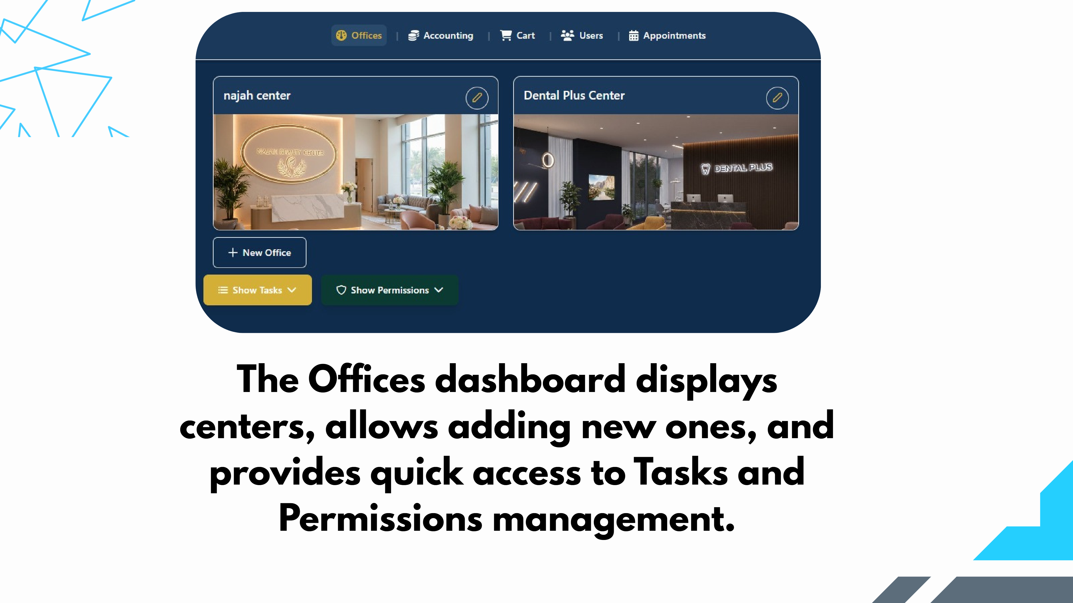
Slide 45
Notes:
The Offices dashboard displays centers, allows adding new ones, and provides quick access to Tasks and Permissions management.

Slide 46
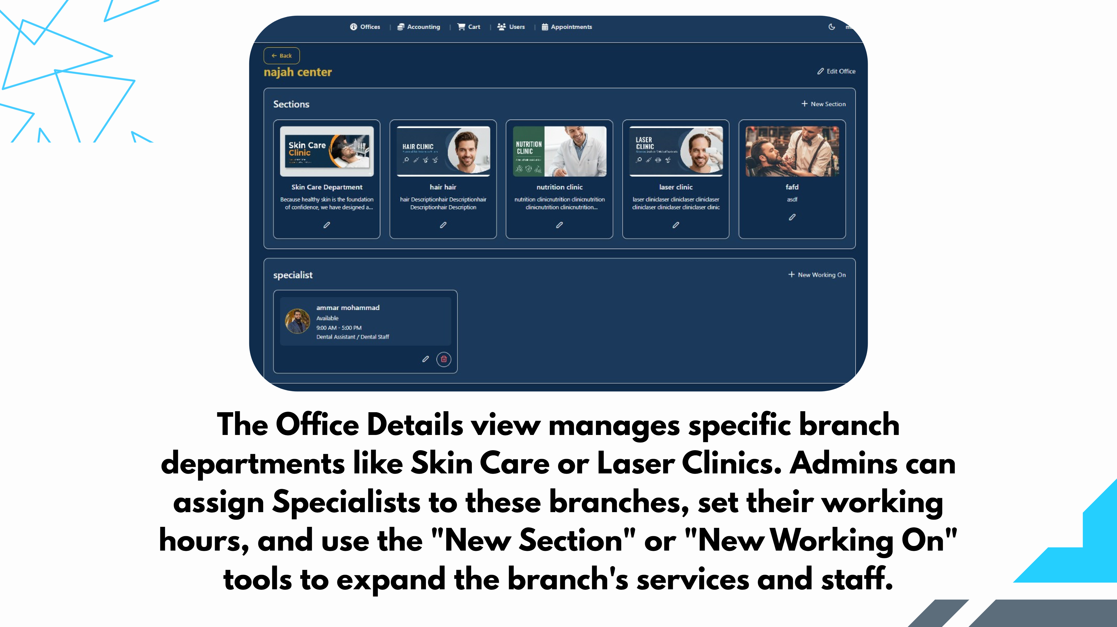
Slide 46
Notes:
The Office Details view manages specific branch departments like Skin Care or Laser Clinics. Admins can assign Specialists to these branches, set their working hours, and use the "New Section" or "New Working On" tools to expand the branch's services and staff.

Slide 47
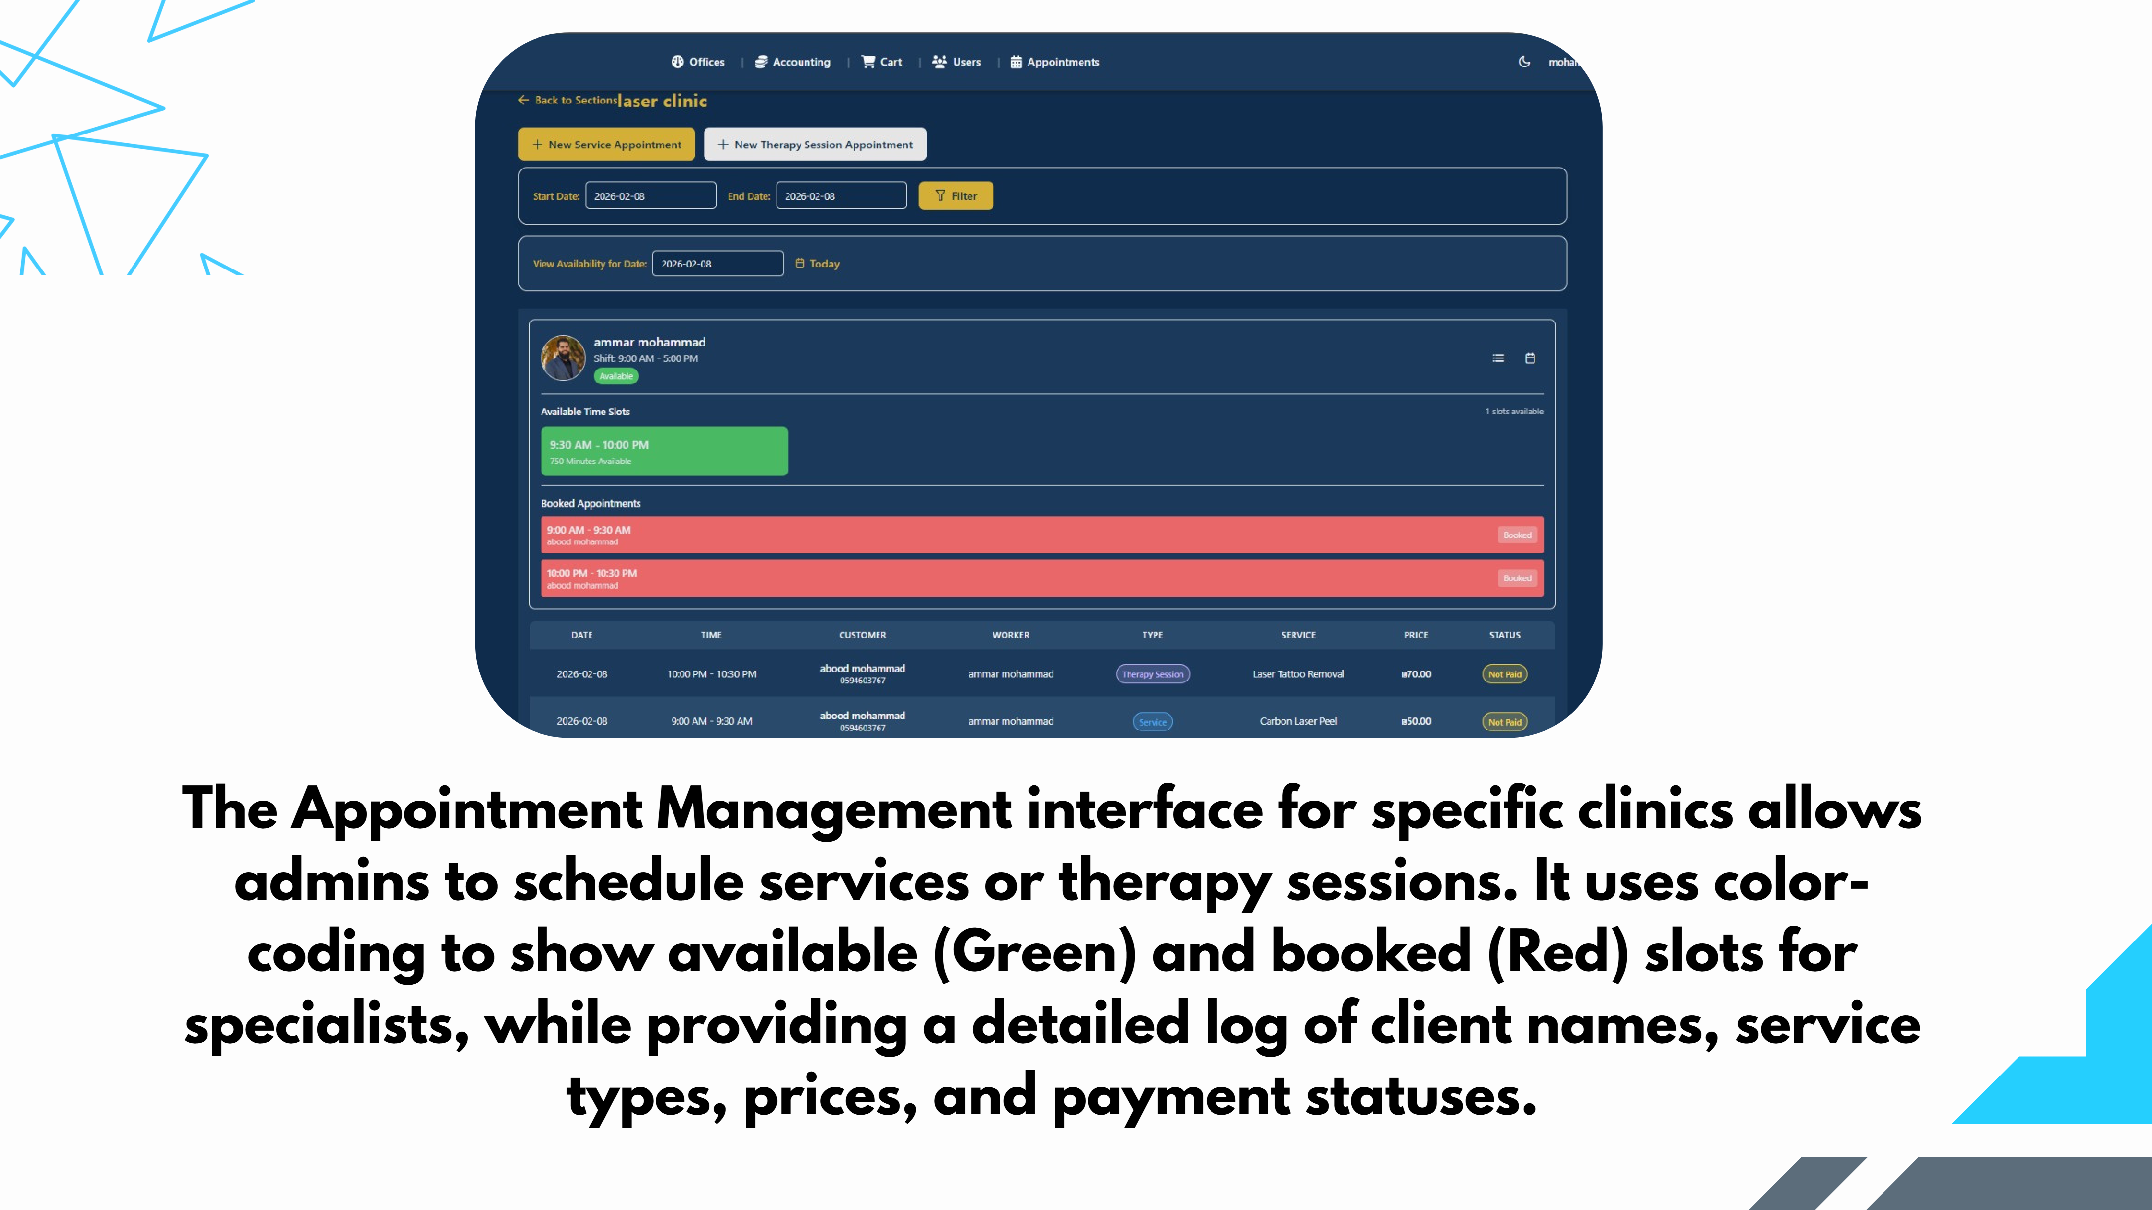
Slide 47
Notes:
The Appointment Management interface for specific clinics allows admins to schedule services or therapy sessions. It uses color- coding to show available (Green) and booked (Red) slots for specialists, while providing a detailed log of client names, service types, prices, and payment statuses.

Slide 48
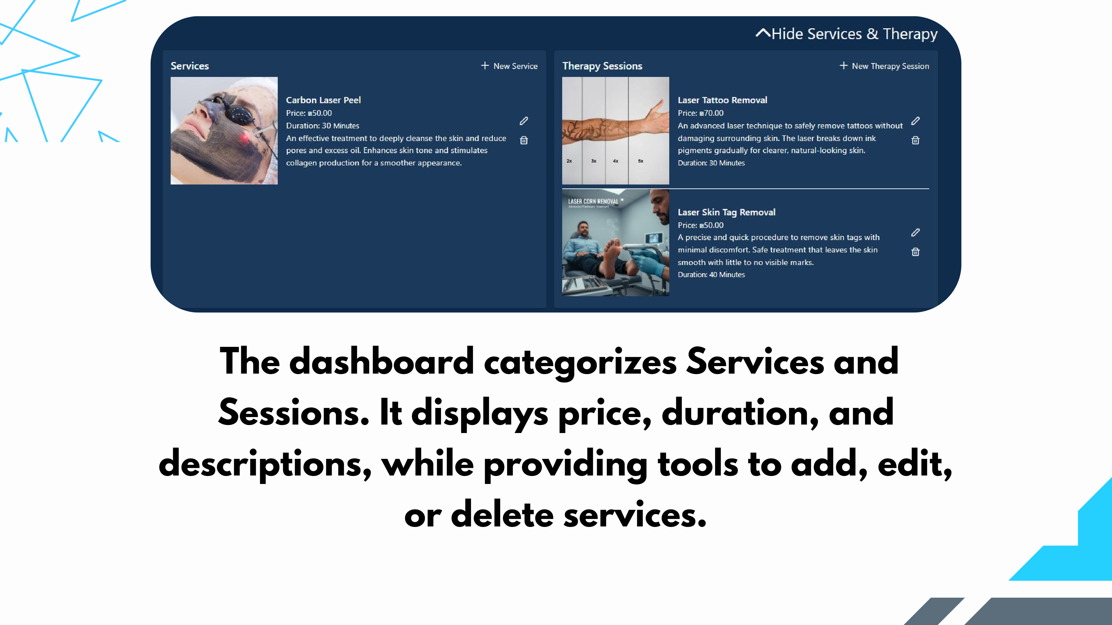
Slide 48
Notes:
The dashboard categorizes Services and Sessions. It displays price, duration, and descriptions, while providing tools to add, edit, or delete services.

Slide 49
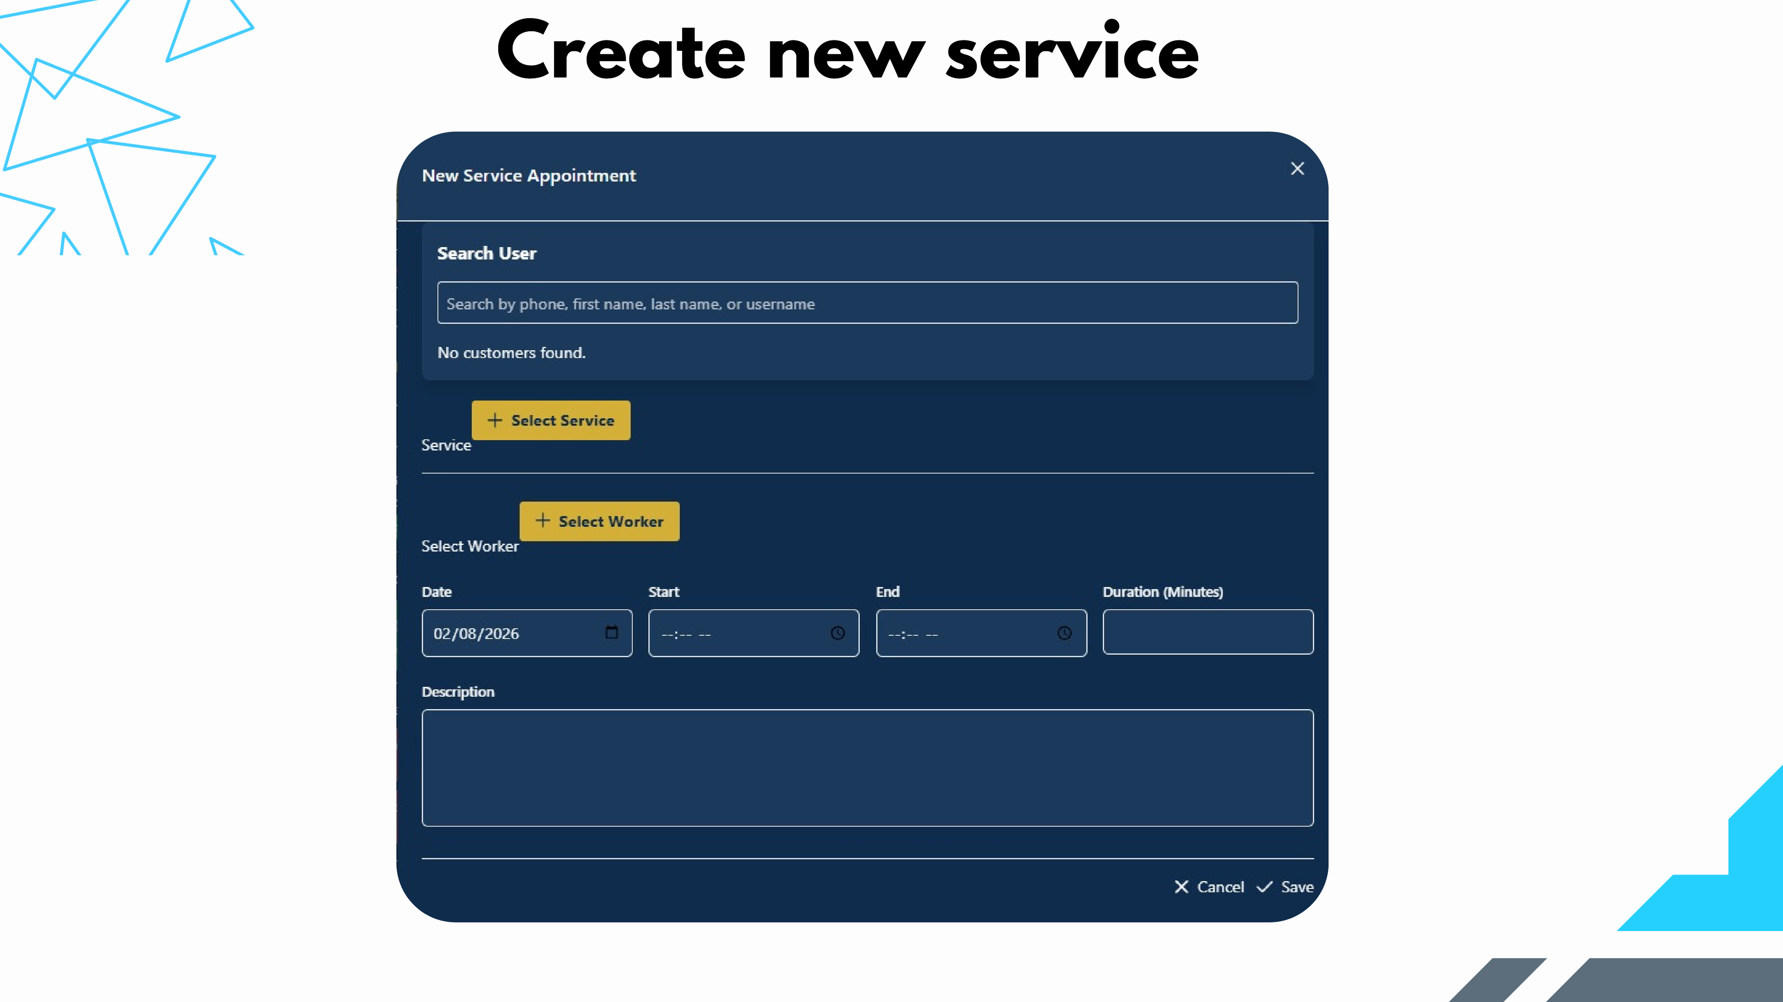
Slide 49
Notes:
Create new service

Slide 50
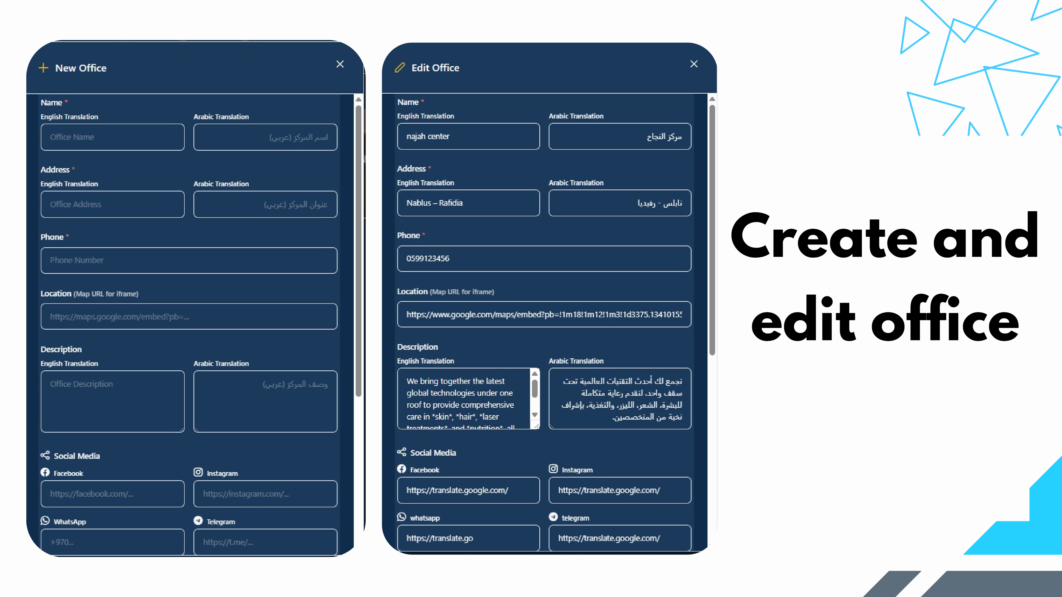
Slide 50
Notes:
Create and edit office

Slide 51
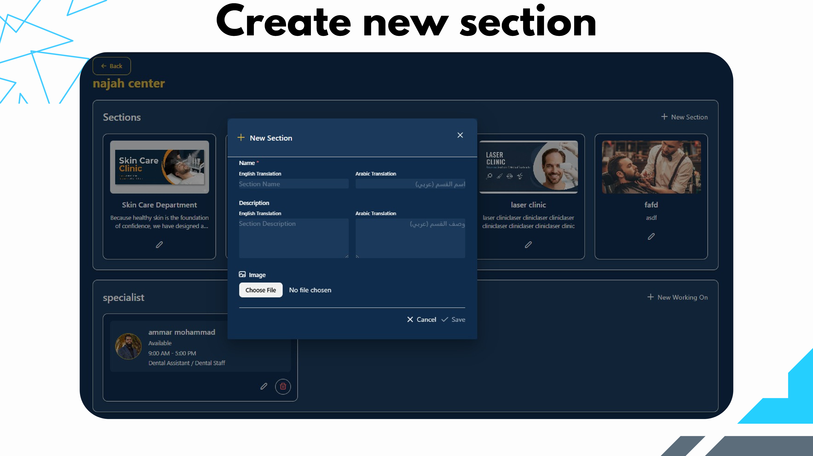
Slide 51
Notes:
Create new section

Slide 52

Slide 52
Notes:
Edit section

Slide 53

Slide 53
Notes:
The interface manages multi- session treatments by allowing continuous updates to Case Plans and Daily Cares. It tracks cumulative payments and uses Images to document clinical progress across the entire Session History.

Slide 54

Slide 54
Notes:
The system tracks multi-session progress by updating Case Plans and Images over time. It manages partial payments through Add Payment, recalculating the Remaining Balance across the entire Session History.

Slide 55

Slide 55
Notes:
The Points System rewards users on payment with instant notifications showing their new balance.

Slide 56

Slide 56
Notes:
The Points & Analytics dashboard tracks total points and user balances. Admins can create rewards via New Offer by setting point costs and monitoring conversion rates.

Slide 57

Slide 57
Notes:
The points earned by the customer can be used for booking .

Slide 58

Slide 58
Notes:
Create and edit courses

Slide 59

Slide 59
Notes:
The Teacher's dashboard allows viewing course schedules and managing student attendance. Teachers can record absences with reasons, which automatically notifies the student via the app.

Slide 60

Slide 60
Notes:
The Accounting dashboard summarizes Income, Outcomes, and Net Total. It logs every transaction by source (Course, Product, or Session) and allows filtering by date or office for precise tracking.

Slide 61

Slide 61
Notes:
The Enrollment Details dashboard tracks student payments, remaining balances, and payment history. It also allows admins to record student absences, view enrollment contracts, and add performance comments.

Slide 62

Slide 62
Notes:
The Specialist view displays a personal schedule with specific times, customer names, and service types. It tracks payment status for each appointment and allows filtering by date.

Slide 63

Slide 63

Slide 64

Slide 64
Notes:
We plan to integrate an AI Chatbot as a future development to provide automated, real-time guidance for customers. The bot will intelligently assist users through streamlining support and enhancing the overall user experience. Future Work

Slide 65

Slide 65
Notes:
ACKNOWLEDGMENT Special thanks to our supervisor, Dr. Khalid Dauod, for his continuous guidance. And to the examiners, Dr. Manar Qamhiyah and Dr. Hanal Abu Zant

Slide 66

Slide 66
Notes:
THANK YOU! ANY QUESTION?

