Slide 1
Comparison Between Different Slab Systems
(Structural and Economical)
Prepared by :
Abdullah Shehab
Jihad Zakarnah
Mohammed Al-Qasim

Slide 2
In this project
3D model had been designed with different slab systems
Quantity survey and cost estimate has been done for each system.
Bill of quantity was constructed for each of them.
The most economical system was selected.

Slide 3
We used four slab systems:
1- Two-way Flat Plate
2- Two-way Solid Slab
3- Two-Way Ribbed Slab
4- One-Way Ribbed Slab

Slide 4
The project is about a residential building
Salfit City - Palestine
Floor | Area (m²) | Consistence and use of floor
Ground floor | 182.5 | consists a three bed rooms, kitchen, three bath rooms, entrance and living room
First floor | 182.5 | is the same as the ground floor
Staircase | 14.3
Total | 379.3

Slide 5
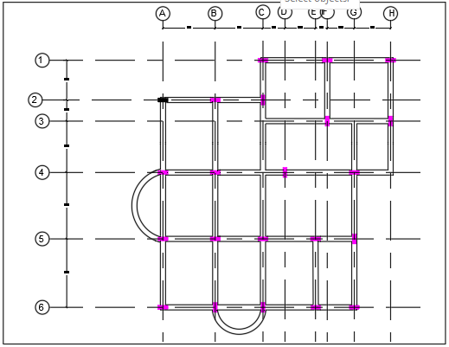
Centre Line Plan

Slide 6
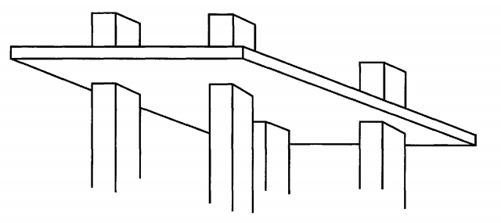
Flat plate slab system

Slide 7
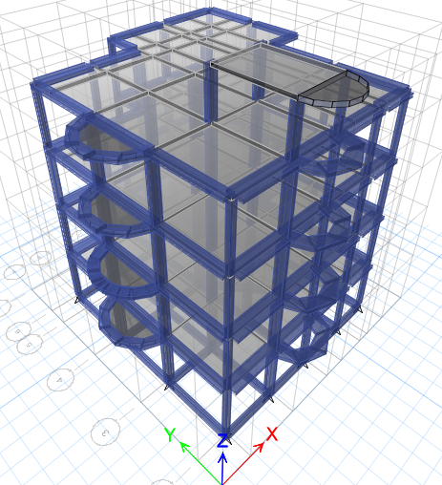
THREE-DIMENSIONAL STRUCTURAL ANALYSIS

Slide 8
Slab and beams
Thickness of Slab = 200 mm
For Beams we used Edge beams:
Width of Beam1 (B1) = 300 mm
Depth of Beam1 (B1) = 200 mm
Width of Beam2 (B2) = 450 mm
Depth of Beam2 (B2) = 200 mm

Slide 9
Columns
Column Group | Column Dimensions (mm) | Longitudinal Steel | Stirrups
C1 | 700 X 200 | 10 ∅ 14 mm | 1 ∅10 @ 200 mm
C2 | 400 X 200 | 8 ∅ 12 mm | 1 ∅10 @ 190 mm
C3 | 300 X 200 | 6 ∅ 12 mm | 1 ∅10 @ 190 mm

Slide 10
Footings
Type of footing | Dimension ( m ) | Bottom steel |  | Top steel
 |  | Long Direction | Short Direction | Long Direction | Short Direction
Single footings | 1.4 X 1.4 X 0.35 | 8 ∅12 | 8 ∅12 | 4 ∅12 | 4 ∅12
Single footings | 1.6 X 1.6 X 0.35 | 9 ∅12 | 9 ∅12 | 5 ∅12 | 5 ∅12
Single footings | 1.85 X 1.85 X 0.35 | 11 ∅12 | 11 ∅12 | 6 ∅12 | 6 ∅12

Slide 11
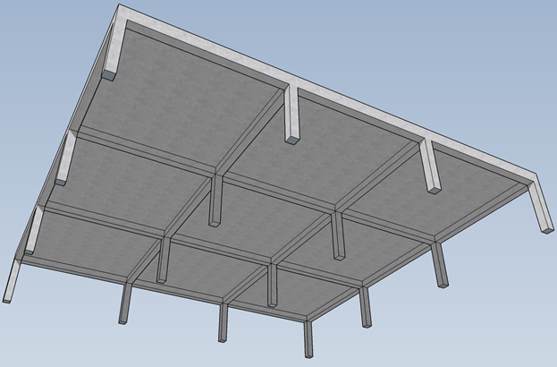
Two way solid slab system

Slide 12
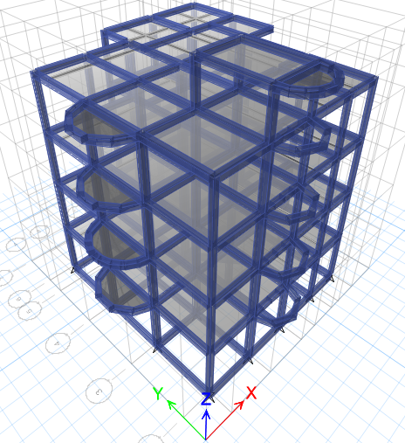
Three-Dimensional Structural Analysis

Slide 13
Slab and beams
Thickness of Slab = 150 mm
Width of beams = 300 mm
Depth of beams = 300 mm

Slide 14
Columns
Column Group | Column Dimensions (mm) | Longitudinal Steel | Stirrups
C1 | 550 X 200 | 10 ∅ 12 mm | 1 ∅10 @ 190 mm
C2 | 400 X 200 | 8 ∅ 12 mm | 1 ∅10 @ 190 mm
C3 | 300 X 200 | 6 ∅ 12 mm | 1 ∅10 @ 190 mm

Slide 15
Footings
Type of footing | Dimension ( m ) | Bottom steel |  | Top steel
 |  | Long Direction | Short Direction | Long Direction | Short Direction
Single footings | 1.4 X 1.4 X0.35 | 8 ∅12 | 8 ∅12 | 4 ∅12 | 4 ∅12
Single footings | 1.6 X 1.6 X 0.35 | 9 ∅12 | 9 ∅12 | 5 ∅12 | 5 ∅12
Single footings | 1.85 X 1.85 X 0.4 | 12 ∅12 | 12 ∅12 | 6 ∅12 | 6 ∅12

Slide 16
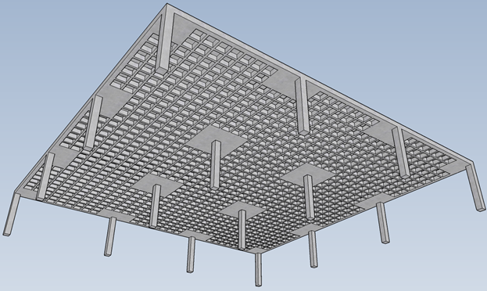
Two way ribbed slab system
(Waffle slab)

Slide 17
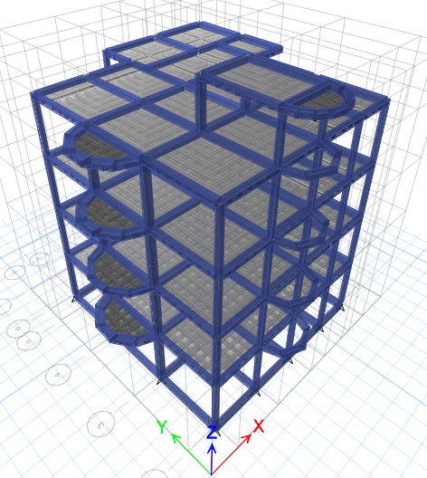
THREE-DIMENSIONAL STRUCTURAL ANALYSIS

Slide 18
Slab
Total Thickness of Slab = 250 mm
Width of Rib bw = 120 mm
Flange Width = 520 mm
Block Dimensions = 40 X 25 X 17 cm Height

Slide 19
Beams
We used two types of beams and they are hidden beams:
B1 with width = 450 mm
B1 with depth = 250 mm
B2 with width = 300 mm
B2 with depth = 250 mm

Slide 20
Columns
Column Group | Column Dimensions (mm) | Longitudinal Steel | Stirrups
C1 | 550 X 200 | 10 ∅ 12 mm | 1 ∅10 @ 190 mm
C2 | 400 X 200 | 8 ∅ 12 mm | 1 ∅10 @ 190 mm
C3 | 250 X 200 | 6 ∅ 12 mm | 1 ∅10 @ 190 mm

Slide 21
Footings
Type of footing | Dimension ( m ) | Bottom steel |  | Top steel
 |  | Long Direction | Short Direction | Long Direction | Short Direction
Single footings | 1.2 X 1.2 X 0.3 | 6 ∅12 | 6 ∅12 | 3 ∅12 | 3 ∅12
Single footings | 1.5 X 1.5 X 0.35 | 9 ∅12 | 9 ∅12 | 5 ∅12 | 5 ∅12
Single footings | 1.8 X 1.8 X 0.4 | 12 ∅12 | 12 ∅12 | 6 ∅12 | 6 ∅12

Slide 22
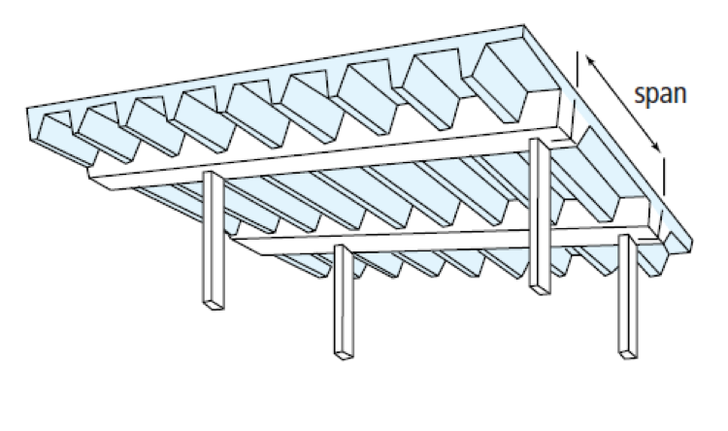
ONE way ribbed slab system

Slide 23
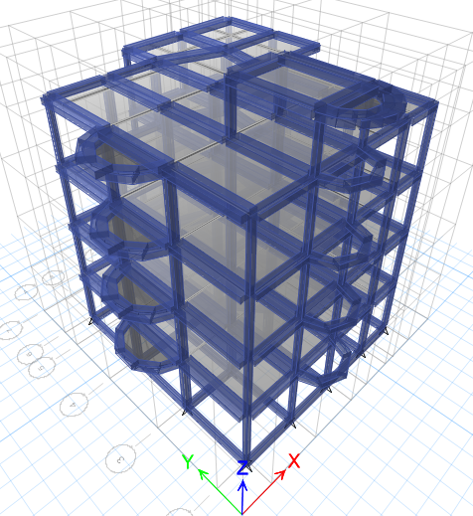
THREE-DIMENSIONAL STRUCTURAL ANALYSIS

Slide 24
Slab
Total Thickness of Slab = 300 mm
Width of Rib bw = 120 mm
Flange Width = 520 mm
Block Dimensions = 40 X 25 X 24 cm Height

Slide 25
Beams
We used two types of beams and they are hidden beams:
B1 with width = 700 mm
B1 with depth = 300 mm
B2 with width = 400 mm
B2 with depth = 300 mm

Slide 26
Columns
Column Group | Column Dimensions (mm) | Longitudinal Steel | Stirrups
C1 | 550 X 200 | 10 ∅ 12 mm | 1 ∅10 @ 190 mm
C2 | 400 X 200 | 8 ∅ 12 mm | 1 ∅10 @ 190 mm
C3 | 250 X 200 | 6 ∅ 12 mm | 1 ∅10 @ 190 mm

Slide 27
Footings
Type of footing | Dimension ( m ) | Bottom steel |  | Top steel
 |  | Long Direction | Short Direction | Long Direction | Short Direction
Single footings | 1.3 X 1.3 X 0.35 | 8 ∅12 | 8 ∅12 | 4 ∅12 | 4 ∅12
Single footings | 1.55 X 1.55 X 0.35 | 9 ∅12 | 9 ∅12 | 5 ∅12 | 5 ∅12
Single footings | 1.75 X 1.75 X 0.4 | 12 ∅12 | 12 ∅12 | 5 ∅12 | 5 ∅12

Slide 28
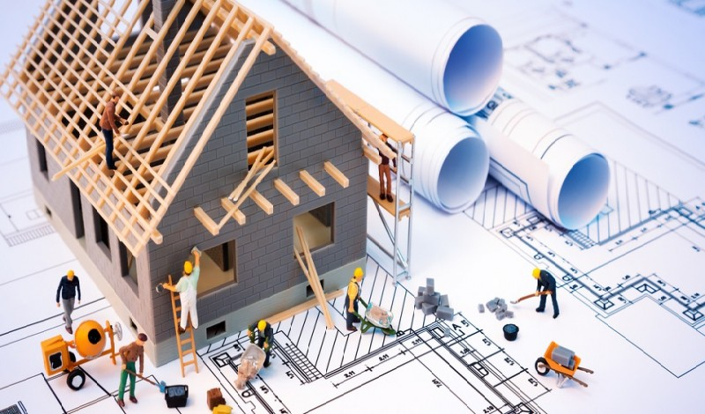
Quantity surveying &
Cost estimate

Slide 29
Quantity And Material Takeoff
Quantity takeoff : is a process of measuring the work of the project in the form of a series of quantified work items.
Material takeoff : is used to compute the quantity of materials that need to be purchased in order to construct a particular item of the project.

Slide 30
Quantity Surveying (QS)
Consultant QS
Contractor QS

Slide 31
Estimation
Estimating is an approximation that defines the Cost of construction Activity or activities prior to commencement of work V.S the cost of work during and after construction, which is the Actual cost.
Activity Cost in general is basically the cost of material, labor and equipment.
Conceptual Estimate & Detailed Estimate

Slide 32
Work Breakdown Structure (WBS)
A hierarchical system which sub-divides larger elements of the project to smaller elements.
The smallest unit of the WBS is the work package.
work packages should be manageable, independent and Measurable

Slide 33
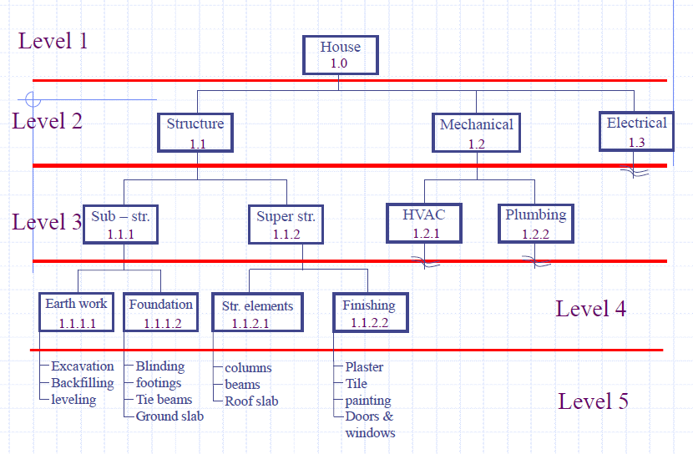
Work Breakdown Structure (WBS)

Slide 34
Bill Of Quantity ( BOQ)
The Bill of Quantities (sometimes referred to as ‘BOQ' or 'BQ') is a document prepared by the cost consultant (often a Quantity Surveyor) that provides project specific measured quantities of the items of work identified by the drawings and specifications in the tender documentation.
The quantities may be measured in number, length, area, volume, weight or time Preparing a bill of quantities requires that the design is complete and a specification has been prepared.

Slide 35
Project Quantities
Quantities were made for two major elements:
Structural elements: including Footings, Column necks, Columns, Beams and Slabs.
Nonstructural elements: mainly the interior finishing works.
Nonstructural elements had calculated for one time since it had never changed for different slab systems.

Slide 36
Tow-way Flat Plate
Excavation For Footings
Assume allowance from each side = 0.5 m
Excavation For Footing
Type of Footing | No. of Footing | Length(m) | Width (m) | Depth(m) | Volume of Bank(m^3) | Swell Factor | Volume of Loose(m^3)
F1 | 9 | 2.4 | 2.4 | 1.5 | 77.76 | 1.5 | 116.64
F2 | 8 | 2.6 | 2.6 | 1.5 | 81.12 | 1.5 | 121.68
F3 | 5 | 2.85 | 2.85 | 1.5 | 60.91875 | 1.5 | 91.378125
Total |  |  |  |  | 219.79875 |  | 329.698125

Slide 37
Tow-way Flat Plate
Footings: Blinding & main Concrete
Volume of Blinding Concrete
Type of Footing | N | L(m) | W(m) | D(m) | Volume(m³)
F1 | 9 | 1.60 | 1.60 | 0.10 | 2.30
F2 | 8 | 1.80 | 1.80 | 0.10 | 2.60
F3 | 5 | 2.05 | 2.05 | 0.10 | 2.10
Total |  |  |  |  | 7.00
Volume of Main Concrete
Type of Footing | N | L(m) | W(m) | D(m) | Volume (m³)
F1 | 9 | 1.4 | 1.4 | 0.35 | 6.17
F2 | 8 | 1.6 | 1.6 | 0.35 | 7.17
F3 | 5 | 1.85 | 1.85 | 0.4 | 6.85
Total |  |  |  |  | 20.19

Slide 38
Tow-way Flat Plate
Footings: Formwork & Reinforcement
Type of Footing | N | L (m) | W (m) | D (m) | Thickness (m) | Volume (m³)
F1 | 9 | 1.4 | 1.4 | 0.4 | 0.025 | 0.504
F2 | 8 | 1.6 | 1.6 | 0.4 | 0.025 | 0.512
F3 | 5 | 1.85 | 1.85 | 0.4 | 0.025 | 0.37
Total |  |  |  |  |  | 1.386
Type of Footing | N | Bar Size (mm) | Weight (Kg) | L(m) | No. of Bar | Total Weight (Ton)
F1 | 9 | 12 | 0.888 | 1.25 | 24 | 0.24
F2 | 8 | 12 | 0.888 | 1.45 | 28 | 0.29
F3 | 5 | 12 | 0.888 | 1.7 | 34 | 0.26
Total |  |  |  |  |  | 0.79

Slide 39
Tow-way Flat Plate
Column necks: Concrete & Formwork Volumes
Volume of Concrete
Group of Column | N | L(m) | W (m) | D(m) | Volume (m³)
C1 | 9 | 0.3 | 0.2 | 1.15 | 0.62
C2 | 8 | 0.4 | 0.2 | 1.15 | 0.74
C3 | 5 | 0.7 | 0.2 | 1.1 | 0.77
Total |  |  |  |  | 2.13
Volume of Formwork
Type of Column | N | L(m) | W(m) | D(m) | Thickness(m) | Volume (m³)
C1 | 9 | 0.3 | 0.2 | 1.2 | 0.025 | 0.27
C2 | 8 | 0.4 | 0.2 | 1.2 | 0.025 | 0.29
C3 | 5 | 0.7 | 0.2 | 1.1 | 0.025 | 0.25
Total |  |  |  |  |  | 0.81

Slide 40
Tow-way Flat Plate
Column necks: Longitudinal & Transverse Reinforcement
Longitudinal Reinforcement
Group of Column | N | Bar Size(mm) | Weight (Kg) | L(m) | No. of Bar | Total Weight (Ton)
C1 | 9 | 12 | 0.889 | 2.4 | 6 | 0.1152
C2 | 8 | 12 | 0.889 | 2.4 | 8 | 0.136533
C3 | 4 | 14 | 1.21 | 2.4 | 10 | 0.116148
 | 1 | 14 | 1.21 | 2.4 | 18 | 0.052267
Total |  |  |  |  |  | 0.42
Transverse Reinforcement
Group of Column | N | Size (mm) | Weight (Kg) | No. of Stirrup | Width stirrup(m) | Depth stirrup(m) | Peri. Of ST(m) | Total Weight (Ton)
C1 | 9 | 10 | 0.617 | 8 | 0.25 | 0.15 | 0.8 | 0.03555556
C2 | 8 | 10 | 0.617 | 8 | 0.35 | 0.15 | 1 | 0.03950617
C3 | 4 | 10 | 0.617 | 8 | 0.73 | 0.3 | 2.1 | 0.04069136
 | 1 | 10 | 0.617 | 8 | 1.27 | 0.45 | 3.4 | 0.01698765
Total |  |  |  |  |  |  |  | 0.13274074

Slide 41
Tow-way Flat Plate
Ground Beams: Blinding, main Concrete & Formwork volumes
Lengths of tie beams are found using AutoCAD.
Volume of Blinding Concrete
Volume of Main Concrete
Type of Tie Beams | L(m) | W(m) | D(m) | Volume(m³)
T1 | 131 | 0.3 | 0.1 | 3.93
Total |  |  |  | 3.93
Type of Tie Beams | L(m) | W(m) | D(m) | Volume(m³)
T1 | 131 | 0.2 | 0.5 | 13.1
Total |  |  |  | 13.1
Volume of Formwork
Type of Tie Beams | L(m) | W(m) | D(m) | Thickness(m) | Volume (m³)
T1 | 131 | 0.2 | 0.6 | 0.025 | 3.93
Total |  |  |  |  | 3.93

Slide 42
Tow-way Flat Plate
Ground Beams: Longitudinal & Transverse Reinforcement
Longitudinal Reinforcement
Type of TB | L(m) | Bar Size(mm) | Weight (Kg) | No. of Bar | Total Weight (Ton)
TB | 151 | 14 | 1.20988 | 4 | 0.730765432
Total |  |  |  |  | 0.730765432
Transverse Reinforcement
Size (mm) | Weight (Kg) | Spacing (m) | L (m) | N | W (m) | D (m) | Perimeter | Total Weight (Ton)
10 | 0.61728 | 0.2 | 131 | 655 | 0.15 | 0.45 | 1.2 | 0.485

Slide 43
Tow-way Flat Plate
Ground Slab: Concrete & Formwork Volumes
Volume of Concrete
Elevation | Area(m³) | t(m) | V(m³)
0.00 | 182.5 | 0.1 | 18.25
Total Concrete V(m³) |  |  | 18.25
Volume of Formwork
Ground Slab | Perimeter (m) | Depth(m) | Thickness(m) | Volume (m³)
 | 65 | 0.1 | 0.025 | 0.1625

Slide 44
Tow-way Flat Plate
Ground Slab: Longitudinal Reinforcement
Longitudinal Reinforcement
No. of Bars | length of Bar (m) | Total Length (m) | Bar Size (mm) | Weight (Kg) | Total Weight (Ton)
40 | 11.1 | 444 | 8 | 0.395061728 | 0.175407407
10 | 17.4 | 174 | 8 | 0.395061728 | 0.068740741
20 | 13.2 | 264 | 8 | 0.395061728 | 0.104296296
30 | 12.3 | 369 | 8 | 0.395061728 | 0.145777778
10 | 7 | 70 | 8 | 0.395061728 | 0.027654321
25 | 14.32 | 358 | 8 | 0.395061728 | 0.141432099
Total |  |  |  |  | 0.663308642

Slide 45
Tow-way Flat Plate
Floor Slab: Concrete Volumes
Volume of Concrete
Floor | Area (m²) | Thickness(m) | Volume(m³)
First | 182.5 | 0.2 | 36.5
Second | 182.5 | 0.2 | 36.5
Third | 14.3 | 0.2 | 2.86
Total |  |  | 75.86

Slide 46
Tow-way Flat Plate
Floor Slab: Formwork Volumes
Assumptions for Formwork
Assume distance between Shores = 0.5 m in direction1 and 0.9 m in direction 2
Assume distance between Stringer = 0.9 m in each direction
Assume distance between Joist = 0.4 m in each direction
Stringer 0.05 X 0.1 X Length
Joist 0.05 X 0.1 X Length
Sheeting 0.025 X 0.1 X Length
Volume of Formwork
Total Area of Sheating (m²) | 379
Total Volume of Sheating (m³) | 9.475
Total Volume of Formwork (m³) | 16.555
Total No. of Shores | 843

Slide 47
Tow-way Flat Plate
Floor Slab: Slab Reinforcement
Top Reinforcement For Slab in direction 1
Floors | Top Bar
 | No. of Bars | φ(mm) | Weight (Ton) | Length (m) | Total Weight
Direction1 | 36 | 12 | 0.00089 | 8.7 | 0.2784
 | 20 | 12 | 0.00089 | 2.8 | 0.049777778
 | 10 | 14 | 0.00121 | 9.7 | 0.117358025
 | 8 | 12 | 0.00089 | 9.3 | 0.066133333
 | 10 | 14 | 0.00121 | 9.3 | 0.112518519
 | 15 | 12 | 0.00089 | 5.6 | 0.074666667
 | 20 | 12 | 0.00089 | 3 | 0.053333333
Total Reinforcement For Slab = 6.362 Tons

Slide 48
Tow-way Flat Plate
Frames: Longitudinal Reinforcement For Frames
Top Reinforcement For First Four frames
Frame Type | Top Bar
 | No. of Bars | φ(mm) | Weight (Ton) | Length (m) | Total Weight (Ton)
Frame1 | 6 | 12 | 0.00088889 | 3.4 | 0.018133333
 | 4 | 12 | 0.00088889 | 2.3 | 0.008177778
Frame2 | 8 | 12 | 0.00088889 | 8.8 | 0.062577778
 | 4 | 12 | 0.00088889 | 6.7 | 0.023822222
Frame3 | 10 | 12 | 0.00088889 | 4.3 | 0.038222222
Frame4 | 8 | 12 | 0.00088889 | 4.5 | 0.032
 | 4 | 12 | 0.00088889 | 4.4 | 0.015644444
Total Longitudinal Reinforcement For Frames = 1.432 Tons

Slide 49
Tow-way Flat Plate
Frames: Transverse Reinforcement For Frames
Transverse Reinforcement For First Four frames
Stirrup
Frame Type | No.of ST. | φ(mm) | Perimeter(m) | Weight (Ton) | Total Weight (Ton)
Frame1 | 90 | 10 | 1.04 | 0.0006173 | 0.057777778
Frame2 | 200 | 10 | 1.54 | 0.0006173 | 0.190123457
Frame3 | 40 | 10 | 1.04 | 0.0006173 | 0.025679012
Frame4 | 52 | 10 | 1.54 | 0.0006173 | 0.049432099
Total Transverse Reinforcement For Frames = 0.87 Tons

Slide 50
Tow-way Flat Plate
Columns:
Columns are divided into three groups according to their elevations,
these groups are:
columns from 0.78-4.16 m
columns from 4.16-7.54 m
columns from 7.54 – 9.97 m
We will show the calculations for columns form 0.78-4.16 m

Slide 51
Tow-way Flat Plate
Columns: Concrete, Formwork & Joists Volumes
Volume of Concrete
Volume of Formwork
Group of Column | N | L(m) | W(m) | D(m) | Volume (m³)
C1 | 9 | 0.3 | 0.2 | 3.38 | 1.8252
C2 | 8 | 0.4 | 0.2 | 3.38 | 2.1632
C3 | 5 | 0.7 | 0.2 | 3.38 | 2.366
Total |  |  |  |  | 6.3544
Type of column | N | L (m) | Width (m) | D(m) | Thickness(m) | Volume (m³)
C1 | 9 | 0.3 | 0.2 | 3.38 | 0.025 | 0.7605
C2 | 8 | 0.4 | 0.2 | 3.38 | 0.025 | 0.8112
C3 | 5 | 0.7 | 0.2 | 3.38 | 0.025 | 0.7605
Total |  |  |  |  |  | 2.3322
Volume of Joists
No. of Joist | Volume of one Joist (m³) | Volume of Joist (m³)
10 | 0.005 | 0.045
10 | 0.006 | 0.048
10 | 0.009 | 0.045
Total |  | 0.138

Slide 52
Tow-way Flat Plate
Columns: Longitudinal & Transverse Reinforcement
Longitudinal Reinforcement
Group of Column | N | Bar Size(mm) | Weight (Kg) | L(m) | No. of Bar | Total Weight (Ton)
C1 | 9 | 12 | 0.888889 | 4.7 | 6 | 0.2256
C2 | 8 | 12 | 0.888889 | 4.7 | 8 | 0.2673778
C3 | 4 | 14 | 1.209877 | 4.7 | 10 | 0.2274568
 | 1 | 14 | 1.209877 | 4.7 | 18 | 0.1023556
Total |  |  |  |  |  | 0.8227901
Transverse Reinforcement
Group of Column | N | Size (mm) | Weight (Kg) | No. of Stirrup | W(m) | D(m) | P(m) | Total Weight(Ton)
C1 | 9 | 10 | 0.617284 | 18 | 0.25 | 0.15 | 0.8 | 0.08
C2 | 8 | 10 | 0.617284 | 18 | 0.35 | 0.15 | 1 | 0.088889
C3 | 4 | 10 | 0.617284 | 17 | 0.73 | 0.3 | 2.06 | 0.086469
 | 1 | 10 | 0.617284 | 17 | 1.27 | 0.45 | 3.44 | 0.036099
Total |  |  |  |  |  |  |  | 0.291457

Slide 53
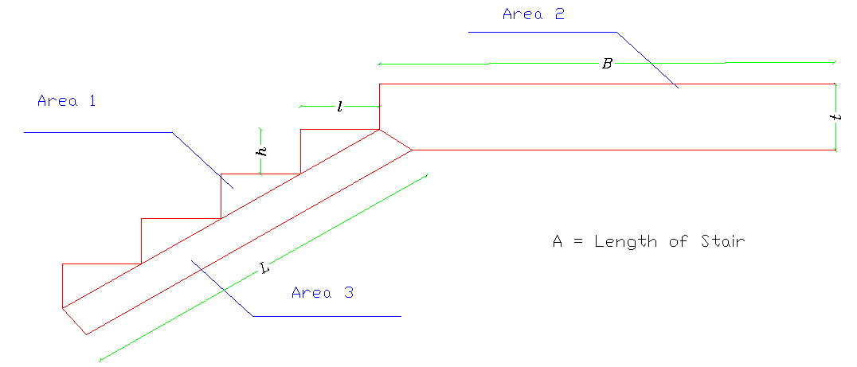
Tow-way Flat Plate
Stairs:
The stairs are divided into areas to calculate their volume, as shown in figure.

Slide 54
Tow-way Flat Plate
Stairs: Concrete & Formwork Volumes
Detailing’s For Stairs
Level | A | B | t | L | # Stairs | l | h | Triangles Area | Concrete Volume Vc (m³) | Formwork Volume Vw(m³)
00-0.78 | 1.3 | 1.13 | 0.3 | 1.379 | 4 | 0.3 | 0.17 | 0.102 | 0.805 | 0.192
0.78-2.47 | 1.3 | 1.13 | 0.2 | 3.448 | 10 | 0.3 | 0.17 | 0.255 | 1.314 | 0.342
2.47-4.16 | 1.3 | 1.13 | 0.3 | 3.448 | 10 | 0.3 | 0.17 | 0.255 | 1.461 | 0.351
4.16-5.85 | 1.3 | 1.13 | 0.2 | 3.448 | 10 | 0.3 | 0.17 | 0.255 | 1.314 | 0.342
5.85-7.54 | 1.3 | 1.13 | 0.3 | 3.448 | 10 | 0.3 | 0.17 | 0.255 | 1.461 | 0.351
Total |  |  |  |  |  |  |  |  | 6.354 | 1.577

Slide 55
Tow-way Flat Plate
Stairs: Longitudinal Reinforcement
Longitudinal Reinforcement For stairs
Level | φ | ΣL | Linear Density | W(ton)
00-0.78 | 12 | 37.52440406 | 0.000888889 | 0.033355026
 | 14 | 26.73440406 | 0.001209877 | 0.032345328
0.78-2.47 | 12 | 58.56151016 | 0.000888889 | 0.052054676
 | 14 | 45.56151016 | 0.001209877 | 0.055123802
2.47-4.16 | 12 | 58.56151016 | 0.000888889 | 0.052054676
 | 14 | 45.56151016 | 0.001209877 | 0.055123802
4.16-5.85 | 12 | 58.56151016 | 0.000888889 | 0.052054676
 | 14 | 45.56151016 | 0.001209877 | 0.055123802
5.85-7.54 | 12 | 58.56151016 | 0.000888889 | 0.052054676
 | 14 | 45.56151016 | 0.001209877 | 0.055123802
Total |  |  |  | 0.439290464

Slide 56
Tow-way Flat Plate
Plastering & Painting
Assumptions:
Plaster thickness is 2 cm.
Paint thickness is 0.6 cm.
Results:
Area of Plastering For Walls = 1123.48 m²
Area of Plastering For Floors = 304.5 m²
Area of Painting For Walls = 1123.48 m²
Area of Painting For Floors = 304.5 m²

Slide 57
Tow-way Flat Plate
Tiles
Results:
→ For Ground Tiles:
Area of Ground Tile = 274.02 m²
Total area of bathroom tiles = 194.68 m²
For Skirting Tiles (Panel):
Area of ground tile = 251.34 m
→ Total Filling Volume = 30.45 m³
→ Total Mortar Volume = 5.496 m³

Slide 58
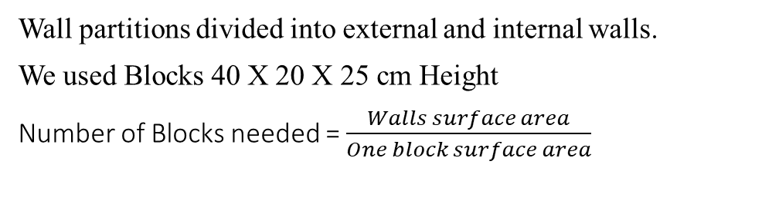
Tow-way Flat Plate
Wall Partitions
Wall partitions divided into external and internal walls.
We used Blocks 40 X 20 X 25 cm Height
Number of Blocks needed = $\frac{Walls surface area}{One block surface area}$
Results:
Area for external partitions = 437.24 m²
Area for internal partitions = 35 m²
Area for Parapet Partitions = 65 m²
Total no. of boxes of block 10 needed | 23
Total no. of boxes of block 20 needed | 89
Total volume of mortar needed (CM) | 5.80

Slide 59
Tow-way Flat Plate
Natural Stone
Natural stone used as a cover for the villa, we used natural stone with 4 cm thickness
Area Of Stone | Area Of Opening | Total Area(m²)
119.7 | 36.67 | 83.03
120 | 13 | 107
126.98 | 14 | 112.98
126.98 | 29.28 | 97.7
39 | 2.47 | 36.53
Total |  | 437.24
From the factory, factor of area = 1.5
Total Area of natural stone needed = 437.24 * 1.5 = 655.86 m²

Slide 60
Tow-way Flat Plate
Doors & Windows
Material Type | Shape | Height | Width | No. | Surface area (m²)
Aluminum | Flat | 130 | 160 | 14 | 29.12
Aluminum | Flat | 104 | 160 | 2 | 3.328
Aluminum | Flat | 130 | 120 | 2 | 3.12
Aluminum | Flat | 78 | 60 | 8 | 3.744
Aluminum | Slider | 234 | 168 | 4 | 15.7248
Aluminum | Slider | 624 | 104 | 2 | 12.9792

Slide 61
Tow-way Flat Plate
Waste Factors
The physical waste includes loss of materials and damages while cost and time overrun refers to non-physical waste. In building material, waste can be described as the difference between total quantity of material brought on site and actual quantity used.
So, according to be conservative in calculating quantities the contractor QS should take in considerations materials that will be lost during construction process by multiply each material quantity to its waste factor.
Waste factors different for contractor to other according to the historical database.

Slide 62
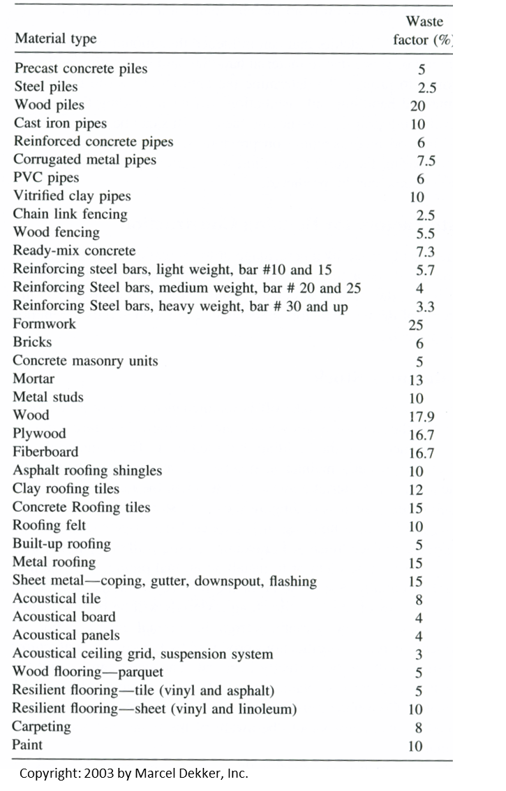
Tow-way Flat Plate
Waste Factors
The waste factors used in this project:

Slide 63
Tow-way Flat Plate
Summery Quantities
Structural Elements | Material | Waste Factor | Calculated Value | Total Value
Footings | Con. B300 | 7.30% | 20.187 | 21.66
 | Con. B150 | 7.30% | 7 | 7.51
 | Wood | 25% | 1.386 | 1.73
 | Steel | 5.70% | 0.7856 | 0.83
Column Necks | Con. B300 | 7.30% | 2.127 | 2.28
 | Wood | 25% | 0.8055 | 1.01
 | Steel | 5.70% | 0.552888889 | 0.58
Tie Beams | Con. B300 | 7.30% | 13.1 | 14.06
 | Con. B150 | 7.30% | 3.93 | 4.22
 | Wood | 25% | 3.93 | 4.91
 | Steel | 5.70% | 1.215950617 | 1.29
Ground Slab | Con. B300 | 7.30% | 18.25 | 19.58
 | Wood | 25% | 0.1625 | 0.20
 | Steel | 5.70% | 0.663308642 | 0.70

Slide 64
Tow-way Flat Plate
Summery Quantities
Structural Elements | Material | Waste Factor | Calculated Value | Total Value
columns (0.78 - 4.16 ) | Con. B300 | 7.30% | 6.3544 | 6.82
 | Wood | 25% | 2.4702 | 3.09
 | Steel | 5.70% | 1.114246914 | 1.18
columns ( 4.16-7.54) | Con. B300 | 7.30% | 6.3544 | 6.82
 | Wood | 25% | 2.4702 | 3.09
 | Steel | 5.70% | 1.114246914 | 1.18
columns (7.54-9.97) | Con. B300 | 7.30% | 0.729 | 0.78
 | Wood | 25% | 0.30245 | 0.38
 | Steel | 5.70% | 0.113160494 | 0.12
Floors Slab | Con. B300 | 7.30% | 75.86 | 81.40
 | Wood | 25% | 16.555 | 20.69
 | Steel | 5.70% | 6.596622222 | 6.97
Frames | Steel | 5.70% | 2.308696296 | 2.44

Slide 65
Tow-way Flat Plate
Summery Quantities
Structural Elements | Material | Waste Factor | Calculated Value | Total Value
Stairs | Con. B300 | 7.30% | 6.354067943 | 6.82
 | Wood | 25% | 1.577140874 | 1.97
 | Steel | 5.70% | 0.439290464 | 0.46
Sloping Screed | Con. B150 | 7.30% | 5.046 | 5.41
plastering Floors | mortar | 13% | 1427.4 | 1612.96
painting Floors (Ceiling) | - | 10% | 304.5 | 334.95
Walls |  | 10% | 1124.545455 | 1237.00
Tiles | Ground | 6% | 274.02 | 290.46
 | Wall | 6% | 194.68 | 206.36
 | Skriting | 6% | 17.92 | 19.00
 | mortar | 13% | 456.64 | 516.00
 | Filling |  | 340

Slide 66
Tow-way Flat Plate
Summery Quantities
Structural Elements | Material | Waste Factor | Calculated Value | Total Value
Wall Partitions | External (20) | 5.60% | 4712 | 4975.87
 | Internal (20) | 5.60% | 346 | 365.38
 | Internal (10) | 5.60% | 2696 | 2846.98
 | mortar | 13% | 5.1784 | 5.85
Concrete over Parapet | Con. B300 | 7% | 0.52 | 0.56
Beams | Con. B300 | 7% | 6.26 | 6.72
 | Wood | 25% | 1.83 | 2.29
 | Steel | 6% | 0.615111111 | 0.65
Natural Stone | Stone | 5.70% | 655.86 | 693.24
Concrete Between Stone and Block | Con. B300 | 7% | 17.4896 | 18.77

Slide 67
Tow-way Flat Plate
Summery Costs
Name | Cost | Unit Cost | Unit
Excavation for Footing | 4442.8 | 13.48 | $/CM
Footing | 3697.45 | 170.7 | $/CM
Column Neck | 989.22 | 433.87 | $/CM
Tie Beams | 3583.27 | 254.86 | $/CM
Ground Slab | 2420.1 | 123.6 | $/CM
Columns | 5248.16 | 363.95 | $/CM
Floors Slab | 18680.43 | 49.25 | $/SM
Frames | 2035.2 | 834.1 | $/Ton
Stairs | 1137.61 | 166.8 | $/CM
Sloping Screed | 465.64 | 86.07 | $/CM
Plastering Floors | 9677.78 | 6 | $/SM
Painting Floors | 4808.71 | 3.06 | $/SM

Slide 68
Tow-way Flat Plate
Summery Costs
Name | Cost | Unit Cost | Unit
Tiles | 12310.86 | 23.87 | $/SM
Blocks | 10054.07 | 88.97 | $/Box
Stone | 38599.8 | 55.68 | $/SM
Beam | 2581.18 | 384.1 | $/CM
Doors | 5322.36 | 134.17 | $/SM
Windows | 5441.6 | 80 | $/SM
Staircase Rail | 606.8 | 40 | $/SM
Staircase Tile | 1021.44 | 38 | $/SM
Window stone | 2057.6 | 40 | $/SM
Granite Stone | 800 | 100 | $/SM
Total Direct Cost | 135982.07

Slide 69
Tow-way Flat Plate
BOQ
Bill of Quantity
Item | Description | Quantity |  | Unit Price |  | Total Price $
 |  | Value | Unit | Value | Unit
1 | Excavation for Footing | 329.70 | CM | 16.04 | $/CM | 5288.78
2 | Footing | 21.66 | CM | 203.13 | $/CM | 4399.86
3 | Column Neck | 2.28 | CM | 516.31 | $/CM | 1177.18
4 | Tie Beams | 14.06 | CM | 303.28 | $/CM | 4264.16
5 | Ground Slab | 19.58 | CM | 147.08 | $/CM | 2879.90
6 | Columns | 14.42 | CM | 433.10 | $/CM | 6245.31
7 | Floors Slab | 379.30 | SM | 58.61 | $/SM | 22229.82
8 | Frames | 2.44 | Ton | 992.58 | $/Ton | 2421.89
9 | Stairs | 6.82 | CM | 198.49 | $/CM | 1353.72
10 | Sloping Screed | 5.41 | CM | 102.42 | $/CM | 554.11
11 | Plastering Floors | 1612.96 | SM | 7.14 | $/SM | 11516.53
Assumptions:
%JO = 10%
%OO = 3%
%P = 5%

Slide 70
Tow-way Flat Plate
BOQ
Bill of Quantity
Item | Description | Quantity |  | Unit Price |  | Total Price $
 |  | Value | Unit | Value | Unit
12 | Paintening Floors | 1571.95 | SM | 3.64 | $/SM | 5724.10
13 | Tiles | 515.82 | SM | 28.41 | $/SM | 14652.02
14 | Blocks | 113.00 | Box | 105.87 | $/Box | 11963.80
15 | Stone | 693.24 | SM | 66.26 | $/SM | 45933.53
16 | Beam | 6.72 | CM | 457.08 | $/CM | 3071.57
17 | Doors | 41.75 | SM | 159.66 | $/SM | 6665.90
18 | Windows | 68.02 | SM | 95.20 | $/SM | 6475.50
19 | Staircase rail | 15.17 | SM | 47.60 | $/SM | 722.09
20 | Staircase Tile | 26.88 | SM | 45.22 | $/SM | 1215.51
21 | Window Stone | 51.44 | SM | 47.60 | $/SM | 2448.54
22 | Granite Stone | 8.00 | SM | 119.00 | $/SM | 952.00
Total Bid Price |  |  |  |  |  | 162155.82

Slide 71
Two-way Solid Slab
Summery Quantities
Structural Elements | Material | Waste Factor | Calculated Value | Total Value
Footings | Con. B300 | 7.30% | 19.714 | 21.15
 | Con. B150 | 7.30% | 6.901 | 7.40
 | Wood | 25% | 1.376 | 1.72
 | Steel | 5.70% | 0.7824 | 0.83
Column Necks | Con. B300 | 7.30% | 1.933 | 2.07
 | Wood | 25% | 0.759 | 0.95
 | Steel | 5.70% | 0.483377778 | 0.51
Tie Beams | Con. B300 | 7.30% | 13.1 | 14.06
 | Con. B150 | 7.30% | 3.93 | 4.22
 | Wood | 25% | 3.93 | 4.91
 | Steel | 5.70% | 1.215950617 | 1.29
Ground Slab | Con. B300 | 7.30% | 18.25 | 19.58
 | Wood | 25% | 0.1625 | 0.20
 | Steel | 5.70% | 0.663308642 | 0.70

Slide 72
Two-way Solid Slab
Summery Quantities
Structural Elements | Material | Waste Factor | Calculated Value | Total Value
columns (0.78 - 4.16 ) | Con. B300 | 7.30% | 5.746 | 6.17
 | Wood | 25% | 2.3091 | 2.89
 | Steel | 5.70% | 0.976022222 | 1.03
columns ( 4.16-7.54) | Con. B300 | 7.30% | 5.746 | 6.17
 | Wood | 25% | 2.3091 | 2.89
 | Steel | 5.70% | 0.976022222 | 1.03
columns (7.54-9.97) | Con. B300 | 7.30% | 0.729 | 0.78
 | Wood | 25% | 0.30245 | 0.38
 | Steel | 5.70% | 0.113160494 | 0.12
Floors Slab | Con. B300 | 7.30% | 56.895 | 61.05
 | Wood | 25% | 16.555 | 20.69
 | Steel | 5.70% | 5.873422222 | 6.21

Slide 73
Two-way Solid Slab
Summery Quantities
Structural Elements | Material | Waste Factor | Calculated Value | Total Value
Stairs | Con. B300 | 7.30% | 6.354067943 | 6.82
 | Wood | 25% | 1.577140874 | 1.97
 | Steel | 5.70% | 0.439290464 | 0.46
Sloping Screed | Con. B150 | 7.30% | 5.046 | 5.41
plastering Floors | mortar | 13% | 1427.4 | 1612.96
painting Floors (Ceiling) | - | 10% | 304.5 | 334.95
Walls |  | 10% | 1124.545455 | 1237.00
Tiles | Ground | 6% | 274.02 | 290.46
 | Wall | 6% | 194.68 | 206.36
 | Skriting | 6% | 17.92 | 19.00
 | mortar | 13% | 456.64 | 516.00
 | Filling |  | 340
Stairs | Con. B300 | 7.30% | 6.354067943 | 6.82

Slide 74
Two-way Solid Slab
Summery Quantities
Structural Elements | Material | Waste Factor | Calculated Value | Total Value
Frames (Drop) | B300 | 7.30% | 13.1 | 14.06
 | Wood | 25.00% | 2.91 | 3.64
 | Steel | 5.70% | 3.436641975 | 3.63
Wall Partitions | External (20) | 5.60% | 4712 | 4975.87
 | Internal (20) | 5.60% | 346 | 365.38
 | Internal (10) | 5.60% | 2696 | 2846.98
 | mortar | 13% | 5.1784 | 5.85
Concrete over Parapet | Con. B300 | 7% | 0.52 | 0.56
Beams | Con. B300 | 7% | 6.26 | 6.72
 | Wood | 25% | 1.83 | 2.29
 | Steel | 6% | 0.615111111 | 0.65
Natural Stone | Stone | 5.70% | 655.86 | 693.24
Concrete Between Stone and Block | Con. B300 | 7% | 17.4896 | 18.77

Slide 75
Two-way Solid Slab
Summery Costs
Name | Cost | Unit Cost | Unit
Name | Cost | Unit Cost | Unit
Excavation for Footing | 4384.11 | 13.42 | $/CM
Footing | 3632.040951 | 171.7 | $/CM
Column Neck | 884.5349805 | 426.47 | $/CM
Tie Beams | 3583.27 | 254.86 | $/CM
Ground Slab | 2420.1 | 123.6 | $/CM
Columns | 4729.495643 | 360.67 | $/CM
Floors Slab | 27231.24669 | 71.79 | $/SM
Frames | 4235.759407 | 1232.53 | $/Ton
Stairs | 1137.61 | 166.8 | $/CM
Sloping Screed | 465.64 | 86.07 | $/CM
Plastering Floors | 9677.78 | 6 | $/SM

Slide 76
Two-way Solid Slab
Summery Costs
Name | Cost | Unit Cost | Unit
Tiles | 12310.86 | 23.87 | $/SM
Blocks | 10054.07 | 88.97 | $/Box
Stone | 38599.8 | 55.68 | $/SM
Beam | 2581.18 | 384.1 | $/CM
Doors | 5322.36 | 134.17 | $/SM
Windows | 5441.6 | 80 | $/SM
Staircase rail | 606.8 | 40 | $/SM
Staircase Tile | 1021.44 | 38 | $/SM
Window Stone | 2057.6 | 40 | $/SM
Granite Stone | 800 | 100 | $/SM
Total Direct Cost | 145986.0077

Slide 77
Two-way Solid Slab
Bill of Quantity
Item | Description | Quantity |  | Unit Price |  | Total Price $
 |  | Value | Unit | Value | Unit
1 | Excavation for Footing | 326.63 | CM | 15.97 | $/CM | 5216.26
2 | Footing | 21.15 | CM | 204.32 | $/CM | 4322.07
3 | Column Neck | 2.07 | CM | 507.50 | $/CM | 1052.61
4 | Tie Beams | 14.06 | CM | 303.28 | $/CM | 4264.16
5 | Ground Slab | 19.58 | CM | 147.08 | $/CM | 2879.90
6 | Columns | 13.11 | CM | 429.20 | $/CM | 5628.12
7 | Floors Slab | 379.30 | SM | 85.43 | $/SM | 32403.64
8 | Frames | 3.44 | Ton | 1466.71 | $/Ton | 5040.56
9 | Stairs | 6.82 | CM | 198.49 | $/CM | 1353.72
10 | Sloping Screed | 5.41 | CM | 102.42 | $/CM | 554.11
11 | Plastering Floors | 1612.96 | SM | 7.14 | $/SM | 11516.53
BOQ

Slide 78
Two-way Solid Slab
BOQ
Bill of Quantity
Item | Description | Quantity |  | Unit Price |  | Total Price $
 |  | Value | Unit | Value | Unit
12 | Painting Floors | 1571.95 | SM | 3.64 | $/SM | 5724.10
13 | Tiles | 515.82 | SM | 28.41 | $/SM | 14652.02
14 | Blocks | 113.00 | Box | 105.87 | $/Box | 11963.80
15 | Stone | 693.24 | SM | 66.26 | $/SM | 45933.53
16 | Beam | 6.72 | CM | 457.08 | $/CM | 3071.57
17 | Doors | 41.75 | SM | 159.66 | $/SM | 6665.90
18 | Windows | 68.02 | SM | 95.20 | $/SM | 6475.50
19 | Staircase rail | 15.17 | SM | 47.60 | $/SM | 722.09
20 | Staircase Tile | 26.88 | SM | 45.22 | $/SM | 1215.51
21 | Window Stone | 51.44 | SM | 47.60 | $/SM | 2448.54
22 | Granite Stone | 8.00 | SM | 119.00 | $/SM | 952.00
Total Bid Price |  |  |  |  |  | 174056.25

Slide 79
Two-way Ribbed Slab (Waffle)
Summery Quantities
Structural Elements | Material | Waste Factor | Calculated Value | Total Value
Footings | Con. B300 | 7.30% | 16.8705 | 18.10
 | Con. B150 | 7.30% | 6.151 | 6.60
 | Wood | 25% | 1.221 | 1.53
 | Steel | 5.70% | 0.7096 | 0.75
Column Necks | Con. B300 | 7.30% | 1.916 | 2.06
 | Wood | 25% | 0.79075 | 0.99
 | Steel | 5.70% | 0.40 | 0.42
Tie Beams | Con. B300 | 7.30% | 13.1 | 14.06
 | Con. B150 | 7.30% | 3.93 | 4.22
 | Wood | 25% | 3.93 | 4.91
 | Steel | 5.70% | 1.215950617 | 1.29
Ground Slab | Con. B300 | 7.30% | 18.25 | 19.58
 | Wood | 25% | 0.1625 | 0.20
 | Steel | 5.70% | 0.663308642 | 0.70

Slide 80
Two-way Ribbed Slab (Waffle)
Summery Quantities
Structural Elements | Material | Waste Factor | Calculated Value | Total Value
columns (0.78 - 4.16) | Con. B300 | 7.30% | 5.6446 | 6.06
 | Wood | 25% | 2.2477 | 2.81
 | Steel | 5.70% | 1.036748148 | 1.10
columns (4.16-7.54) | Con. B300 | 7.30% | 5.6446 | 6.06
 | Wood | 25% | 2.2477 | 2.81
 | Steel | 5.70% | 0.981190123 | 1.04
columns (7.54-9.97) | Con. B300 | 7.30% | 0.6318 | 0.68
 | Wood | 25% | 0.2673 | 0.33
 | Steel | 5.70% | 0.104439506 | 0.11
Floors Slab | Con. B300 | 7.30% | 65.7854 | 70.59
 | Wood | 25% | 16.555 | 20.69
 | Steel | 5.70% | 6.744 | 7.13
 | Blocks | 5.00% | 2129.75 | 2236.24
Frames | Steel | 5.70% | 4.461520988 | 4.72

Slide 81
Two-way Ribbed Slab (Waffle)
Summery Quantities
Structural Elements | Material | Waste Factor | Calculated Value | Total Value
Stairs | Con. B300 | 7.30% | 6.354067943 | 6.82
 | Wood | 25% | 1.577140874 | 1.97
 | Steel | 5.70% | 0.439290464 | 0.46
Sloping Screed | Con. B150 | 7.30% | 5.046 | 5.41
plastering Floors | mortar | 13% | 1427.4 | 1612.96
painting Floors (Ceiling) | - | 10% | 304.5 | 334.95
Walls |  | 10% | 1124.545455 | 1237.00
Tiles | Ground | 6% | 274.02 | 290.46
 | Wall | 6% | 194.68 | 206.36
 | Skriting | 6% | 17.92 | 19.00
 | mortar | 13% | 456.64 | 516.00
 | Filling |  | 340

Slide 82
Two-way Ribbed Slab (Waffle)
Summery Quantities
Structural Elements | Material | Waste Factor | Calculated Value | Total Value
Wall Partitions | External (20) | 5.60% | 4712 | 4975.87
 | Internal (20) | 5.60% | 346 | 365.38
 | Internal (10) | 5.60% | 2696 | 2846.98
 | mortar | 13% | 5.1784 | 5.85
Concrete over Parapet | Con. B300 | 7% | 0.52 | 0.56
Beams | Con. B300 | 7% | 6.26 | 6.72
 | Wood | 25% | 1.83 | 2.29
 | Steel | 6% | 0.615111111 | 0.65
Natural Stone | Stone | 5.70% | 655.86 | 693.24
Concrete Between Stone and Block | Con. B300 | 7% | 17.4896 | 18.77

Slide 83
Two-way Ribbed Slab (Waffle)
Summery Costs
Name | Cost | Unit Cost | Unit
Excavation for Footing | 4192.897514 | 13.91 | $/CM
Footing | 3169.391633 | 175.0847139 | $/CM
Column Neck | 810.0514413 | 394.0191886 | $/CM
Tie Beams | 3587.78 | 255.18 | $/CM
Ground Slab | 2418.74 | 123.53 | $/CM
Columns | 4705.235948 | 367.848506 | $/CM
Floors Slab | 22857.96312 | 60.26354631 | $/SM
Frames | 3933.000288 | 834 | $/Ton
Stairs | 1137.61 | 166.8 | $/CM
Sloping Screed | 465.64 | 86.07 | $/CM
Plastering Floors | 9677.78 | 6 | $/SM

Slide 84
Two-way Ribbed Slab (Waffle)
Summery Costs
Name | Cost | Unit Cost | Unit
Tiles | 12310.86 | 23.87 | $/SM
Blocks | 10054.07 | 88.97 | $/Box
Stone | 38599.8 | 55.68 | $/SM
Beam | 2581.18 | 384.1 | $/CM
Doors | 5322.36 | 134.17 | $/SM
Windows | 5441.6 | 80 | $/SM
Staircase rail | 606.8 | 40 | $/SM
Staircase Tile | 1021.44 | 38 | $/SM
Window Stone | 2057.6 | 40 | $/SM
Granite Stone | 800 | 100 | $/SM
Total Direct Cost | 140560.51

Slide 85
Two-way Ribbed Slab (Waffle)
Bill of Quantity
Item | Description | Quantity |  | Unit Price |  | Total Price $
 |  | Value | Unit | Value | Unit
1 | Excavation for Footing | 301.48 | CM | 16.55 | $/CM | 4989.55
2 | Footing | 18.10 | CM | 208.35 | $/CM | 3771.58
3 | Column Neck | 2.06 | CM | 468.88 | $/CM | 963.96
4 | Tie Beams | 14.06 | CM | 303.66 | $/CM | 4268.40
5 | Ground Slab | 19.58 | CM | 147.08 | $/CM | 2879.90
6 | Columns | 12.79 | CM | 437.74 | $/CM | 5599.23
7 | Floors Slab | 379.30 | SM | 71.71 | $/SM | 27200.98
8 | Frames | 4.72 | Ton | 992.46 | $/Ton | 4680.27
9 | Stairs | 6.82 | CM | 198.49 | $/CM | 1353.72
10 | Sloping Screed | 5.41 | CM | 102.42 | $/CM | 554.11
11 | Plastering Floors | 1612.96 | SM | 7.14 | $/SM | 11516.53
BOQ

Slide 86
Two-way Ribbed Slab (Waffle)
BOQ
Bill of Quantity
Item | Description | Quantity |  | Unit Price |  | Total Price $
 |  | Value | Unit | Value | Unit
12 | Painting Floors | 1571.95 | SM | 3.64 | $/SM | 5724.10
13 | Tiles | 515.82 | SM | 28.41 | $/SM | 14652.02
14 | Blocks | 113.00 | Box | 105.87 | $/Box | 11963.80
15 | Stone | 693.24 | SM | 66.26 | $/SM | 45933.53
16 | Beam | 6.72 | CM | 457.08 | $/CM | 3071.57
17 | Doors | 41.75 | SM | 159.66 | $/SM | 6665.90
18 | Windows | 68.02 | SM | 95.20 | $/SM | 6475.50
19 | Staircase rail | 15.17 | SM | 47.60 | $/SM | 722.09
20 | Staircase Tile | 26.88 | SM | 45.22 | $/SM | 1215.51
21 | Window Stone | 51.44 | SM | 47.60 | $/SM | 2448.54
22 | Granite Stone | 8.00 | SM | 119.00 | $/SM | 952.00
Total Bid Price |  |  |  |  |  | 167602.79

Slide 87
One-way Ribbed Slab
Summery Quantities
Structural Elements | Material | Waste Factor | Calculated Value | Total Value
Footings | Con. B300 | 7.30% | 18.67 | 20.04
 | Con. B150 | 7.30% | 6.538 | 7.02
 | Wood | 25% | 1.334 | 1.67
 | Steel | 5.70% | 0.762 | 0.81
Column Necks | Con. B300 | 7.30% | 1.962 | 2.11
 | Wood | 25% | 0.76425 | 0.96
 | Steel | 5.70% | 0.528 | 0.56
Tie Beams | Con. B300 | 7.30% | 13.1 | 14.06
 | Con. B150 | 7.30% | 3.93 | 4.22
 | Wood | 25% | 3.93 | 4.91
 | Steel | 5.70% | 1.215950617 | 1.29
Ground Slab | Con. B300 | 7.30% | 18.25 | 19.58
 | Wood | 25% | 0.1625 | 0.20
 | Steel | 5.70% | 0.663308642 | 0.70

Slide 88
One-way Ribbed Slab
Summery Quantities
Structural Elements | Material | Waste Factor | Calculated Value | Total Value
columns (0.78 - 4.16 ) | Con. B300 | 7.30% | 5.8474 | 6.27
 | Wood | 25% | 2.336 | 2.92
 | Steel | 5.70% | 0.9936 | 1.05
columns ( 4.16-7.54) | Con. B300 | 7.30% | 5.8474 | 6.27
 | Wood | 25% | 2.336 | 2.92
 | Steel | 5.70% | 0.9936 | 1.05
columns (7.54-9.97) | Con. B300 | 7.30% | 0.7047 | 0.76
 | Wood | 25% | 0.289875 | 0.36
 | Steel | 5.70% | 0.116 | 0.12
Floors Slab | Con. B300 | 7.30% | 79 | 84.77
 | Wood | 25% | 16.555 | 20.69
 | Steel | 5.70% | 6.078410746 | 6.42
 | Blocks | 5.00% | 1832 | 1923.60
Frames | Steel | 5.70% | 4.7577 | 5.03

Slide 89
One-way Ribbed Slab
Summery Quantities
Structural Elements | Material | Waste Factor | Calculated Value | Total Value
Stairs | Con. B300 | 7.30% | 6.354067943 | 6.82
 | Wood | 25% | 1.577140874 | 1.97
 | Steel | 5.70% | 0.439290464 | 0.46
Sloping Screed | Con. B150 | 7.30% | 5.046 | 5.41
plastering Floors | mortar | 13% | 1427.4 | 1612.96
painting Floors (Ceiling) | - | 10% | 304.5 | 334.95
Walls |  | 10% | 1124.545455 | 1237.00
Tiles | Ground | 6% | 274.02 | 290.46
 | Wall | 6% | 194.68 | 206.36
 | Skriting | 6% | 17.92 | 19.00
 | mortar | 13% | 456.64 | 516.00
 | Filling |  | 340

Slide 90
One-way Ribbed Slab
Summery Quantities
Structural Elements | Material | Waste Factor | Calculated Value | Total Value
Wall Partitions | External (20) | 5.60% | 4712 | 4975.87
 | Internal (20) | 5.60% | 346 | 365.38
 | Internal (10) | 5.60% | 2696 | 2846.98
 | mortar | 13% | 5.1784 | 5.85
Concrete over Parapet | Con. B300 | 7% | 0.52 | 0.56
Beams | Con. B300 | 7% | 6.26 | 6.72
 | Wood | 25% | 1.83 | 2.29
 | Steel | 6% | 0.615111111 | 0.65
Natural Stone | Stone | 5.70% | 655.86 | 693.24
Concrete Between Stone and Block | Con. B300 | 7% | 17.4896 | 18.77

Slide 91
One-way Ribbed Slab
Summery Costs
Name | Cost | Unit Cost | Unit
Excavation for Footing | 4311.3 | 13.7 | $/CM
Footing | 3461.665298 | 172.76 | $/CM
Column Neck | 930.4206102 | 441.96 | $/CM
Tie Beams | 3583.27 | 254.86 | $/CM
Ground Slab | 2420.1 | 123.6 | $/CM
Columns | 4802.830968 | 360.99 | $/CM
Floors Slab | 22779.01305 | 60.06 | $/SM
Frames | 4194.106185 | 834 | $/Ton
Stairs | 1137.61 | 166.8 | $/CM
Sloping Screed | 465.64 | 86.07 | $/CM
Plastering Floors | 9677.78 | 6 | $/SM
Painting Floors | 4808.71 | 3.06 | $/SM

Slide 92
One-way Ribbed Slab
Summery Costs
Name | Cost | Unit Cost | Unit
Tiles | 12310.86 | 23.87 | $/SM
Blocks | 10054.07 | 88.97 | $/Box
Stone | 38599.8 | 55.68 | $/SM
Beam | 2581.18 | 384.1 | $/CM
Doors | 5322.36 | 134.17 | $/SM
Windows | 5441.6 | 80 | $/SM
Staircase rail | 606.8 | 40 | $/SM
Staircase Tile | 1021.44 | 38 | $/SM
Window Stone | 2057.6 | 40 | $/SM
Granite Stone | 800 | 100 | $/SM
Total Direct Cost | 141368.1561

Slide 93
One-way Ribbed Slab
BOQ
Bill of Quantity
Item | Description | Quantity |  | Unit Price |  | Total Price $
 |  | Value | Unit | Value | Unit
1 | Excavation for Footing | 314.70 | CM | 16.30 | $/CM | 5130.45
2 | Footing | 20.04 | CM | 205.58 | $/CM | 4119.39
3 | Column Neck | 2.11 | CM | 525.93 | $/CM | 1107.21
4 | Tie Beams | 14.06 | CM | 303.28 | $/CM | 4264.16
5 | Ground Slab | 19.58 | CM | 147.08 | $/CM | 2879.90
6 | Columns | 13.30 | CM | 429.58 | $/CM | 5715.39
7 | Floors Slab | 379.30 | SM | 71.47 | $/SM | 27109.10
8 | Frames | 5.03 | Ton | 992.46 | $/Ton | 4990.99
9 | Stairs | 6.82 | CM | 198.49 | $/CM | 1353.72
10 | Slooping Screed | 5.41 | CM | 102.42 | $/CM | 554.11
11 | Plastering Floors | 1612.96 | SM | 7.14 | $/SM | 11516.53

Slide 94
One-way Ribbed Slab
BOQ
Bill of Quantity
Item | Description | Quantity |  | Unit Price |  | Total Price $
 |  | Value | Unit | Value | Unit
12 | Paintening Floors | 1571.95 | SM | 3.64 | $/SM | 5724.10
13 | Tiles | 515.82 | SM | 28.41 | $/SM | 14652.02
14 | Blocks | 113.00 | Box | 105.87 | $/Box | 11963.80
15 | Stone | 693.24 | SM | 66.26 | $/SM | 45933.53
16 | Beam | 6.72 | CM | 457.08 | $/CM | 3071.57
17 | Doors | 41.75 | SM | 159.66 | $/SM | 6665.90
18 | Windows | 68.02 | SM | 95.20 | $/SM | 6475.50
19 | Staircase rail | 15.17 | SM | 47.60 | $/SM | 722.09
20 | Staircase Tile | 26.88 | SM | 45.22 | $/SM | 1215.51
21 | Window Stone | 51.44 | SM | 47.60 | $/SM | 2448.54
22 | Granite Stone | 8.00 | SM | 119.00 | $/SM | 952.00
Total Bid Price |  |  |  |  |  | 168565.52

Slide 95
Conclusion
We will do comparison between all slab systems in Quantities and costs.
Quantities Comparison
Footings
Footings
Item description | Solid Sab system | Flat Plate system | Two-way Ribbed Slab system (Waffle) | One-way Ribbed slab system
Volume of Excavation (m³) | 326.63 | 329.70 | 301.48 | 314.70
Total Concrete Volume (m³) | 28.56 | 29.17 | 24.70 | 27.05
Volume of framework (m³) | 1.72 | 1.73 | 1.53 | 1.67
Reinforcing (tones) | 0.83 | 0.83 | 0.75 | 0.81
Flat Plat System have the largest quantities of concrete and steel with small differences.

Slide 96
Conclusion
Quantities Comparison
Column Necks
Column Neck
Item description | Solid Sab system | Flat Plate system | Two-way Ribbed Slab system (Waffle) | One-way Ribbed slab system
Total Concrete Volume (m³) | 2.07 | 2.28 | 2.06 | 2.11
Volume of framework (m³) | 0.95 | 1.01 | 0.99 | 0.96
Reinforcing (tones) | 0.51 | 0.58 | 0.42 | 0.56
Flat Plat System have the largest quantities of concrete and steel with small differences.

Slide 97
Conclusion
Quantities Comparison
Columns
Column
Item description | Solid Sab system | Flat Plate system | Two-way Ribbed Slab system (Waffle) | One-way Ribbed slab system
Total Concrete Volume (m³) | 13.11 | 14.42 | 12.79 | 13.30
Volume of framework (m³) | 6.15 | 6.55 | 5.95 | 6.20
Reinforcing (tones) | 2.18 | 2.48 | 2.24 | 2.22
Flat Plat System have the largest quantities of concrete and steel with small differences.

Slide 98
Conclusion
Quantities Comparison
Floor Slabs
Floor Slabs
Item description | Solid Sab system | Flat Plate system | Two-way Ribbed Slab system (Waffle) | One-way Ribbed slab system
Total Concrete Volume (m³) | 61.05 | 81.40 | 70.59 | 84.77
Volume of framework (m³) | 20.69 | 20.69 | 20.69 | 20.69
Reinforcing (tones) | 6.21 | 6.97 | 7.13 | 6.42
No. of Blocks | 0 | 0 | 2236.24 | 1923.60
One-way Ribbed slab system has the largest quantity of concrete. On the other hand Two – Way Ribbed system has the largest quantity of steel.

Slide 99
Conclusion
Quantities Comparison
Frames
Frames
Item description | Solid Sab system | Flat Plate system | Two-way Ribbed Slab system (Waffle) | One-way Ribbed slab system
Total Concrete Volume (m³) | 14.06 | 0.00 | 0.00 | 0.00
Volume of framework (m³) | 3.64 | 0.00 | 0.00 | 0.00
Reinforcing (tones) | 3.63 | 2.44 | 4.72 | 5.03
Flat Plate system has the smallest quantities of steel and concrete in frames (Drop).

Slide 100
Conclusion
Price Comparison
We decide to compare between them according to 1 m² of slab since area of slab is constant for all
The nonstructural elements will be eliminated because they are the same for all systems, so we will calculate the price for each structural element per 1 m² of slab and finally the total price per 1 m² for each system:
For nonstructural elements, Total Price per 1 m² = 298.56 $

Slide 101
Conclusion
Slab Systems
Item Discription | Solid Slab system | Flat Plate system | Two-way Ribbed Slab system(Waffle) | One-way Ribbed slab system
Labor cost ($) | 41651 | 38396 | 41571 | 40303
Material cost ($) | 99952 | 93143.00 | 94797 | 96754
Equipment Cost ($) | 4384 | 4443.00 | 4193 | 4312
Total Direct Cost ($) | 145987 | 135982.00 | 140561 | 141369
% Labor | 28.53 | 28.24 | 29.58 | 28.51
% Equipment | 3 | 3.27 | 2.98 | 3.05
% Material | 68.47 | 68.49 | 67.44 | 68.44

Slide 102
Conclusion
Slab Systems
Item Description | Solid Sab system | Flat Plate system | Two-way Ribbed Slab system (Waffle) | One-way Ribbed slab system
Excavation for footings | 13.75 | 13.94 | 13.15 | 13.53
Footings | 11.39 | 11.60 | 9.94 | 10.86
Column Neck | 2.78 | 3.10 | 2.54 | 2.92
Tie Beams | 11.24 | 11.24 | 11.25 | 11.24
Ground Slab | 7.59 | 7.59 | 7.59 | 7.59
Columns | 14.84 | 16.47 | 14.76 | 15.07
Floors Slab | 85.43 | 58.61 | 71.71 | 71.47
Frames | 13.29 | 6.39 | 12.34 | 13.16
Total Price From Structural elements ($/m²) | 160.31 | 128.94 | 143.28 | 145.84
Total Price ($/m²) | 458.87 | 427.5 | 441.84 | 444.4
Price Comparison
After of all, we can notice that the least total price system is Flat Plate Slab with Total Price = 162450 $

Slide 103
The end
Thank You

