Slide 1
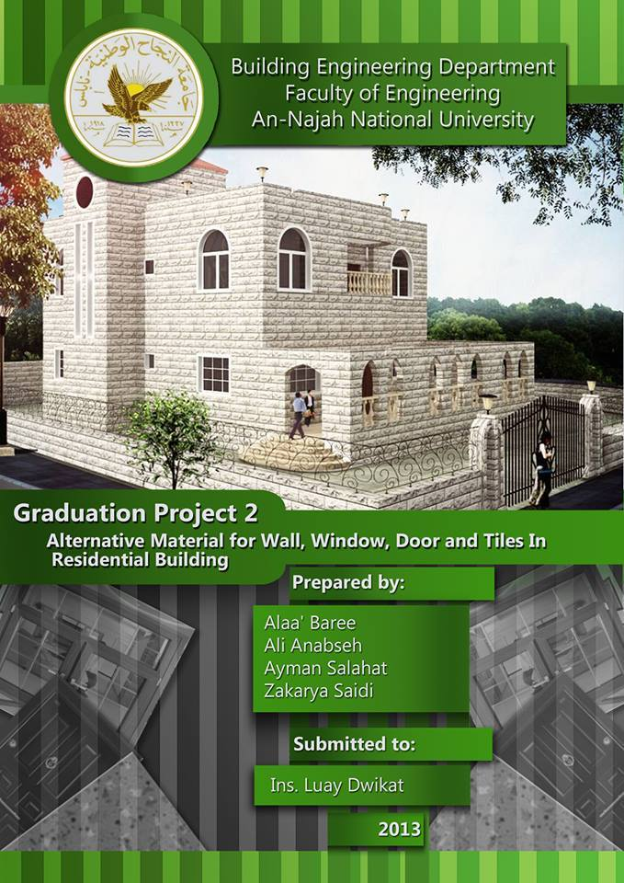

Slide 2
Outlines:-
Architectural Design Modifications.
  Environmental Design.
  Lighting and Mechanical Design.
  Structural Design
  Quantity compare

Slide 3
Objective:
The principal objectives of this project are to reduce the construction cost of residential buildings, through proposing material alternative for floor tiles, door, window and walls.

Slide 4
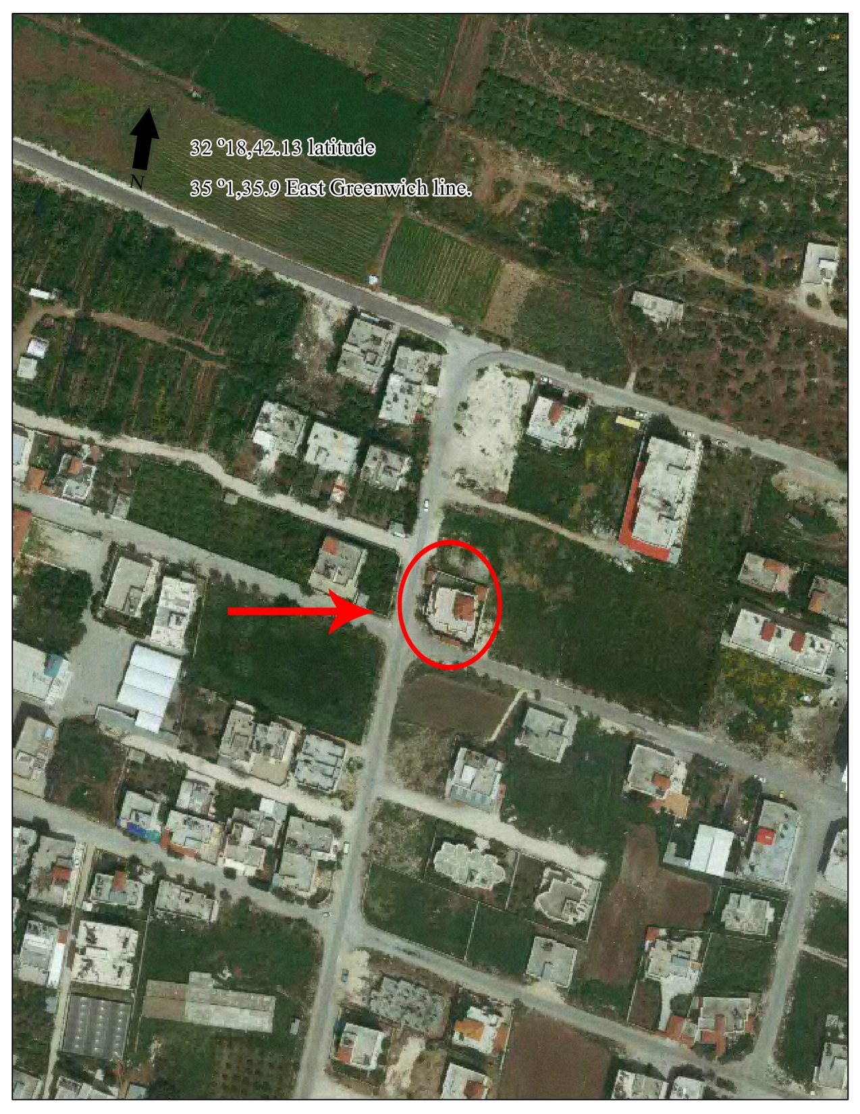
Objective:

Slide 5
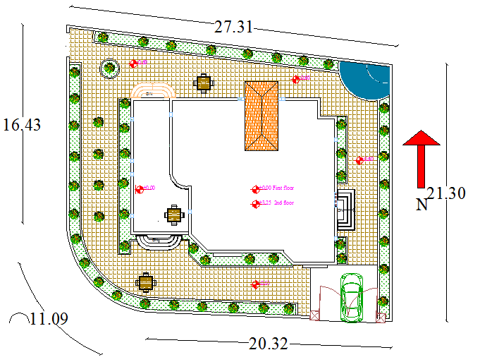
Site plan :

Slide 6
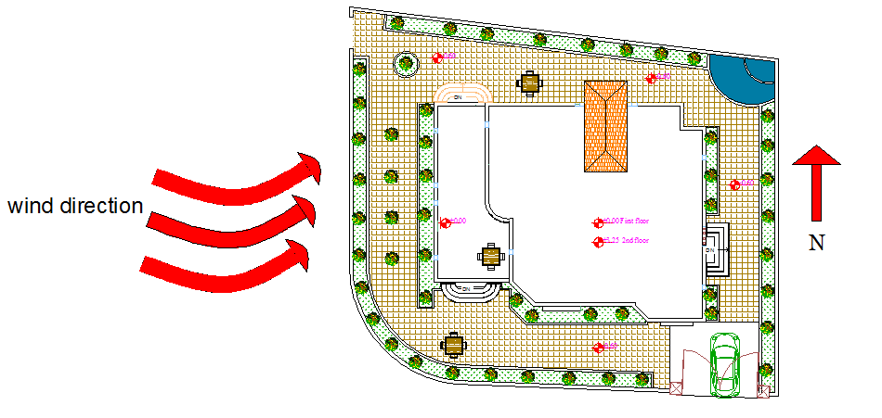
Wind direction :

Slide 7
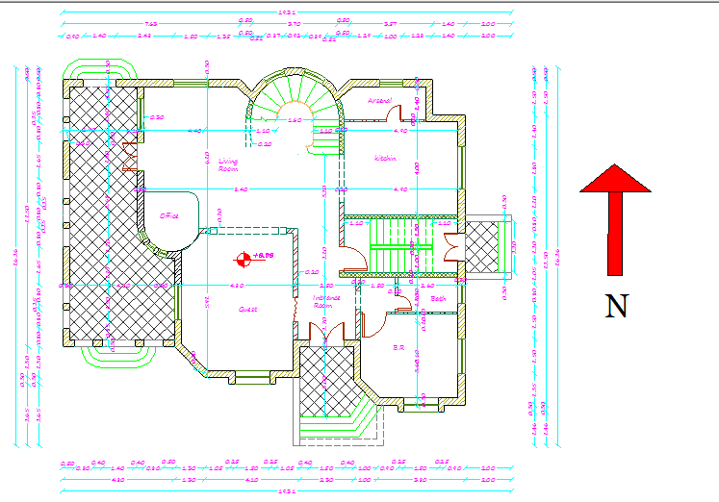
Old design :

Slide 8
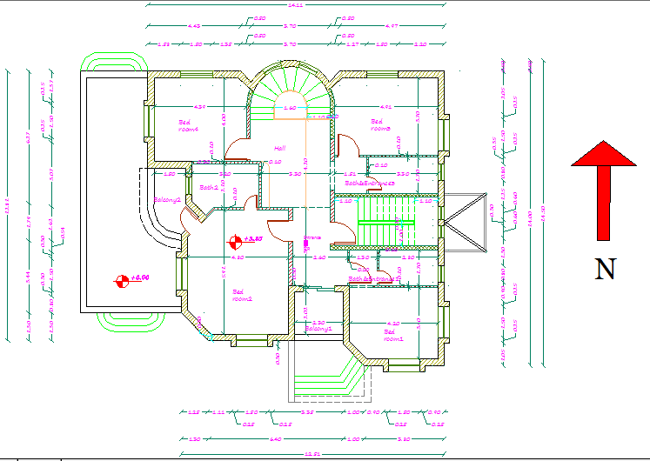
Old design :

Slide 9
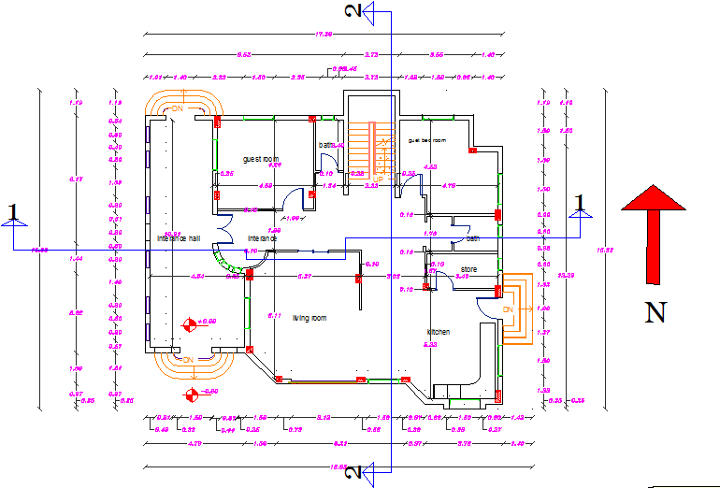
New design :

Slide 10
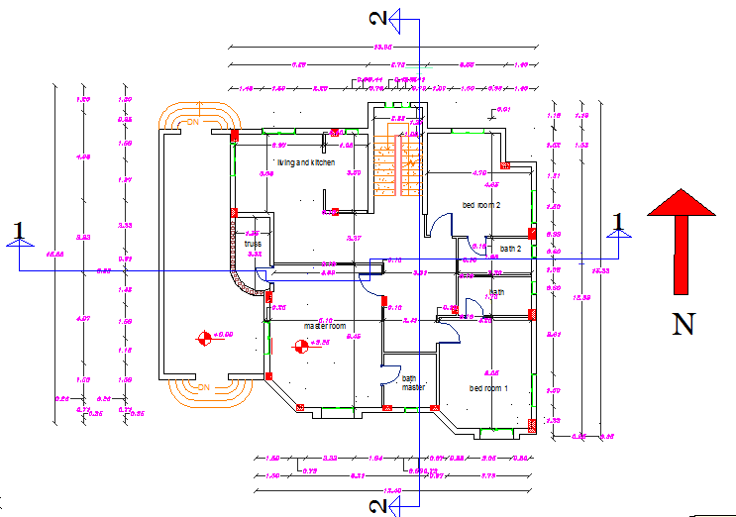
2nd floor:

Slide 11
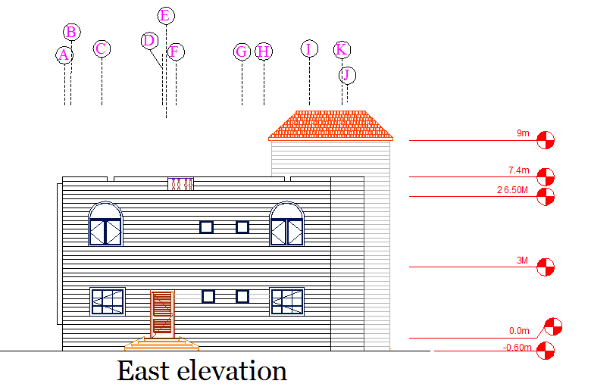
Elevation :

Slide 12
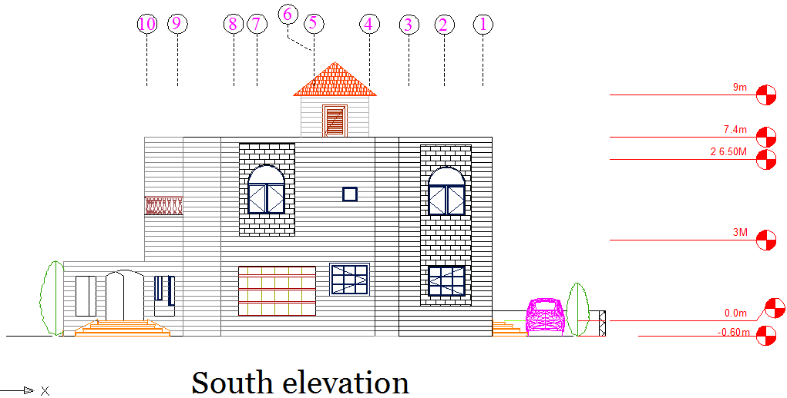
Elevation :

Slide 13
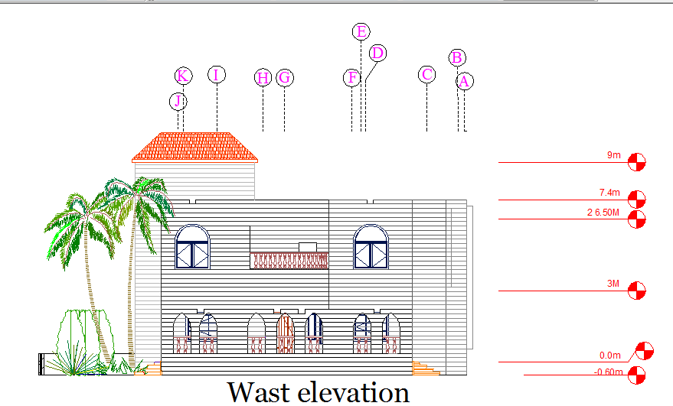
Elevation :

Slide 14
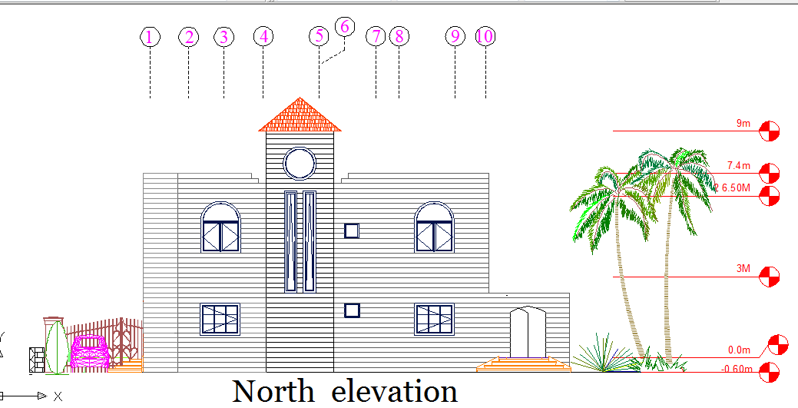
Elevation :

Slide 15
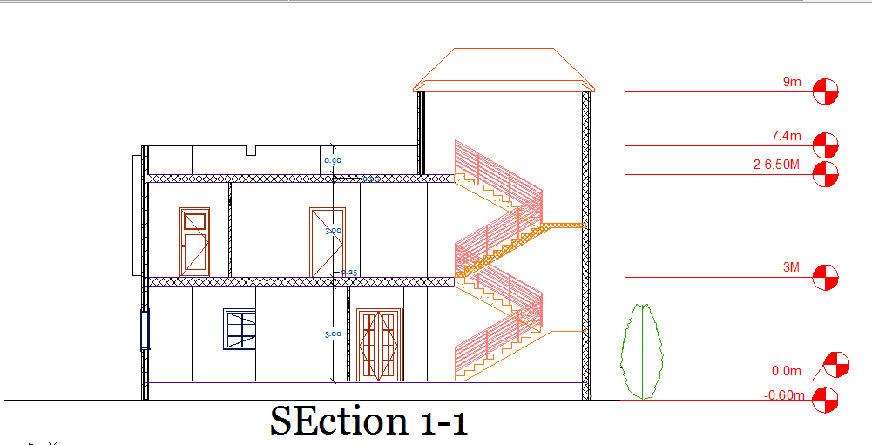
Section :

Slide 16
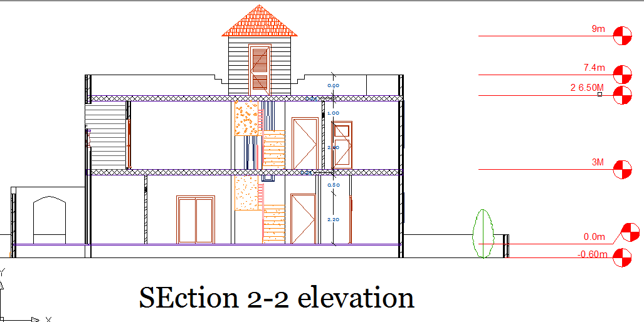
Section :

Slide 17
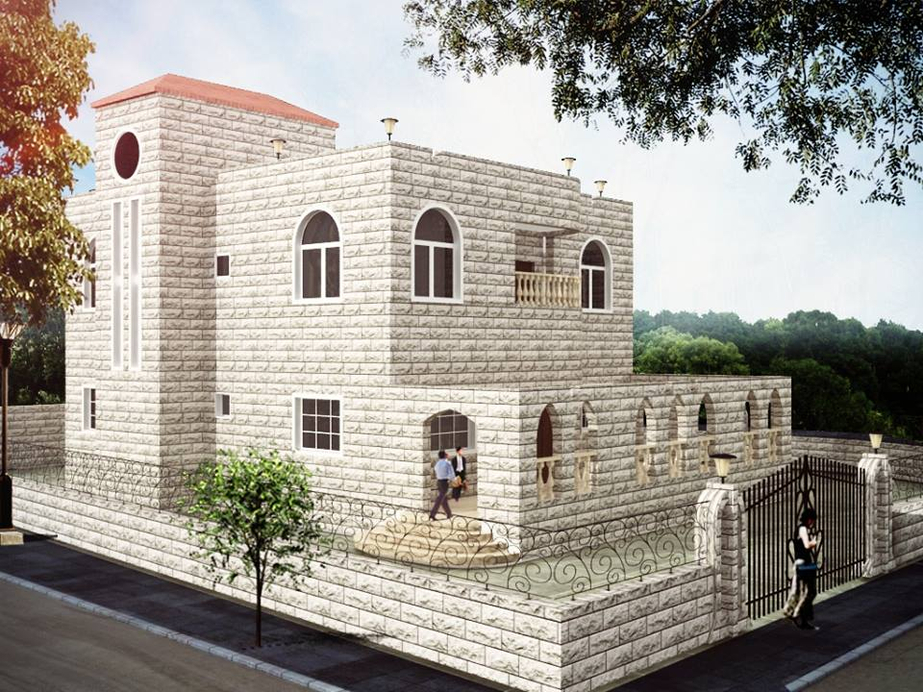
3d :

Slide 18
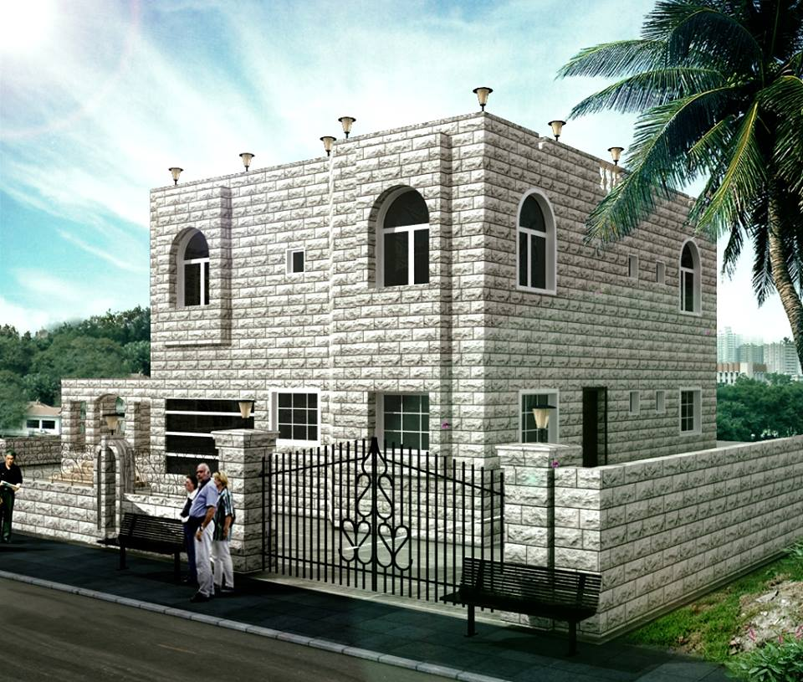

Slide 19
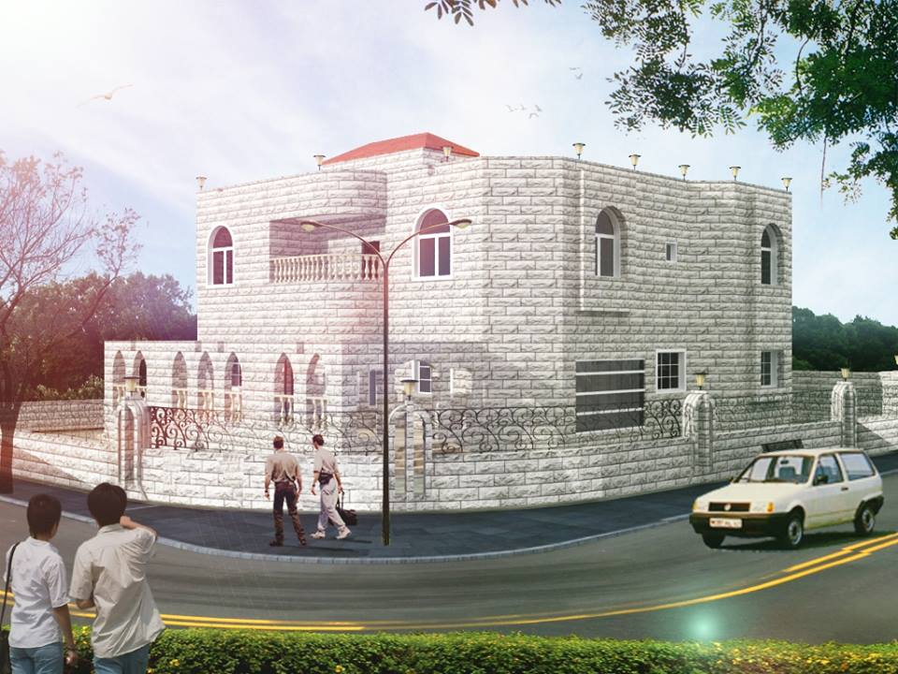

Slide 20
Passive solar
At the south we decide to make solar window…..Why??
* Because solar chimney is not effected as shown in calculation

Slide 21
Passive solar
Solar chimney calculated:
A = 4 ft2
T1-T2 = 30 F in winter
H = 18 ft.
Q= 540*A*√h (T1-T2)
= 540*4*√18 (30)
= 50193.86 ft3/ hr.
Volume of space = 9486 ft3
Number of change = Q/ V
=50193.86/9486 = 5.2 change/hour and that less than 6 so the chimney not efficacy in the house ,

Slide 22
Shading :
Sample calculation:
Design the horizontal lover in the 21/5 at 12 pm
X = h/ (tan (Alt))
X= horizontal length of lover
H = glass height
Alt =Altitude at 21/5 at 12 pm and equal 78
So the first design for h = 40 cm and y = 0
X = 0.4/ (tan (78)) = 9 cm
And anther design for h = 120cm and y = 0
X = 1.2/ (tan (78)) = 25cm

Slide 23
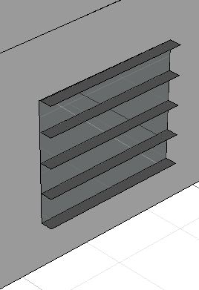
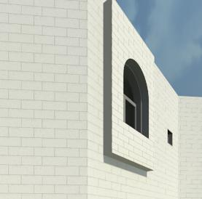
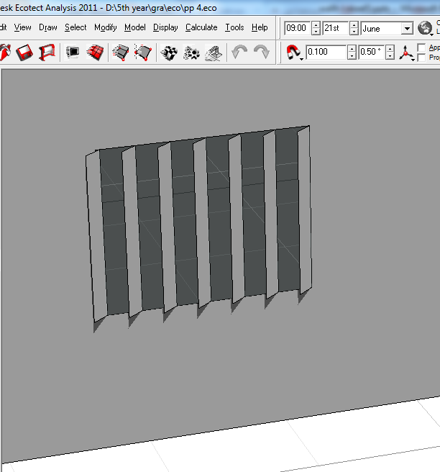

Slide 24
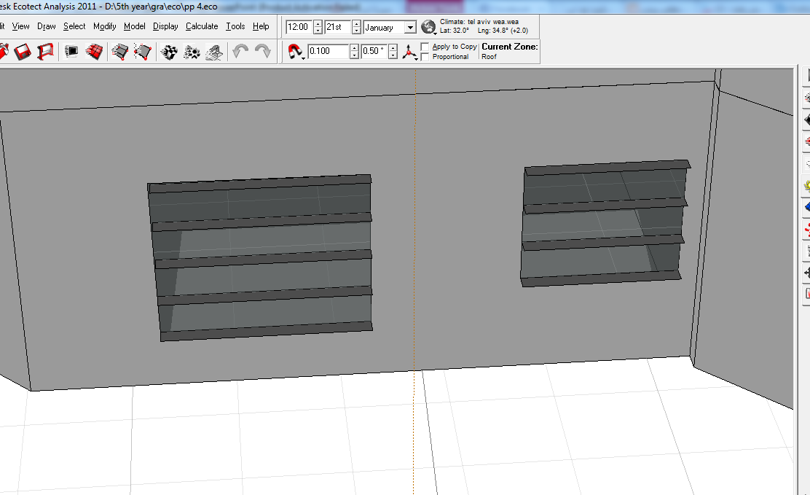

Slide 25
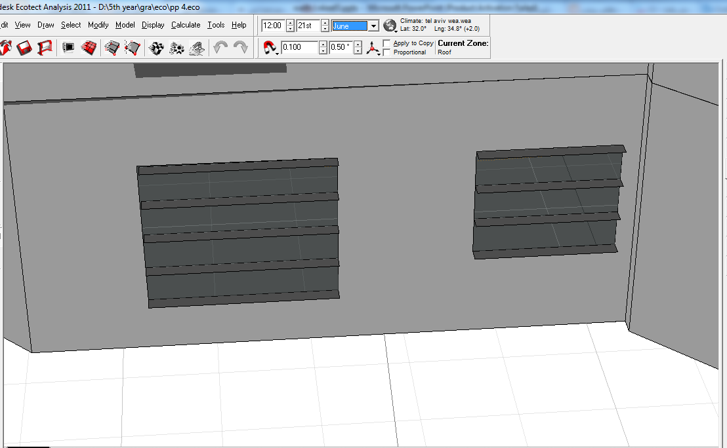

Slide 26
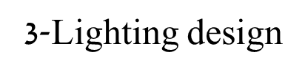
Environmental :
Artificial lighting
Emergency lighting
Natural lighting

Slide 27
Environmental :
        Natural lighting
compute the D.F by ECOTECT program
Function | D.F% | Standard value | Accept
Guest room | 3.1 | 2.5-4 | √
Living 1st floor | 3 | 2.5-4 | √
Kitchen | 2.9 | 2.5-4 | √
Bath | 1.5 | 1.5-2.5 | √
Corridor | 1.9 | 1.5-2.5 | √
Master bed room | 2.6 | 2.5-4 | √
Room 3 | 2.7 | 2.5-4 | √
Living 2nd floor | 3 | 2.5-4 | √
Bed room 1 | 2.6 | 2.5-4 | √
Bed room 2 | 2.4 | 2.5-4 | √
Bed room 3 | 2.8 | 2.5-4 | √

Slide 28
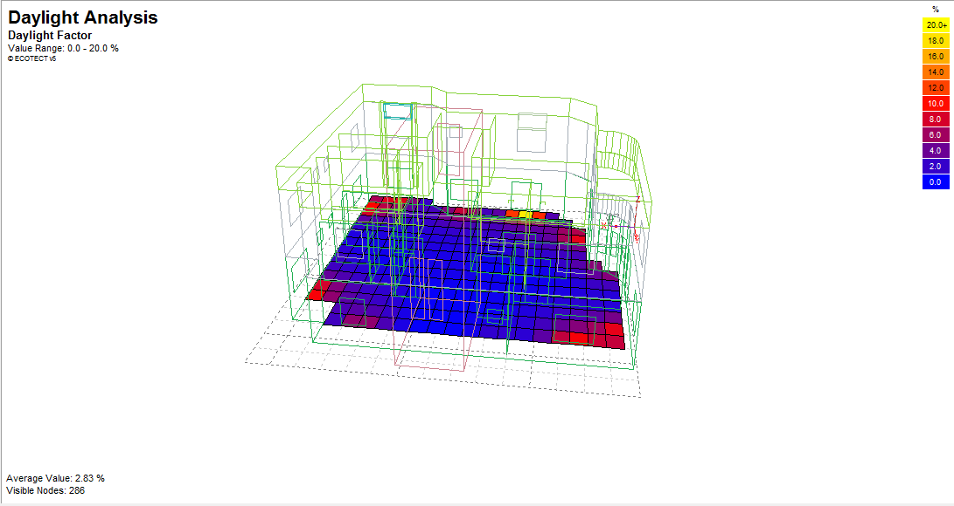
Environmental :

Slide 29
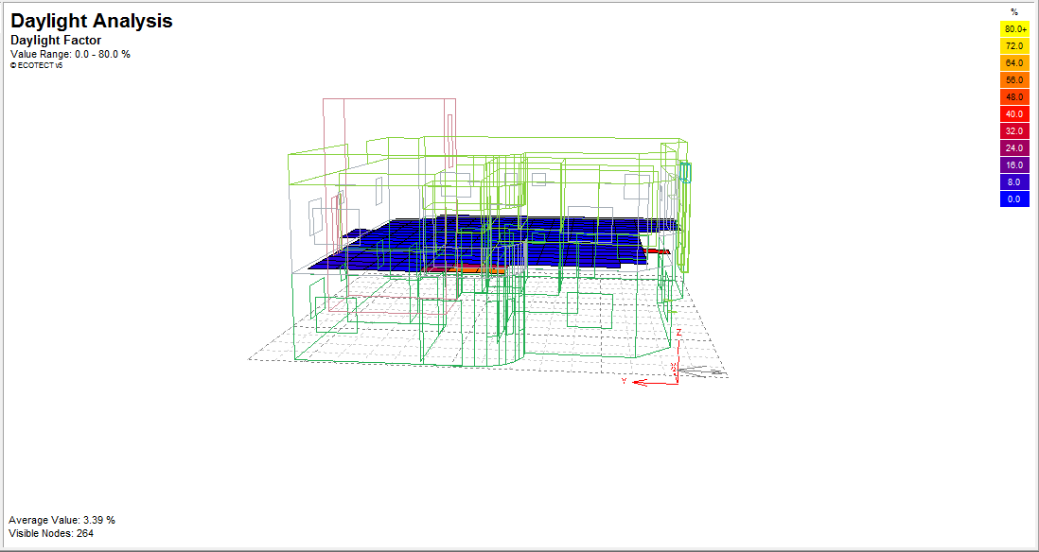
Environmental :

Slide 30

Environmental :
B-Artificial lighting
DIALUX software was used to design the Artificial lighting system

Slide 31
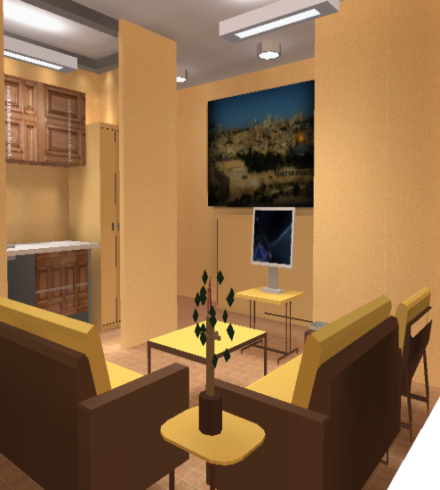
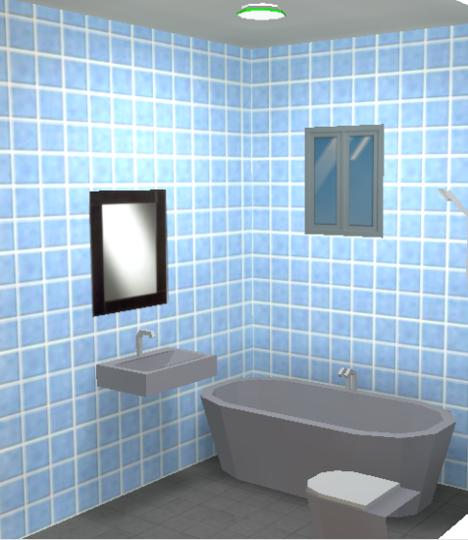
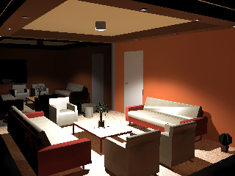
Environmental :
Technical values for design
Function | Eavg | Work plan
Gust room | 250-300 | 0.75m
Kitchen room | 350-500 | 1m
Living room | 300-500 | 0.75m
Corridor | 150 | 1-1.5m
Bath | 150 | 0.75m

Slide 32
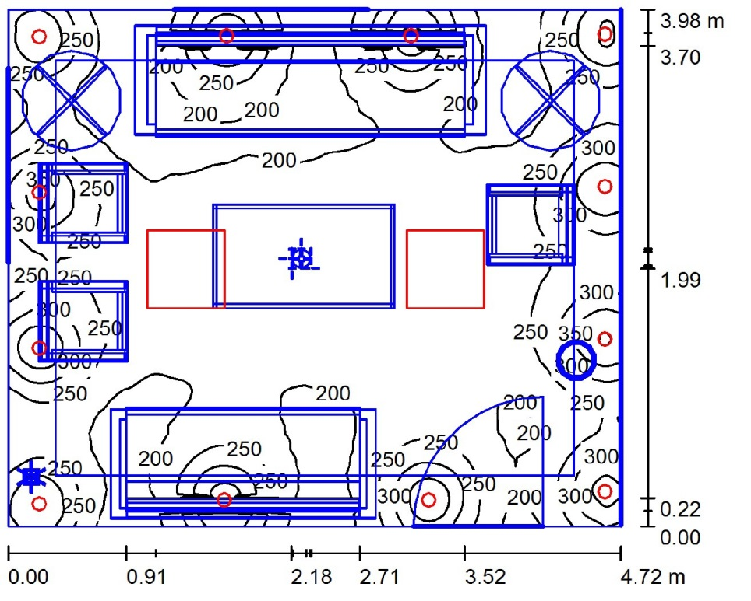
Environmental :
SAMPLE:.
Guest room
Laminar distributed
Illumenance =250 lux
Work plane =75cm
uniformity= 0.66
#of lamps=2 lamps
12Led

Slide 33
Environmental :

Slide 34
Environmental :
SAMPLE:.
Bed room
Laminar distributed
Illumenance =340lux
Work plane =75cm
uniformity= 0.66
#of lamps=7 lamps
18Led

Slide 35
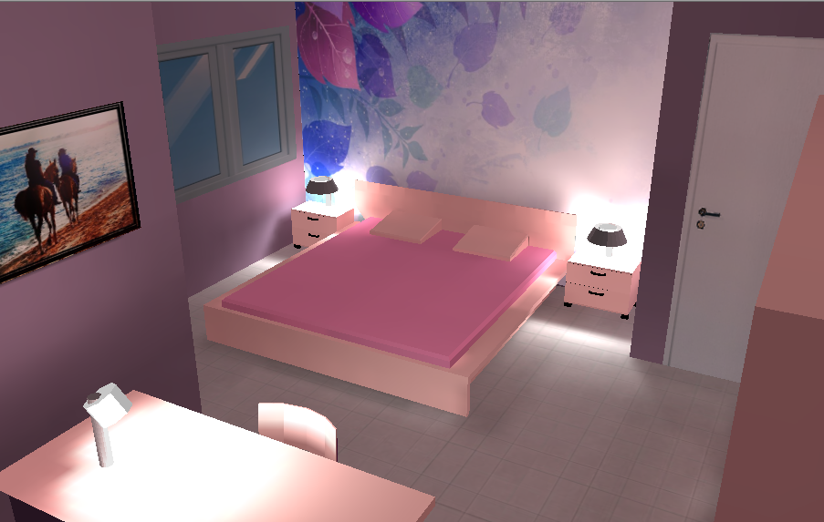
Environmental :

Slide 36
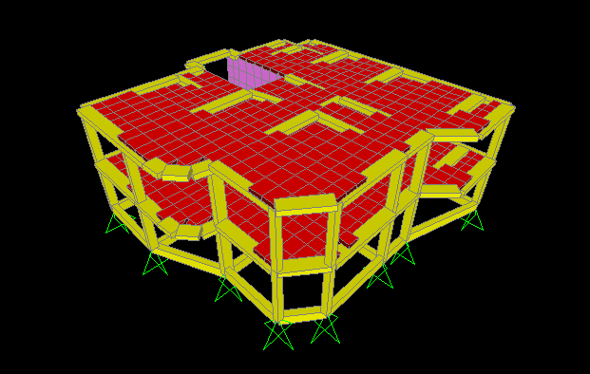
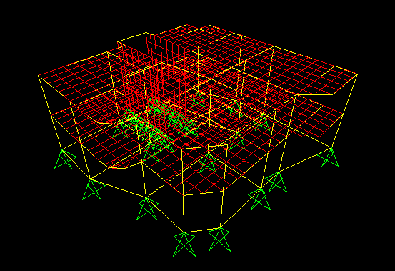
Structural

Slide 37
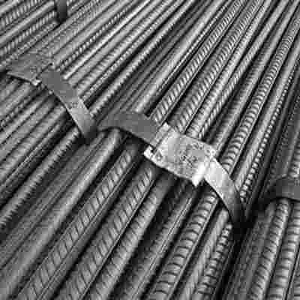
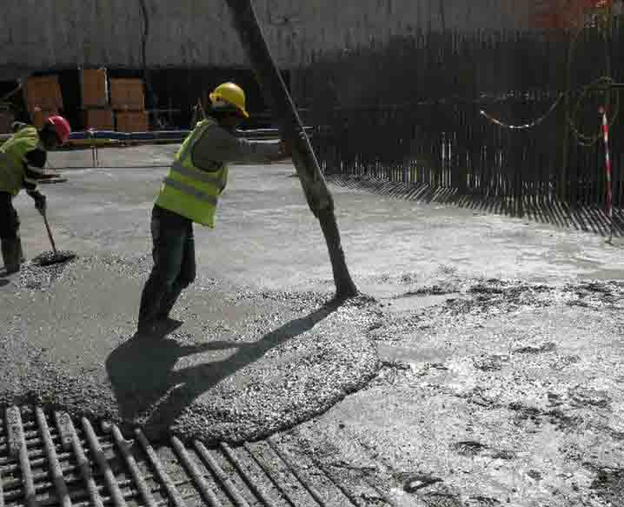
Construction material properties:
Concrete, f’c= 24MPa
steel, fy= 420MPa

Slide 38
loads
super impose dead Load=2.5KN/M2
building parameter wall load =21KN/M
Live load =4KN/M2

Slide 39
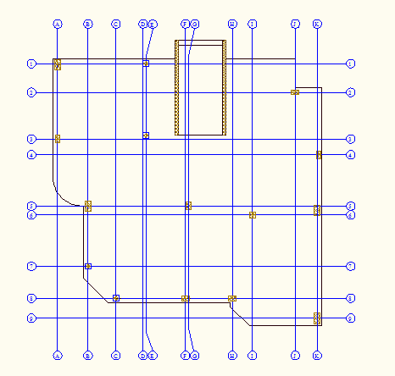
COLUMNS

Slide 40
SOME CHECK On RESULT from SAP
  DEAD LOAD from = 6446 kN/m2 calculation=6446KN/M2 KNkN/m2
  DEAD LOAD from Sap =6234 kN/m2
40

Slide 41
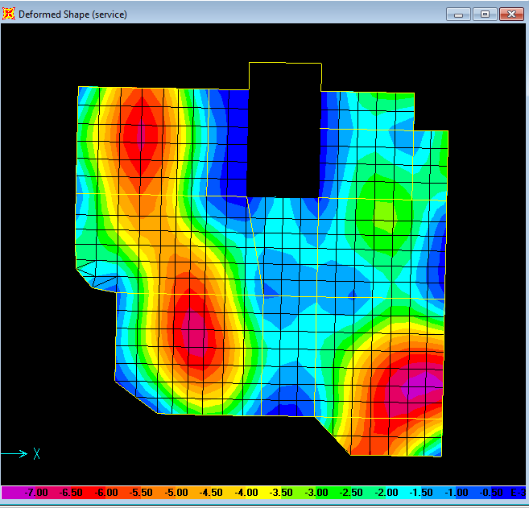
CHECK On deflection
Max deflection=7mm
∆max= 19.7mm
19.7≻7 ok
∆max= 19.7mm
19.7≻7 ok
41

Slide 42
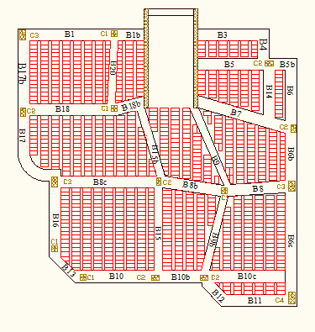
Design beam
Main beam(60*25)
Asmin=440mm2
Secondary beam(40*25)
Asmin=295mm2
42

Slide 43
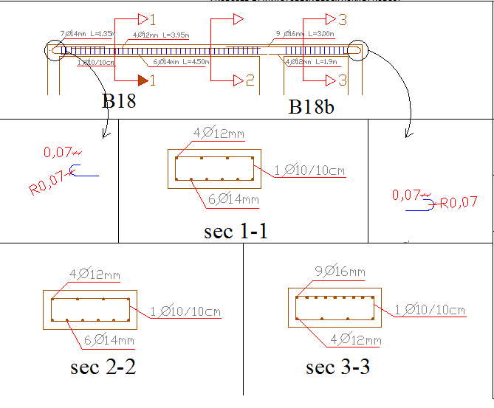

Slide 44
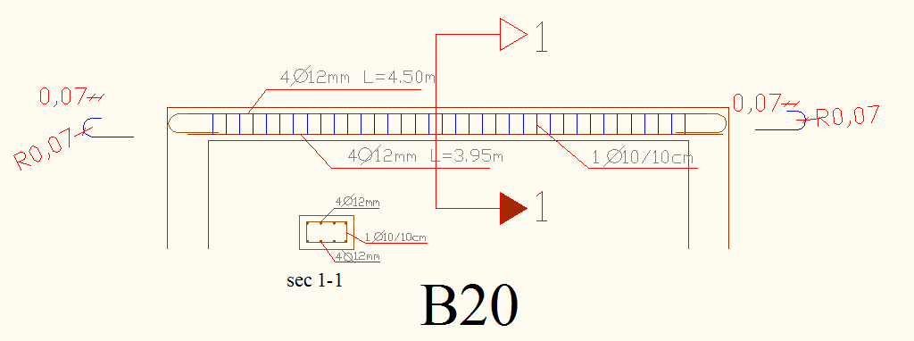

Slide 45
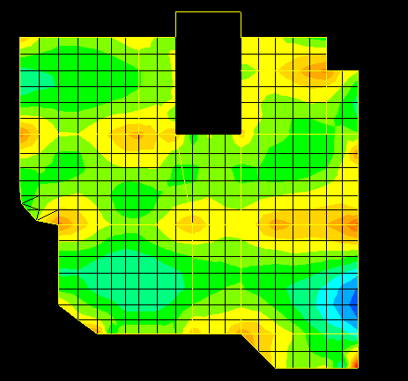
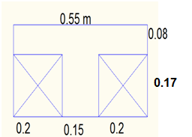
Design slab

Slide 46
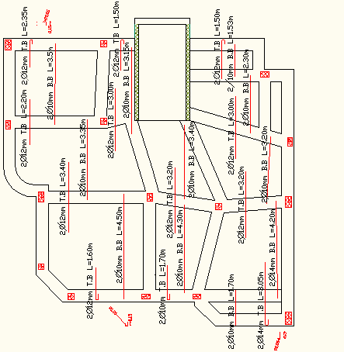
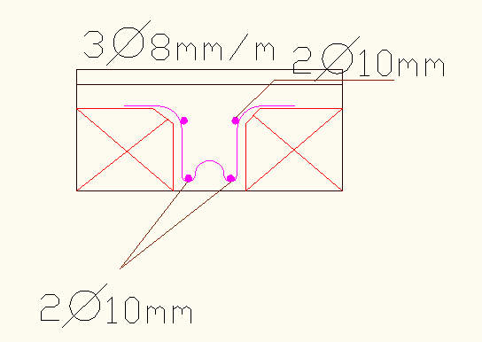
Design slab

Slide 47
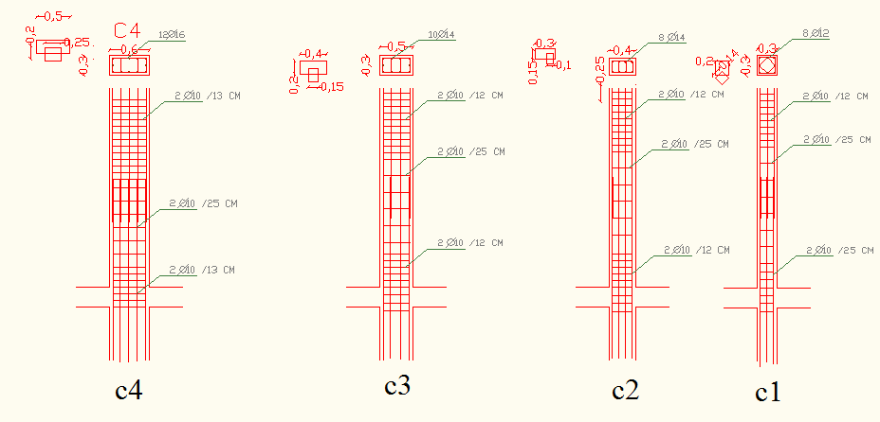
Design column
47

Slide 48
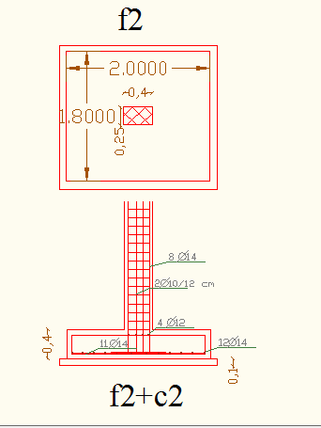
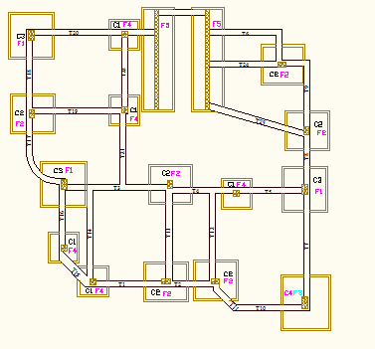
Footing Design
48

Slide 49
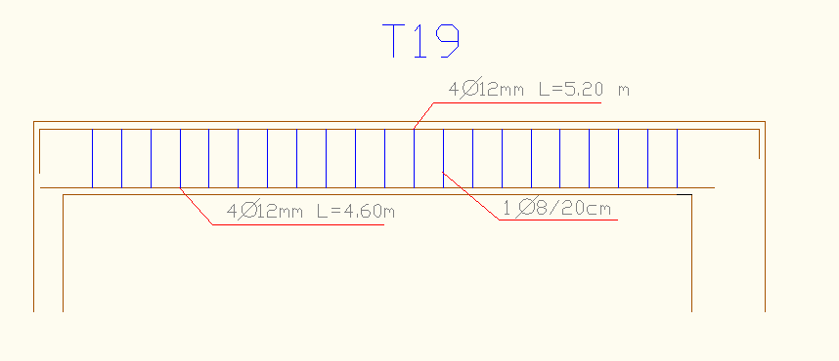
Design Tie beam
Tie beam(50*30 cm)
49

Slide 50
HVAC System
The former design did not design for HVAC system.
Element of the wall and slab

Slide 51
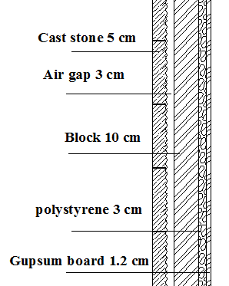
External Wall

Slide 52
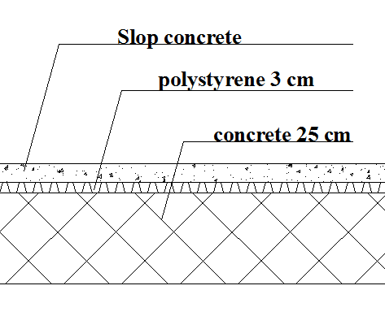
Internal wall Ceiling

Slide 53
Ground

Slide 54
Heating Load
Heat transfer through wall and slab.
Infiltration through window and door.
Out side temperature = 8C
Inside temperature =20C
Total heating load = 10 KW

Slide 55
Heating Load
# of zone | Q Total | Q total kw | Q TR
1 | 1227.03 | 1.23 | 0.35
2 | 1173.60 | 1.17 | 0.33
3 | 310.36 | 0.31 | 0.09
4 | 748.74 | 0.75 | 0.21
5 | 210.88 | 0.21 | 0.06
6 | 638.26 | 0.64 | 0.18
7 | 1946.52 | 1.95 | 0.55
8 | 917.16 | 0.92 | 0.26
9 | 423.55 | 0.42 | 0.12
10 | 444.15 | 0.44 | 0.13
11 | 859.10 | 0.86 | 0.24
12 | 342.84 | 0.34 | 0.10
13 | 1109.74 | 1.11 | 0.32
Total | 10351.95 | 10.35 | 2.94

Slide 56
Cooling Load
Heat transfer through wall and slab.
Infiltration through window and door.
due to equipment
Outside temperature = 35C
Total cooling load = 9 KW

Slide 57
Cooling Load
# Zone | Q Totlal | Qtotal kw | Q TR
1 | 2682.83 | 2.68 | 0.76
2 | 42.03 | 0.04 | 0.01
3 | 90.21 | 0.09 | 0.03
4 | 603.04 | 0.60 | 0.17
5 | 53.76 | 0.05 | 0.02
6 | 655.74 | 0.66 | 0.19
7 | 1406.38 | 1.41 | 0.40
8 | 911.51 | 0.91 | 0.26
9 | 142.55 | 0.14 | 0.04
10 | 171.06 | 0.17 | 0.05
11 | 1097.41 | 1.10 | 0.31
12 | 193.73 | 0.19 | 0.06
13 | 1123.31 | 1.12 | 0.32
 | 9173.56 | 9.17 | 2.61

Slide 58
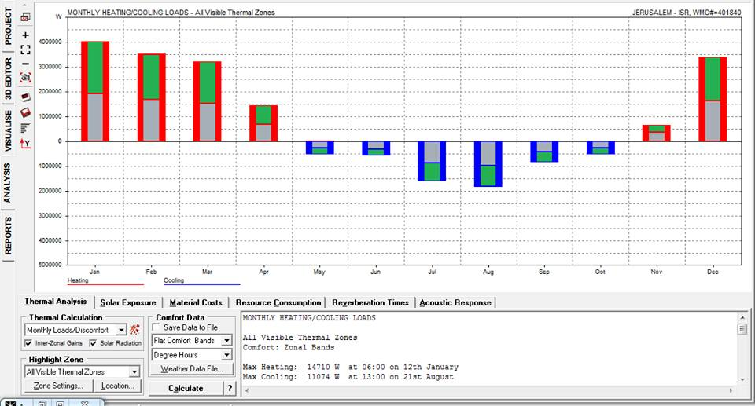
Average heating and cooling load in building.

Slide 59
Use split unit
total | price | Number | Type
27000 | 3000 | 9 | 9000 Btu
252 | 14 | 18 | Pipe 1.5”
27252 |  |  | total

Slide 60
Installation of split unit

Slide 61
Electrical design

Slide 62
Circuit breaker board

Slide 63
Earth system

Slide 64

Lighting distribution in ground floor

Slide 65
Lighting distribution in first floor

Slide 66
Socket distribution in ground floor

Slide 67
Socket distribution in first floor

Slide 68


Protection system :
Fire extinguisher (two class)
1-Class K Fire Extinguisher
2-Class C Fire Extinguisher

Slide 69

Water Systems design ( plumping system) :
Diameter used:
Vertical feeder = 1.25 inch
Horizontal feeder = 1 inch
Branch = ¾ inch

Slide 70

Water Systems design:

Slide 71


The collector location:

Slide 72
Drainage Systems design:
Black water :W.CS & kitchen sink
Grey water : Laundries & shower head

Slide 73

Black water:

Slide 74

Grey water :

Slide 75
Quantity and comparison:
Divide into two types :
1- cost without using alternative materials with area equal 350 m 2 (former design)
2- cost after revised and using alternative materials with area equal 354 m 2 (revised design)

Slide 78


Slide 79


Slide 80


Slide 81


Slide 82


Slide 83
Conclusion:
Using the alternative materials, external stone, PVC windows, doors, fiber hollow block in the internal wall and PVC floors tiles, reducing the total cost about 21%, with the same or best efficiency than the local material.

Slide 84
Thanks
For Your Attention

