Slide 1

Graduation Project II
Ehab Ma’aly
Sameh Bsharat

Slide 2
SMART OLIVE
PRESS MACHINE

Slide 3
Index
SUBJECT | SLIDES
1-1:INTRODUCTION | 4-7
1-2:STEPS OF OLIVE PRESS | 8
2-1:PLC
2-2:PLC FATEK
2-3:SCADA SYSTEM
2-4:FV-DESIGNER
3-1: Ladder | 13-26
3-1:PRACTICAL SIDE
3-4: operation | 31
4- 1:Financial STYDY
4-2:PROBLEMS
4-3:PROJECT EXTRACT
4-4:CONCLOUSION

Slide 4
1-1: Introduction-GPI
*problem overview
1-Problems in olive squeezing
-less of reliability
-not full Automatic
-cant detect the process
-not confidence maybe happened mixing in the olives

Slide 5
1-1: Introduction-GPI
*problem overview
2-Guarantees to solve the problems
-Full Automation
By detecting sensors in each step -full detect process
-SCADA system
-using Graphical representation for customers
-measure the weight and volume
-not mixed between customers

Slide 6
1-1: Introduction-GPI
*problem overview
3-INP/OUT
**There are about 32 inputs in this project.
**42 outputs in our project

Slide 7
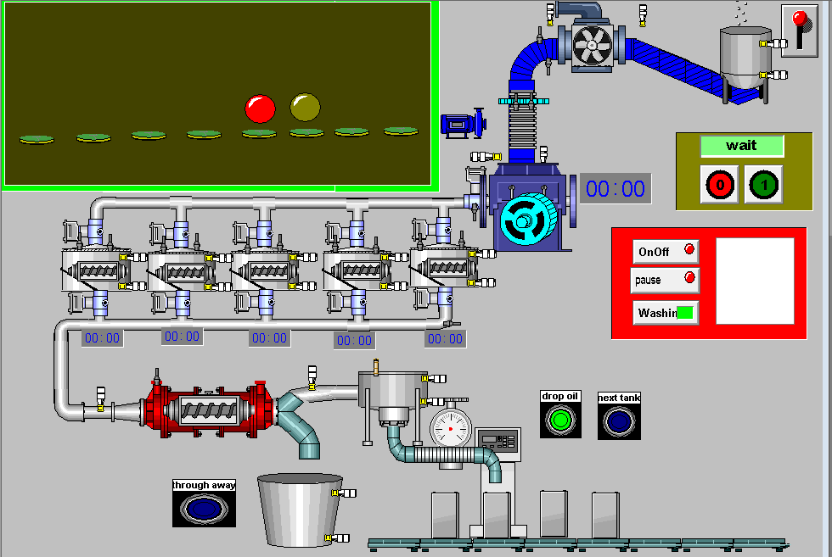
1-1: Introduction-GPI
*problem overview
4- SCADA

Slide 8
1-2: Steps of Olive PRESS
1-Moving and suction
2
1
2- washing
4
3- crushing
3
4- Tanks
6
5-turbine
6-Filling Tank oil
5

Slide 9
A programmable logic controller (PLC), or programmable controller is an industrial digital computer which has been ruggedized and adapted for the control of manufacturing processes, such as assembly lines, or robotic devices, or any activity that requires high reliability control and ease of programming and process fault diagnosis.
2-1: PLC

Slide 10
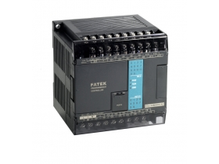
** ** We used the plc fatek FBs:
1-easy for used.
2-The program is available for free.
3-we can use HMI by computer.
4- cheap
2-2: PLC Fatek
**14OUT(digital)/10INP(digital).
**24 VDC.

Slide 11
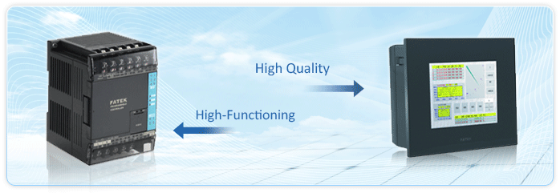
Supervisory control and data acquisition (SCADA) is a control system architecture that uses computers, networked data communications and graphical user interfaces for high-level process supervisory management.
2-3: SCADA
**In project1,we used a wonderware in touch programing.
**In graduation project2,we used FV-designer programing.

Slide 12
2-3: SCADA

Slide 13
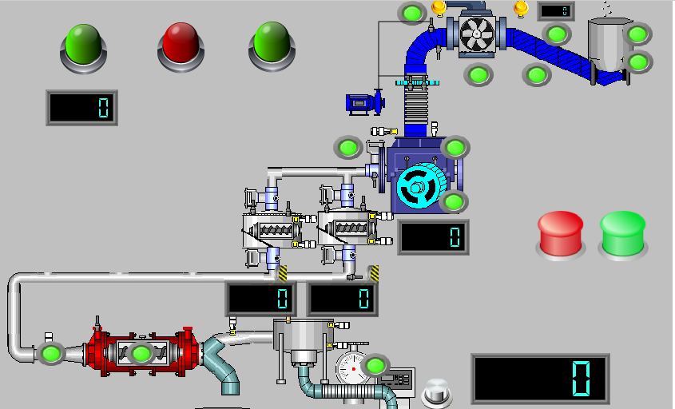
2-4: Fv-Designer

Slide 14
3-1: ladder
* Ladder of project with 86 line
** 24 IN/OUT external variables with a lot of internals
*** using two modes that there are two tanks
**** using odd/even to change the mode
***** using matrix to link the processes
****** dependent/independet process/variable

Slide 15
3-1: ladder
External input
Pin number | Object of the pin
X0 | On/Off switch to the machine.
X1 | As there are olives in the fill tank at the begging .
X2 | Push button as detecting sensor for calculating the weight of the olives.
X3 | Push button as start new customer in the machine.
X4 | Push button as washing the olives in the sear.
X5 | As detecting the olives in the bottom of Crushing olives section.
X6 | Push button as finish the customer in the machine.
X7 | As detecting the olives in the top of Crushing olives section.
X8 | As detecting sensor in Tank 2 in the bottom.
X9 | As detecting sensor in Tank 2 in the top.
X10 | As detecting sensor in Tank 1 in the bottom.
X11 | As detecting sensor in Tank 1 in the top.
X12 | As detecting sensor before the olives going to the turbine.
X13 | Push button to fill the oil in the flowmeter sensor.

Slide 16
3-1: ladder
External output
Pin number | Object of the pin
Y0 | Motor as Crushing process
Y1 | Led as ready machine for new customer
Y2 | Led as the machine in the user process
Y3 | Motor as moving the olives in the sear
Y4 | Motor in Tank 1
Y5 | Led as pause process to short time
Y6 | valve as control in valve of the crushing section
Y7 | Motor in Tank 2
Y8 | Motor as moving the turbine
Y9 | Led as the oil is ready in the tank.

Slide 17
3-1: ladder
***type of processes
process | dependent | independent
Olives filling | ✓
Washing |  | ✓
Crushing | ✓
Tanks1 | ✓
Tanks2 | ✓
Turbine |  | ✓
Ready oil |  | ✓

Slide 18
3-1: ladder
***matrix way
process | Mode 1-odd- | Mode 2-even-
Olives filling | M71 | M70
Washing | M73 | M72
Crushing | M75 | M75
Tanks1 | M77 | M76
Tanks2 | M79 | M78
Turbine | M81 | M86
Ready oil | M83 | M82

Slide 19
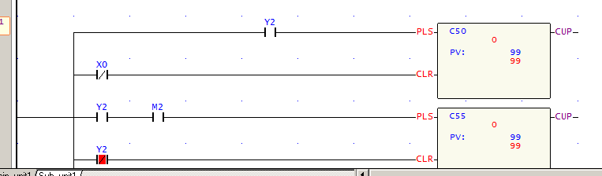
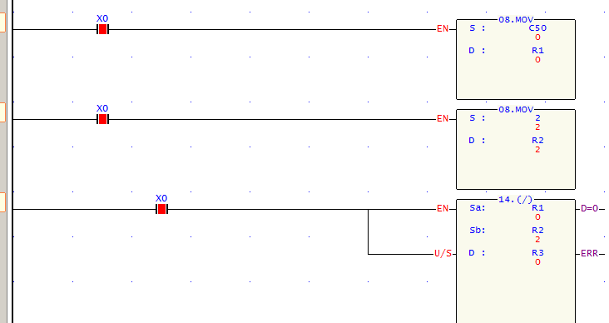
3-1: ladder
*Users and changing the mode:

Slide 20
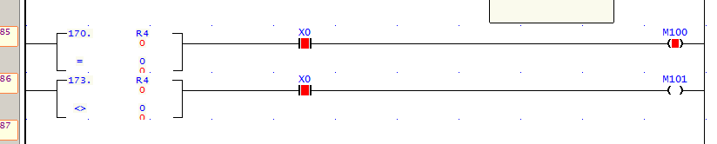
3-1: ladder

Slide 21

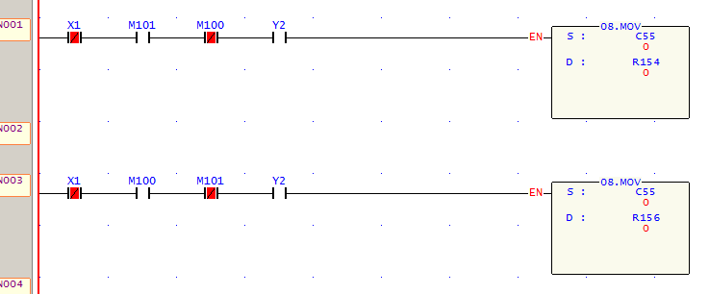
3-1: ladder
**weight measurement

Slide 22
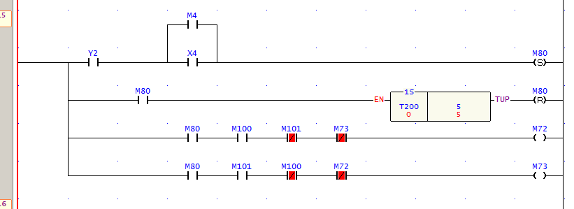
3-1: ladder
**washing process

Slide 23

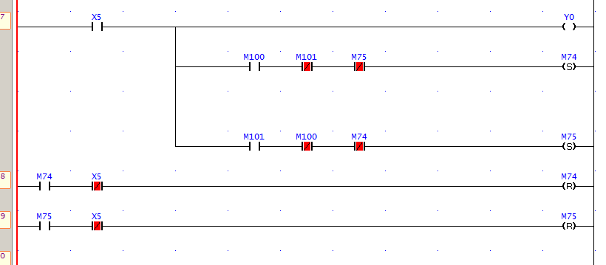
3-1: ladder
***crushing

Slide 24
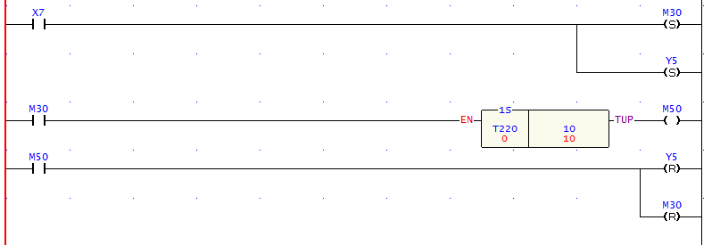
3-1: ladder
***pause process

Slide 25
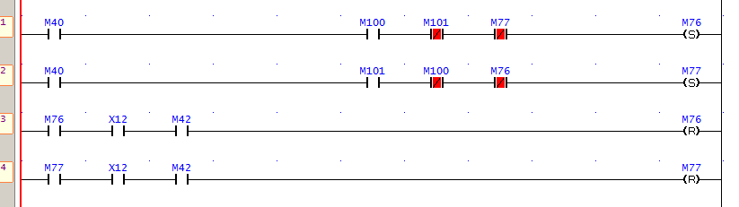
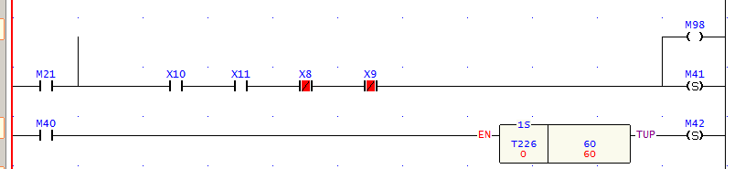
3-1: ladder
***Tank 1 / Tank2

Slide 26
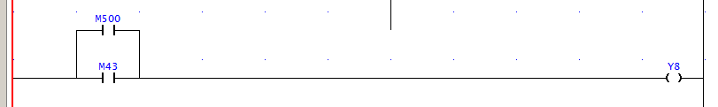
3-1: ladder
***Turbine

Slide 27
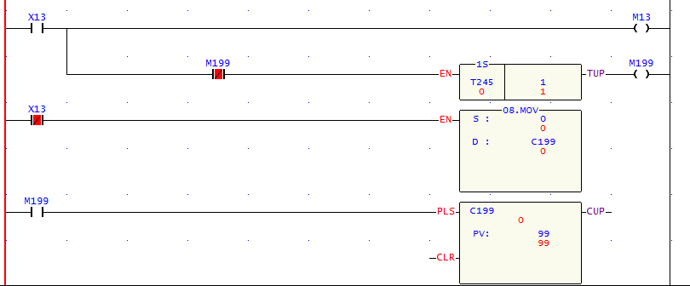
3-1: ladder
***volume

Slide 28
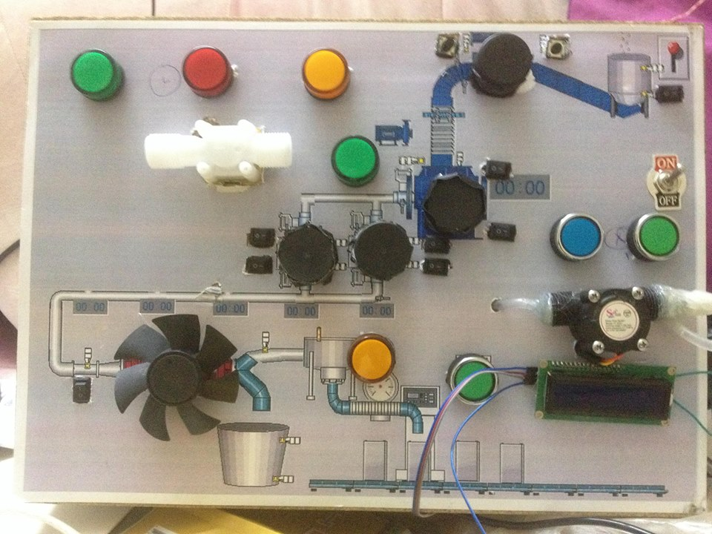
3-2: Practical

Slide 29
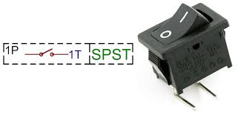
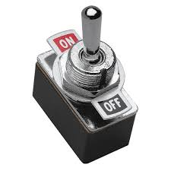
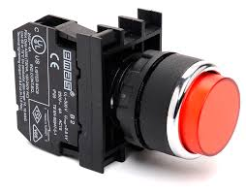
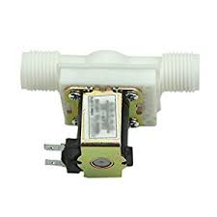
The following table shows some of the electrical parts that we used to complete the graduation project 2:
The parts used in the project:
:
Nameof element | image
Electrical switches
pushbutton
Water valve

Slide 30
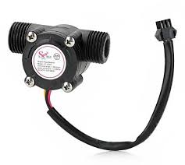



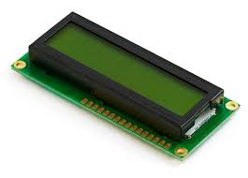
Flow meter
Dc motors(12 volt)
Led(12 volt)
LCD2*16

Slide 31
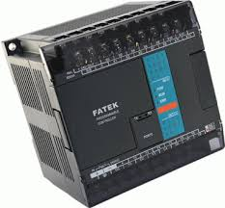
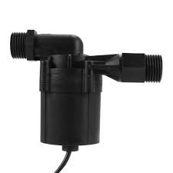
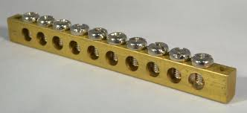
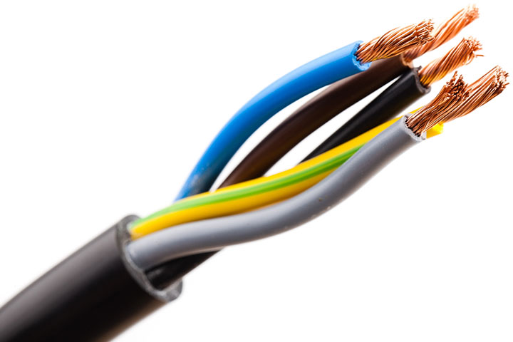
PLC x 24 fatek
Water pump(12 volt)
Busbar
Wire

Slide 32
3-4: Operation

Slide 33
4-1: Financial stydy
1-OLd Financial
Name of element | Number | Cost in $
Detect sensor | 21 | 9 | 9*21=189
pushbutton | 8 | 1 | 1*8=8
Valve water flow meter with control | 1 | 68.88 | 68.88*1=68.88
Weight machine | 1 | 20 | 20*1=20
Relay | 6 | 10.02 | 10.02*6=60.12
valve | 30 | 11.57 | 11.57*30=347.1
timers | 6 | 2.94 | 2.94*6=17.76
Variable voltage variable frequency | 5 | 90 | 90*5=450
LCDs | collection | 29.89+6.87+50 | 86.76
PLC x 32 | 1 | 169 | 169
PLC x 16 | 1 | 49.99 | 49.99
Summation |  |  | 1466.61 $

Slide 34
4-1: Financial stydy
2-Practical Financial
Name of element | Number | Cost in( NIS)
Pushbutton )small) | 2 | 1 | 2*1=2
Pushbutton ) big) | 3 | 10 | 3*10=30
Switches | 8 | 1 | 1*8=8
Valve water | 1 | 40 | 40*1=40
flow meter with control | 1 | 45 | 45*1=45
Led | 5 | 5 | 5*5=25
Dc motor 12volt | 5 | 5 | 5*5=25
Water pumb | 1 | 30 | 30*1=30
Busbar | 2 | 35 | 2*35=70
LCD 2 x16 | 1 | 25 | 1*25=25
PLC x 24 | 1 | 720 | 1*720=720
Cable of PLC | 1 | 100 | 1*100=100
Wood Box | 1 | 20 | 1*20=20
Image A3 | 1 | 10 | 1*10=10
Summation |  |  | 1150 NIS =319.4 $

Slide 35
4-2: Problems
**financial.
**hard to save PLC in time.
*build sampling that can’t save the requirements of the full project
**over load current.

Slide 36
4-3:Project Extracts
1-Dealing with PLC
2-Dealing with sensors
3-Planning to
Build machine ,simulation ,

Slide 37
** we learned how to connect the computer with the logical computer programmed, as well as how to deal with the language of its programming.
**we learned how to address the practical and software problems that we faced during the work of the project.
**Finally ,we learn how to dealing for SCADA system with PLC in our project.
4-4: conclusion

Slide 38
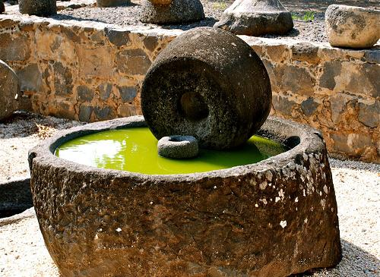
Thank you
for listening

