Slide 1

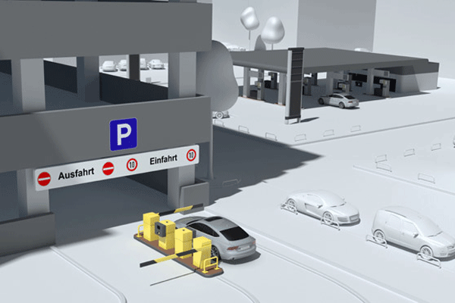

Smart Parking System Using RFID Technology
Prepared by :Aya Al-Fouqha
Mais Al-Masri
Dr. Saed Tarapiah

Slide 2
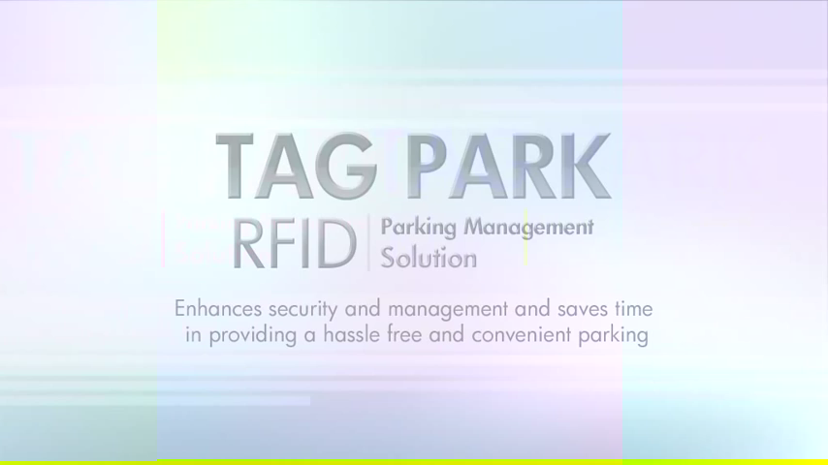
Project Clip

Slide 3
OUTLINE
Objectives
Economical study
Recommendations
Motivations
Earlier Course Work
System Design
Results & Discussions
Flow Chart
Conclusions
SWOT Analysis
Difficulties

Slide 4
Objectives
Our objective from the project:
Design and develop Radio Frequency Identification parking system.
The system provides a more user-friendly affordable, efficient, and secure application.

Slide 5
Motivations
Why we choose this project:
It provides a more user-friendly, affordable, and an efficient means to track vehicles accurately in a parking lot.
It provides a more secure way to enter into the parking than traditional parking systems.
The system contains two parts : paid and unpaid system

Slide 6
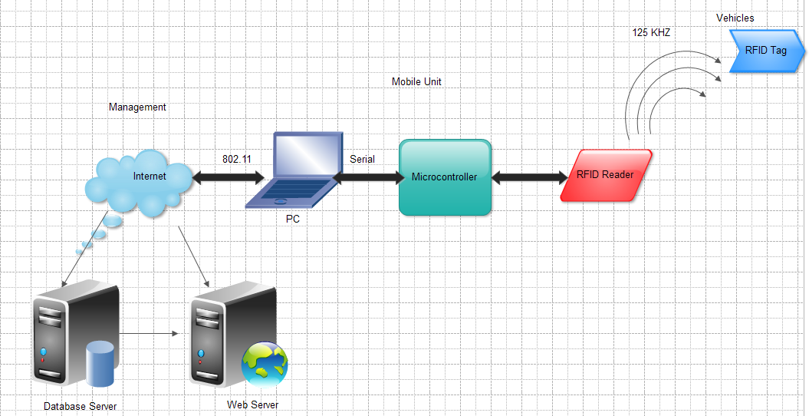
System Design
Notes:
The project is an integrated system that utilizes RFID, Global System for Mobile (GSM),wireless connectivity and an advanced web-based system to show current parking utilization.

Slide 7
System Components
There are three major components that compose the project:
The Vehicle component system
The Mobile Unit
The database and management module.
Notes:
1.The Vehicle component system is simple, a 125 KHz RFID tag placed on a vehicle. This is just to indicate the presence of a vehicle at the gate. A Mobile Unit which includes GSM module, microcontroller, and RFID reader picks this tag up when it passes by. If no tag is read, the assumption is that no car at the gate.
2. The Mobile Unit contains a Personal Computer (PC), an RFID reader, and an 802.11 internet connection [5]. The RFID reader identifies the vehicle, while the wireless connectivity is required to transmit the data real-time to a database, GSM required to send Short Message Service (SMS) notification. In our system we notify the vehicle owners of any transaction made from their vehicle via SMS. These SMS are sent automatically from the system using a GSM modem. We have used serial communication and universal AT-Commands to send these SMS.
3. The database and management module is the most important part of the project. The mobile unit and the vehicle are simple modules, just to aid in the data collection process, while this module is responsible for storing, analyzing and controlling the parking data. Data coming in from numerous mobile units is stored in the database; reports generated from this data are published automatically using a web-server.

Slide 8
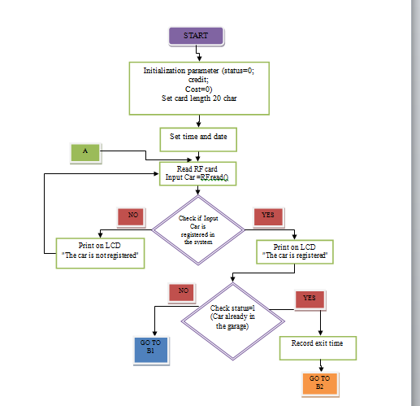
Flow Chart

Slide 9
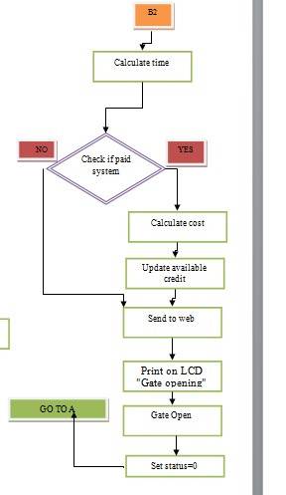
Flow Chart
Notes:
بنحزف send SMS

Slide 10
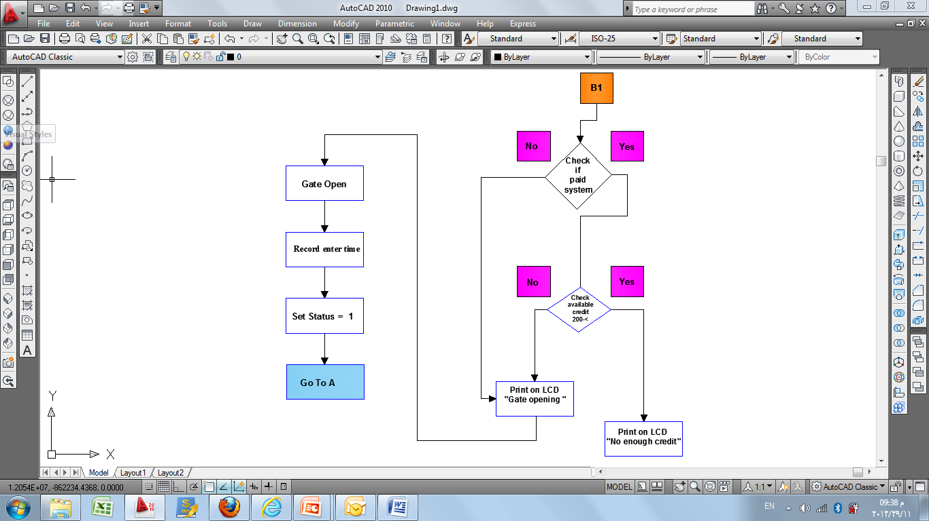
Flow Chart

Slide 11
SWOT Analysis
Strengths
Weaknesses
Threats
Opportunities

Slide 12
STRENGTHS
Existing RFID Technology.
Used Widely In Different Applications.
RFID Doesn't Need a Close Distance.
SWOT Analysis

Slide 13
WEAKNESSES
Separated Standardization Of Technologies.
Still Some Challenges With Basic Issues(interference of material, collision etc.) .
Jamming on RFID.
Typically Need Short Distances.
SWOT Analysis

Slide 14
THREATS
Standardization Can Not Be Done On Global Level.
Other Technologies May Replace RFID In Some Potential Applications.
SWOT Analysis

Slide 15
OPPORTUNITIES
Can be used in different application like:
Toll road
Public parking system
Private parking system
Shopping malls
SWOT Analysis

Slide 16
Economical Study
The cost of the component that we used in our project:
RFID Reader(ID20) :180 NIS
Microcontroller : 170 NIS
RF Tag: 20 NIS
Servo Motor : 100 NIS
Wire and Board: 30 NIS
Total cost : 500 NIS

Slide 17
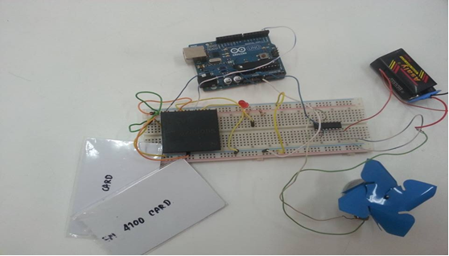
Earlier Course Work
We connected the circuit as shown below:
Next

Slide 18
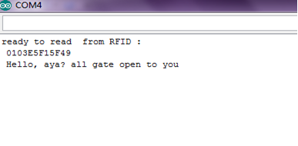
Earlier Course Work
After we applied the programed ,we used an allowable RFID Tag.
Next

Slide 19
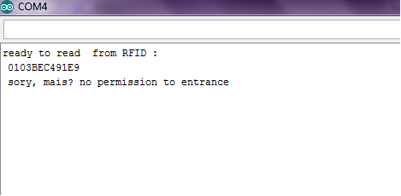
Earlier Course Work
When unallowable ID tag used

Slide 20
Results And Discussions
We accomplished the hardware that monitors the time of entry and exist of the car.
We checked if the system paid or not, calculated the cost in case the system is paid.
We created database and web page, sent all information to web page, each user has a profile.
Next

Slide 21
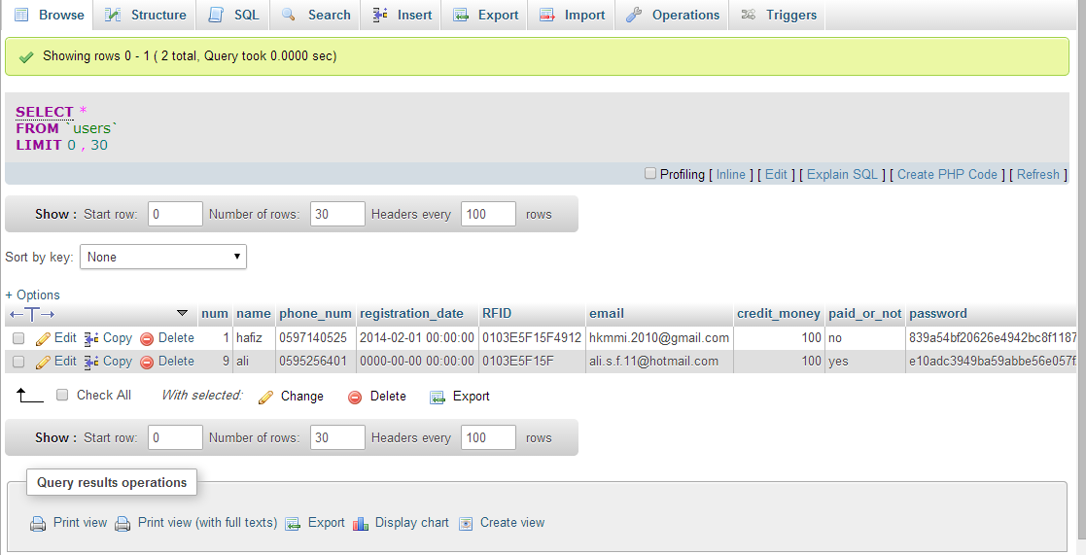
Results And Discussions
we created database and stored two users, one of them for paid system and another for non-paid system.
Next

Slide 22
Results And Discussions
In this project we have three cases:
Allowable User With Paid System.
Allowable User With Unpaid System.
Unallowable User.

Slide 23
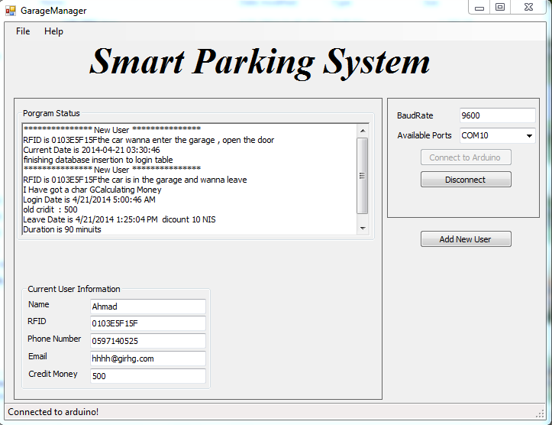
Results And Discussions
Allowable User With Paid System.
Next
Notes:
When the car want to enter the garage the RFID reader reads the tag and set the time of entering, store the data database and open the door as shown:
When car want to leave the garage, reader read the tag, calculate the cost in paid system
Calculate the duration that car found in garage and send all this information to web page
That user has an account in it.

Slide 24
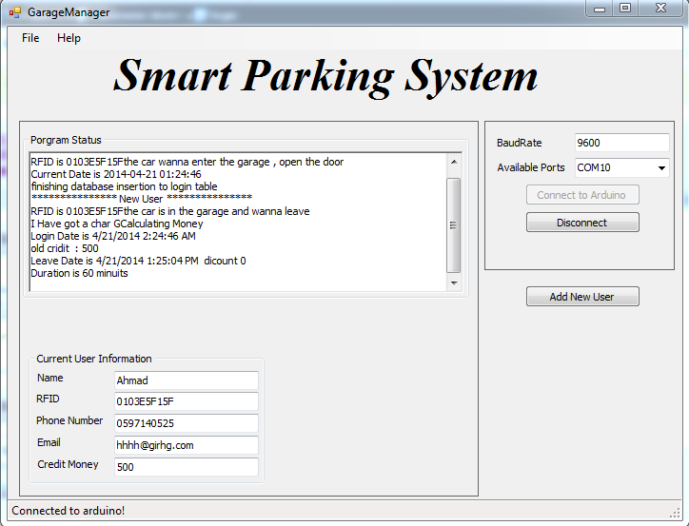
Results And Discussions
Allowable User With Unpaid System.
Next
Notes:
When car want to leave the garage, reader read the tag for unpaid system, Calculate the duration that car found in garage and send all this information to web page that user has an account in it.

Slide 25
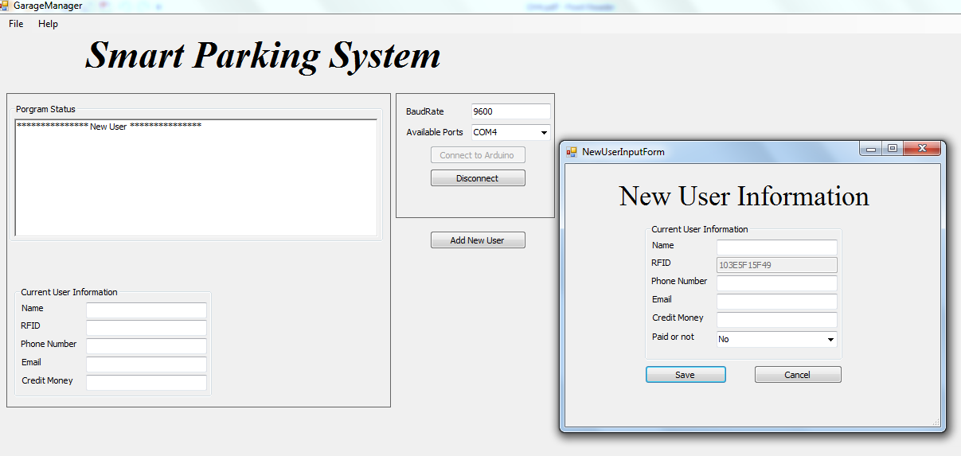
Results And Discussions
Unallowable User.
We have two options: add this tag to database like new user.
Next
Notes:
When the car want to enter the garage and the tag not found in database, we have two options: prevent this car to enter, or add this tag to database like new user as shown below:

Slide 26
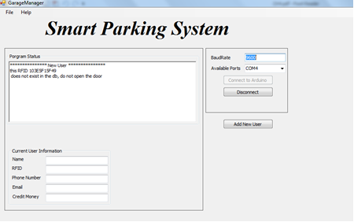
Results And Discussions
Or prevent this car to enter
Next

Slide 27
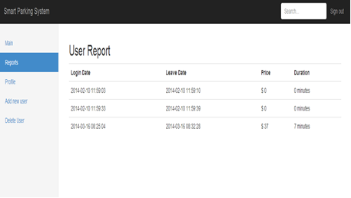
Results And Discussions
All data will send to webpage:
Next

Slide 28
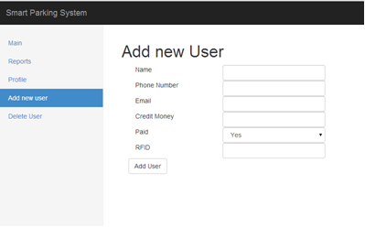
Results And Discussions
Admin can add and delete the user as shown:
Next

Slide 29
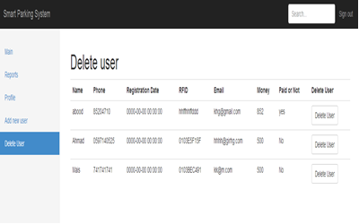
Results And Discussions

Slide 30
Conclusions
The project offered us lots of services we need to keep up with this stage such as:
Saving Time And Efforts.
Solving Problems Of Illegal Parking, Reduction Of Traffic Jam.
Offering More Safety Parking Which Have High Technique That Helps To prevent Accidents.
Logging Full Record For Each Vehicle (time entering, leaving ,cost).

Slide 31
Recommendations
The ability to develop this project could be done in many fields:
In our project we used RFID with range 15cm, we recommend to use wide range.
In our project we used servo motor with torque 1.8 Kg-cm, we recommend using motor with larger torque.
We recommend applying this project in our university to save time and effort.
End

Slide 32

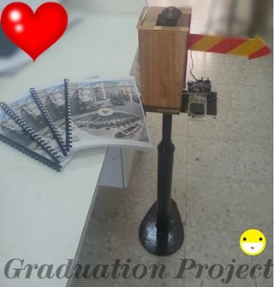

Aya Al Fouqha
Mais Al Masri

Slide 33
