Slide 1

An-Najah National University
Faculty Of Engineering
Building Engineering Department
Graduation project II
Design of an environmental and energy efficient bank building

Slide 2
Supervised by:
Dr. Muhannad Haj Hussein
Prepared by:
Amani Mosleh
Salam Alzoubi
Mohannad Ghannam
Waed Hamad

Slide 3
Outline
Site of the project
Architectural Design
Structural and Seismic Design
Environmental Design.
Electrical Design
Mechanical Design
Safety Design
Conclusion.

Slide 4
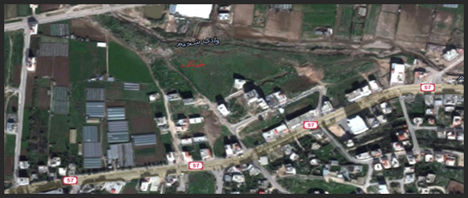
Site of the project
Location and Site: Area = 2300 Square Meter.

Slide 5
Architectural Design

Slide 6
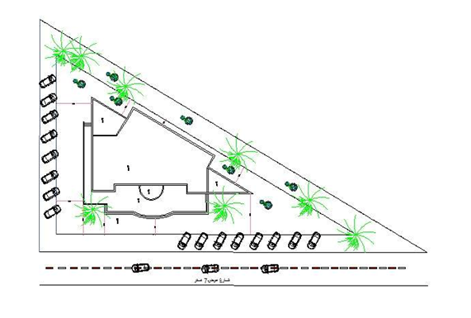
The site plan for the project

Slide 7
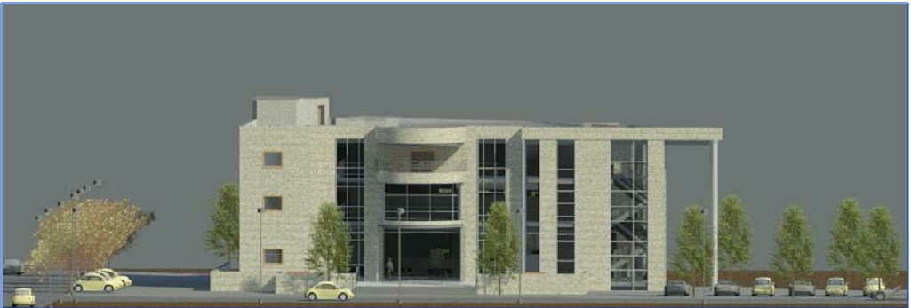
Rivet

Slide 8
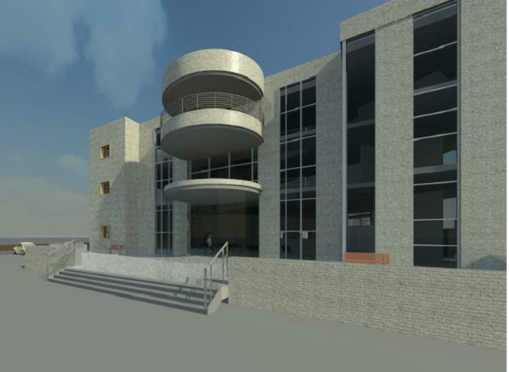

Slide 9
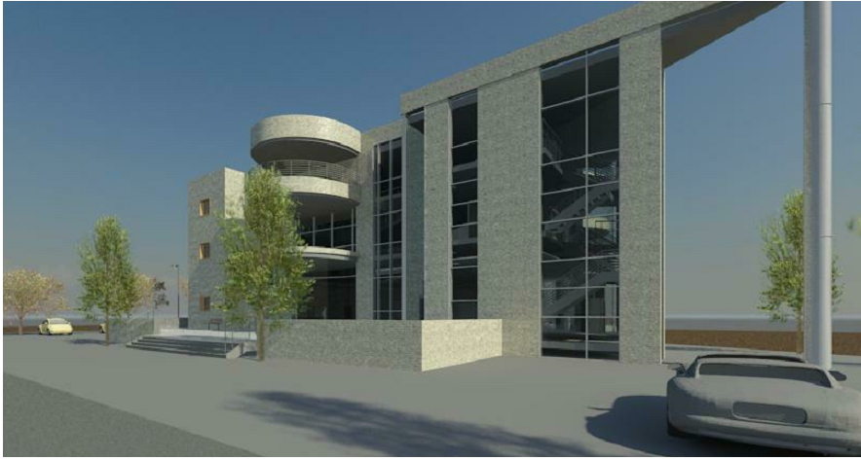

Slide 10
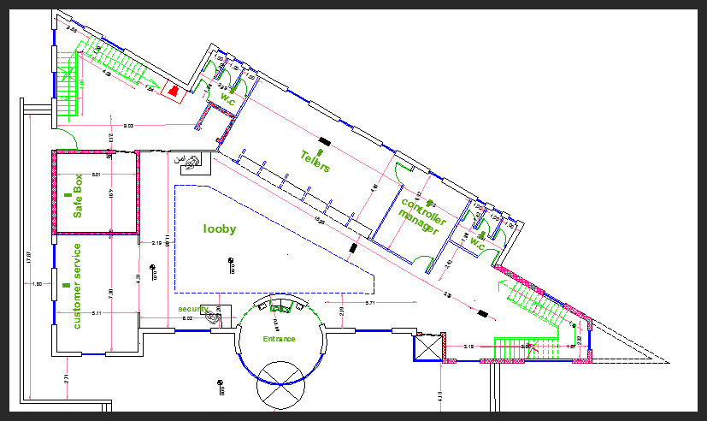
Ground floor plan (Area = 480 m2)

Slide 11
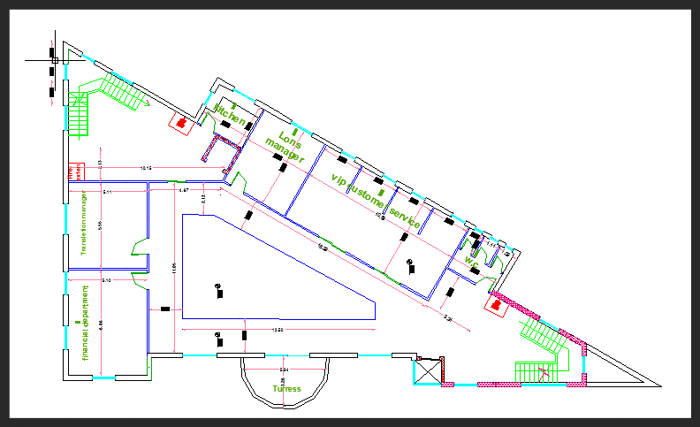
First floor plan (Area = 480m2)

Slide 12
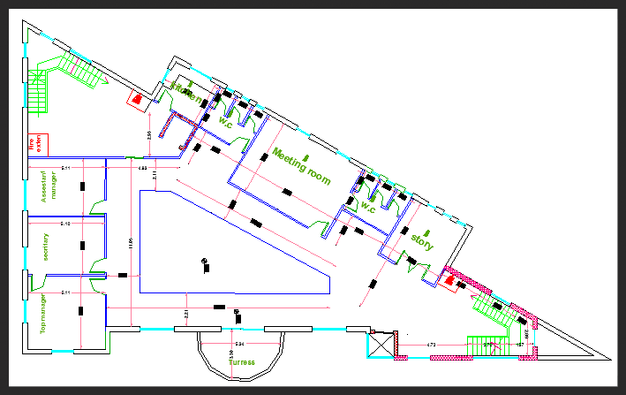
Second floor plan (Area = 480 m2)

Slide 13
Elevation

Slide 14
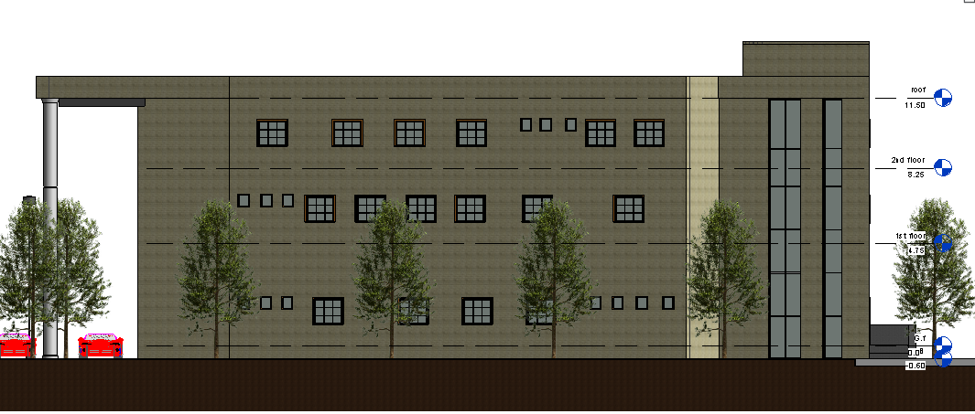
North Elevation

Slide 15
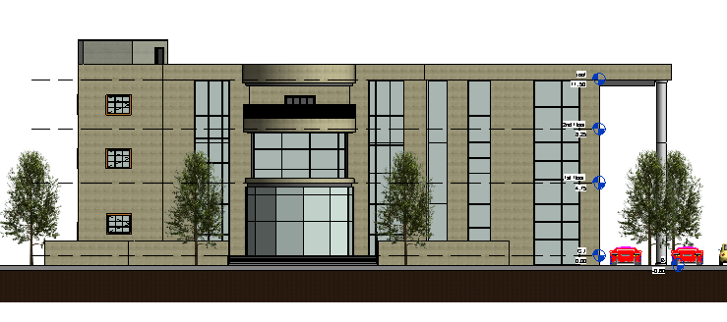
South Elevation

Slide 16
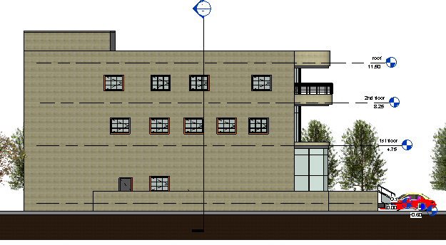
West Elevation

Slide 17
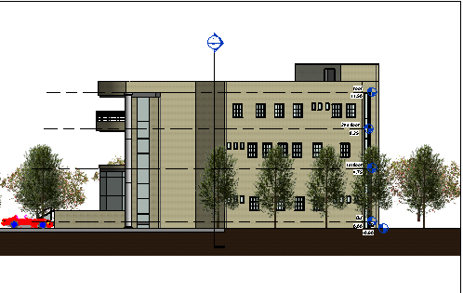
East Elevation

Slide 18
Section

Slide 19
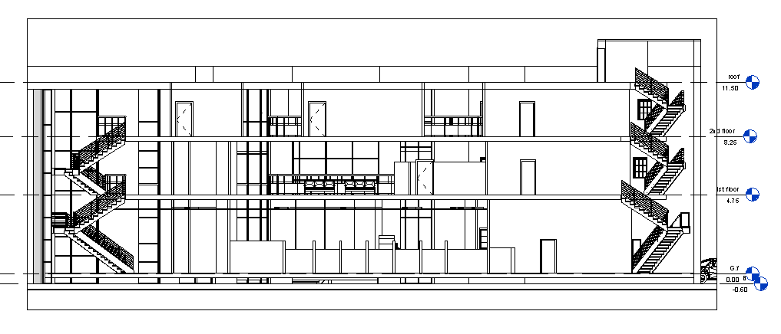
Section A-A

Slide 20
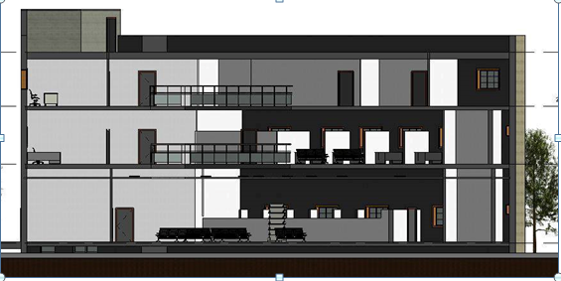
Section B-B

Slide 21
Structural and Seismic Design

Slide 22
Codes of design
The American Concrete Institute code ACI 318-08.The seismic design according to UBC-97. The analysis and design were done using sap program

Slide 23
Design Data
Concrete Compressive Strength :
F’c =24 Mpa For Slabs, Shear Wall,Footing .
F’c =28 Mpa ForColumns&Beam.
Yielding Strength Of Steel :The Yield Strength of Steel Fy= 420 mpa

Slide 24
Structural System
Ribbed slab with drop beams
Thickness of slab :
The longest span (two end continues) = 600 Cm.
The Thickness Of Slab (H) = Ln/21 = 600/21 = 28.5cm
The Thickness Of Slab (H) = 30cm

Slide 25
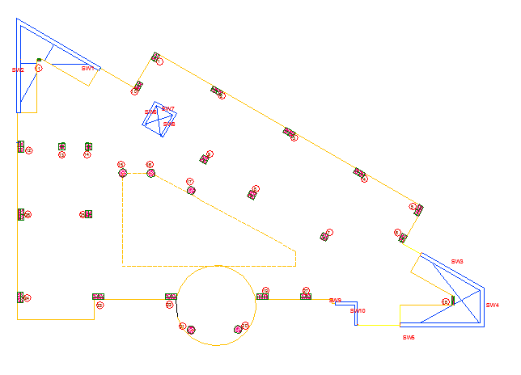
The distribution of columns and shear walls in the building

Slide 26
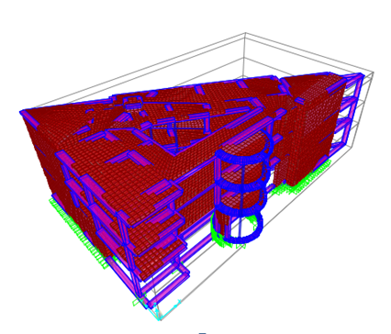
3D modeling from Sap Program

Slide 27
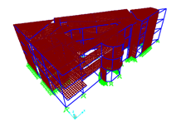
Check model: Compatibility Check

Slide 28

Equilibrium Checks

Slide 29
Seismic Design Using Response Spectrum – UBC 97:
W = 31219.5KN
Soil type SE
I = 1.25
R = 5.5
Cv = 0.50
Ca =
= 0.34 sec.
V = 532.1 ton.

Slide 30
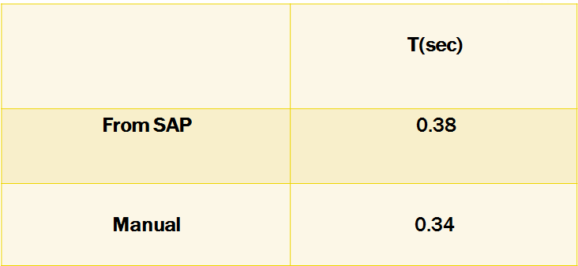
Natural Period (T) for the building:

Slide 31
Structural systems design

Slide 32
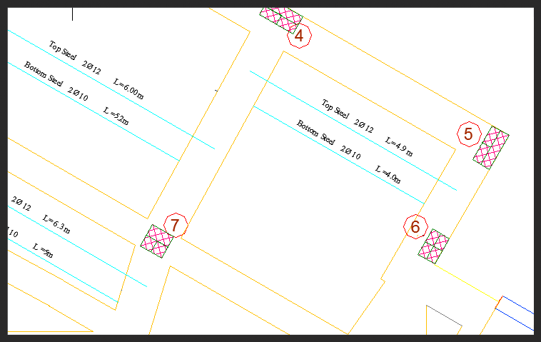
Slab design

Slide 33
Beam design

Slide 34
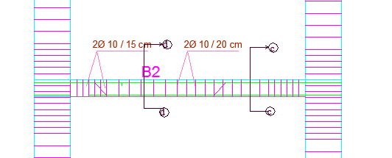
1. Main Beam Design

Slide 35
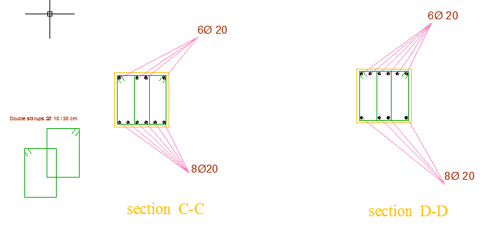
Details for the beam

Slide 36
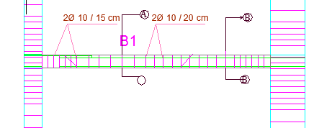
2. Secondary Beam Design

Slide 37
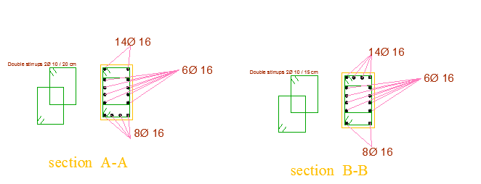
Details for the beam

Slide 38
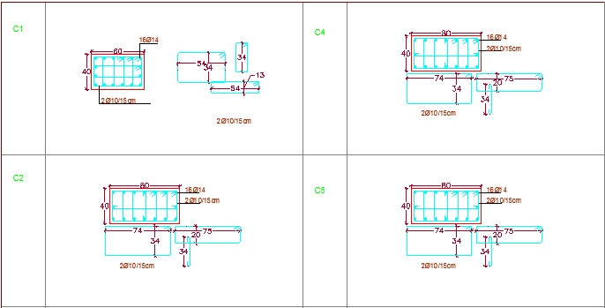
Column Design

Slide 39
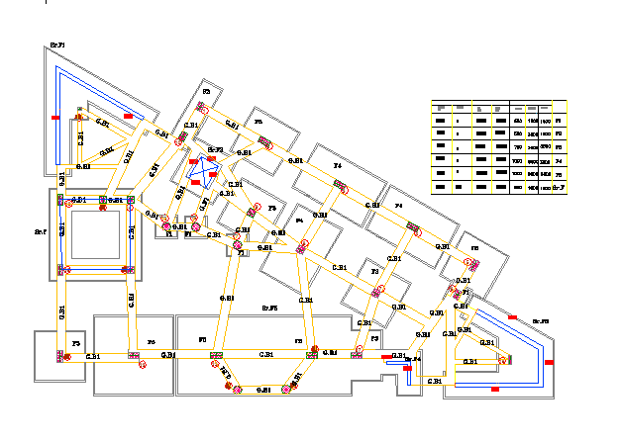
Footing Design

Slide 40
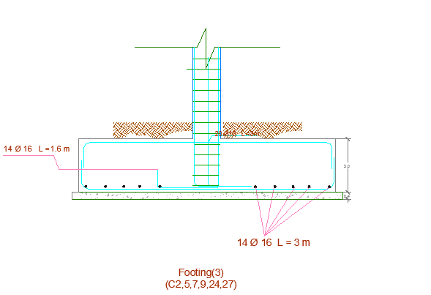
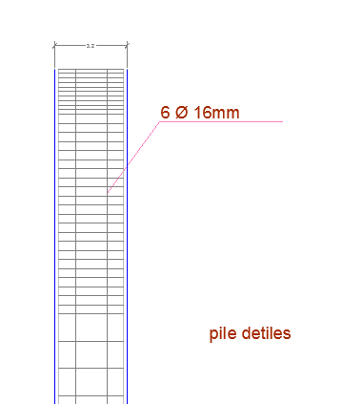
Details for the pile footing

Slide 41
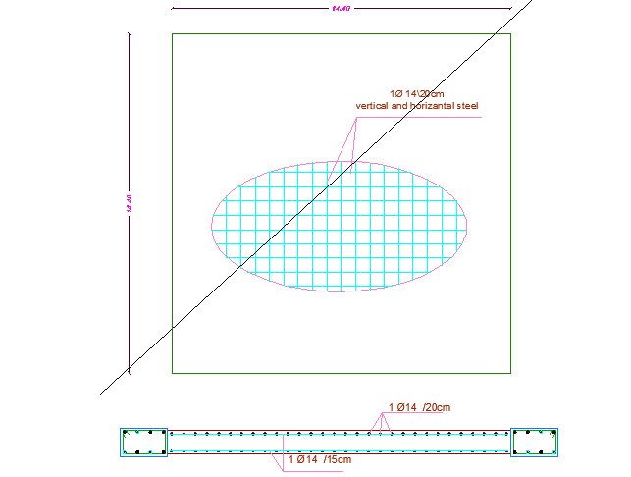
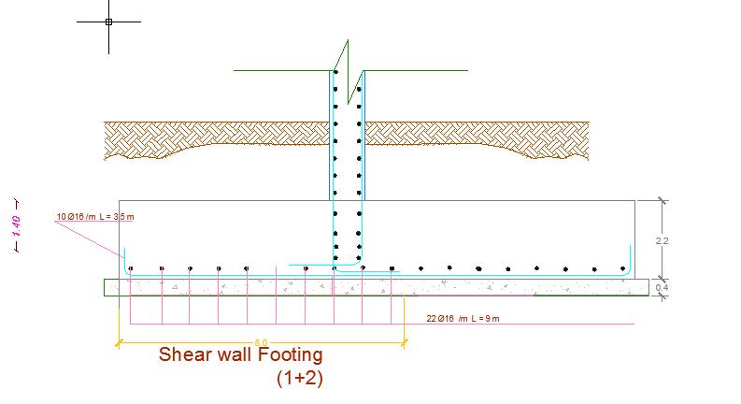
Wall Footing

Slide 42
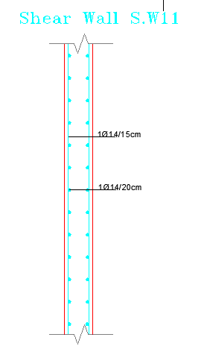
Shear wall design

Slide 43
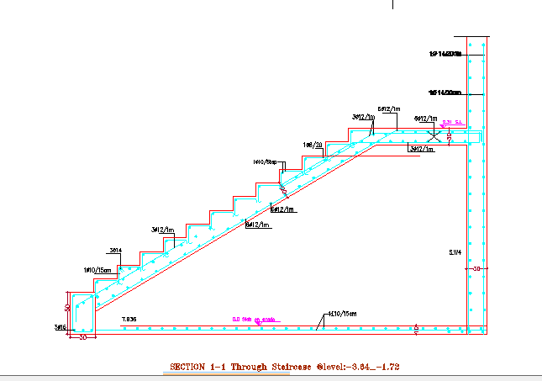
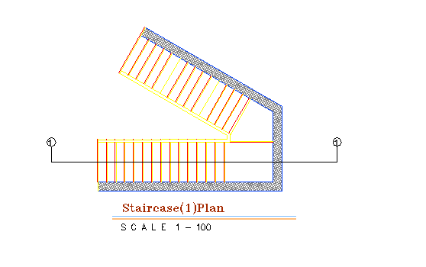
Stairs design

Slide 44
Environmental Design

Slide 45
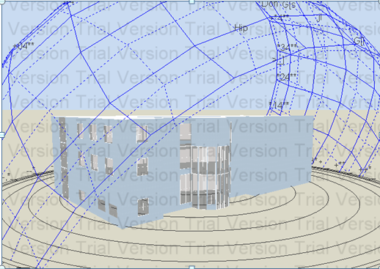
Design Builder Was used for Thermal performance analysis and Simulation

Slide 46
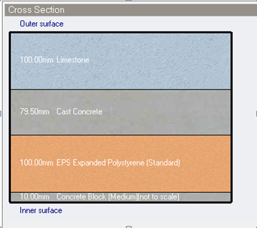
1. Insulation : insulation 10cm.
Layers of external walls in original building
U = 0.345 W/m2-k

Slide 47
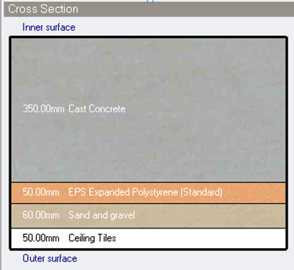
Layers of floors and ceilings
U = 0.371 W/m2-k

Slide 48
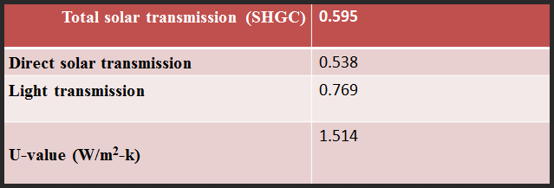
2- Glazed area-type of glass in building
Type of glass used: Dbl Clr 3mm/13mm Arg

Slide 49
3.Used Mechanical ventilation
4.Shading :
In the south windows we used one horizontal louver above the window and vertical louvers in both left and right of the windows.

Slide 50
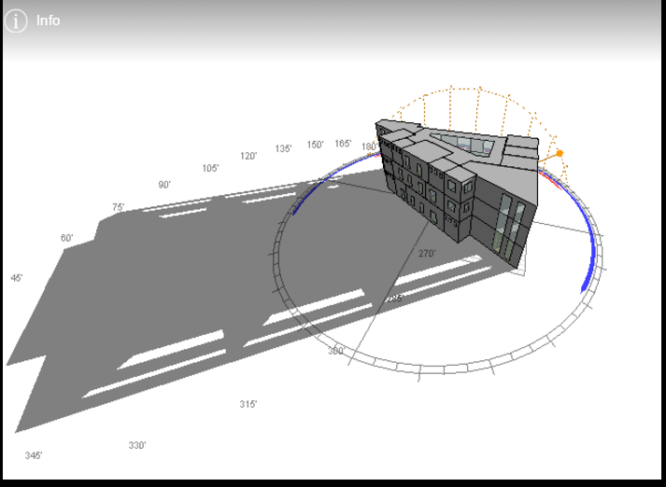
Shading
1/1 at 2:30

Slide 51
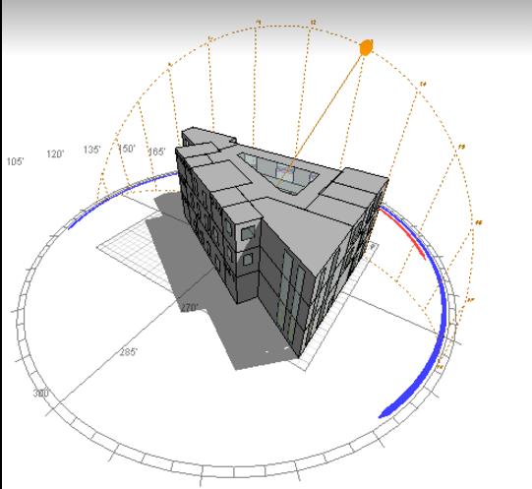
1/7 at 2:30

Slide 52
Environmental Design Results - Simulation
Energy consumption intensity per total building area = 139.01kWh/m2 The design is energy efficient .

Slide 53
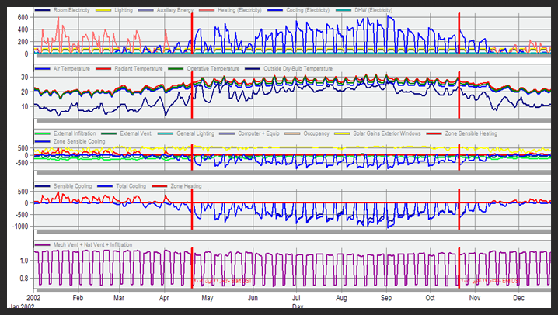

Slide 54
Environmental Design Results – Heating Design
Heating Load design: Total design heating capacity for building = 93kW.District heating intensity per total building area = 17.40KWhr/m2

Slide 55
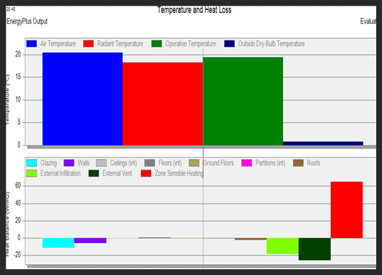

Slide 56
Environmental Design Results – Cooling Design
Cooling Load design: Total design cooling capacity = 101.86 kW District cooling intensity per total building area = 84.48 KWh/m2

Slide 57
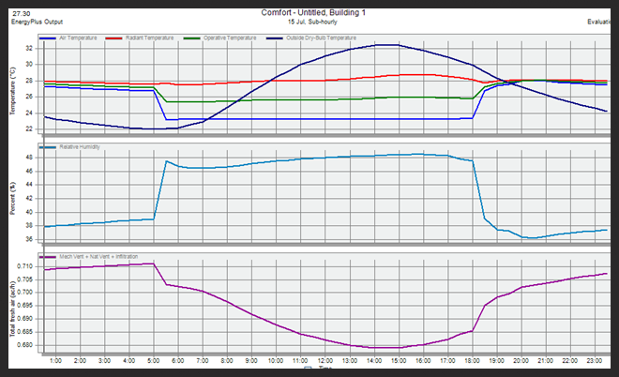

Slide 58
Daylight Analysis
Reception hall: Type of glass used: Dbl Clr 3mm/13mm Arg Light transmission = 77%Average calculated DF= 3.87%Recommend value from specifications =3.42%Calculated value> Required
Pass

Slide 59
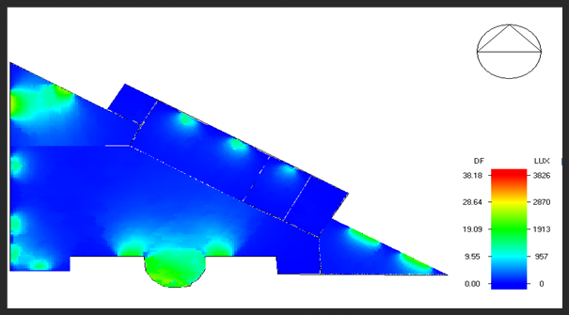
Daylight factor diagram for the building Generated by Design Builder

Slide 60
Acoustic design
Absorptive materials we used in the building:

Slide 61
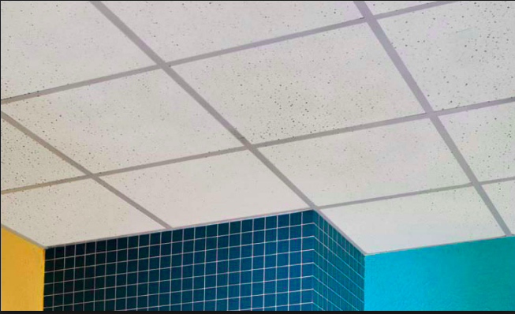
Acoustic Tile board suspended
NRC vary from 0.75 to 0.88

Slide 62
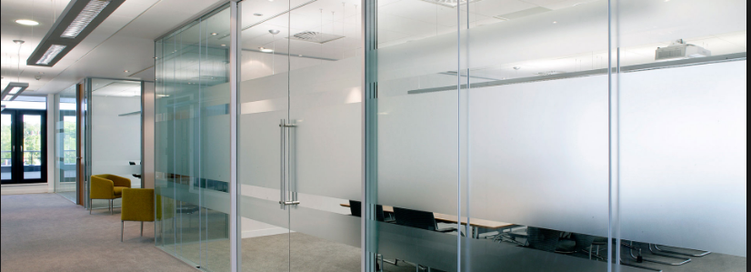
Acoustical for glass
NRC vary from 0.01 to 0.05

Slide 63
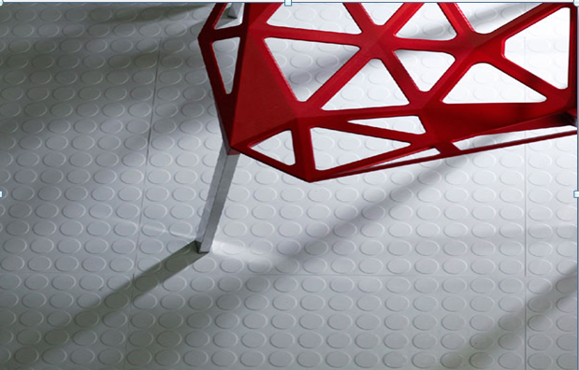
Acoustical for Floor rubber tile
Sound absorbent:
elasticity can reduce noise from walking and wheel chairs by up to 18 decibels.
Resistance to heavy impact loads.
No health or environmental concerns.
Recyclable.
Easy to maintain.
NRC vary from 0.01 to 0.03

Slide 64
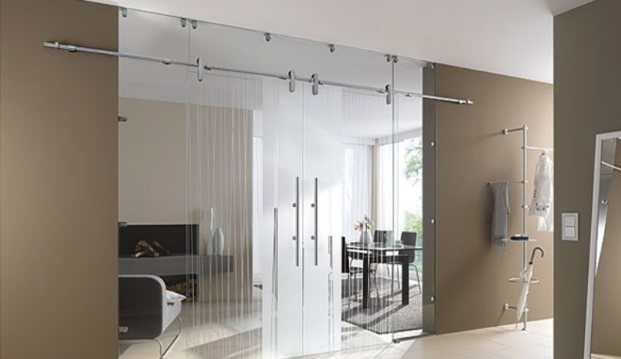
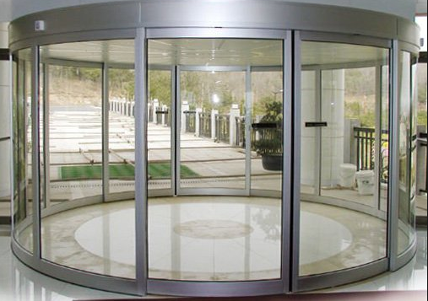
Acoustical for glass sliding doors
NRC vary from 0.01 to 0.51

Slide 65
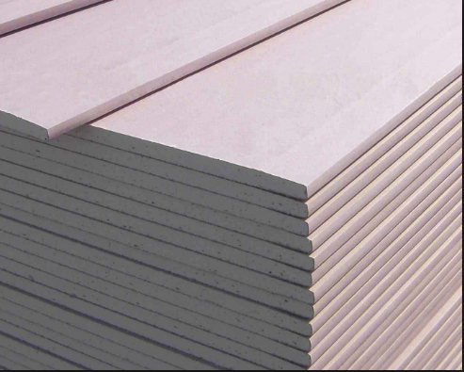
Acoustical for gypsum board
NRC vary from 0.04 to 0.29

Slide 66
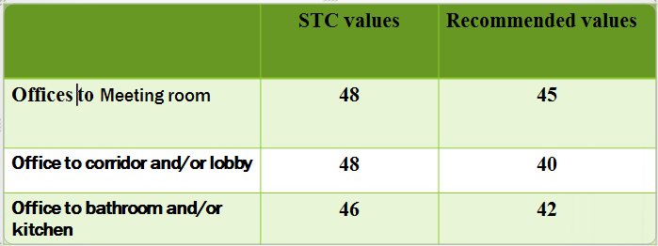
Sound Transmission class (STC)

Slide 67
Reverberation Time (RT60):

Slide 68
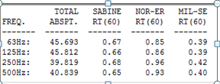
A sample of customer services
Reverberation Time (RT60) results :
0.35-0.75

Slide 69

RT60 from 0.35-0.75

Slide 70

Reverberation Time (RT60) results before improving :

Slide 71

RT60 from 0.5-0.8

Slide 72
Electrical Design

Slide 73
Artificial Lighting Design
Functions Designed by DIALux 4.13

Slide 74


Manager room
Average illuminance on workplace =460Luxand the recommended illuminance 500 Lux

Slide 75

Main Types of lamps

Slide 76

Tellers

Slide 77

Average illuminance on workplace =632Luxand the recommended illuminance = 500 Lux

Slide 78


Slide 79

Lighting arrangement

Slide 80

Mechanical Design

Slide 81


Water Supply Design
Use auxiliary pump with +6 psi at second floor and +12 psi at third floor

Slide 82

small roof tank (10m3) and pump is used.
Small water tank is to ensure adequate water pressure in the building. And it allows the user to have both water pressure and water supply in case where there is no electrical power.

Slide 83

Water supply for ground floor

Slide 84

Water supply for first floor

Slide 85

Water supply for second floor

Slide 86

Drainage system
ground floor

Slide 87

Ground floor

Slide 88

1st floor

Slide 89

Second floor

Slide 90

HVAC System Design
We use VRF system total design cooling capacity = 80.40 kW

Slide 91

To cover this needs we will use 3 outdoor units of Mitsubishi PUZ-A30NHA4 type that has 30 KW cooling load and 32 KW heating load

Slide 92
Diffuser selection
We selected 450*450 mm size Each diffuser will cover about 20 m2.Use 18 diffusers for each G.F and F.F with area 360 m2Use 21 diffusers for second floor with area 415 m2

Slide 93


Slide 94

we used two types of indoor units * Type 1: Unit with 4.5KW cooling capacity and 5KW Heating capacity * Type 2: Unit with 3.6 KW cooling capacity and 4 KW Heating capacity

Slide 95

Safety Design

Slide 96
Emergency Exists for ground floor
Firefighting system: We used different types of firefighting system depends on the type of function in the building for example: For offices and waiting areas we used water sprinkler system, hose stations, Fire extinguishers, smoke detector and alarm system.

Slide 97


Types of fire systems:
Fire hose
Smoke detector

Slide 98

design of sprinkler we assumed each sprinkler cover 12m2
For G.F Area =340 use 29 sprinklers

Slide 99

Distribution of Fire Fighting system

Slide 100


Slide 101

Quantity Surveying

Slide 102


