Slide 1

  An Najah National University
  Graduation project 2.
  Deir Al-Hatab Mosque.
  Submitted to : Dr.Munther Diab .
Prepared by : Rana Abu hamed.
Inas Hanoon.
Bara’ah Al Thaher.

Slide 2
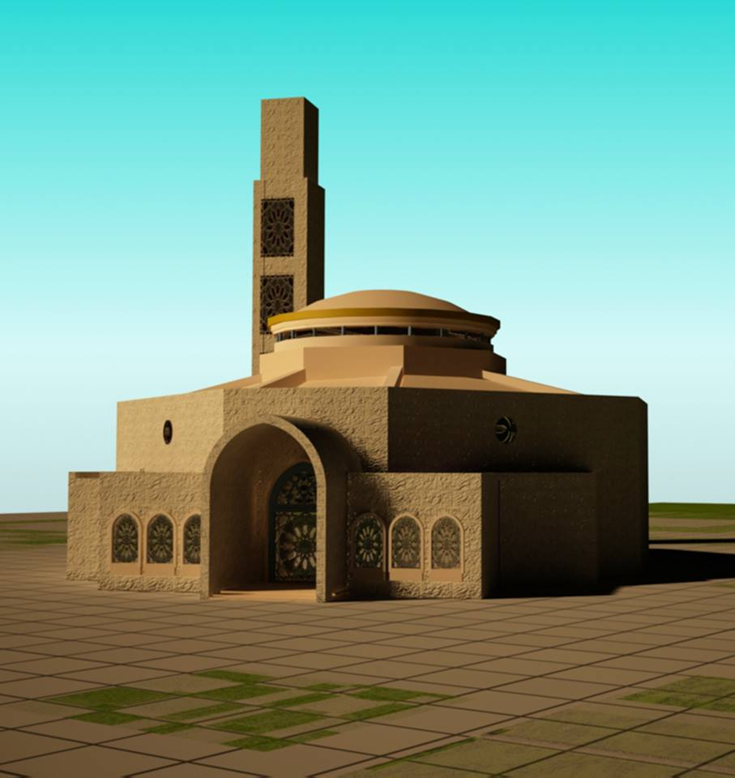


Slide 3

Outline:
Introduction.
Design criteria.
Loads.
Materials.
Dynamic analysis and design.
SAP analysis.
Structural elements.
Steel preliminary design.

Slide 4
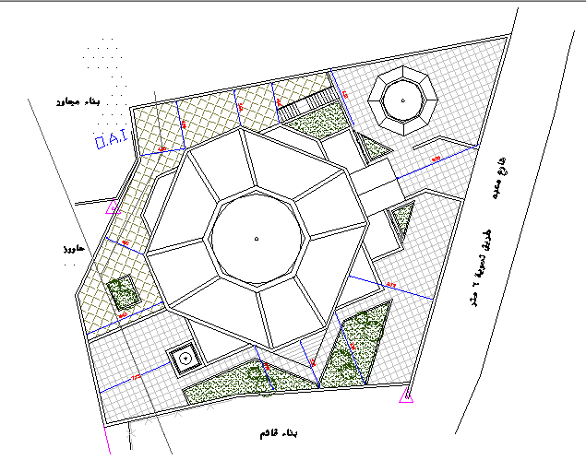
Introduction :

Slide 5
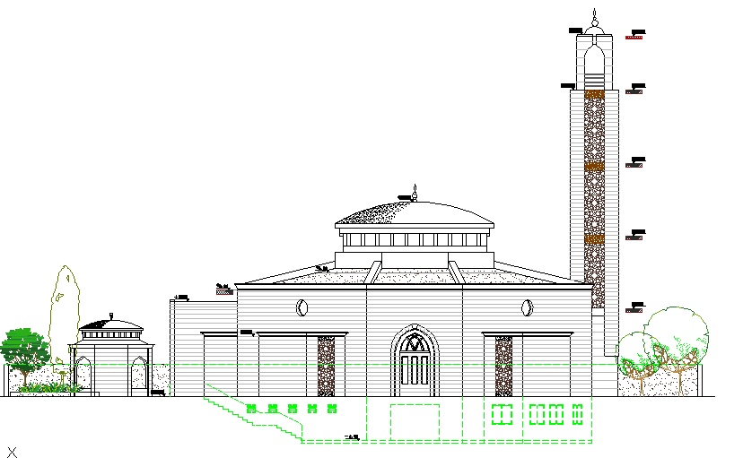

Slide 6
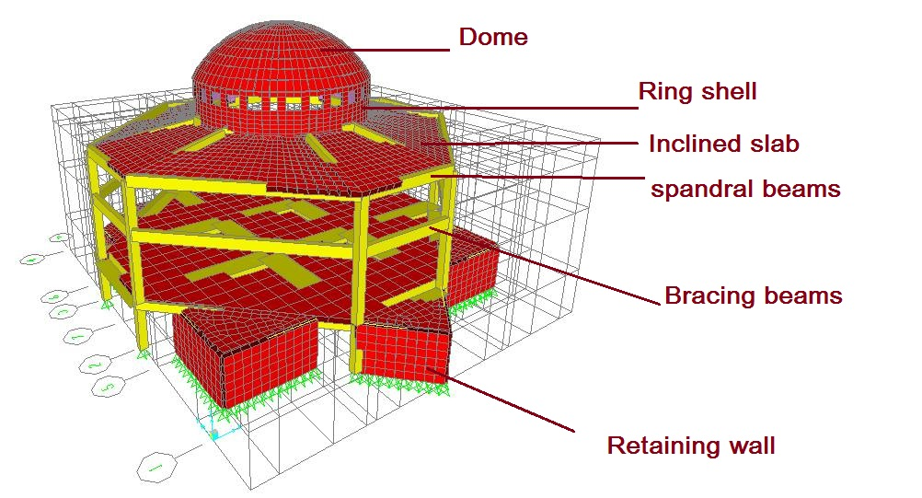
Modeling

Slide 7
Different types of analysis and design are done in this project in order to choose the most safe and economical type and method for the design.
Then :
Ribbed slab system was considered in 1st floor
solid slab system was considered in 2nd floor
Flat
Solid
Ribbed

Slide 8

Design criteria :
These two criteria are:
Strength criterion.
Serviceability criterion.

Slide 9
Loads .
loads
Gravity
Dead
Live &
snow
Lateral
earthquake

Slide 10
Referring to ACI code and reality , we assumed live load to be 6 KN/m², super imposed were calculated as follow
Super imposed = (.02*19)+(.07*15)+(.02*19)+(.03*22)=2.5 kN/m² .
for inclined slab, we assumed the live load to be 0.1 from live load on floor slab = .6 KN/m²
Super imposed = 1.9* .02 = .038 KN/m²
 | ɣ (kN/m²)
plaster | 19
Sand | 15
mortar | 19
tile | 22

Slide 11
Referring to ACI equation , we determined depth of slabs in order to calculate own weight , then ultimate load on it
(Wu)
Slab | Flat plate | Two way ribbed | Two way solid
H (m) | .27 | .4 | .18
Own weight(KN) | 6.75 | 2.82 | 4.5
Wu(KN/m₂ ) | 20.7 | 16 | 18

Slide 12
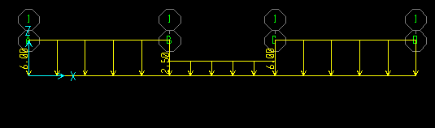
Load cases:
To get the critical case of loading :
Max positive moment on exterior span

Slide 13
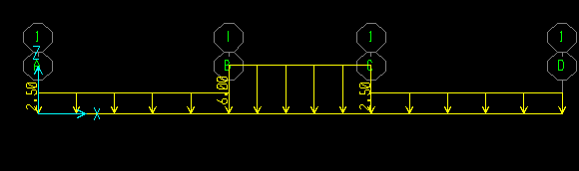
Max positive moment in interior span

Slide 14
Materials
Concrete strength = 24 Mpa.
Steel yield strength = 420 Mpa
unit weight of concrete = 25 KN/m³
modulus of elasticity (Ec) = 23*10^³ Mpa

Slide 15
Systems
Frame system
Shell system
Beams
Inclined slabs
Ring
Beams
Columns
slabs
Dome

Slide 16
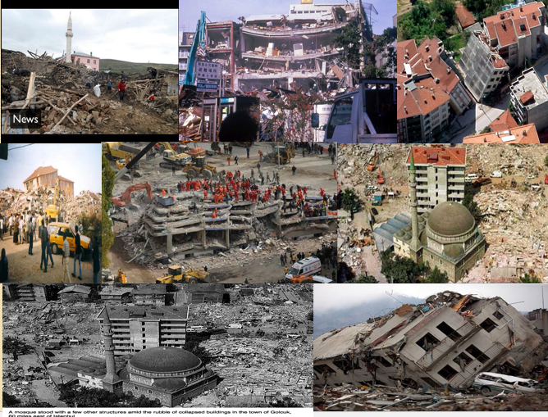

Slide 17
Dynamic analysis and design
After doing all static load analysis and make sure from all calculations of it by comparing all values with sap and do all required checks. We take into consideration dynamic analysis and design because its of important to the structure sustainability and stability .
The following tables shows the differences between manual, static and dynamic calculations .
All design values and detailing drawings are relative to dynamic values .
It can be noticed that all preliminary (static) dimensions remain the same before and after earthquake effect .

Slide 18
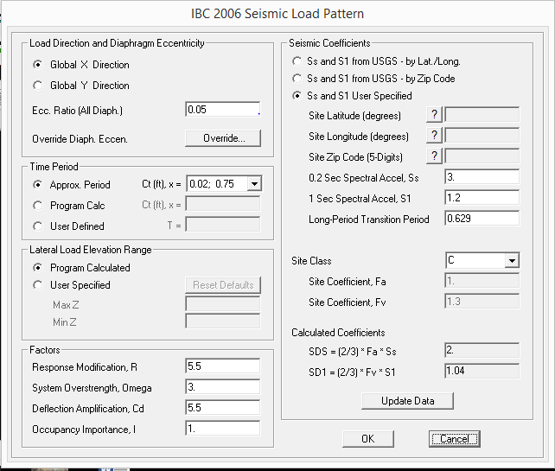
“SAP” Results

Slide 19
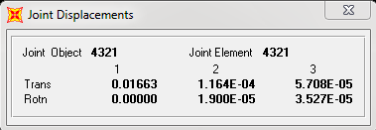
The following figure show deflection value from response spectrum.
response spectrum manual solution:
∆ = m*a /k = .0124
% of error = 9% <10% …ok

Slide 20
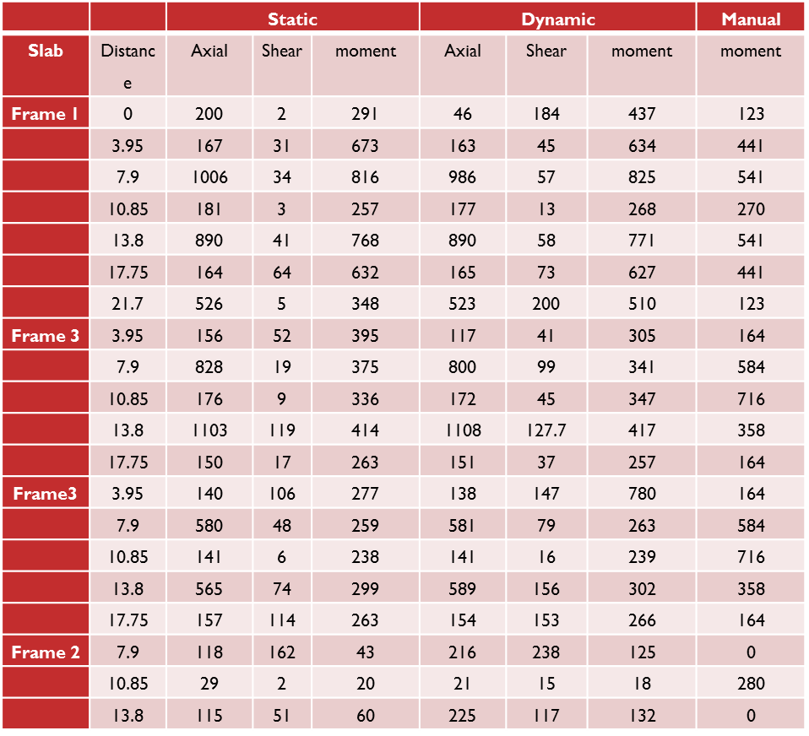
Table of slabs
1st slab (M11)

Slide 21
M22
 |  | Static |  |  | Dynamic |  |  | Manual
Slab | Distance | Axial | Shear | Moment | Axial | Shear | Moment | Moment
Mid-x | 0 | 278 | 10 | 430 | 319 | 148 | 515 | 123
 | 3.95 | 181 | 5 | 563 | 181 | 52 | 562 | 441
 | 7.9 | 887 | 41 | 680 | 840 | 74 | 682 | 541
 | 10.85 | 159 | 2.9 | 254 | 163 | 13 | 261 | 270
 | 13.8 | 840 | 42 | 734 | 840 | 39 | 246 | 541
 | 17.75 | 165 | 11 | 607 | 166 | 52 | 590 | 441
 | 21.7 | 467 | 3 | 223 | 474 | 238 | 414 | 123
Top-y | 3.95 | 131 | 117 | 248 | 135 | 143 | 250 | 164
 | 7.9 | 979 | 35 | 409 | 980 | 55 | 409 | 584
 | 10.85 | 165 | 28 | 349 | 165 | 60 | 350 | 716
 | 13.8 | 558 | 853 | 272 | 555 | 123 | 294 | 358
 | 17.75 | 161 | 31 | 226 | 151 | 60 | 230 | 164
Bottom-y | 3.95 | 134 | 116 | 246 | 130 | 144 | 284 | 164
 | 7.9 | 770 | 51 | 188 | 772 | 102 | 216 | 584
 | 10.85 | 161 | 22 | 334 | 130 | 34 | 255 | 716
 | 13.8 | 1009 | 100 | 450 | 983 | 107 | 434 | 358
 | 17.75 | 169 | 18 | 331 | 167 | 40 | 251 | 164
Small –y | 7.9 | 302 | 5 | 99 | 303 | 49 | 148 | 0
 | 10.85 | 12 | 1.5 | 25 | 13 | 16 | 25 | 280
 | 13.8 | 188 | 13 | 91 | 188 | 46 | 463 | 0

Slide 22
Table of beams
Beam | Axial static | Axial Dynamic | Moment Dynamic | Moment Static | Shear Dynamic | Shear Static | Moment Manual
B1 | -10/-27 | 158/-163 | 92/-43 | 14/4 | 161/-51 | 25/7 | 192
B2 | 4/1 | 68/-62 | 44/-34 | 5/1 | 3.5/-36 | -2/-6 | 262.7
B3 | 3.5/1.2 | 36/-39 | 17/-110 | -11/38 | -18/-92 | -11.125/-40 | 192
B4 | 0/1 | 82/-71 | 62/-38 | 9/3 | 25/-34 | 1/0 | 262.7
b5 | 341/285 | 355/168 | -43/-206 | 1/-6 | -49/-149 | 1/-5 | 72
B6 | 350/434 | -265/-420 | 7/2 | 0/-1 | -30/-49 | 4/-1 | 15.5
B7 | 397/493 | -376/-591 | 7/3 | 0/-2 | -7/-11 | 0/0 | -
B8 | 227/179 | 227/124 | 55/-169 | .7/.1 | -6/-47 | .3/0 | -
B9 | 145/103 | 165/85 | 193/-247 | -.6/3 | 61/-89 | .7/.2 | -
B10 | 1/-2 | 19/-49 | 37/-200 | 23/83 | -17/-141 | -20/-70 | 559.1

Slide 23
Table of columns
Column | Static axial | Dynamic axial | Moment dynamic | Moment static | Shear dynamic | Shear static | Manual axial
Rec(2.75) | 826/897 | 480/ 933 | 137/.38 | 110/70 | 49/.14 | 40/26 | 800
Rec (6.6) | 486/574 | 330/574 | 100/422 | 342/289 | 182/55 | 156/130 | 530
Circular | 664/972 | 408/971 | 6.7/1.7 | -4/-6.5 | 2.5/.6 | 1.5/2.3 | 800

Slide 24
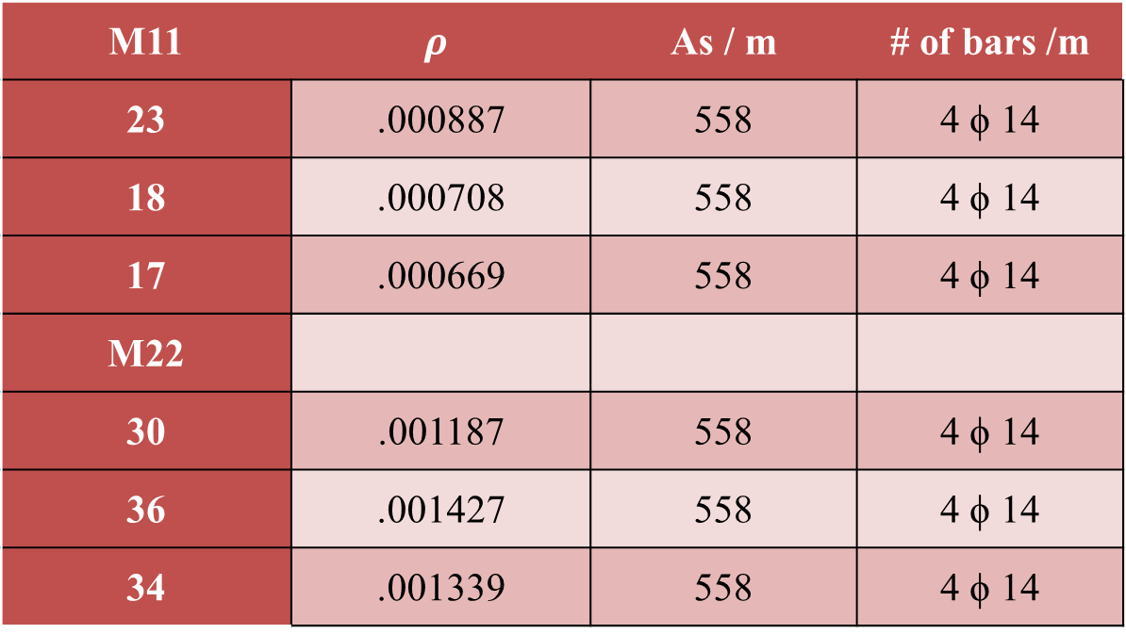
2nd floor (M11 & M22)
M11 | $$ρ$$ | As / m | # of bars /m
23 | .000887 | 558 | 4 ϕ 14
18 | .000708 | 558 | 4 ϕ 14
17 | .000669 | 558 | 4 ϕ 14
M22
30 | .001187 | 558 | 4 ϕ 14
36 | .001427 | 558 | 4 ϕ 14
34 | .001339 | 558 | 4 ϕ 14

Slide 25
structural elements:
Slab
Shell
Bearing wall
Beam
Column
Foundation

Slide 26
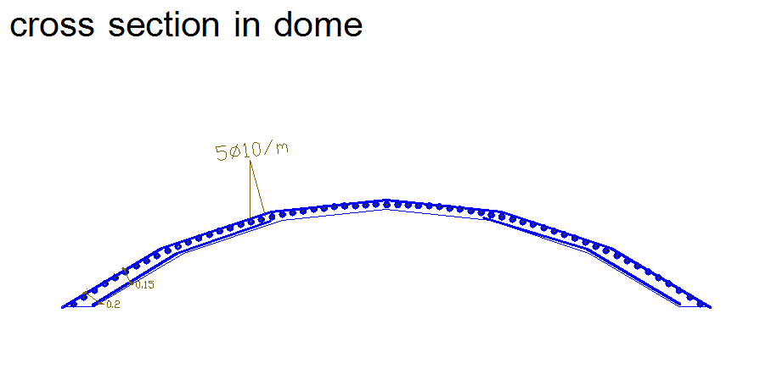
Shells
1.
Thickness = .15 m
Height = 1.95 m
Reinforcement :
Dome

Slide 27
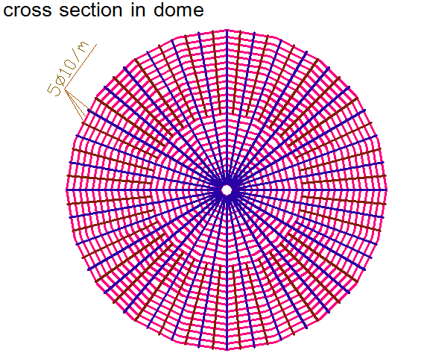

Slide 28
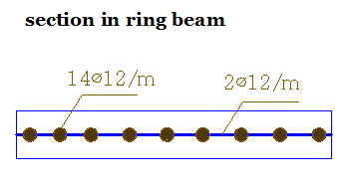
2.
Thickness = .15 m
Height = 2.45 m
Reinforcement :
Ring

Slide 29
Slabs
1.
Type : Ribbed slab
Thickness = .4 m
Reinforcement:
1st floor

Slide 30
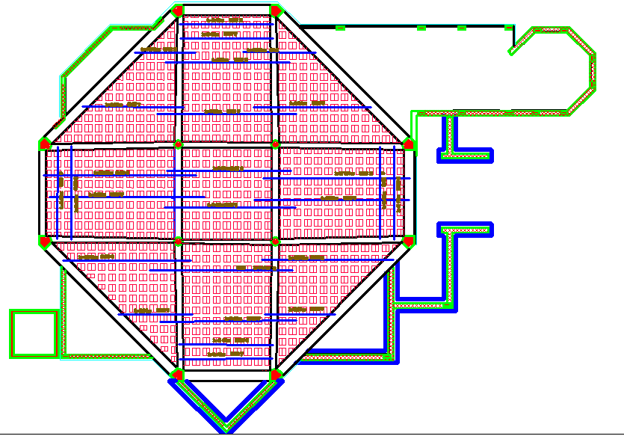

Slide 31
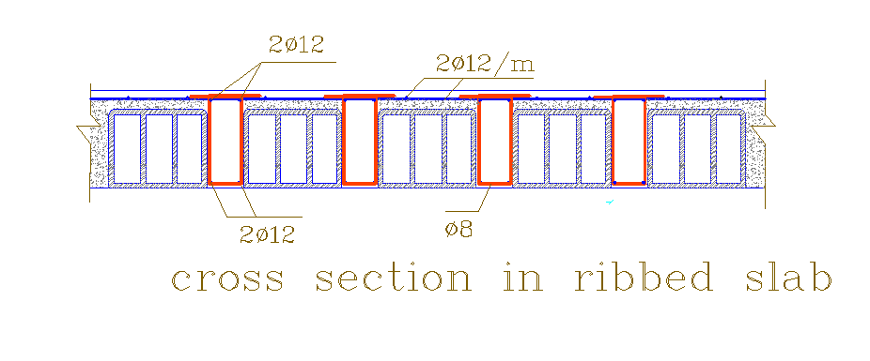

Slide 32
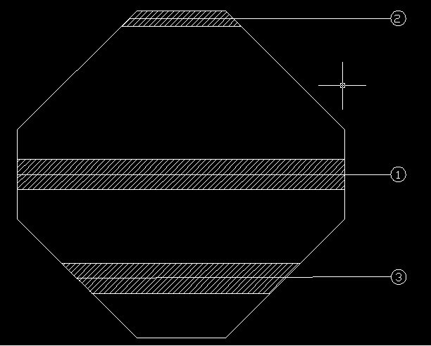
Frames :

Slide 33
2.
Type : inclined solid slab
Thickness = .30 m
Reinforcement:
2nd floor

Slide 34
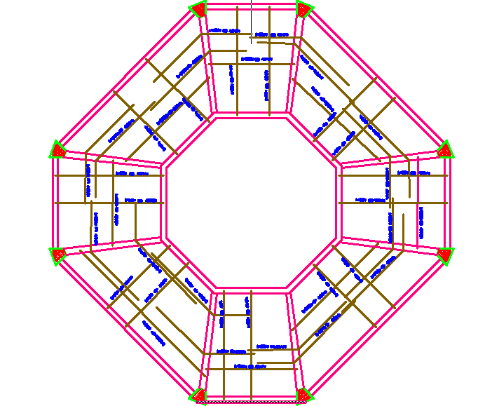

Slide 35
Columns
C1
Type : circular
Diameter = .35 m
Height =2.75 m
C2
Type : Rectangular
Dimensions = .45*.45 m
Height = 2.75 m
C3
Type : Rectangular
Thickness = .45*.45 m
Height= 6.6 m

Slide 36
Note
Columns in this project has 6.6 m high but in the same time, it subjected to small load so that we design it short column with braces to avoid buckling .

Slide 37
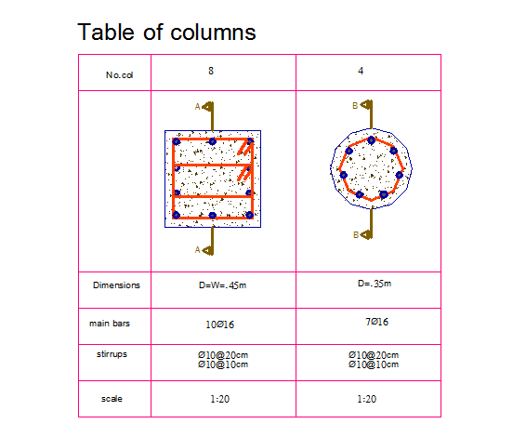

Slide 38
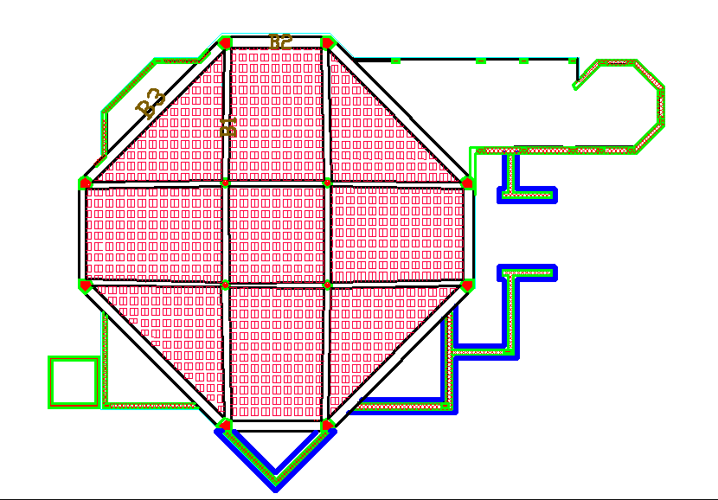
Beams
1.
layout
1st floor

Slide 39
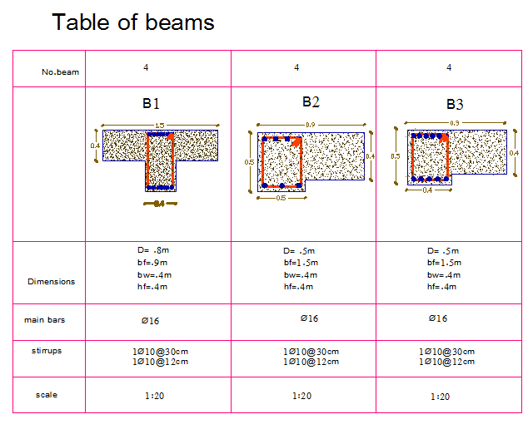

Slide 40
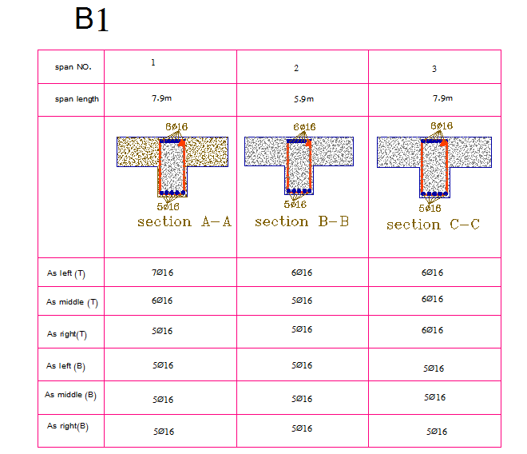

Slide 41
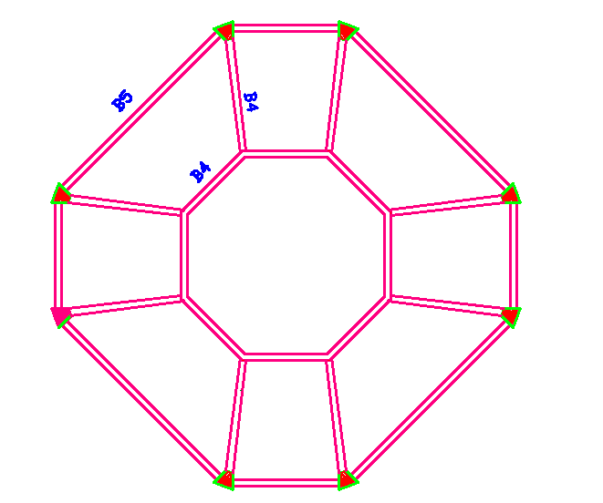
2.
layout
2nd floor

Slide 42
B4 :-
As shown in table above, beams are subjected to axial force.
Depending on the equation
If P_{u} < .1 * f_{c} * A_{g}
( design it as beam otherwise design it as column ).
591 > (.1* 24 * 300 * 600 )/1000
591 > 432 so design it as column .

Slide 43
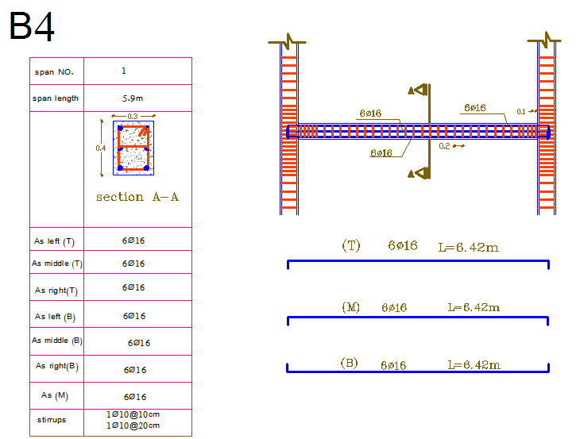

Slide 44
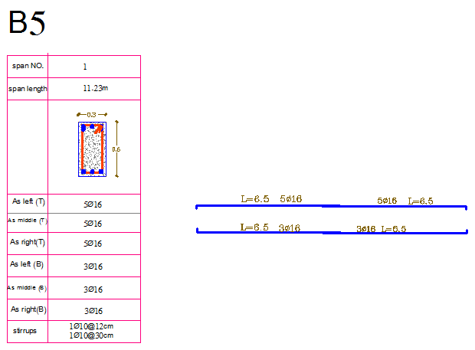

Slide 45
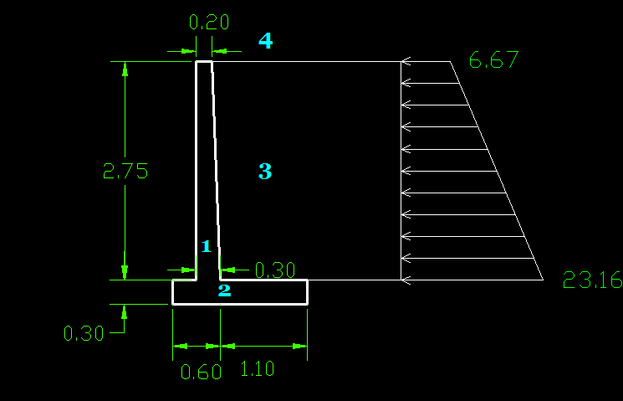
Bearing wall
Type : basement retaining wall
Dimensions :

Slide 46
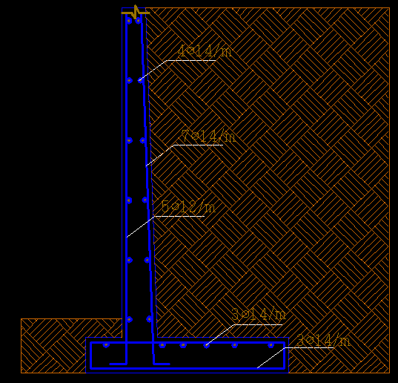
Reinforcement

Slide 47
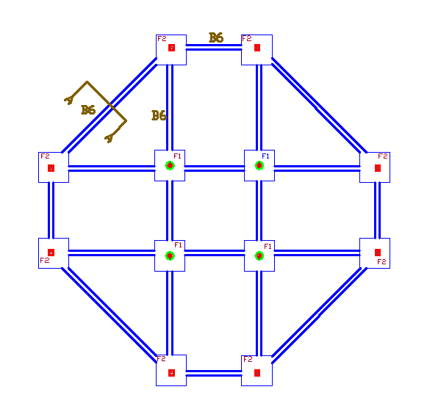
Footings
All footings were designed as Single footing except minaret footing designed as mat.
Layout:

Slide 48
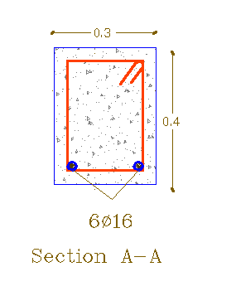
Tie beams

Slide 49
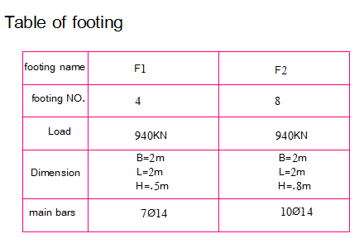

Slide 50
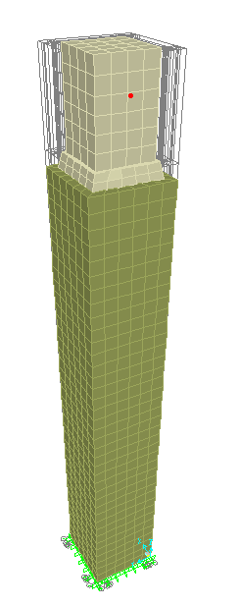
Minaret
minaret walls was designed depending on shear wall design process of intermediate frame as explained in chapter six . (6.3)

Slide 51
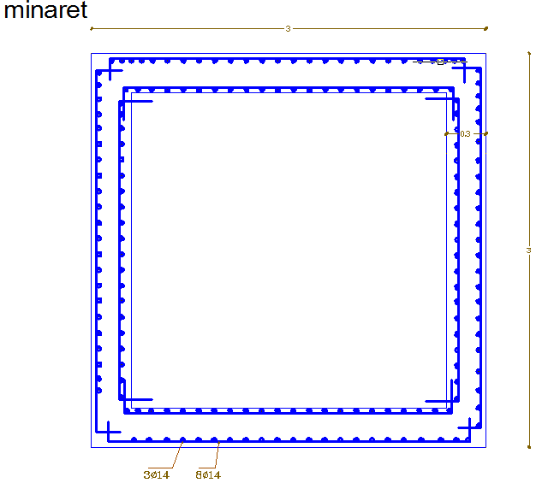

Slide 53
Steel preliminary design
1st floor Manual Calculations :
Live load = 6KN/m²
Dead load = 2.5 KN/m²
T = .1 m
Distance between girders = 2 m
ɣ _{concrete}= 25 KN/m²
A36 steel
F_{y} = 248mpa
F_{u} = 400 mpa
Wu = 12.6 KN/m²

Slide 54
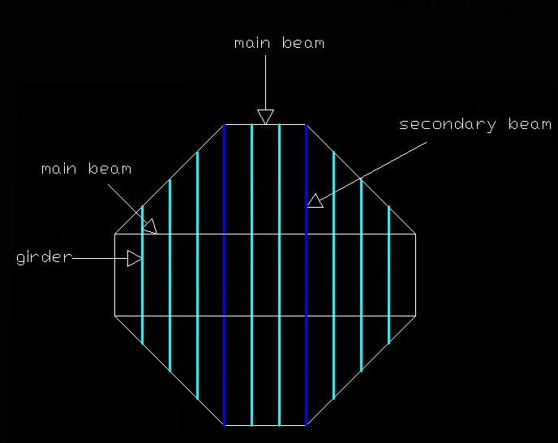

Slide 55
Beams design
Name | Section
B1 | W6*12
B2 | W6*8.5
B3 | W4*13
Girder | W14*211

Slide 56
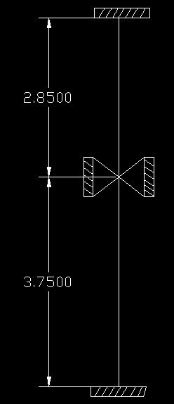
Columns design
Section : W10*19

Slide 57
2nd floor
Live load = .6KN/m²
Dead load = 25 * .02 = .5 KN/m²
T = .02m
ɣ _{concrete}= 25 KN/m²
A36
Wu = 1.56 KN/m²

Slide 58
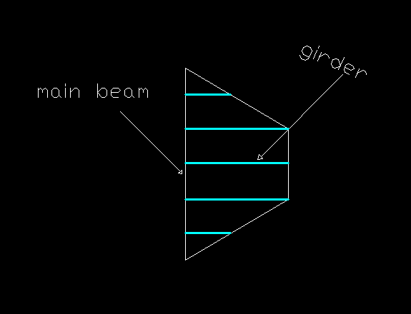

Slide 59
Beam design
Name | Section
B1 | W6*8.5
B2 | W6*8.5
B3 | W6*8.5
Girder | W14*211

Slide 60


