Slide 1


MOBILE
ROBOT
Ameer Mialeh
Zayd Falah
Supervisor:
Dr.Anas Toma

Slide 2

TABLE OF CONTENTS
Introduction
Features
Hardware Modules
Constraints
Future Work

Slide 3
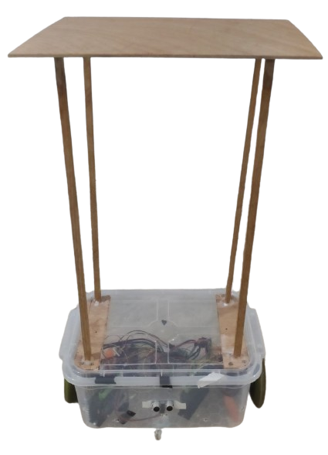
INTRODUCTION
Why we use mobile robot ?
We use mobile robot in our system to save time and effort that the waiter took and save money that we can employment less number of waiter
And we can use it in hotel to deliver the packages and request from the Customer

Slide 4
FEATURES
1
Automation drive
Automation of food delivery processes such as room mapping
2
Shortest Path search
Find the shortest path to goal using BFS algorithm
3
Bluetooth control
Bluetooth functionality, allowing staff to manually control the car when necessary.

Slide 5
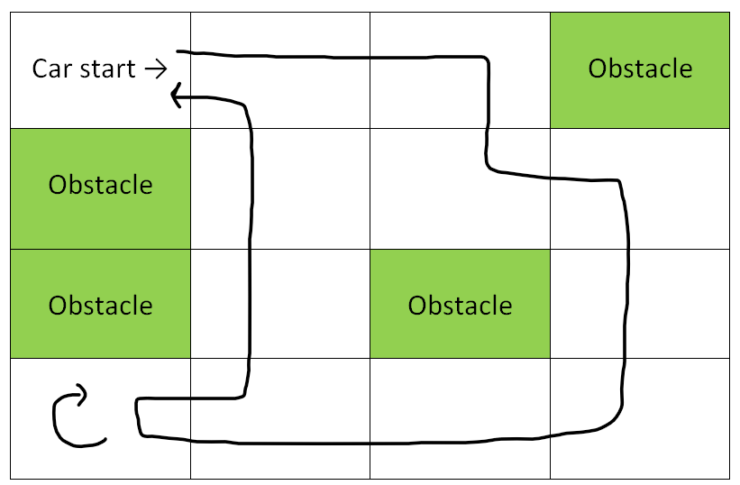
AUTOMATION DRIVE

Slide 6
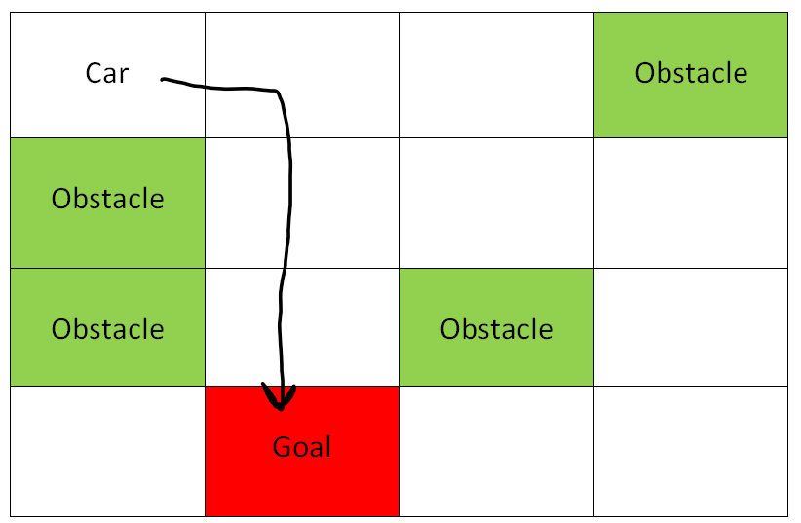
SHORTEST PATH SEARCH

Slide 7
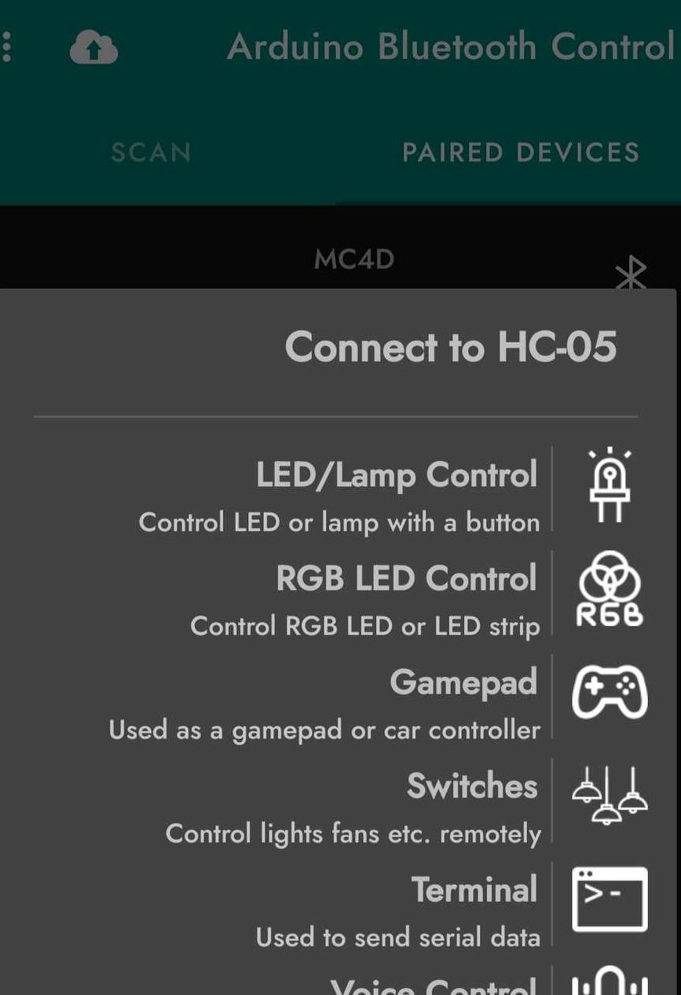
BLUETOOTH CONTROL
U: Auto drive
M: Manual drive
G: Go to goal
#: Back to base
*: Reset

Slide 8
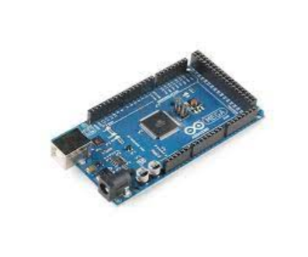
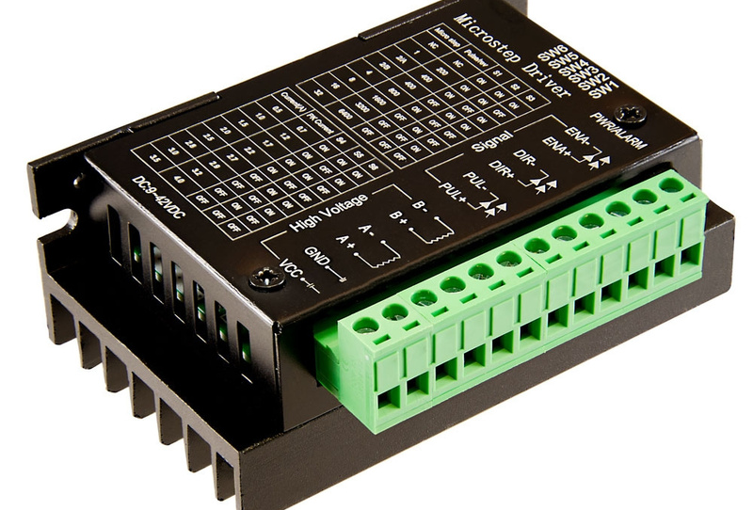
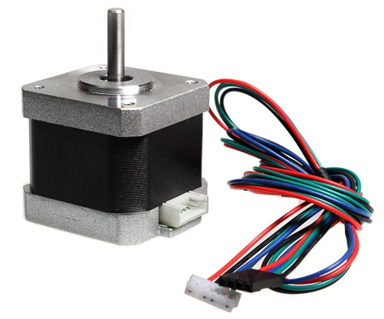
Mega 2560
HARDWARE MODULES
tb6600
Steper motor driver
Steper motor

Slide 9
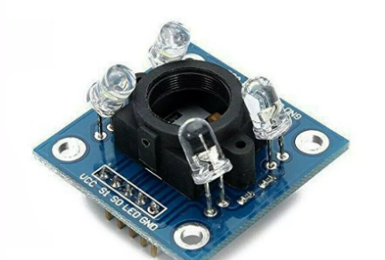
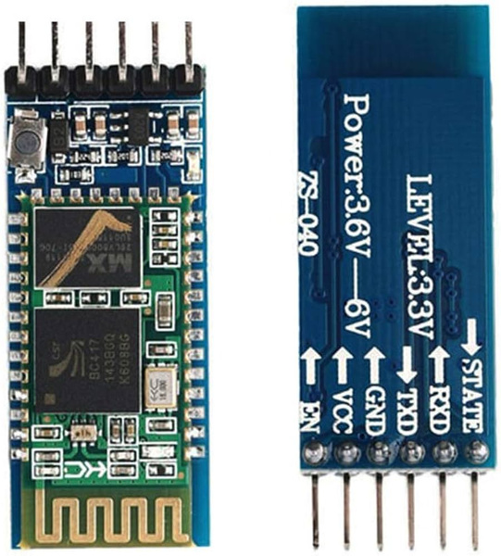
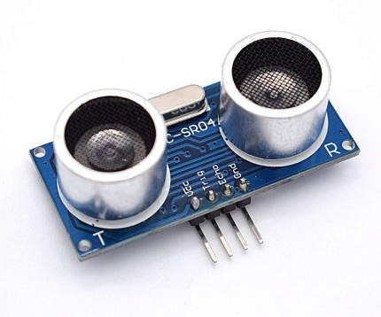
HARDWARE MODULES
TCS3200
Color sensor
Bluetooth
HC-05
Ultrasonic sensor

Slide 10
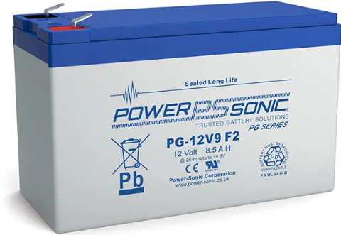
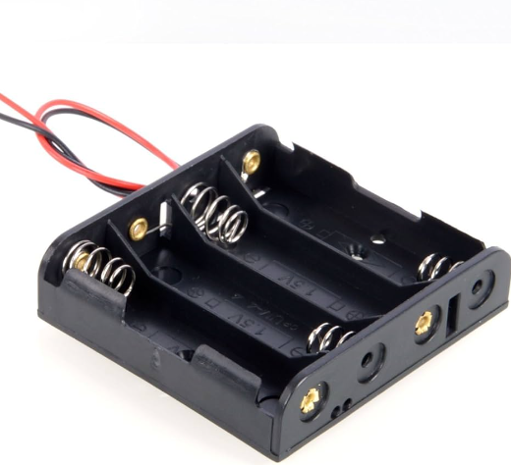
POWER
12v
8.5 AH
5V Battery

Slide 11
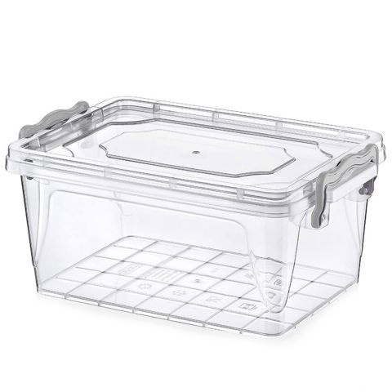
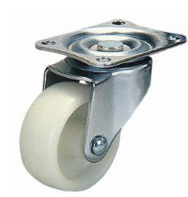
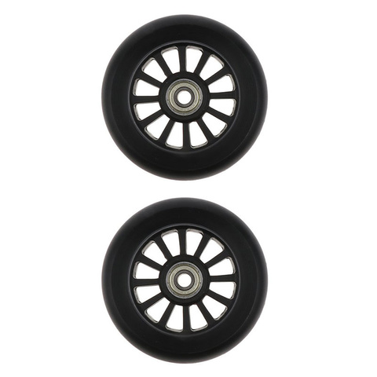
BODY
Body
Wheels

Slide 12
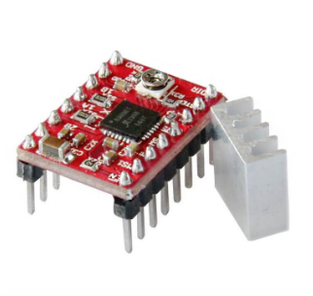
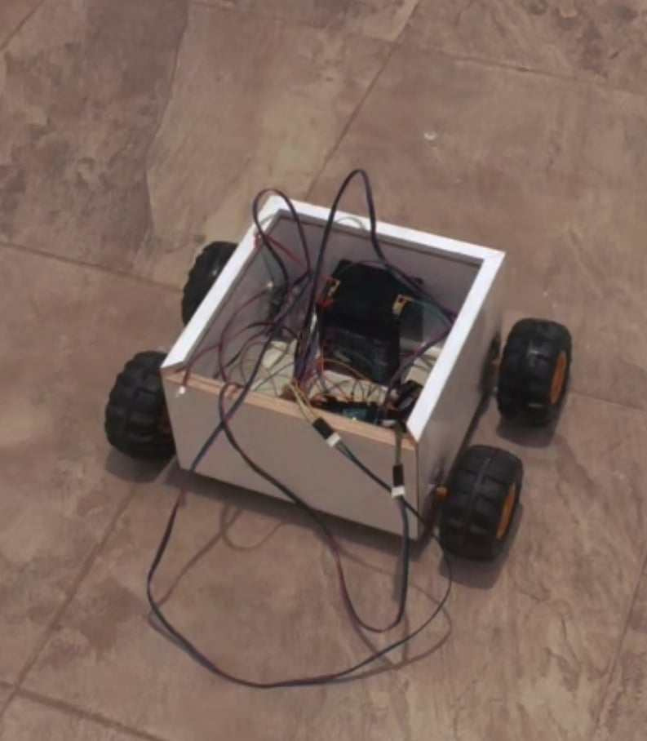
CONSTRAINTS
A4988
Stepper Motor Driver
Steper motor driver
Body design

Slide 13
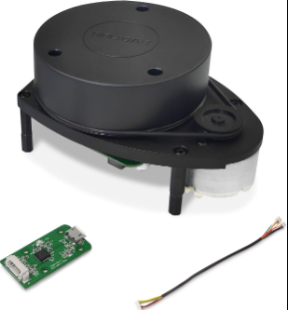
FUTURE WORK
Enhanced Communication and Feedback Systems
Advanced Sensor Technologies
Using ROS with respray pi

Slide 14


