Slide 1

Graduation Project Seminar
Prepared By :
Fayrooz Tayyah Walaa Hattab
Supervisor :
Dr. Samer Arandi

Slide 2
Outline
What is MySmartEye ?
Motivation, objectives.
Implementation.
Programming techniques.
Future Work.
Demo.

Slide 3
Outline
What is MySmartEye ?
Motivation, objectives.
Implementation.
Programming techniques.
Future Work.
Demo.

Slide 4
What is MySmartEye ?
Android Application that targets the visually impaired people.
Features 6 sub-applications and supports English Language.
Supports touch input using the Braille alphabet.

Slide 5
Outline
What is MySmartEye ?
Motivation, objectives.
Implementation.
Programming techniques.
Future Work.
Demo.

Slide 6
Motivation
High percentage of the visually impaired world-wide and in Palestine.
The emergence of touch screens
  more difficult for blind people to use phones.

Slide 7
Objectives
Our application helps the visually impaired in four main ways:
Typing in Braille by detecting multi touches on the screen.
Speaks out instructions and received information.
Audio Chat system.
Image Processing Techniques to help the user identify textual and pictorial information.

Slide 8
Outline
What is MySmartEye ?
Motivation, objectives.
Implementation.
Programming techniques.
Future Work.
Demo.

Slide 9
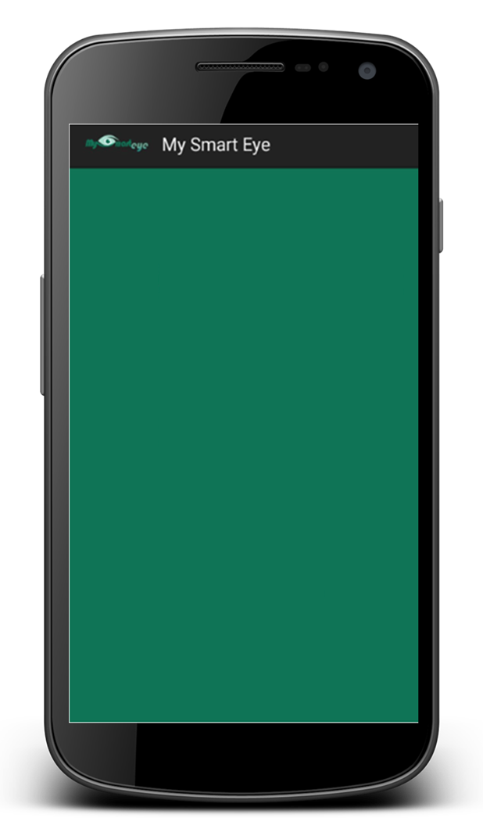
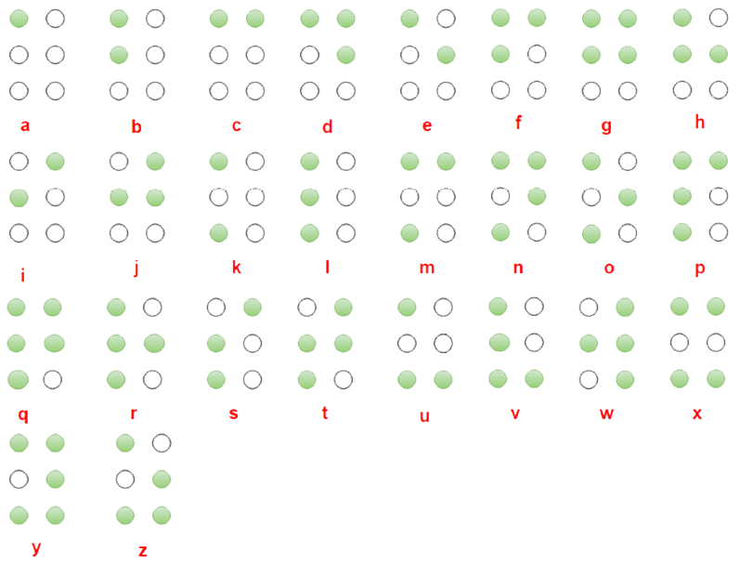
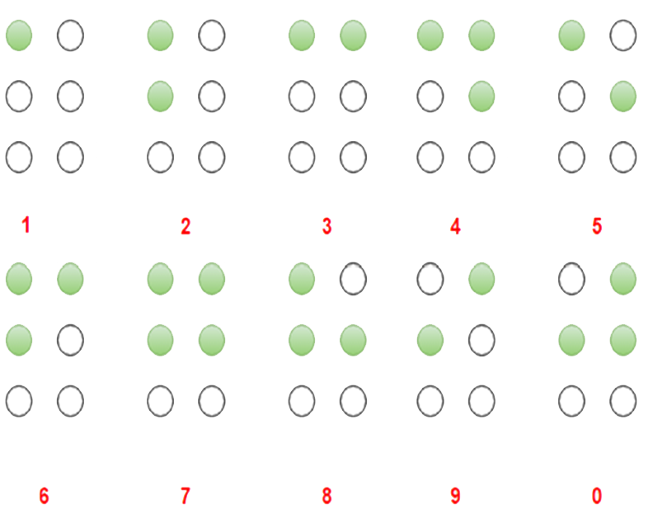
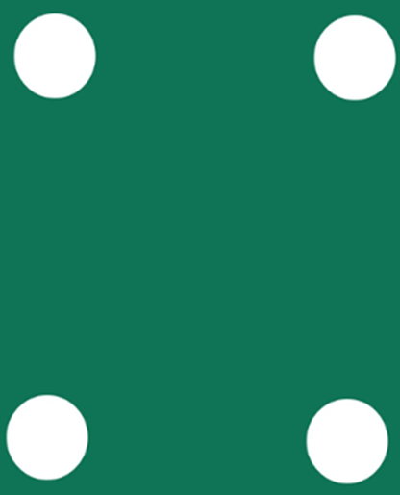


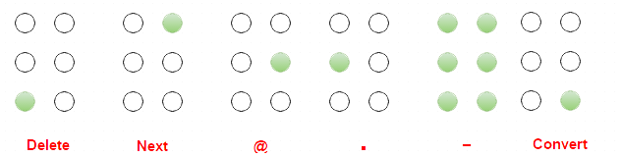


Braille Touch Input main idea

Slide 10
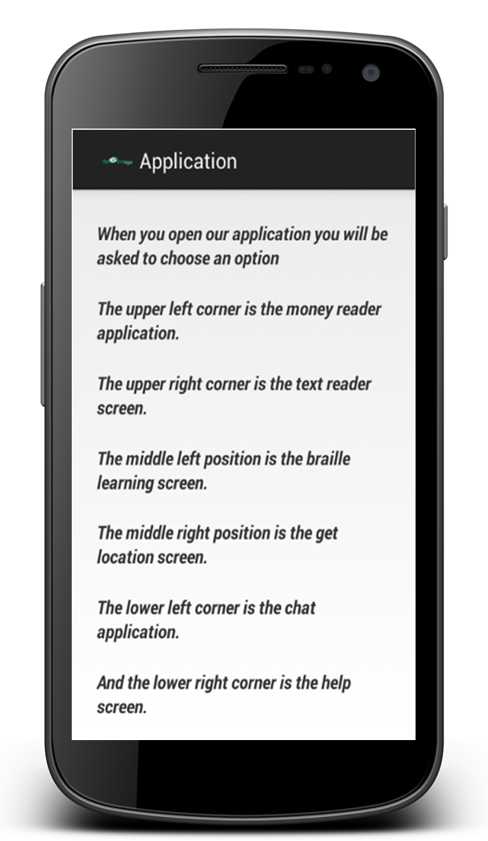
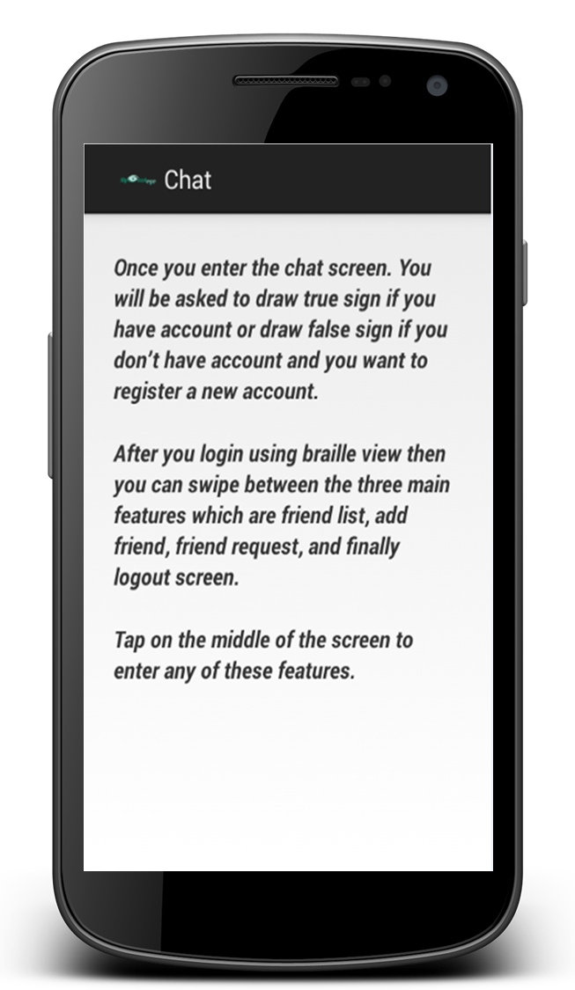
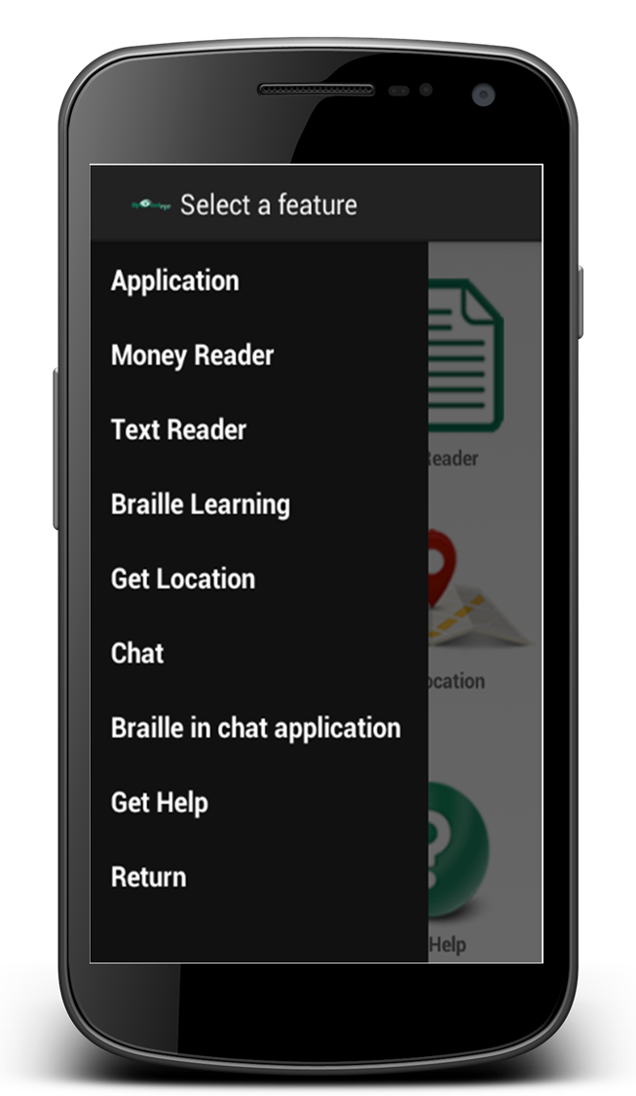
Manual
It’s provides a full description of how the whole system works.

Slide 11
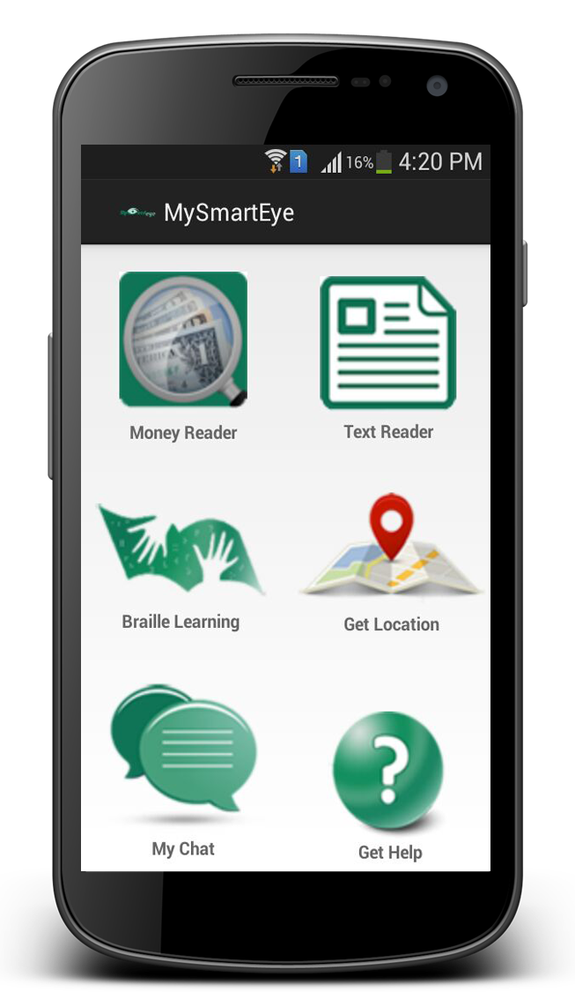
Sub Applications
Our application consists of 6 sub
applications:
          - Ordered in the same ordering of Braille Cells.

Slide 12
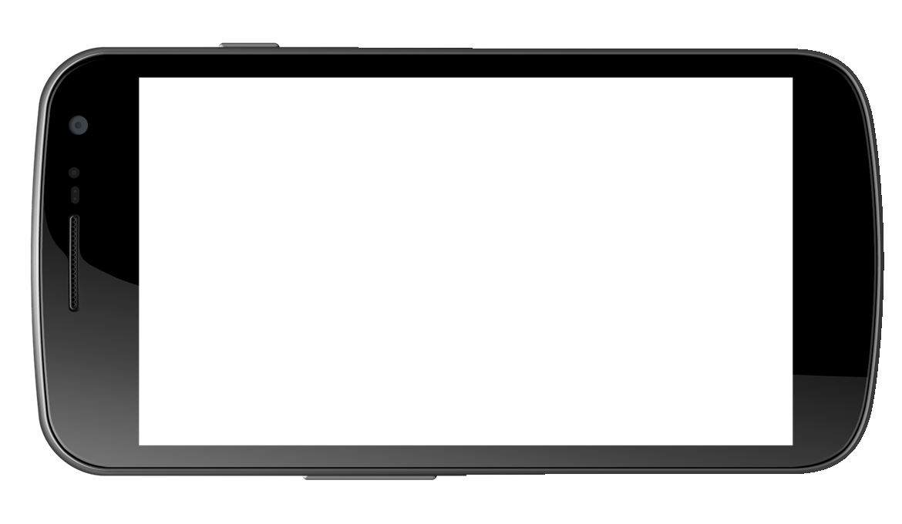
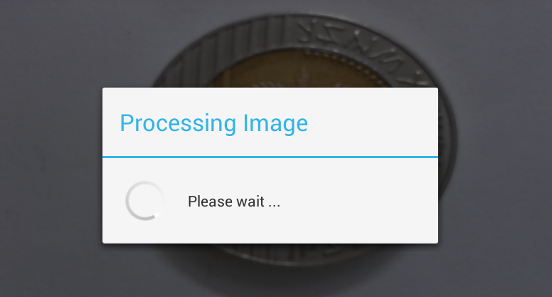
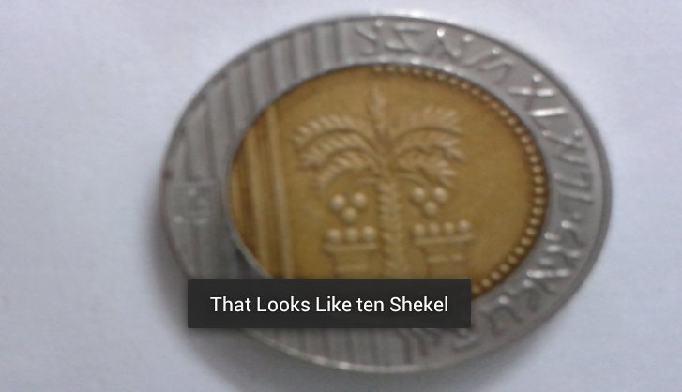
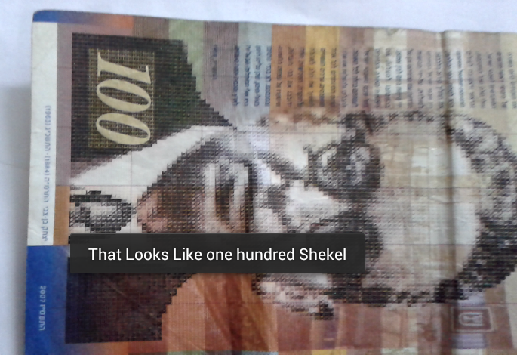
1.Money Reader
Recognize the values of different shekel bills and coins.

Slide 13
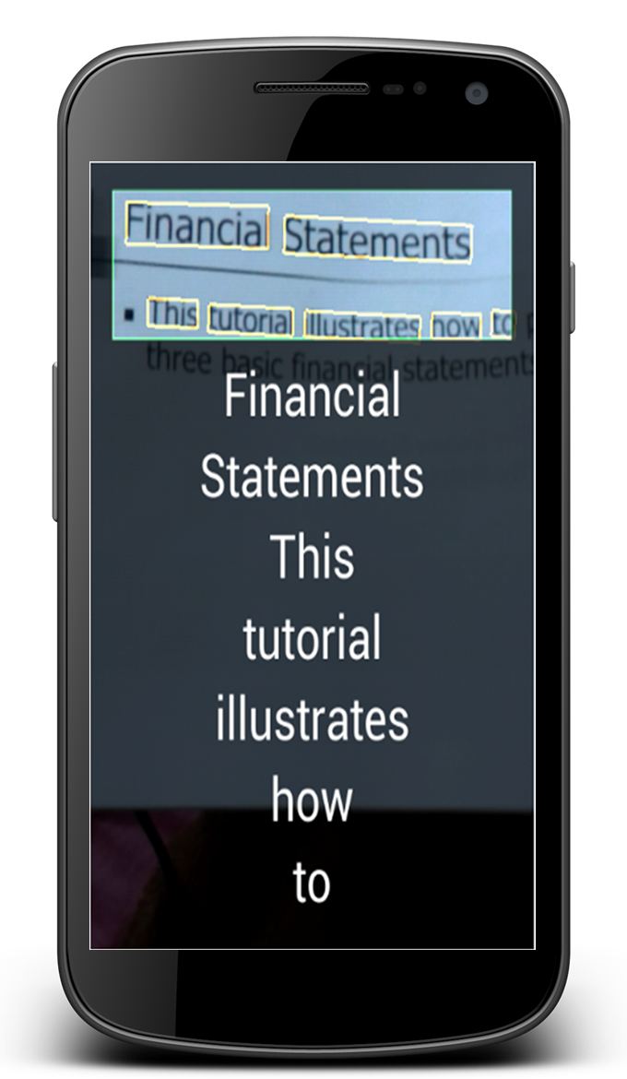
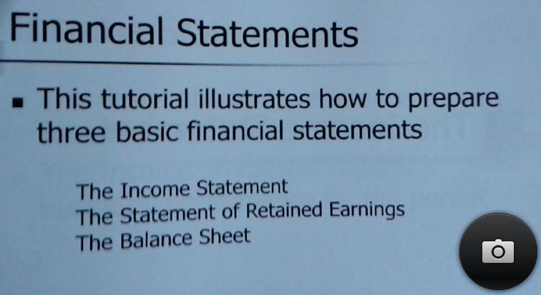
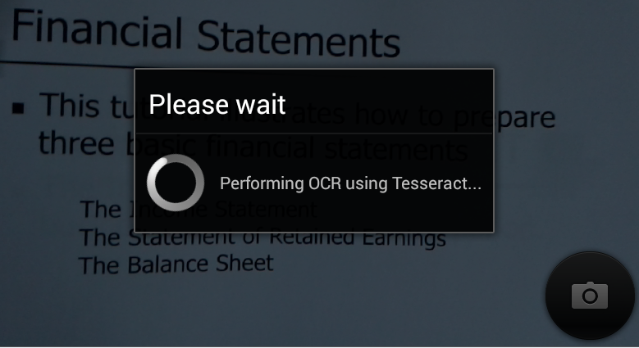
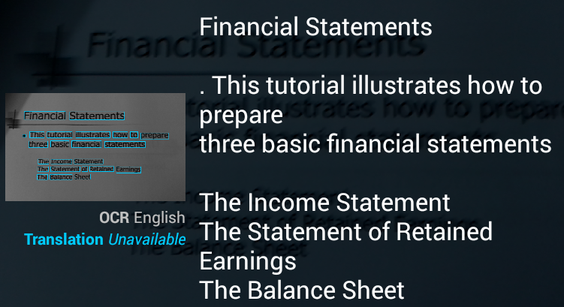
2.Text Reader
Read the text by using
mobile camera.
Real-time text recognition.
Two modes: Quick & Accurate
Fixed camera.

Slide 14
3.Braille Learning
Contains five levels.
Shake to move from one level to another.
Swipe to grab the device in the right way.
Left side
Right side

Slide 15
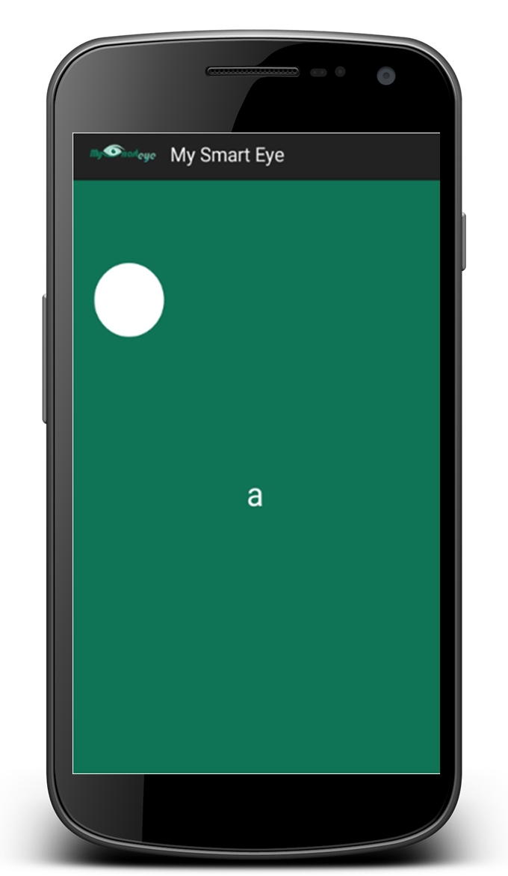
3.Braille Learning
First level
Learn braille by typing any number and character on the screen.

Slide 16
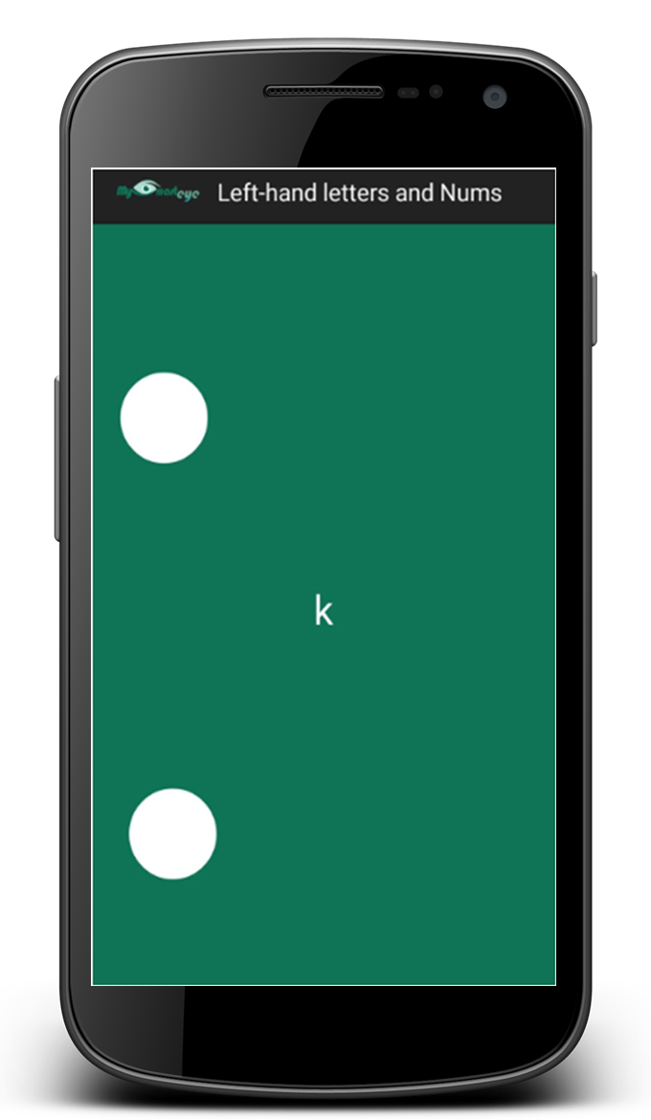
3.Braille Learning
Second level
Focus on letters and numbers that can be written by the left fingers.

Slide 17
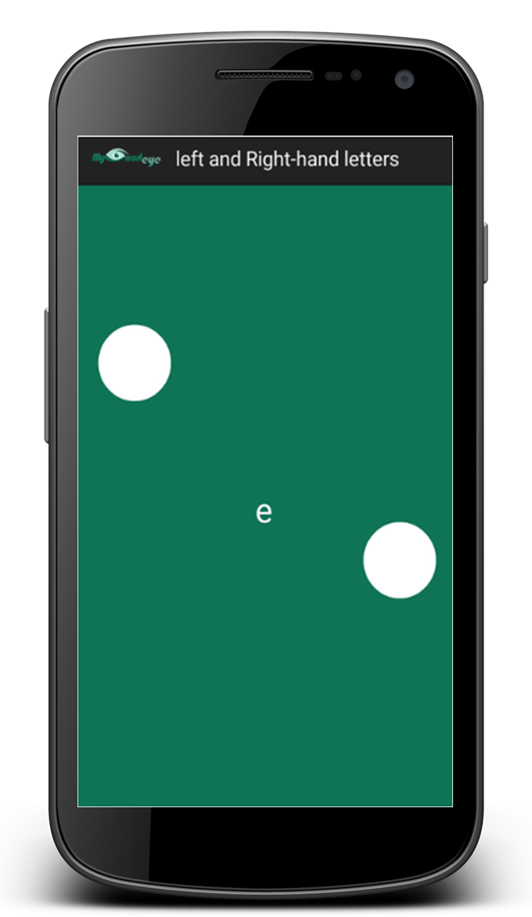
3.Braille Learning
Third level
Focus on letters that can be written by the left and right fingers.

Slide 18
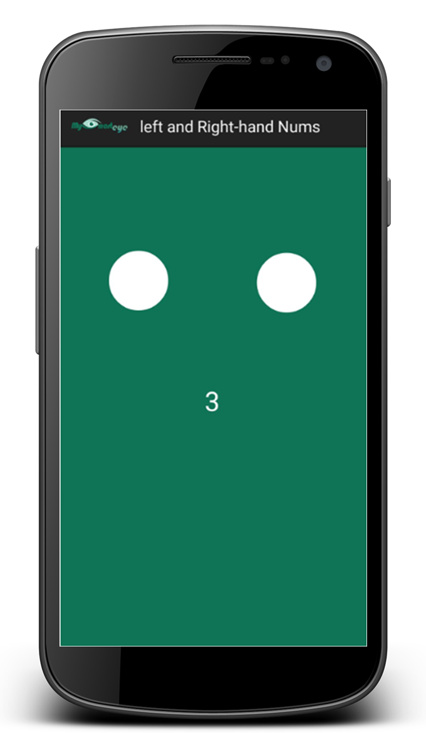
3.Braille Learning
Fourth level
Focus on numbers that can be written by the left and right fingers.

Slide 19
3.Braille Learning
Fifth level
Take on a small challenge.

Slide 20
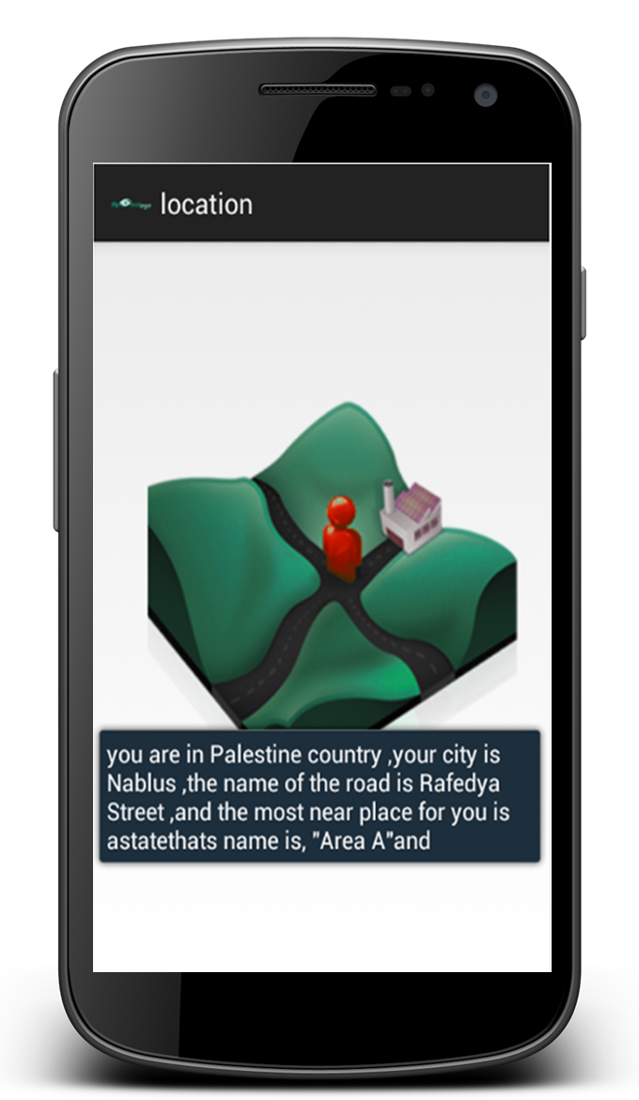
4. Get Location
1
Help the user identify the current location and the nearest places around.

Slide 21
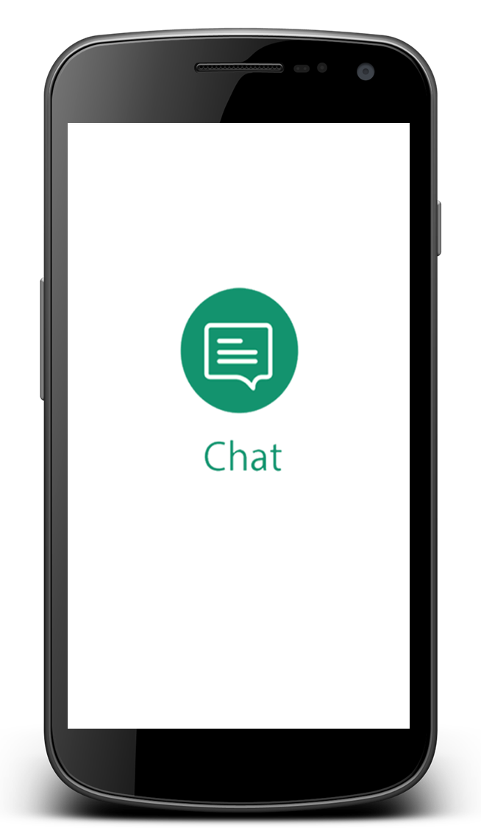
5. Chat
Support the basic functionalities of a chatting system.
These include:
Log In.
Sign Up.
Add new friend.
Accept or decline requests from friends.
Show online and offline friends.
Chat with friends using voice.

Slide 22
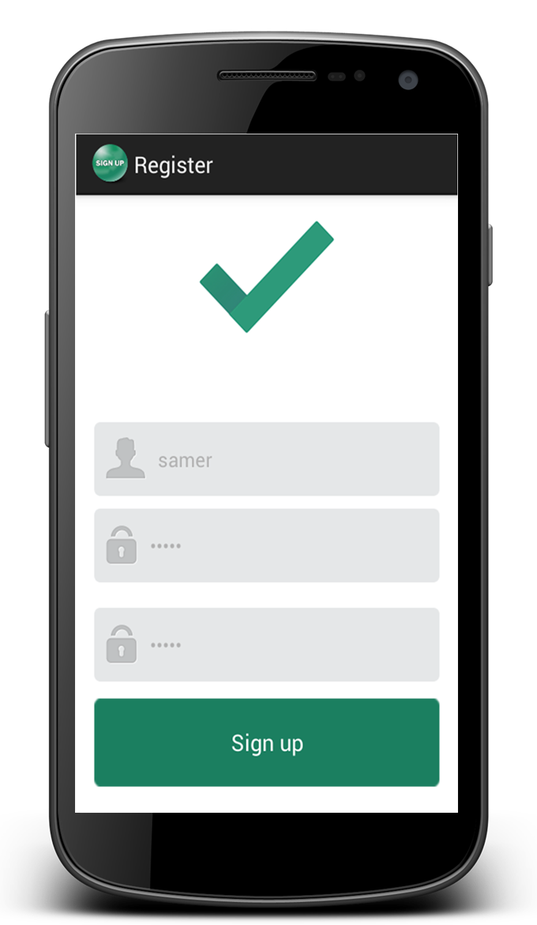
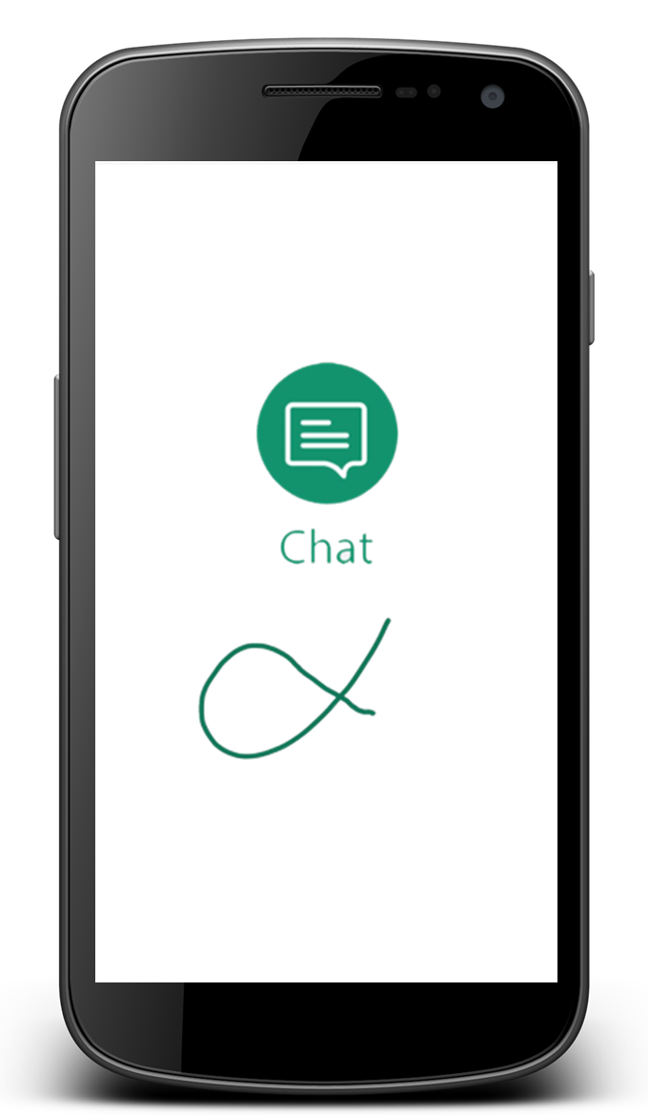
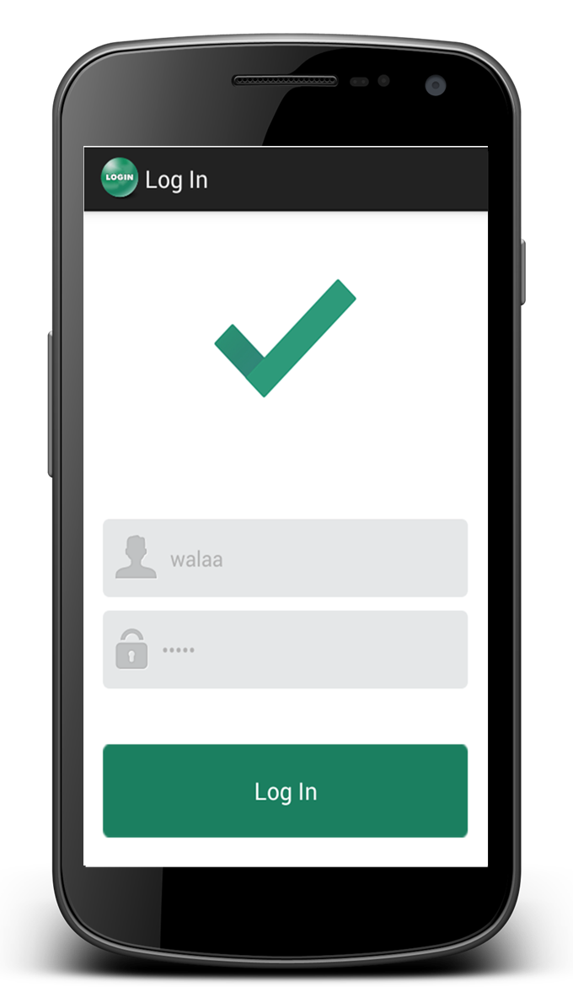
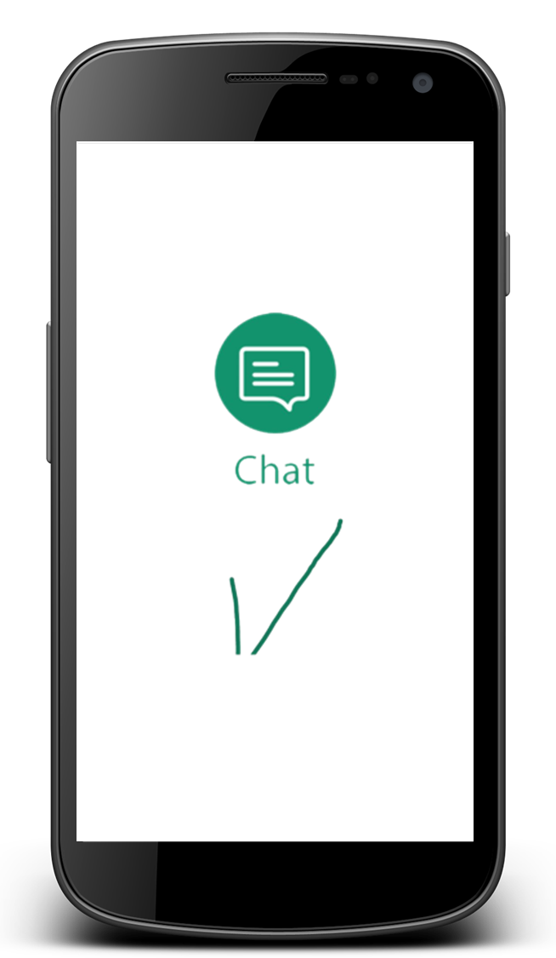
5. Chat
SignUp/LogIn

Slide 23
5. Chat
Acts as enter
Braille typing in chat
This feature is consistent throughout the whole chatting system in any activity that requires typing in Braille.
Delete
Convert

Slide 24
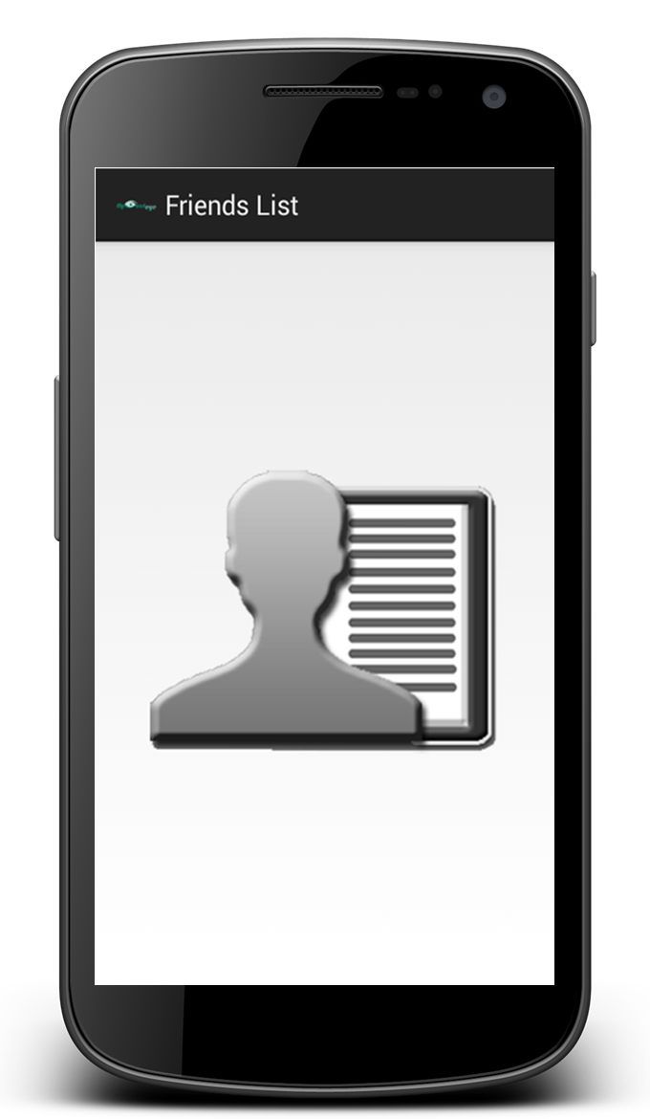
5. Chat
Friends List

Slide 25
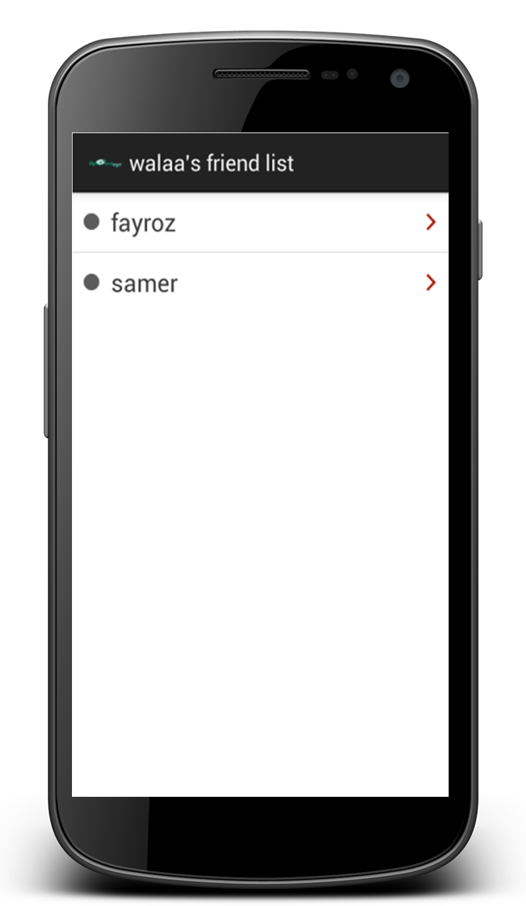
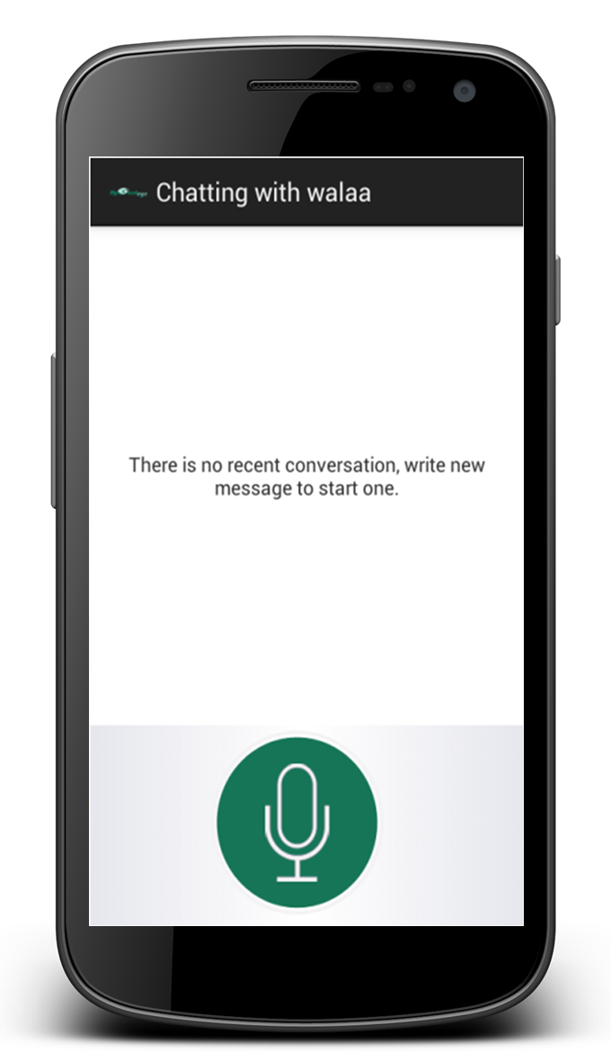
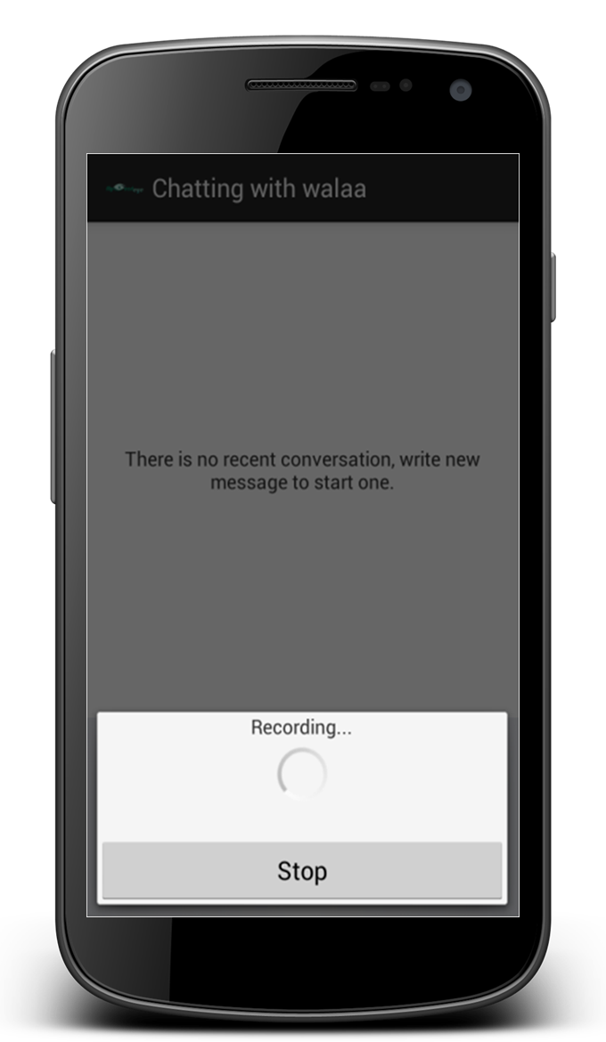
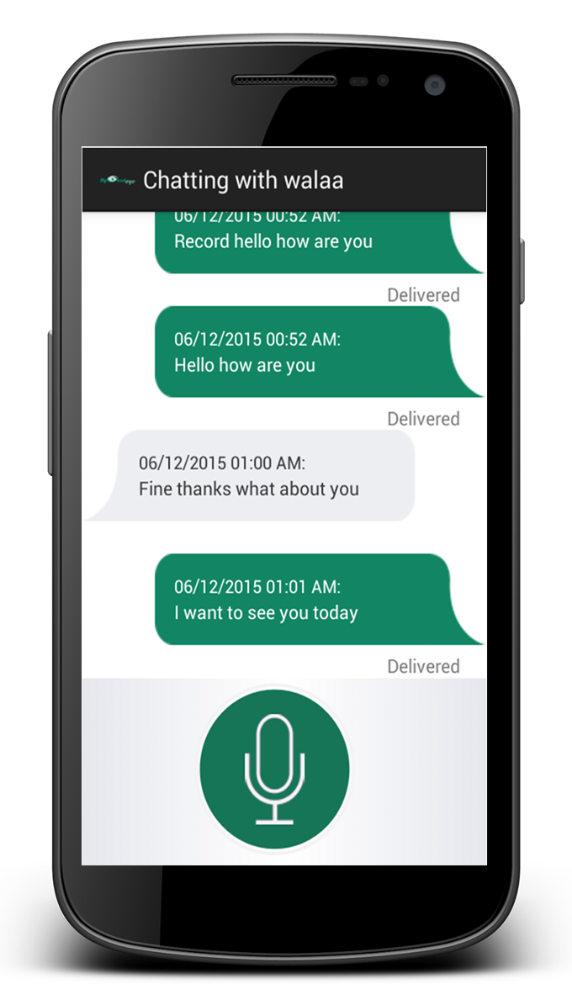
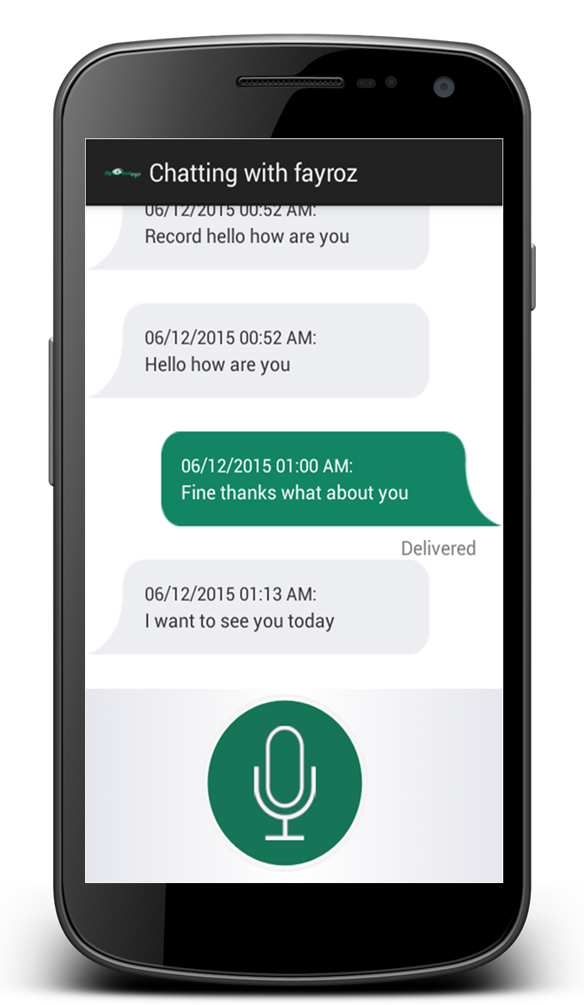
5. Chat
Friends List

Slide 26
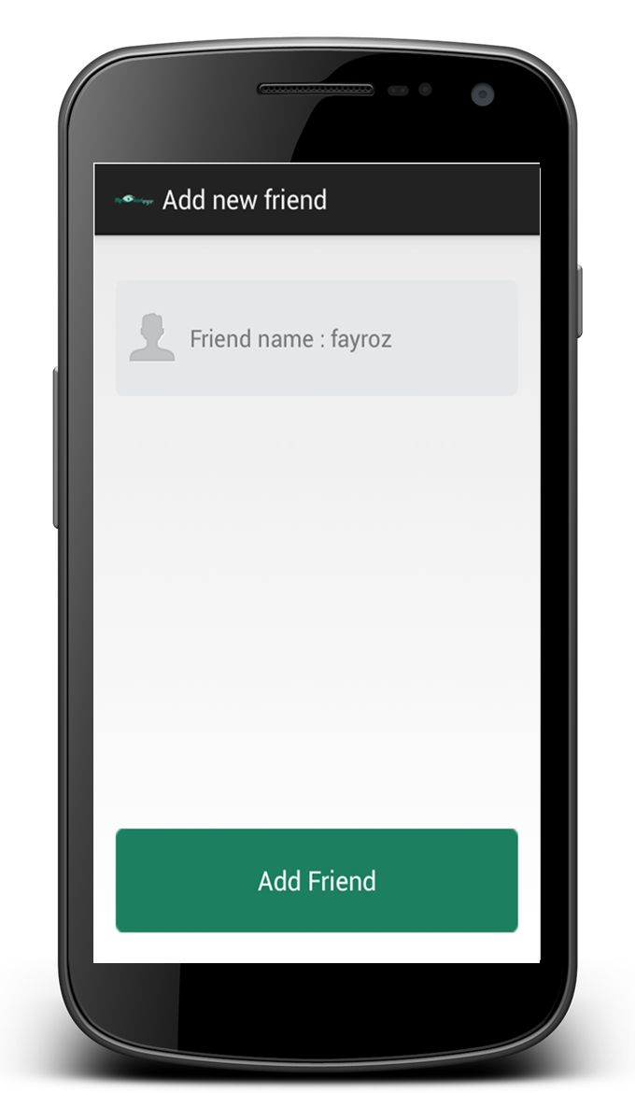
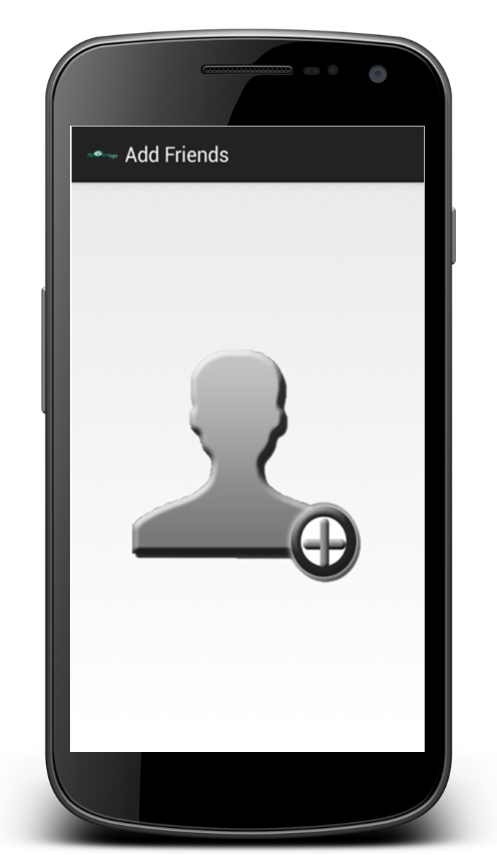
5. Chat
Add Friend

Slide 27
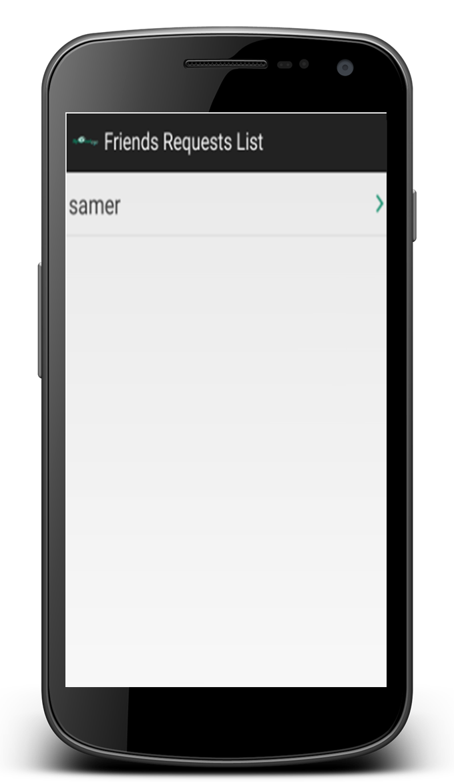
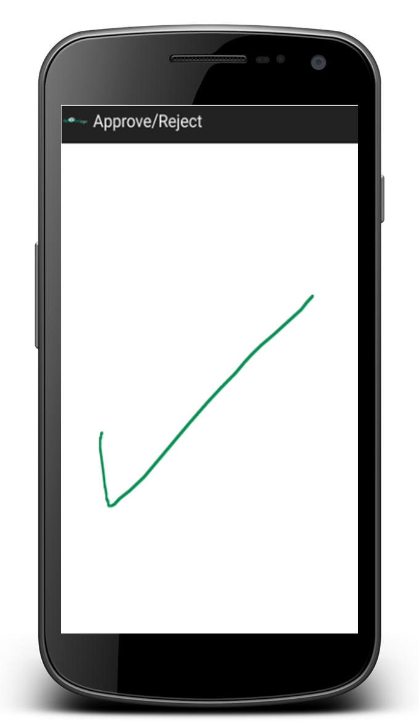
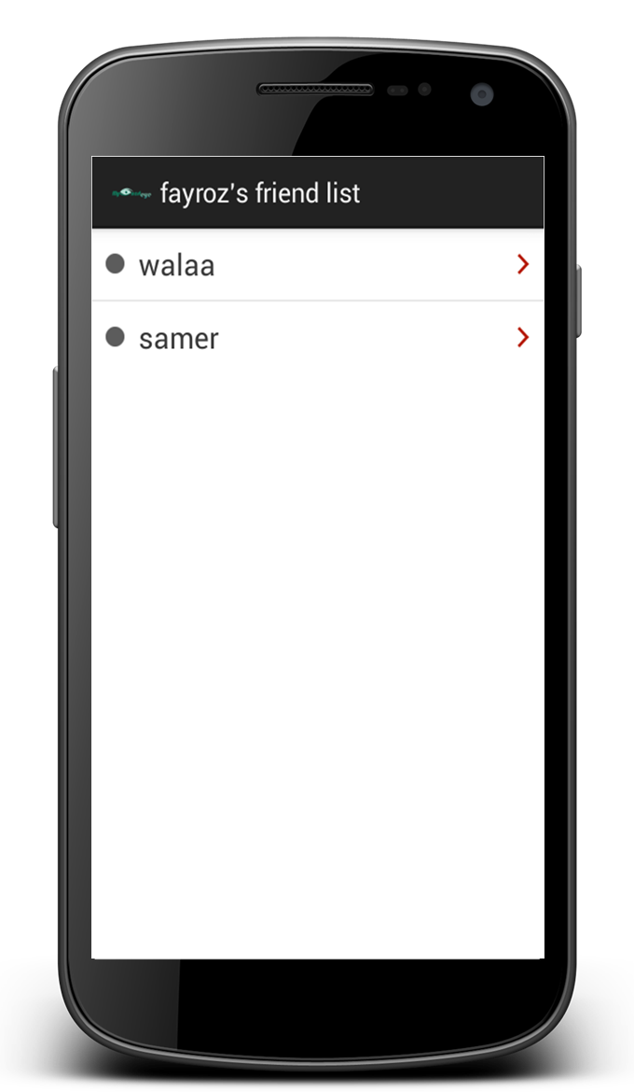
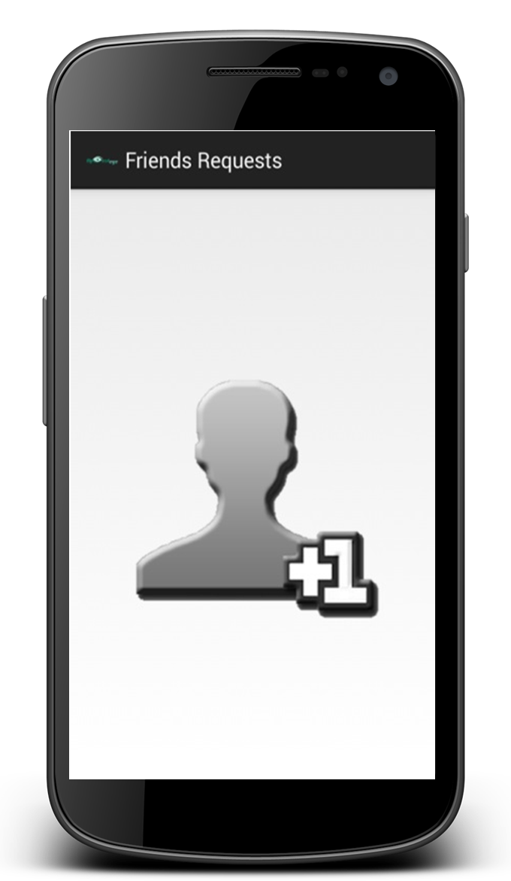
5. Chat
Friends Requests

Slide 28
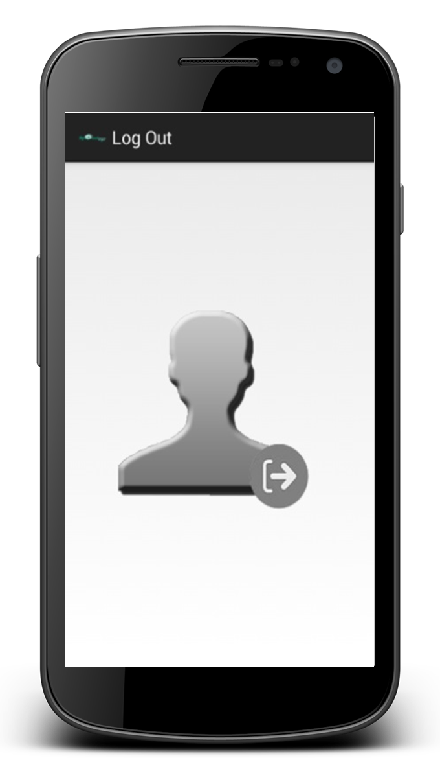
5. Chat
Log Out

Slide 29
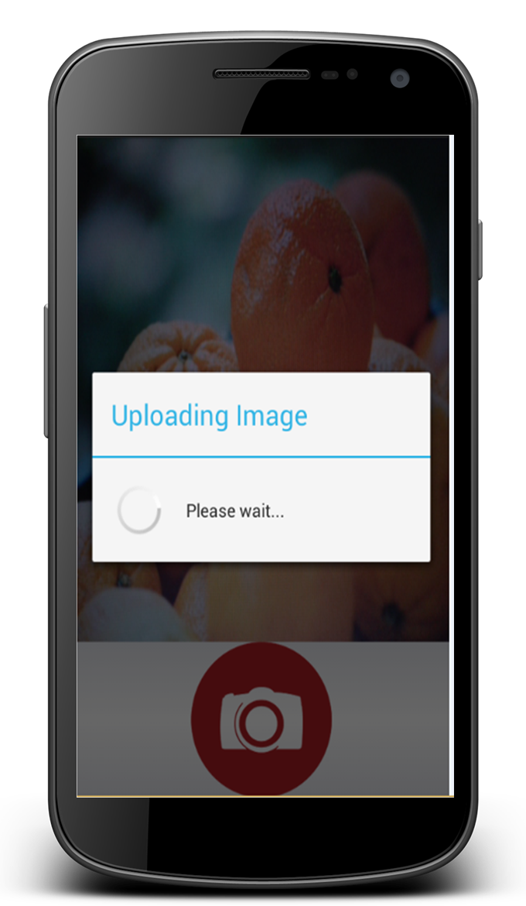

6. Get Help
- Crowd-based approach
- The user can send images
to a network of volunteers then receive descriptions about these images.

Slide 30
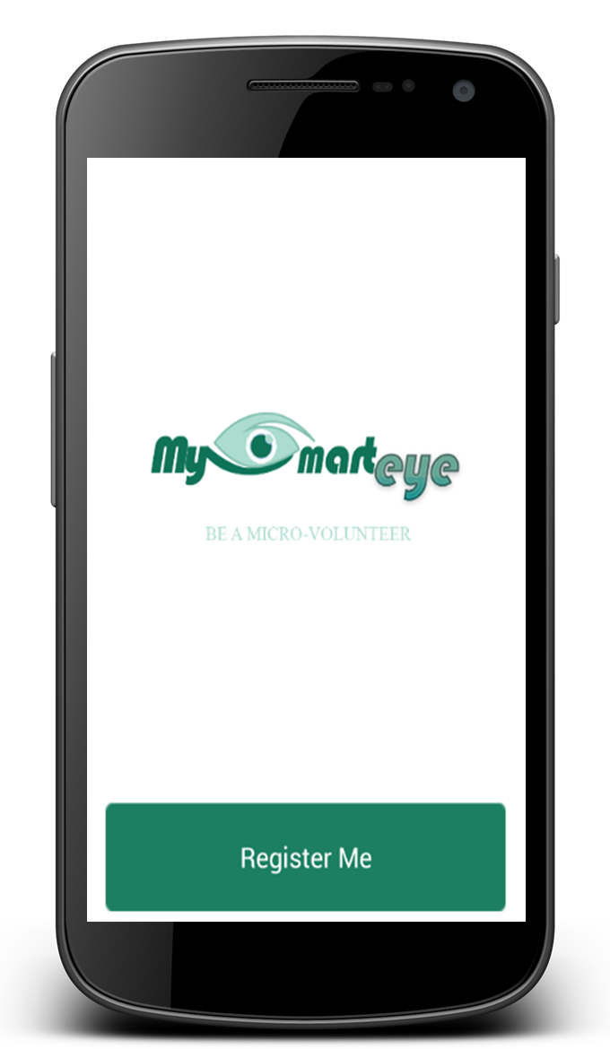
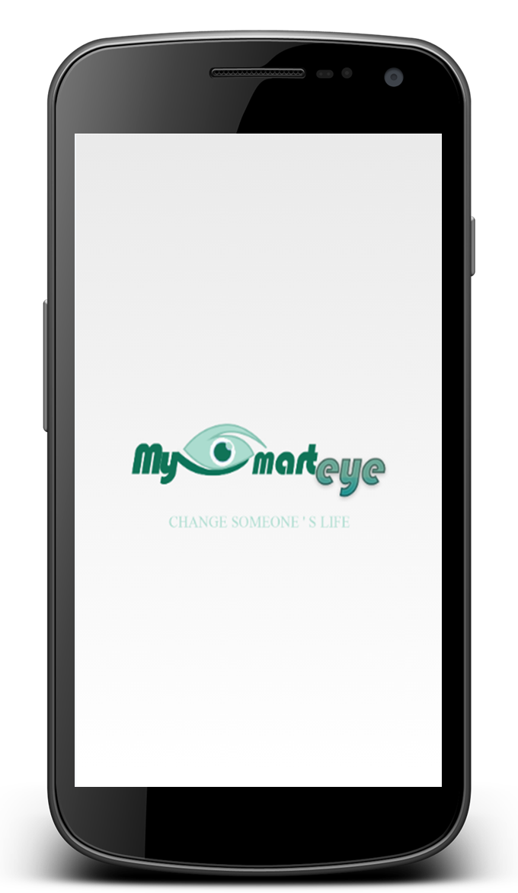
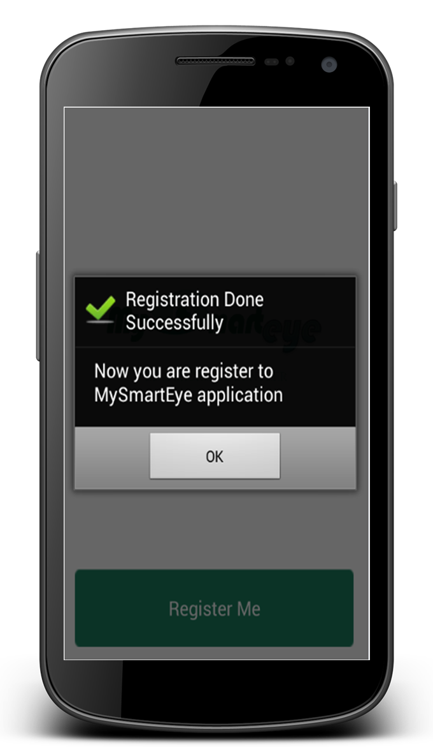
6. Get Help
Volunteer’s application

Slide 31
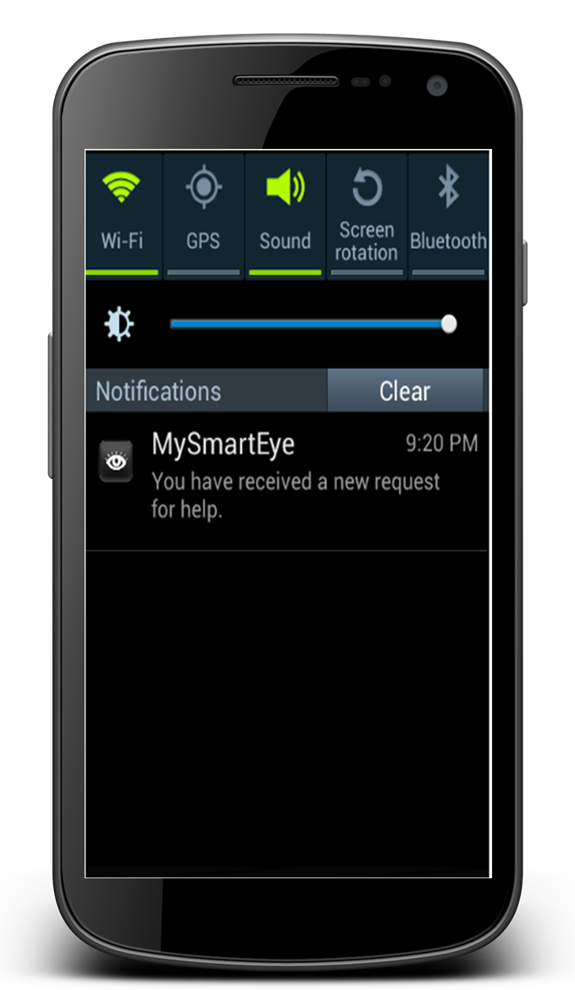
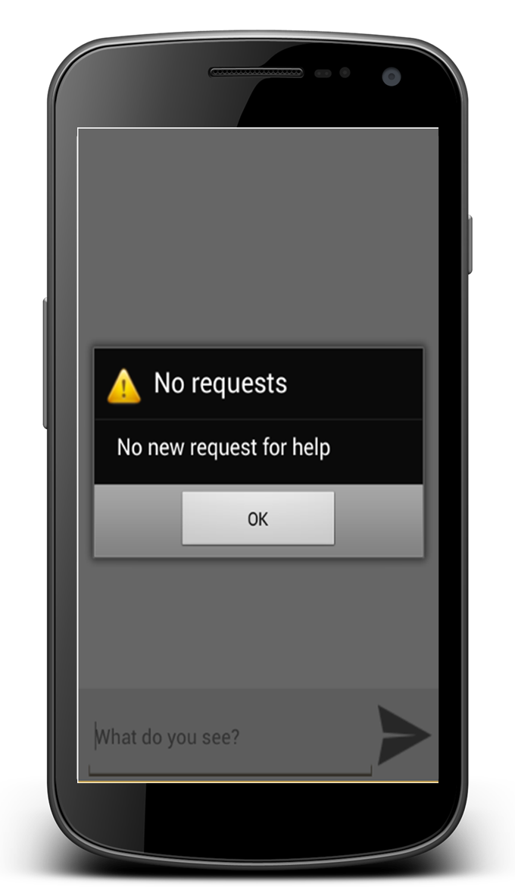
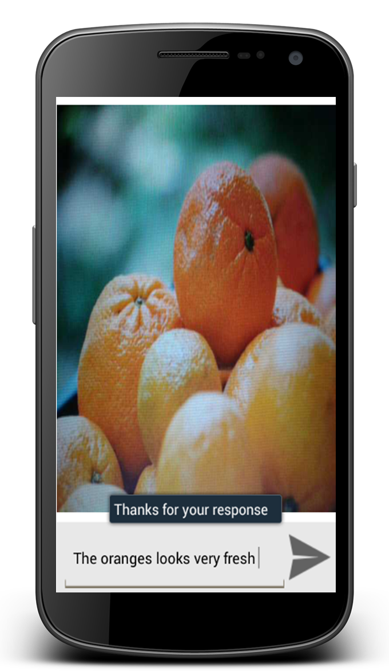
6. Get Help
Volunteer’s application

Slide 32
Outline
What is MySmartEye ?
Motivation, objective.
Implementation.
Programming techniques.
Future Work.
Demo.

Slide 33
Text-To-Speech Synthesizer
The Android platform includes a Text-to-Speech (TTS) capability which enables an Android device to "speak" text in various languages.

Slide 34
2. Speech-To-Text Synthesizer
Using Dragon Speech kit to record an audio in the chatting system.

Slide 35
3. Overriding the volume buttons
Android gives the ability to override hardware buttons.
We overrode the volume buttons so that:
  In the chatting system re-enter information in Braille typing

Slide 36
4. Android Location Providers (GPS, Network) Provider
Android supports two types of location provider.
1. GPS provider.
2. Network provider.
In our application, we use both by switching between them.

Slide 37
5. Android Accelerometer
The Android platform supports three broad categories of sensors:
1. Motion sensors.
2. Environmental sensors.
3. Position sensors.
We used the motion sensors (3-axis):
  Acceleration forces
  Rotational forces

Slide 38
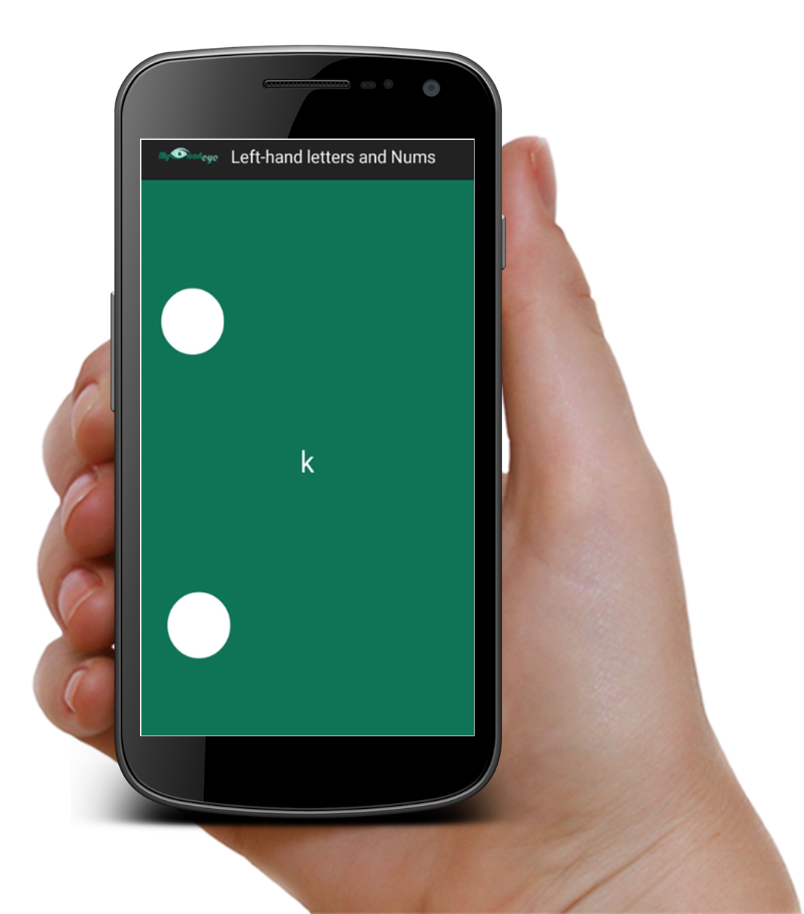
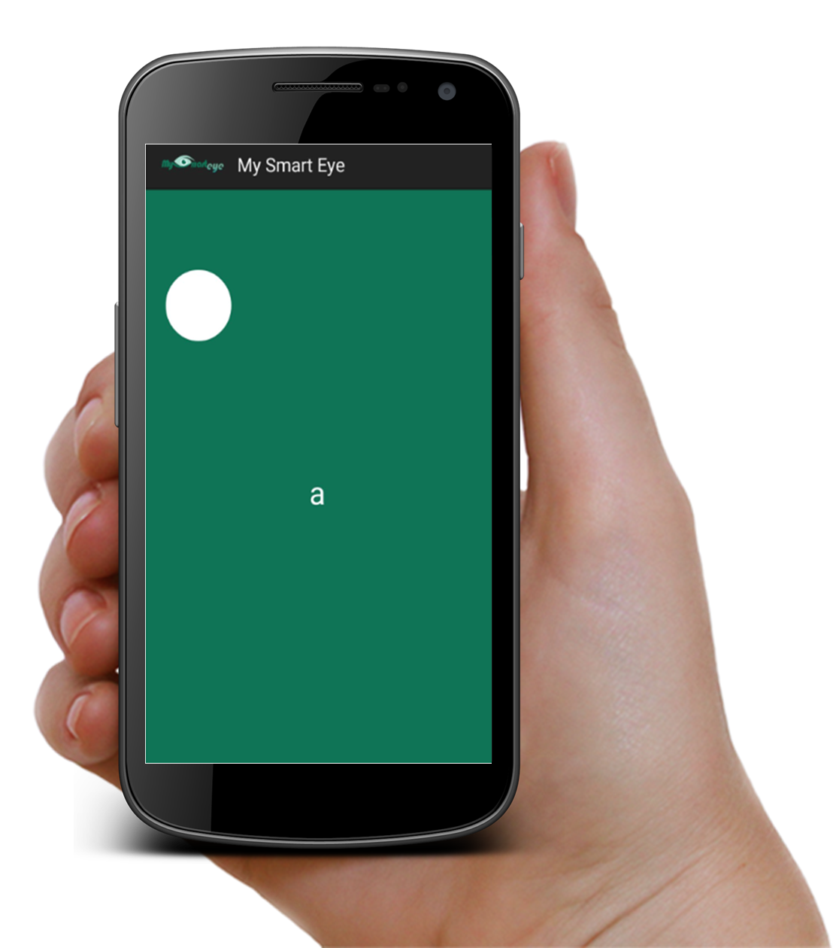
SHAKE!
  Chat system
  Shaking to read friend’s name & status in the friends list screen.
  Shaking to read the name of friend
  who sent a friend request in the
  friends requests list screen.
  In Braille learning
  Shaking to move from one level to
  another.

Slide 39

6. Gestures
We built two new gestures that allow the user to choose between two options in the chat system
  Draw true sign: the user have an account and wants to log in.
  Draw false sign: the user don’t have account and want to sign up.
  Draw true/false sign to accept/decline a friend request.

Slide 40
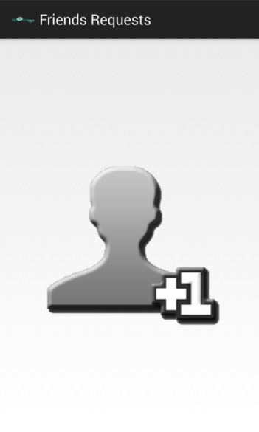
6. Gestures
Four sliding screens in the chat system.
Using “Swipe” Gesture to switch between these sliding screens.

Slide 41
Outline
What is MySmartEye ?
Motivation, objective.
Implementation.
Programming techniques.
Future Work.
Demo.

Slide 42
Future work
Make another version of our application for the Arabic Language.
Improve the money reader to get more accurate results and to be able to recognize more than one coin and one bill at the same image

Slide 43
Outline
What is MySmartEye ?
Motivation, objective.
Implementation.
Programming techniques.
Future Work.
Demo.

Slide 44
Questions?
Thank you

