Slide 1
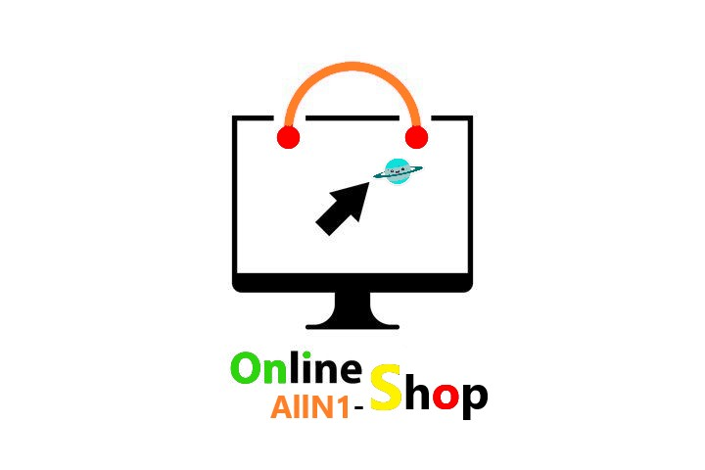
AllN1 -Shop
Website
An Online Shopping Website Designed just for you.
Yamen Mohsen
Eman Amleh
Mostafa Mousa
supervised by : Dr. Baker Abd-alhaq

Slide 2

INTRODUCTION
What is the problem?
Make online shopping the dominant approach of shopping
What is AllN1 website?
provides all the needs of the user and saves him effort and time
the possibility of commenting and evaluating products

Slide 3
Authentication Vs. Authorization
Authentication verifies the identity of users, and authorization determines their access rights.

Slide 4
Common Types of Authentication
Something you know
  Passwords
  security questions
Something you have
  Physical devices such mobile phones
Something you are
  Biometric authentication mechanisms such as fingerprints

Slide 5
Common Types of Authorization
To answer this question “Someone logs into website. What can that person do?”, this will depend on what protocol is used:
Role-Based Access Control (RBAC)
  RBAC protocol answer that question depends on that person's role.
Attribute-Based Access Control (ABAC)
  ABAC protocol answer that question depends on
    The user
    The resource attributes
    The environment.

Slide 6
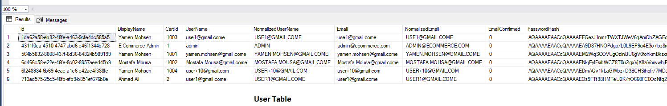
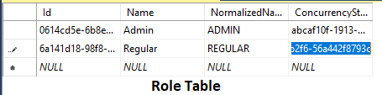
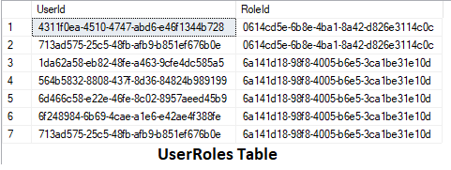
RBAC Implementation in ALLN1

Slide 7
Edit user role
UPDATE AspNetUserRoles
SET RoleId = '0614cd5e-6b8e-4ba1-8a42-d826e3114c0c'
WHERE UserId = '5ec5fd3b-8798-40fb-891d-cde7035cf3c2';

Slide 8
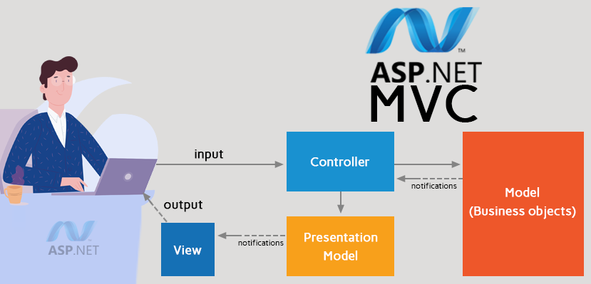
SYSTEM ARCHITECTURE

Slide 9
Controller
It is the 1st recipient, which interacts with incoming HTTP Request.
The controller gets the data from the model and passes it to the view, after that view is rendered.

Slide 10
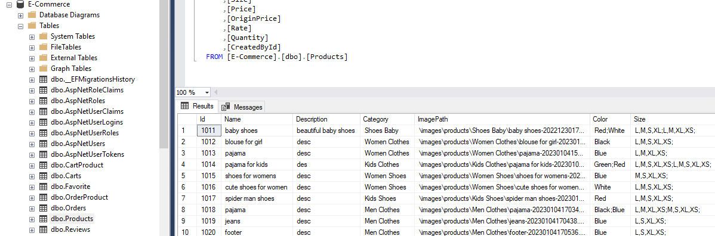
Model
A model is a class that contains the business logic of the application.
It also used for accessing data from the database.
  Used DB: Microsoft SQL Server

Slide 11
View
Views are .cshtml files that use the C# programming language in Razor markup.
Views consist of HTML, JS, css, and HTML Helpers provided by ASP.NET.
A controller pass data in presentation model form to a view.
  Presentation model: classes used to represent the objects that will be passed to the view.
HTML Helpers used to generate content in a view.

Slide 12


Slide 13
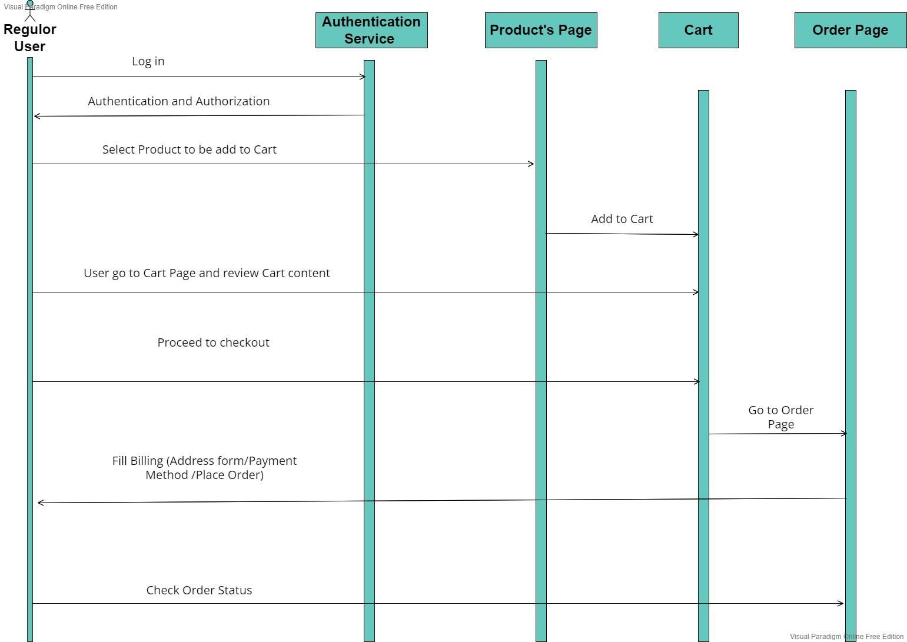
Sequence Diagram

Slide 14
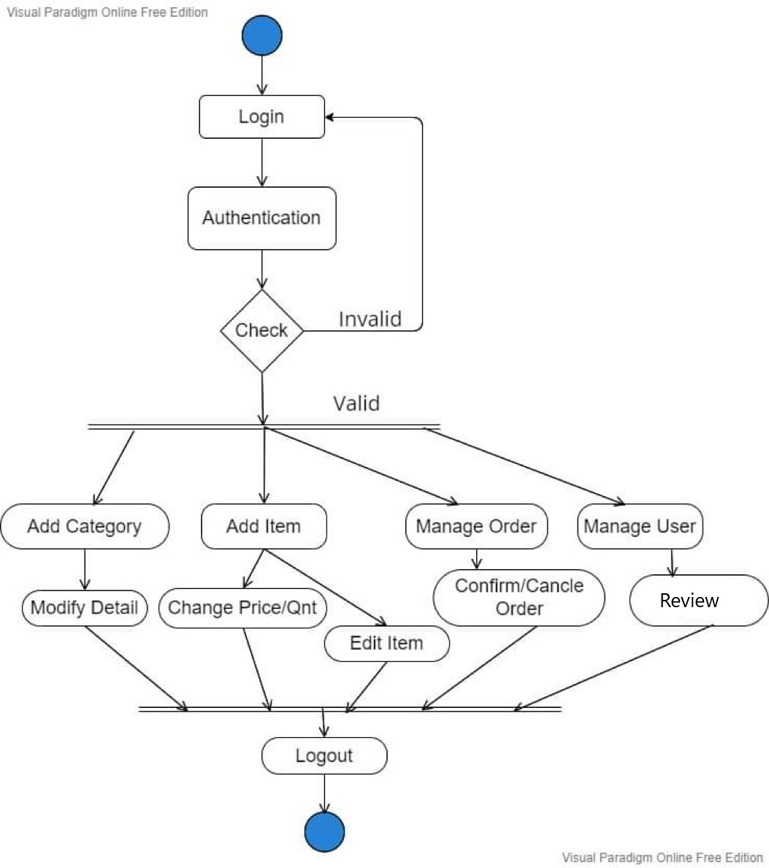
Activity Diagram
Admin Side

Slide 15
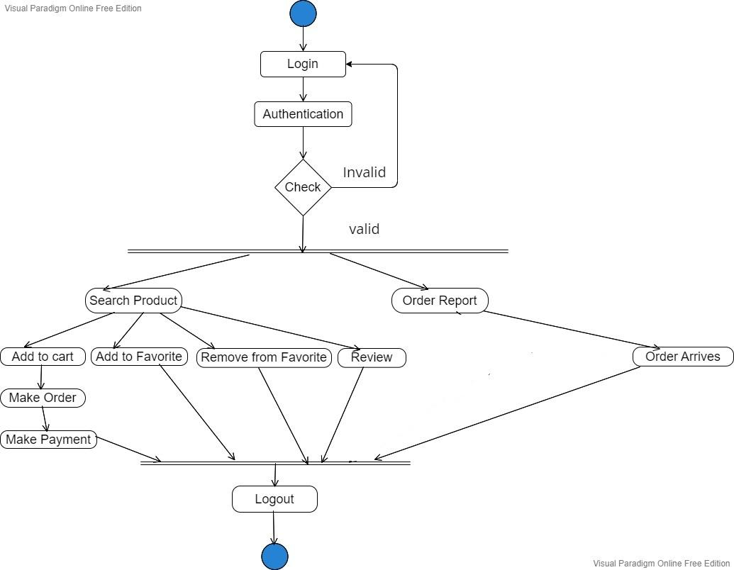
Activity Diagram
User Side

Slide 16
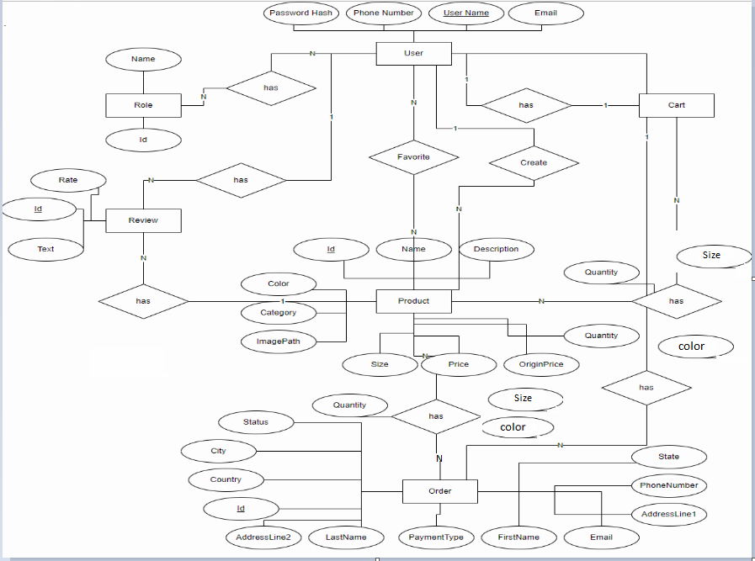
DATABASE ER-DIAGRAM

Slide 17



FUTURE WORK
Framework
NOTIFICATIONS
FRAMEWORK
EDIT ADMIN ROLE
CHAT BETWEEN USERS
EDIT/DELETE COMMENTS
DYNAMIC WEBSITES

Slide 18

THANK YOU

