Slide 1
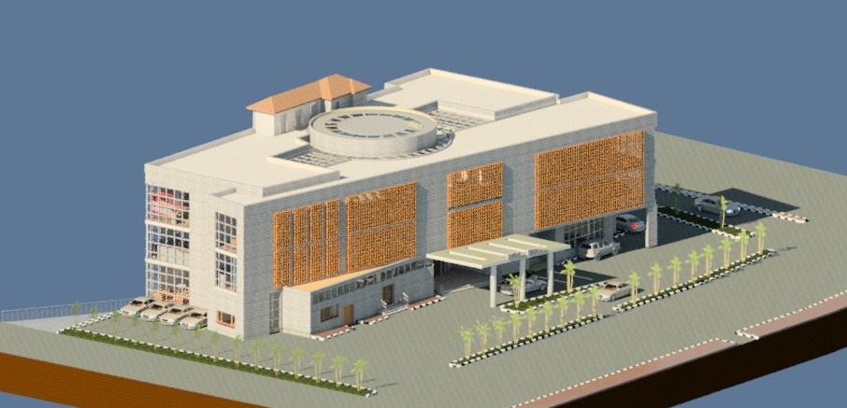

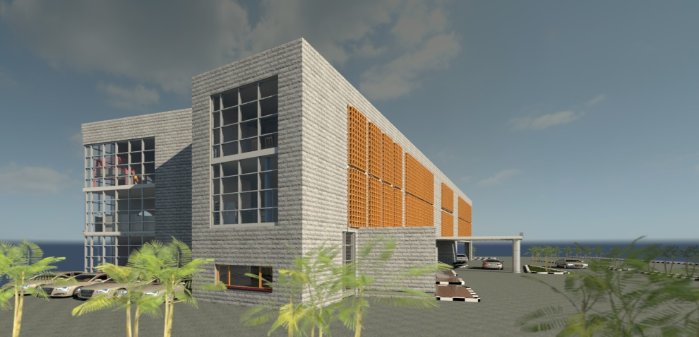
An-Najah National University
Faculty of Engineering
Building Engineering Department
Graduation Project – 2
Mini-Mall
Prepared By:
Mohammed Mansour
Ashraf Yasin
Zaid Abu Muhsain
Project supervisor:
Eng. Fadi Fatayer
2013 - 2014

Slide 2
Outline:
Site of the project
Architectural Design
Structural and Seismic Design
Mechanical Design
Lighting Design

Slide 3
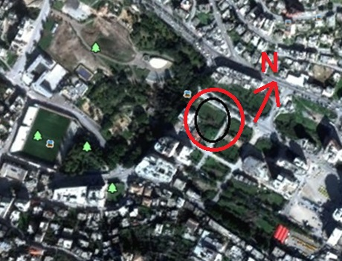
Site of the project:
Location and Site: Area = 1700 square meter.

Slide 4
Architectural Design

Slide 5
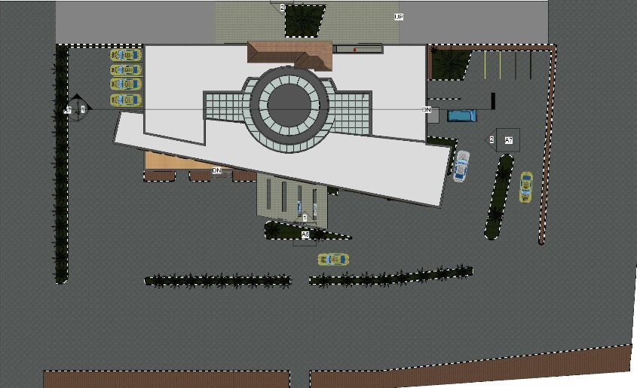
The Site Plan for the project:

Slide 6
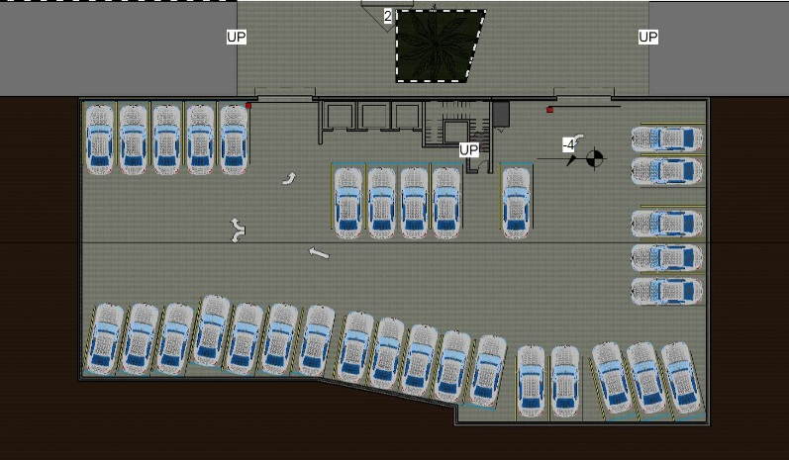
Basement Floor (Area = 1045square meter):

Slide 7
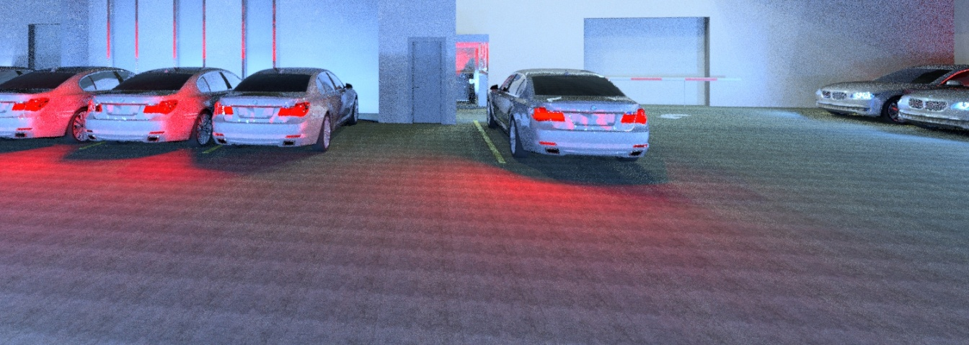
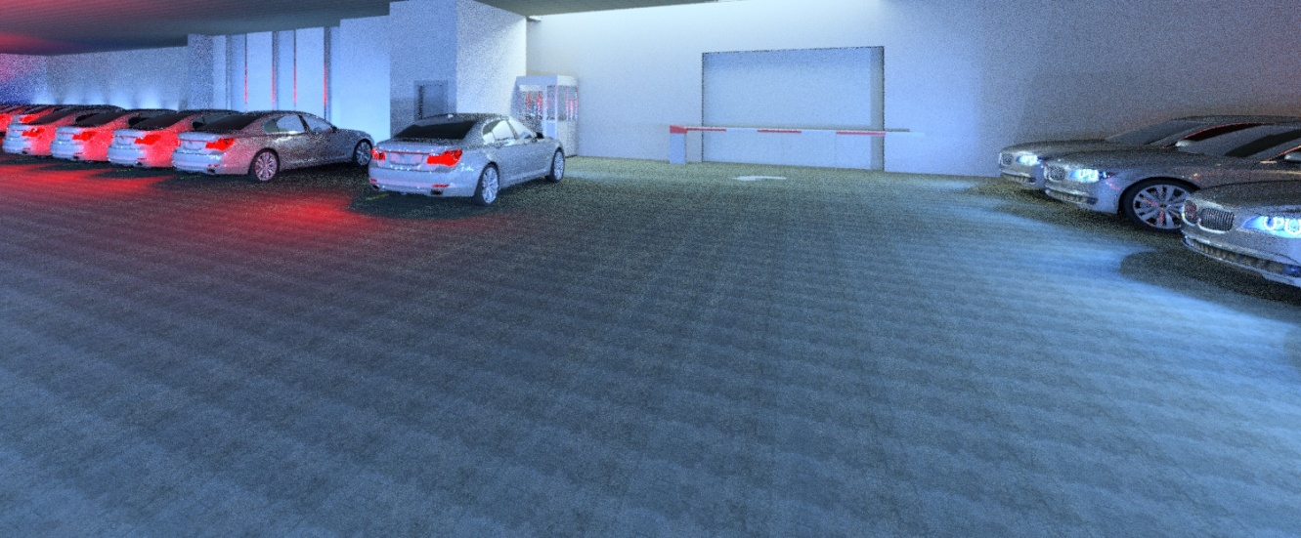
Basement Floor

Slide 8
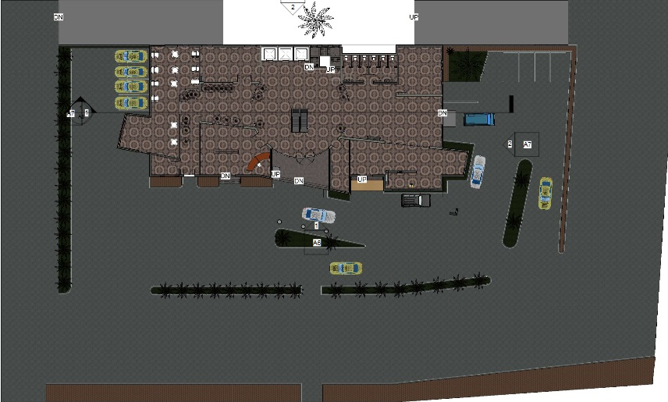
Ground Floor ( Area = 1014 square meter) and the landscape:

Slide 9
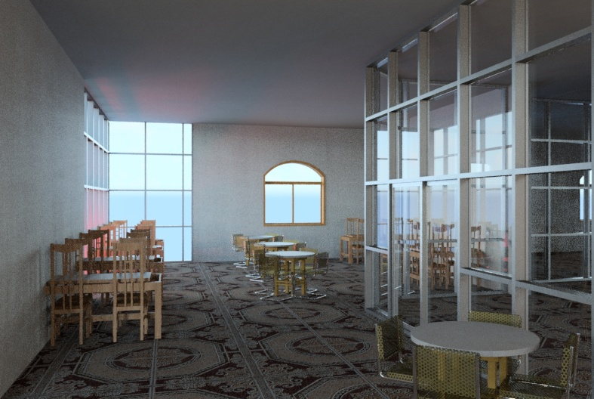
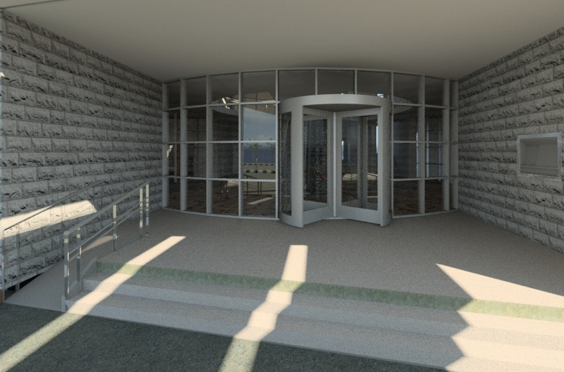
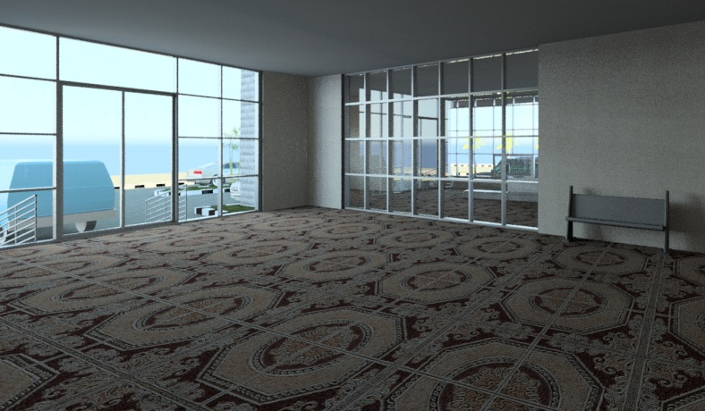
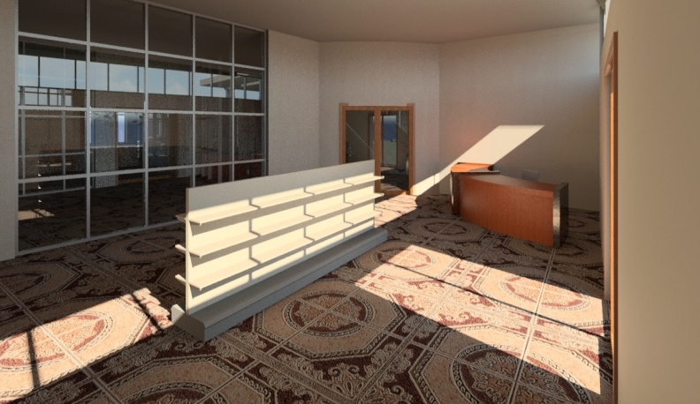
Ground Floor

Slide 10
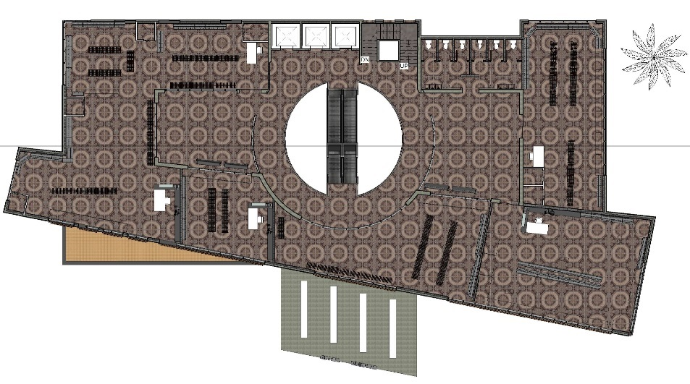
First Floor (Area = 1085 square meter):

Slide 11
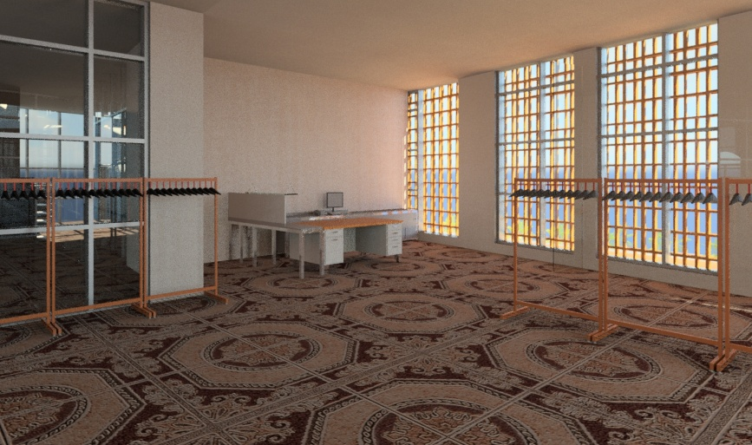
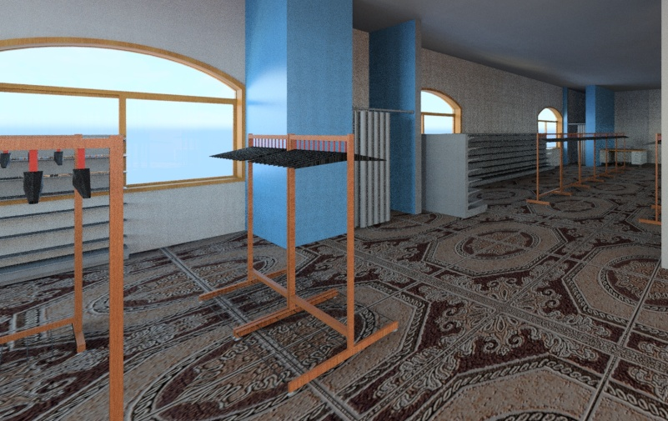
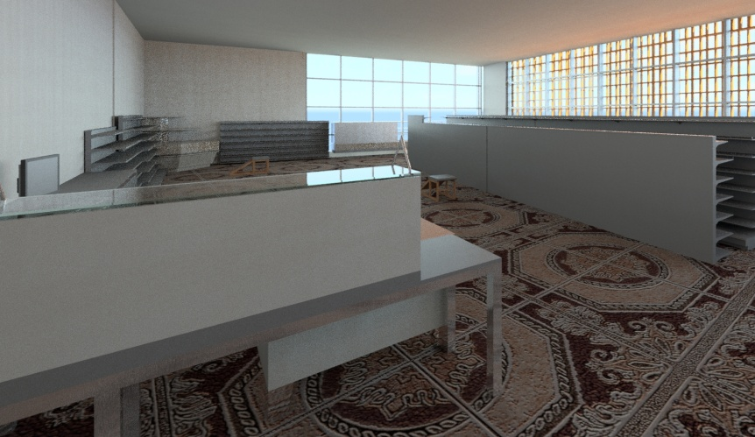
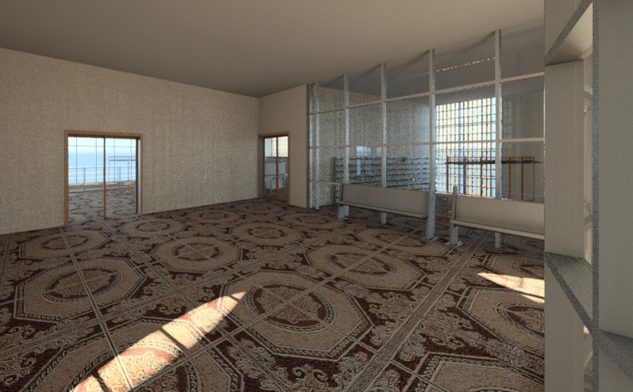
First Floor

Slide 12
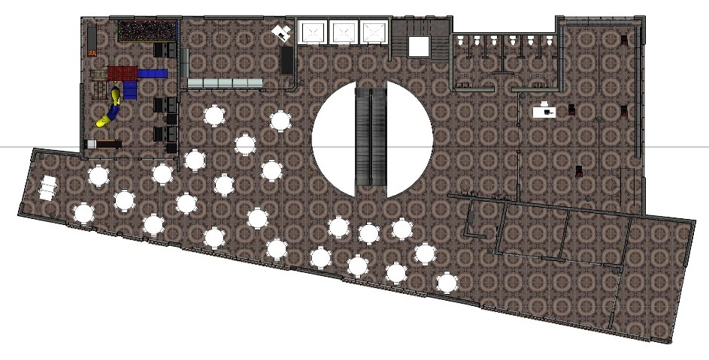
Second Floor (Area = 1085 square meter):

Slide 13
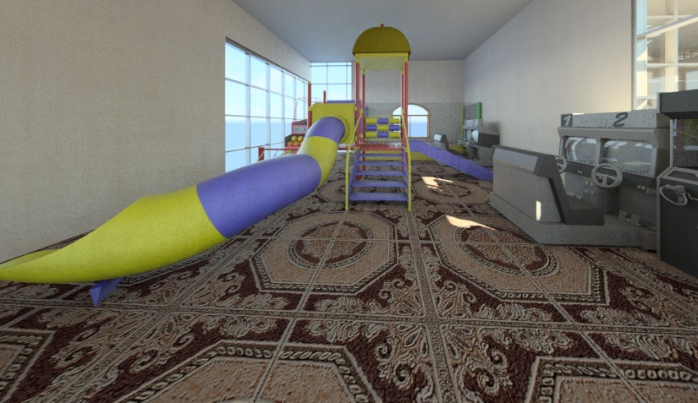
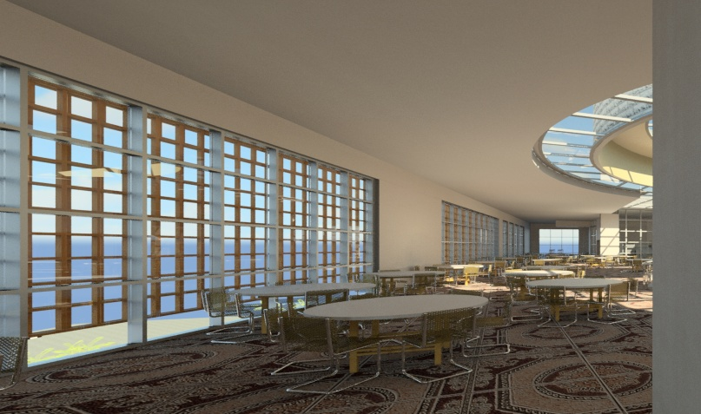
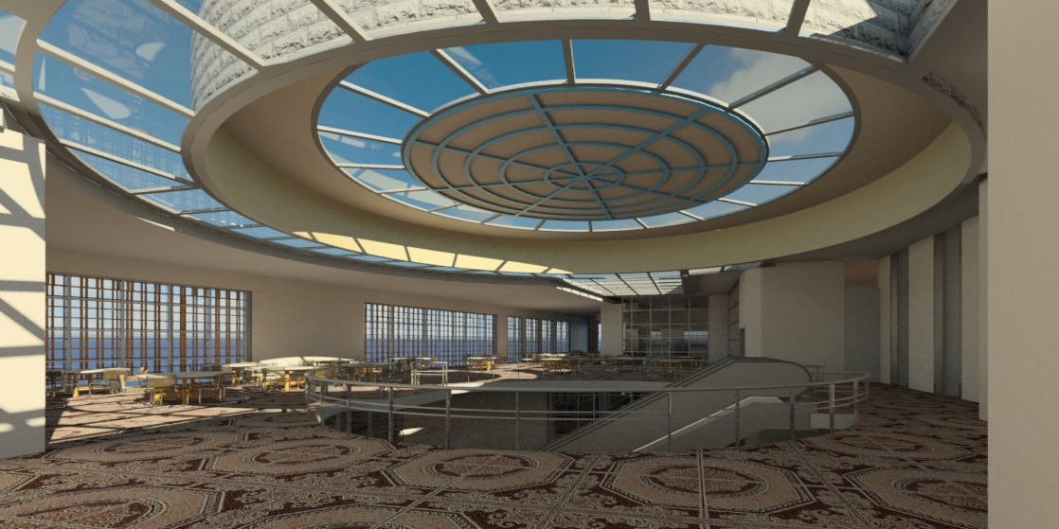
Second Floor

Slide 14
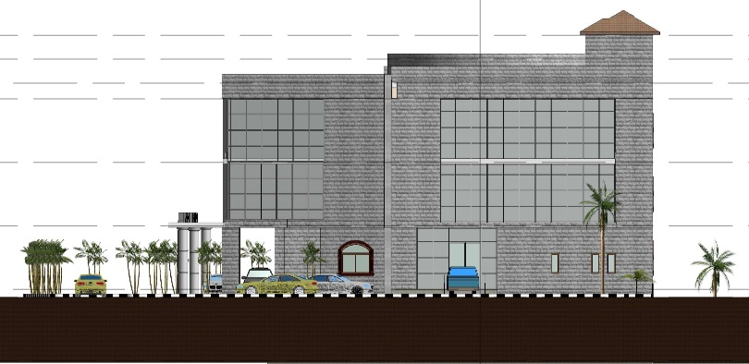
North Elevation:

Slide 15
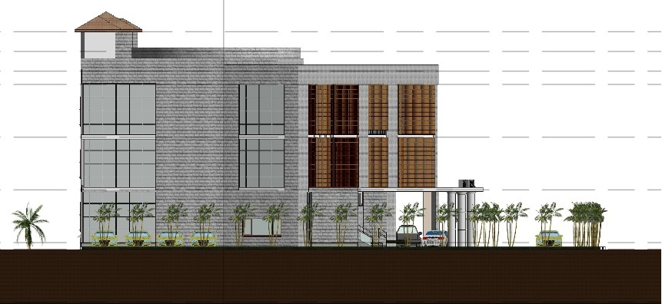
South Elevation:

Slide 16
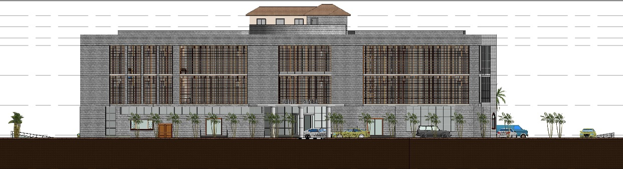
East Elevation (Main Elevation):

Slide 17
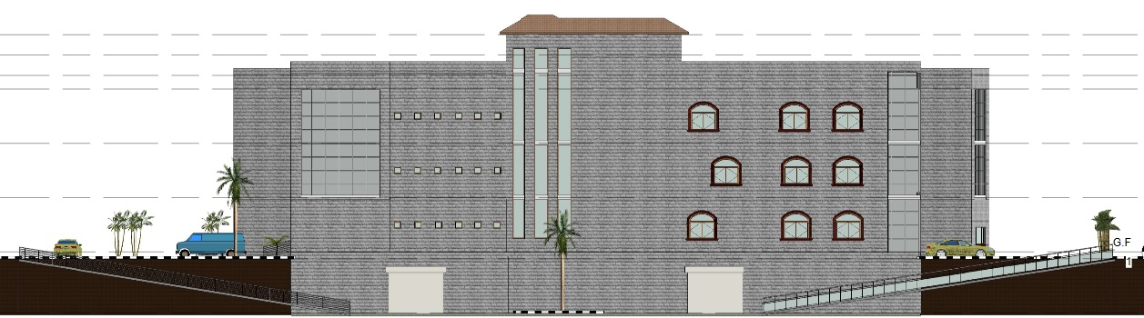
West Elevation:

Slide 18
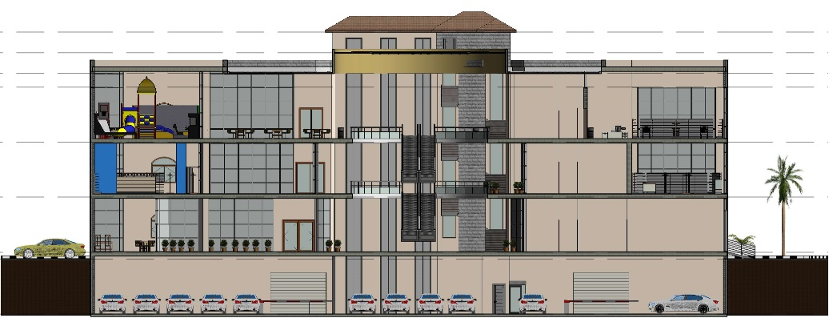
Section 1-1:

Slide 19
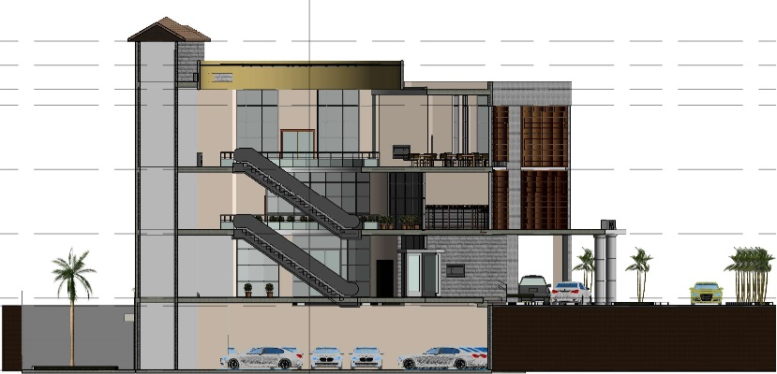
Section 2-2:

Slide 20
Structural and Seismic Design

Slide 21
Design Codes
Structural Design
The American Concrete Institute specifications ACI 318-08.
The seismic design according to UBC-97.
The analysis and design were done using SAP2000 program.

Slide 22
* Design data :
1. Concrete compressive strength :
f’c =24 MPa.
2.Yielding strength of steel
The yield strength of steel Fy= 420MPa
3. Bearing capacity of soil
the bearing capacity of soil = 100 KN/m²

Slide 23
Structural system:
One and Two way waffle slabs
Thickness of slab:
Thickness of one way = 42
Thickness of two way = 42
The thickness of slab (h) = 45 cm

Slide 24
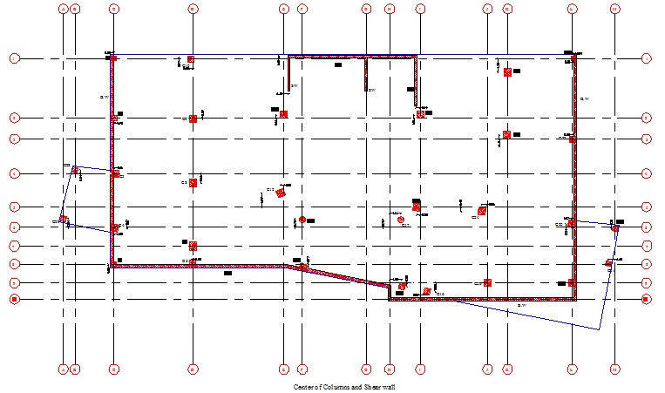
The distribution of columns and shear walls in the building:

Slide 25
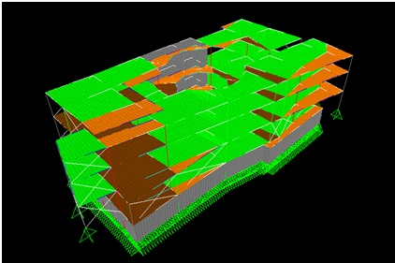
3D Modeling from SAP2000 Program:

Slide 26
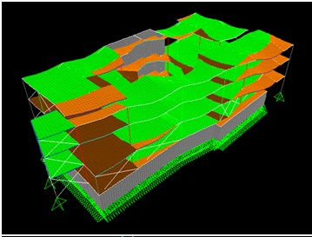
Check Model: Compatibility check

Slide 27
Equilibrium checks:
Error% | SAP | Manual
1.69 % | 68643.497 | 69808 | Dead load + S.I.D.L
0.02 % | 17998.464 | 17998 | Live load

Slide 28
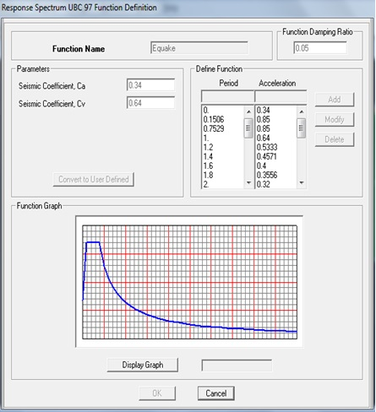
Seismic design using Response Spectrum – UBC 97:
Vmax = 16448
Soil type SE
I = 1
R = 4.5
C_{v} = 0.64
C_{a} = 0.34
T = 0.39 sec.

Slide 29
Natural Period (T) for the building:
T(sec)
0.45 | From SAP
0.39 | Manual

Slide 30
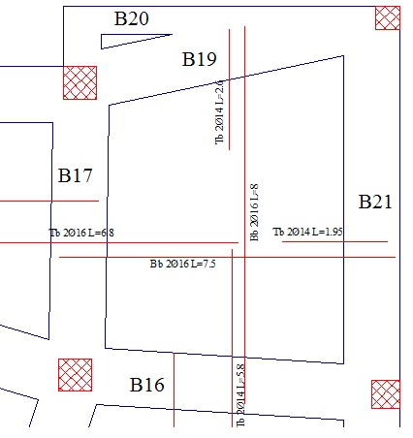
:Structural System Design
    1. Slab design: (Two way)

Slide 31
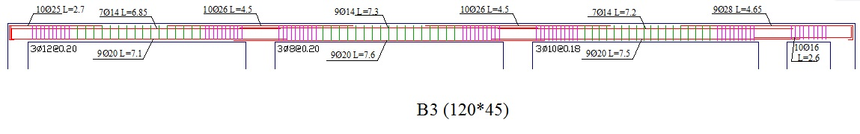
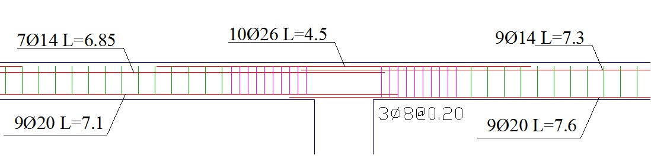
    2. Main Beam Design:

Slide 32
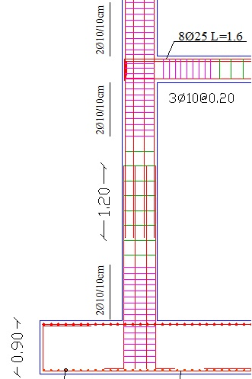
    3. Columns Design (Square Column):

Slide 33
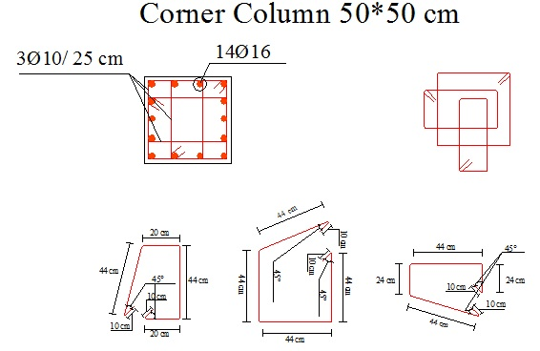
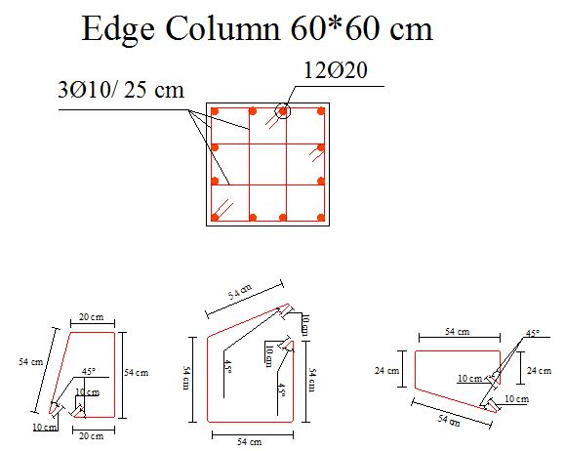
    3. Columns Design (Square Column):

Slide 34
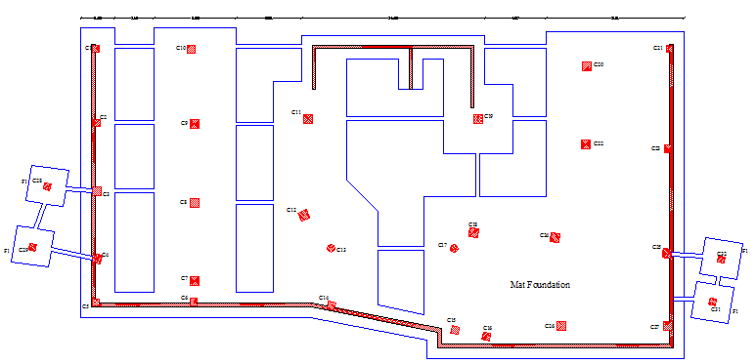
    4. Footings Design:

Slide 35
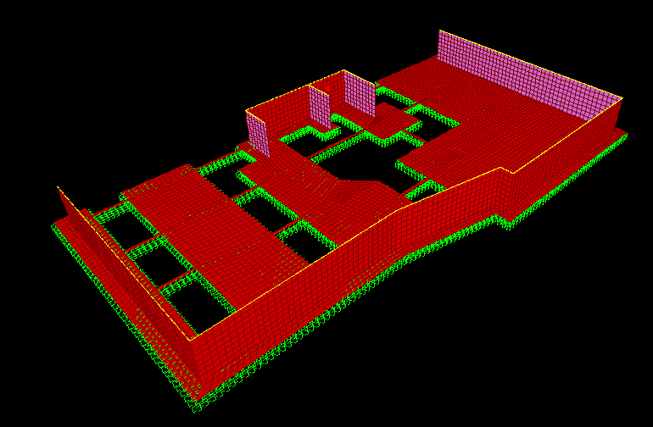
    4. Footings Design (Mat):
Sap model

Slide 36
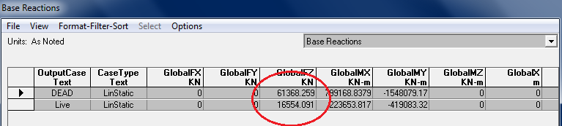
    4. Footings Design (Mat):
    Check:
1- compatible
2- Equilibrium check
Case | Reaction from sap | Calculated | Error
Dead | 61368 | 57084 | 6%
Live | 16554 | 15972 | 3.50%

Slide 37
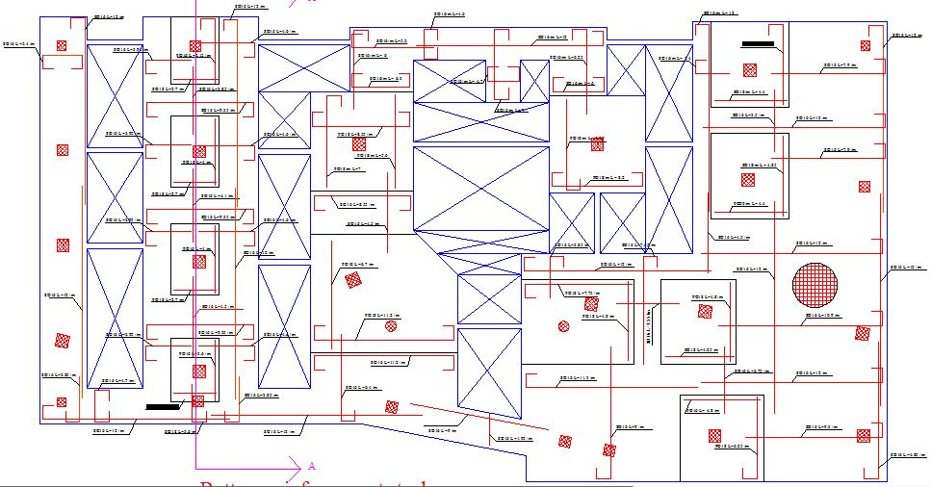
    4. Footings Design (Mat):
Reinforcement

Slide 38
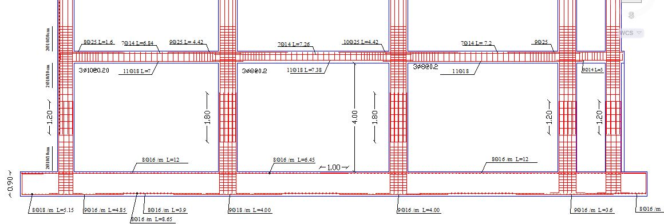
    4. Footings Design (Mat):
Section A-A

Slide 39
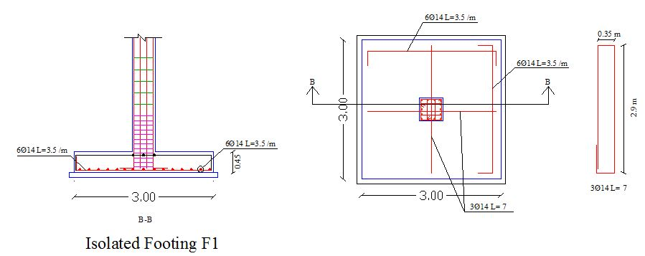
    4. Footings Design (Isolated):

Slide 40
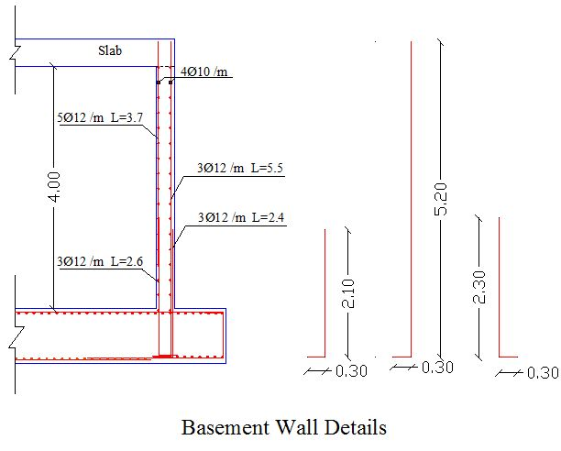
    5. Basement Wall:

Slide 41
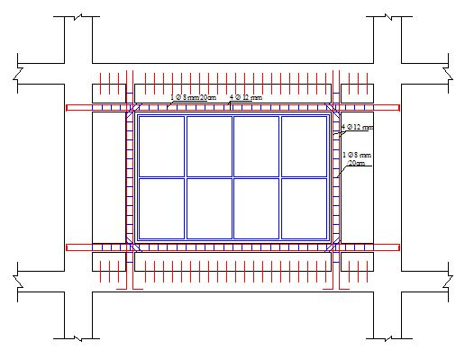
    6. Reinforcement details around openings:

Slide 42
Mechanical
Design

Slide 43
General
Mechanical design of a building involves many aspects including:
1. HVAC System.
2. Vertical Transportation (Elevators and Escalator).
3. Water Supply System.
4. Drainage System Design

Slide 44
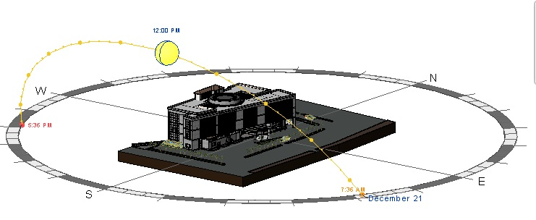
Sun path

Slide 45
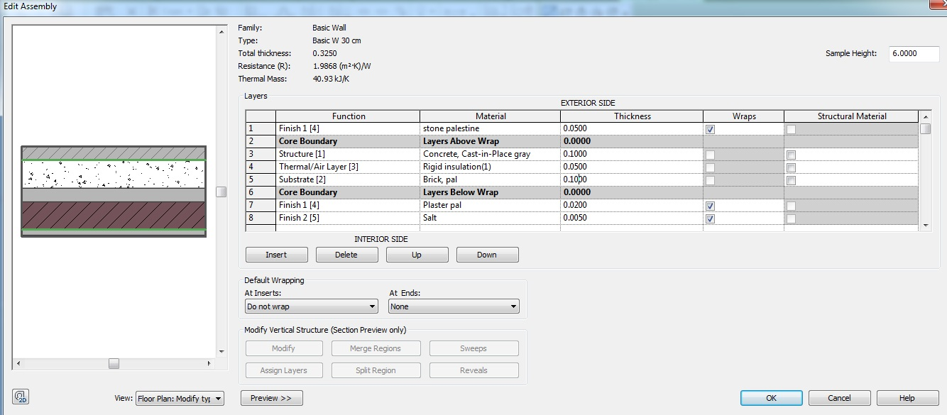
:1-HVAC system
U-value:
Partion | thiCkness | K | R
Outside | - | - | 0.03
Jamaan stone(2650 Kg/m³) | 0.05 | 2.6 | 0.019231
Concrete (2400 kg/m) | 0.1 | 2.1 | 0.047619
Polystyrene Extruded (Extruded) (40 Kg/m3) | 0.05 | 0.028 | 1.785714
Hollow Blocks(10x20x40)(11Kg) | 0.1 |  | 0.12
Plaster ( 2000 kg/m³ ) | 0.02 | 1.4 | 0.014286
inside |  |  | 0.12
R _{total} |  |  | 2.13685
U1 |  |  | 0.467979

Slide 46
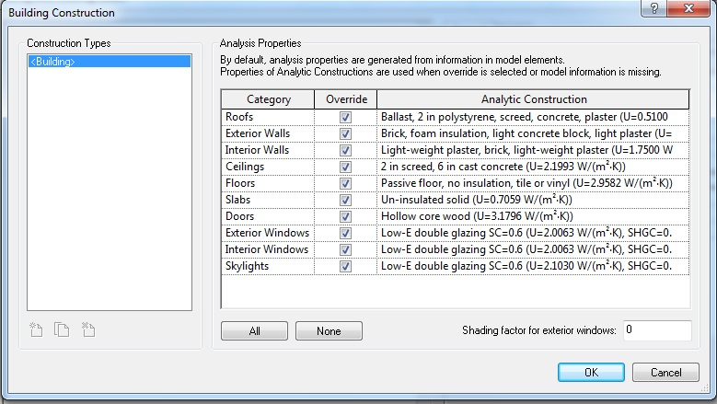
:HVAC system
U-value:

Slide 47
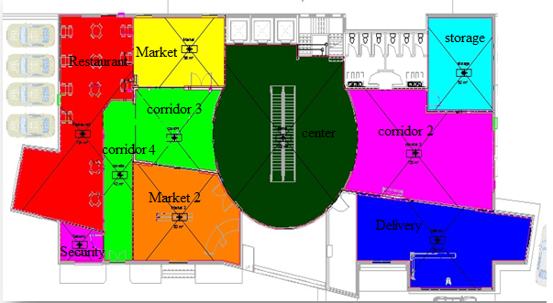
:HVAC system
Ground floor zones:

Slide 48
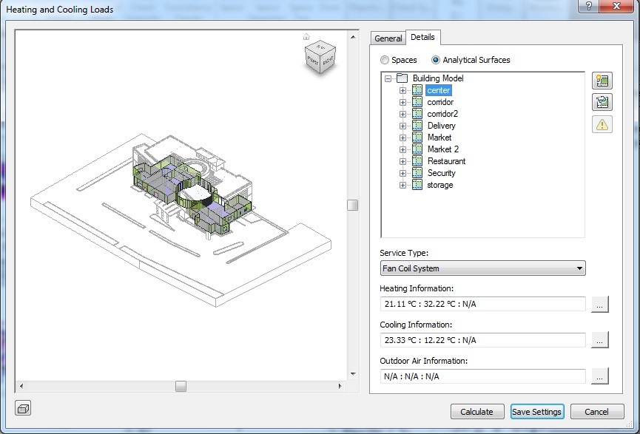
:HVAC system
System used fan coil unit

Slide 49
:HVAC system
HVAC analysis data
Result for ground floor
Location and Weather
Project | Mini-mall
Address | Nablus
Calculation Time | Thursday, April 17, 2014 4:57 PM
Report Type | Detailed
Latitude | 32.23°
Longitude | 35.26°
Summer Dry Bulb | 32 °C
Summer Wet Bulb | 22 °C
Winter Dry Bulb | 1 °C
Mean Daily Range | -8 °C
Calculated Results
Peak Cooling Total Load (W) | 67,556
Peak Cooling Month and Hour | September 1:00 PM
Peak Cooling Sensible Load (W) | 56,820
Peak Cooling Latent Load (W) | 10,735
Maximum Cooling Capacity (W) | 85,339
Peak Cooling Airflow (L/s) | 6,003.6
Peak Heating Load (W) | 16,208
Peak Heating Airflow (L/s) | 1,205.4
Checksums
Cooling Load Density (W/m²) | 80.34
Cooling Flow Density (L/(s·m²)) | 7.14
Cooling Flow / Load (L/(s·kW)) | 88.87
Cooling Area / Load (m²/kW) | 12.45
Heating Load Density (W/m²) | 19.28
Heating Flow Density (L/(s·m²)) | 1.43

Slide 50
:HVAC system
Summary of calculations:
Space Name | Area (m²) | Volume (m³) | Peak Cooling Load (W) | Cooling Airflow (L/s) | Peak Heating Load (W) | Heating Airflow (L/s)
4 center | 192 | 753.21 | 20,540 | 1,508.4 | 3,019 | 224.5
Space Name | Area (m²) | Volume (m³) | Peak Cooling Load (W) | Cooling Airflow (L/s) | Peak Heating Load (W) | Heating Airflow (L/s)
6 corridor | 55 | 214.08 | 6,153 | 465.7 | 711 | 52.9
9 corridor | 42 | 160.50 | 993 | 75.2 | 416 | 30.9
Space Name | Area (m²) | Volume (m³) | Peak Cooling Load (W) | Cooling Airflow (L/s) | Peak Heating Load (W) | Heating Airflow (L/s)
2 corridor 2 | 123 | 475.69 | 4,440 | 306.5 | 1,347 | 100.2
Space Name | Area (m²) | Volume (m³) | Peak Cooling Load (W) | Cooling Airflow (L/s) | Peak Heating Load (W) | Heating Airflow (L/s)
1 Delivery | 103 | 398.23 | 10,941 | 881.0 | 3,100 | 230.6

Slide 51
:HVAC system
Space Name | Area (m²) | Volume (m³) | Peak Cooling Load (W) | Cooling Airflow (L/s) | Peak Heating Load (W) | Heating Airflow (L/s)
5 Market | 56 | 216.09 | 4,312 | 343.7 | 879 | 65.4
Space Name | Area (m²) | Volume (m³) | Peak Cooling Load (W) | Cooling Airflow (L/s) | Peak Heating Load (W) | Heating Airflow (L/s)
7 Market 2 | 82 | 315.56 | 6,227 | 497.1 | 1,522 | 113.2
Space Name | Area (m²) | Volume (m³) | Peak Cooling Load (W) | Cooling Airflow (L/s) | Peak Heating Load (W) | Heating Airflow (L/s)
8 Restaurant | 124 | 481.89 | 24,172 | 1,509.4 | 3,226 | 239.9
Space Name | Area (m²) | Volume (m³) | Peak Cooling Load (W) | Cooling Airflow (L/s) | Peak Heating Load (W) | Heating Airflow (L/s)
10 Security | 12 | 44.23 | 3,901 | 316.2 | 735 | 54.7
Space Name | Area (m²) | Volume (m³) | Peak Cooling Load (W) | Cooling Airflow (L/s) | Peak Heating Load (W) | Heating Airflow (L/s)
3 storage | 52 | 201.40 | 1,454 | 100.4 | 1,252 | 93.1

Slide 52
:HVAC system
Flow rate supply, return and fresh air.
 | Flow L/s))Supply | Area | People | Fresh air (L/s/M²) | Fresh air (L/s/PERSON) | Flow Fresh air. (L/s) | Flow Return L/s
Delivery | 994.2 | 103 | 6 | ……. | 8 | 48 | 946.2
corridor 2 | 680.3 | 123 | 82 | 0.25 | …….. | 30.75 | 649.55
storage | 105.4 | 52 | 3 | 0.75 | 2.5-12.5 | 39 | 66.4
center | 1500 | 192 | 77 |  | 10.5 | 808.5 | 691.5
Market | 434.2 | 56 | 28 | …………. | 8 | 224 | 210.2
6 corridor | 576.7 | 55 | 37 | 0.25 | …….. | 13.75 | 562.95
Market 2 | 580.7 | 82 | 41 | …………. | 8 | 328 | 252.7
Restaurant | 1500 | 124 | 87 | ……….. | 10 | 870 | 630
9 corridor. | 212.6 | 42 | 27 | 0.25 | …….. | 10.5 | 202.1
Security | 320 | 12 | 2 | 2.5-10 | 10 | 20 | 300

Slide 53

:HVAC system
Cooling load for ground floor.

Slide 54

:HVAC system
Heating load for ground floor.

Slide 55

:HVAC system
3D Distribution for ducts.

Slide 56

:HVAC system
Duct’s flow.

Slide 57




2.Vertical Transportation (Elevators and Escalator).

Slide 58

    3.Water Supply System.
Number of fixture unit in Ground floor
Fixture or Group | Type of Supply Control | Number of Function | Number of FU
WC | Flash tank | 6 | 30
Lavatory | Faucet | 6 | 12
kitchen sink | Faucet | 1 | 4
Total FU. Units |  |  | 46

Slide 59

    Water Supply System.
Number of fixture unit in First floor
Fixture or Group | Type of Supply Control | Number of Function | Number of FU
WC | Flash tank | 6 | 30
Lavatory | Faucet | 6 | 12
Total FU. Units |  |  | 42

Slide 60

    Water Supply System.
Number of fixture unit in Second floor
Fixture or Group | Type of Supply Control | Number of Function | Number of FU
WC | Flash tank | 6 | 30
Lavatory | Faucet | 6 | 12
kitchen sink | Faucet | 12 | 24
Total FU. Units |  |  | 66

Slide 61
    Water Supply System:
    Water demand for each floor:
Floor | Number of fixture unit | Water demand (gpm)
Ground floor | 46 | 22
First floor | 42 | 20
Second floor | 66 | 35
The total fixture unit=154
Water flow for all building =57 gpm.
Available pressure at the fixtures:
P = 0.433(8/2+5+ (13*3)-3) = 19.05 psi
Height of main feeder = (13*3) +5 = 44ft
The equivalent length =44*1.5 =66 (vertical).
Pipe diameter | 3 inches | 2 .5 inches | 2 inches
Loss /100 ft | .6 | 1.4 | 4.5
Loss /66ft | 0.39 | 0.92 | 2.97

Slide 62
    Water Supply System:
    Water demand for each floor:
The equivalent length =1.2×20=24ft (horizontal pipes).
Pipe diameter | 1.5 inches | 1.25 inches | 1 inches
Loss /100 ft | 2.3 | 5.8 | 17
Loss /24ft | 0.39 | 1.4 | 4.1
The actual length =1.2× 15=18ft (branch pipes) .
Pipe diameter | 1inches | 3/4 inches | 1/2 inches
Loss /100 ft | 5 | 6 | 35
Loss /18 ft | .9 | 1.1 | 6.3

Slide 63

    4. Drainage System Design:
    Number of fixture unit in Ground floor
Fixture or Group | Type of Supply Control | Number of Function | Number of FU | Total
WC | Flash tank | 6 | 4 | 24
Lavatory | Faucet | 6 | 1 | 6
kitchen sink | Faucet | 1 | 2 | 2
Total FU. Units |  |  |  | 32

Slide 64

    4. Drainage System Design:
    Number of fixture unit in First floor
Fixture or Group | Type of Supply Control | Number of Function | Number of FU | Total
WC | Flash tank | 6 | 4 | 24
Lavatory | Faucet | 6 | 1 | 6
Total FU. Units |  |  |  | 30

Slide 65

    4. Drainage System Design:
    Number of fixture unit in second floor
Fixture or Group | Type of Supply Control | Number of Function | Number of FU | Total
WC | Flash tank | 6 | 4 | 24
Lavatory | Faucet | 12 | 1 | 12
kitchen sink | Faucet | 6 | 2 | 12
Total FU. Units |  |  |  | 48

Slide 66
    4. Drainage System Design:
    Stack diameter
Floor | Ground floor | Floor 1 | Floor 2
Fixture unit | 32 | 30 | 48
Stack diameter | 4' | 4' | 4'

Slide 67

Lighting
Design

Slide 68




Coffee Shop
E avg =288 lux

Slide 69


Clothing store :
E avg =520 lux

Slide 70
Thank you

