Slide 1
Replacing streetlights from ordinary lighting to LEED lighting with Solar Cells in Tubas city
Student name:-
Du'a Tamer Daraghmeh
Supervisor name:-
Dr.Raed jaber

Slide 2
This project proposes a feasibility analysis of replacing streetlights from ordinary lighting to LED lighting with Solar Cells in Tubas city considering technical and economical requirements.
The aim is to design an optimal solar system reduces the future economic costs and expenses, and ensures the sustainable development of national energy and reduces depending on Israeli energy. A feasibility study should be first performed in the system analysis stage of the system development life cycle, where, carrying out the feasibility study determine whether the project idea in viable or we need to find other feasible options.
A feasibility study was carried out in order to install a LED lighting with Solar Cells in Tubas city and to evaluate whether the project is technically sensible. The economic feasibility of this photovoltaic system contains sufficient details such as electricity prices in Tubas, the investment cost, the number of streetlight columns and, the bill of quantities, and the economic analysis.

Slide 3
يقترح هذا المشروع تحليل جدوى لاستبدال إنارة الشوارع من الإضاءة العادية إلى إضاءة LED بالخلايا الشمسية في مدينة طوباس مع مراعاة المتطلبات الفنية والاقتصادية. الهدف من ذلك هو تصميم نظام شمسي مثالي يقلل من التكاليف والمصاريف الاقتصادية المستقبلية ، ويضمن التنمية المستدامة للطاقة الوطنية ويقلل اعتمادًا على الطاقة الإسرائيلية. يجب إجراء دراسة الجدوى أولاً في مرحلة تحليل النظام في دورة حياة تطوير النظام ، حيث ، عند إجراء دراسة الجدوى ، تحدد ما إذا كانت فكرة المشروع قابلة للحياة أم نحتاج إلى إيجاد خيارات أخرى ممكنة. أجريت دراسة جدوى من أجل تثبيت إضاءة LED مع الخلايا الشمسية في مدينة طوباس وتقييم ما إذا كان المشروع معقول تقنياً. تحتوي الجدوى الاقتصادية لهذا النظام الكهروضوئي على تفاصيل كافية مثل أسعار الكهرباء في طوباس ، وتكلفة الاستثمار ، وعدد أعمدة إنارة الشوارع ، وفاتورة الكميات ، والتحليل الاقتصادي

Slide 4
Tubas area in the west bank of Palestine; within an area of 500 square kilometers, is located at the geographic latitude of approximately 32.3◦ N, and 35.3◦ E. It rises from the surface of sea around 200 to 850 meters. However, no traditional natural energy resources; all of the country's electric power and fuel are imported from Israel where they are derived from imported coal and natural gas. The power consumption in Tubas in 2017 reached 22MW (1). Tubas is granted high solar radiation potential and high sunshine hours throughout the year in which the horizontal yearly average daily solar radiation about 5.2 kWh/m², with about 3000 sunshine hours

Slide 5
Palestinian distribution electricity companies tend to use on-grid solar power for the following reasons:
You don’t have to buy an expensive battery to store any excess energy, so you are saving money.
Live greener; live in green future; since the batteries emit some toxic gases such as hydrogen sulfide

Slide 6
OBJECTIVE:
To study the current light quality situation in Tubas city.
To compare between HPS & LED technologies from different aspects: Economic, social and environmental impacts and PHOTOPHOLTIC CELL.
Suggest a plan on Tubas Electricity Distribution Company to retrofit its older streetlights by new technologies to save money & reduce greenhouse gas emissions .
1.2:SCOPE OF THE WORK:
In my study I decided to make a comparative life cycle assessment between HPS & LED and pv cells but I did not get into the details of the manufacturing process, also the environmental impacts were taken from previous studies since we will address it in this semester. Furthermore, i carried out life cycle cost analysis (LCCA).
1.3:SIGNIFICNAE OF THE WORK:
my work is considered to be important because it deals with public safety. The vision should be clear for both of the pedestrians and drivers in order to reduce the number of accidents

Slide 7
ORGANIZATION OF THE REPORT:
At first, I wrote general background about street lighting and then we made a comparative LCA that includes the framework. After that, some economical calculations were made in order to be able find out the better technology and recommend it
CONSTRAINS, STANDARDS/ CODES AND EARLIER COURSE WORK
I have faced many constraints, especially in collecting data and information about the loads, determining the type of street light in Tubas, the suitable led street light and the solar potential in Tubas

Slide 8
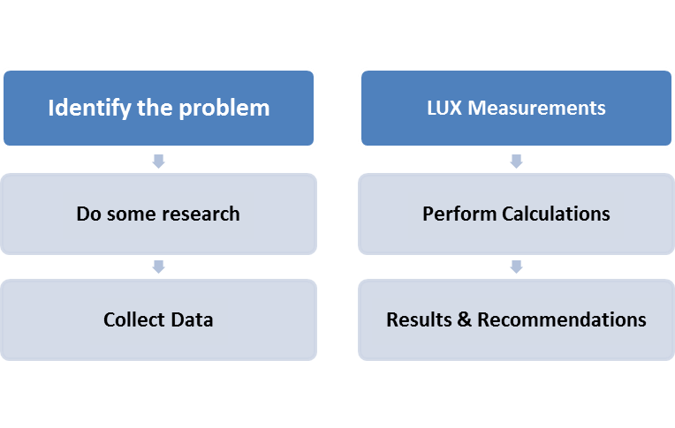
Figure 3. 1:Methodology Frame work

Slide 9
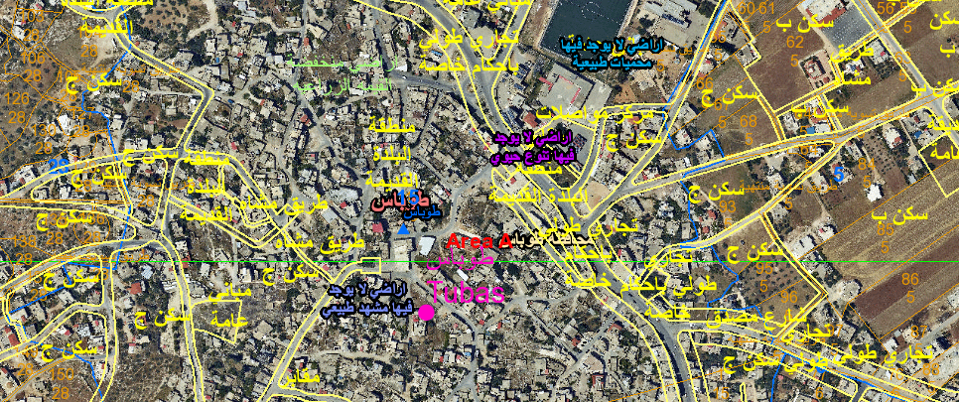
Figure3.2 : Map of Tubas city taken from google map

Slide 10
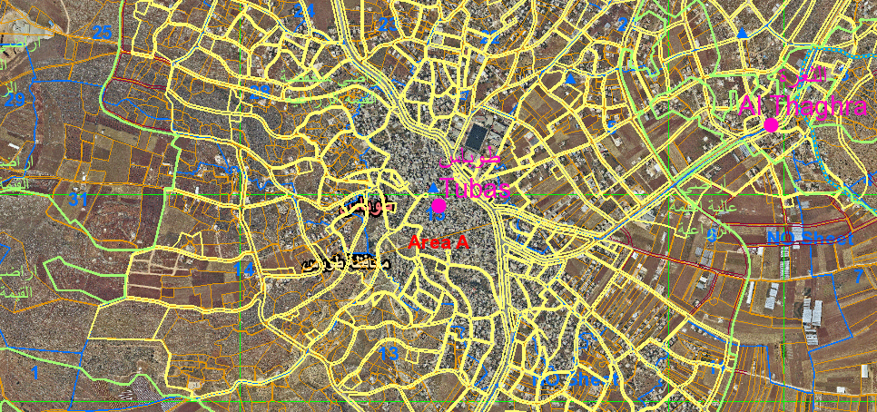
Figure 3.3: Map of Tubas city taken from Geomolg

Slide 11
THE SPECIFIC OBJECTIVES
To develop a standard procedures for installing a solar/LED street light in Tubas in order to analyze the technical and financial performances of this project based on measured data were taken from Palestinian Meteorological Department.
This will include the following steps
Ch4.Analysis of solar resources and irradiation in Tubas area

Slide 12
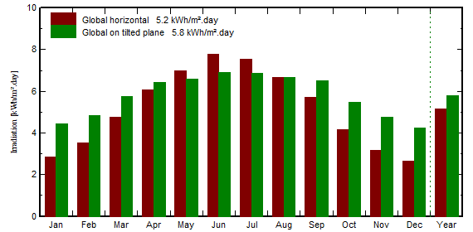
Figure 4.1: Plot of Irradiation in Tubas during a year of 2019.

Slide 13
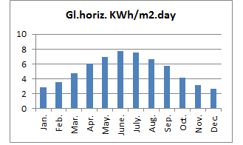
CH5.METROLOGICA IRRADIATION
DATA ANALYSIS
Figure 5.1: The horizontal global irradiation

Slide 14
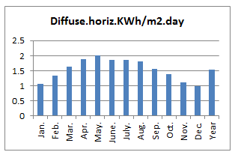
.
Figure 5.2 shows the Horizontal diffuse radiation.

Slide 15
Figure 5.3: The global incident

Slide 16
POTENTIAL SOLAR ENERGY PRODUCTION IN TUBAS CITY
 | System output KWh/day | System output (KWh/month) = KWh/day*number of days in each month
Jan. | 3.49 | 108
Feb. | 3.93 | 110
Mar. | 4.81 | 149
Apr. | 5.38 | 161
May. | 5.75 | 178
June. | 5.90 | 177
July. | 5.88 | 182
Aug. | 5.80 | 180
Sep. | 5.64 | 169
Oct. | 4.84 | 150
Nov. | 3.97 | 119
Dec. | 3.33 | 103
Yearly Avg. | 58.72/12=4.933 | 1786/12=148.834
Table5.1: The energy production of 1KWp in Tubas.

Slide 17
Figure 5.4: The daily system output in KWh
Figure 5.5: The monthly system output in kwh

Slide 18
LOCATION
Fig5.6 site of station takes in geomolg website

Slide 19
CH6.Comparing between mercury and sodium street light and solar/LED street light lamp
Number of lamps | 2000
Power/lamp | 350 watts
Total power consumption | 700Kw
Table 7.1 shows the data of mercury vapor lamp

Slide 20
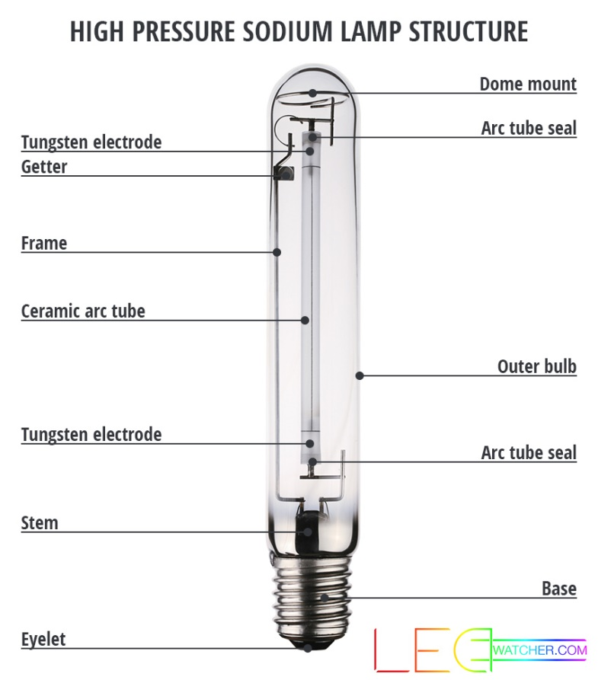
HPS Technology
Figure 7.1 HPS Components

Slide 21
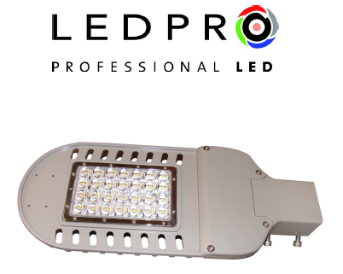
P/N | DIMENSION：L * W * H（mm)
MS-ST037030 | 436*175*68
MS-ST058050 | 436*175*68
SOLAR ENERGAY P/N | DIMENSION：L * W * H（mm)
MS-ST068030 | 436*175*68
MS-ST069050 | 436*175*68
Table 7.2: PRODUCT CHARACTERISTIC & SPEC

Slide 22
Number of lamps | 2000 lamp
Power/lamp | 50 Watts
Total power consumption | 100KW
Calculating the consumption of LED
CH.8:Life Cycle Assessment (LCA)

Slide 23
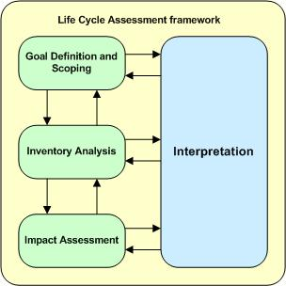
Figure 8.1:.(Phases of the LCA method (adapted from ISO 14040(ISO 2006a))

Slide 24
LCA Element | Summary of this work
Intended Application | Create a comparative life cycle assessment (LCA) of two common street lighting technologies (HPS & LED), the technologies will be compared one to one replacement of HPS with LED.
Reasons for the study | . To quantify the energy consumption of each technology . . To study the environmental impacts of LED & HPS lamps,and solar panel . . To inform the city in their decision making process as well as cities involved in a future lighting retrofits.
Audience | Decision makers which will be useful for comparing options that will be implemented on a large scale and for along term.
Results | The results of this study will be addressed in this report.
Bulb Type | Wattage (W) | Color Rendering Index | Lumens | Color Temperature (K) | Life Time (hrs) | Pole height (m) | Spaces between Poles (m)
HPS | 350 | 25 | 28,000 | 2,000 | 24,000 | 10 | 46
LED | 50 | 70 | 12,000 | 5,300 | 75,000 | 10 | 30
Table 8.3:Specification of the two lighting bulbs

Slide 25
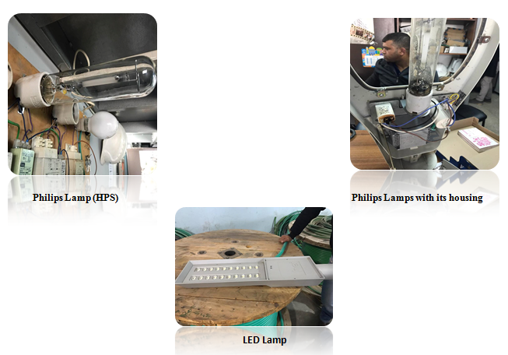

Slide 26
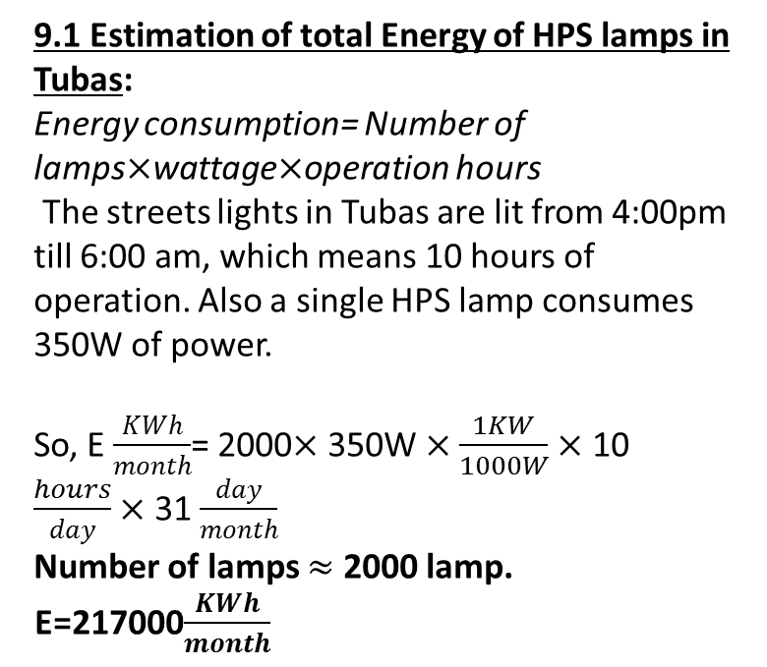
CH .9:LIFE CYCLECOST ANALYSIS (LCCA
9.1 Estimation of total Energy of HPS lamps in Tubas: Energy consumption= Number of lamps$×$wattage$×$operation hours
The streets lights in Tubas are lit from 4:00pm till 6:00 am, which means 10 hours of operation. Also a single HPS lamp consumes 350W of power. So, E $\frac{KWh}{month}$= 2000$×$ 350W $×\frac{1KW}{1000W}×$ 10 $\frac{hours}{day}×$ 31 $\frac{day}{month}$
Number of lamps $≈$ 2000 lamp.
E=217000$\frac{KWh}{month}$

Slide 27
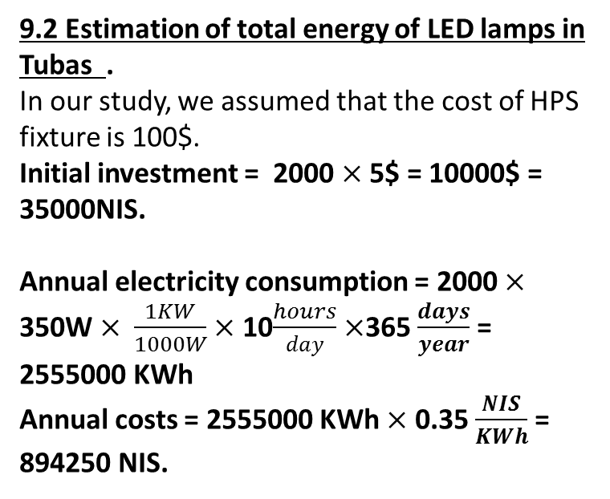
9.2 Estimation of total energy of LED lamps in Tubas . In our study, we assumed that the cost of HPS fixture is 100$. Initial investment = 2000 $×$ 5$ = 10000$ = 35000NIS. Annual electricity consumption = 2000 $×$ 350W $×$ $\frac{1KW}{1000W}×$ 10$\frac{hours}{day}$ $×$365 $\frac{days}{year}$ = 2555000 KWh
Annual costs = 2555000 KWh $×$ 0.35 $\frac{NIS}{KWh}$ = 894250 NIS.

Slide 28
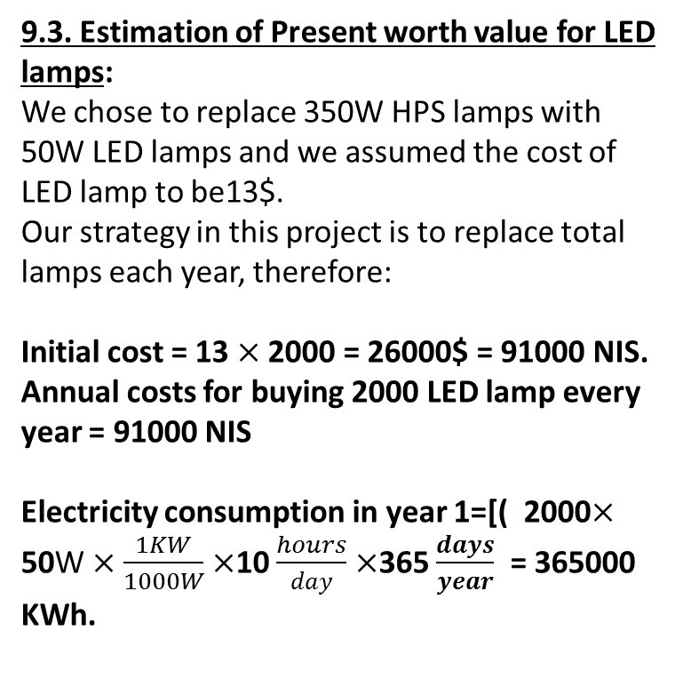
9.3. Estimation of Present worth value for LED lamps:
We chose to replace 350W HPS lamps with 50W LED lamps and we assumed the cost of LED lamp to be13$.
Our strategy in this project is to replace total lamps each year, therefore: Initial cost = 13 $×$ 2000 = 26000$ = 91000 NIS.
Annual costs for buying 2000 LED lamp every year = 91000 NIS Electricity consumption in year 1=[( 2000$×$ 50W $×$ $\frac{1KW}{1000W}×$10 $\frac{hours}{day}$ $×$365 $\frac{days}{year}$ = 365000 KWh.

Slide 29
9.4:. Calculation of costs for solar cells
Photovoltaic Q cells 350 watt =50$
Battery lead acid =70$
Regulator=15$
Cables=1$
Tot cost for photovoltaic cells =50+70+15+1=136$ * 3.5NIS =476NIS
Then the total costs for the whole system =
Cost .pv+Cost .batt+Cost. reg+Cost.cables+Cost .LED
Total cost =50+70+15+1+15=151$ * 3.5NIS =528.5NIS

Slide 30
CH.10 RESULT AND FINALY SAVING:
10.1:Expected Savings
2000 Lamp *5$HPS=10000$=35000NIS
Saving=35000-528.5=34471.5NIS
Initial cost = 2000*151$=302000$=1057000NIS
Saving (NIS)= 1057000-35000=1022000NIS
2000lamp*350watt*10hour=7000000watt=7000kwh/day
Saving per year=0.34NIS/Kwh*7000kwh / day *365day/year=1008000NIS /year
Saving per 5 year =403200*4=403200 NIS/5year

Slide 31
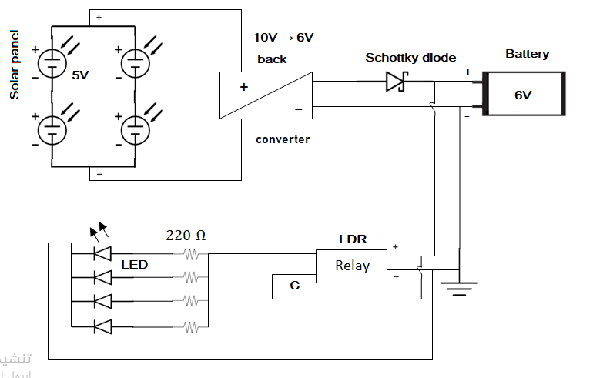
ch.11: Discussion
Figure8.3 The main circuit for my project

Slide 32
ch.12:Conclusions and Recommendation
Ch.13:Bibliography
CH.14:Appendices

