Slide 1


Slide 2
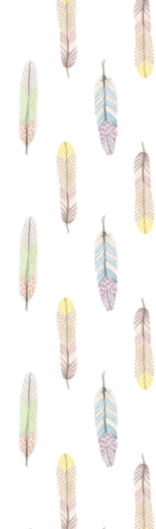
What is MWAHEB ?
It is an e-commerce website that joins together students with unique talents and customers that prefer customized and unique gifts.

Slide 3
Why call it MWAHEB ?
We choose the name because it is easier to give you a first impression of the content of the website, it is also easy to memorize and write.

Slide 4
Why choose us not them ?
Home delivery service
Refund
policy
50% discount
for delays
Customized products

Slide 5
SWOT ANALYSIS
Weaknesses
customers lack of online experience.
Lack of trust in the online selling industry.
Strengths
Affordable prices.
Quality Products.
The urge for customized gifts.
Less Expenses

Slide 6
SWOT ANALYSIS Con ..
Threats
Future market entry.
Offline competition stores.
Opportunities
Gaining customers trust.
Possibility of global expanding products.
Taking advantage of online technologies..

Slide 7
Market segments
Buyers
Those who want to buy unique and customized products
Sellers
Talented artists
Passionate interrupters
Competitors
Offline stores
Those interested in reasonable prices
Social media pages

Slide 8
Revenue
Current Revenue
Future Revenue
MWAHEB charges 10% commission of sales revenue.
Advertising on the site
Purchase raw materials and sell them to craftsmen

Slide 9
Cost structure
Delaying costs
Monthly fees
Domain Cost
Advertising costs

Slide 10
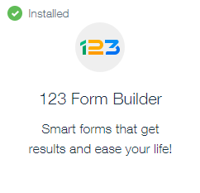
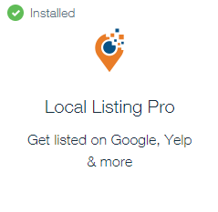
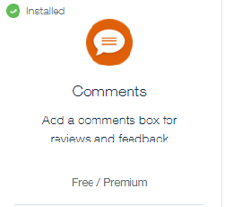
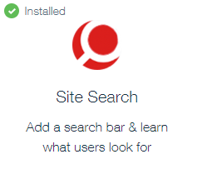
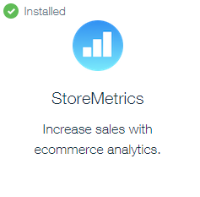
Used Tools

Slide 11
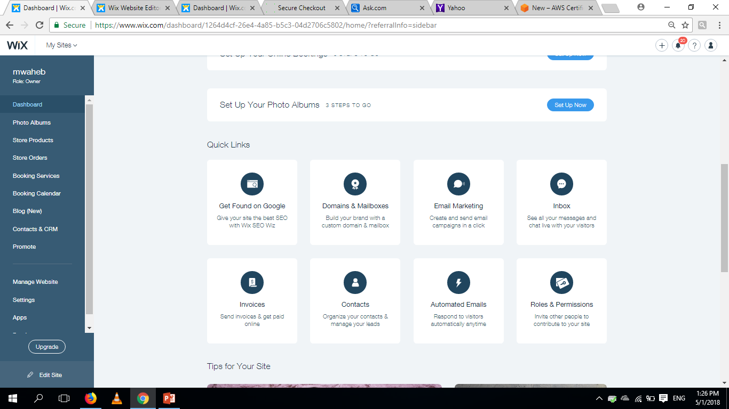
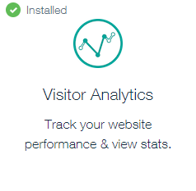
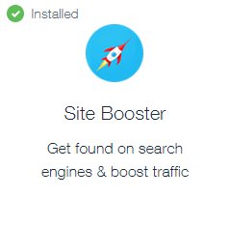

Used Tools Con ..

Slide 12
Dashboard reports
Several reports were used:
Order Report
Sales Report
Visitor Report
Comment dashboard
Search Report and SEO Insights

Slide 13

Thank you !

