Slide 1
Kids Tracker Bracelet
Rawzan Masood & Yasmeen Abd el-Haq

Slide 2
Contents:
Introduction.
Motivations.
Hardware components.
Methodology.
Challenges.
Future work.
Conclusion.

Slide 3
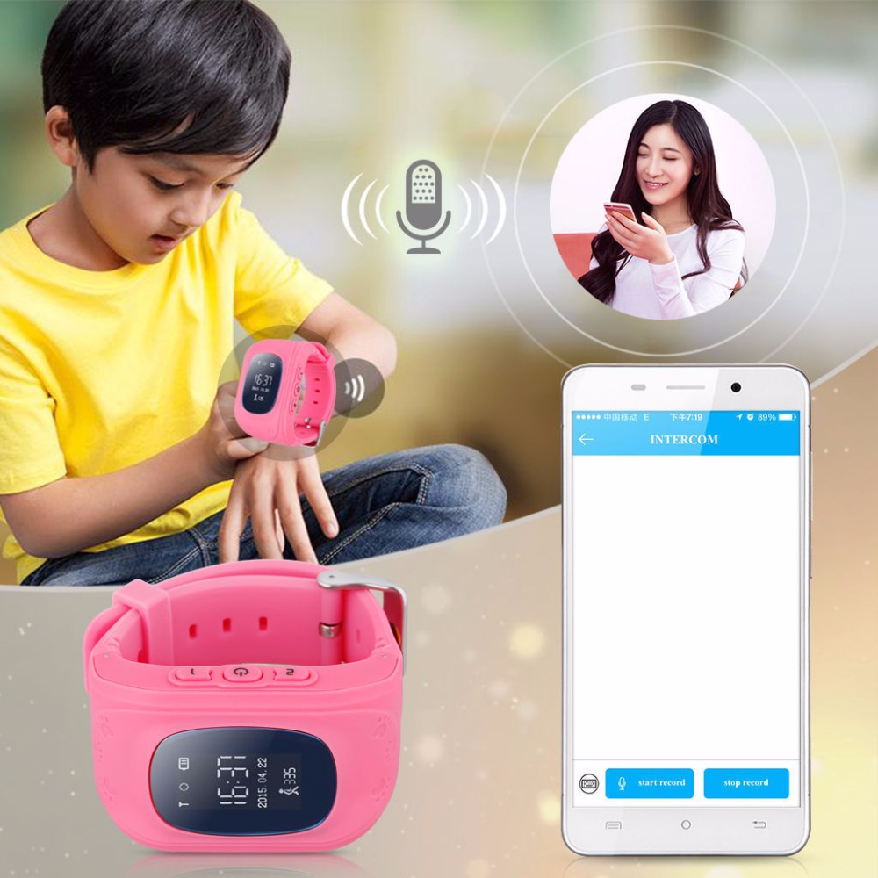
Introduction
Nowadays, technology become
involved in everything in our life,
so we thought to use it to protect
children and to keep in touch with
them.

Slide 4
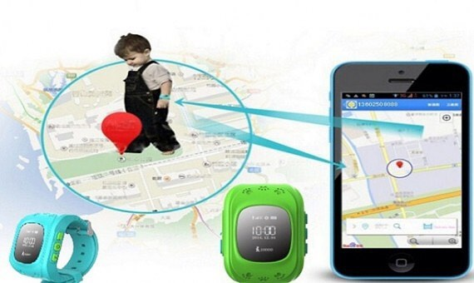
Motivations
People are looking for a way that allows them to reassure about their children, if they compelled to leave them alone in anywhere even there is no Wi-Fi connections, or if they lost them in some place.

Slide 5
Hardware components
Arduino Nano.
Sim900 gsm/gprs shield.
NE0-6M MiniGPS Module.
Heart/Pulse sensor.
Temperature sensor(tmp36).
Lipo Battery.
Charger Step Up Power Module.
Mini breadboard.
Connecters & Wires.

Slide 6
Methodology

Slide 7
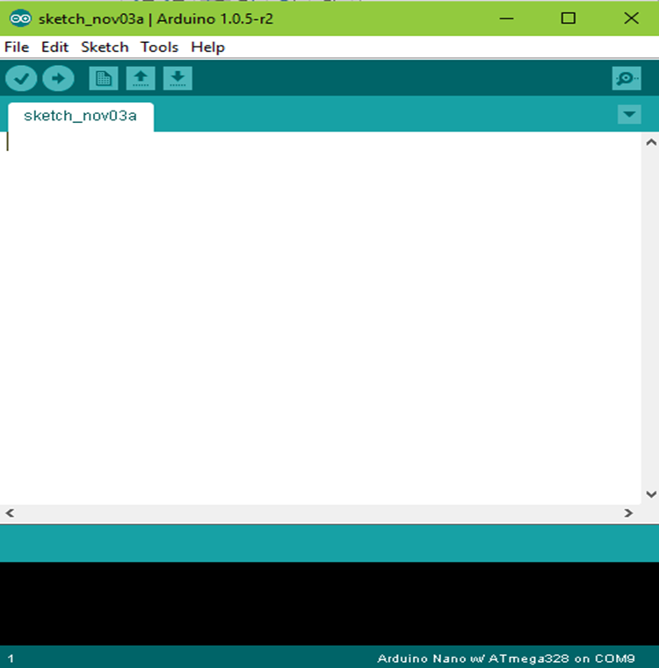
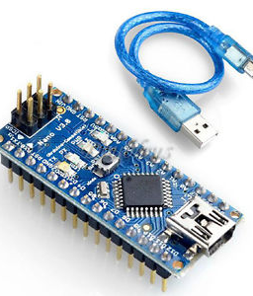
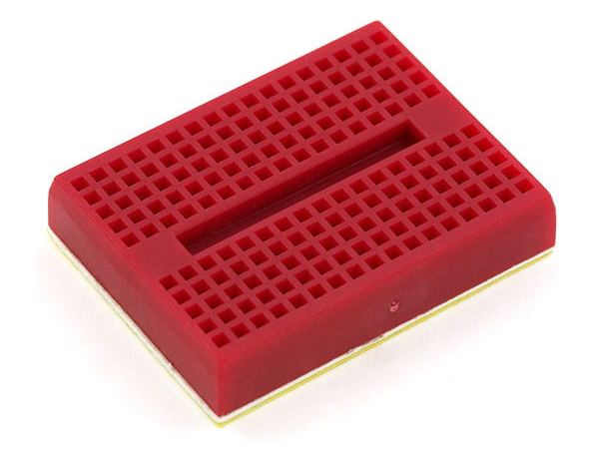
Arduino Nano (w/ATmega328)
We used the Arduino Nano as our microcontroller due to it’s small size.

Slide 8
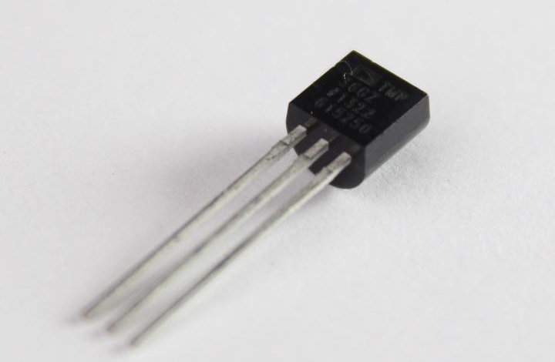
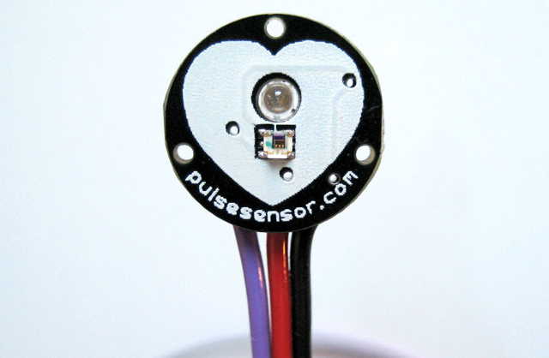
The sensors
Temperature sensor(TMP36)
Pulse sensor

Slide 9
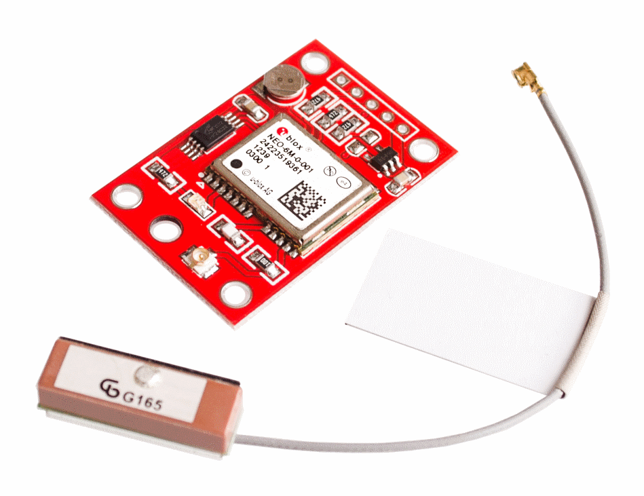
NE0-6M Mini GPS Module
We used this module to get the Latitude and longitude of the current location.

Slide 10
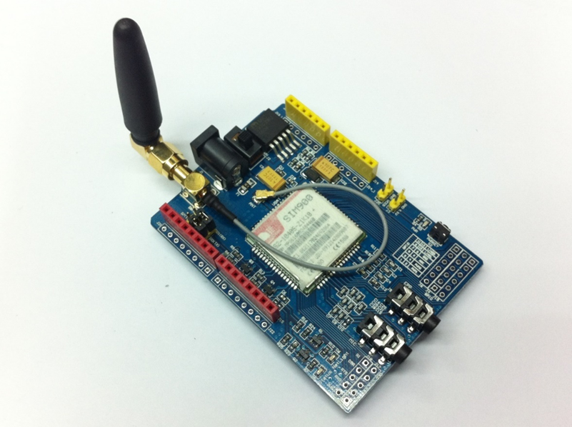
Sim900 quad-band gsm/gprs shield
We used this module to send and receive the messages.

Slide 11
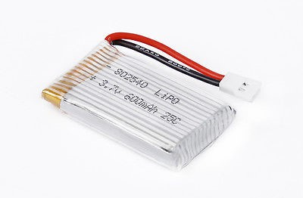
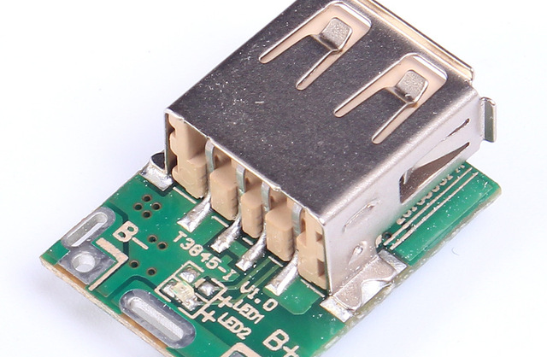
Battery and Step-Up Charger
3.7V 600mAh 25C Capacity Lipo Battery.
5V-Step-Up-Module-Boost-Converter-Lithium-Battery-Charging-Protection-For-DIY-Charger.

Slide 12
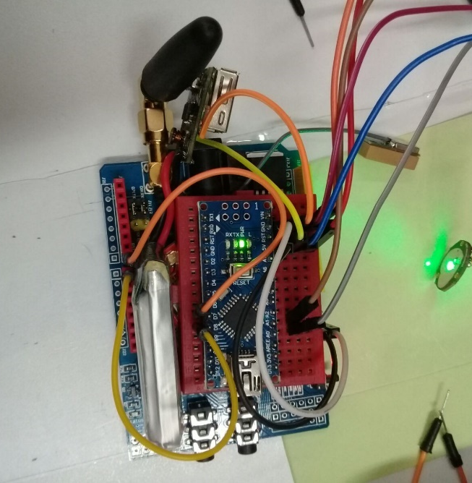
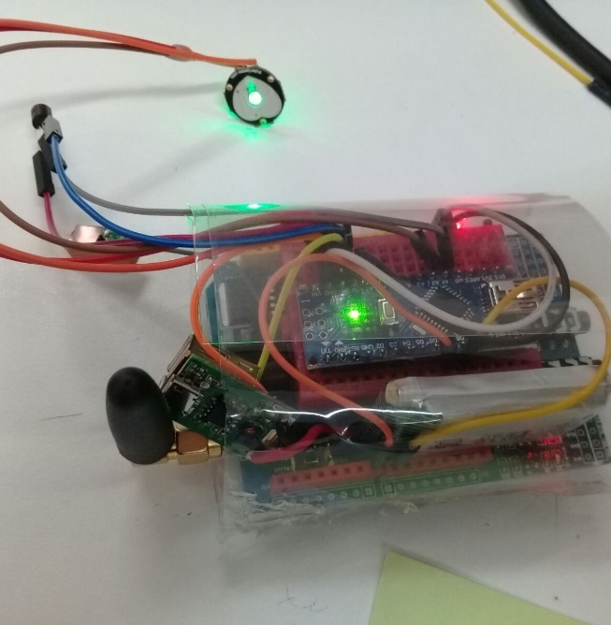
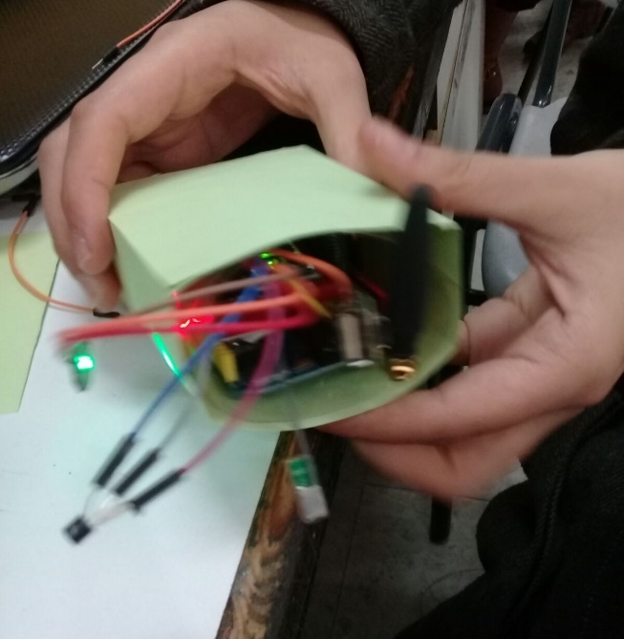
Design

Slide 13
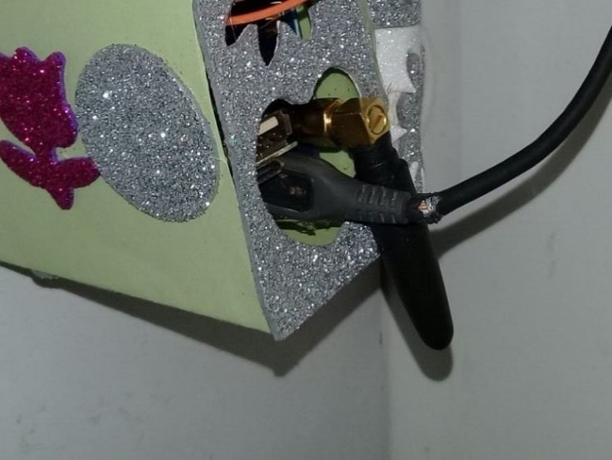
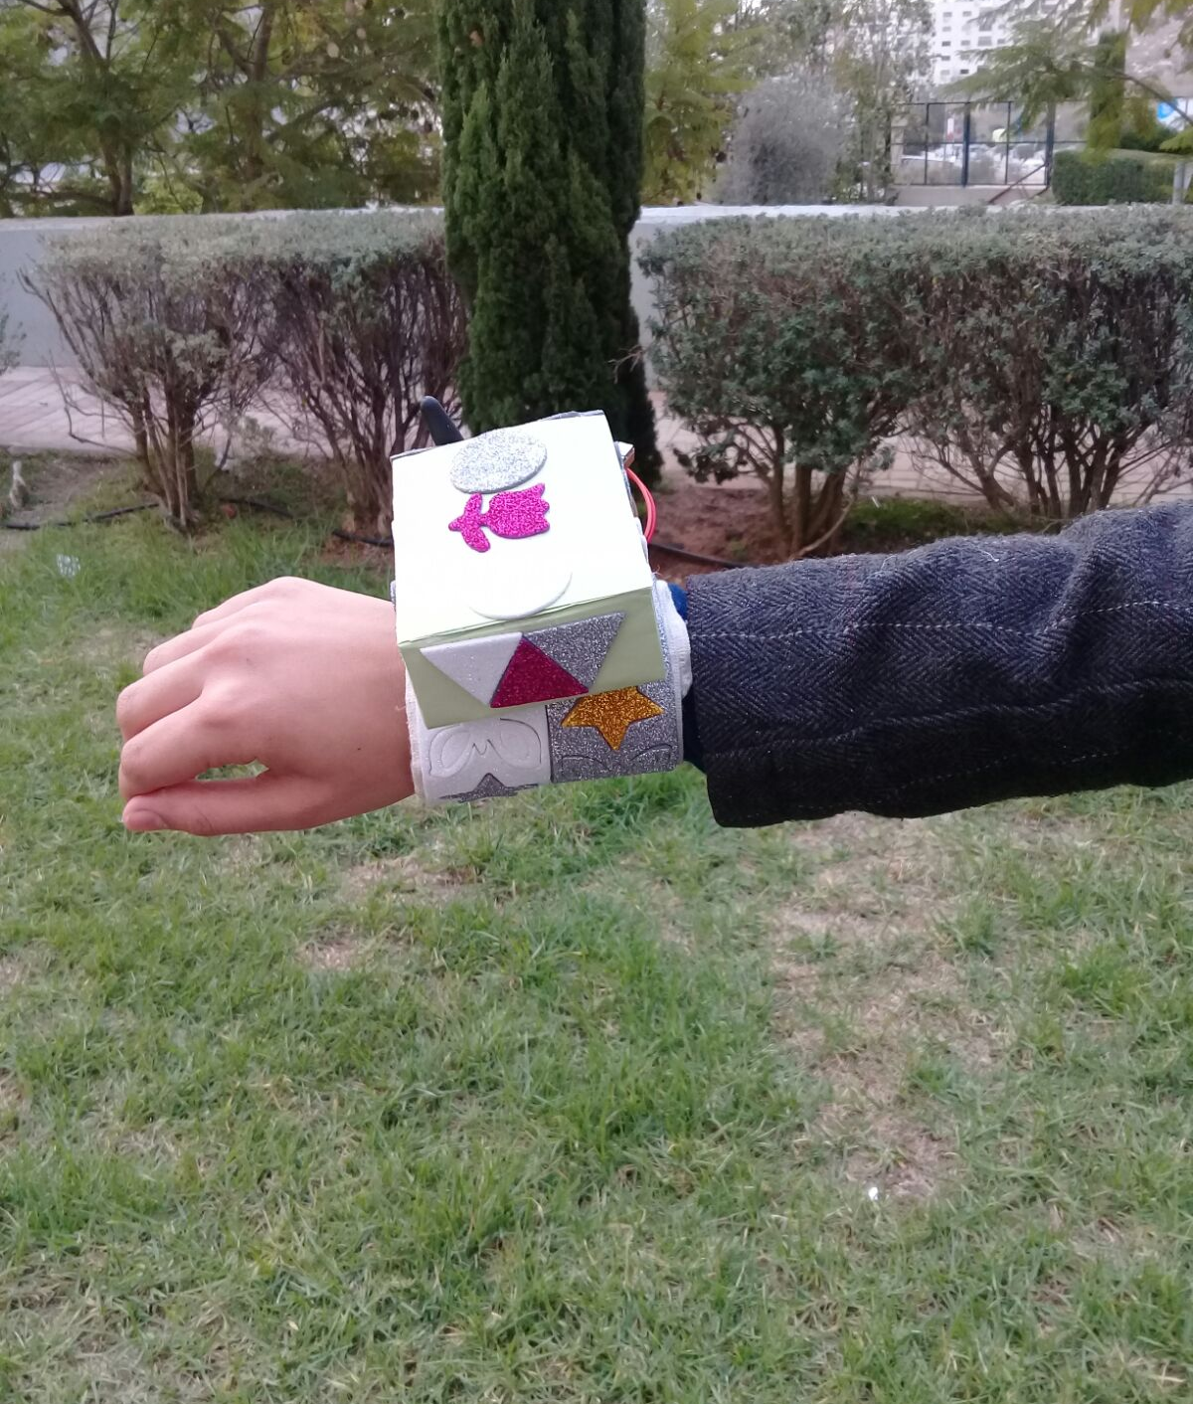
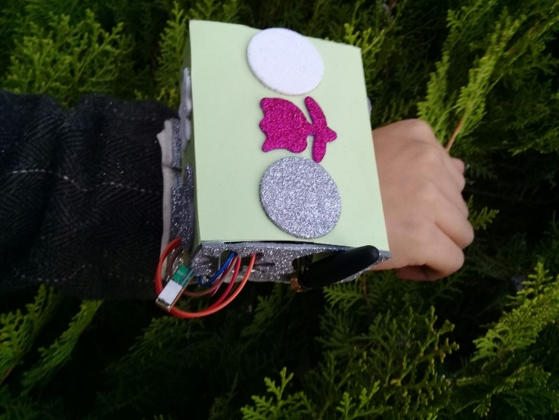
Final Design
Finally we finished the design of the Bracelet.

Slide 14
Challenges

Slide 15
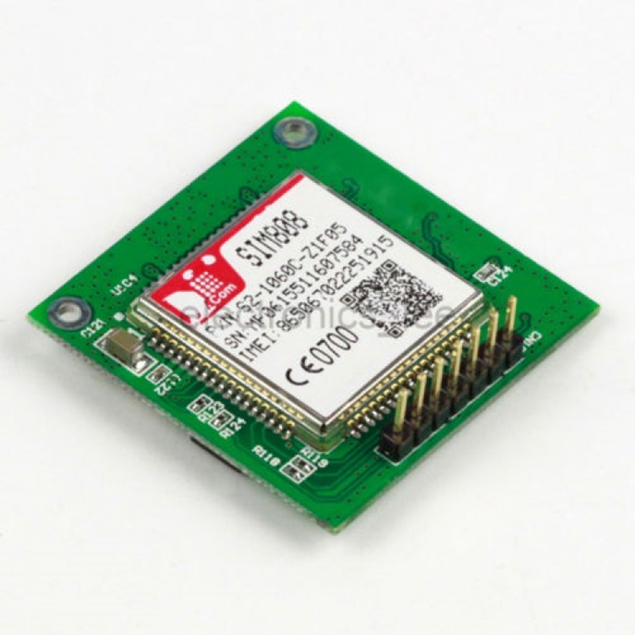
SIM808 GSM+GPRS+GSM Cellular Module
We tried to use this module as it has both GSM and GPS on one small chip, however we can’t program it due to software problems, so we had to replace it with two larger modules which led to enlarge the size of the bracelet.

Slide 16
The Global Positioning System (GPS)
Once the GPS module connects to at least four satellites, it sends several messages containing GPS data to the Arduino microcontroller.
We found that the module doesn’t have any data indoor!
Therefore, we used the latest information received from the module.

Slide 17
Future work
Decreasing the size of the bracelet by using smaller components.
Using 3G to send messages instead of the SMS.
Improve the bracelet by adding more features such as blood pressure checking.

Slide 18
Conclusion
After hard work, we came out with kids bracelet which track the motion of the child and check some of his/her health status, then sending this information to the mother phone either when the mother sends a message to the bracelet or when there are abnormal changes of child temperature or heart beat rate.

Slide 19
Demo
Thank you

