Slide 1
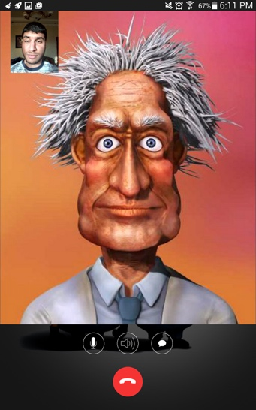
Cartoon Talk
Prepared by: Aladdin Odeh & Abdul-Aziz Masood
Supervised by: Dr. Raed Al-Qadi
An-Najah University
Software Graduation Project

Slide 2
Outline :
What is Cartoon Talk?
Motivation, Objective and Main idea.
Android Application.
Website.
Future work.

Slide 3
What is Cartoon Talk ?
Is a chat program that targets the Android platform and the Web.
The Android application allows the users to chat, perform voice and cartoon calls, in addition to other functionalities used in any conversation app.
The web page provides the basic features of the application, but without managing the user (Anonymously).
The main feature of the project is using cartoon characters in the video call.

Slide 4
Motivation and Objective:
It's fun to have a conversation with a cartoon character.
Maintain user privacy either by not showing user's face in a video chat or by performing anonymous calls.
All you need is the basic Internet speed of making VOIP calls.

Slide 5
Android Development Process:
Authentication:
Cartoon talk is using firebase authentication services to handle the authentication process.
It supports two type of authentication:
-> Automatically, using Google account.
->Manually, using email and password.

Slide 6
Android Development Process:
Contacts:
The user can see his friends and their status, last appearances and can perform different actions on them ( calling, chatting, unfriend).
Conversations:
A List contains the last message in each conversation with the contacts, by pressing on an item the user will enter the conversation activity.

Slide 7
Android Development Process:
Calls:
A List contains the calls either they are missed or not and their duration and time, the user can recall using the items of the list.
Add Contacts:
To add friends and search for them ( the search will suggest emails when the user type any letter in the search box).

Slide 8
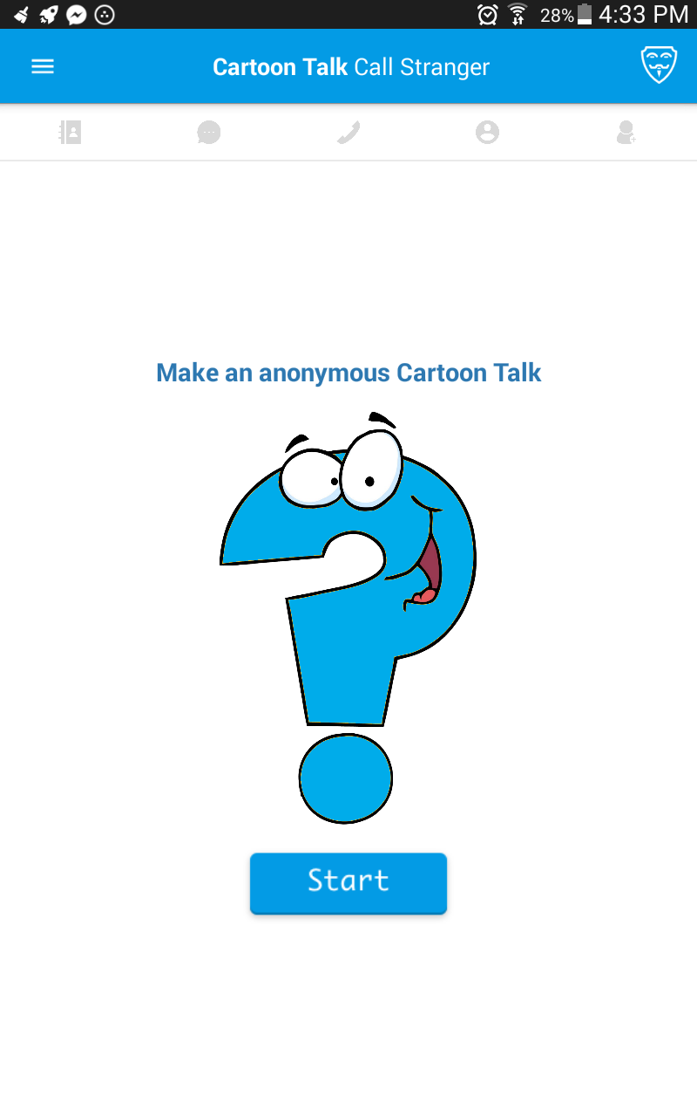
Android Development Process:
Profile:
User’s name, email, profile picture, and location are there, the user can change his name, password, picture and cartoon character.
Stanger Cartoon Call:
One click and the user will enter a cartoon call with a stranger.

Slide 9
Android Development Process:
Notifications:
Like any chat application, the notification is supported in this app. (Friend Requests / new messages ).

Slide 10
Android Development Process:
Chatting:
Firebase real-time database has been used for chatting.
The chatting in both web and android based on the real-time database(JSON structured). Each 2 users are sharing one unique node.

Slide 11
Android Development Process:
Calls:
Sinch SDK was used to make voice calls.
Firebase growing (Notifications) used to signal the callee when its in the background.

Slide 12
Android Development Process:
Cartoon Calls- Voice :
Sinch SDK was used to transmit the voice.
Each user analyzes the input and output voice during the cartoon call.
The character talks based on the value of RMS calculated from a 32 FFT.

Slide 13
Android Development Process:
For analyzing the facial emotions :
Open the device camera and take snapshots (around 10-15 frames per second based on the device capabilities).
Affectiva SDK takes the frame as input and analyze them, around 10 frame analyzed per second ).
Affectiva returns numeric meters as output.
Based on the output the user will send the commands to the other party, and reflect the animation on his character .

Slide 14
Android Development Process:
Animation:
Crazy Talk Animator has been used to create the animation scenes.
Texture Packer used to create the sprite-sheets from the frame sequence of images.
libGDX framework used to animate the sprite sheets.

Slide 15
Web Development Process:
Main Page:
The Cartoon Talk website based on anonymous communicating, such that each user just enters a nickname then press a button from three buttons (chatting, calling and Cartoon Talk).

