Slide 1
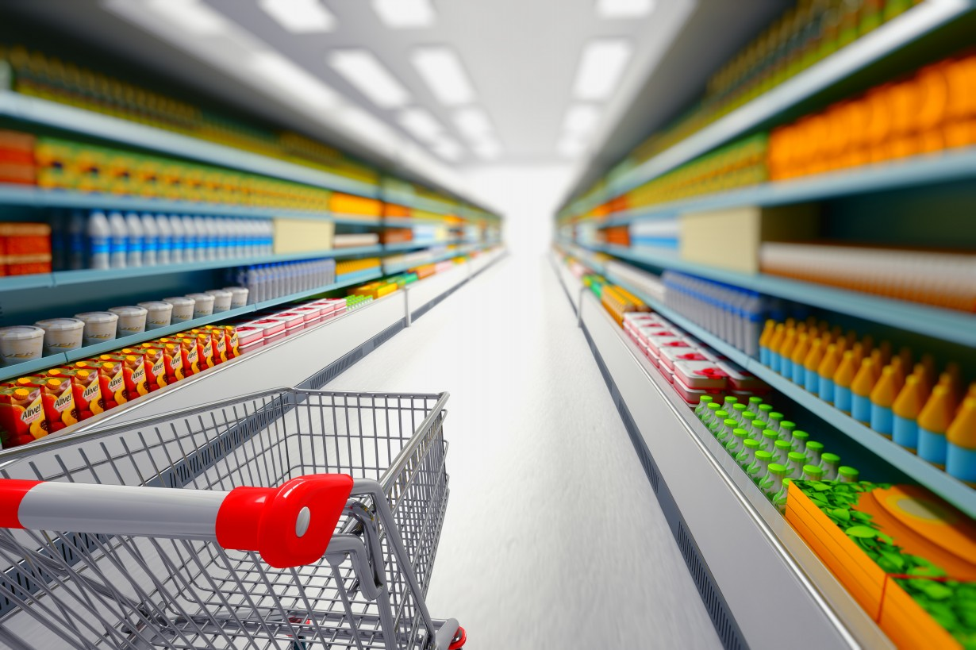

    Nabeel AbuBaker & Mustafa Shbere
  Supervisor : Dr. Ashraf Armoush
Computer Engineering Department

Slide 2

OUTLINE
Introduction.
The Following Cart.
Indoor Localization.
Parting Words.
Demo.

Slide 3
OUTLINE
Introduction.
The Following Cart.
Indoor Localization.
Parting Words.
Demo.

Slide 4

Objective & Scope
Objective
  Improve shopping experience.
    →Shopping becomes easier and more “fancy”.
Scope
  Large shopping malls.

Slide 5
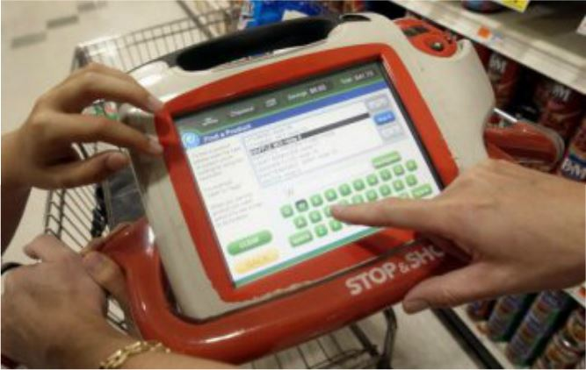
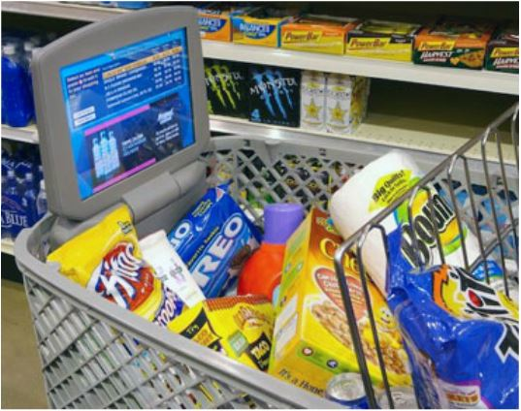
Related Literature
LCD based devices.
SK Telekom cart, IBM’s cart, ...etc.
Keep track of the shopped items.
Product location.

Slide 6
OUTLINE
Introduction.
The Following Cart.
Indoor Localization.
Parting Words.
Demo.

Slide 7
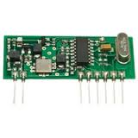
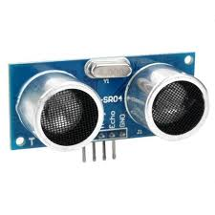
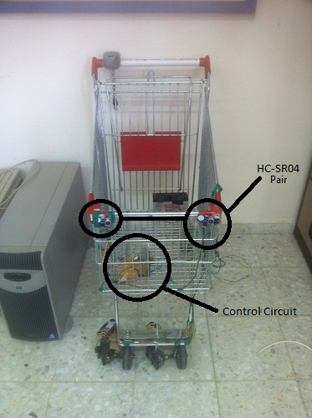
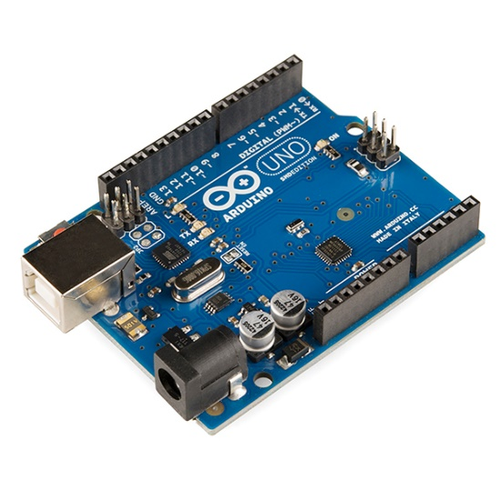
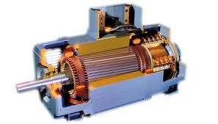
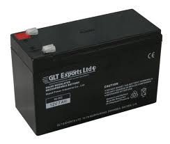
The Following Cart
Components

Slide 8
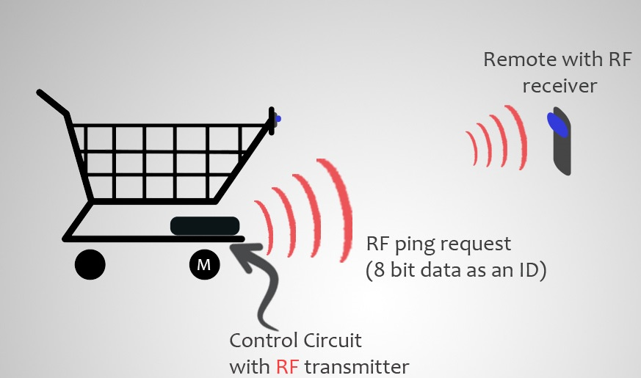
The Following Cart
Methodology
  Arduino periodically triggers the RF-transmitter in order to send a PING request to the receiver remote.

Slide 9
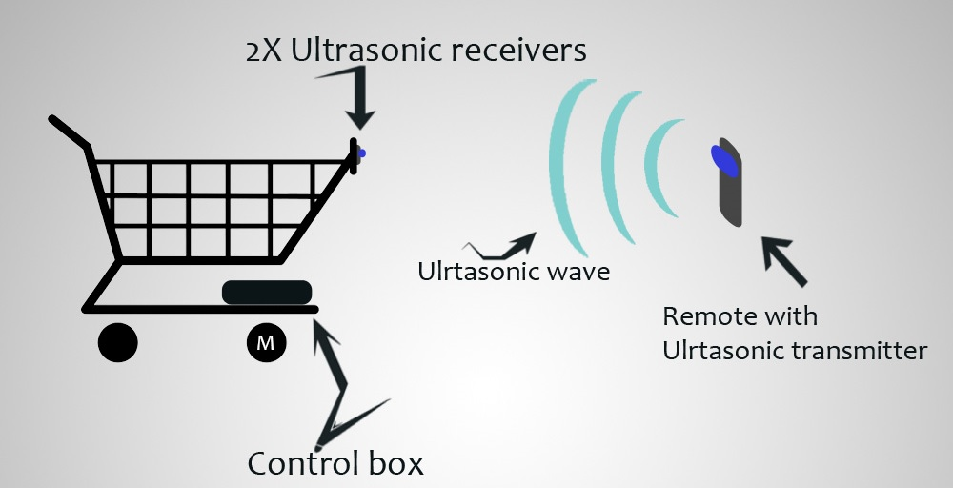
The Following Cart
Methodology
  When the RF-receiver in the receiver remote receives this PING Request, it will interrupt the Arduino in the receiver; therefore, it will trigger its ultrasonic to send its signal.

Slide 10
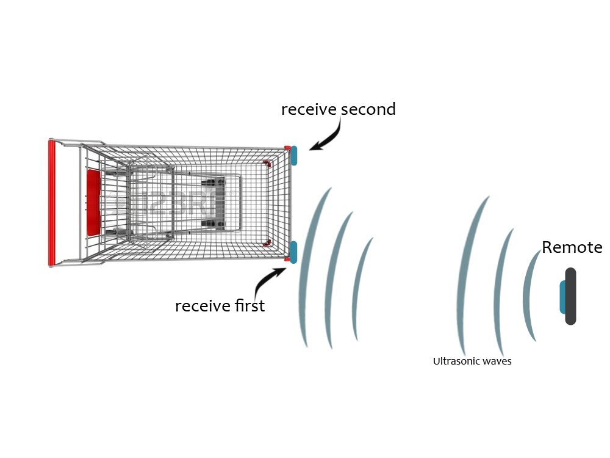
The Following Cart
Methodology
  Depending on by which the signal is being detected first!

Slide 11
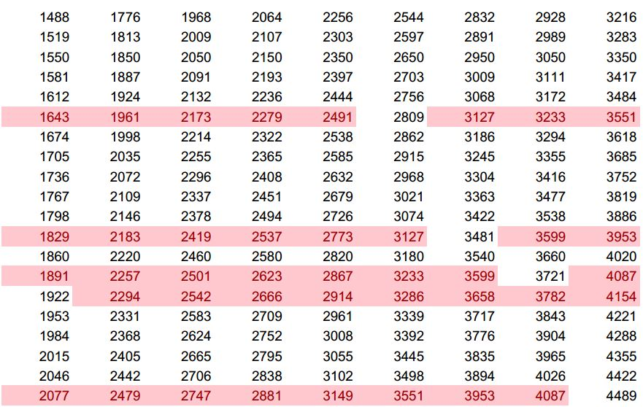
The Following Cart
Additional Issues
RF Collision Avoidance.
Ultrasonic Collision Avoidance.
    Prime-multiples transmission rate.
    CSMA/CA.

Slide 12
OUTLINE
Introduction.
The Following Cart.
Indoor Localization.
Parting Words.
Demo.

Slide 13
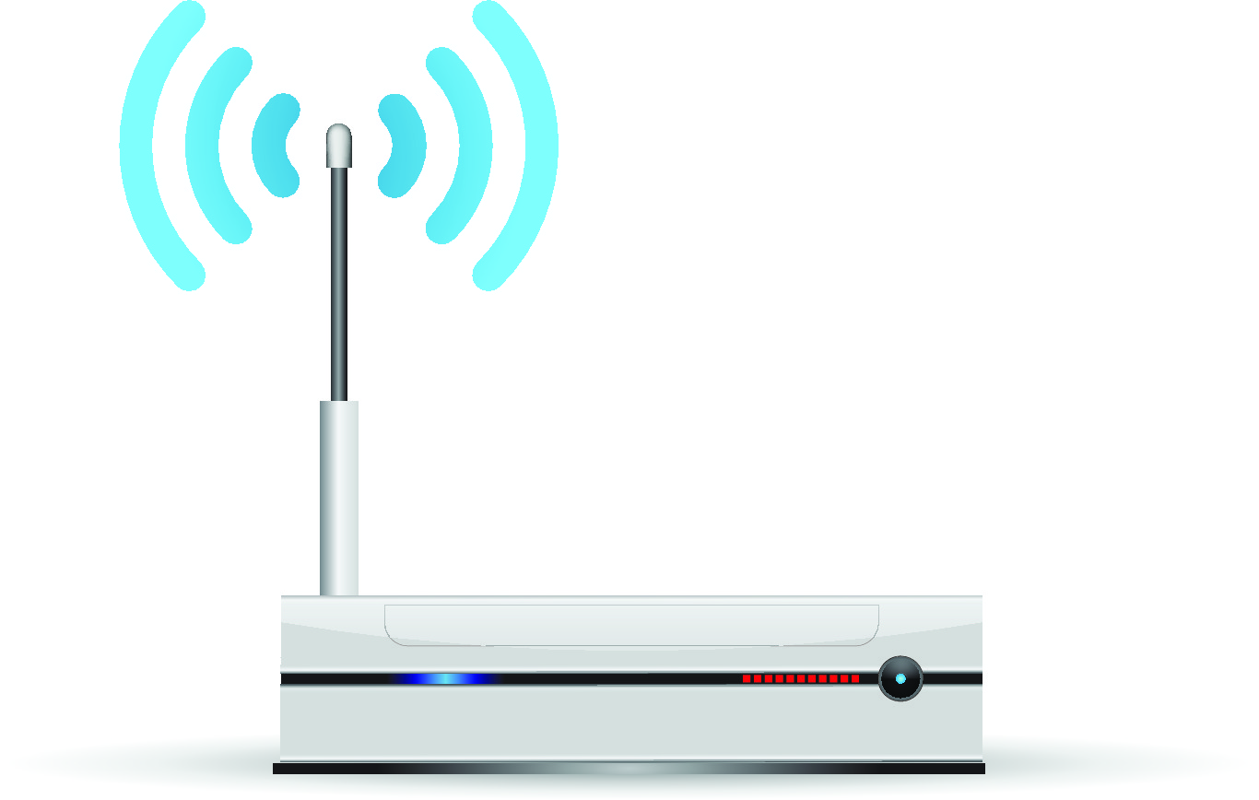
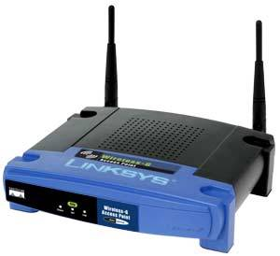
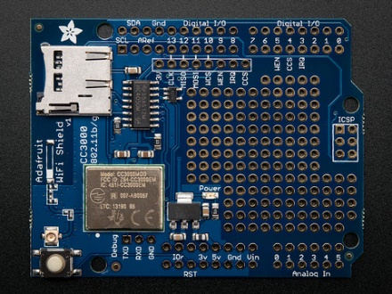

Indoor Localization
Components

Slide 14
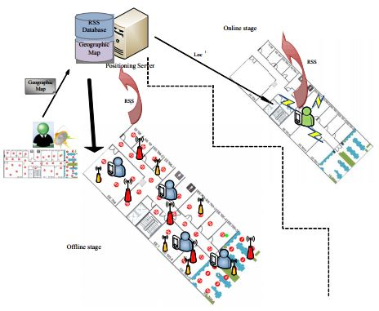
Indoor Localization
Methodology
  Offline Stage.
  Online Stage.

Slide 15
Indoor Localization
Stages
1. Gathering RSS Fingerprint Information.
    Construct the RSS fingerprint data in the desired environment.
2. Generating RSS Fingerprint Data.
    Data filtration and build the RSS Fingerprint.

Slide 16
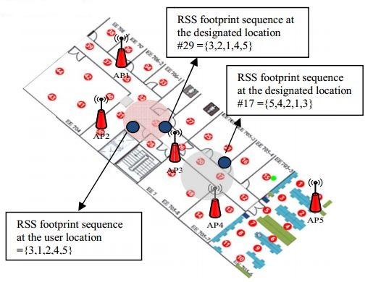
Indoor Localization
3. Generating RSS Footprint Data.

Slide 17
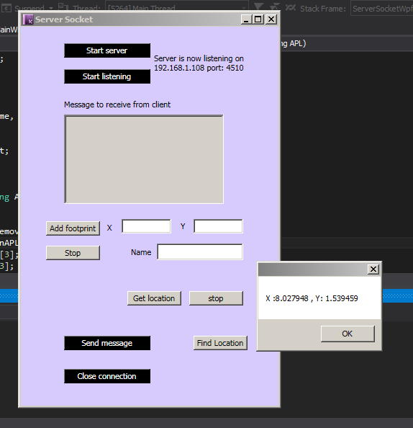
Indoor Localization
Locating the Final Position.
Use a weighted interpolation scheme to determine the possible location.
Send the position’s data to the cart in order to guide it to its charging place.

Slide 18
OUTLINE
Introduction.
The Following Cart.
Indoor Localization.
Parting Words.
Demo.

Slide 19
Parting Words
Our smart shopping cart project was presented.
We believe that there are more needs to do more testing and enhance the collision avoidance and localization issues.
Constraints & Mechanical.

Slide 20
Parting Words
Build a custom mobile application.
Baby car service.
Smart alert of the required goods.
Self-locking functionality to prevent theft.

Slide 21
Resources
< IEEE Journal>
J.-S. Leu, "Received Signal Strength Fingerprint and Footprint," IEEE.

Slide 22
OUTLINE
Introduction.
The Following Cart.
Indoor Localization.
Parting Words.
Demo.

Slide 23
Demo Time!!!

Slide 24
Big Thanks ☺

Slide 25

Questions Time

