Slide 1

Automatic stirrup bending
machine
Faculty of Engineering
Mechanical Engineering Department
GRADUATION PROJECT 2
2019/2020
Presented by: Mohammed Marwan
Ahmad arda
Omair bani oudeh
Thesis Advisor:
Dr. osayed abdul fatah
Committee members:
Dr. Iyad Assaf
Dr. Ihab Alsurkaji

Slide 2
Outline
Research Objectives
introduction and Background
Literature Review
Methodology
Conclusion

Slide 3
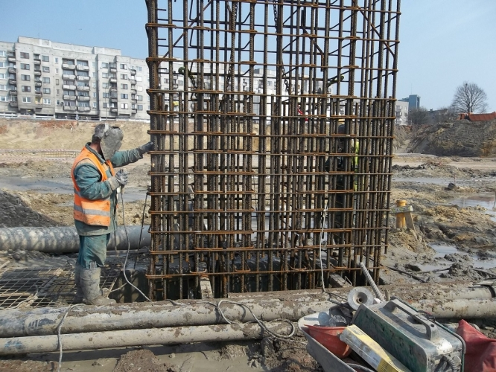
Research objectives
Problem statement :
We have a several problem we face it in Palestine market one of the existed problem we have no availability of a automatic stirrup bending machine for construction column , that means that it is existed but with high cost so the constructer can’t buy it .
stirrups production should be quick and precise production In line with the development in the field of construction and architecture, which progresses day after day, in addition to lacking of the local market for the technology in stirrups bending process.

Slide 4
Objectives :
Achieving with industrial growth in the local market with the international markets in the process of forming stirrups.
Save time and effort to increase the amount of production.
Increase the safety stage for machine’s worker, because he is the most important part in the production process.

Slide 5
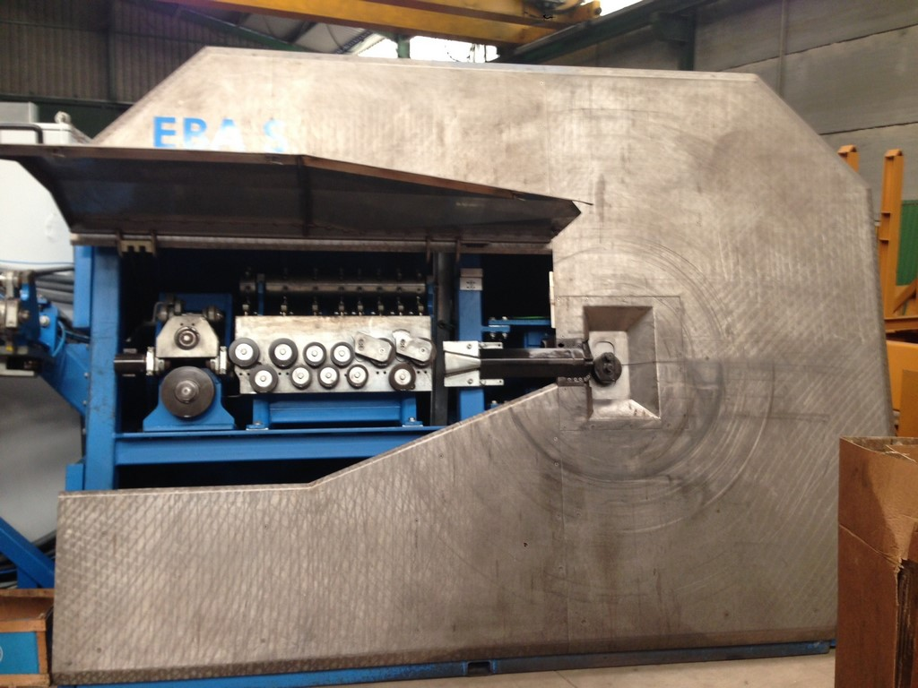
Introduction :
What is automatic stirrup bending machine
What is stirrup bending machine
stirrup bending machine is a machine use to pull , bend and cut of wires and beam that use in construction in different shape square , circle , trapezoidal and rectangular and control the angle of the bending you want and have high capacity of production of stirrup and this type of machine make this operation easy and fast and very accuracy its connected with CNC motor to control it or PLC control it .

Slide 6
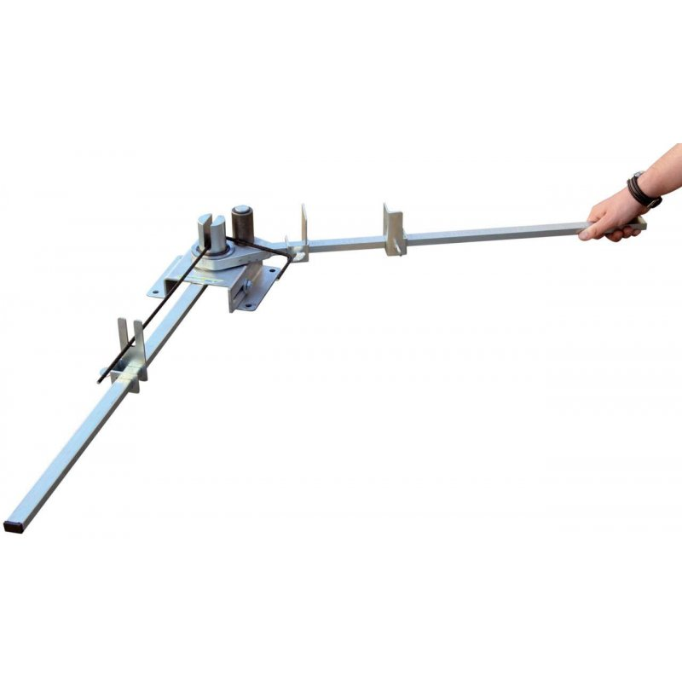
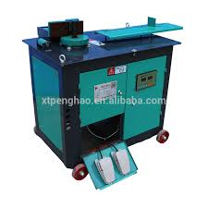
Types of stirrup machine
Automatic stirrup bending machine
Manual bending machine
semiautomatic stirrup bending machine
7

Slide 7
Why we need stirrup in column ?
stirrups have many roles which make using stirrups important in construction include:
1) Stirrups are provided to hold the main reinforcement bar together in a reinforced concrete structure
2) In columns, stirrups are used to prevent buckling of main reinforcement
3) In beams they prevent diagonal cracking due to shear, so they are scientifically called shear reinforcements
4) Improve reinforced concrete ductility so, in earthquake prone zones the number of stirrups increased.

Slide 8
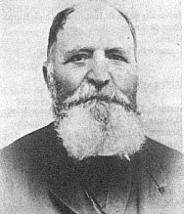
Literature Review :
history
Reinforces in construction site have been used in the mid of 18th century it is used for the first time from a French, joseph monier used small rods in the fencing of his garden after that the idea of reinforcing bars start separate over all the world. and they start to use it in the column of concrete to provide the tension and buckling .

Slide 9
Methodology :
After discussing the problem of lack of machines that produce stirrups in Palestine we came out with a solution to design and manufacture an automatic machine that produces stirrups. The machine was first designed using SolidWorks then manufactured locally.
In this chapter we will mention:
.1 3D Design Using SolidWorks
.2 Components of machine
.3 Process of producing stirrups

Slide 10
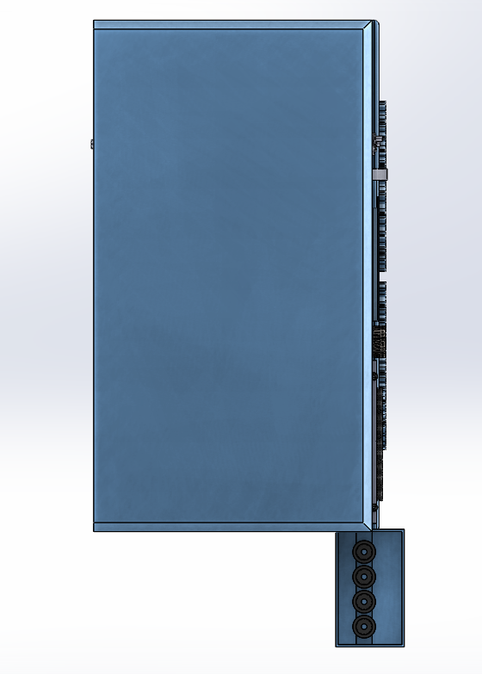
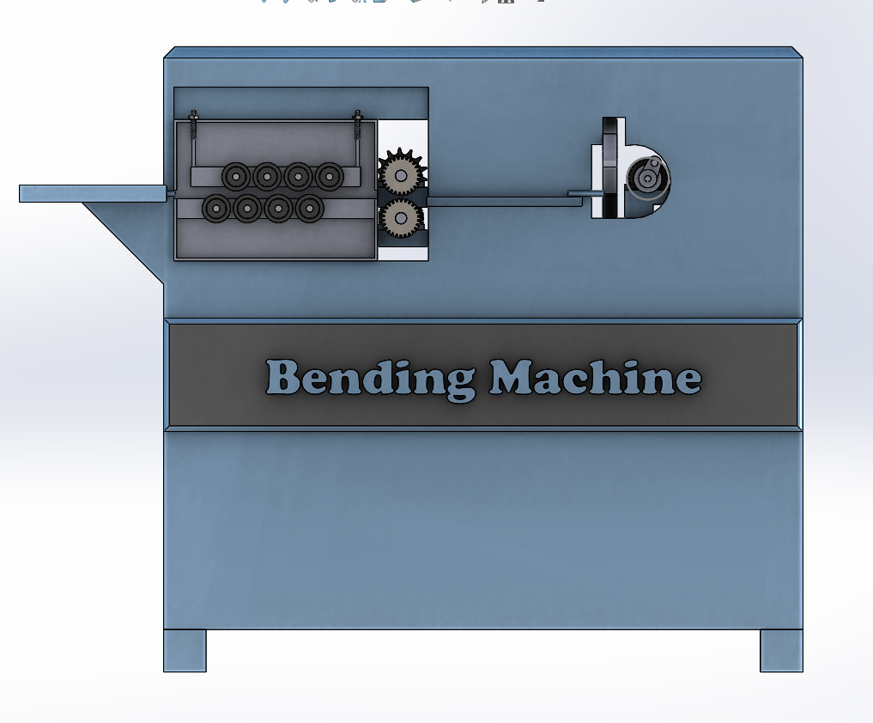
1: 3D Design Using SolidWorks: machine was designed using SolidWorks, because it is the most efficient program to have a close approach to the machine before manufacturing. The machine dimensions are 2.2 x 1.2 x 2 meters as shown below

Slide 11
2: Components of machine :
  2.1 structure of the machine :
The structure was first designed in order to hold the weights of heavy components like motors and prevent unnecessary vibrations. It was manufactured using 5mm H- beams, 5mm U- beams and 20x20mm steel profiles.

Slide 12
2.1: pulling motor :
The motor is connected to gear box to control the speed of pulling, and it is connected with a shaft through chain and gear system. The shaft is connected with its end with helical gear have 30 teeth that meshes with another helical gear with adjustable clearance between them enough for the rod to be pulled. The motor load is 1.5 hp to be able to pull a steel rod with maximum diameter of 8 mm that control with encoder sensor.

Slide 13
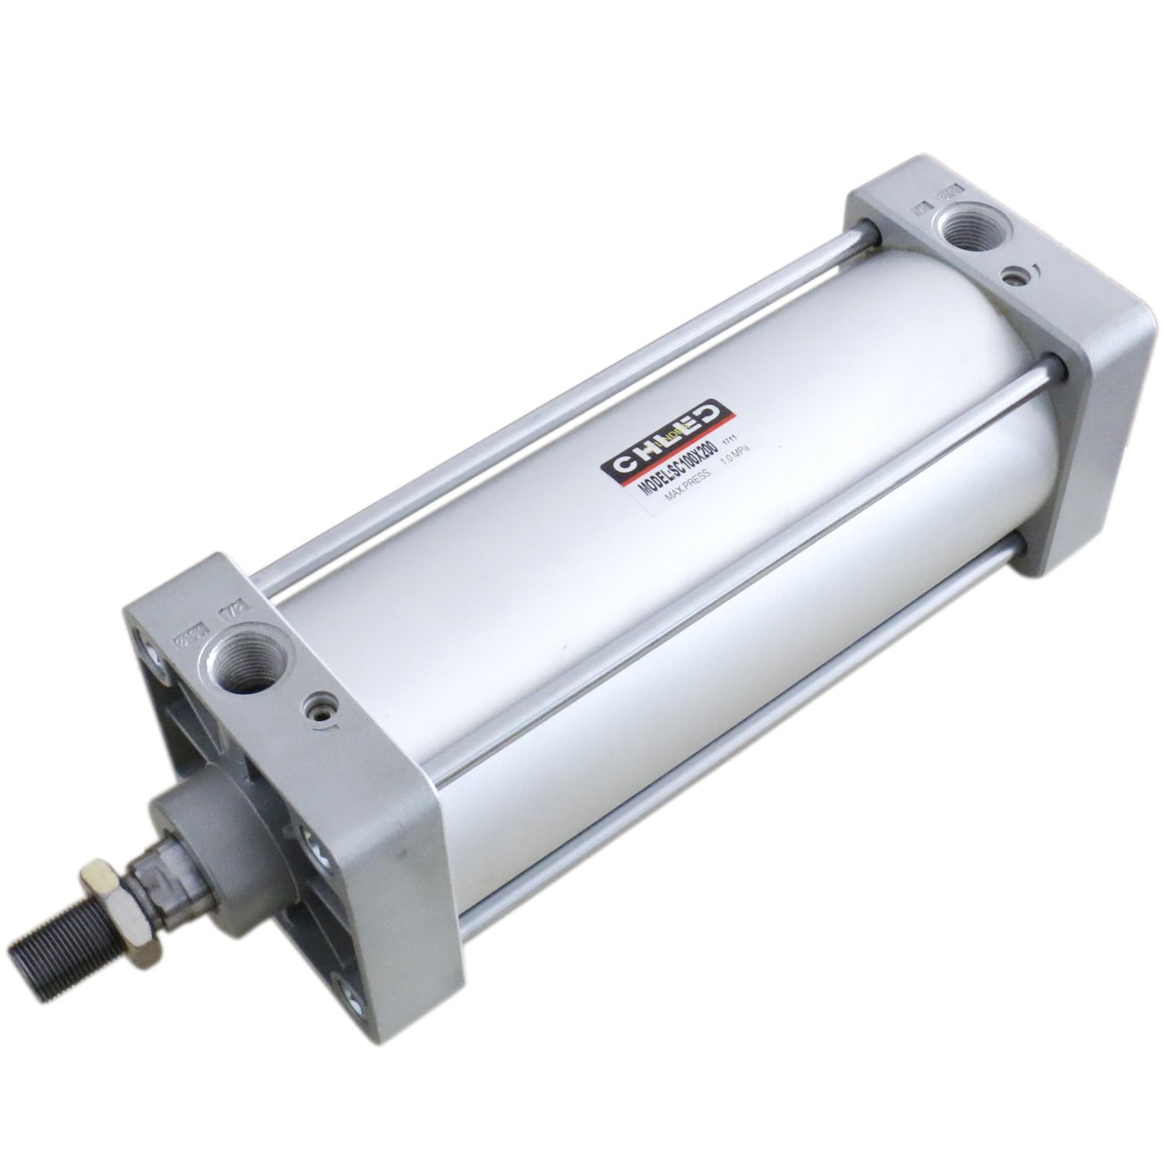
2.2 bending piston : The piston is connected in its end with a crack have 30cm length that meshes with a spur gear, the spur gear is connected with a shaft that is connected with a bending flange that contain fixed pin and rotating pin with a diameter of 6cm , the piston it have 40cm standard length and have 30 cm length when its open and have a pressure of 90bar with two line A&B and we control it through 4/3 double solenoid valve connected with PLC

Slide 14
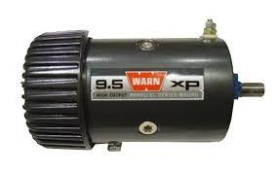
2.3 cutting motor : A motor of 1.5 hp is connected with four bar mechanism where the rocker connected with a blade to cut the rod . the motor synchronized with the movement of bending piston so it the runs after the fifth movement of the bending flange. The cutting process takes only 2 second this processes work such as four bar mechanism.

Slide 15
3: process of producing stirrups :
The process of producing stirrups goes through several steps :
1-The rod goes through the roller to modify the rod in order to make it straight .
2-The rotating helical gears pull the rod from the rollers to the bending processes and its done to the high coefficient of friction between the gear and the rods.
3-The rod enters the bending stage while the cutting motor is off then rod enters the flange to form the shape of stirrups , the movement of the bending piston produce five rotating moves of the flange that form the stirrup .
4-When the flange reach its fifth move a sensor gives order to the cutting motor to run and the stirrups is shaped

Slide 16
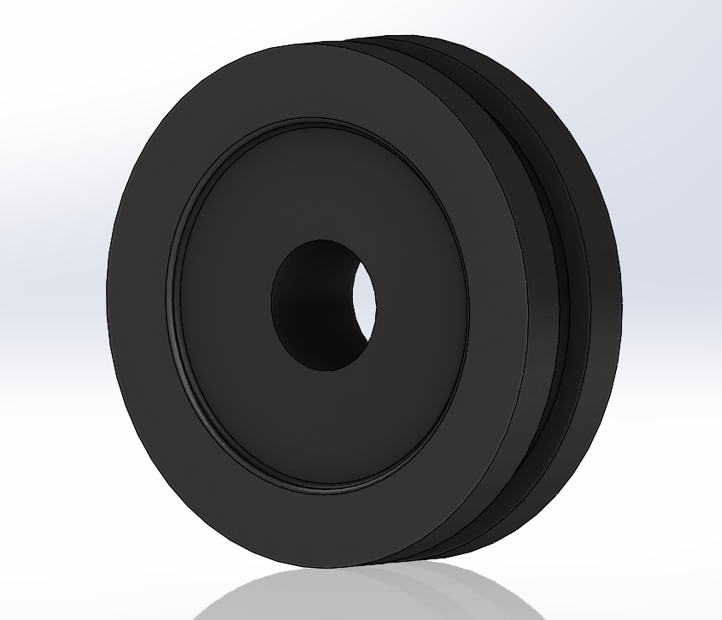
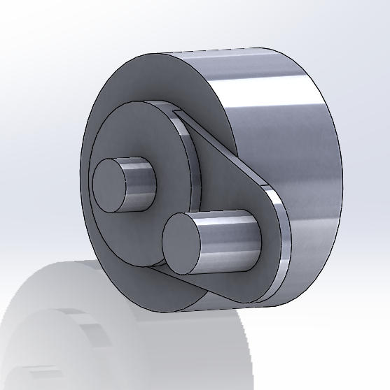

Slide 17
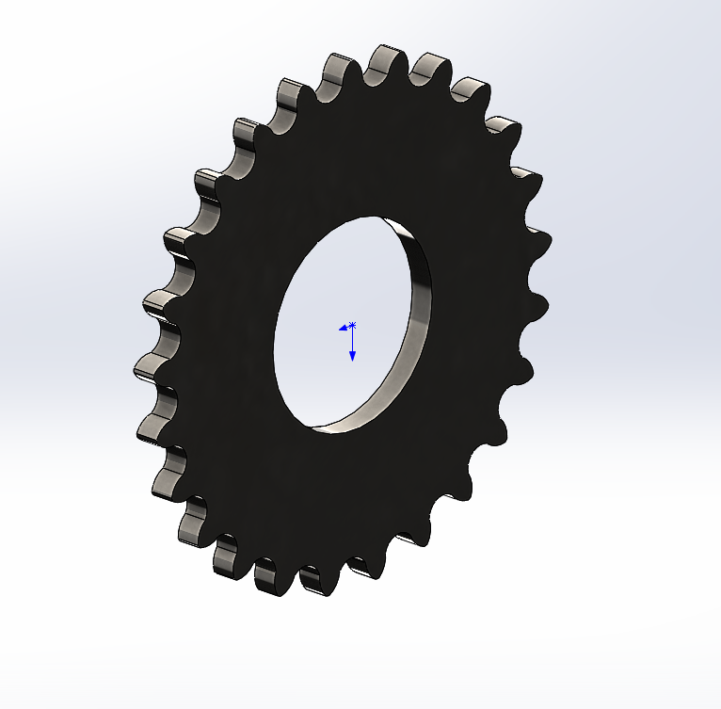
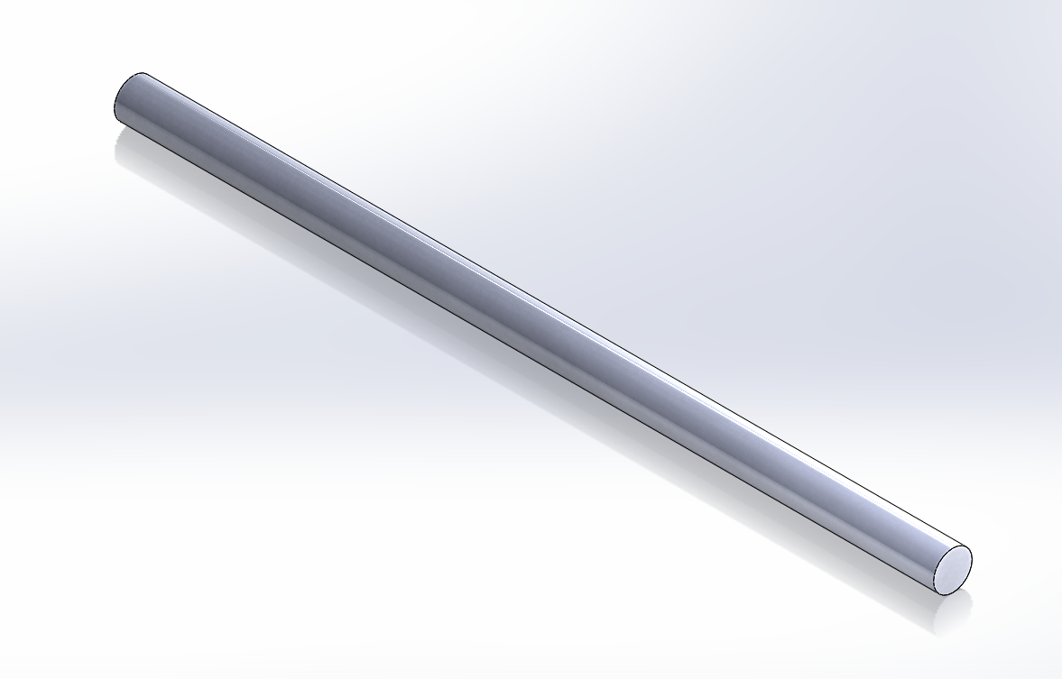

Slide 18
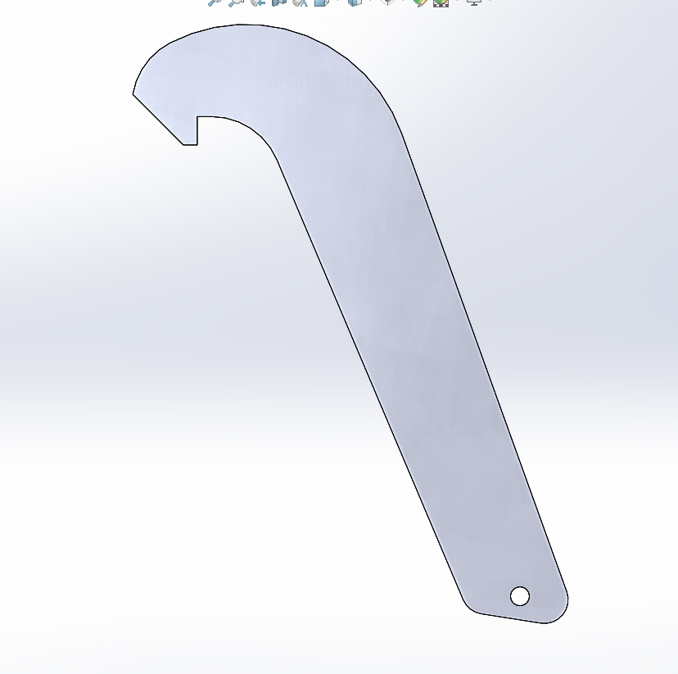
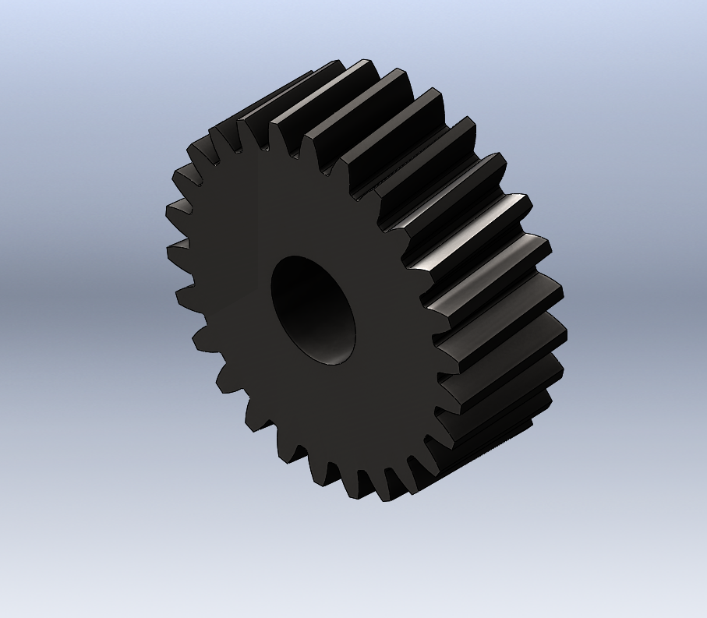

Slide 19
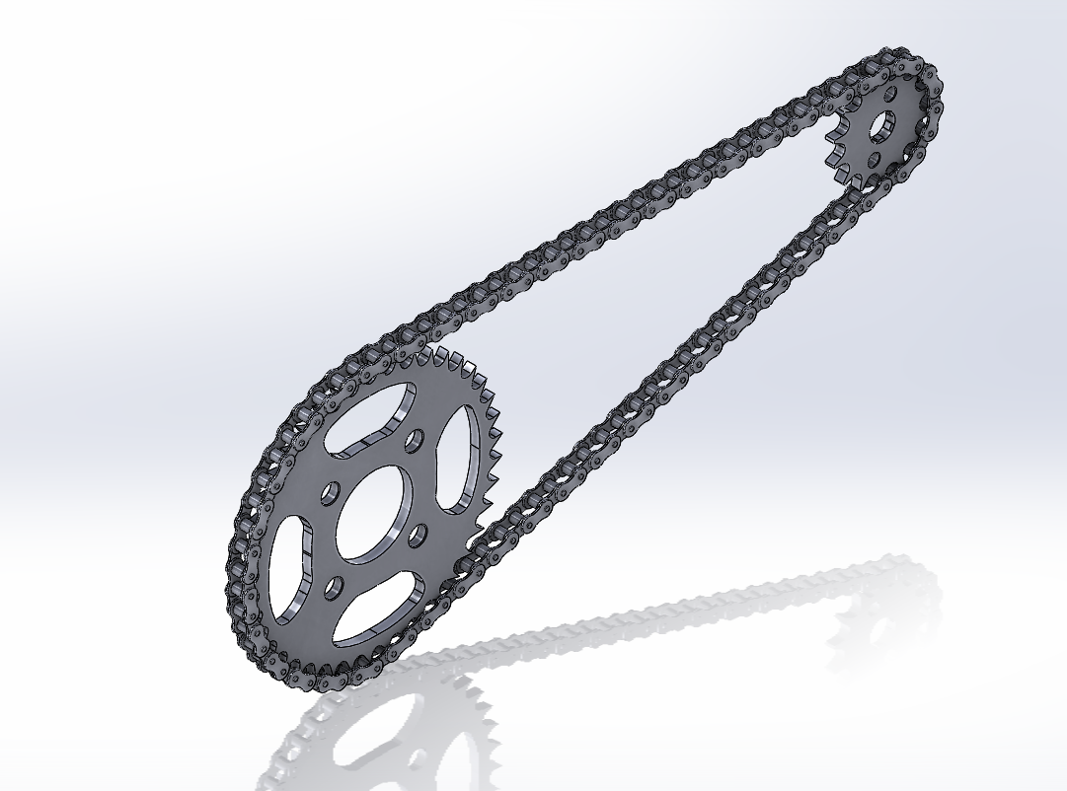
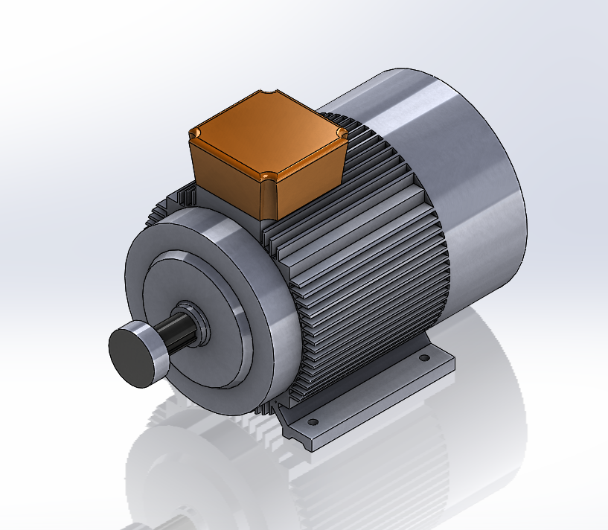

Slide 20
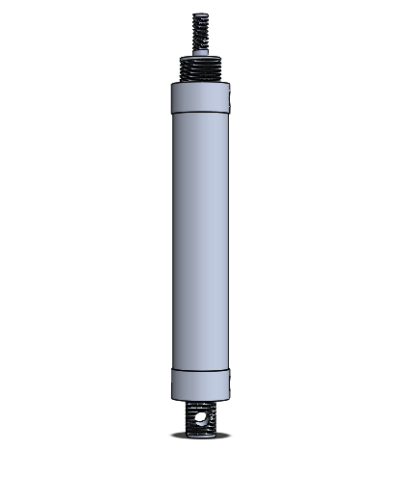

Slide 22
5:recommendation: the aim of any project is develop and continuity the project in this part of recommendation suggested for this aim essentially for those who will work on the project in the future
1-developing machine capacity to form stirrups with different radius such as 10mm , 12mm,16mm and 32mm.
2-change the programming logic controller (PLC) with computer numerical control (CNC) to forming several shape such as circle and trapezoidal in different dimension .
3-developing and increase the bending stage of the machine from bending 2 reinforce bar to 6 reinforce bar in the shortest time and different shape and dimension and enhance the safety .

Slide 23
Conclusion :
The automatic stirrup bending machine reduces time, effort and money of stirrups making processes much more than the manual process, the machine produces 150-200 stirrups per hour. Using helical gears instead of spur gears in the pulling process is more efficient because it reduces slipping of rod. using piston in the bending process gives more force than bending motor which made it possible for the machine to bend rods with higher diameter such as 8mm, and the piston could be modified to bend 10mm rods.
We faced several challenges in manufacturing in the machine:
1-Electrical and PLC work that need it to control the automatic processes because there must be synchronization between the running motors in order to have perfect and accurate of stirrups.
2+-Lack of material and equipment such as speed controlled motors and the bending flange we had to design it make it in CNC machine .
3-The high prices of motors and equipment used in the machine that was self funded which made us use some used equipment .

