Slide 1


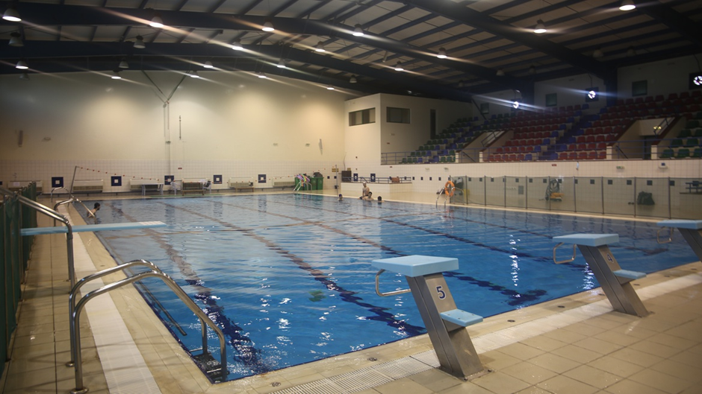

An-Najah National University Energy Engineering and Environment Department
"Comprehensive Energy Audit and Renewable Integration for Enhanced Efficiency and Sustainability of a Half-Olympic Swimming Pool at An-Najah National University"
By : Omar Hatem
Abdullah Hatem
Fatema Najem
Supervisor:
Dr. Mohammad Alsayed

Slide 2



Our Team
Eng. Omar Hatem
Eng. Abdullah Hatem
Eng. Fatem najem

Slide 3


Agenda
Introduction
01
THEORETICAL BACKGROUND
02
Literature Review
03
METHODOLGY
04
CASE STUDY
05
results and analysis
06
Discussion
07
Conclusion
08

Slide 4
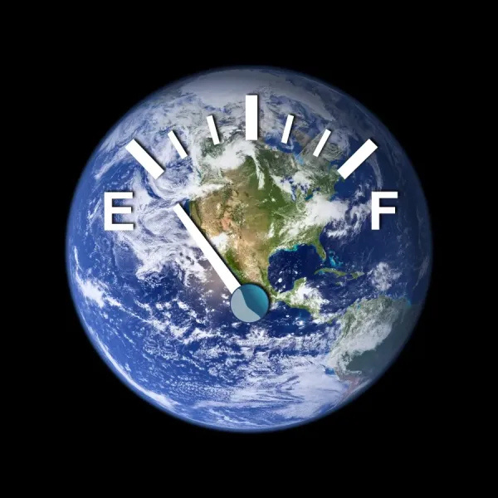
Introduction
⚡Energy Situation in Palestine
  Palestine faces multiple challenges in the energy sector, such as high electricity costs, frequent power shortages, and heavy dependence on external sources like the Israeli Electric Corporation (IEC). Additionally, political conditions often hinder the implementation of large-scale renewable energy projects.
  Therefore, energy efficiency becomes critically important, as it helps reduce electricity consumption, save money, and improve supply stability. In this project, we conducted a case study on the swimming pool at An-Najah National University and implemented practical solutions to reduce energy use and costs. Our findings show that improving energy efficiency can be highly beneficial for Palestine.

Slide 5
🏊 Energy Problem in An-Najah’s Pool
The Half-Olympic swimming pool is a high energy consumer, requiring constant heating (26–28°C).
Major issues:
❌ No pool cover → high evaporative losses
❌ Uninsulated pipes
❌ Old diesel boiler (low efficiency, high CO₂)
❌ 34 out of 52 solar collectors are underperforming
Result: >70,000 liters diesel/year, costing over 400,000 ILS annually
The pool currently has no cover, which leads to significant heat loss through three main mechanisms:
radiation, convection, and evaporation.
The establishment uses an antiquated diesel boiler with poor thermal efficiency, which raises fuel consumption and operating costs because of its poor energy conversion.
Objectives :
Applying passive measures
Integrating solar thermal and PV systems
Replacing diesel with a high-efficiency heat pump

Slide 6

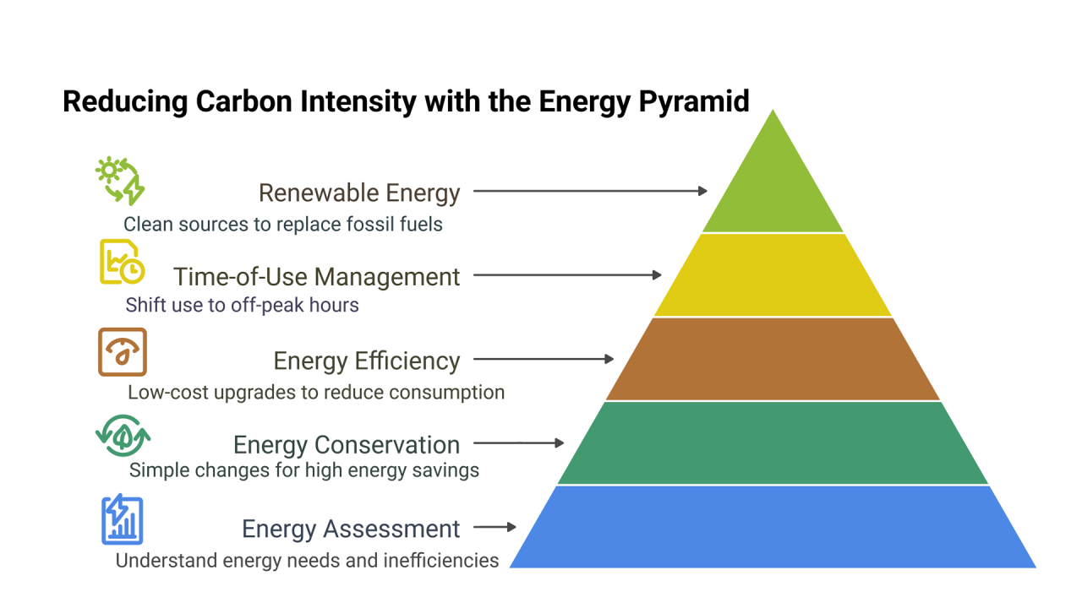
Energy Pyramid
ASHRAE Audit
Heat Loss in Pools
Theoretical Background
Solar Heating
Boilers vs Heat Pumps

Slide 7
Literature Review – International Case Studies
🟦 University of Naples (Italy)
Result: Combined solar + heat pump system reduced thermal energy use by 79%.
🟦 Hong Kong Polytechnic University
Result: Solar-assisted heat pump (COP = 4.5) achieved 79% energy savings.
🟦 University of Illinois (USA)
Result: Pool covers combined with solar heating led to up to 47% energy savings.

Slide 8
Methodology
  Analyze the thermal performance and heat loss of the pool system.
  Model seven energy optimization scenarios:
    Lowering pool water temperature
    Thermal insulation of pipes
    Adding a pool cover (hypothetical scenario)
    Replacing the diesel boiler with a gas boiler
    Replacing the boiler with a high-efficiency heat pump
    Integrating solar thermal collectors
    Installing a photovoltaic (PV) system
  Evaluate each scenario based on:
    Total energy consumption
    CO₂ emissions
    Operational cost
    Economic indicators: Simple Payback Period (SPP), Net Present Value (NPV), and Internal Rate of Return (IRR)

Slide 9


Case Study
Pool Overview
Existing System
  Indoor half-Olympic pool (312.5 m², 625 m³)
  used for training and education with high energy demand.
  34 active solar collectors out of 52
  inefficient diesel boiler (<60% efficiency)

Slide 10
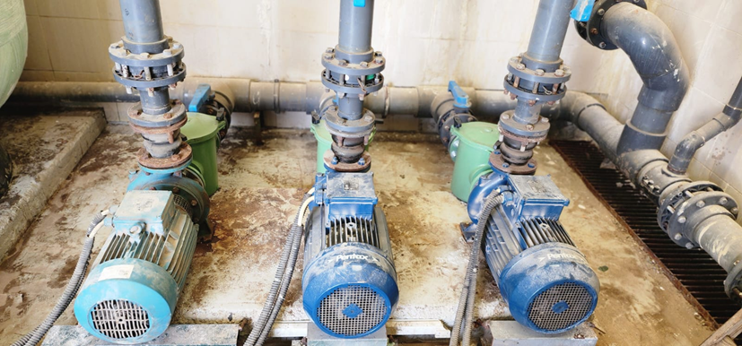
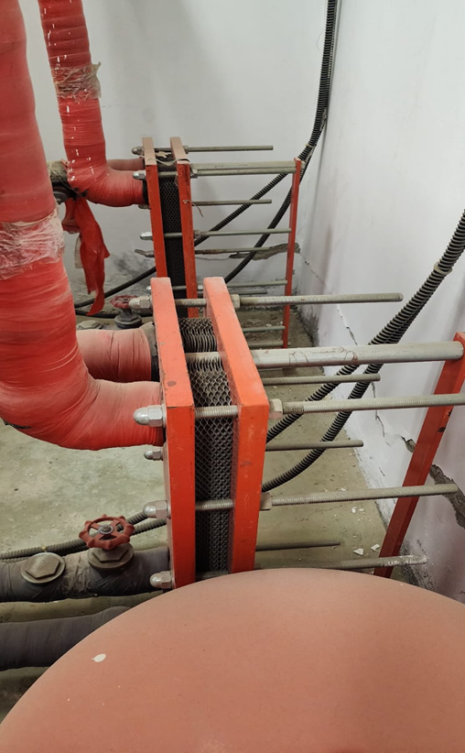
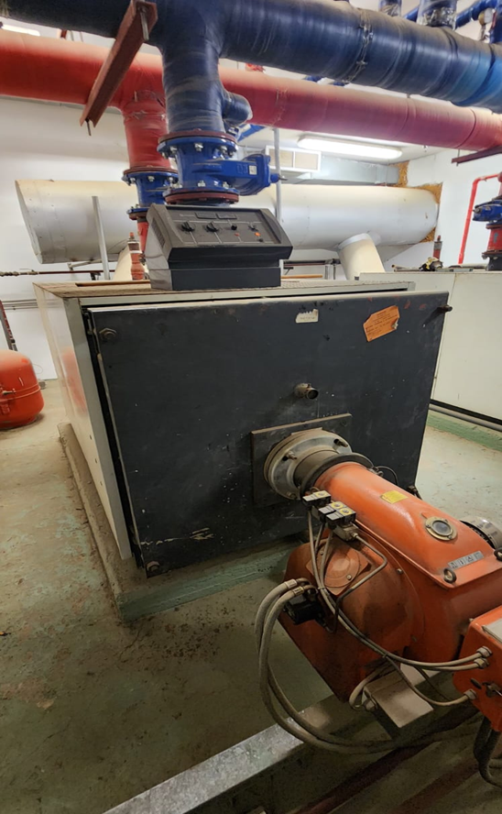
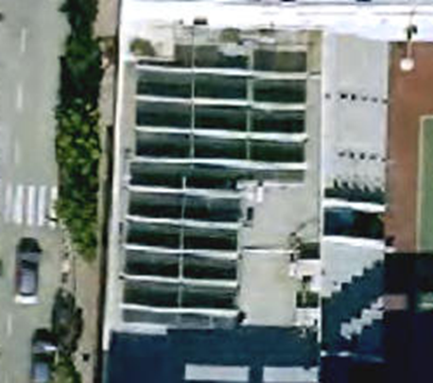
water circulation pumps
Heat exchangers
system components
Diesel Boiler
solar thermal collectors

Slide 11

results and analysis
results and analysis

Slide 12
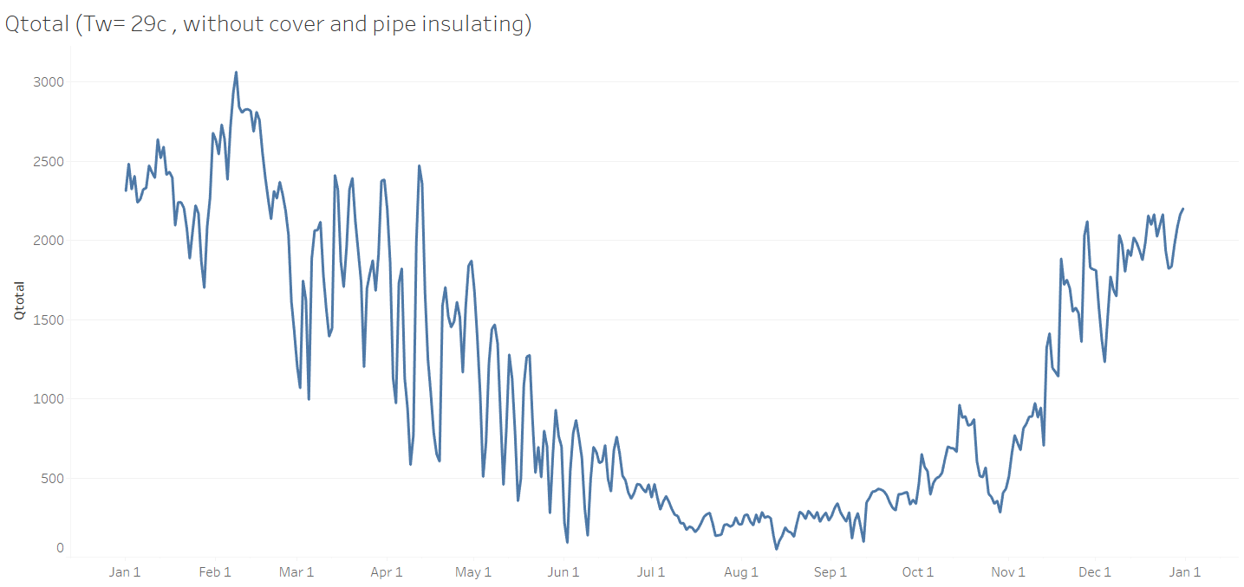
Qtotal ( kwh / day )
  No optimization measures applied (no cover, no pipe insulation).
  Peak losses exceed 3000 kWh/day in winter.
  Minimum losses drop below 200 kWh/day in summer.
  High variation due to ambient temperature differences.

Slide 13
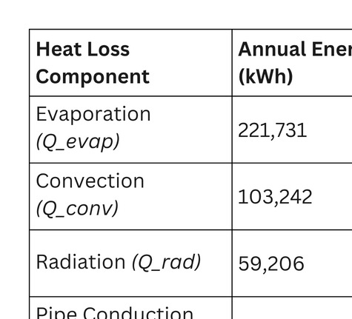
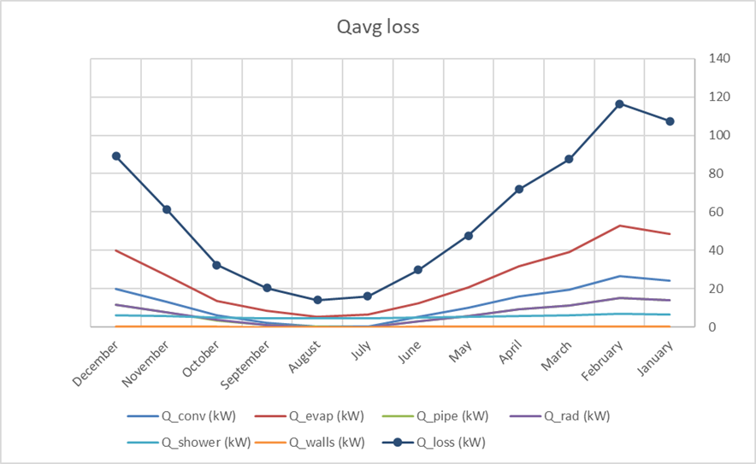
Heat loss (Qloss)

Slide 14
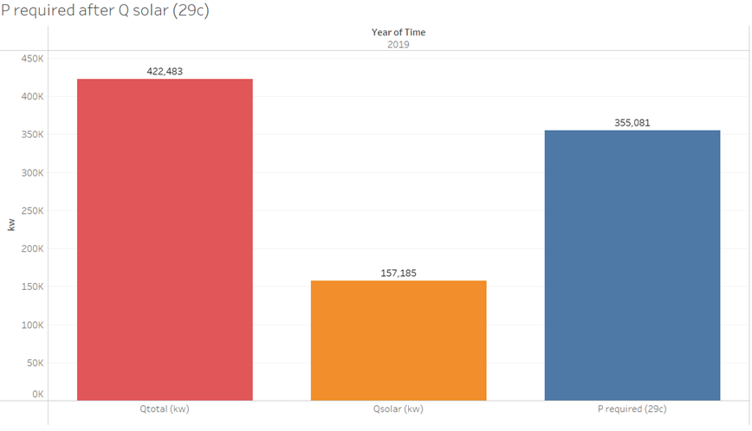
Power required after Q solar
** this is the baseline scenario, without any optimization
exist system : 34 solar thermal collectors , diesel boiler

Slide 15
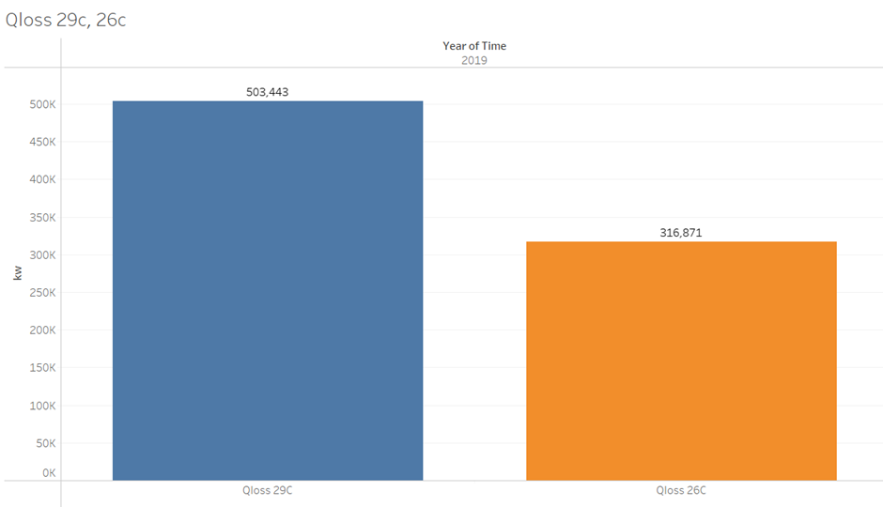
(1) Lowering Pool Water Temperature (Tw) from 29°C to 26°C
Q evaporation reduced 52%

Slide 16
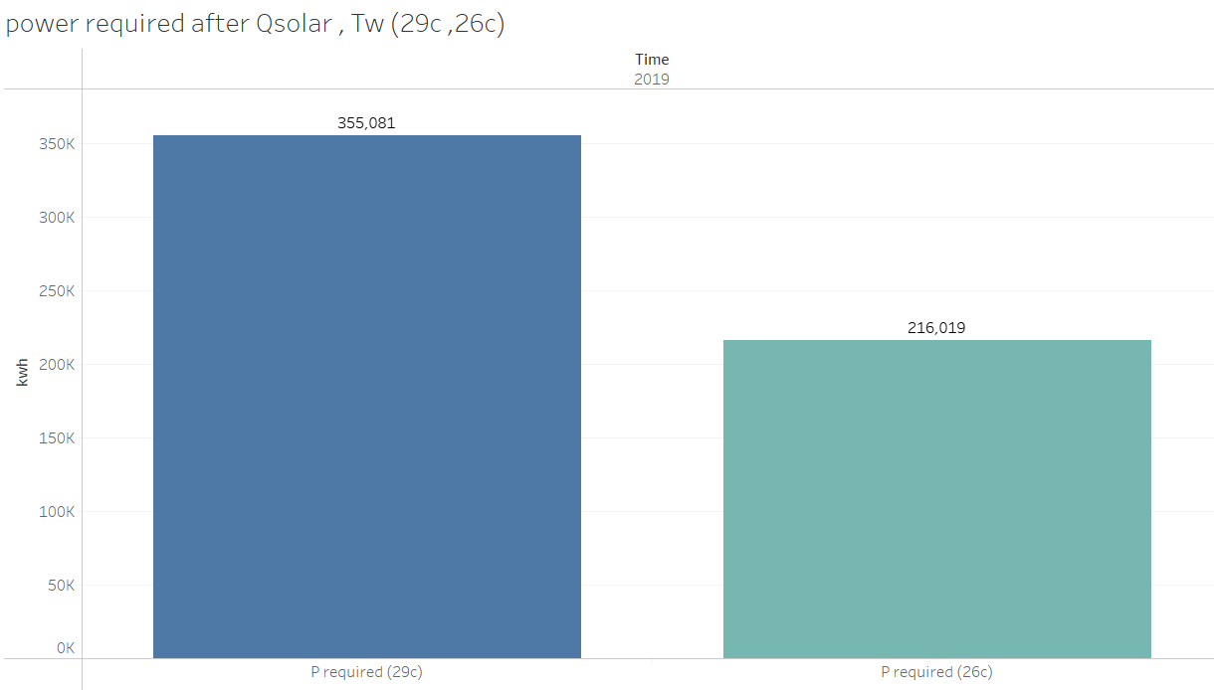
power required After q solar when Tw (29 C, 26 C)
Reducing pool temperature from 29°C to 26°C lowered the required auxiliary heating from 355,081 kWh to 216,019 kWh — a reduction of 39% .

Slide 17
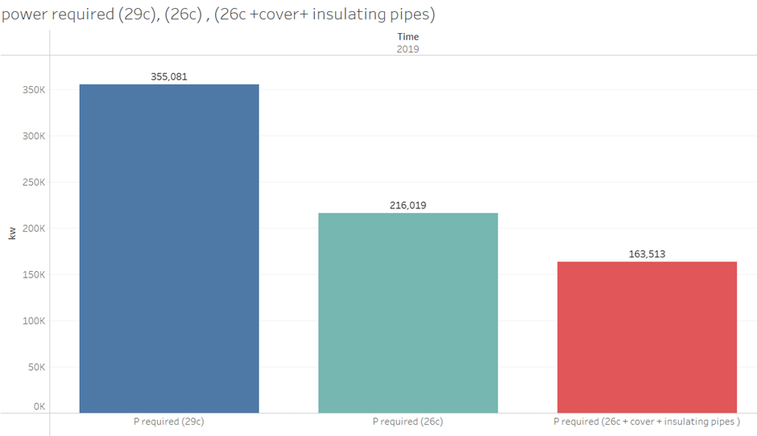
(2) power required after adding Pool Cover, and Pipe Insulation

Slide 18
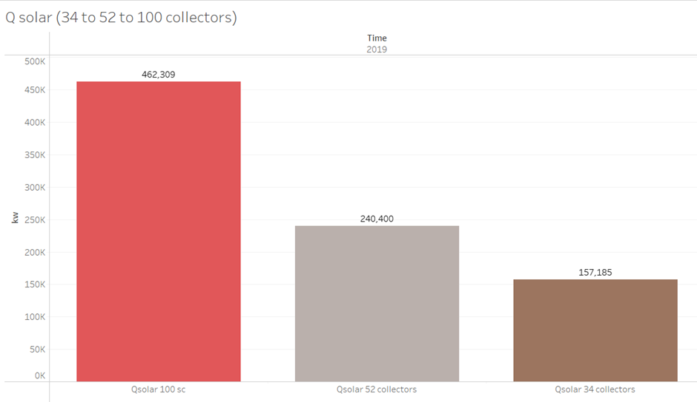
(3) Optimization of Solar Thermal Collector Performance

Slide 19
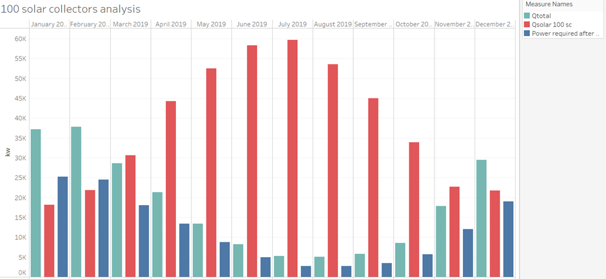
Impact on Auxiliary Heating Demand
Issues with Using 100 Solar Collectors:
  Risk of system overproduction during low-load periods
  Increased likelihood of component overheating
  Potential for long-term system degradation

Slide 20
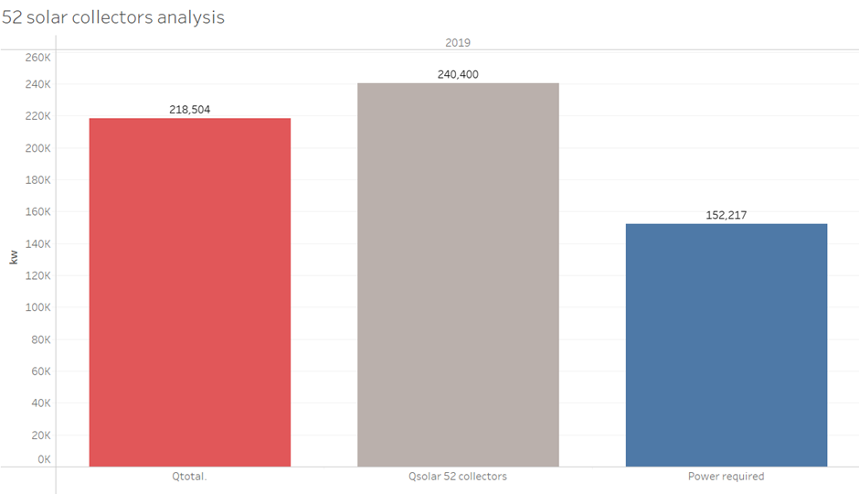
52 solar collectors analysis
Final Decision: the selected strategy is to restore the full 52 collectors to operational status, without introducing additional collectors. This solution balances performance improvement, system reliability, and economic feasibility, while utilizing existing infrastructure and controls.

Slide 21
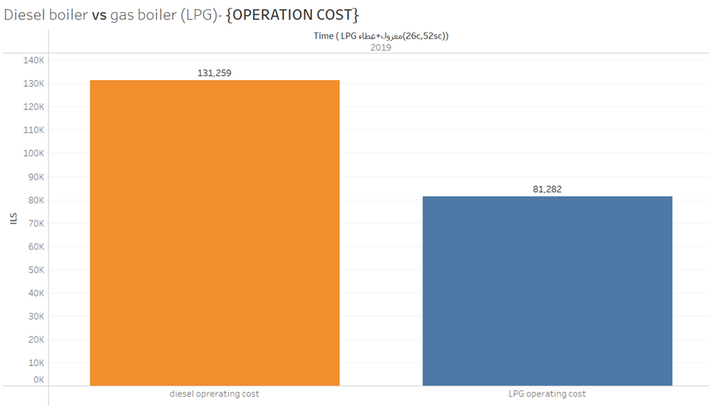
(4) Replace Diesel Boiler with LPG Boiler

Slide 22
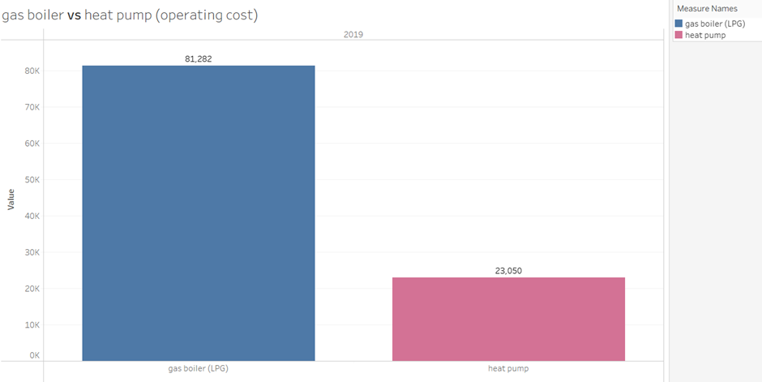
(5) Replacing LPG Boiler with Heat Pump (COP=3.5)

Slide 23
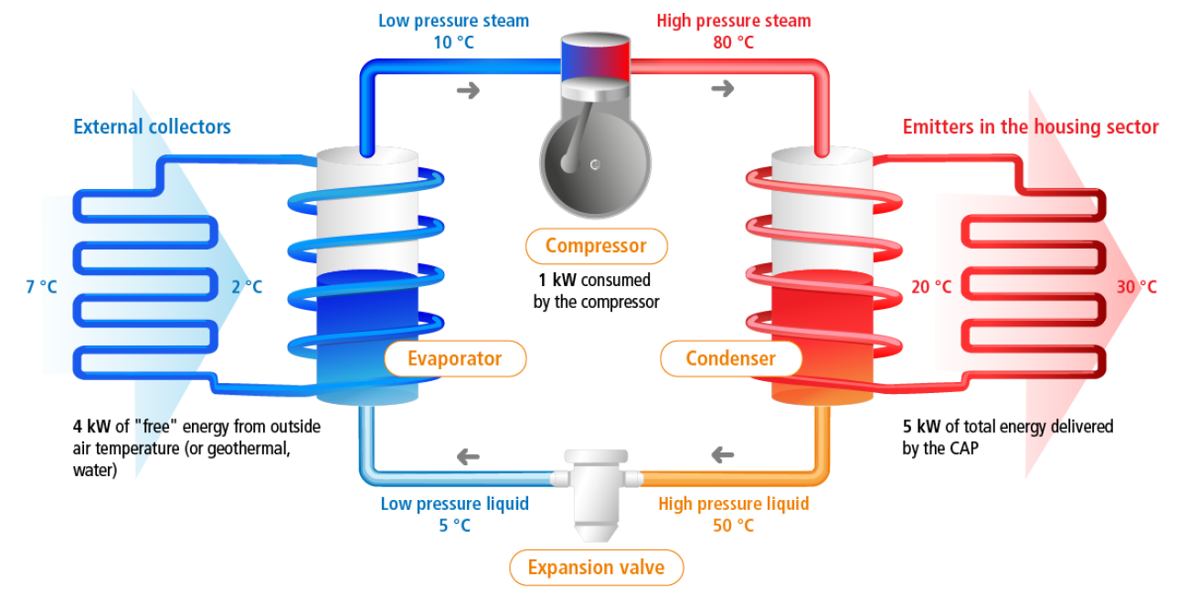
(6) Improving COP via Compressor Optimization

Slide 24
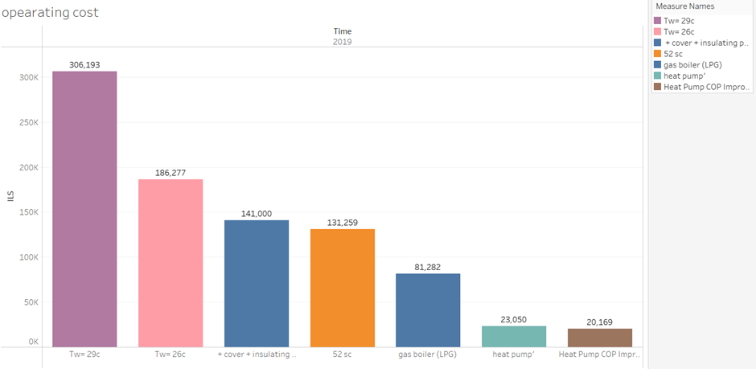
Annual Operating Costs Across System Optimization Scenarios
the final annual cost dropped to just 20,169 ILS, representing a 94.95% total cost reduction.

Slide 25
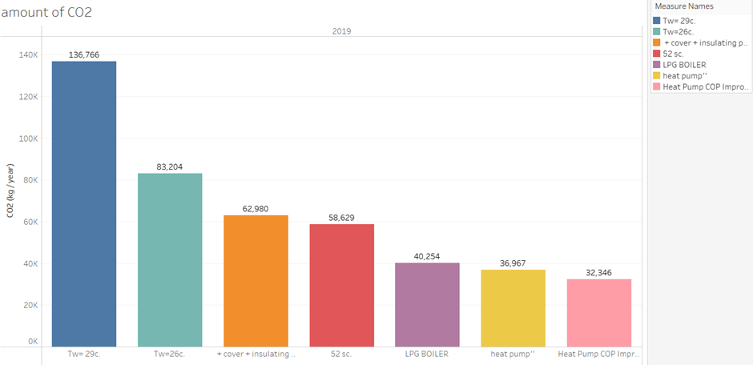
CO₂ Emissions Reduction Across System Optimization Scenarios
The cumulative optimization measures led to a CO₂ emissions reduction of approximately 76.35%, dropping from 136,766 kg/year to 32,346 kg/year.

Slide 26
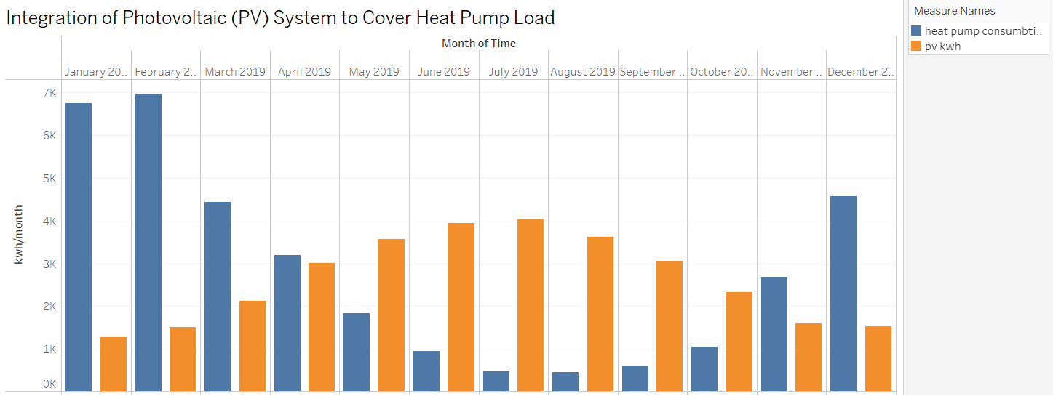
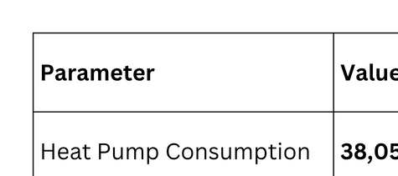
(7) Integration of Photovoltaic (PV) System to Cover Heat Pump Load

Slide 27
Full System Optimization with Heat Pump and PV System vs Existing System – Economic and Environmental Impact
Optimized System Configuration :
  Pool water temperature reduced from 29°C to 26°C
  Installed motorized pool cover and pipe insulation
  Restored all 52 solar thermal collectors
  Replaced diesel boiler with a high-efficiency heat pump(COP=4)
  Installed a 26 kWp PV system to cover 100% of the heat pump's electricity needs
Cost & Economic Analysis :
Annual Operating Cost:
  Diesel Boiler (Baseline): ~400,000 ILS/year
  Optimized System (no PV): 20,169 ILS/year
  Optimized System with PV: 0 ILS/year
Total Investment :
  Automatic Pool cover + insulation: 53,550 ILS
  Solar collector maintenance: 10,000 ILS
  Heat pump(60kw): 60,000 ILS
  PV system (26kw): 65,000 ILS
  Others : 20,000 ILS
  Total: 208,550 ILS
Economic Indicators :
  Annual saving = 400,000 ILS (PV covered heat pump load).
  Simple Payback Period (SPP): 0.52 years
  Present Worth (PW @10%, 15 yrs): ~3,042,440 ILS
  Rate of Return (RoR): ~237.3%
Environmental Impact :
  Before optimization: >150,000 kg CO₂/year
  After heat pump installation: ~32,346 kg CO₂/year
  After PV system: ~0 kg CO₂/year
  ~100% emissions reduction

Slide 28


DISCUSSION

Slide 29
95% reduction in operating costs
(from 400,000 ILS to 20,169 ILS).
01
Key Achievements :
76% decrease in CO₂ emissions with
heat pump; ≈0 kg CO₂/year after PV.
02
100% of heat pump electricity supplied
by 26 kWp PV system.
03
04

Slide 30
Problem Resolution
Initial Problem: Excessive diesel consumption & high operating costs.
Solution Path:
Sequential
energy-saving interventions.
Replaced diesel boilers with heat pump system.
Shift to solar-powered operation.
Outcome: A cost-effective, low-emission, and sustainable pool heating system.

Slide 31
Innovations and Limitations
Innovations:
Limitations:
  Cumulative scenario-based method tailored to pools.
  Heat pump + solar thermal collectors .
  PV system sized to match annual demand (≈38,000 kWh/year).
  Seasonal mismatch (PV generation vs. winter load).
  Relied on simulated data; no real-time monitoring.
  Lack of smart energy control systems.

Slide 32




Conclusion
From diesel-reliant and costly to a renewable-powered, efficient system.
Started with passive measures (lowering water temp, insulation, pool cover)
Ended with full renewable integration
Technically feasible
Economically viable
Environmentally sustainable

Slide 33

THANK YOU!

