Slide 1
Haptic Glove
Hardware Graduation Project
Prepared by
Yaman A. Salman
Eman M. Masarweh
2012

Slide 2
Outline
Motivation and Achievements .
System design .
Hardware .
Software
Hardware/software interface design .
Applications .
Conclusion .

Slide 3
Motivation
As computer technologies improve year by year, advanced and intuitive user interfaces become increasingly necessary to allow proper manipulation of various types of programs, in different fields and markets.

Slide 4
Motivation
In the case of haptic glove devices, a fraction of the fields that come to mind are rehabilitation after injury, training simulations to learn particular movements or even allowing surgeons to operate on a patient on the other side of the globe.

Slide 5
Motivation
The aim of this project is to design a haptic glove that is lightweight, simple, easy to manipulate while still being precise enough to perform as a user interface for virtual reality systems or any other applications it may have.

Slide 6
Achievements
We successfully created a glove that provides movement feedback of the hand and make effort on providing tactile feedback of virtual object . Also we created applications for a haptic glove includes use in virtual reality, gaming ( playing a 3D video game).

Slide 7
System Design
Our system consist of two main components:
Whole hand haptic system comprising
a glove wired by user.
a three-dimensional display of a hand
model with its animation to simulate
the real hand movements.
Notes:
1-this glove holds flex sensors on its fingers that detect the bending of each finger, also an accelerometer to detect slight changes in hand position in the three dimensions. These sensors are directly connected to the microcontroller which is programmed so that it can process these sensors values and pass it to second part of the system.
2-Our driving application is a simple 3D video game that contains the hand model and user can play it using our glove.

Slide 8
System Design
The whole project design is divided into three sections:
Master Section
Processor Section
Slave Section

Slide 9
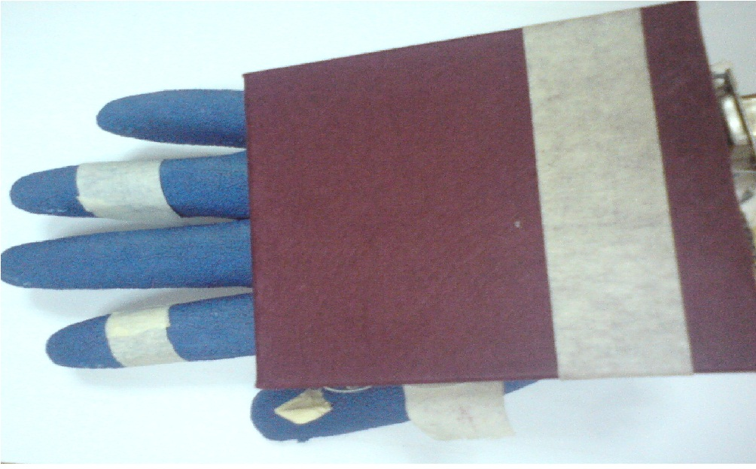
Master Section
The Master Section is nothing but the Motion Sensing Glove with its circuit that gives signals.
Notes:
The glove we use is a normal leather glove with flex sensors attached to each finger. As we move the fingers of the hand with the glove on, the movement causes the flex sensors to bend ,and accelerometer control the direction of movement left ,right , backward ,forward thus producing a signal which causes the virtual hand to move.

Slide 10
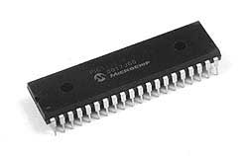
Processor Section
The processor section accepts the signals from the circuit box through the ADC ports.

Slide 11
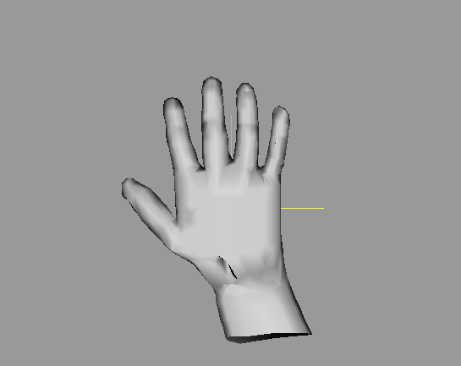
Slave Section
The Slave section is nothing but the software hand that mimics the master controller movements.
Notes:
The software hand receive the signal from the master section via the controller.

Slide 12
Hardware
Hardware Components :
Flex sensors.
Accelerometers.
Microcontroller .
Voltage Regulator.

Slide 13
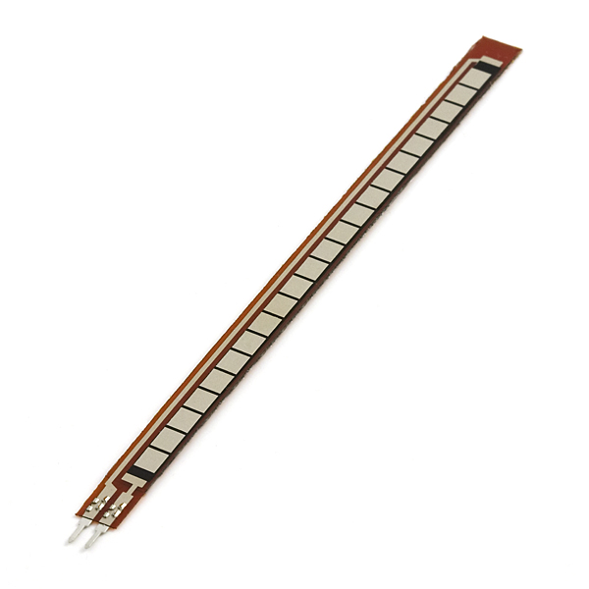
Hardware
Flex sensors : are sensors that change in resistance depending on the amount of bend on the sensor.

Slide 14
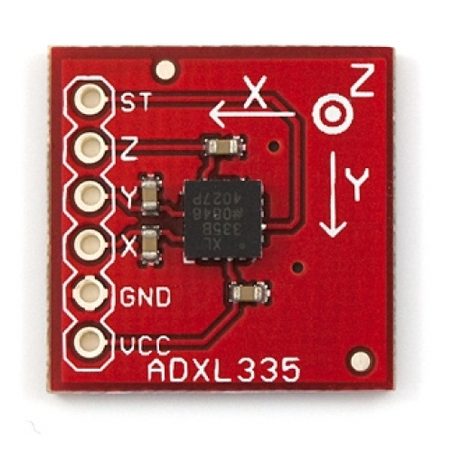
Hardware
Accelerometers: The accelerometer can detect the three-dimensional orientation of the hand . In our project we use ADXL335 is a triple axis accelerometer with extremely low noise and power consumption .

Slide 15
Hardware
Microcontroller : The processor that is used in our project is microcontroller Pic18F46.

Slide 16
Software Development
Microcontroller Programming :
We programmed the Pic 18F4620 using PIC-C , because we connect these components to the ADC port on pic , In the code we read the ADC from it and write algorithm to compute voltage average and send it to serial then to software part .

Slide 17
Software
Human Hand Model : We created a human hand model using “Milk Shape” software program :
1. Drawing “Joints” that simulates bones and joints in our hands.
2.Adding some textures to appear like in this picture.

Slide 18
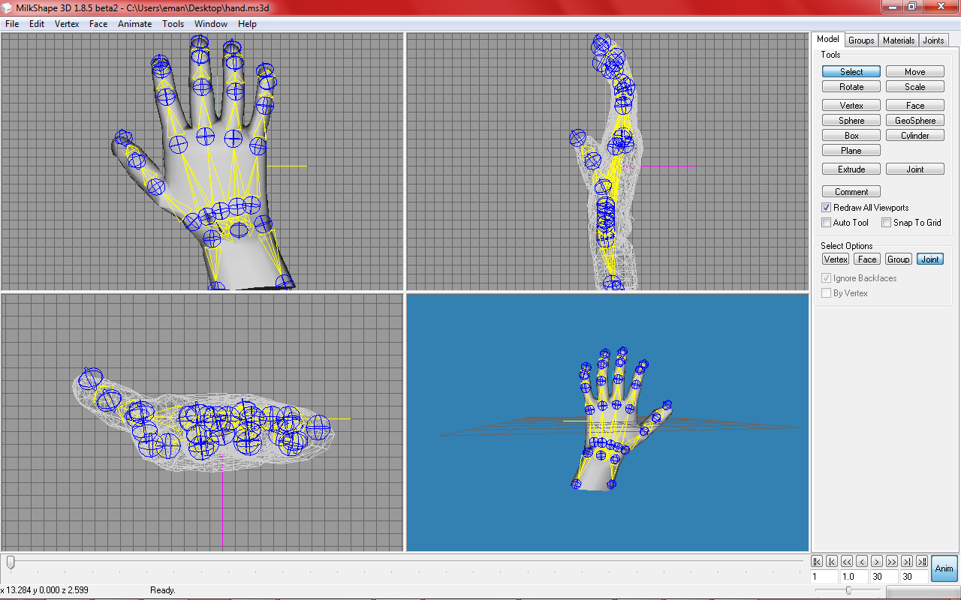
Software

Slide 19
Software
3. Adding animation on this model like : rotate fingers, rotate hand left ,right, up and down using “Animate” and then adding Key Frames.

Slide 20
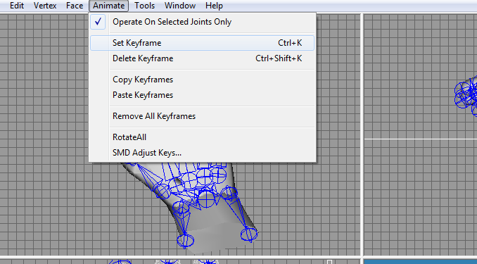
Software

Slide 21
Software
4.“Milk Shape” divides the model into many frames ,the user control their number, and at each frame we added some animation (key frame) and save it .
5. Importing the model as” MD2 format”.

Slide 22
Software
MD2 Loader : C++ code that Load the MD2 model to Open Gl
(read the model and redraw it also play it’s animation).

Slide 23
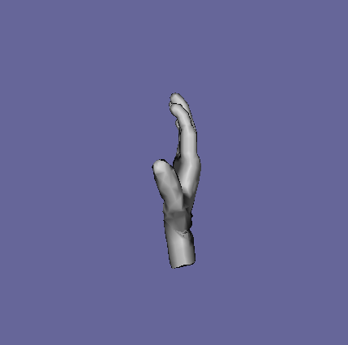
Software

Slide 24
Hardware/Software Interface Design
Controlling any virtual object using an external controller requires a communication channel between the controller and the controllable object.
Notes:
// we don’t need this slide bs e76ya6 5leeha

Slide 25
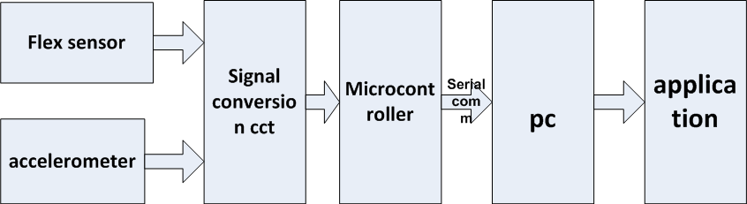
Hardware /Software
Notes:
As the hand and fingers moves the flex sensors and acc values change directly (analog ). Then these analog values enter a signal conversion cct then to micro controller this make a serial comm with PC … softwares on PC controll the applications to reflect this hand movement

Slide 26
Applications
1. 2D simple game:
We build a C# Game played depending on hand direction just move your hand left or right to stay alive !

Slide 27
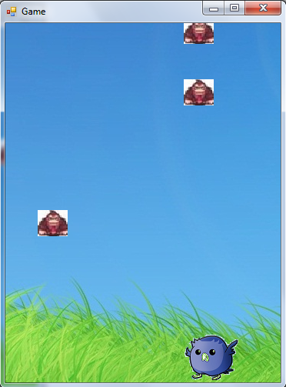
Applications

Slide 28
Applications
2. 3D video Game :
we bring an open source 3D game engine
and enter the hand model in it to get some tactile simulation .Unfortunately, time didn’t help us and we can’t solve the few problems and complete it on time , so we can’t show a full demo of this application but here is some screen shots

Slide 29
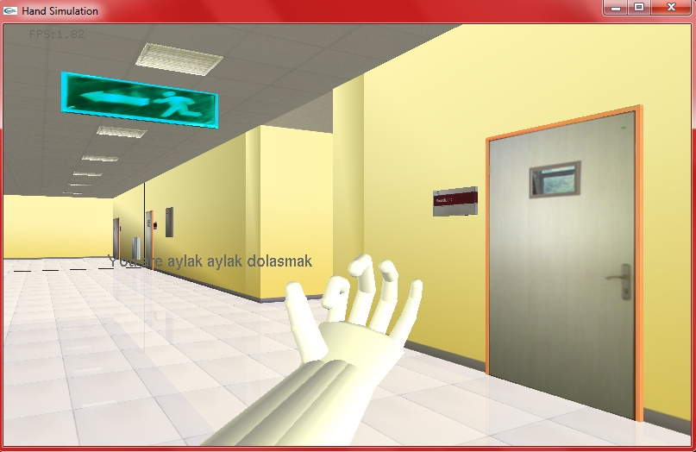

Slide 30
Thanks For Attention
☺

