Slide 1

An-Najah National University.
Faculty of Engineering.
Civil Engineering Department.
Graduation Project (II) Structural Analysis and Design of Al-Mashhad Building for Static and Dynamic Loads.
Under supervision of: Dr. Mahmoud Dwaikat
Prepared By:
Adnan K. Abdat
Mohammad A. Ali
Baker M. Bani Odeh

Slide 2
Table of contents
Introduction
Project description
Architectural views
Structural description
Loads
Analysis
Design
Analysis for footing

Slide 3
Introduction
It’s a residential building built for students who live far away from Jenin and it’s a private property owned by Nasser Al-Kasbri and Its located 2 kilometers away from the Arab American University.
In order to solve the increasing number of students who live away from the university, many residential buildings have been built near the university for students which require to be designed by engineers.

Slide 4
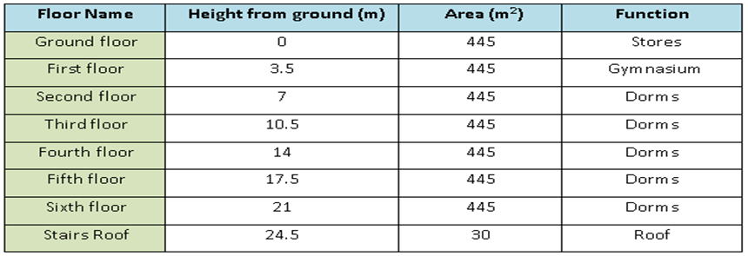
Project description
Al-Mashhad building is one of many building that service various needs and activities of students. This building has stores, dorms and a fitness club which are distributed in 6 different stories.
The following table shows the area of each story and its function

Slide 5
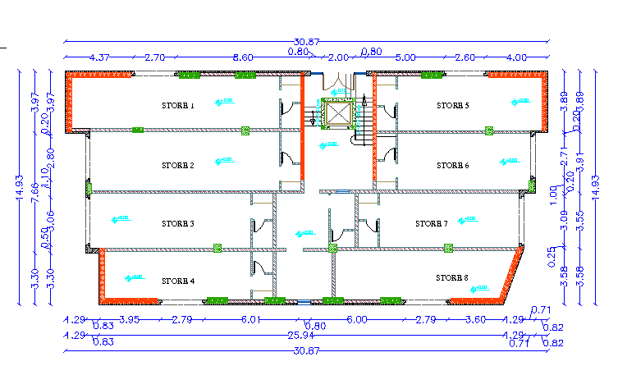
Architectural views part(1):
The following plan shows the ground floor

Slide 6
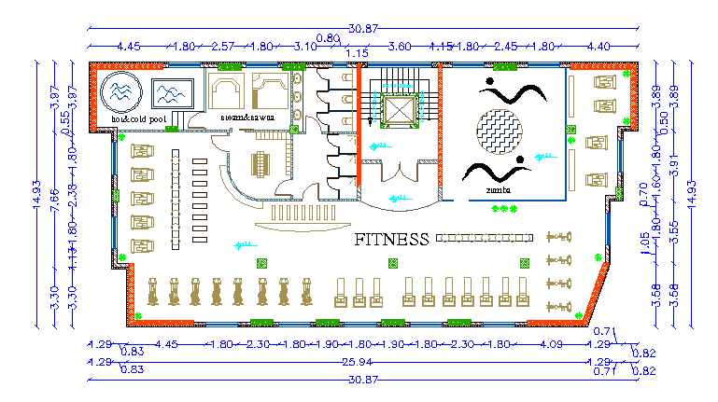
Architectural views part(2):
The following plan shows the first floor

Slide 7
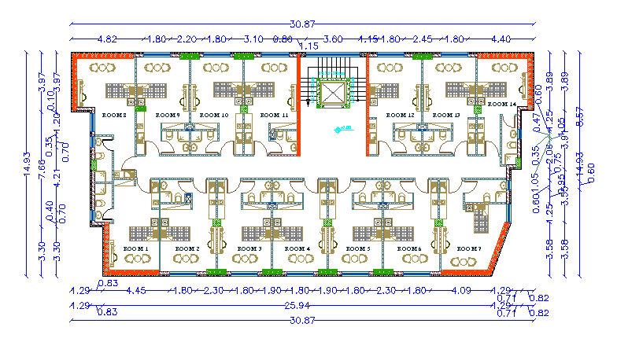
Architectural views part(3):
The following plan shows the rest floors

Slide 8
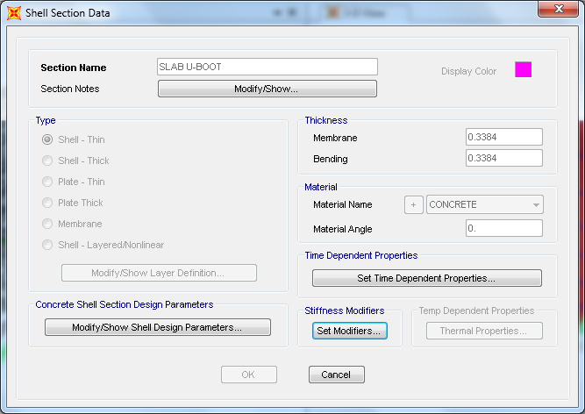
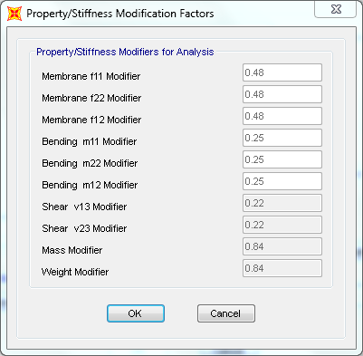
Structural description
1- Slab system:
In Al-Mashhad building, Two-way U-Boot slab system is used and the following figures show the thickness and modifiers of the equivalent section.

Slide 9
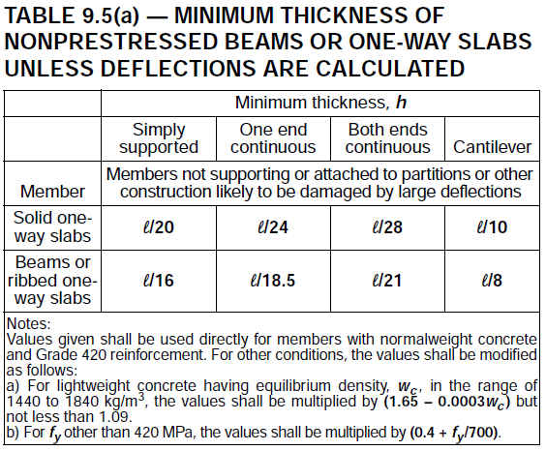
Structural description(continued)
2- Beams:
A hidden beam was used with a width of 600mm and a depth of 400m. The thickness of the beam was found as ACI-318-11 table 9.5(a) shows:

Slide 10
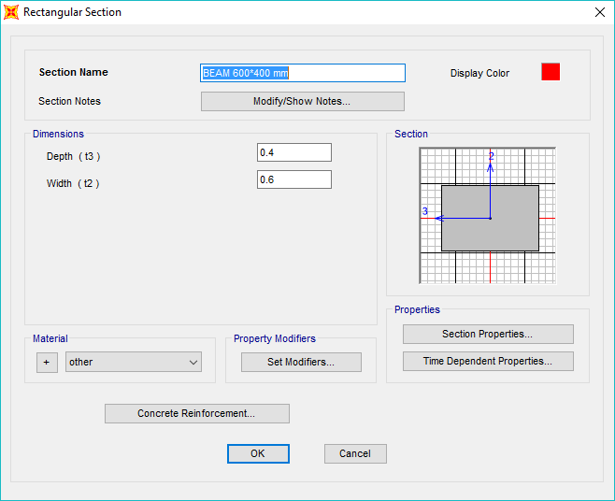
Structural description(continued)
2- Beams:
The following figure shows the dimensions of the beam

Slide 11
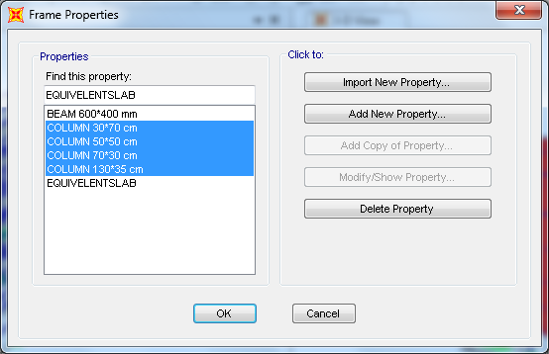
Structural description(continued)
3- Columns:
In this project, we used four different cross-sections of columns based on preliminary analysis as the following figure shows:

Slide 12
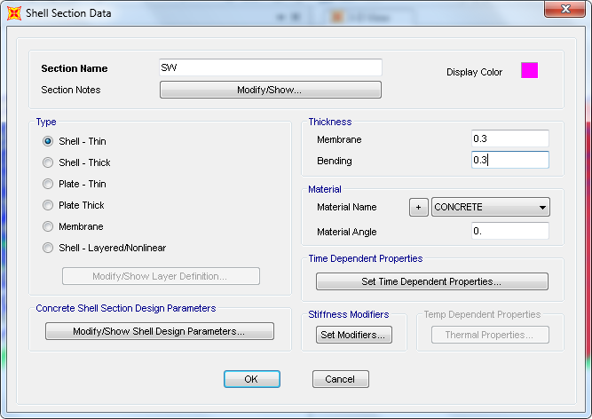
Structural description(continued)
4- Shear walls:
They are the lateral forces resisting system in our building and the section used is as the figure shows:

Slide 13
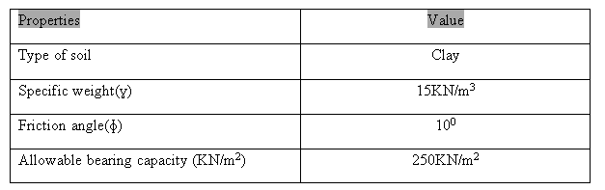
Structural description(continued)
5- Footings:
Based on the bearing capacity of the soil the single footings area is greater than 50% of the area of the building, So we used a mat footing for a more economical design.

Slide 14
Loads
Dead load = 6.9KN/m2.
Super-imposed load = 4.1KN/m2.
Live load = 5KN/m2.

Slide 15
Analysis
Period
Before any seismic analysis and design the natural frequency of the structure must be found to predict it's behavior.
Method 1:
T=0.1N = 0.1*6 = 0.6Second.

Slide 16
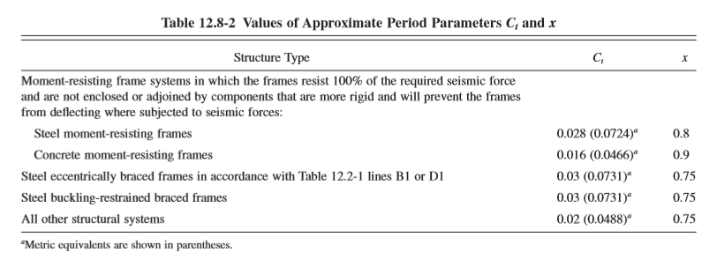
Analysis(continued)
Method 2:
T_{a} = C_{t} (h_{n})ª
Where: h_{n}: height of structure in meters.
C_{t} = 0.0488 for all other building.
a = 0.75
T_{a} = C_{t} (h_{n})^{3/4} = 0.0488*(21)^{3/4} = 0.48 sec.

Slide 17
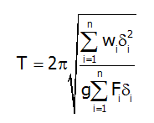

Analysis(continued)
Method 3 (Rayleigh’s formula):
T = 2*3.14$\sqrt{\frac{55765.81∗0.461245∗10^−6}{9.81∗0.30832}}$ = 0.58 sec.

Slide 18
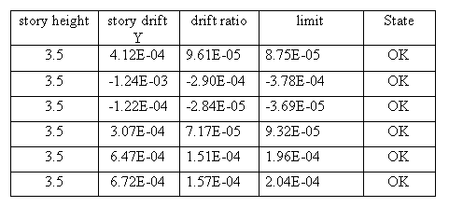
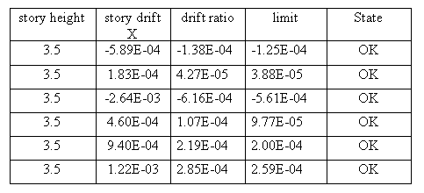
Analysis(continued)
Drift Check:
We must check the lateral story drift to ensure that no additional moment will be developed in the columns
Story drift in y-direction Story drift in x-direction

Slide 19
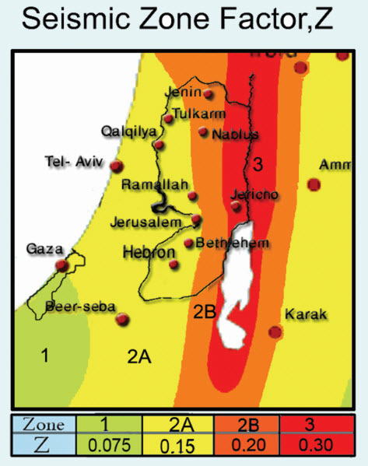

Design
Seismic design parameters
1- Seismic zone factor (Z)
Z = 0.2 from table.

Slide 20
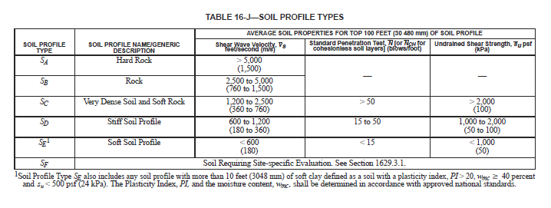
Design(continued)
Seismic design parameters
2- Soil profile type : Sc
3- Importance factor I =1.25

Slide 21
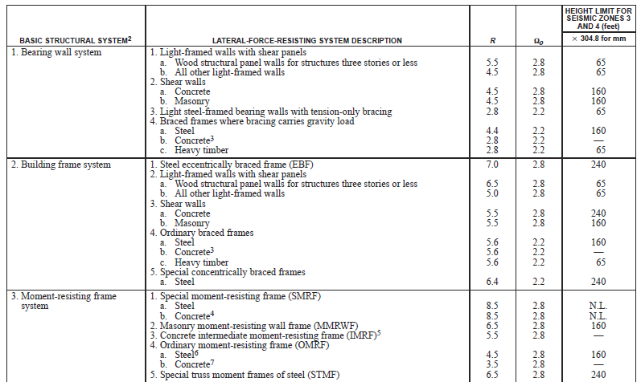
Design(continued)
Seismic design parameters
4- Response modification factor (R)
R =5.5 from table.

Slide 22
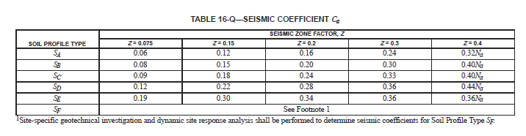
Design(continued)
Seismic design parameters
5- Seismic coefficient Ca = 0.28

Slide 23
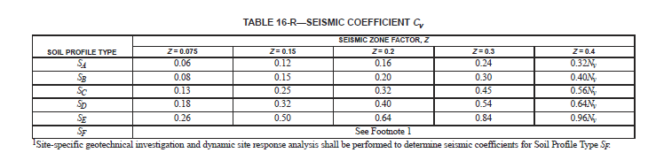
Design(continued)
Seismic design parameters
6- Seismic coefficient Cv = 0.4

Slide 24
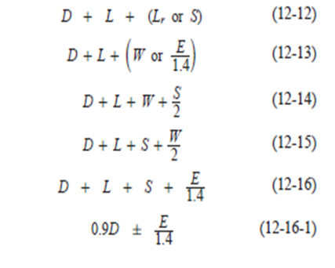
Design(continued)
Load combination:
1- Service combination
The following combinations will give the higher load values:
D+0.71EQx+0.21EQy
D-0.71EQx-0.21EQy
D+0.71EQy+0.21EQx
D-0.71EQy-0.21EQx
0.9D+0.71EQx+0.21EQy
0.9D-0.71EQx-0.21EQy
0.9D+0.71EQy+0.21EQx
0.9D-0.71EQy-0.21EQx
D+0.75L+0.54EQx+0.16EQy
D+0.75L-0.54EQx-0.16EQy
D+0.75L+0.54EQy+0.16EQx
D+0.75L-0.54EQy-0.16EQx

Slide 25
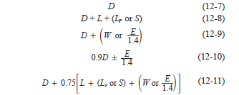
Design(continued)
2- Ultimate combination:
The following combinations will give the higher load values:
1.4D
1.2D+1.6L
1.34D+1.0L+1.0EQx+0.3EQy
1.34D+1.0L-1.0EQx-0.3EQy
1.34D+1.0L+1.0EQy+0.3EQx
1.34D+1.0L-1.0EQy-0.3EQx
0.76D+1.0EQx+0.3EQy
0.76D -1.0EQx-0.3EQy
0.76D+1.0EQy+0.3EQx
0.76D -1.0EQy-0.3EQx

Slide 26
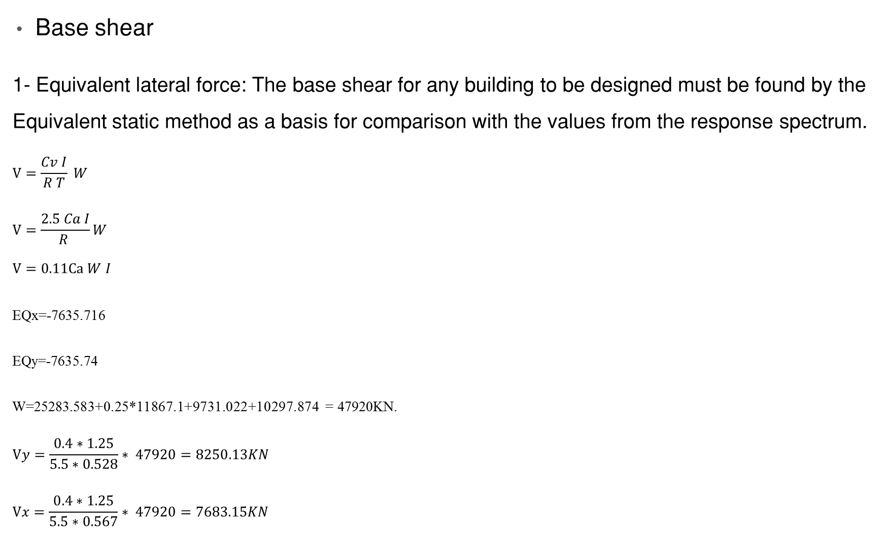
Design(continued)
Base shear
1- Equivalent lateral force: The base shear for any building to be designed must be found by the Equivalent static method as a basis for comparison with the values from the response spectrum.
$$V=\frac{Cv I}{R T} W$$
$$V=\frac{2.5 Ca I}{R }W$$
$$V=0.11Ca W I$$
EQx=-7635.716
EQy=-7635.74
W=25283.583+0.25*11867.1+9731.022+10297.874 = 47920KN.
$$Vy=\frac{0.4∗1.25}{5.5∗0.528}∗ 47920=8250.13KN$$
$$Vx=\frac{0.4∗1.25}{5.5∗0.567}∗ 47920=7683.15KN$$

Slide 27
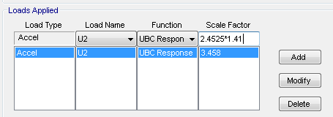
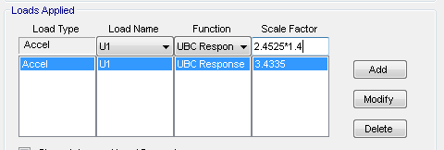
Design(continued)
2- Response spectrum : Because the participation of the mass in both the X and Y direction was below 90%, We had to use the response spectrum method And the base shear was increased to the equivalent static by the following factor
Response spectrum in y-direction Response spectrum in x-direction

Slide 28
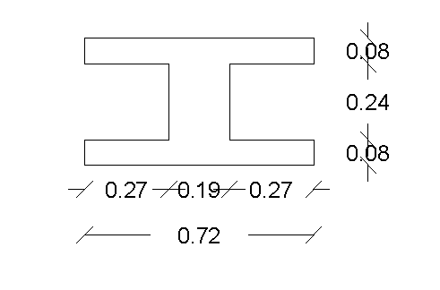

Design(continued)
Elements design
1- Slab
Shear stresses in slab check:
The shear capacity of the slab was calculated and compared with SAP maximum shear value:
ФVc = 1.1×$\frac{1}{6}$ × ʎ×√fc ×𝑏𝑤×𝑑
= 1.1×$\frac{1}{6}$ ×0.75×1×√28 ×190×360/1000
= 66.3 KN
Slab section

Slide 29
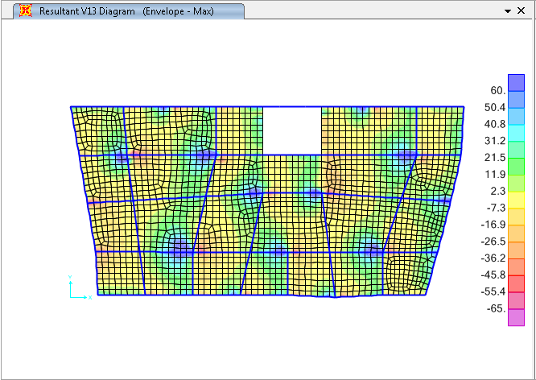

Design(continued)
Elements design
1- Slab
Shear stresses in slab check:
Maximum shear value from sap:
The Maximum stress in slab is less than the shear capacity, so the section size is adequate.
Maximum shear stresses in X-direction on slab
Maximum shear stresses in Y-direction on slab

Slide 30
Design(continued)
Elements design
1- Slab
The moment capacity of the slab was calculated and compared with SAP maximum moment value:
ФMn = 0.9*As*fy*(d-a/2).
Assume As = 308mm²(2Ф14mm).
Assume a = 80mm.
d = 360mm.
ФMn = 0.9*308*420*(360-80/2) = 37.25 kN.m
Check a:
a = As*fy/0.85f’c*b = 308*420/0.85*28*720
= 7.5mm < 80mm OK.
Slab section

Slide 31
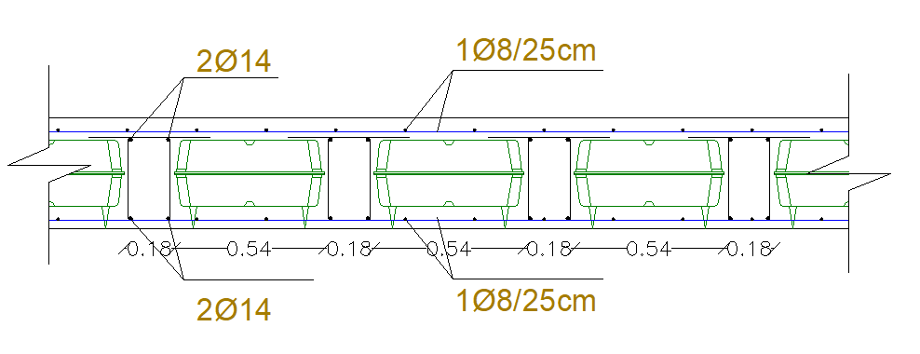
Design(continued)
The top and bottom flange will be reinforced with minimum steel.
As min = 0.0018*b*h = 0.0018*1000*80 = 144mm².
Use 4Ф8/m.

Slide 32
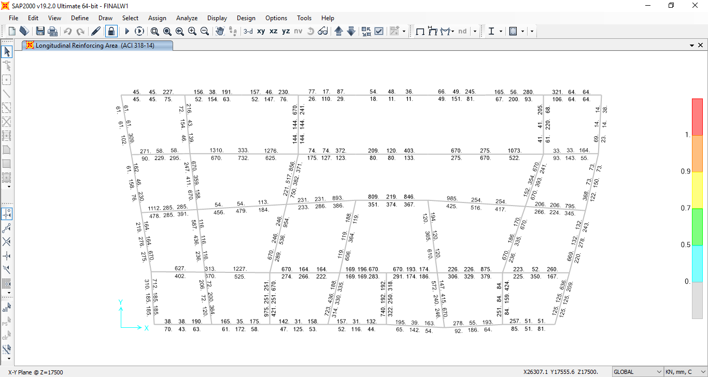
Design(continued)
2- Beams
The flexural reinforcement for beams will be obtained from SAP results.

Slide 33
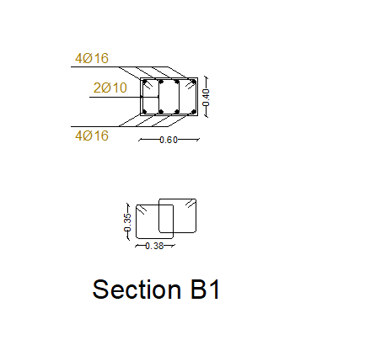
Design(continued)
2- Beams
minimum reinforcement = ρ*b*d
As = 0.00333*600*360 = 720mm².
Vu =50KN (from sap), so minimum shear
reinforcement will be used.

Slide 34
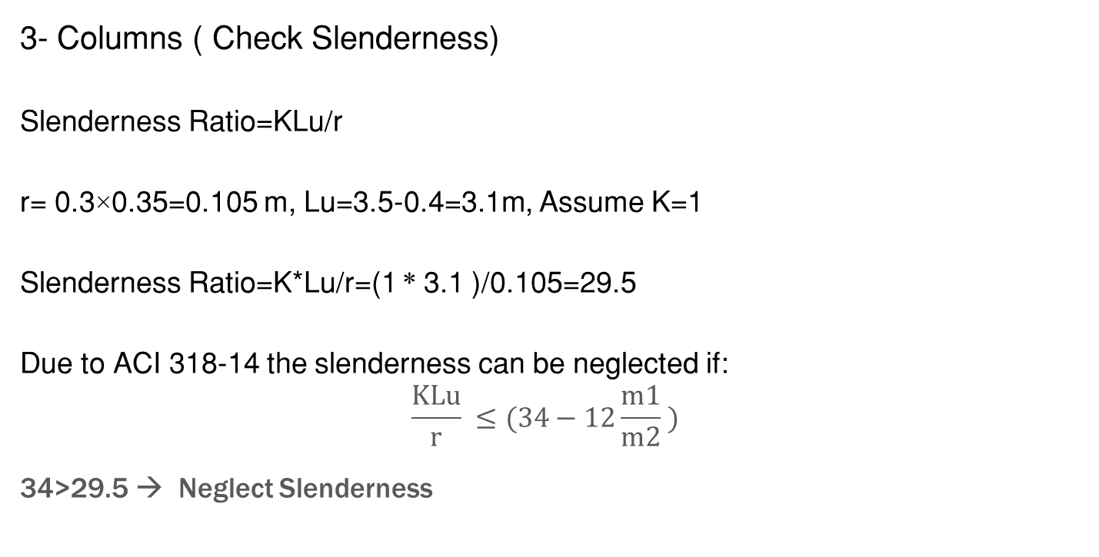
Design(continued)
3- Columns ( Check Slenderness)
Slenderness Ratio=KLu/r
r= 0.3×0.35=0.105 m, Lu=3.5-0.4=3.1m, Assume K=1
Slenderness Ratio=K*Lu/r=(1 * 3.1 )/0.105=29.5
Due to ACI 318-14 the slenderness can be neglected if:
$$\frac{KLu}{r} ≤(34−12\frac{m1}{m2} )$$
34>29.5 → Neglect Slenderness

Slide 35
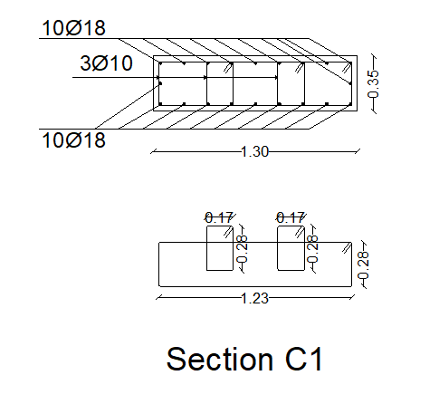
Design(continued)
3- Column
P_{n,max}=0.8*(0.85*fc(Ag-As)+As*Fy)
=10105.5KN >>223KN OK.
Use A_{s,min} :
A_{s,min} = 0.01*1300*350 =4550mm²
Use 20Ф18.
Ties:
3Ф10/10cm at column ends.
3Ф10/20cm at the middle of the column .

Slide 36
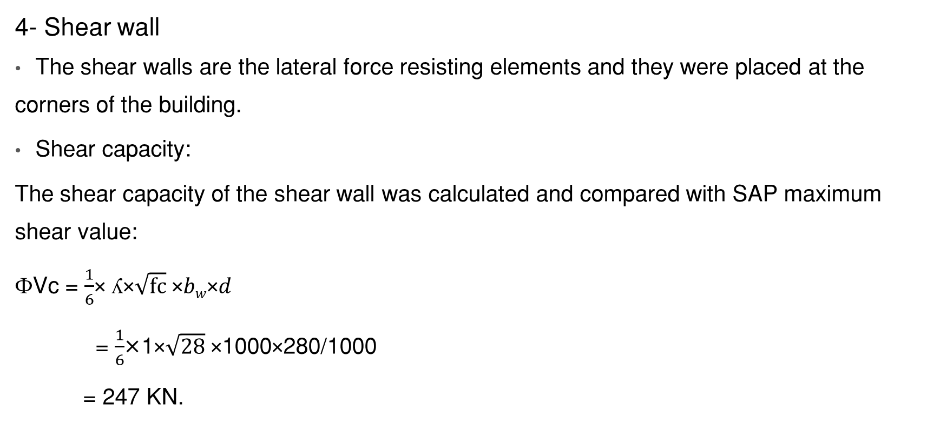
Design(continued)
4- Shear wall
The shear walls are the lateral force resisting elements and they were placed at the corners of the building.
Shear capacity:
The shear capacity of the shear wall was calculated and compared with SAP maximum shear value:
ФVc = $\frac{1}{6}$× ʎ×$\sqrt{fc}$ ×𝑏_{𝑤}×𝑑
= $\frac{1}{6}$×1×$\sqrt{28}$ ×1000×280/1000
= 247 KN.

Slide 37
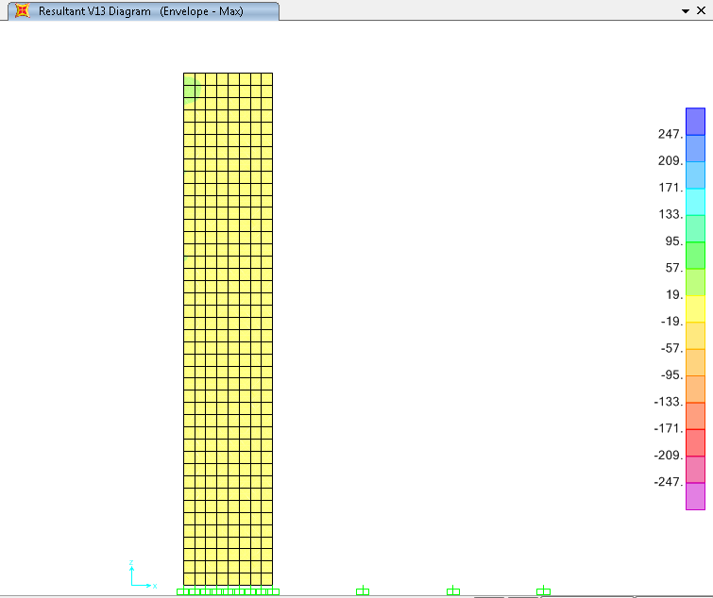
Design(continued)
4- Shear Wall
Vu < ФVc ... No need for sheer reinforcement

Slide 38
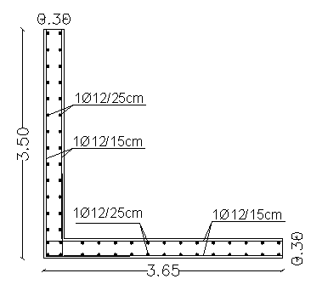
Design(continued)
4- Shear Wall
Flexural reinforcement for shear wall
For a 1-meter strip:
As_{min} = 0.0033*b*h
= 0.0033*1000*300 = 90mm².
Using interpolation: ФMn = 90*40/308 = 12KN.m.
2Ф12mm is adequate to resist flexural stresses in both the horizontal and vertical directions with a spacing of 150mm in the horizontal direction between bars and 250mm in the vertical direction.

Slide 39
Analysis for footing
Mat foundation
The bearing capacity of the soil was 200KN/m², but it was increased to 250 KN/m² by adding a 60cm layer of base coarse, so a thickness of 80cm was adequate based on the shear capacity of the footing.
One way shear:
ФVc= 1/6*(28) ^0.5*0.75*1000*720/1000 = 476KN.
This value is higher than the shear from the loads in mat.

Slide 40
Analysis for footing
Taking the critical column:
Dimension 50*50 cm
Interior column.
Pu=4405KN.
Punching shear
The allowable shear ФVc,p is the least of:
Case 1: Ф*0.17*(1+2/B) *b_{o}*d*(f_{c}/)^{0.5}
Case 2: Ф*0.083*(2+α_{s}*d/b_{o}) *b_{o}*d*(f_{c}/)^{0.5}
Case 3: Ф*0.333*b_{o}*d*(f_{c}/)^{0.5}
fc’=28Mpa.
d=800-80=720mm.
Ф=0.75.
bo=4*(500+720) =4880mm.
B=500/500=1.
α_{s}=40 (interior column).

Slide 41
Analysis for footing
Case 1: ФVc,p=7112KN.
Case 2: ФVc,p=9145KN.
Case 3: ФVc,p=4644KN. → Vu< ФVc OK.
So, the 80cm thickness is adequate and will be used for the footing.
Structural details are provided using auto cad.

Slide 42
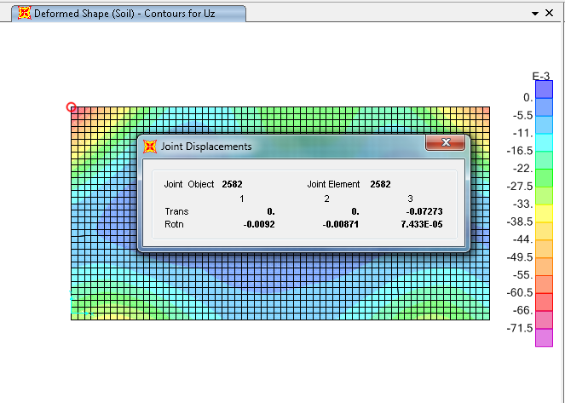
Analysis for footing
Deflection From SAP2000
Allowable deflection:
F=K*d
250=3000*d
d=8.3cm.
Maximum deflection =7.3cm <8.3cm OK.

Slide 43
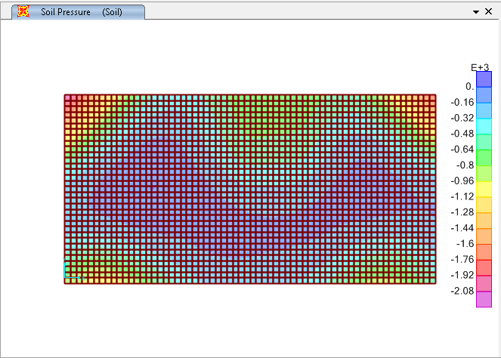
Analysis for footing
Stresses
Allowable bearing capacity=250KN/m².
As can be seen from the picture, the stresses of the footing are less than the allowable bearing capacity.

Slide 44


